Slide 1


Statistical Data Analysis 2024/25
Lecture Week 6
London Postgraduate Lectures on Particle Physics
University of London MSc/MSci course PH4515
Glen Cowan
Physics Department
Royal Holloway, University of London
g.cowan@rhul.ac.uk
www.pp.rhul.ac.uk/~cowan
Course web page via RHUL moodle (PH4515) and also
www.pp.rhul.ac.uk/~cowan/stat_course.html

Slide 2
Statistical Data Analysis
Lecture 6-1
p-values
Definition
Important properties
Relationship to hypothesis test

Slide 3
Testing significance / goodness-of-fit
Suppose hypothesis H predicts pdf f (x|H) for a set of
observations x = (x₁,...x_{n}).
We observe a single point in this space: x_{obs}.
How can we quantify the level of compatibility between the data and the predictions of H?
x_{j}
x_{obs}
Decide what part of
the data space represents equal or less compatibility with H than does the point x_{obs}. (Not unique!)
ω> = { x : x “more
compatible” with H }
ω≤ = { x : x “less
or eq. compatible”
with H }
x_{i}

Slide 4
p-values
Express level of compatibility between data and hypothesis (sometimes ‘goodness-of-fit’) by giving the p-value for H:
= probability, under assumption of H, to observe data with equal or lesser compatibility with H relative to the data we got.
= probability, under assumption of H, to observe data as discrepant with H as the data we got or more so.
Basic idea: if there is only a very small probability to find data
with even worse (or equal) compatibility, then H is “disfavoured by the data”.
If the p-value is below a user-defined threshold α (e.g. 0.05) then H is rejected (equivalent to hypothesis test as discussed previously).

Slide 5

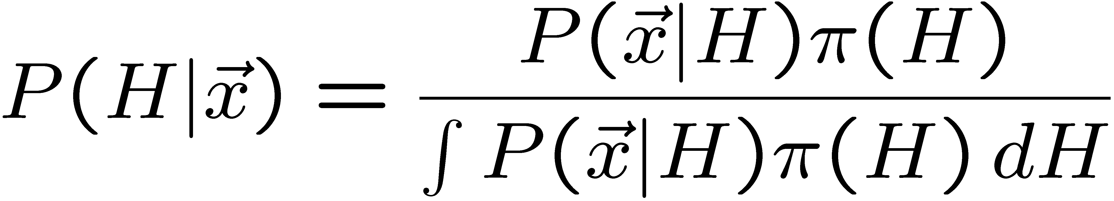
p-value of H is not P(H)
The p-value of H is not the probability that H is true!
In frequentist statistics we don’t talk about P(H) (unless H
represents a repeatable observation).
If we do define P(H), e.g., in Bayesian statistics as a degree of belief, then we need to use Bayes’ theorem to obtain
where π(H) is the prior probability for H.
For now stick with the frequentist approach;
result is p-value, regrettably easy to misinterpret as P(H).

Slide 6
Compatibility with H
What does it mean for a region of data space to be less compatible with the predictions of H?
It must mean that that region of data space is more compatible with some relevant alternative H′.
So although the definition of the p-value does not need to refer explicitly to an alternative, this enters implicitly through its role in determining the partitioning of the data space into more and less-or-equally compatible regions.
As in the case of hypothesis tests, there may be more than one relevant alternative.

Slide 7
Example of p-value: exponential decay time
A nuclear sample contains two radioactive isotopes with mean lifetimes τ = 0.2 s and τ = 1.0 s.
For either isotope we expect the decay time to follow
A nucleus is observed to decay after a time t_{obs} = 0.6 s.
The p-value of the hypothesis H that the
nucleus is of the type with τ = 0.2 s is
Here we take t ≥ t_{obs} as being less compatible with τ = 0.2 s , because greater t is more characteristic of τ = 1.0 s.
If the relevant alternative had been τ = 0.1 s, then one would define the p-value as

Slide 8
p-value from test statistic
x_{j}
x_{obs}
ω> = { x : x “more
compatible” with H }
surface described by test statistic
ω≤ = { x : x “less
or eq. compatible”
with H }
x_{i}
If e.g. we define the region of less or eq. compatibility to be t(x) ≥ t_{obs} then the p-value of H is

Slide 9


Distribution of the p-value
The p-value is a function of the data, and is thus itself a random
variable with a given distribution. Suppose the p-value of H is
found from a test statistic t(x) as
The pdf of p_{H} under assumption of H is
g(p_{H}|H′)
In general for continuous data, under
assumption of H, p_{H} ~ Uniform[0,1]
and is concentrated toward zero for
some (broad) class of alternatives.
g(p_{H}|H)
p_{H}
0
1

Slide 10


Using a p-value to define test of H₀
So the probability to find the p-value of H₀, p₀, less than α is
We started by defining critical region in the original data space (x), then reformulated this in terms of a scalar test statistic t(x).
We can take this one step further and define the critical region
of a test of H₀ with size α as the set of data space where p₀ ≤ α .
Formally the p-value relates only to H₀, but the resulting test will
have a given power with respect to a given alternative H₁, and the test statistic t(x) used to obtain the p-value can be designed to achieve this, e.g., a likelihood ratio t(x) = P(x|H₁)/P(x|H₀).

Slide 11
Statistical Data Analysis
Lecture 6-2
More examples of p-values
  Coin
  Poisson counting experiment
Equivalent Gaussian significance

Slide 12
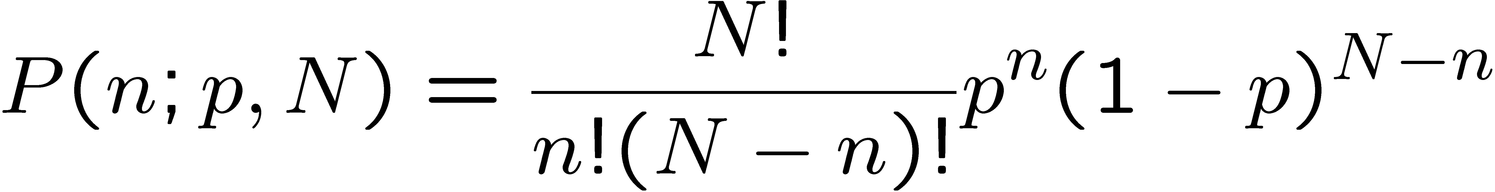
p-value example: testing whether a coin is ‘fair’
Probability to observe n heads in N coin tosses is binomial:
Hypothesis H: the coin is fair (p = 0.5).
Suppose we toss the coin N = 20 times and get n = 17 heads.
Region of data space with equal or lesser compatibility with
H relative to n = 17 is: n = 17, 18, 19, 20, 0, 1, 2, 3. Adding
up the probabilities for these values gives:
i.e. p = 0.0026 is the probability of obtaining such a bizarre
result (or more so) ‘by chance’, under the assumption of H.

Slide 13
p-value example for coin (2)
Note that the region of equal or lesser compatibility seems
“obvious” but could be different.
For example, suppose the person tossing the coin works for the “Mostly-Heads-Trick-Coin Company”, then maybe
ω≤ = {17,18,19,20}, and p_{fair} = 0.0013.
Note as well the clear distinction between the p-value of a fair
coin and the probability (degree of belief) that the coin is fair:
Suppose you get the coin as change at a cafe. You then flip the coin 20 times and get 17 heads:
p-value p_{fair} = 0.0026,
P(fair) = probably still close to 1, depending on prior π(fair).
Suppose a representative of the MHTC Co. proposes a betting game in which they win money from you if there is an excess of heads. The result is 17 heads out of 20. P(fair) = low.

Slide 14

The Poisson counting experiment
Suppose we do a counting experiment and observe n events.
Events could be from signal process or from background –
we only count the total number.
Poisson model:
s = mean (i.e., expected) # of signal events
b = mean # of background events
Goal is to make inference about s, e.g.,
test s = 0 (rejecting H₀ ≈ “discovery of signal process”)
test all non-zero s (values not rejected = confidence interval)
In both cases need to ask what is relevant alternative hypothesis.

Slide 15
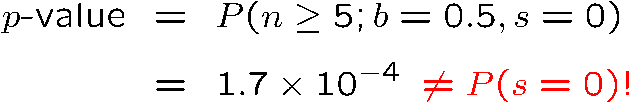
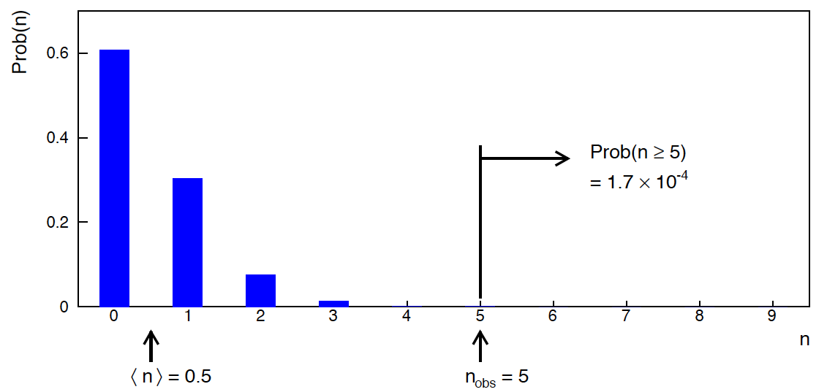
Poisson counting experiment: discovery p-value
Suppose b = 0.5 (known), and we observe n_{obs} = 5.
Should we claim evidence for a new discovery?
Give p-value for hypothesis s = 0:

Slide 16
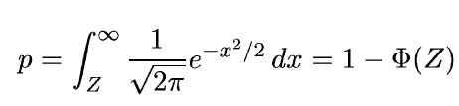
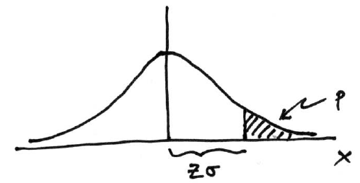

Significance from p-value
Often define significance Z as the number of standard deviations
that a Gaussian variable would fluctuate in one direction
to give the same p-value.
in ROOT:
p = 1 - TMath::Freq(Z)
Z = TMath::NormQuantile(1-p)
in python (scipy.stats):
p = 1 - norm.cdf(Z) = norm.sf(Z)
Z = norm.ppf(1-p)
Result Z is a “number of sigmas”. Note this does not mean that
the original data was Gaussian distributed.

Slide 17

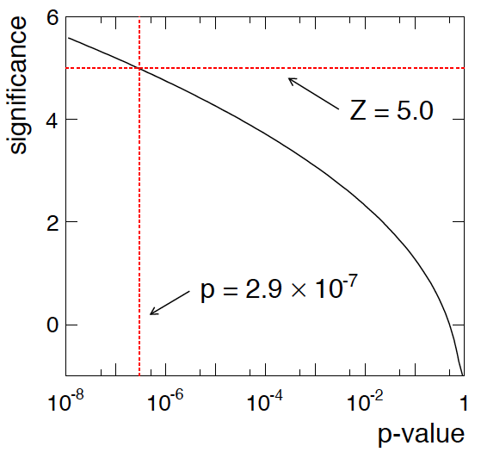
Poisson counting experiment: discovery significance
Equivalent significance for p = 1.7 × 10⁻⁴:
Often claim discovery if Z > 5 (p < 2.9 × 10⁻⁷, i.e., a “5-sigma effect”)
In fact this tradition should be revisited: p-value intended to quantify probability of a signal-like fluctuation assuming background only; not intended to cover, e.g., hidden systematics, plausibility signal model, compatibility of data with signal, “look-elsewhere effect”
(~multiple testing), etc.

Slide 18
Statistical Data Analysis
Lecture 6-3
Test based on histogram
Pearson’s chi-squared

Slide 19

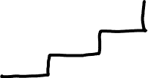
Test using histogram of data
Suppose the data are a histogram n = (n₁,...,n_{N}) of values and a hypothesis predicts mean values ν = E[n] = (ν₁,...,ν_{N}).

Slide 20
Modeling the data
Consider e.g. the following hypotheses:
independent, treat as continuous n_{i} ~ Gauss(ν_{i}, σ_{i})
independent n_{i} ~ Poisson(ν_{i})
n ~ Multinomial(n_{tot}, p), n_{tot} = Σ_{i} n_{i}, p = ν / n_{tot}

Slide 21
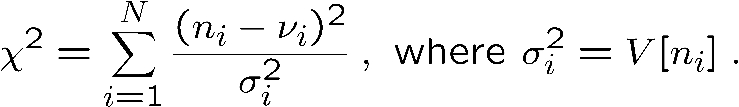
Pearson’s χ² statistic
We can take as the test statistic
(Pearson’s χ²
statistic)
χ² = sum of squares of the deviations of the ith measurement from the ith predicted mean, using σ_{i} as the ‘yardstick’ for the comparison.
χ² ≥ χ²_{obs} defines the region of “equal or lesser compatibility” for purposes of computing a p-value.
need this pdf

Slide 22
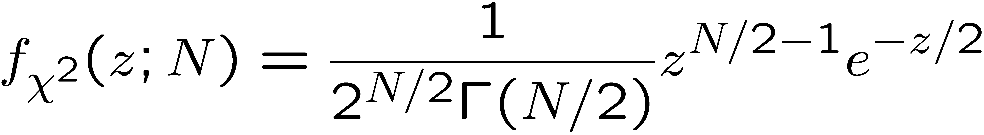
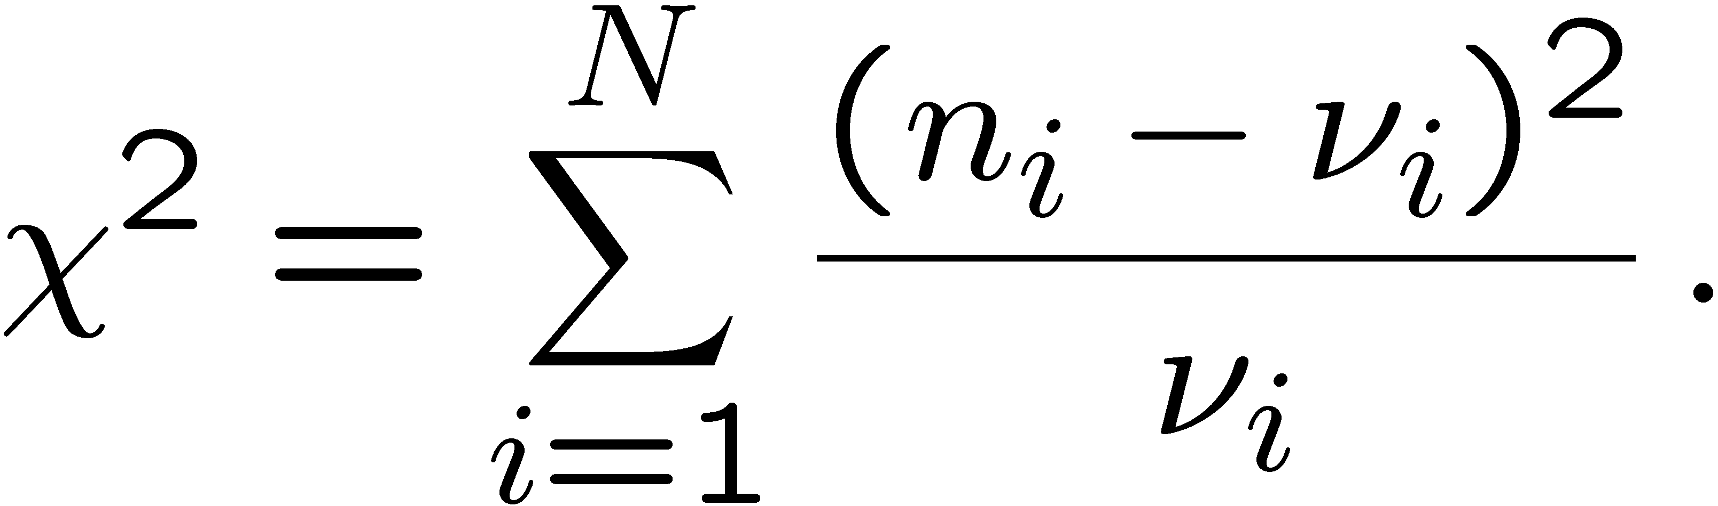
Distribution of Pearson’s χ² statistic
If n_{i} ~ Gauss(ν_{i} , σ_{i}²), then Pearson’s χ² will follow the chi-square pdf (here write χ² = z) for N degrees of freedom:
For proof using characteristic functions (Fourier transforms) see e.g. SDA Sec. 10.2.
If the n_{i} ~Poisson(ν_{i}) then V[n_{i} ] = ν_{i} and so
If ν_{i} >> 1 (in practice OK for ν_{i} > half dozen) then the Poisson dist. becomes Gaussian (see SDA Sec. 10.2) and therefore Pearson’s χ² statistic here as well follows the chi-square pdf.
This is called the “large-sample” or “asymptotic” limit.

Slide 23
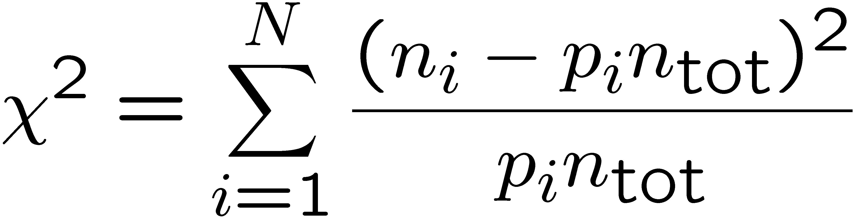
Pearson’s χ² with multinomial data
If n_{tot} = Σ_{i}^{Ν} n_{i} is fixed, then we can model the histogram using
n ~ Multinomial(p, n_{tot}) with p_{i} = ν_{i} / n_{tot}.
In this case we can take Pearson’s χ² statistic to be
Note here the denominator is not the variance V[n_{i}] = n_{tot} p_{i} (1−p_{i}),
and also since the n_{i} ~ multinomial they are not independent.
But with this definition, if all p_{i} n_{tot} >> 1 (the “large sample limit”) one can show the statistic will follow the chi-square pdf for N−1 degrees of freedom.

Slide 24
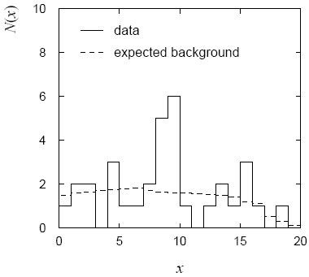
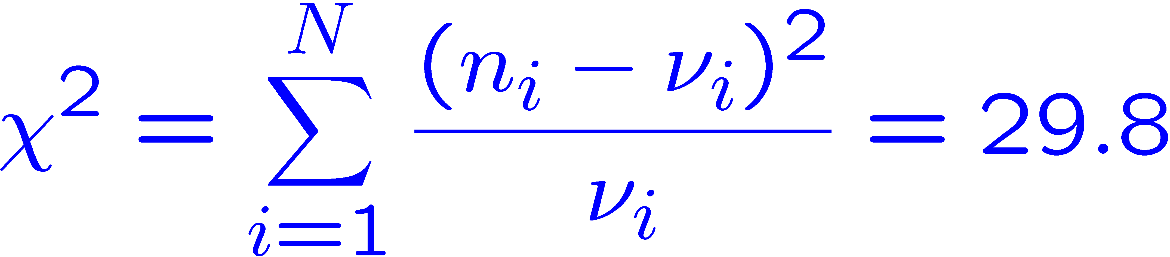
Example of a χ² test
Suppose we have the data below (solid) and prediction (dashed)
of a “background” hypothesis, model n_{i} ~Poisson(ν_{i}).
← This gives
for N = 20 dof.
Now need to find p-value, but... many bins have few (or no)
entries, so here we do not expect χ² to follow the chi-square pdf.

Slide 25
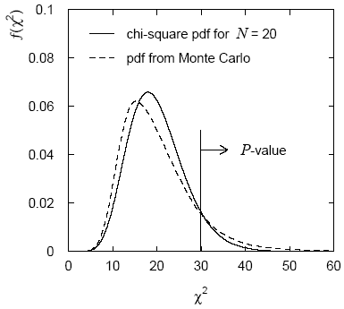
Using MC to find distribution of χ² statistic
If the distribution of the χ² statistic is not expected to be well approximated by the asymptotic chi-square distribution, we can still use it but need some other way to find its pdf.
To find its sampling distribution, simulate the data with a
Monte Carlo program, i.e., generate n_{i} ~Poisson(ν_{i}) for i = 1,...,N
Here data sample simulated 10⁶
times. The fraction of times we
find χ² > 29.8 gives the p-value:
p = 0.11
If we had used the chi-square pdf
we would find p = 0.073.

Slide 26
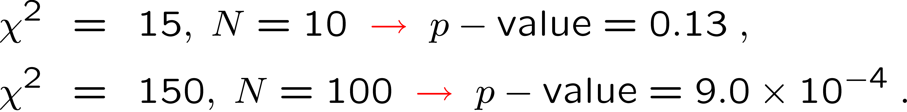
The ‘χ² per degree of freedom’
Recall that for the chi-square pdf for N degrees of freedom,
This makes sense: if the hypothesized ν_{i} are right, the rms
deviation of n_{i} from ν_{i} is σ_{i}, so each term in the sum contributes ~1.
One often sees χ²/N reported as a measure of goodness-of-fit.
But... better to give χ² and N separately. Consider, e.g.,
i.e. for N large, even a χ² per dof only a bit greater than one can
imply a small p-value, i.e., poor goodness-of-fit.

Slide 27
Statistical Data Analysis
Lecture 6-4
Introduction to (frequentist) parameter estimation
The method of Maximum Likelihood
MLE for exponential distribution

Slide 28
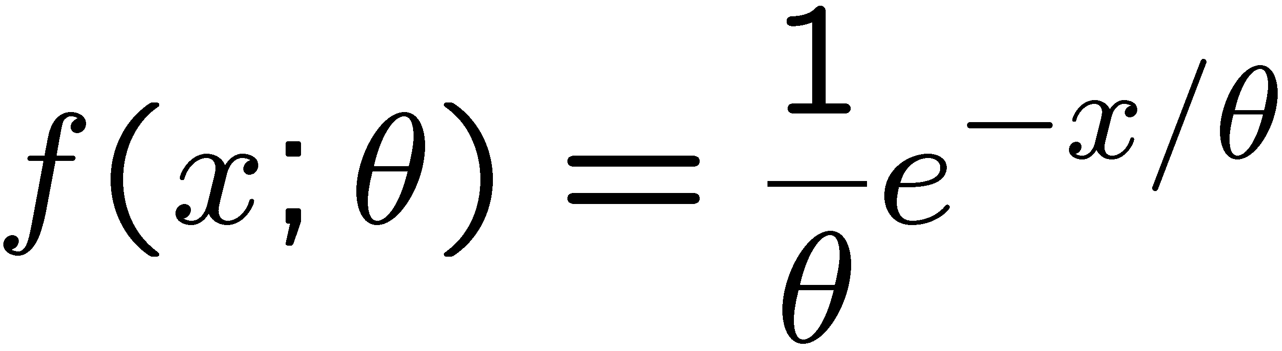
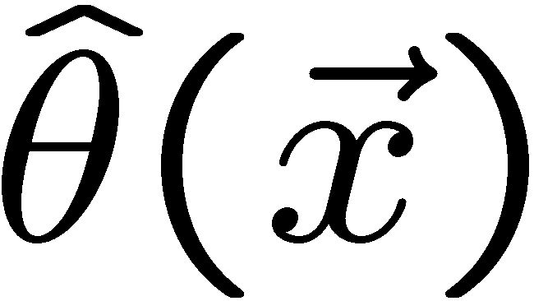
Parameter estimation
The parameters of a pdf are any constants that characterize it,
i.e., θ indexes a
set of hypotheses.
r.v.
parameter
Suppose we have a sample of observed values: x = (x₁, ..., x_{n})
We want to find some function of the data to estimate the
parameter(s):
← estimator written with a hat
Sometimes we say ‘estimator’ for the function of x₁, ..., x_{n};
‘estimate’ for the value of the estimator with a particular data set.

Slide 29
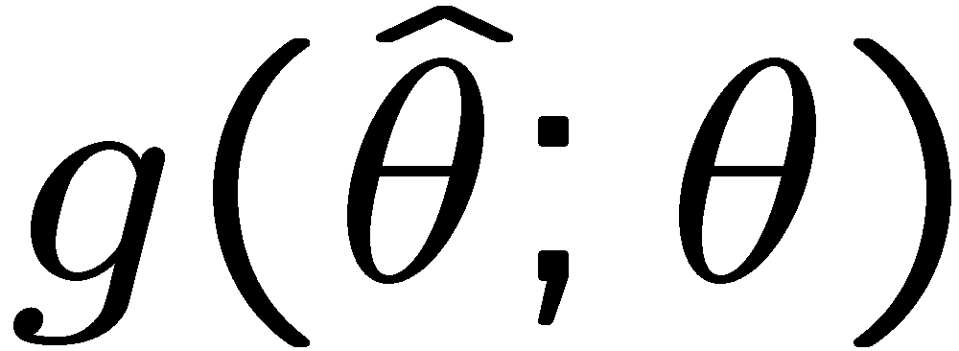
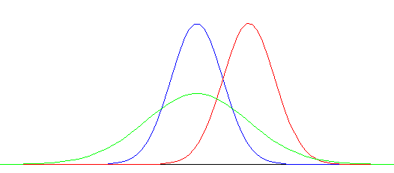


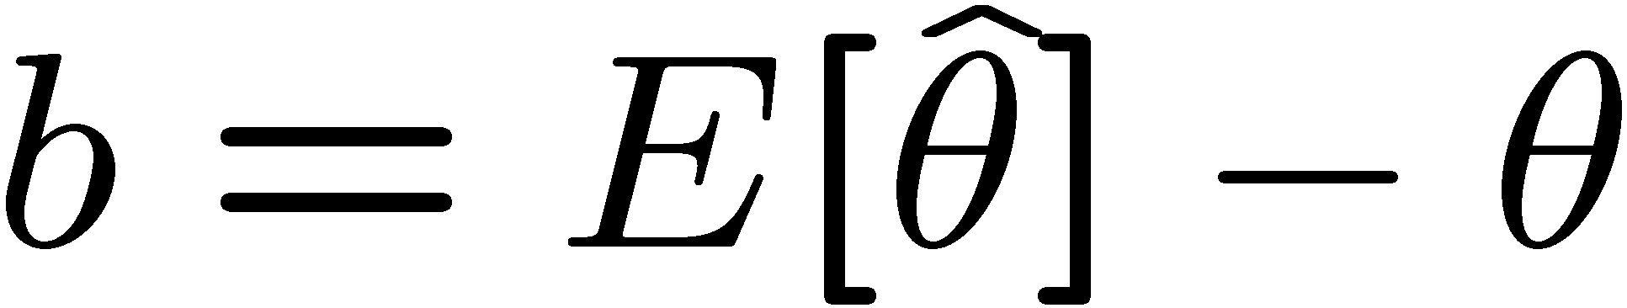

Properties of estimators
If we were to repeat the entire measurement, the estimates
from each would follow a pdf:
best
large
variance
biased
We want small (or zero) bias (systematic error):
→ average of repeated measurements should tend to true value.
And we want a small variance (statistical error):
→ small bias & variance are in general conflicting criteria

Slide 30

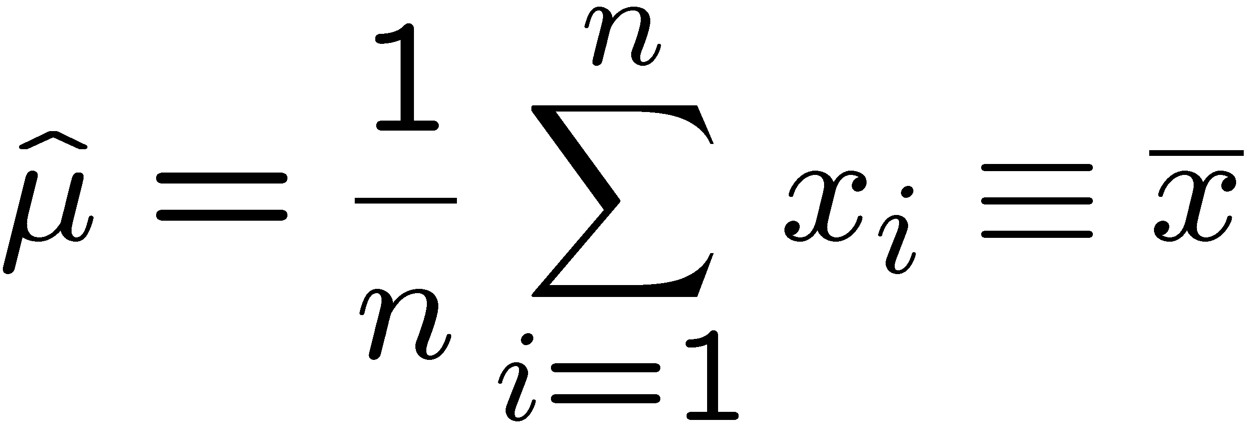
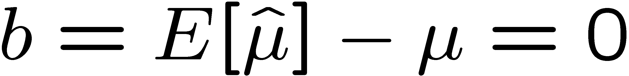
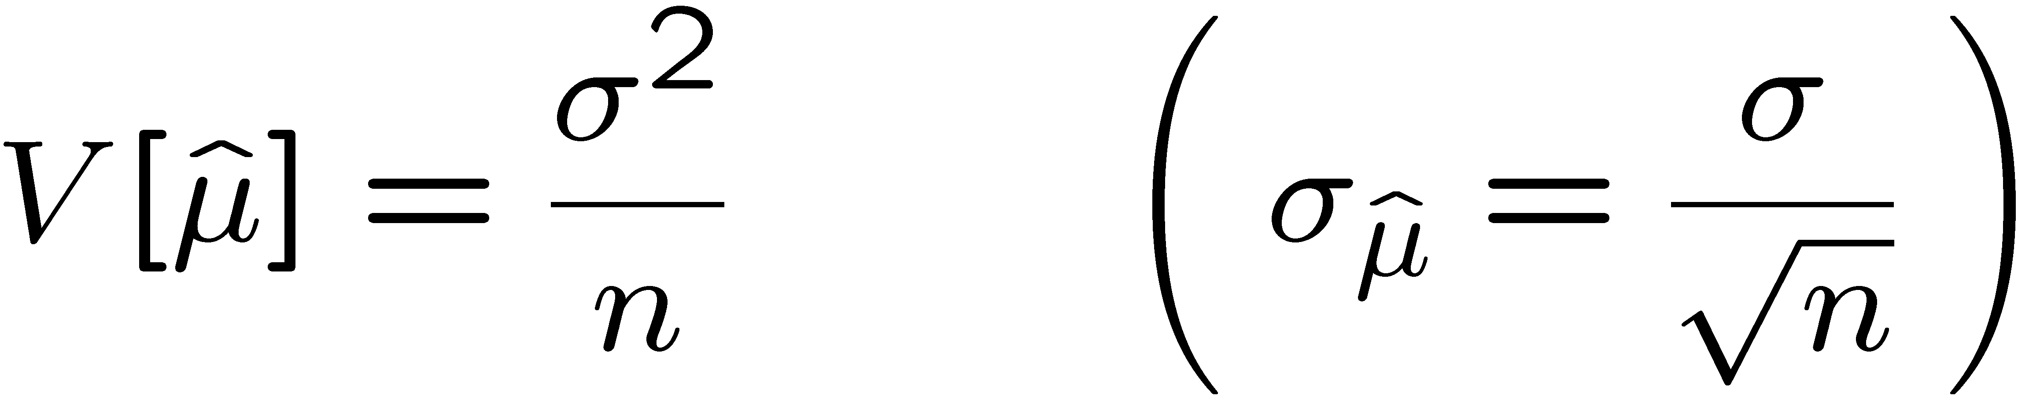
An estimator for the mean (expectation value)
Parameter:
Suppose we have a sample of n independent values x₁,...,x_{n}.
Estimator:
(‘sample mean’)
We find:

Slide 31

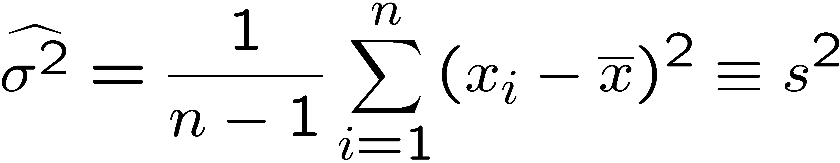
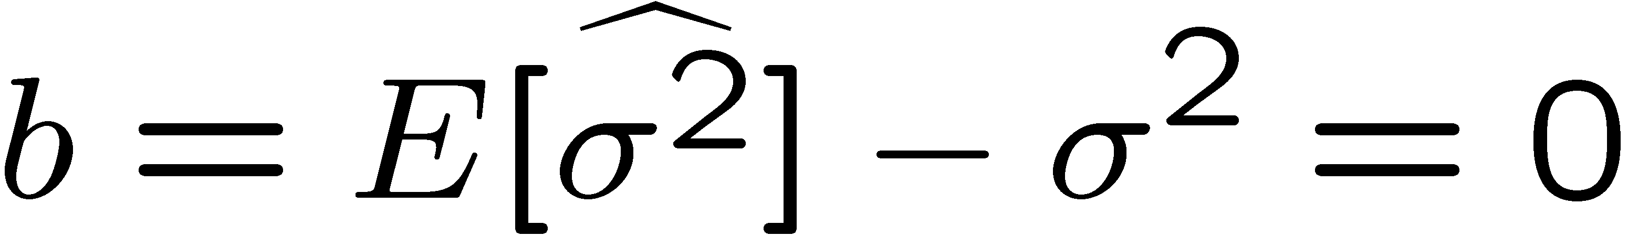
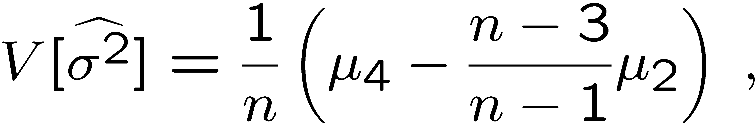
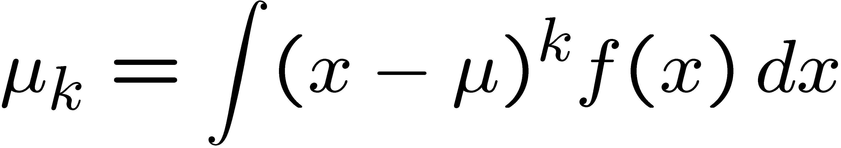
An estimator for the variance
Parameter:
Estimator:
(‘sample
variance’)
We find:
(factor of n-1 makes this so)
where

Slide 32


The likelihood function
Suppose the entire result of an experiment (set of measurements)
is a collection of numbers x, and suppose the joint pdf for
the data x is a function that depends on a set of parameters θ:
Now evaluate this function with the data obtained and
regard it as a function of the parameter(s). This is the likelihood function:
(x constant)

Slide 33
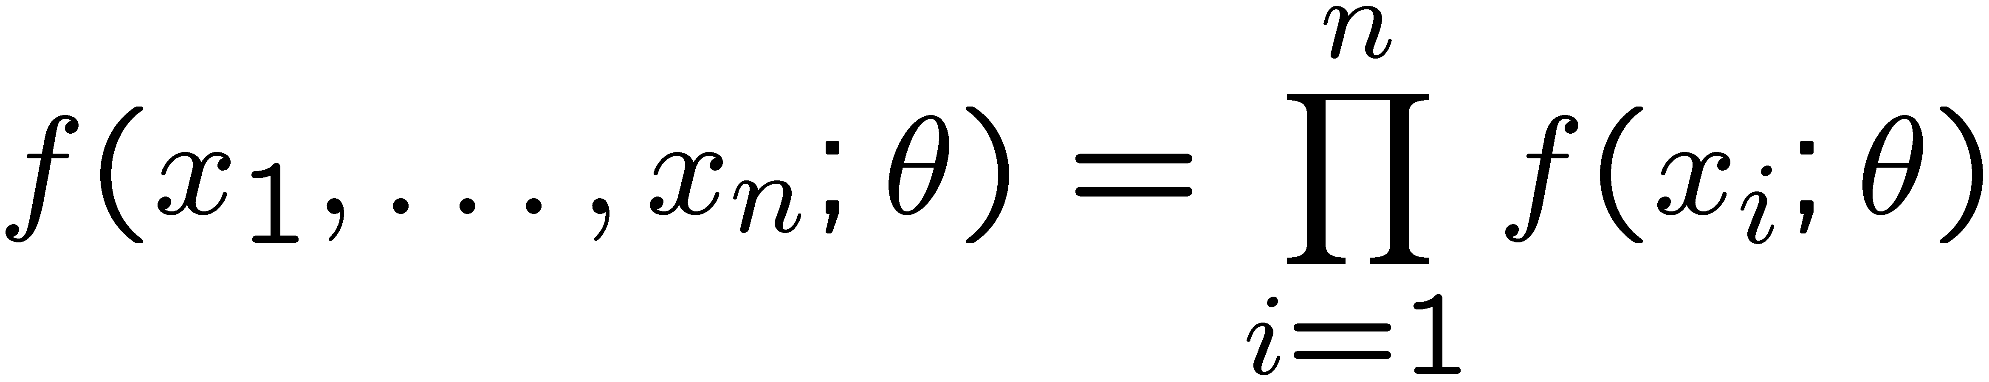
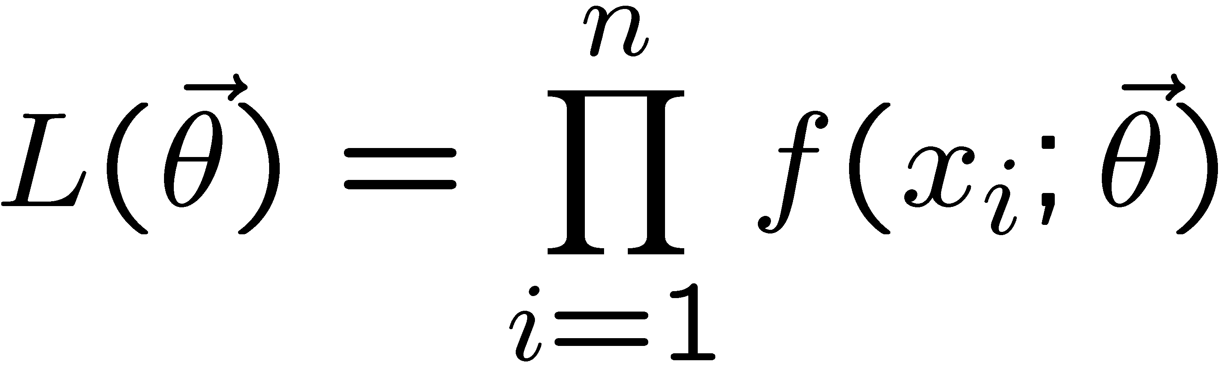
The likelihood function for i.i.d.*. data
* i.i.d. = independent and identically distributed
Consider n independent observations of x: x₁, ..., x_{n}, where
x follows f (x; θ). The joint pdf for the whole data sample is:
In this case the likelihood function is
(x_{i} constant)

Slide 34
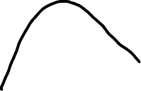
Maximum Likelihood Estimators (MLEs)
We define the maximum likelihood estimators or MLEs to be
the parameter values for which the likelihood is maximum.
Maximizing L equivalent
to maximizing log L
Could have multiple maxima (take highest).
MLEs not guaranteed to have any ‘optimal’ properties, (but in practice they’re very good).

Slide 35
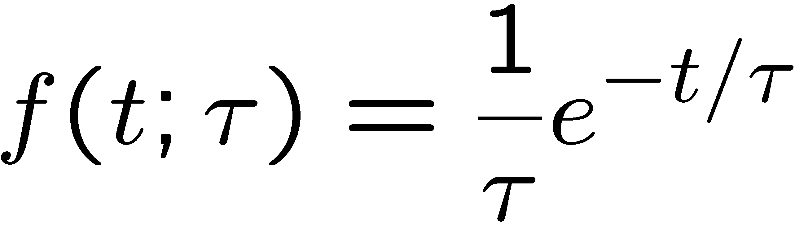
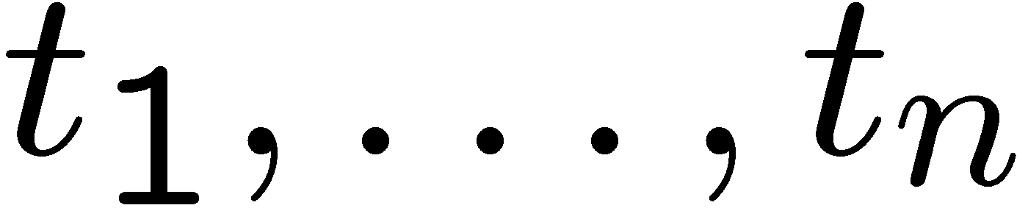
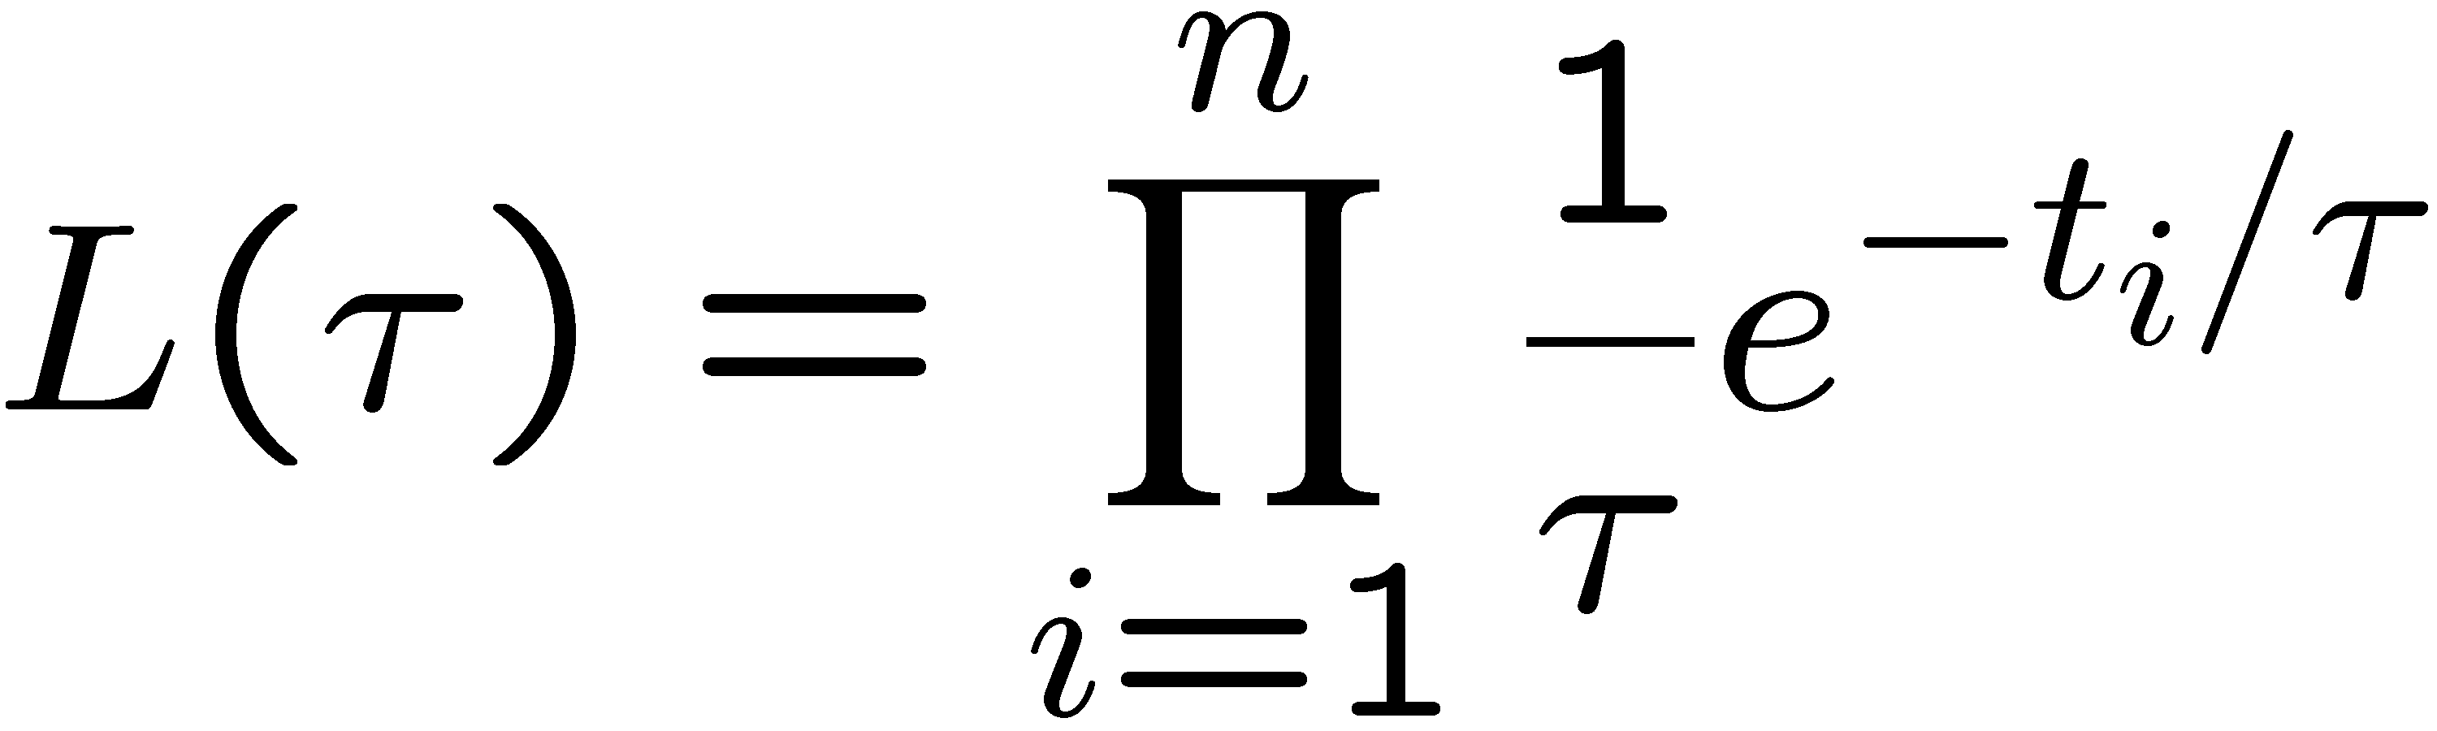
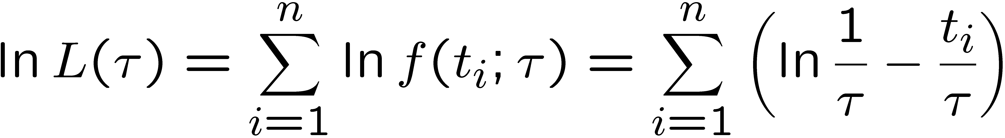
MLE example: parameter of exponential pdf
Consider exponential pdf,
and suppose we have i.i.d. data,
The likelihood function is
The value of τ for which L(τ) is maximum also gives the
maximum value of its logarithm (the log-likelihood function):

Slide 36
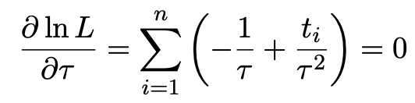
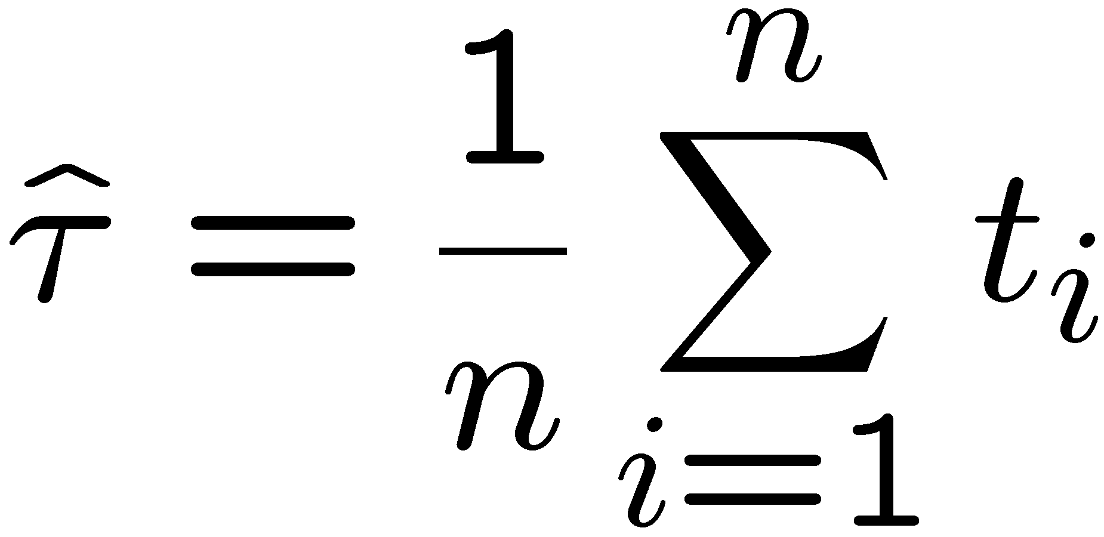
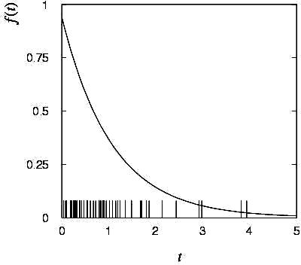

MLE example: parameter of exponential pdf (2)
Find its maximum by setting
→
Monte Carlo test:
generate 50 values
using τ = 1:
We find the ML estimate:

Slide 37






MLE example: parameter of exponential pdf (3)
For the exponential distribution one has for mean, variance:
For the MLE
we therefore find
→
→

Slide 38
Extra slides

Slide 39
Software for Machine Learning
We will practice ML with the Python package scikit-learn
scikit-learn.org ← software, docs, example code
scikit-learn built on NumPy, SciPy and matplotlib, so you need
import scipy as sp
import numpy as np
import matplotlib
import matplotlib.pyplot as plt
and then you import the needed classifier(s), e.g.,
from sklearn.neural_network import MLPClassifier
For a list of the various classifiers in scikit-learn see the docs
on scikit-learn.org, also a very useful sample program:
http://scikit-learn.org/stable/auto_examples/classification/plot_classifier_comparison.html

Slide 40
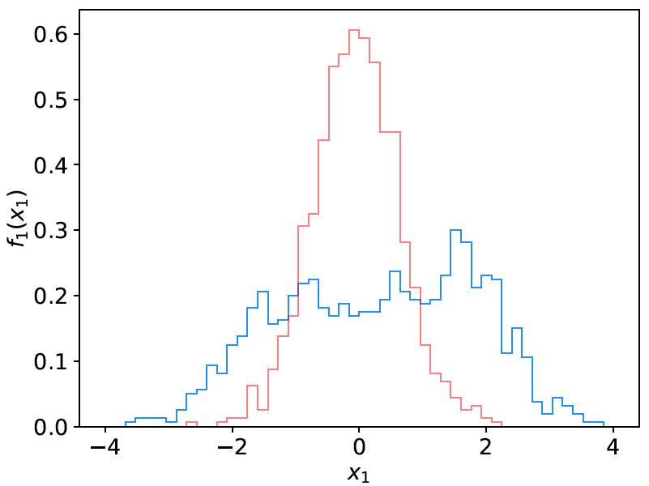
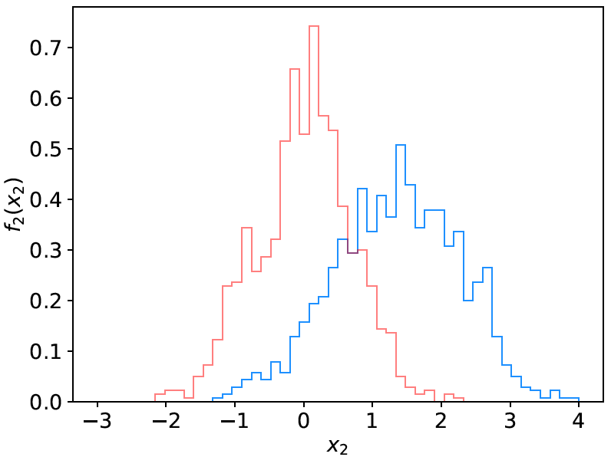
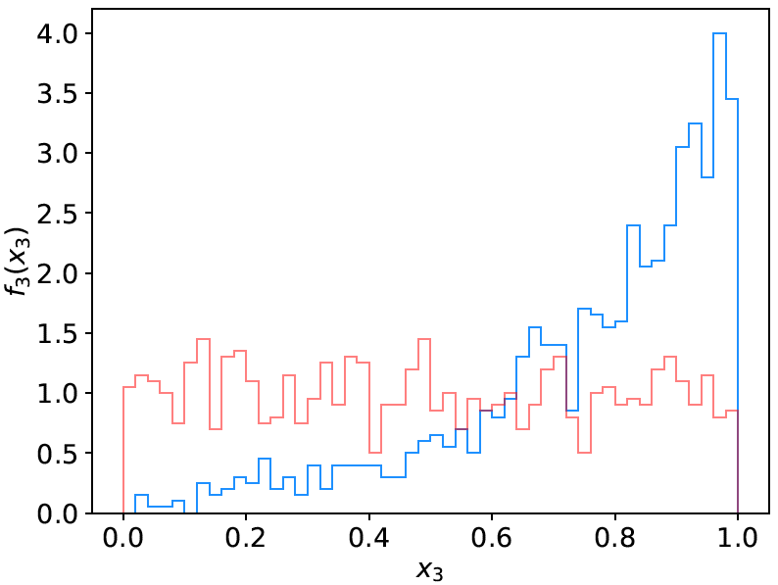
Example: the data
We will do an example with data corresponding to events
of two types: signal (y = 1, blue) and background (y = 0, red).
Each event is characterised by 3 quantities: x = (x₁, x₂, x₃).
Components are correlated.
Suppose we have 1000 events each of signal and background.

Slide 41
Reading in the data
scikit-learn wants the data in the form of numpy arrays:
# read the data in from files,
# assign target values 1 for signal, 0 for background
sigData = np.loadtxt('signal.txt')
nSig = sigData.shape[0]
sigTargets = np.ones(nSig)
bkgData = np.loadtxt('background.txt')
nBkg = bkgData.shape[0]
bkgTargets = np.zeros(nBkg)
# concatenate arrays into data X and targets y
# split into two parts: use one for training, the other for testing
X = np.concatenate((sigData,bkgData),0)
y = np.concatenate((sigTargets, bkgTargets))
# split data into training and testing samples
X_train, X_test, y_train, y_test = train_test_split(X, y, test_size=0.5,
random_state=1)

Slide 42
Create, train, evaluate the classifier
Create an instance of the MLP (multilayer perceptron) class
and “train”, i.e., adjust the values of the weights to minimise
the loss function.
Here we request 3 hidden layers with 10 nodes each:
# create classifier object and train
clf = MLPClassifier(hidden_layer_sizes=(10,10,10), activation='tanh',
max_iter=2000, random_state=6)
clf.fit(X_train, y_train)
Use test data to see what fraction of events are correctly classified
(default takes threshold of 0.5 for decision function)
# evaluate its accuracy (= 1 – error rate) using the test data
y_pred = clf.predict(X_test)
print(metrics.accuracy_score(y_test, y_pred))

Slide 43
Evaluating the decision function
So now for any point (x₁, x, x₃) in the feature space,
we can evaluate the decision:
# Test evaluation of decision function for a specific point in feature space
xt = np.array([0.37, 2.46, 0.42]).reshape((1,-1))
#t = clf.decision_function(xt)[0] # not available for MLP
t = clf.predict_proba(xt)[0, 1] # for MLP use this instead
Usually we have an array of points in x-space, so we can
get an array of probabilities:
t = clf.predict_proba(X_test)[:, 1] # returns prob to be of type y=1
Can get this separately for the signal and background events
and make histograms (see sample code).
Note for most other classifiers, the decision function is called
decision_function – use this instead of predict_proba.

Slide 44
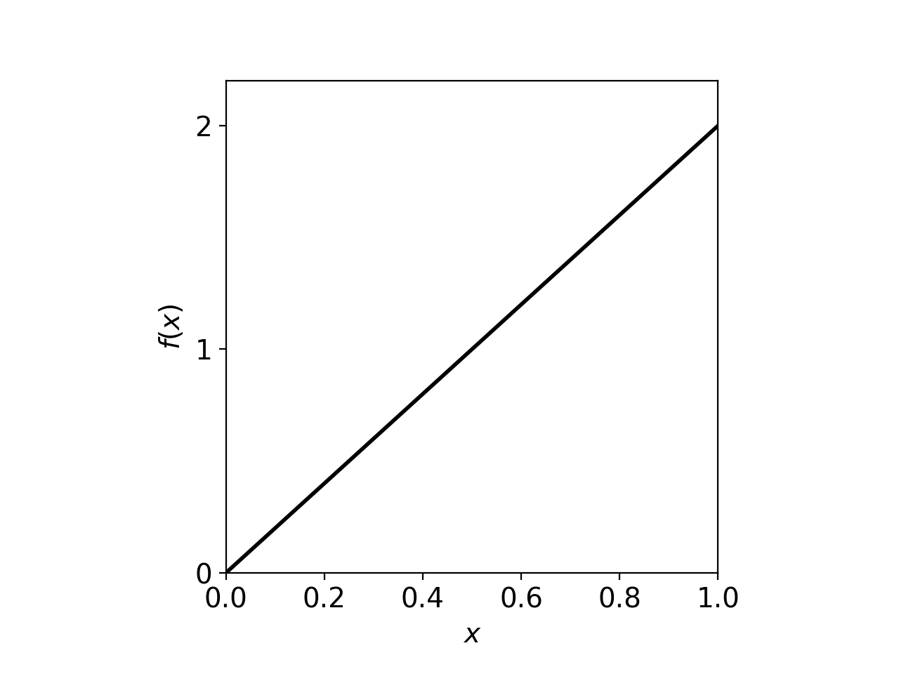
On defining a p-value
Earlier it was argued that the region of “equal or lesser compatibility” with H had greater compatibility with the predictions of some alternative hypothesis.
But shouldn’t it be possible to identify such a region by using the pdf f (x|H)?
In general, no.
Consider cubic crystal grains
produced by a process H that
have a size distribution
Observe grain of uncertain origin,
measure x,
find p-value of H.
If we observe a value x_{obs}, naively we could regard x ≤ x_{obs} as constituting equal or less agreement with the predictions of f (x|H).

Slide 45
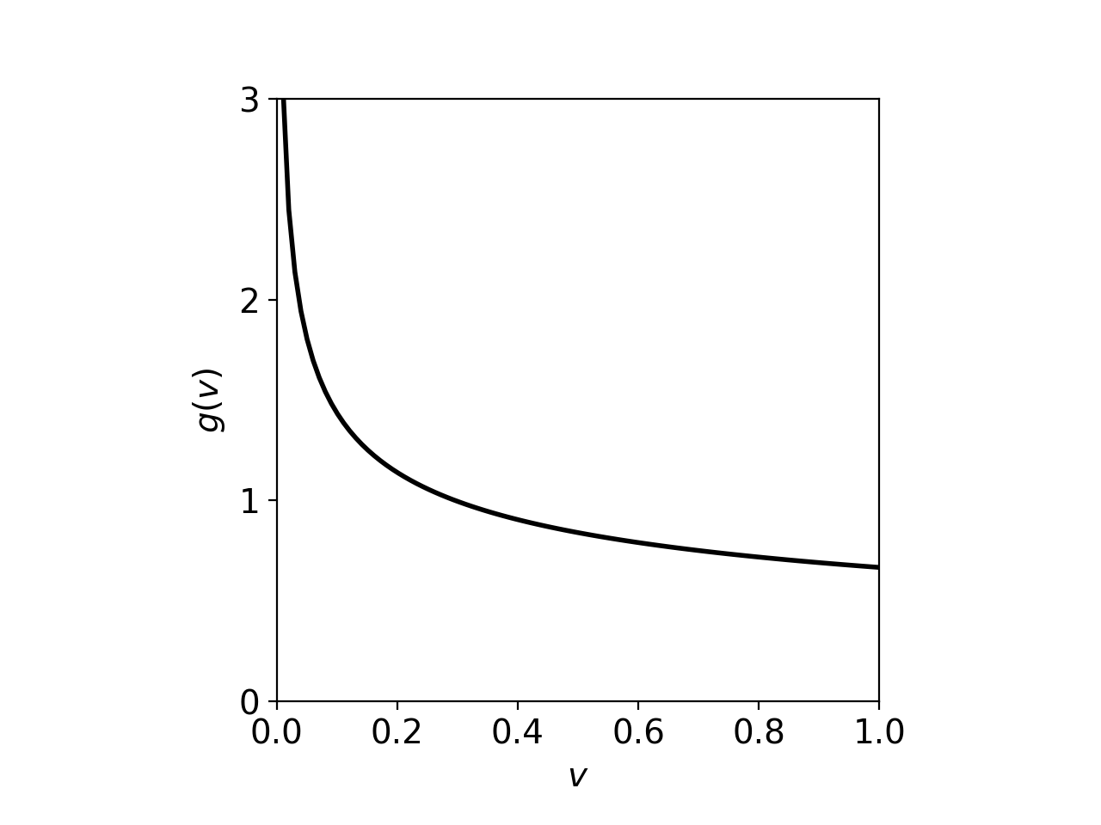
On defining a p-value (2)
But suppose we took the volume v = x³ of the cube to represent its size.
The volume distribution is
So now it appears that smaller sizes are more compatible with H.
Conclusion: deciding what region of data space constitutes greater or lesser
compatibility with H cannot be done by looking at the data distribution alone;
it requires that one consider an alternative H’.

Slide 46


Slide 47
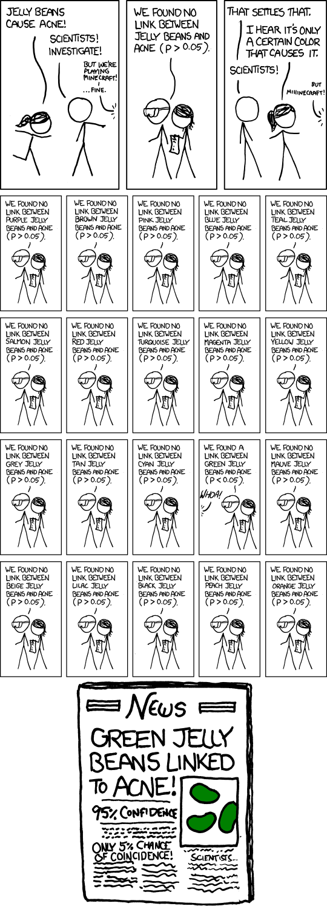


https://imgs.xkcd.com/comics/significant.png

