Slide 1


Statistical Data Analysis 2024/25
Lecture Week 7
London Postgraduate Lectures on Particle Physics
University of London MSc/MSci course PH4515
Glen Cowan
Physics Department
Royal Holloway, University of London
g.cowan@rhul.ac.uk
www.pp.rhul.ac.uk/~cowan
Course web page via RHUL moodle (PH4515) and also
www.pp.rhul.ac.uk/~cowan/stat_course.html

Slide 2
Statistical Data Analysis
Lecture 7-1
Reminder of maximum likelihood
The information inequality
Large-sample properties of MLEs

Slide 3
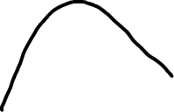
Reminder of maximum likelihood
The estimators for parameters θ are defined to be the values
that maximize the likelihood function L(θ) = P(x|θ):

Slide 4
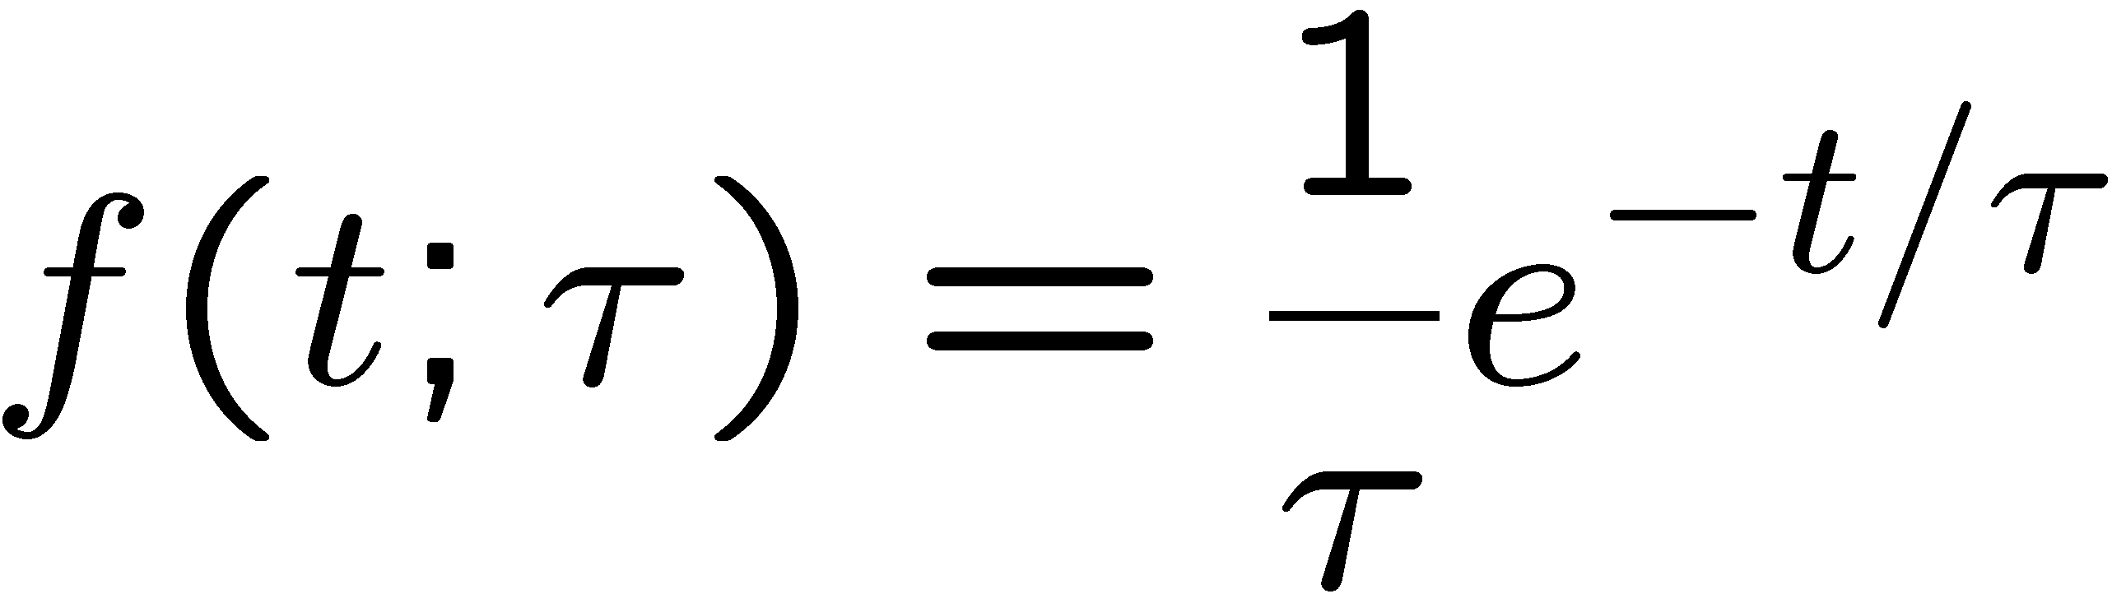
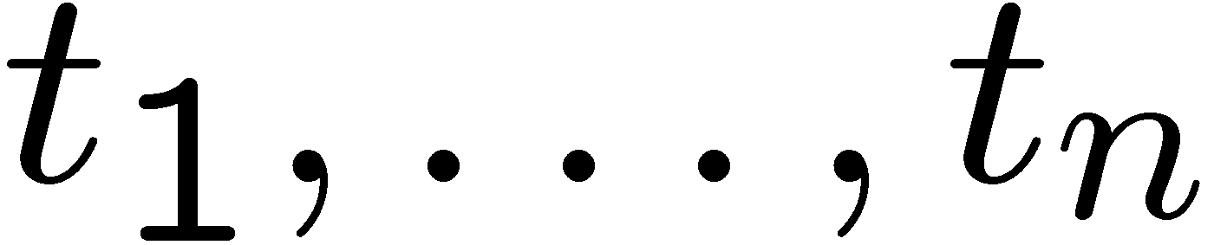
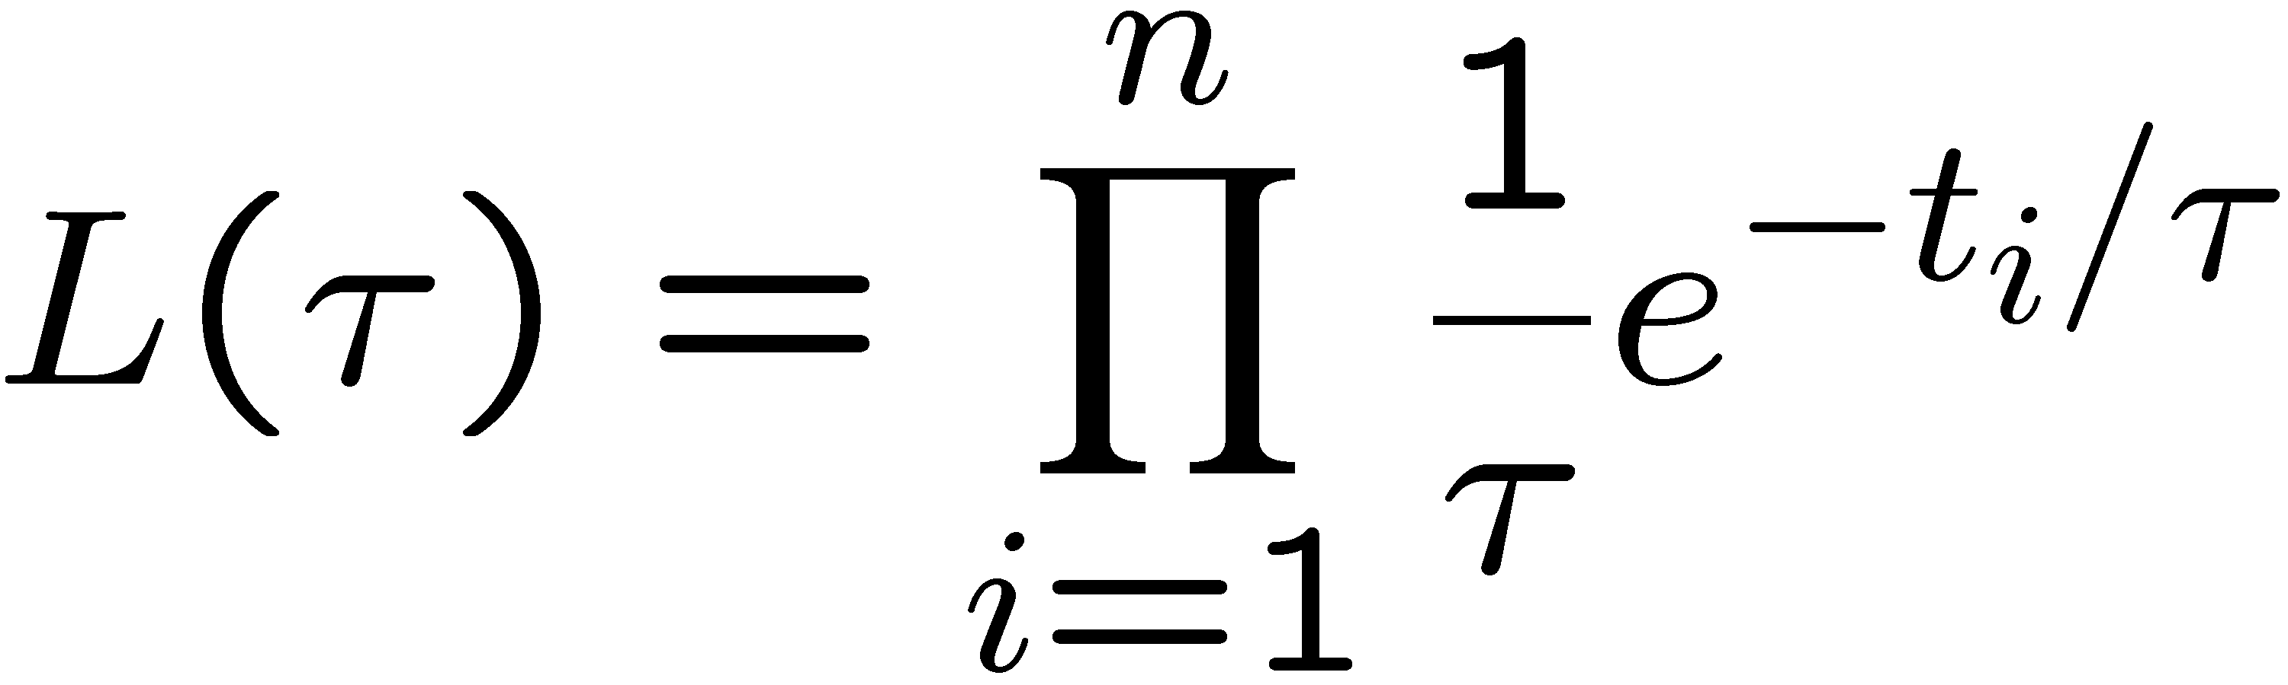

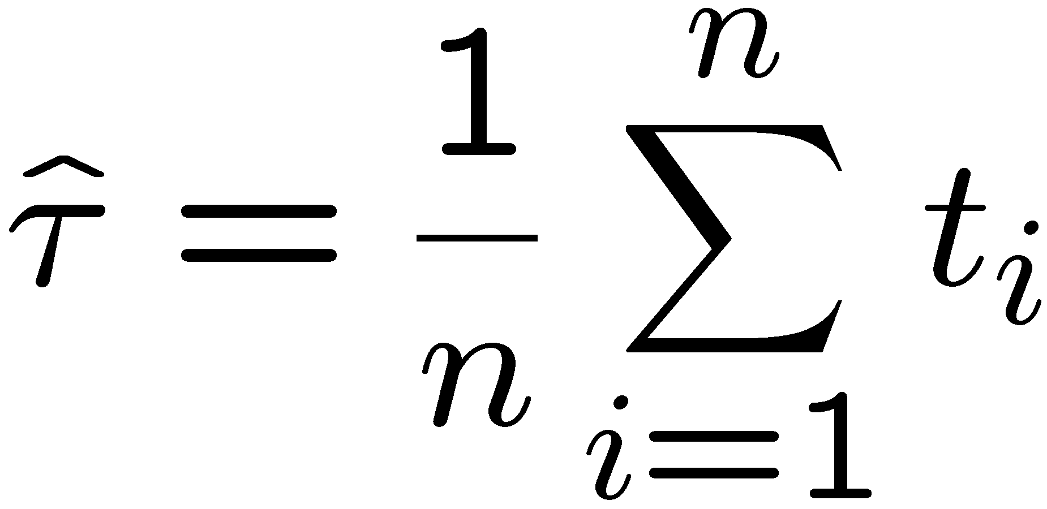
Reminder of MLE for exponential
Exponential pdf,
, i.i.d. data
Likelihood function:
Log-likelihood function:
Set
and solve for τ.
Bias:
MLE:
Variance:

Slide 5
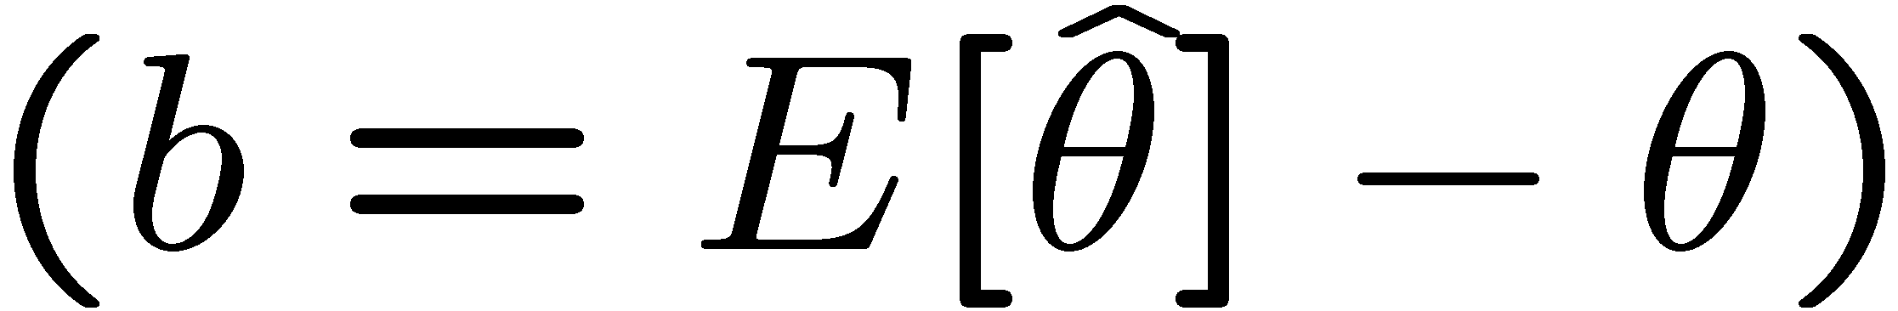
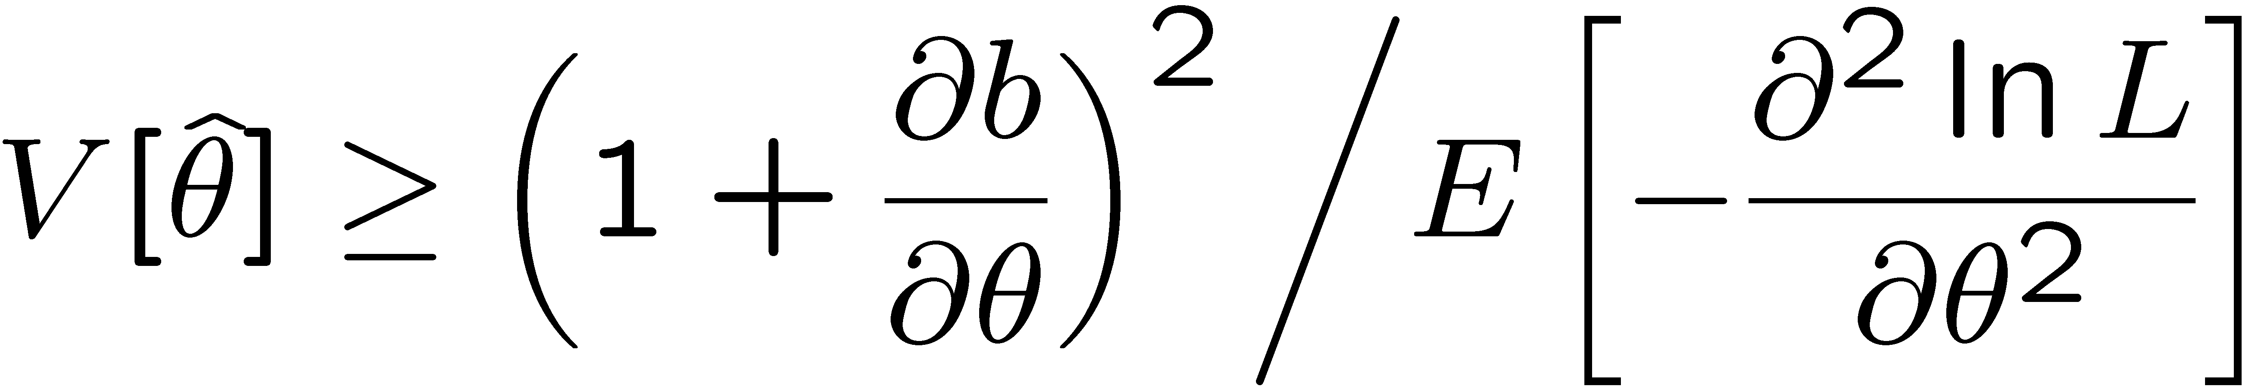
The information inequality
The information inequality (RCF) sets a lower bound on the
variance of any estimator (not only MLE). For a single parameter:
= MVB (Minimum
Variance Bound)
where
Proof in Exercise 6.6 of SDA, https://www.pp.rhul.ac.uk/~cowan/sda/prob/prob_6.pdf
“Efficiency” of an estimator = MVB / actual variance.
An estimator whose variance equals the MVB is said to be efficient.

Slide 6
MVB for MLE of exponential parameter
Find
We found for the exponential parameter the MLE
and we showed b = 0, hence 𝜕b/𝜕τ = 0.
We find
and since E[t_{i}] = τ for all i,
,
and therefore
.
So here the MLE is efficient.

Slide 7
Large-sample (asymptotic) properties of MLEs
Suppose we have an i.i.d. data sample of size n: x₁,...,x_{n}
In the large-sample (or “asymptotic”) limit (n → ∞) and assuming regularity conditions one can show that the likelihood and MLE have several important properties.
The regularity conditions include:
the boundaries of the data space cannot depend on the parameter;
the parameter cannot be on the edge of the parameter space;
ln L(θ) must be differentiable;
the only solution to 𝜕ln L/𝜕θ = 0 is θ.
^
In the slides immediately following, the properties are shown without proof for a single parameter; the corresponding properties hold also for the multiparameter case, θ = (θ₁,..., θ_{m}).

Slide 8
log-likelihood becomes quadratic
The likelihood function becomes Gaussian in shape, i.e. the log-likelihood becomes quadratic (parabolic).
The MLE becomes increasingly precise as the (log)-likelihood becomes more tightly concentrated about its peak,
but L(θ) = P(x|θ) is the probability for x, not a pdf for θ.

Slide 9
The MLE converges to the true parameter value
In the large-sample limit, the MLE converges in probability
to the true parameter value.
That is, for any ε > 0,
The MLE is said to be consistent.

Slide 10
MLE is asymptotically unbiased
In general the MLE can be biased, but in the large-sample limit, this bias goes to zero:
(Recall for the exponential parameter we found the bias was
identically zero regardless of the sample size n.)

Slide 11
The MLE’s variance approaches the MVB
In the large-sample limit, the variance of the MLE approaches the minimum-variance bound, i.e., the information inequality becomes an equality (and bias goes to zero):
The MLE is said to be asymptotically efficient.

Slide 12
The MLE’s distribution becomes Gaussian
In the large-sample limit, the pdf of the MLE becomes Gaussian,
where
is the minimum variance bound (note bias is zero).
For example, exponential MLE with sample size n = 100.
Note that for exponential, MLE is arithmetic average, so Gaussian MLE seen to stem from Central Limit Theorem.

Slide 13
Distribution of MLE of exponential parameter

Slide 14
Statistical Data Analysis
Lecture 7-2
Finding the variance of MLEs
Information inequality for multiple parameters
MLEs for 2-parameter example

Slide 15
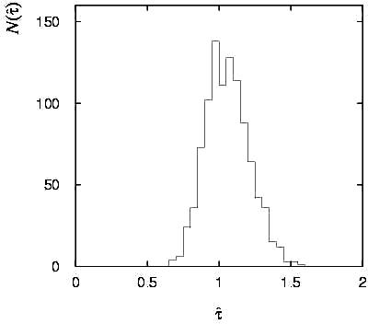
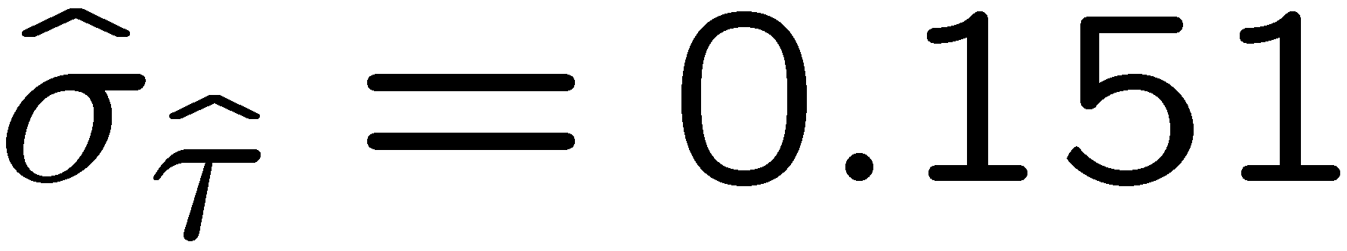
Variance of estimators: Monte Carlo method
Having estimated our parameter we now need to report its
‘statistical error’, using e.g. the estimator’s standard deviation, or (co)variance.
It is usually not possible to do this with an exact calculation.
Another way is to simulate the entire experiment many times with a Monte Carlo program (use ML estimate for MC).
For exponential example (n=50), from sample variance of estimates we find:

Slide 16
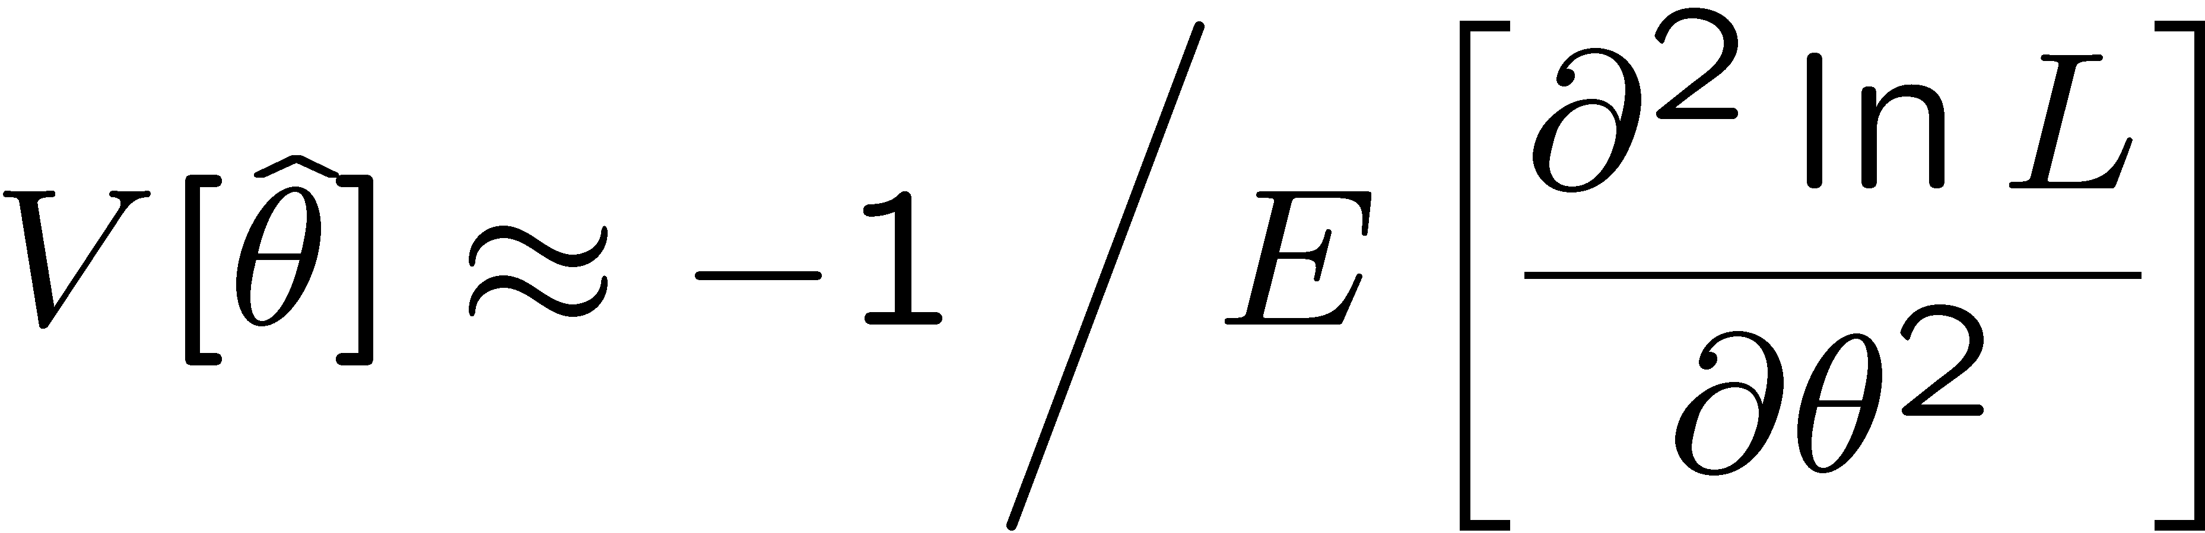
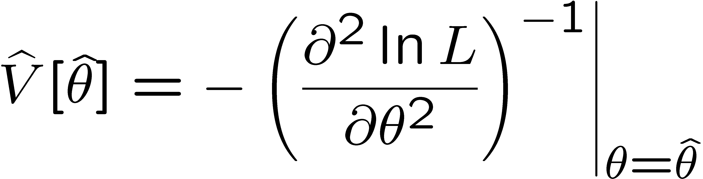
Variance of estimators from information inequality
Recall the information inequality (RCF) sets a lower bound on the
variance of any estimator (not only MLE):
MVB
Often the bias b is small, and equality either holds exactly or
is a good approximation (e.g. large data sample limit). Then,
Estimate this using the 2nd derivative of ln L at its maximum:

Slide 17
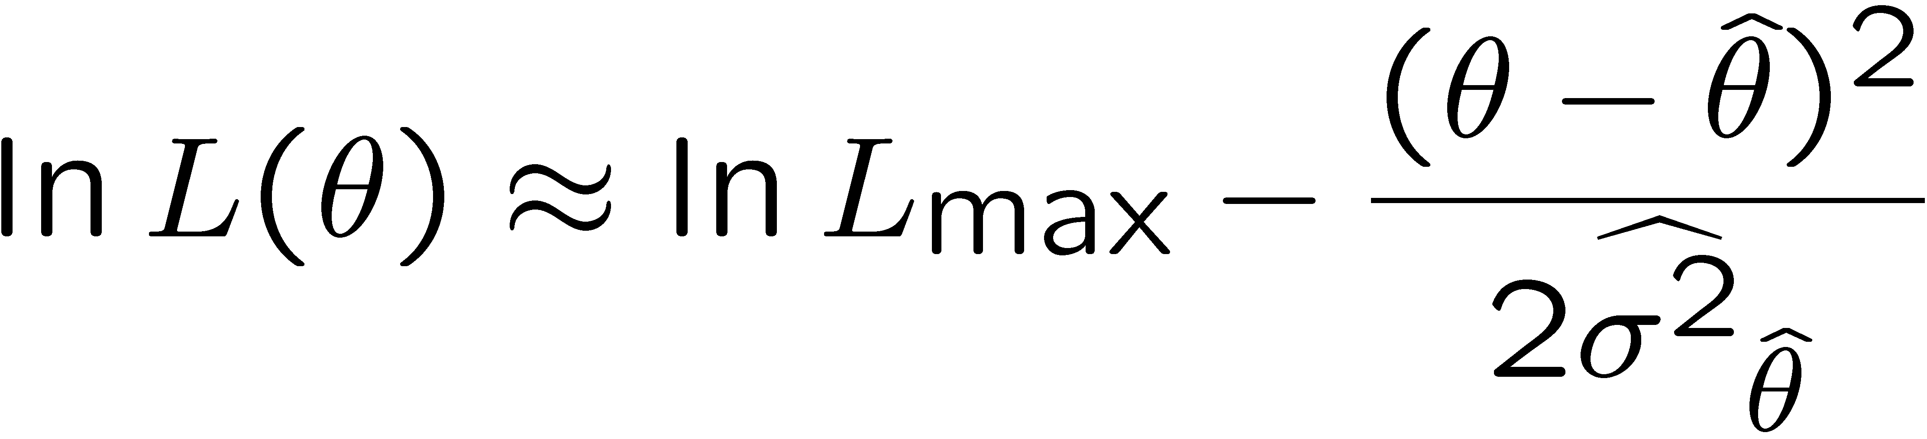
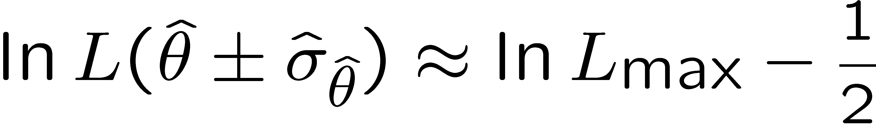
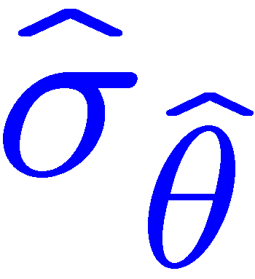

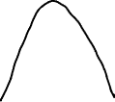
Variance of estimators: graphical method
Expand ln L (θ) about its maximum:
First term is ln L_{max}, second term is zero, for third term use
information inequality (assume equality):
→ to get
, change θ away from
until ln L decreases by 1/2.

Slide 18
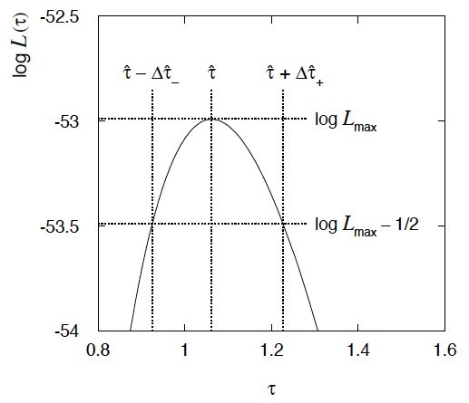
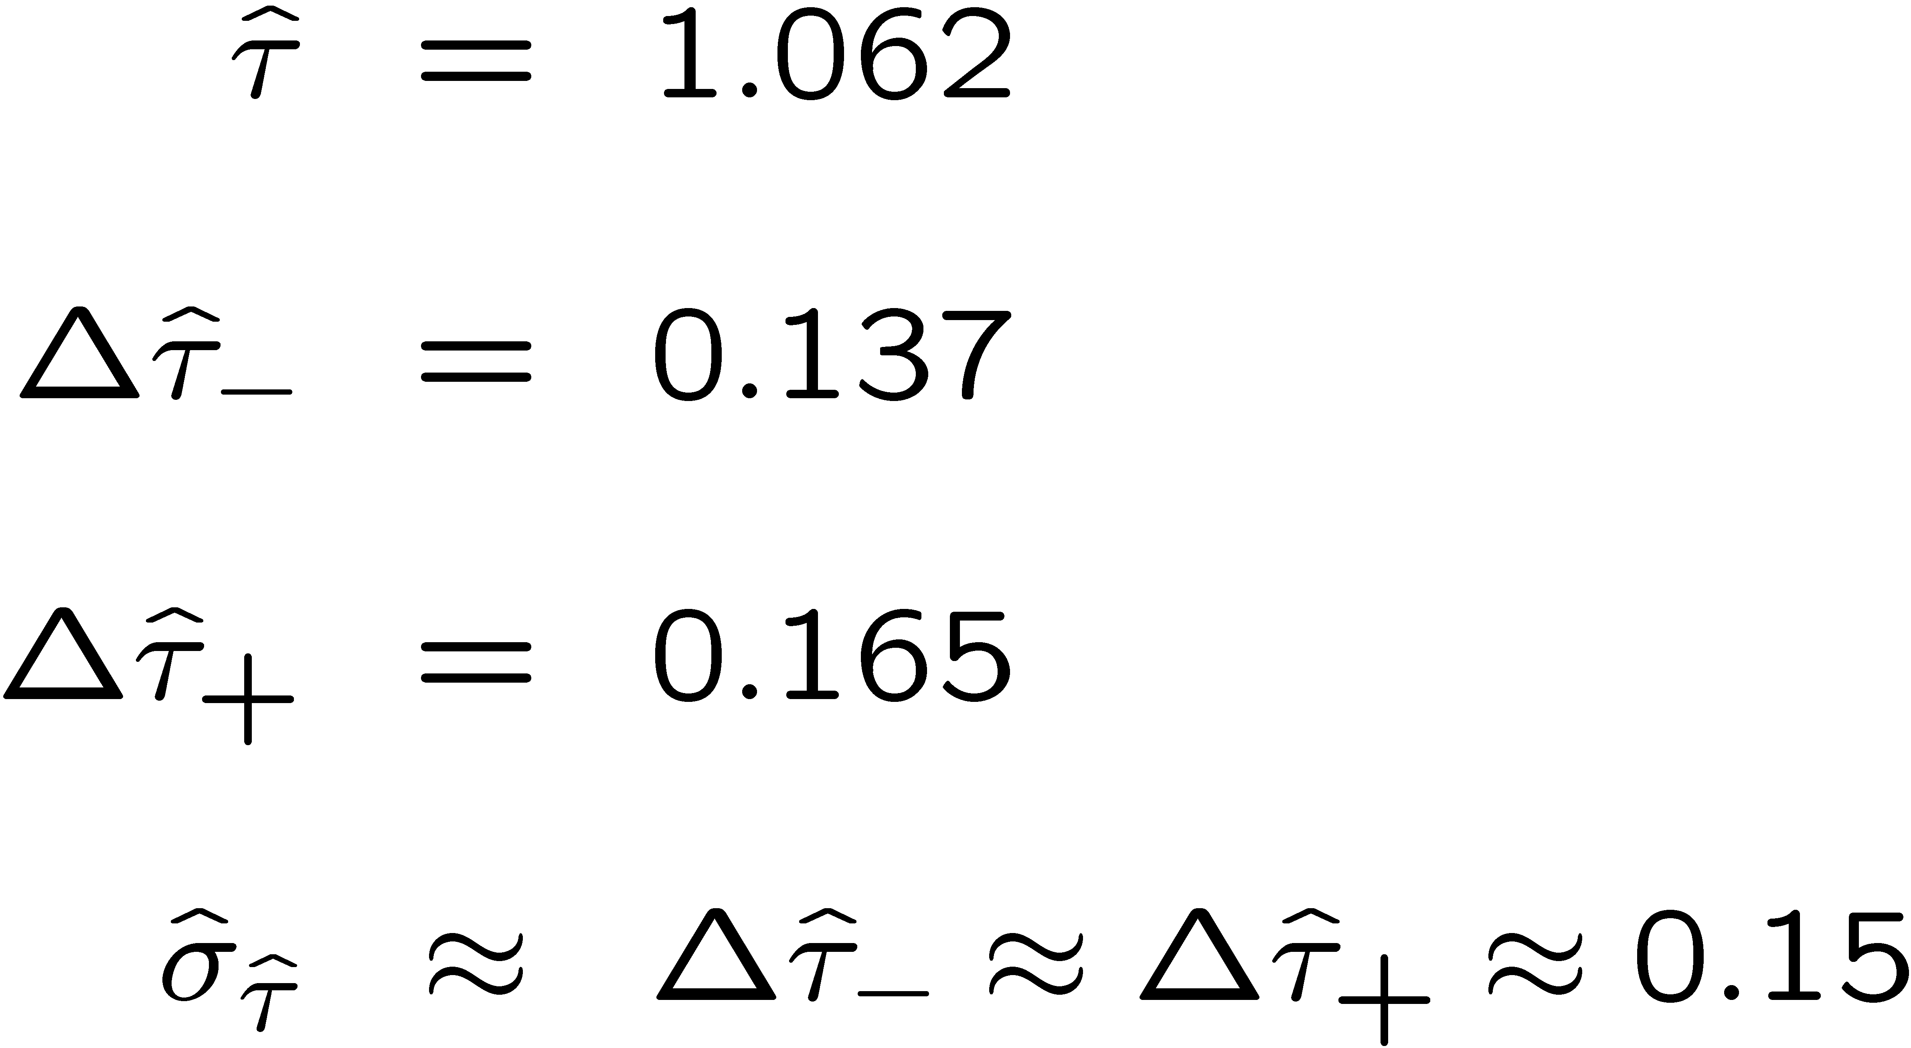
Example of variance by graphical method
ML example with exponential:
Not quite parabolic ln L since finite sample size (n = 50).

Slide 19
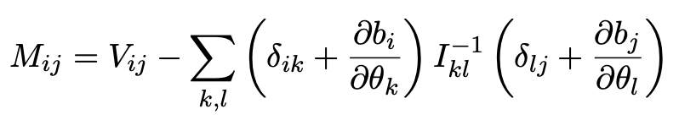
Information inequality for N parameters
Suppose we have estimated N parameters θ = (θ₁,...,θ_{N})
The Fisher information matrix is
^
and the covariance matrix of estimators θ is
The information inequality states that the matrix
is positive semi-definite:
z^{T}Mz ≥ 0 for all z ≠ 0, diagonal elements ≥ 0

Slide 20
Information inequality for N parameters (2)
In practice the inequality is ~always used in the large-sample limit:
bias → 0
inequality → equality, i.e, M = 0, and therefore V = I⁻¹
That is,
This can be estimated from data using
Find the matrix V⁻¹ numerically (or with automatic differentiation),
then invert to get the covariance matrix of the estimators

Slide 21
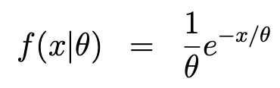

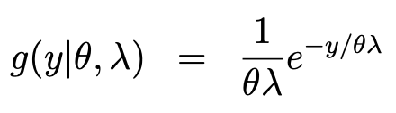

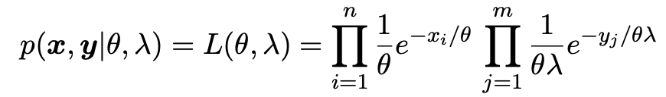
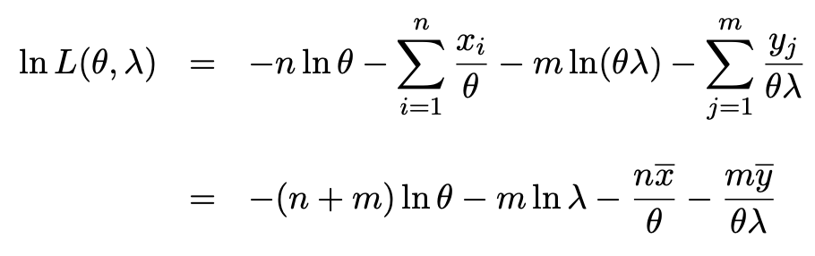
Example of MLEs for two parameters
Consider two independent i.i.d. samples:
→
→
The likelihood function and its log are:

Slide 22
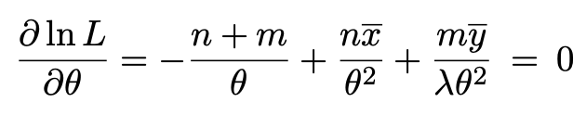
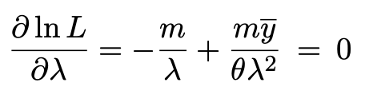
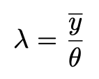
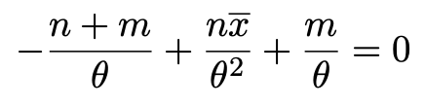

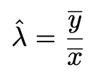
Example of MLEs for two parameters (2)
Set the derivatives of the log-likelihood function to zero:
Eq. (1)
Eq. (2)
From Eq. (2), find
→ use in Eq. (1)
Solve for the MLEs:
,
Not defined if n = 0.

Slide 23
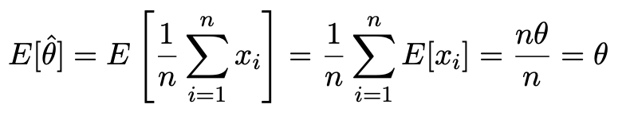

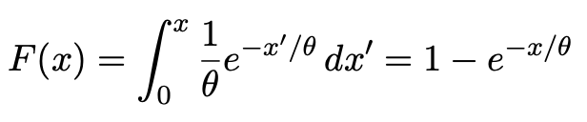



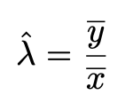

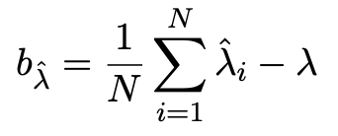
Bias of MLEs
＾
For bias of θ
so
＾
Expectation of λ not calculable in closed form, could investigate
bias with Monte Carlo study:
Find cdf
or use –θ ln r
Set
→
Generate a data set:
→
Repeat N times, estimate bias :
Depends in general on n, m, λ, θ

Slide 24
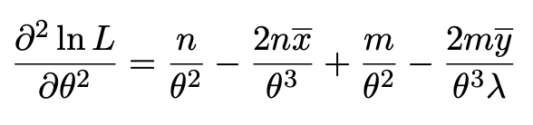
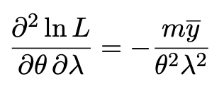
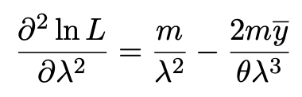
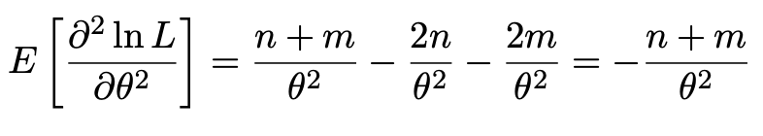

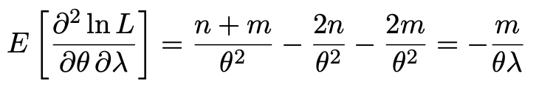

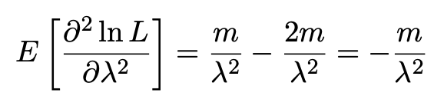
Covariance of MLEs from Fisher information
Find the 2nd derivatives of ln L
Using
find expectations:

Slide 25
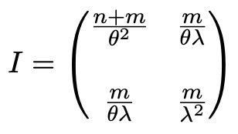
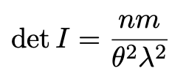


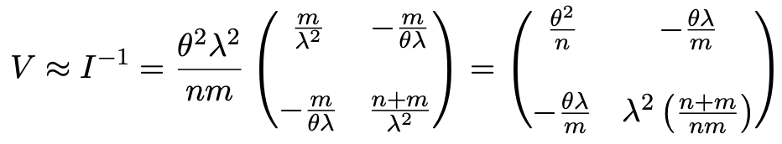

Covariance of MLEs from Fisher information (2)
For estimates of the covariances, evaluate with the MLEs.

Slide 26
Statistical Data Analysis
Lecture 7-3
Numerical example of 2-D MLE
The ln L = ln L_{max} – ½ contour
MLE for function of a parameter

Slide 27
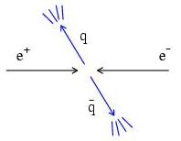
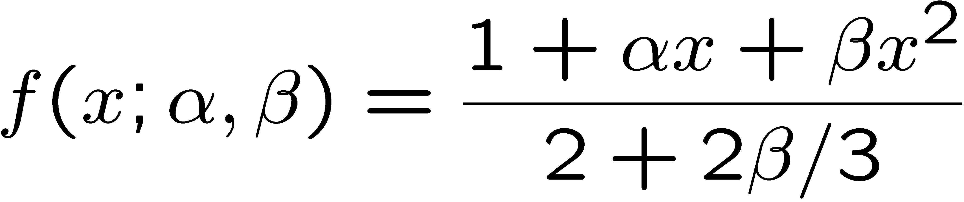
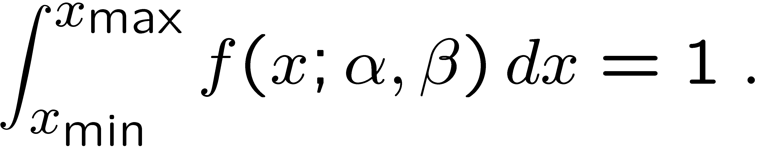
Example of ML with 2 parameters
Consider a scattering angle distribution with x = cos θ,
or if x_{min} < x < x_{max}, need to normalize so that
Example: α = 0.5, β = 0.5, x_{min} = −0.95, x_{max} = 0.95, generate n = 2000 events with Monte Carlo.
need to find maximum
numerically

Slide 28
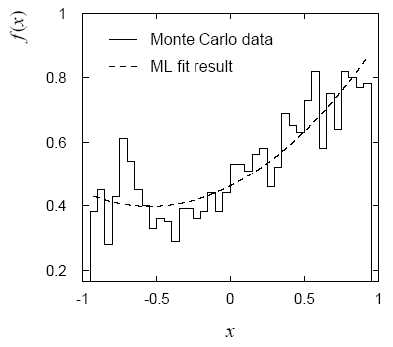
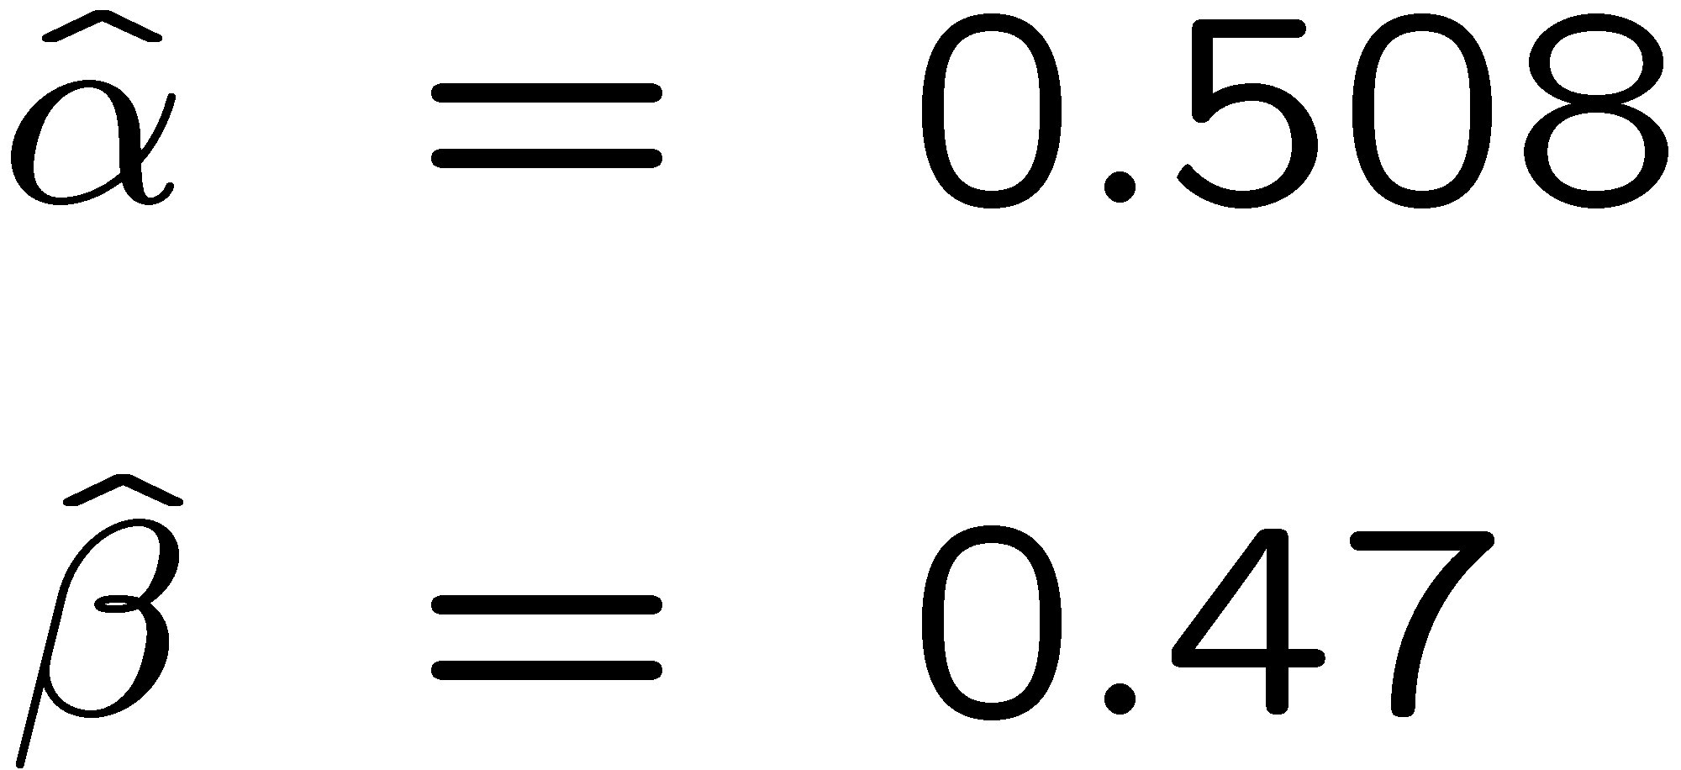
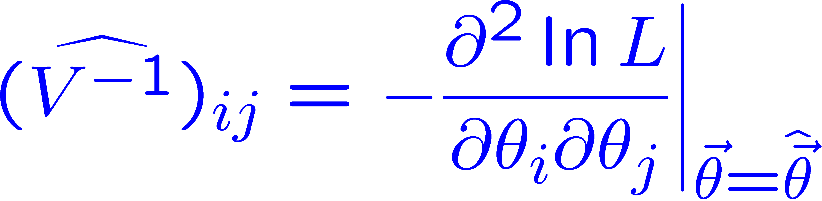
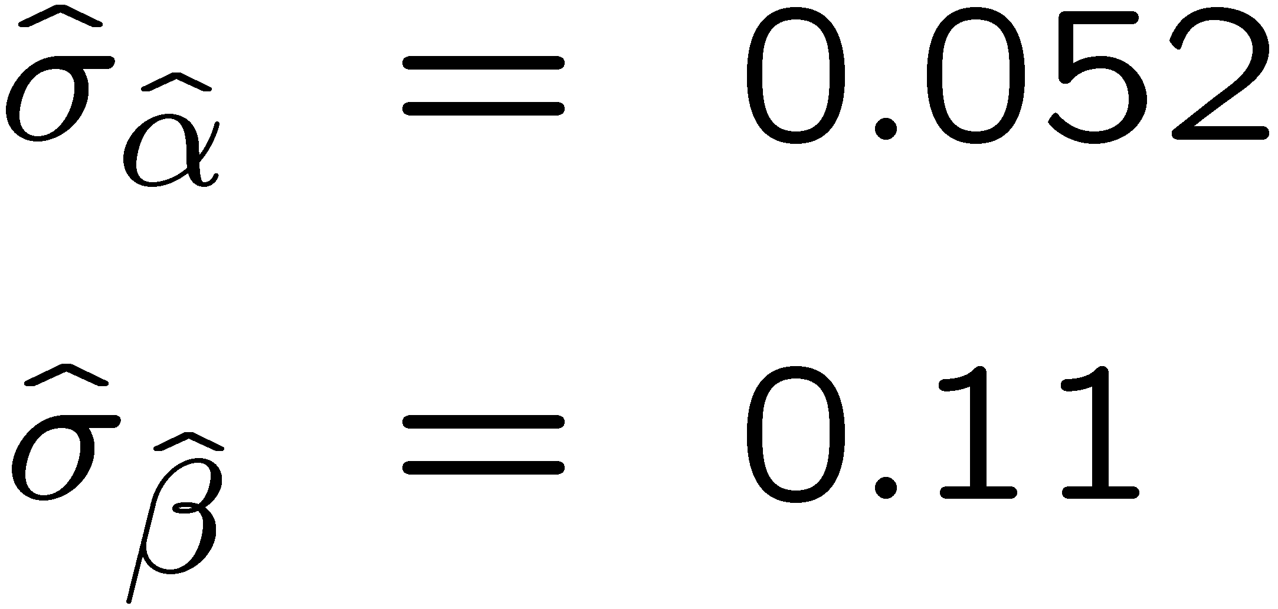
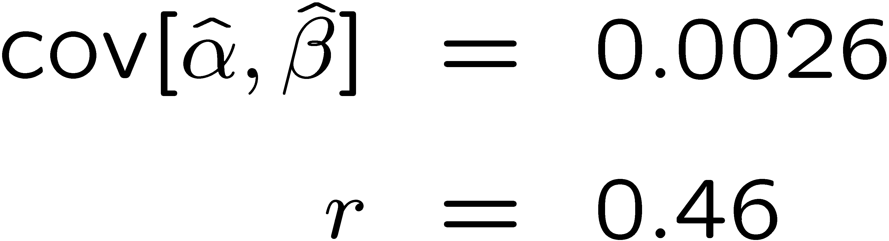
Example of ML with 2 parameters: fit result
Finding maximum of ln L(α, β) numerically gives
N.B. No binning of data for fit,
but can compare to histogram for
goodness-of-fit (e.g. ‘visual’ or χ²).
(Co)variances from
= correlation coefficient

Slide 29
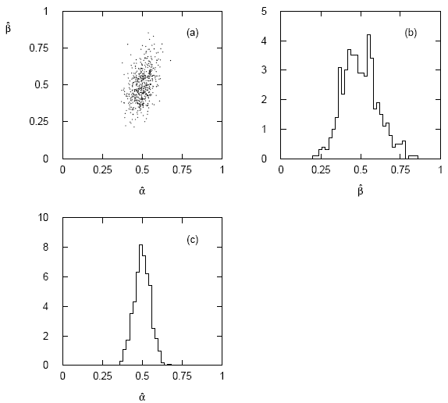




Two-parameter fit: MC study
Repeat ML fit with 500 experiments, all with n = 2000 events:
Estimates average to ~true values;
(Co)variances close to previous estimates;
marginal pdfs approximately Gaussian.

Slide 30
Multiparameter graphical method for variances
Expand ln L(θ) to 2nd order about MLE:
ln L_{max}
zero
relate to covariance matrix of MLEs using information (in)equality.
Result:
So the surface
corresponds to
, which is the equation of a (hyper-) ellipse.

Slide 31



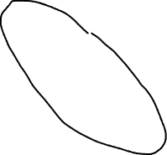
Multiparameter graphical method (2)
Distance from MLE to tangent planes gives standard deviations.

Slide 32


The ln L_{max} − 1/2 contour for two parameters
For large n, ln L takes on quadratic form near maximum:
The contour
is an ellipse:

Slide 33


(Co)variances from ln L contour
The α, β plane for the first
MC data set
→ Tangent lines to contours give standard deviations.
→ Angle of ellipse φ related to correlation:

Slide 34
Functions of maximum-likelihood estimators
Suppose likelihood has a parameter θ.
Define a new parameter α given by function α = a(θ).
What is the MLE of α?
For now suppose a(θ) has a unique inverse, so θ = a⁻¹(α).
The likelihood is L(θ) = L(a⁻¹(α)).
The maximum of the likelihood is L_{max} = L(θ).
So to maximize L, find α ≡ α such that
^
^
MLE of a function is the function of the MLE.
Still works when function is not one-to-one. Very useful result.

Slide 35





Functions of MLEs: exponential example
Suppose we had written the exponential pdf as
i.e., we use λ = 1/τ. What is the MLE estimator for λ?
For the decay constant we have
Caveat:
is biased, even though
is unbiased.
Can show
(bias → 0 for n → ∞)
In general MLE for a function of an unbiased estimator stays unbiased only for a linear function.

Slide 36
Statistical Data Analysis
Lecture 7-4
Extended maximum likelihood
Maximum likelihood with a histogram of data
Relationship between MLE and Bayesian estimator

Slide 37


Extended ML
We observe n independent values of x ~ f (x;θ).
Suppose we regard n not as fixed, but as a Poisson r.v., mean ν.
Result of experiment defined as: n, x₁, ..., x_{n}.
P(n, x) = P(n) P(x|n), so the (extended) likelihood function is:
Suppose theory gives ν = ν(θ), then the log-likelihood is
where C represents terms not depending on θ.

Slide 38



Extended ML (2)
Example: expected number of events
where the total cross section σ(θ) is predicted as a function of
the parameters of a theory, as is the distribution of a variable x.
Extended MLE uses information both from the number of events n as well as the observed values of x.
→ smaller errors for (compared to using x alone).
If ν does not depend on θ but remains a free parameter,
extended ML gives:

Slide 39





ML with binned data
Often put data into a histogram:
Hypothesis specifies
where
If we model the data as multinomial (n_{tot} constant),
then the log-likelihood function is:

Slide 40



Example with binned data
Previous example with exponential, now put data into histogram:
Binning results in loss of information, increased std. dev. of MLE.
Limit of zero bin width → usual unbinned MLE.
If n_{i} treated as Poisson, we get extended log-likelihood:

Slide 41

Relationship between ML and Bayesian estimators
Recall the Bayesian approach:
Both parameters θ and data x are random variables.
Use subjective probability for hypotheses (θ);
before experiment, knowledge summarized by prior pdf π(θ);
use Bayes’ theorem to update prior in light of data:
Posterior pdf (conditional pdf for θ given x)

Slide 42



ML and Bayesian estimators (2)
Purist Bayesian: p(θ | x) contains all knowledge about θ.
Pragmatist Bayesian: p(θ | x) could be a complicated function,
→ summarize using an estimator
Take mode of p(θ | x), (could also use e.g. expectation value)
What do we use for π(θ)?
No golden rule (subjective!), often represent ‘prior ignorance’ by π(θ) = constant, in which case

Slide 43
ML and Bayesian estimators (3)
Note π_{θ}(θ) = const. cannot be normalized – “improper prior”.
Can be allowed for some problems; prior always appears multiplied
by likelihood, so product L(θ)π_{θ}(θ) can result in normalizable posterior probability.
But... we could have used a different parameter, e.g., λ= 1/θ,
and if prior π_{θ}(θ) is constant, then π_{λ}(λ) is not:
Maybe we know say we nothing about λ, so take π_{λ}(λ) = const.
Then
‘Complete prior ignorance’ is not well defined.

Slide 44
Extra slides

Slide 45

Graphical method for standard deviations

Slide 46

MLE for number of taxis
The number plate of taxis in every canton in Switzerland ends with a number N from 1 to N_{tot}, where N_{tot} is the total number of taxis.
Model the probability for observing plate number N with

Slide 47
MLE for N_{tot}
Suppose you observe one taxi at random with plate number N.
The likelihood function is
which is maximized for
The expectation value and bias of the MLE are
For better estimators, see similar problem with tanks in WW2:
https://en.wikipedia.org/wiki/German_tank_problem
E.g. the minimum-variance unbiased estimator is:

Slide 48
Cheap estimator for mass of W boson
The Particle Physics community has spent huge sums trying to
estimate the mass of the W boson with the smallest possible
statistical and systematic uncertainty.
Here is an estimator with zero statistical uncertainty. And it’s free!
Here is its sampling distribution:
Does this violate the information
inequality?

Slide 49

Cheap estimator for mass of W boson (2)
This estimator’s bias is
Note best estimate of M_{W} is (in 2020) 80.379±0.012 GeV, so the numerical
value of the bias may be fairly small.
But we have
and so
So the information inequality is still satisfied.

Slide 50



Extended ML example
Consider two types of events (e.g., signal and background) each
of which predict a given pdf for the variable x: f_{s}(x) and f_{b}(x).
We observe a mixture of the two event types, signal fraction = θ,
expected total number = ν, observed total number = n.
Let
goal is to estimate μ_{s}, μ_{b}.
→

Slide 51



Extended ML example (2)
Monte Carlo example
with combination of
exponential and Gaussian:
Maximize log-likelihood in
terms of μ_{s} and μ_{b}:
Here errors reflect total Poisson
fluctuation as well as that in
proportion of signal/background.

