Slide 1


Statistical Data Analysis 2024/25
Lecture Week 8
London Postgraduate Lectures on Particle Physics
University of London MSc/MSci course PH4515
Glen Cowan
Physics Department
Royal Holloway, University of London
g.cowan@rhul.ac.uk
www.pp.rhul.ac.uk/~cowan
Course web page via RHUL moodle (PH4515) and also
www.pp.rhul.ac.uk/~cowan/stat_course.html

Slide 2
Statistical Data Analysis
Lecture 8-1
Basic idea of curve fitting
The method of Least Squares (LS)
LS from maximum likelihood
LS with correlated measurements

Slide 3
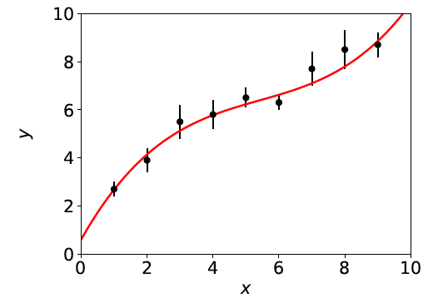
Curve fitting: basic idea
Consider N independent measured values y_{i}, i = 1,.., N.
Each y_{i} has a standard deviation σ_{i}, and is measured at a value x_{i} of a control variable x known with negligible uncertainty:
μ(x; θ)
y_{i} ± σ_{i}
The goal is to find a curve μ(x; θ) that passes “close to” the data points.
Suppose the functional form of μ(x; θ) is given; goal is to estimate its parameters θ (= “curve fitting”).

Slide 4
Minimising the residuals
If a measured value y_{i} has a small σ_{i}, we want it to be
closer to the curve, i.e., measure the distance from point to
curve in units of σ_{i}:
standardized residual of i^{th} point =
Idea of the method of Least Squares is to choose the parameters
that give the minimum of the sum of squared standardized residuals, i.e., we should minimize the “chi-squared”:

Slide 5
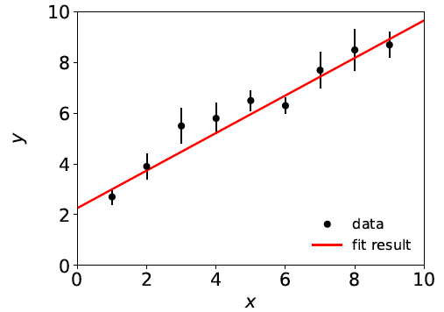
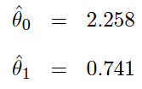
Least squares estimators
The values that minimize χ²(θ) define the least-squares
estimators for the parameters, e.g., here assuming

Slide 6
Gaussian likelihood function → LS estimators
Suppose the measurements y₁, ..., y_{N}, are independent Gaussian r.v.s with means E[y_{i}] = μ(x_{i}; θ) and variances V[y_{i}] = σ_{i}² , so the the likelihood function is
The log-likelihood function is therefore
So maximizing the likelihood is equivalent to minimizing
^
The minimum of χ ²(θ) defines the least squares (LS) estimators θ.

Slide 7
ML ↔︎ LS
So least-squares (LS) estimators same as maximum likelihood (ML) when the measurements are y_{i} ~ Gauss(μ(x_{i}; θ), σ_{i}).
Note that the y_{i} here are independent but not identically distributed. Do not confuse this case with our previous example of an i.i.d. sample with x_{i} ~ Gauss(μ, σ).
If the y_{i} are not Gaussian distributed the minimum of χ ²(θ) still defines the LS estimators. But for most applications in practice the y_{i} are at least approximately Gaussian (a consequence of the Central Limit Theorem).
Often minimize χ²(θ), numerically (e.g. programs like curve_fit or MINUIT).

Slide 8
History
Least Squares fitting also called “regression”
F. Galton, Regression towards mediocrity in hereditary
stature, The Journal of the Anthropological Institute of Great
Britain and Ireland. 15: 246–263 (1886).
Developed earlier by Laplace and Gauss:
C.F. Gauss, Theoria Motus Corporum Coelestium in Sectionibus
Conicis Solem Ambentium, Hamburgi Sumtibus Frid. Perthes et
H. Besser Liber II, Sectio II (1809);
C.F. Gauss, Theoria Combinationis Observationum Erroribus
Minimis Obnoxiae, pars prior (15.2.1821) et pars posterior
(2.2.1823), Commentationes Societatis Regiae Scientiarium
Gottingensis Recectiores Vol. V (MDCCCXXIII).

Slide 9
LS with correlated measurements
If y ~ multivariate Gaussian with covariance matrix V_{ij} = cov[y_{i},y_{j}]
where μ^{T} = (μ(x₁),...,μ(x_{N})), then maximizing the likelihood is equivalent to minimizing

Slide 10
LS with correlated measurements (2)
For the special case of a diagonal covariance matrix, i.e., uncorrelated measurements. Then
→
V ⁻¹_{ij} = δ_{ij} /σ_{i}², carry out one of the sums, χ ²(θ) same as before:

Slide 11
Statistical Data Analysis
Lecture 8-2
Finding the LS estimators
The linear Least Squares problem
Bias and variance of LS estimators

Slide 12
Recap of Least Squares
Measurements, y₁, ..., y_{N}
Standard deviations σ₁, ..., σ_{N}
or V_{ij} = cov[y_{i}, y_{j}]
Control variable x₁, ..., x_{N}
Fit function μ(x_{i}; θ) = E[y_{i}]
μ(x; θ)
y_{i} ± σ_{i}
Estimate θ by minimizing
or

Slide 13

Finding estimators in closed form
For a limited class of problem it is possible to find the LS estimators
in closed form. An important example is when the function μ(x; θ)
is linear in the parameters θ , e.g., a polynomial of order M (note
the function does not have to be linear in x):
As an example consider a straight line (two parameters):
We need to minimize:

Slide 14
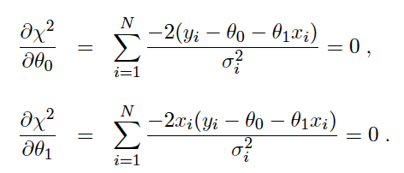
Finding estimators in closed form (2)
Set the derivatives of χ²(θ) with respect to the parameters equal
to zero:

Slide 15
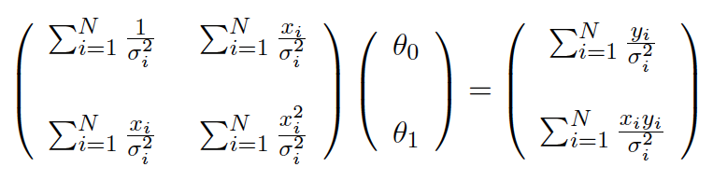
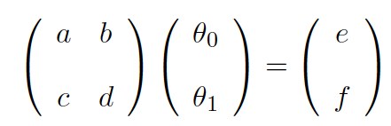
Finding estimators in closed form (3)
The equations can be rewritten in matrix form as
which has the general form
Read off a, b, c, d,
e, f, by comparing
with eq. above.

Slide 16
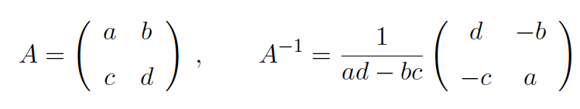
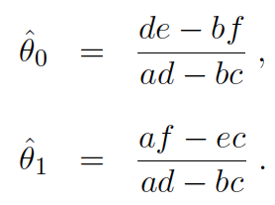
Finding estimators in closed form (4)
Recall inverse of a 2×2 matrix:
Apply A⁻¹ to both sides of previous eq. to find the estimators:
Note estimators are linear functions of the measured y_{i}.

Slide 17
Linear LS Problem
Suppose the fit function is linear in the parameters θ^{T} = (θ₁,..., θ_{Μ}),
where the a_{i}(x) are a set of linearly independent basis functions,
and write μ^{T}(θ) = (μ(x₁; θ),..., μ(x_{N}; θ)) .
Define N⨉M matrix A_{ij} = a_{j}(x_{i}), so μ(θ) = Aθ.
To find the LS estimators minimize:

Slide 18
Linear LS Problem (2)
Set derivatives with respect to θ_{i} to zero,
Solve system of M linear equations to find the LS estimators,
Note that the estimators are linear functions of the measured y_{i}.

Slide 19
Bias of LS estimators
By hypothesis E[y] = μ = Aθ so for the linear problem, the LS estimators are unbiased:
For the general nonlinear problem the LS estimators can have
a bias.

Slide 20
Variance of LS estimators for linear problem
For the linear LS problem, the variance can be found using
error propagation. Using
We find
Since the estimators are linear in the y_{i}, error propagation gives an exact result.

Slide 21
Variance of LS estimators for Gaussian data
If y_{i} ~ Gauss, then we found
To the extent this (approximately) holds, we can use
and so we estimate the inverse covariance matrix with
and invert to estimate the covariance matrix U.
For Gaussian data with the linear LS problem, U is the minimum variance bound (the LS estimators are unbiased and efficient).

Slide 22
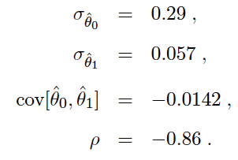
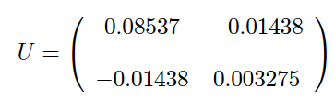
Covariance from derivatives of χ²(θ)
This is what programs like curve_fit and MINUIT do (derivatives computed numerically). Example with straight-line fit gives:
,

Slide 23
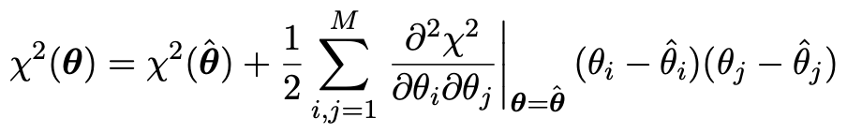



The contour χ ²(θ) = χ ²_{min} + 1
If μ(x; θ) is linear in the parameters, then χ²(θ) is quadratic:
Standard deviations from
tangents to (hyper-) planes of
(corresponds to
ln L(θ) = ln L_{max} – ½)

Slide 24
Statistical Data Analysis
Lecture 8-3
Goodness of fit from χ ²_{min}
Example of least-squares fit

Slide 25
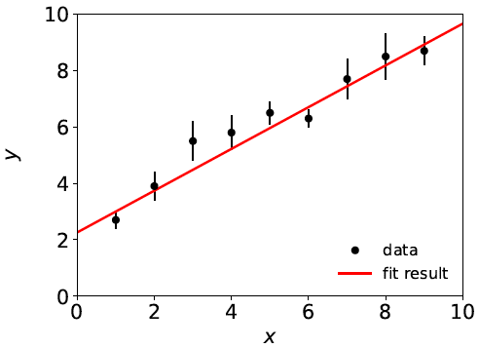
A “good” fit
In an earlier example we fitted data that were reasonably well described by a straight line:

Slide 26
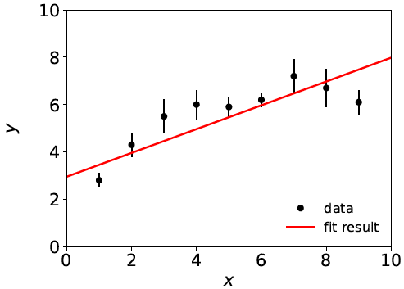
A “bad” fit
But what if a straight-line fit looks like this:
Test hypothesized form of fit function with p-value, if this is below some (user-defined) threshold, reject the hypothesis and try some other function, e.g. a polynomial of higher order.

Slide 27
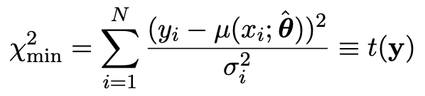
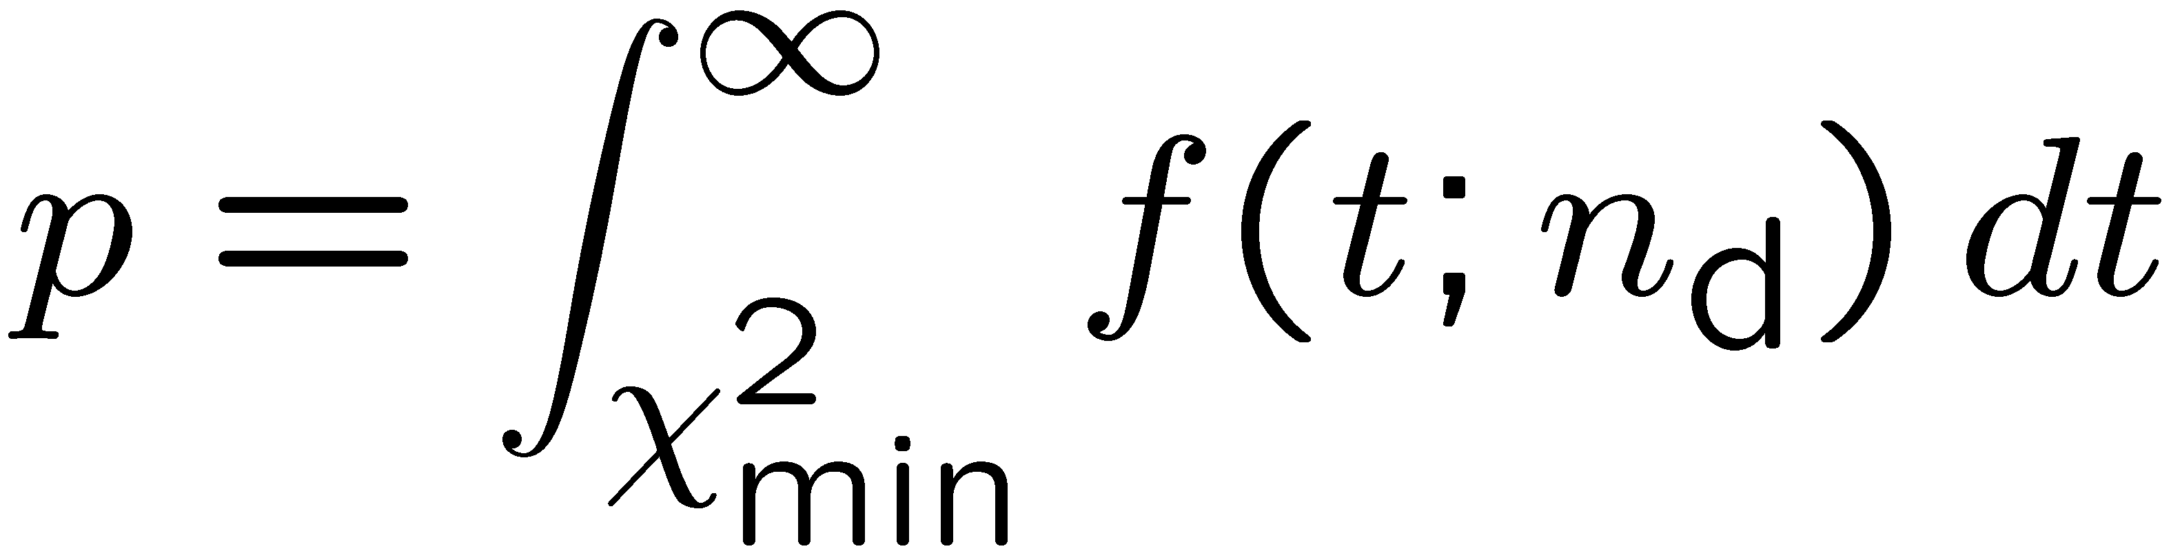
Goodness-of-fit from χ ²_{min}
The value of the χ² at its minimum is a measure of the level
of agreement between the data and fitted curve:
It can therefore be used as a goodness-of-fit statistic t(y) to
test the hypothesized functional form μ(x; θ).
The p-value of the hypothesized functional form is
= the probability, under assumption of μ(x; θ), to get a χ²_{min} as high as the one we got or higher.

Slide 28
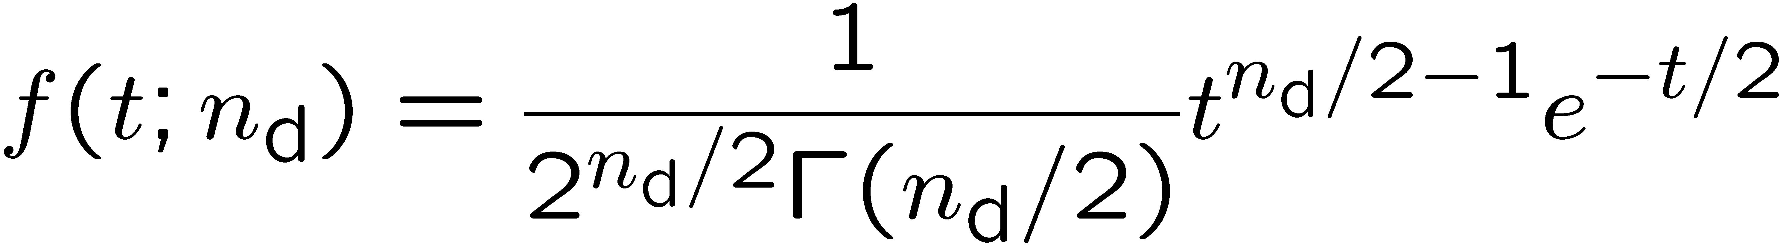
Distribution of χ ²_{min}
One can show that if the data follow y ~ Gauss(μ(x; θ),σ), i.e., if the fit function is correct for some θ, then the statistic t = χ²_{min} follows the chi-square pdf,
where the number of degrees of freedom is
n_{d} = number of data points - number of fitted parameters
Note that the composite hypothesis with E[y] = μ(x; θ) is only fully specified when we fix θ.
So the p-value is in principle a function of θ, and we should only reject μ(x; θ) if p ≤ α for all θ.
But here the pdf of our statistic χ²_{min} is independent of θ, so whatever we get for p holds for any θ.

Slide 29
The “chi-square per degree of freedom”
Recall also the chi-square pdf has an expectation value equal to the number of degrees of freedom, so
χ²_{min} ~ n_{d} → fit is “good”
χ²_{min} ≫ n_{d} → fit is “bad”
χ²_{min} ≪ n_{d} → fit is better than what one would expect given
fluctuations that should be present in the data.
Often this is done using the ratio χ²_{min}/n_{d}, i.e. fit is good if
the “chi-square per degree of freedom” comes out not much
greater than 1.
But, best to quote both χ²_{min} and n_{d}, not just their ratio, since e.g.
χ²_{min} = 15, n_{d} = 10 → p-value = 0.13
χ²_{min} = 150 n_{d} = 100 → p-value = 0.00090

Slide 30
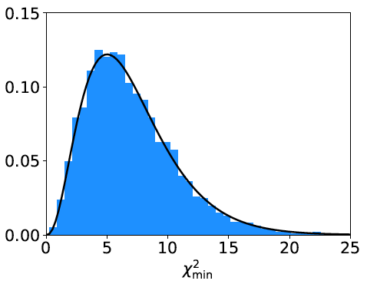
p-value for the “good” fit
N = 9 data points, m = 2 fitted parameters,
χ²_{min} /n_{dof} = 8.2/7 = 1.2
χ²_{min} = 8.2
p-value
= 0.32
If the straight-line hypothesis is true, expect equal or worse
agreement almost 1/3 of the time (i.e. our result is not unusual).

Slide 31
p-value for the “bad” fit
N = 9 data points, m = 2 fitted parameters,
χ²_{min} /n_{dof} = 20.9/7 = 3.0
χ²_{min} = 20.9
p-value
= 0.0039
So is the straight-line hypothesis correct? It could be, but if
so we would expect a χ²_{min} as high as observed or higher
only 4 times out of a thousand.

Slide 32

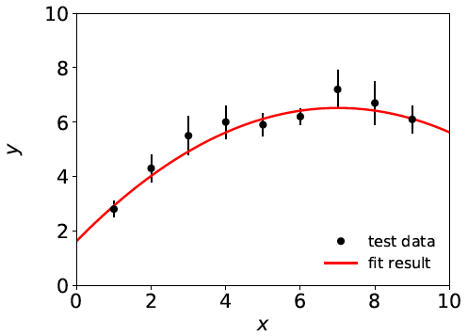
A better fit
If we decide the agreement between data and hypothesis is
not good enough (exact threshold is a subjective choice), we can
try a different model, e.g., a 2nd order polynomial:
χ²_{min} = 3.5 for n_{dof} = 6
χ²_{min} /n_{dof} = 0.58
p-value = 0.75

Slide 33

Goodness-of-fit vs. statistical errors
If the fit is “bad”, something is “wrong” and you may expect large statistical errors for the fitted parameters (std. devs. of estimators). This is not the case.
The statistical errors say how much the parameter estimates should fluctuate when repeating the experiment. This is not the same as the degree to which the fit function can describe the data.
If the hypothesized μ(x; θ) is not correct, the fitted parameters will have some systematic uncertainty – a more complex question that we will take up later.

Slide 34
Statistical Data Analysis
Lecture 8-4
Example of a least-squares fit
Least squares to combine measurements

Slide 35
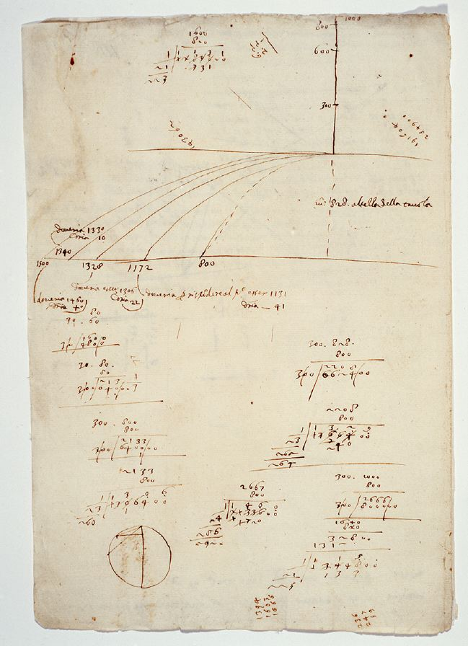
Ball and ramp
data from Galileo
Galileo Galilei, Manuscript f.116,
Biblioteca Nazionale Centrale di Firenze,
www.bncf.firenze.sbn.it
In 1608 Galileo carried out
experiments rolling a ball
down an inclined ramp to
investigate the trajectory of
falling objects.

Slide 36
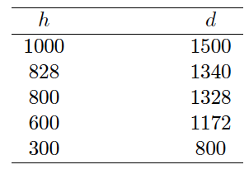
Ball and ramp data from Galileo
Units in punti
(approx. 1 mm)
Suppose h is set with negligible uncertainty, and
d is measured with an uncertainty σ = 15 punti.

Slide 37



Analysis of ball and ramp data
What is the correct law that relates d and h?
Try different hypotheses:

Slide 41
Summary of ball-and-ramp analysis
Clearly the best fit suggests d ~ h^{½,} and this is exactly what Newton’s laws predict!

Slide 42
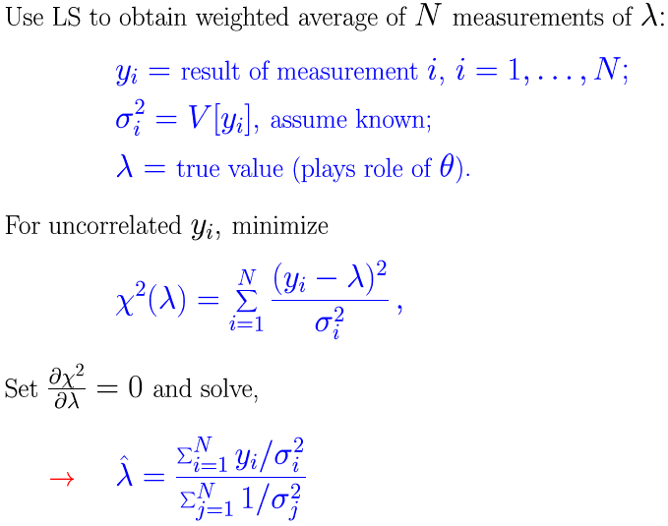
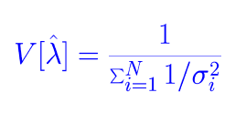
Using LS to combine measurements
= E[y_{i}] for all i

Slide 43
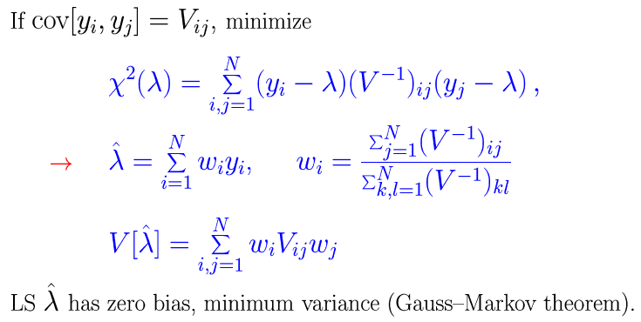
Combining correlated measurements with LS

Slide 44
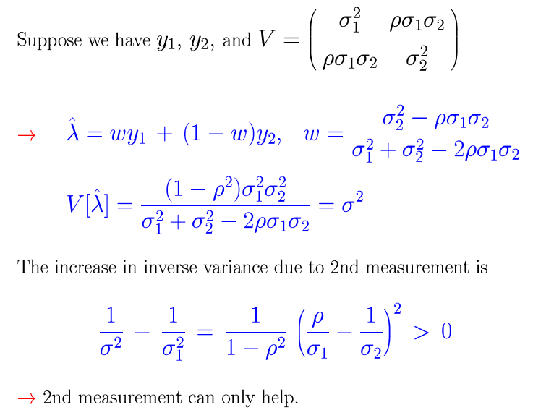
Example: averaging two correlated measurements

Slide 45
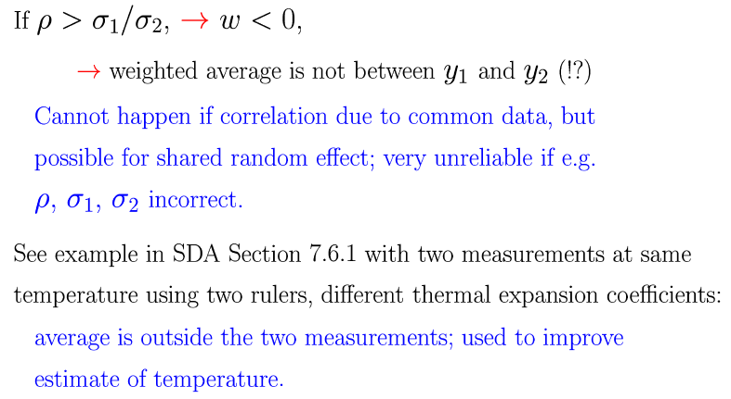
Negative weights in LS average

Slide 46
Extra slides

Slide 47
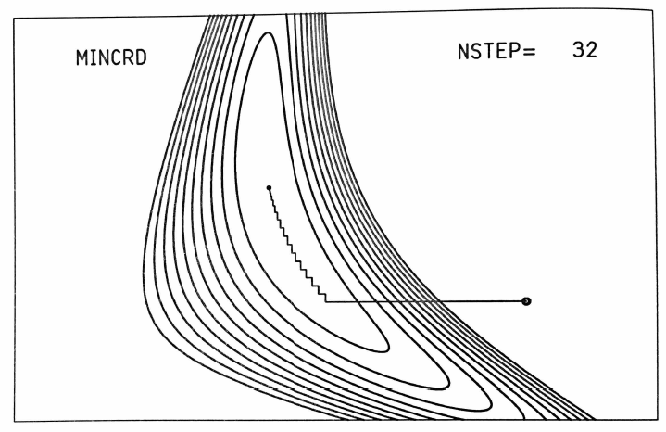
Finding LS estimators numerically
Start at a given point in the parameter space and move around
according to some strategy to find the point where χ²(θ) is a
minimum.
θ_{j}
For example, alternate minimizing with respect to each component of θ:
minimum
starting point
Many strategies possible,
e.g., steepest descent,
conjugate gradients, ...
(see Brandt Ch. 10).
θ_{i}
Siegmund Brandt, Data Analysis: Statistical and Computational Methods for Scientists and Engineers 4th ed., Springer 2014

Slide 48
Simple Least Squares fits
A simple way to do least squares curve fitting is with the python routine curve_fit.
For an introduction to this see the the materials from RHUL's year-3 introduction to statistics.
This includes a short program simpleFit.py for doing least-squares fits; also a root/C++ version simpleFit.C.

Slide 49

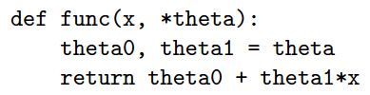
Fitting the parameters with Python
The routine routine curve_fit from scipy.optimize can
find LS estimators numerically. To use it you need:
We need to define the fit function μ (x; θ), e.g., a straight line:

Slide 50


Fitting the parameters with Python (2)
The data values (x_{i}, y_{i}, σ_{i}) need to be in the form of NumPy
arrays, e.g,
Start values of the parameters can be specified:
To find the parameter values that minimize χ²(θ), call curve_fit:
Returns estimators and covariance matrix as NumPy arrays.
Need absolute_sigma=True for the fit errors (cov. matrix) to have
desired interpretation.

Slide 51
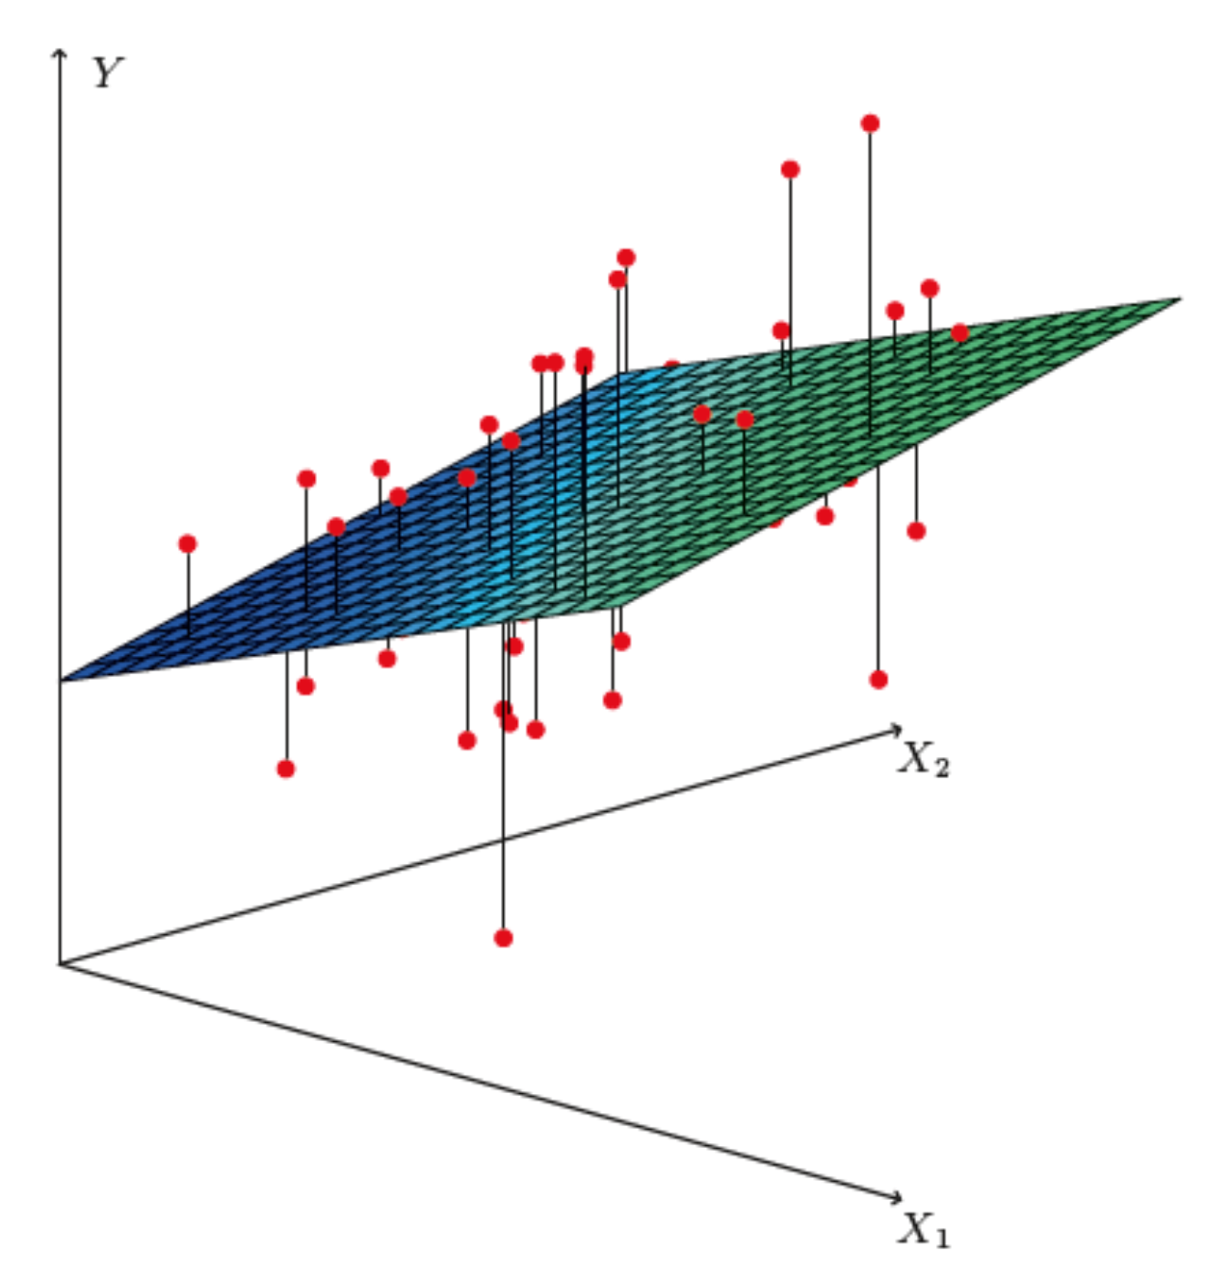
http://www-bcf.usc.edu/~gareth/ISL/
Brief intro to multiple regression
Multiple regression* can be seen as an extension of curve fitting to the case where the variable x is replaced by a multi-dimensional x = (x₁,...,x_{n}), e.g., fitting a surface. Here suppose the data are points (x_{i}, y_{i}), i = 1,...,N (no error bars) and x is usually a random variable, often called the explanatory or predictor variable.
Equivalently, we can view it as an extension to classification with
the discrete class label y = 0, 1 replaced by a continuous target y (and in this context x can also be called the feature vector).
*Note the term ”multivariate” regression refers to a vector target variable y; here we treat only scalar y.

Slide 52

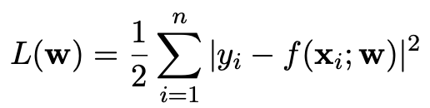
Target (fit) function and loss function
As in the case of curve fitting, we assume some parametric function
of x that represents the mean of the target variable
where w is a vector of adjustable parameters (“weights”).
Suppose we have training data consisting of (x_{i}, y_{i}), i = 1,...,N.
Use these to determine the weights by minimizing a loss function
(analogous to the χ²), e.g.,

Slide 53
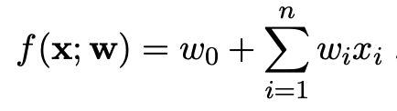
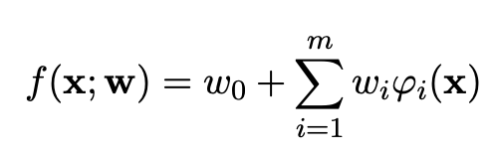
https://www.statlearning.com/
Linear regression
In linear regression, the fit function is of the form
i.e. the problem is equivalent to an unweighted least-squares fit of a (hyper-)plane:
Can be generalized to a nonlinear surface in x-space by transforming x to a set of basis functions φ₁(x),...,φ_{m}(x)
(still linear in the weights)

Slide 54
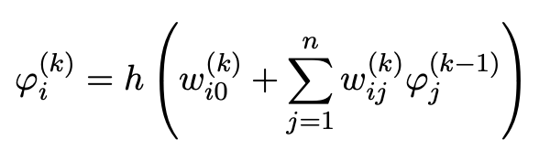
Nonlinear regression
Examples of nonlinear regression include:
MLP (multilayer perceptron) regression
Boosted decision tree regression
Support vector regression
For MLP regression, as with classification, regard the feature vector as the layer k = 0; i.e., φ_{i}⁽⁰⁾ = x_{i}.
The ith node of hidden layer k is
where h is the activation function (tanh, relu, sigmoid,...).

Slide 55
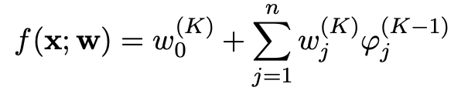
MLP Regression (cont.)
For the final layer (k=K), in MLP regression (in contrast to classification), one omits the activation function, i.e.,
where φ_{j}^{(K−1)} = are the nodes of the last hidden layer (k = K−1).
For info on other types of multiple regression see, e.g.,
https://www.statlearning.com/
and the scikit-learn documentation.

Slide 56
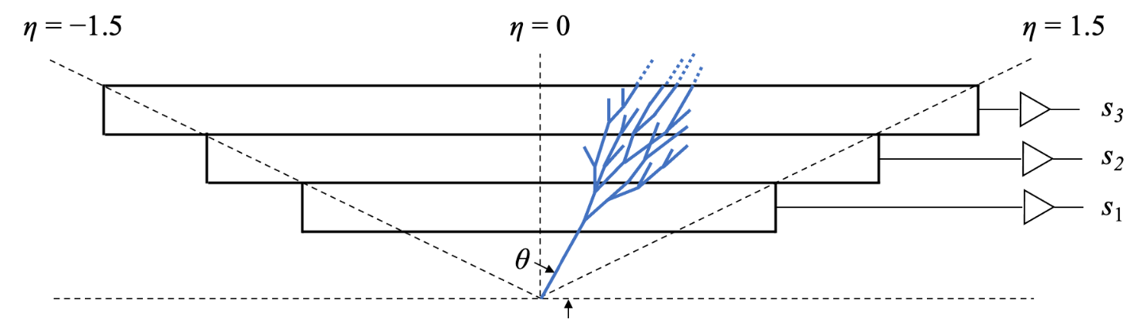
Multiple regression example
Suppose particles with different energies E and angles θ (or equivalently η = − ln tan(θ/2) ) enter a calorimeter and create a particle showers that gives signals in three layers, s₁, s₂ and s₃, as well as an estimate of η.
Some of the energy leaks through, with increased leakage for higher energy and more oblique angles (higher η).
The goal is to estimate the target y_{i} = E_{i} given feature vectors
x_{i} = (η, s₁, s₂,s₃)_{i} for i = 1,...,N training events.

Slide 57

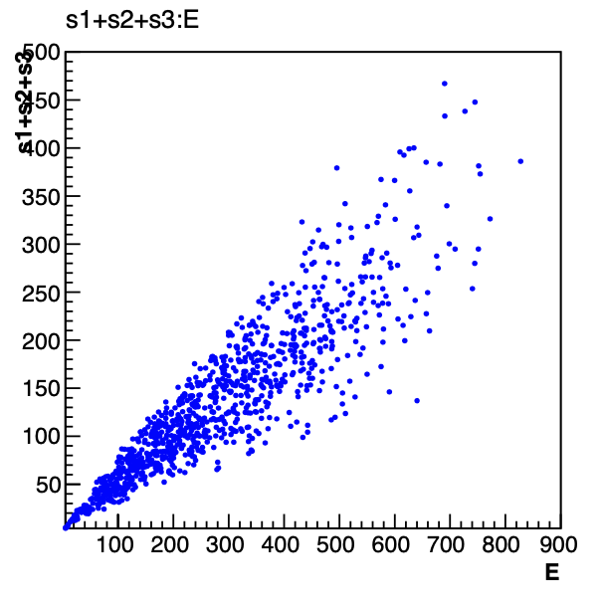
Energy estimate from sum of signals
Naively, one could try just summing the signals:
Gives very poor resolution
because the particles have a
distribution of energies and
angles and hence differing amounts of the energy leak through undetected.

Slide 58
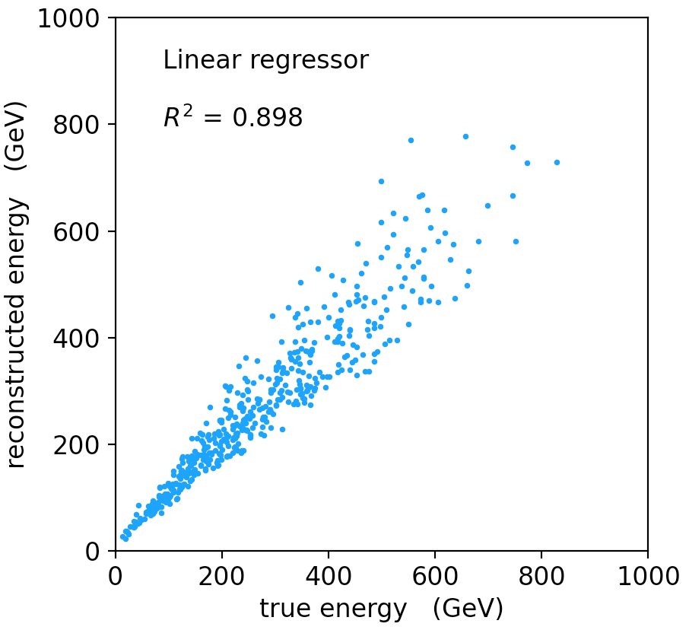
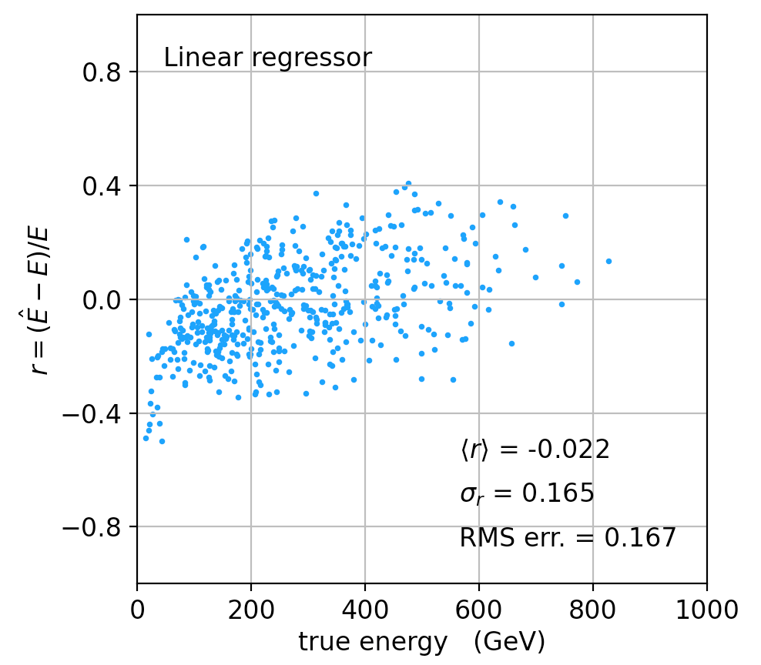
Linear regression
See MVRegressor.py, here using
regr = linear_model.LinearRegression()
regr.fit(X_train, y_train)
Average relative resolution 16.7%.

Slide 59
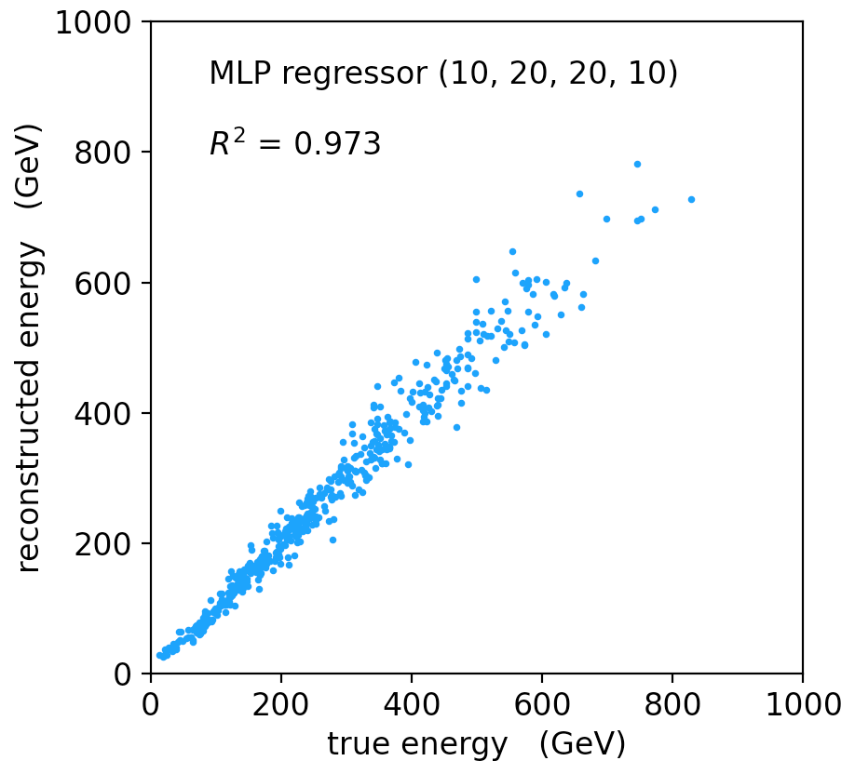
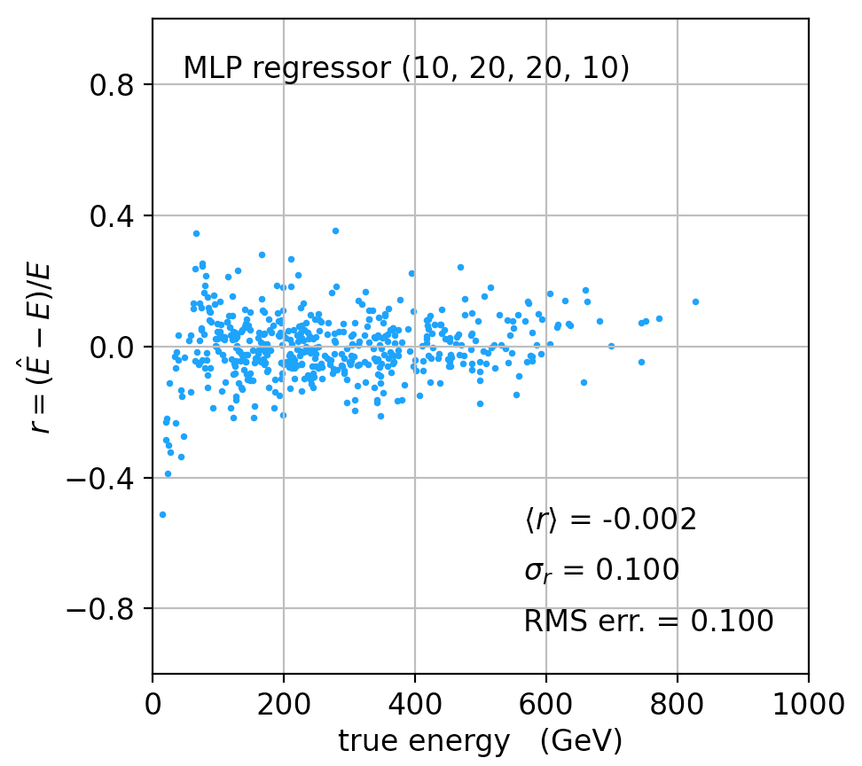
MLP Regression
regr = MLPRegressor(hidden_layer_sizes=(10,20,20,10), activation='relu'
regr.fit(X_train, y_train)
Better resolution (10%), here significant bias at low energies.

Slide 60
Refinements for multiple regression
One can try many improvements:
Scaling of predictor and target variables, e.g., standardize to zero mean and unit variance.
Use cross-validation to assess accuracy (and hence use entire sample of events for training.
Try different loss functions.
Try different regression algorithms (ridge regression, lasso, decision tree, support vector regression,...).
Some simple code using scikit-learn and a short project description can be found here:
https://www.pp.rhul.ac.uk/~cowan/ph3010/ml/regression/

Slide 61

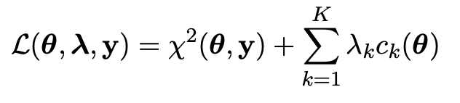
Parameter estimation with constraints
When estimating parameters θ = (θ₁,..., θ_{M}) one may have additional information available in the form of K constraints
In some problems it may be possible to define L = M − K new parameters η₁,..., η_{L} such that every point in η-space satisfies the constraints. If so, estimate η e.g. with Maximum Likelihood or Least Squares and then transform back to θ. But it may be difficult to find new parameters with the required properties.
Suppose the estimators are found by minimizing χ²(θ). One can implement the constraints by minimizing instead the Lagrange function
with respect to θ and the Lagrange multipliers λ = (λ₁,..., λ_{K}).

Slide 62

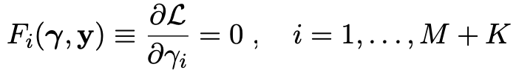
Finding constrained estimators
Define a K+M dimensional vector to contain the parameters and Lagrange multipliers
The estimators for γ are found from the solutions to
This gives the parameter values that minimize χ²(θ) subject to the constraints.

Slide 63



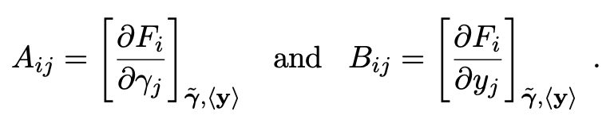




Covariance matrix of estimators
To find the covariance matrix of the estimators, find the solutions
to the equations above when the data y are equal to their
expected values ⟨y⟩ (in practice estimate with the observed values). This gives estimators
where
,
and where
Using this approximation for , find the covariance matrix
using error propagation, i.e.,
where

Slide 64
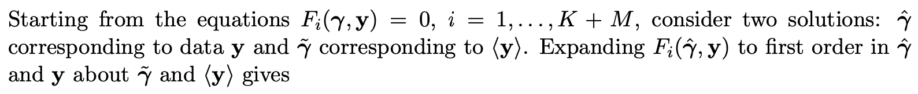
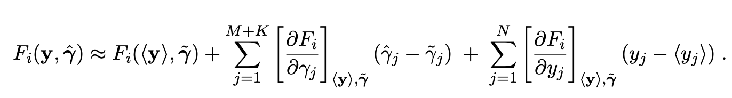
Derivation of formula for covariance
For more details see the PDG review on statistics Sec. 40.2.4 at pdg.lbl.gov or the note:
https://www.pp.rhul.ac.uk/~cowan/stat/notes/lscon.pdf

Slide 65
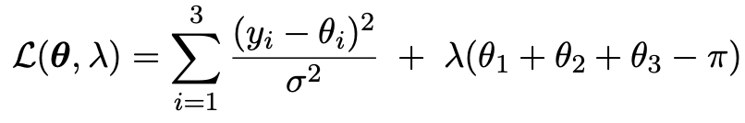
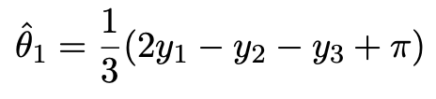
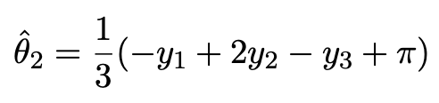
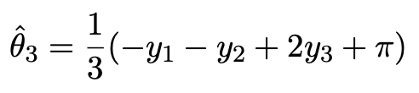
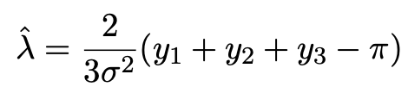
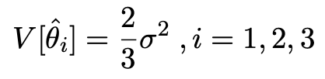
Example of constrained estimators
Suppose we have measurements y₁, y₂ and y₃ of the three angles θ₁, θ₂, θ₃ of a triangle.
Model as independent and Gaussian: y_{i} ~ Gauss(θ_{i}, σ).
To find the estimators, one could replace θ₃ = π − θ₁ − θ₂ and minimize χ²(θ₁,θ₂) .
Alternatively, minimize
→
Variances of estimates reduced by constraint:

