Slide 1
Statistical Data Analysis 2020/21
Exam Revision Session 29 April 2021
London Postgraduate Lectures on Particle Physics
University of London MSc/MSci course PH4515
Glen Cowan
Physics Department
Royal Holloway, University of London
g.cowan@rhul.ac.uk
www.pp.rhul.ac.uk/~cowan
Course web page via RHUL moodle (PH4515) and also
www.pp.rhul.ac.uk/~cowan/stat_course.html

Slide 2
General Info
The exam is online, administered through the course’s moodle page, where you can find details regarding the procedures and rules. You work the exam on paper, scan and upload. For full details see the moodle page.
You should have received a communication from the College about the exam arrangements. If not, please contact
epms-school@rhul.ac.uk
Exam time: 2 ½ hours
Upload time: 1 hour
“The exam time limit is specified [as 2 ½ hours] with the DDS authorised extra time as appropriate. At the end of the time period students are required to stop work and upload their solutions. They have 1 hour for this to allow for technical problems and internet unreliability.”

Slide 3
General Info (2)
The examination is open-book:
You may access any written or online materials but you may not consult with any other people or communicate anything about the exam to others.
You should have all the slides/notes downloaded for easy access during the exam. I would recommend reviewing these so you can find material quickly should you need it.
There is no need for a calculator during the exam.

Slide 4
Reminder of revision resources
There are past exams and (some) solutions on:
http://www.pp.rhul.ac.uk/~cowan/ph4515/
Solutions for the papers since 2011 will not be posted, except for those problems worked in online sessions.
Remember that the solutions to the problem sheets are contained in the written notes from the weekly online sessions.
Here are some notes from a 2019 revision lecture:
http://www.pp.rhul.ac.uk/~cowan/ph4515/statistics_review_lecture_1may19.pdf
And here is a note about the 2015 exam:
http://www.pp.rhul.ac.uk/~cowan/ph4515/ph4515_review.pdf
These were written with a closed-book format in mind but what they say about the material and the nature of the exam (emphasis on problem solving and application of concepts) is still correct.

Slide 5
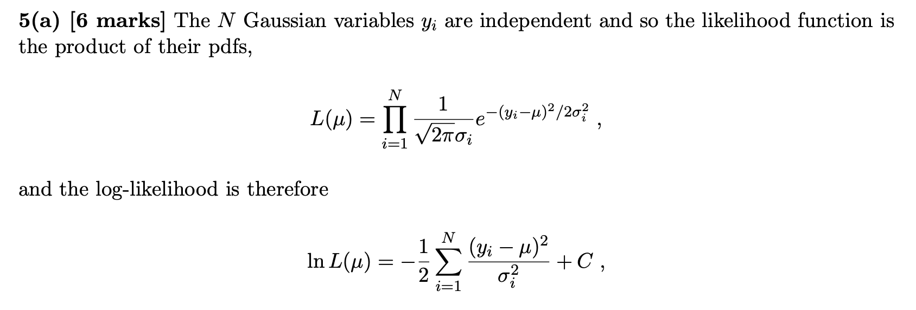
2019 Exam Question 5(a)

Slide 6
2019 Exam Question 5(a)

Slide 7
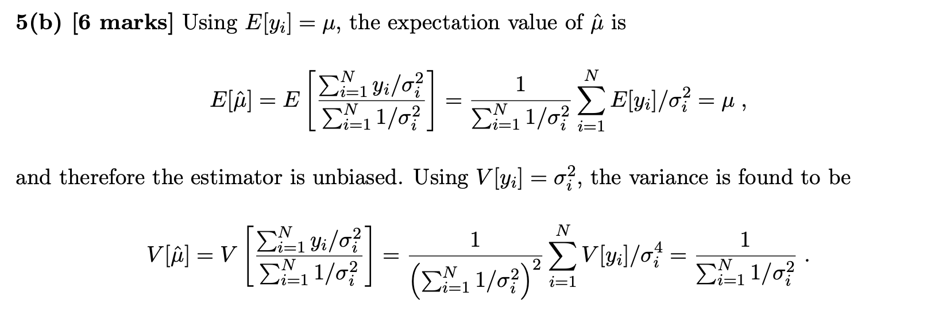
2019 Exam Question 5(b)

Slide 8
2019 Exam Question 5(c)

Slide 9
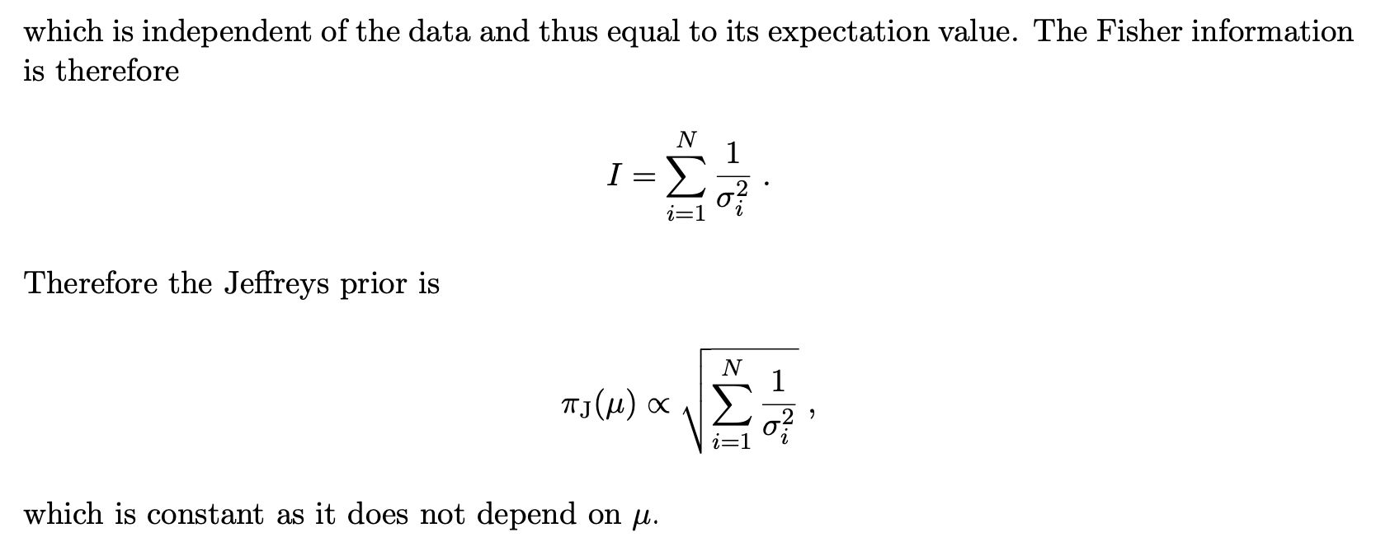
2019 Exam Question 5(d)

Slide 10
2019 Exam Question 5(e)

Slide 11
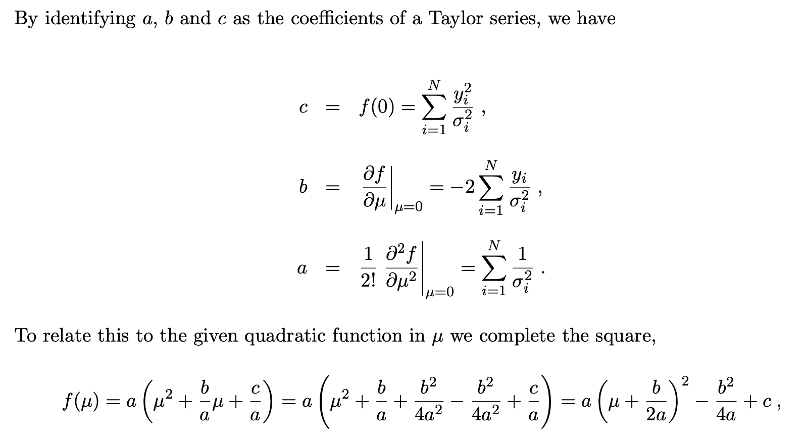
2019 Exam Question 5(e)

Slide 12
2019 Exam Question 5(e)

Slide 13
2019 Exam Question 5(f)

Slide 14
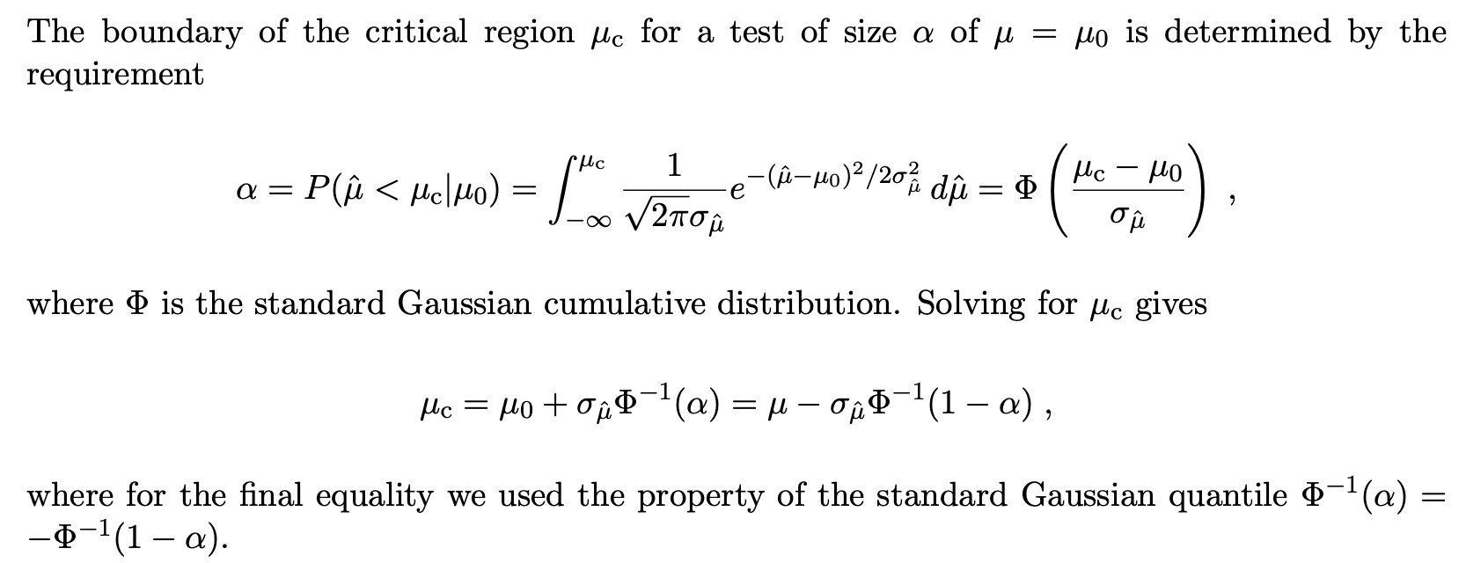
2019 Exam Question 5(f)

Slide 15
2019 Exam Question 5(g)

Slide 16
2019 Exam Question 3(a)

Slide 17
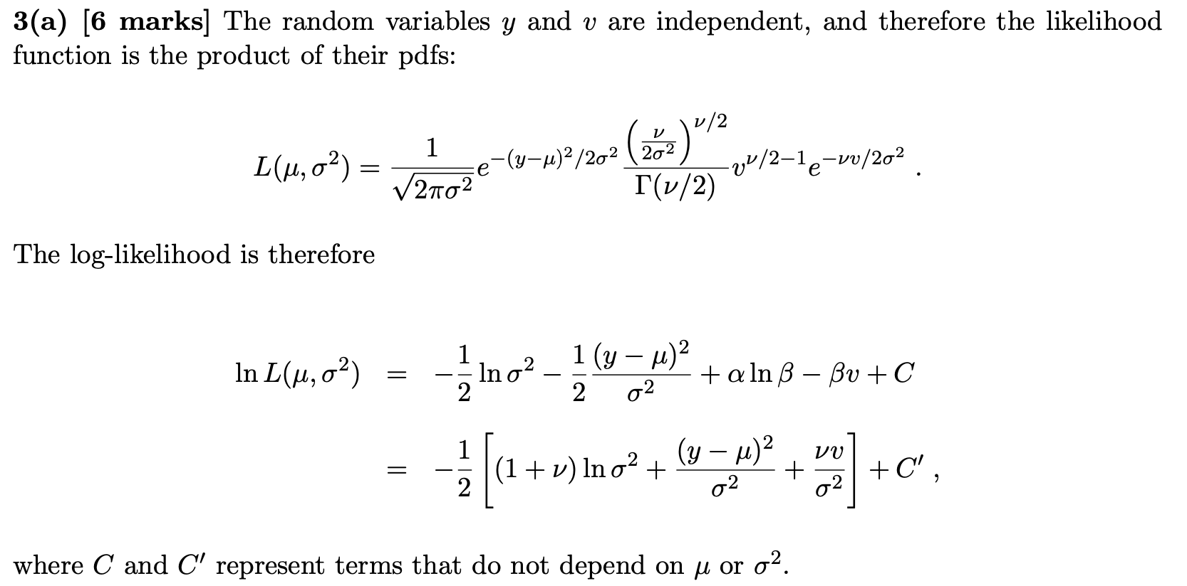
2019 Exam Question 3(a)

Slide 18
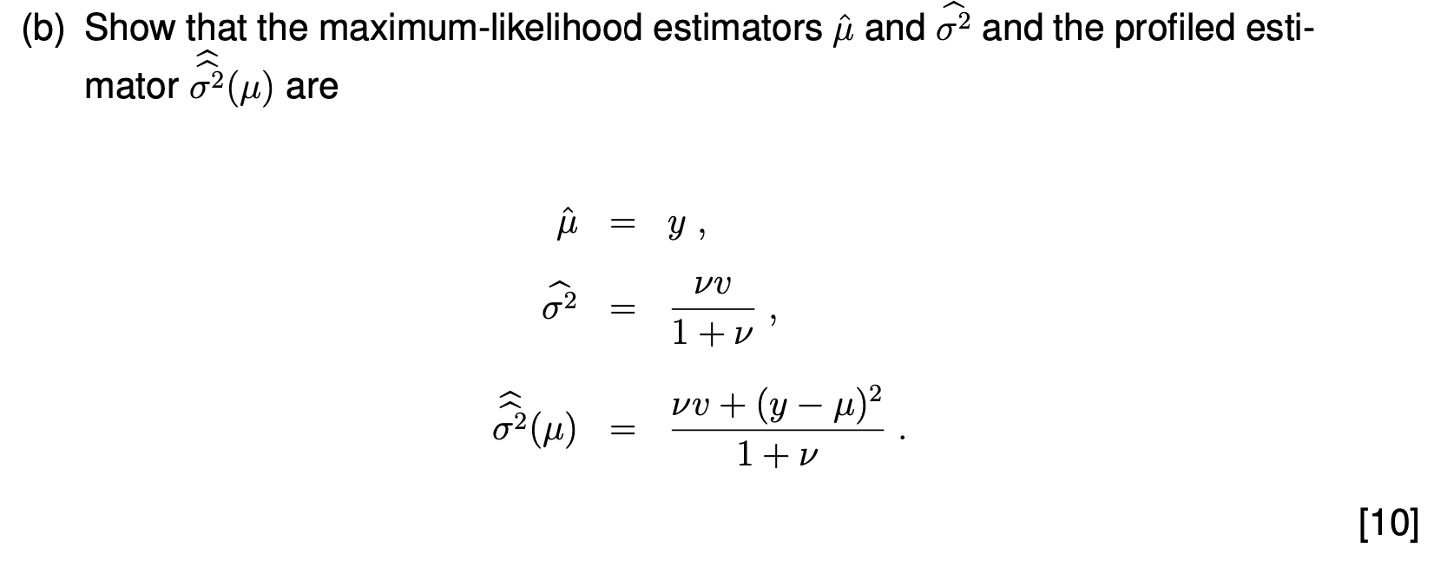
2019 Exam Question 3(b)

Slide 19
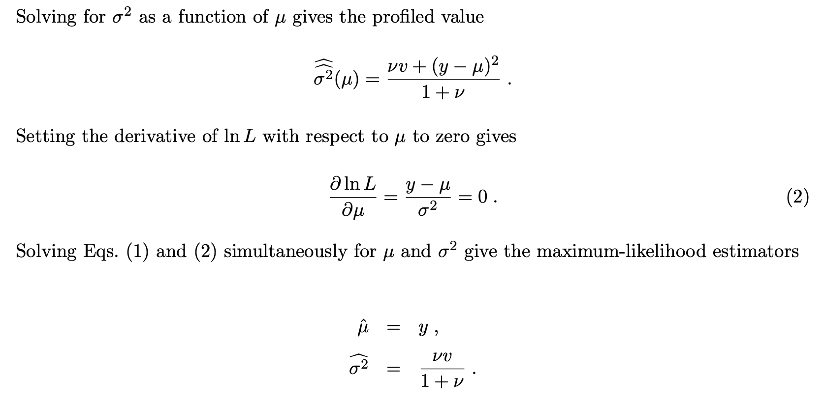
2019 Exam Question 3(b)

Slide 20
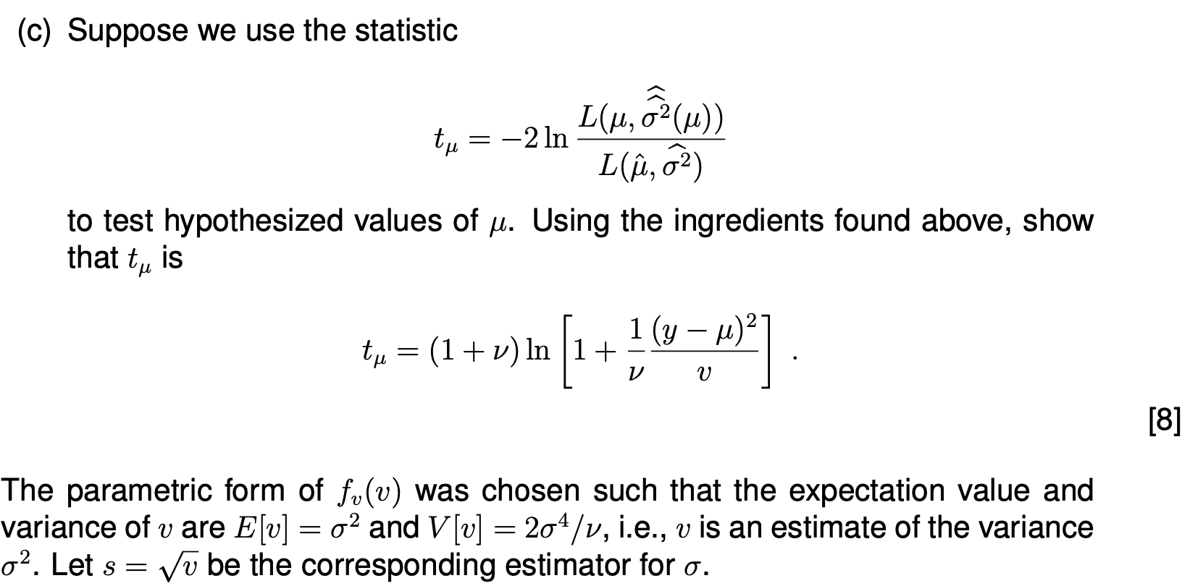
2019 Exam Question 3(c)

Slide 21
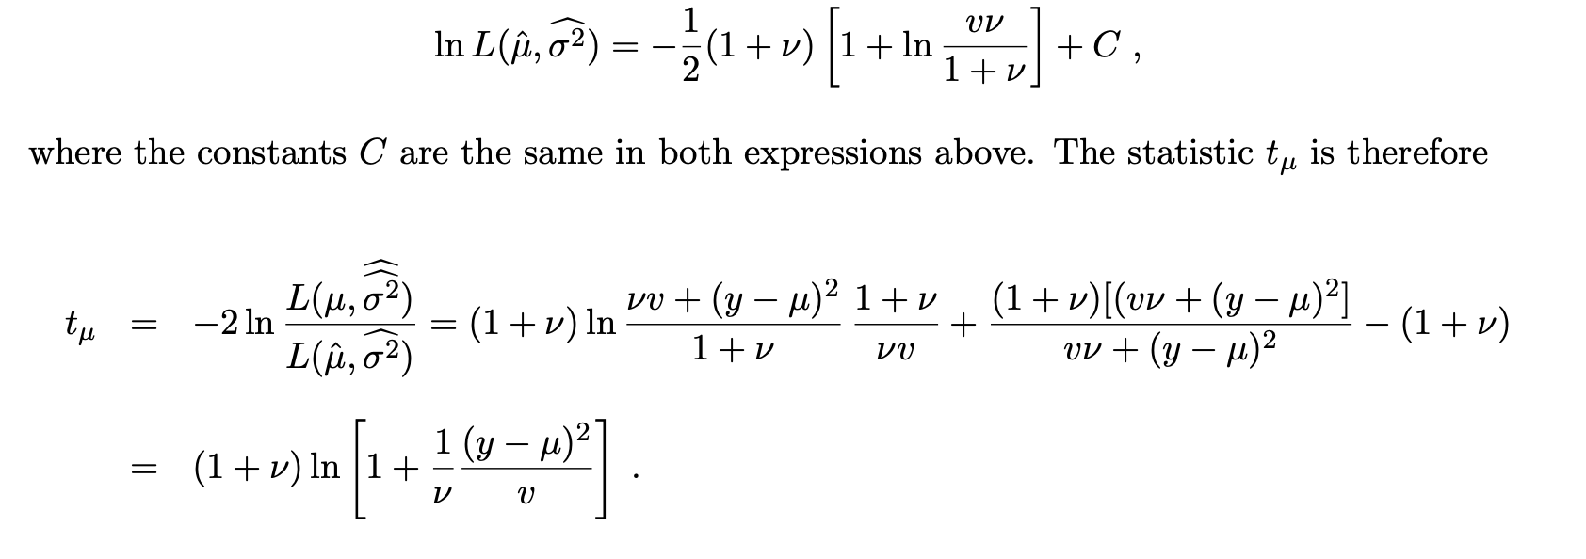
2019 Exam Question 3(c)

Slide 22
2019 Exam Question 3(d)

Slide 23
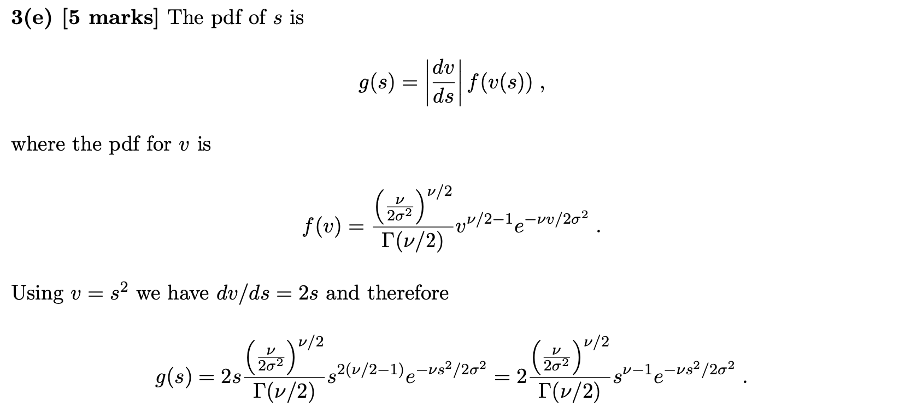
2019 Exam Question 3(e)

Slide 24
2019 Exam Question 3(f)

