Slide 1
Statistical Data Analysis 2020/21
Lecture Week 1
London Postgraduate Lectures on Particle Physics
University of London MSc/MSci course PH4515
Glen Cowan
Physics Department
Royal Holloway, University of London
g.cowan@rhul.ac.uk
www.pp.rhul.ac.uk/~cowan
Course web page via RHUL moodle (PH4515) and also
www.pp.rhul.ac.uk/~cowan/stat_course.html

Slide 2
Statistical Data Analysis Lecture 1-1
Course structure and policies
Outline of topics
Some resources

Slide 3
Course Info (1)
This year completely online:
2 hours per week of recorded lectures (the core material), will be available by start of every Monday.
1 hour per week discussion session (schedule tbc): live video via MS Teams with additional examples, discussion of problem sheets, computing tools, etc.
You should view the lectures before the discussion session.
There will be 9 problem sheets.
Some paper & pencil, some computing problems.
Due weekly Mondays 5 pm starting lecture week 3 through 11.
Late submissions according to College policy (10% off for 24h,
then no credit unless agreed ).

Slide 4
Course Info (2)
For problem sheets, scan/merge into a single pdf file.
Filename: yourName_stat_probsheet_n.pdf (n = 1,2,…)
Please no hi-res photos from phone (use iScanner or similar).
MSc/MSci students: upload into Turnitin on moodle.
PhD students: email single pdf attachment to g.cowan@rhul.ac.uk
Subject line: statistics problem sheet n
Put your name in the pdf file (not just in the email).
Also write on the problem sheet your College and degree programme (MSc, MSci, PhD).
For MSc/MSci students, written exam at end of year (May 2021); format (e.g., open/closed-book) will depend on covid situation.
Msc/Msci: Exam worth 80%, problem sheets 20%.
For PhD students, no statistics exam.

Slide 5
Computing
The coursework includes short computer programs.
Some choice of language – best to use python or C++ in a linux environment (some flexibility here).
The C++ option requires specific software (ROOT and its class library) – cannot just use e.g. visual C++
For PhD students, can use your own accounts – usual HEP setup should be OK.
For MSc/MSci students, you will get an account on the RHUL linux cluster. You create an X-Window on your local machine (e.g. laptop), and from there you remotely login to RHUL.
For mac, install XQuartz from www.xquartz.org and open a terminal window. For windows, various options, e.g., mobaXterm or cygwin/X (more info on web page).

Slide 6
Course Outline
1 Probability, Bayes’ theorem
2 Random variables and probability densities
3 Expectation values, error propagation
4 Catalogue of pdfs
5 The Monte Carlo method
6 Statistical tests: general concepts
7 Test statistics, multivariate methods
8 Goodness-of-fit tests
9 Parameter estimation, maximum likelihood
10 More maximum likelihood
11 Method of least squares
12 Interval estimation, setting limits
13 Nuisance parameters, systematic uncertainties
14 Examples of Bayesian approach

Slide 7
Some statistics books, papers, etc.
G. Cowan, Statistical Data Analysis, Clarendon, Oxford, 1998
R.J. Barlow, Statistics: A Guide to the Use of Statistical Methods in the Physical Sciences, Wiley, 1989
Ilya Narsky and Frank C. Porter, Statistical Analysis Techniques in Particle Physics, Wiley, 2014.
Luca Lista, Statistical Methods for Data Analysis in Particle Physics, Springer, 2017.
L. Lyons, Statistics for Nuclear and Particle Physics, CUP, 1986
F. James., Statistical and Computational Methods in Experimental Physics, 2nd ed., World Scientific, 2006
S. Brandt, Statistical and Computational Methods in Data Analysis, Springer, New York, 1998.
P.A. Zyla et al. (Particle Data Group), Prog. Theor. Exp. Phys. 2020, 083C01 (2020); pdg.lbl.gov sections on probability, statistics, MC.

Slide 8
Statistical Data Analysis Lecture 1-2
Tasks of statistical data analysis in science
The role of uncertainty
Definition of probability

Slide 9
Theory ↔ Statistics ↔ Experiment
Theory (model, hypothesis):
Experiment (observation):
+ response of measurement
apparatus
= model prediction
data

Slide 10
Some tasks of statistical data analysis
Compare data to predictions of competing models
Most models contain adjustable parameters
(e.g., particle physics: G_{F}, M_{Z}, α_{s}, m_{H},... )
Estimate (measure) the unknown parameters
Quantify uncertainty in parameter estimates
Test and quantify the extent to which the model is in agreement with the data.

Slide 11
Uncertainty
Uncertainty enters on several levels
Measurements not in general exactly reproducible
Quantum effects
Random effects (even without QM)
Model prediction uncertain
Approximations used to extract theoretical prediction
Modeling of apparatus
Quantify the uncertainty using PROBABILITY

Slide 12
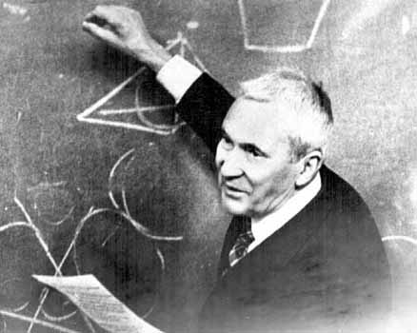
A definition of probability
Consider a set S (the sample space)
Interpretation of elements left open,
S could be e.g. set of outcomes of a repeatable observation.
Label subsets of S as A, B, ...
Kolmogorov (1933)

Slide 13
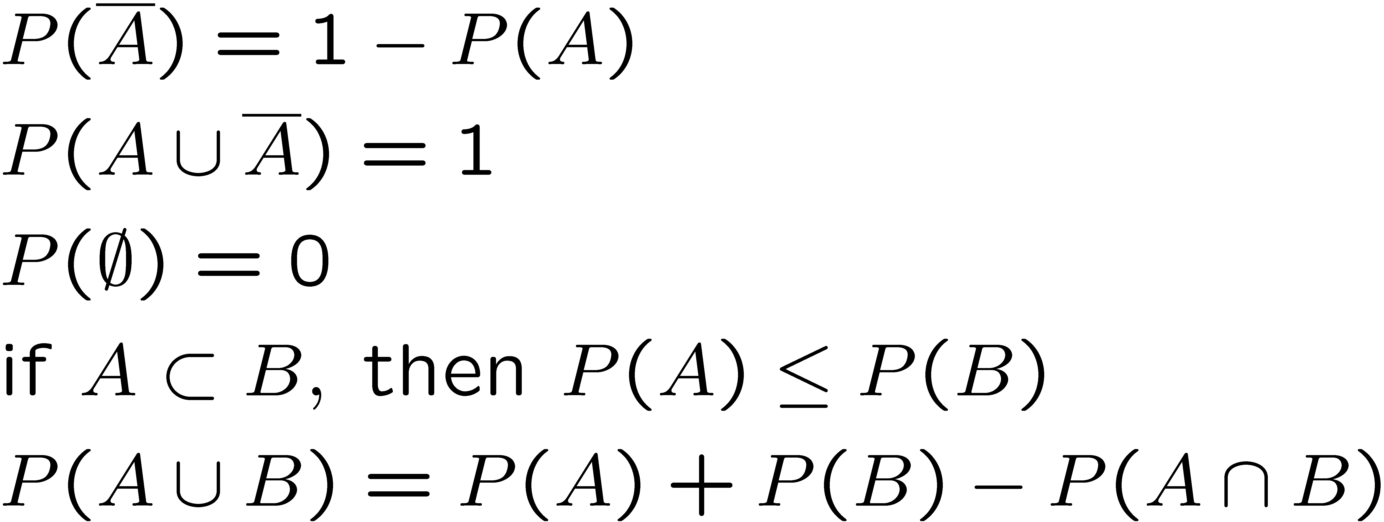
Properties of Probability
From the axioms of probability, further properties can be
derived, e.g.,

Slide 14
Conditional probability
Start with sample space S (e.g., set of outcomes), then restrict
to a subset B (with P(B) ≠ 0).
Define conditional probability of A given B (~4th axiom):
E.g. rolling die, outcome n = 1,2,...,6:

Slide 15
Independence
Subsets A, B independent if:
If A, B independent,
I.e. if A, B, independent, imposing one has no effect on the probability of the other.
N.B. do not confuse with disjoint subsets, i.e., A ∩ B = ∅
E.g. dice: A = n even, B = n odd, A ∩ B = ∅
P(A) = ½
P(A|B) = 0
Requiring B affects probability of A, so A, B not independent.

Slide 16
Statistical Data Analysis Lecture 1-3
Interpretation of probability
Bayes’ theorem
Law of total probability

Slide 17
Interpretation of Probability
I. Relative frequency (→ “frequentist statistics”)
A, B, ... are outcomes of a repeatable experiment
cf. quantum mechanics, particle scattering, radioactive decay...
II. Subjective probability (→ “Bayesian statistics”)
A, B, ... are hypotheses (statements that are true or false)
• Both interpretations consistent with Kolmogorov axioms.
• In particle physics frequency interpretation often most useful, but subjective probability can provide more natural treatment of non-repeatable phenomena: systematic uncertainties, probability that magnetic monopoles exist,...

Slide 18
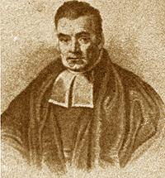
Bayes’ theorem
From the definition of conditional probability we have
and
but
, so
Bayes’ theorem
Bayes’
theorem
First published (posthumously) by the
Reverend Thomas Bayes (1702−1761)
An essay towards solving a problem in the doctrine of chances, Philos. Trans. R. Soc. 53 (1763) 370

Slide 19
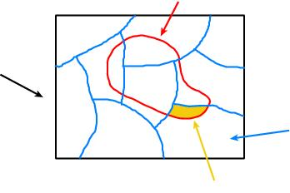
The law of total probability
B
Consider a subset B of
the sample space S,
S
divided into disjoint subsets A_{i}
such that ∪_{i} A_{i} = S,
A_{i}
B ∩ A_{i}
→
→
→
law of total probability
Bayes’ theorem becomes

Slide 20
An example using Bayes’ theorem
Suppose the probability (for anyone) to have a disease D is:
← prior probabilities, i.e.,
before any test carried out
Consider a test for the disease: result is + or −
← probabilities to (in)correctly
identify a person with the disease
← probabilities to (in)correctly
identify a healthy person
Suppose your result is +. How worried should you be?

Slide 21
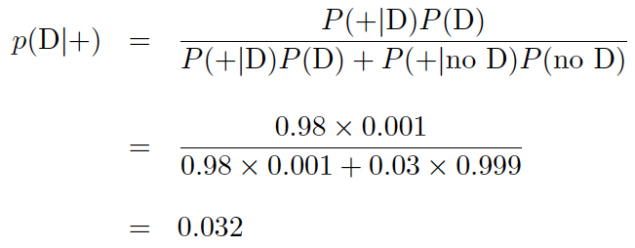
Bayes’ theorem example (cont.)
The probability to have the disease given a + result is
← posterior probability
i.e. you’re probably OK!
Your viewpoint: my degree of belief that I have the disease is 3.2%.
Your doctor’s viewpoint: 3.2% of people like this have the disease.

Slide 22
Frequentist Statistics − general philosophy
In frequentist statistics, probabilities are associated only with
the data, i.e., outcomes of repeatable observations (shorthand: x).
Probability = limiting frequency
Probabilities such as
P (string theory is true),
P (0.117 < α_{s} < 0.119),
P (Biden wins in 2020),
etc. are either 0 or 1, but we don’t know which.
The tools of frequentist statistics tell us what to expect, under
the assumption of certain probabilities, about hypothetical
repeated observations.
Preferred theories (models, hypotheses, ...) are those that predict a high probability for data “like” the data observed.

Slide 23
Bayesian Statistics − general philosophy
In Bayesian statistics, use subjective probability for hypotheses:
probability of the data assuming
hypothesis H (the likelihood)
prior probability, i.e.,
before seeing the data
posterior probability, i.e.,
after seeing the data
normalization involves sum
over all possible hypotheses
Bayes’ theorem has an “if-then” character: If your prior
probabilities were π(H), then it says how these probabilities
should change in the light of the data.
No general prescription for priors (subjective!)

Slide 24
Statistical Data Analysis Lecture 1-4
Random variables
Probability (density) functions:
joint pdf
marginal pdf
conditional pdf

Slide 25
Random variables and probability density functions
A random variable is a numerical characteristic assigned to an element of the sample space; can be discrete or continuous.
Suppose outcome of experiment is continuous value x
→ f (x) = probability density function (pdf)
x must be somewhere

Slide 26
Probability mass function
For discrete outcome x_{i} with e.g. i = 1, 2, ... we have
probability (mass) function
x must take on one of its possible values

Slide 27
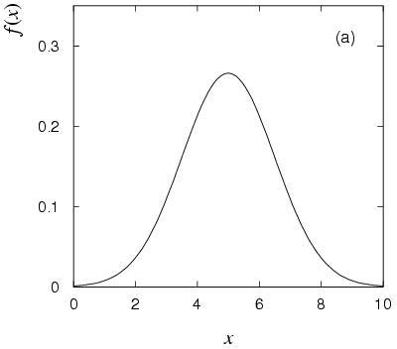
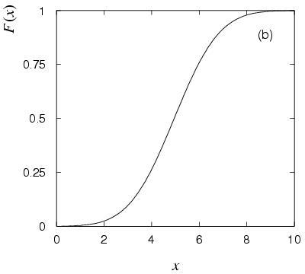
Cumulative distribution function
Probability to have outcome less than or equal to x is
cumulative distribution function
Alternatively define pdf with

Slide 28
Quantiles
Define quantile (α-point) x_{α} by F(x_{α}) = α (0 ≤ α ≤ 1)
i.e., quantile x_{α} is inverse of cumulative distribution: x_{α} = F⁻¹(α),
Special case of quantile: x_{1/2} = median
(compare to peak of pdf = mode)

Slide 29
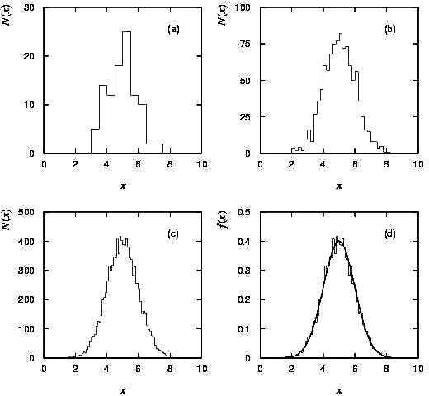
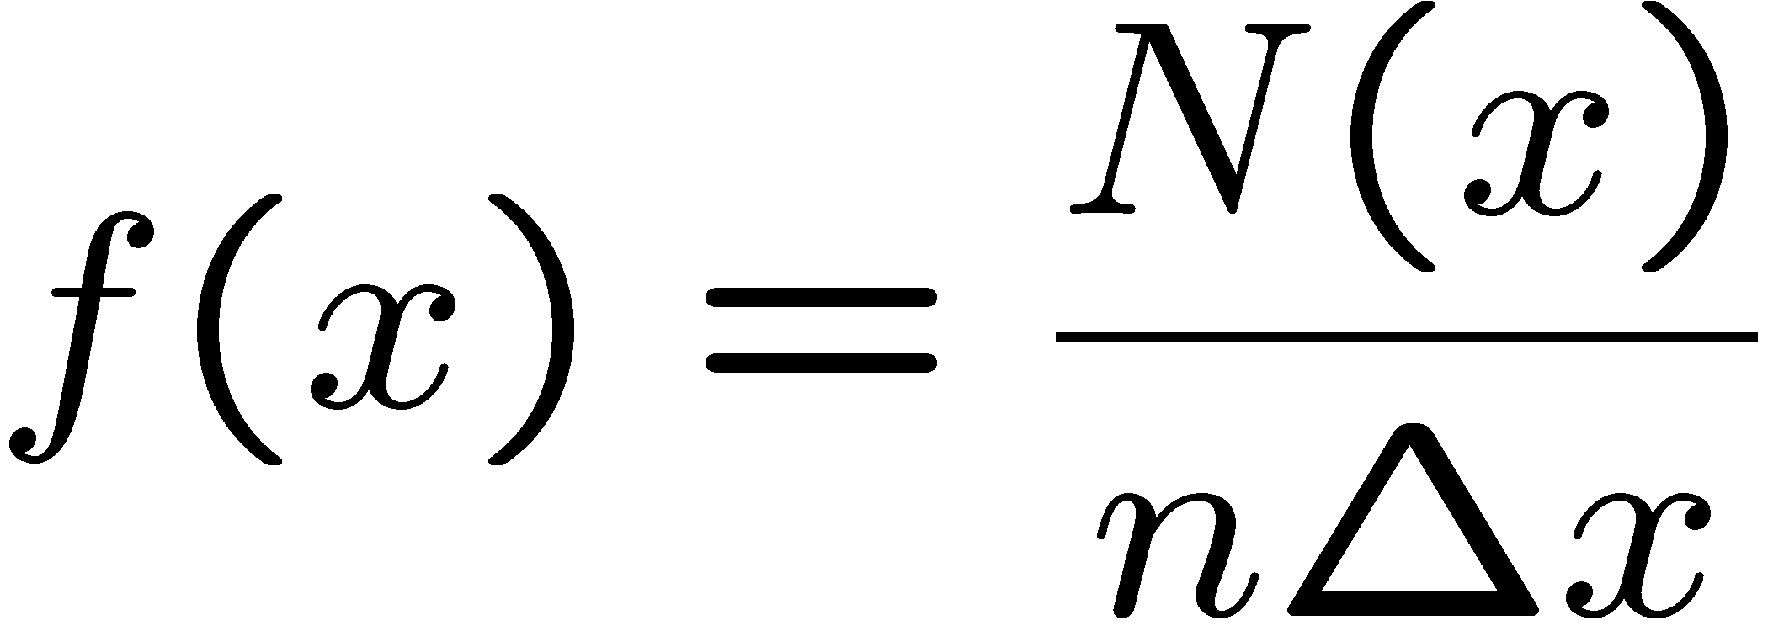
Histograms
Data sample x = (x₁,..., x_{n}),
# events n could be very large.
→ Histogram N = (N₁,..., N_{M})
M bins, bin size Δx.
pdf = histogram with infinite data sample, zero bin width, normalized to unit area.
Often normalize histogram to unit area, compare directly to pdf.

Slide 30
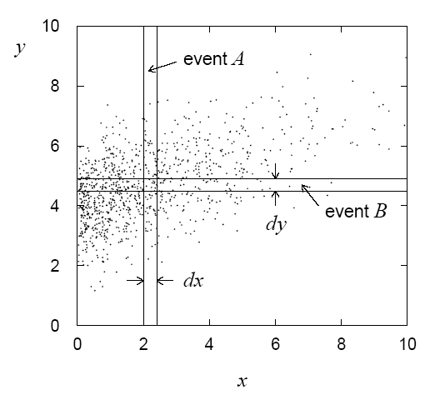
Multivariate distributions, joint pdf
Outcome of experiment charac-
terized by several values, e.g. an
n-component vector, (x₁, ... x_{n})
joint pdf
Normalization:

Slide 31
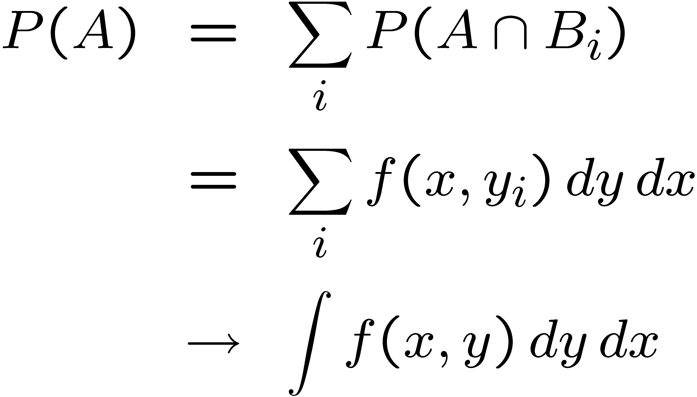
Marginal pdf
Sometimes we want only pdf of
some (or one) of the components:
i
marginal pdf
E.g. to find marginal pdf of x₁ from n-dim. joint pdf, integrate over
all variables except x₁ :

Slide 32
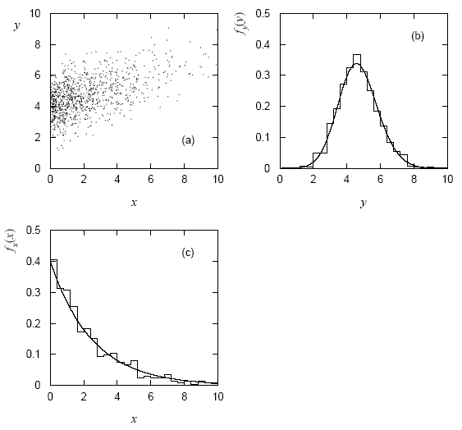
Marginal pdf (2)
Marginal pdf is the projection of joint pdf onto individual axes.

Slide 33
Conditional pdf
Sometimes we want to consider some components of joint pdf as constant. Recall conditional probability:
→ conditional pdfs:
E.g. h(y|x) is a pdf for y, here x is fixed.
The denominator fixes normalization so that

Slide 34
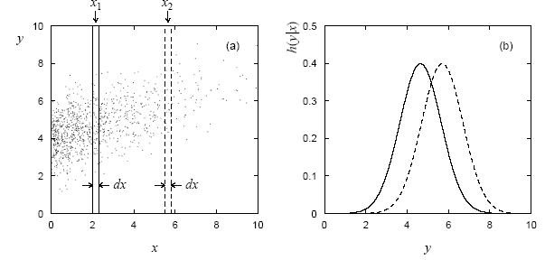
Conditional pdf (2)
E.g. joint pdf f (x,y) used to find conditional pdfs h(y|x₁), h(y|x₂):
Basically treat some of the r.v.s as constant, then divide the joint
pdf by the marginal pdf of those variables being held constant so
that what is left has correct normalization, e.g.,

Slide 35
Bayes’ theorem, independence for conditional pdf
Bayes’ theorem becomes:
Recall A, B independent if
→ x, y independent if
Then e.g. fixing y has no effect on pdf of x:

