Slide 1


Statistical Data Analysis 2020/21
Lecture Week 9
London Postgraduate Lectures on Particle Physics
University of London MSc/MSci course PH4515
Glen Cowan
Physics Department
Royal Holloway, University of London
g.cowan@rhul.ac.uk
www.pp.rhul.ac.uk/~cowan
Course web page via RHUL moodle (PH4515) and also
www.pp.rhul.ac.uk/~cowan/stat_course.html

Slide 2
Statistical Data Analysis
Lecture 9-1
Least squares with histogram data

Slide 3
LS with histogram data
The fit function in an LS fit is not a pdf, but it could be proportional to one, e.g., when we fit the “envelope” of a histogram.
Suppose for example, we have an i.i.d. data sample of n values x₁,..., x_{n} sampled from a pdf f (x;θ). Goal is to estimate θ.
Instead of using all n values, put them in a histogram with N bins, i.e., y_{i} = number of entries in bin i: y = (y₁,..., y_{N}).
The model predicts mean values:
bin centre
bin width

Slide 4
LS with histogram data (2)
The usual models:
for fixed sample size n, take y ~ multinomial,
if n not fixed, y_{i} ~ Poisson(μ_{i})
Suppose that the expected number of entries in each μ_{i} are all ≫ 1 and probability to be in any individual bin p_{i} ≪ 1, one can show
→ y_{i} indep. and ~ Gauss with σ_{i} ≈ √μ_{i}. (→ σ_{i} depends on θ).
The (log-) likelihood functions are then

Slide 5
LS with histogram data (3)
Still define the least-squares estimators to minimize
No longer equivalent to maximum likelihood (equal for μ_{i} ≫ 1 ).
Two possibilities for σ_{i}:
σ_{i} = √μ_{i}(θ) (LS method)
σ_{i} = √y_{i} (Modified LS method)
Modified LS can be easier computationally but not defined if
any y_{i} = 0.
For either method, χ ²_{min} ~ chi-square pdf for μ_{i} ≫ 1, but this breaks down for when the μ_{i} are not large.

Slide 6
LS with histogram data — normalization
Do not “fit” the normalization, i.e., n → free parameter ν:
If you do this, one finds the LS estimator for ν is not n, but rather
Software may include adjustable normalization parameter as default; better to use known n.

Slide 7
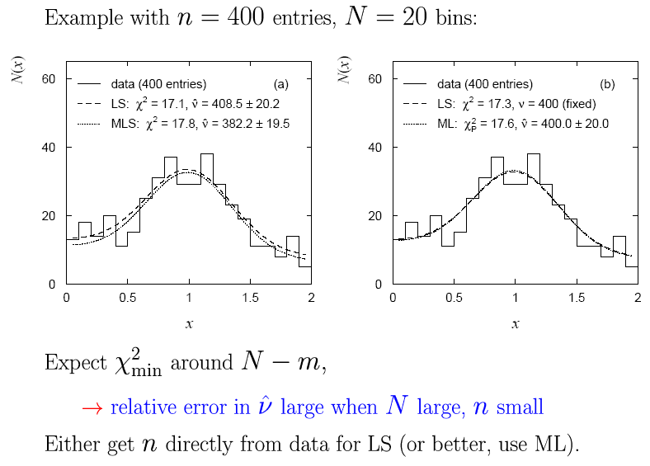
LS normalization example

Slide 8
Statistical Data Analysis
Lecture 9-2
Goodness-of-fit from the likelihood ratio
Wilks’ theorem
MLE and goodness-of-fit all in one

Slide 9


Goodness of fit from the likelihood ratio
Suppose we model data using a likelihood L(μ) that depends on N
parameters μ = (μ₁,..., μ_{Ν}). Define the statistic
⌃
where μ is the ML estimator for μ. Value of t_{μ} reflects agreement
between hypothesized μ and the data.
Good agreement means μ ≈ μ, so t_{μ} is small;
Larger t_{μ} means less compatibility between data and μ.
⌃
Quantify “goodness of fit” with p-value:
need this pdf

Slide 10
Likelihood ratio (2)
Now suppose the parameters μ = (μ₁,..., μ_{Ν}) can be determined by
another set of parameters θ = (θ₁,..., θ_{M}), with M < N.
Want to test hypothesis that the true model is somewhere in the subspace μ = μ(θ) versus the alternative of the full parameter space μ. Generalize the LR test statistic to be
fit M parameters
fit N parameters
To get p-value, need pdf f (t_{μ}|μ(θ)).

Slide 11
Wilks’ Theorem
Wilks’ Theorem: if the hypothesized μ_{i}(θ), i = 1,...,N, are true for some choice of the parameters θ = (θ₁,..., θ_{M}), then in the large sample limit (and provided regularity conditions are satisfied)
MLE of (θ₁,..., θ_{M})
follows a chi-square distribution for N – M degrees of freedom.
MLE of (μ₁,..., μ_{Ν})
The regularity conditions include: the model in the numerator of the likelihood ratio is “nested” within the one in the denominator, i.e., μ(θ) is a special case of μ = (μ₁,..., μ_{Ν}).
Proof boils down to having all estimators ~ Gaussian.

Slide 12




Goodness of fit with Gaussian data
Suppose the data are N independent Gaussian distributed values:
want to estimate
known
N measurements and N parameters ( = “saturated model”)
Likelihood:
Log-likelihood:
ML estimators:

Slide 13
Likelihood ratio for Gaussian data
Now suppose μ = μ(θ), e.g., in an LS fit with μ_{i}(θ) = μ(x_{i}; θ).
The goodness-of-fit statistic for the test of the hypothesis
μ(θ) becomes
chi-square pdf for N-M degrees of freedom
Here t_{μ} is the same as χ ²_{min} from an LS fit.
So Wilks’ theorem formally states the property that we claimed
for the minimized chi-squared from an LS fit with N measurements and M fitted parameters.

Slide 14



Likelihood ratio for Poisson data
Suppose the data are a set of values n = (n₁,..., n_{Ν}), e.g., the
numbers of events in a histogram with N bins.
Assume n_{i} ~ Poisson(ν_{i}), i = 1,..., N, all independent.
First (for LR denominator) treat ν = (ν₁,..., ν_{Ν}) as all adjustable:
Likelihood:
Log-likelihood:
ML estimators:

Slide 15
Goodness of fit with Poisson data (2)
For LR numerator find ν(θ) with M fitted parameters θ = (θ₁,..., θ_{M}):
Wilks’ theorem: in large-sample limit
Exact in large sample limit; in practice good approximation for
surprisingly small n_{i} (~several).
As before use t_{ν} to get p-value of ν(θ),
independent of θ

Slide 16





Goodness of fit with multinomial data
Similar if data n = (n₁,..., n_{Ν}) follow multinomial distribution:
E.g. histogram with N bins but fix:
Log-likelihood:
ML estimators:
(Only N−1 independent; one
is n_{tot} minus sum of rest.)

Slide 17
Goodness of fit with multinomial data (2)
The likelihood ratio statistics become:
Wilks: in large sample limit
One less degree of freedom than in Poisson case because
effectively only N−1 parameters fitted in denominator of LR.

Slide 18


Estimators and g.o.f. all at once
Evaluate numerators with θ (not its estimator); if any n_{i} = 0, omit the corresponding log terms:
(Poisson)
(Multinomial)
These are equal to the corresponding −2 ln L(θ) plus terms not
depending on θ, so minimizing them gives the usual ML
estimators for θ.
The minimized value gives the statistic t_{ν}, so we get
goodness-of-fit for free.

Slide 19
Examples of ML/LS fits
Unbinned maximum likelihood (mlFit.py, minimize negLogL)
No useful measure
of goodness-of-fit
from unbinned ML.

Slide 20
Examples of ML/LS fits
Least Squares fit (histFit.py, minimize chi2LS)
χ ²_{min} = 32.7
n_{dof} = 38
p = 0.71
Many bins with few entries, LS not expected to be reliable.

Slide 21
Examples of ML/LS fits
Multinomial maximum likelihood fit (histFit.py, minimize chi2M)
χ ²_{min} = 35.3
n_{dof} = 37
p = 0.55
Essentially same result
as unbinned ML.

Slide 22
Statistical Data Analysis
Lecture 9-3
Interval estimation
Confidence interval from inverting a test
Example: limits on mean of Gaussian

Slide 23
Confidence intervals by inverting a test
In addition to a ‘point estimate’ of a parameter we should report
an interval reflecting its statistical uncertainty.
Confidence intervals for a parameter θ can be found by
defining a test of the hypothesized value θ (do this for all θ):
Specify values of the data that are ‘disfavoured’ by θ
(critical region) such that P(data in critical region|θ) ≤ α
for a prespecified α, e.g., 0.05 or 0.1.
If data observed in the critical region, reject the value θ.
Now invert the test to define a confidence interval as:
set of θ values that are not rejected in a test of size α
(confidence level CL is 1− α).

Slide 24
Relation between confidence interval and p-value
Equivalently we can consider a significance test for each
hypothesized value of θ, resulting in a p-value, p_{θ}.
If p_{θ} ≤ α, then we reject θ.
The confidence interval at CL = 1 – α consists of those values of
θ that are not rejected.
E.g. an upper limit on θ is the greatest value for which p_{θ} > α.
In practice find by setting p_{θ} = α and solve for θ.
For a multidimensional parameter space θ = (θ₁,... θ_{M}) use same idea – result is a confidence “region” with boundary determined by p_{θ} = α.

Slide 25
Coverage probability of confidence interval
If the true value of θ is rejected, then it’s not in the confidence interval. The probability for this is by construction (equality for continuous data):
P(reject θ|θ) ≤ α = type-I error rate
Therefore, the probability for the interval to contain or “cover” θ is
P(conf. interval “covers” θ|θ) ≥ 1 – α
This assumes that the set of θ values considered includes the true value, i.e., it assumes the composite hypothesis P(x|H,θ).

Slide 26


Example: upper limit on mean of Gaussian
When we test the parameter, we should take the critical region to maximize the power with respect to the relevant alternative(s).
Example: x ~ Gauss(μ, σ) (take σ known)
Test H₀ : μ = μ₀ versus the alternative H₁ : μ < μ₀
→ Put w_{μ} at region of x-space
characteristic of low μ (i.e. at low x)
Equivalently, take the p-value to be

Slide 27
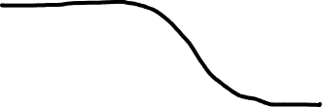
Upper limit on Gaussian mean (2)
To find confidence interval, repeat for all μ₀, i.e., set p_{μ0} = α and solve for μ₀ to find the interval’s boundary
This is an upper limit on μ, i.e., higher μ have even lower p-value and are in even worse agreement with the data.
Usually use Φ⁻¹(α) = −Φ⁻¹(1−α) so as to express the upper limit as x_{obs} plus a positive quantity. E.g. for α = 0.05, Φ⁻¹(1−0.05) = 1.64.

Slide 28

Upper limit on Gaussian mean (3)
μ_{up} = the hypothetical value of μ such that there is only a probability α to find x < x_{obs}.

Slide 29

1- vs. 2-sided intervals
Now test: H₀ : μ = μ₀ versus the alternative H₁ : μ ≠ μ₀
I.e. we consider the alternative to μ₀ to include higher and lower values, so take critical region on both sides:
Result is a “central” confidence interval [μ_{lo}, μ_{up}]:
E.g. for
Note upper edge of two-sided interval is higher (i.e. not as tight
of a limit) than obtained from the one-sided test.

Slide 30
On the meaning of a confidence interval
Often we report the confidence interval [a,b] together with the point estimate as an “asymmetric error bar”, e.g.,
E.g. (at CL = 1 – α = 68.3%):
Does this mean P(80.00 < θ < 80.56) = 68.3%? No, not for a frequentist confidence interval. The parameter θ does not fluctuate upon repetition of the measurement; the endpoints of the interval do, i.e., the endpoints of the interval fluctuate (they are functions of data):

Slide 31
Statistical Data Analysis
Lecture 9-4
Confidence intervals from the likelihood function

Slide 32




Approximate confidence intervals/regions
from the likelihood function
Suppose we test parameter value(s) θ = (θ₁, ..., θ_{n}) using the ratio
Lower λ(θ) means worse agreement between data and hypothesized θ. Equivalently, usually define
so higher t_{θ} means worse agreement between θ and the data.
p-value of θ therefore
need pdf

Slide 33




Confidence region from Wilks’ theorem
Wilks’ theorem says (in large-sample limit and provided
certain conditions hold...)
chi-square dist. with # d.o.f. =
# of components in θ = (θ₁, ..., θ_{n}).
Assuming this holds, the p-value is
← set equal to α
To find boundary of confidence region set p_{θ} = α and solve for t_{θ}:
Recall also

Slide 34




Confidence region from Wilks’ theorem (cont.)
i.e., boundary of confidence region in θ space is where
For example, for 1 – α = 68.3% and n = 1 parameter,
and so the 68.3% confidence level interval is determined by
Same as recipe for finding the estimator’s standard deviation, i.e.,
is a 68.3% CL confidence interval.

Slide 35
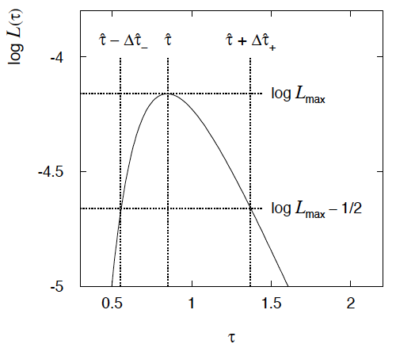

Example of interval from ln L(θ)
For n=1 parameter, CL = 0.683, Q_{α} = 1.
Our exponential
example, now with
only n = 5 events.
Can report ML estimate
with approx. confidence
interval from ln L_{max} – 1/2
as “asymmetric error bar”:

Slide 36

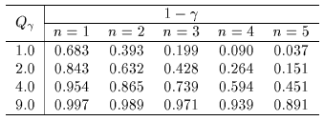

Multiparameter case
For increasing number of parameters, CL = 1 – α decreases for
confidence region determined by a given

Slide 37
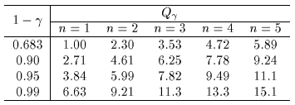
Multiparameter case (cont.)
Equivalently, Q_{α} increases with n for a given CL = 1 – α.

Slide 38
Example: 2 parameter fit:
Example from problem sheet 8, i.i.d. sample of size 200
x ~
Here fit two
parameters:
θ and ξ.

Slide 39
Example: 2 parameter fit:
In iminuit, user can set nsigma = √Q_{α}
nsigma=1
Q_{α} = 1
CL = 0.393
nsigma=2
Q_{α} = 4
CL = 0.865

Slide 40
Extra slides

Slide 41
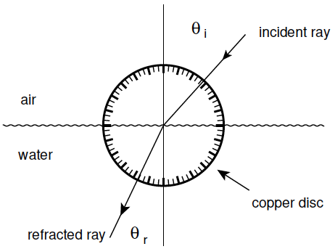
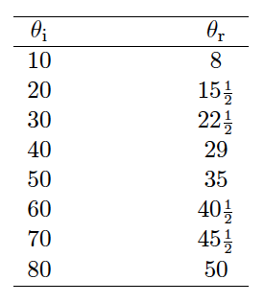
LS example: refraction data from Ptolemy
Astronomer Claudius Ptolemy obtained data on refraction of
light by water in around 140 A.D.:
Angles of incidence and
refraction (degrees)
Suppose the angle of incidence is set with negligible error, and
the measured angle of refraction has a standard deviation of ½°.

Slide 42



Laws of refraction
A commonly used law of refraction was
,
although it is reported that Ptolemy preferred
.
The law of refraction discovered by Ibn Sahl in 984 (and rediscovered by Snell in 1621) is
.
where r = n_{r}/n_{i} is the ratio of indices of refraction of the two media.

Slide 43
LS fit: θ_{r} = αθ_{i}
p = 6.7 ⨉ 10⁻²⁶

Slide 44
LS fit: θ_{r} = αθ_{i} − βθ_{i}²
p = 1.0

Slide 45
LS fit: Snell’s Law
p = 0.051
Fitted index of refraction of water r = 1.3116 ± 0.0056 found not quite compatible with currently known value 1.330.

