Slide 1


Statistical Data Analysis 2021/22
Lecture Week 9
London Postgraduate Lectures on Particle Physics
University of London MSc/MSci course PH4515
Glen Cowan
Physics Department
Royal Holloway, University of London
g.cowan@rhul.ac.uk
www.pp.rhul.ac.uk/~cowan
Course web page via RHUL moodle (PH4515) and also
www.pp.rhul.ac.uk/~cowan/stat_course.html

Slide 2
Statistical Data Analysis
Lecture 9-1
Least squares with histogram data

Slide 3
LS with histogram data
The fit function in an LS fit is not a pdf, but it could be proportional to one, e.g., when we fit the “envelope” of a histogram.
Suppose for example, we have an i.i.d. data sample of n values x₁,..., x_{n} sampled from a pdf f (x;θ). Goal is to estimate θ.
Instead of using all n values, put them in a histogram with N bins, i.e., y_{i} = number of entries in bin i: y = (y₁,..., y_{N}).
The model predicts mean values:
bin centre
bin width

Slide 4
LS with histogram data (2)
The usual models:
for fixed sample size n, take y ~ multinomial,
if n not fixed, y_{i} ~ Poisson(μ_{i})
Suppose that the expected number of entries in each μ_{i} are all ≫ 1 and probability to be in any individual bin p_{i} ≪ 1, one can show
→ y_{i} indep. and ~ Gauss with σ_{i} ≈ √μ_{i}. (→ σ_{i} depends on θ).
The (log-) likelihood functions are then

Slide 5
LS with histogram data (3)
Still define the least-squares estimators to minimize
No longer equivalent to maximum likelihood (equal for μ_{i} ≫ 1 ).
Two possibilities for σ_{i}:
σ_{i} = √μ_{i}(θ) (LS method)
σ_{i} = √y_{i} (Modified LS method)
Modified LS can be easier computationally but not defined if
any y_{i} = 0.
For either method, χ ²_{min} ~ chi-square pdf for μ_{i} ≫ 1, but this breaks down for when the μ_{i} are not large.

Slide 6
LS with histogram data — normalization
Do not “fit” the normalization, i.e., n → free parameter ν:
If you do this, one finds the LS estimator for ν is not n, but rather
Software may include adjustable normalization parameter as default; better to use known n.

Slide 7
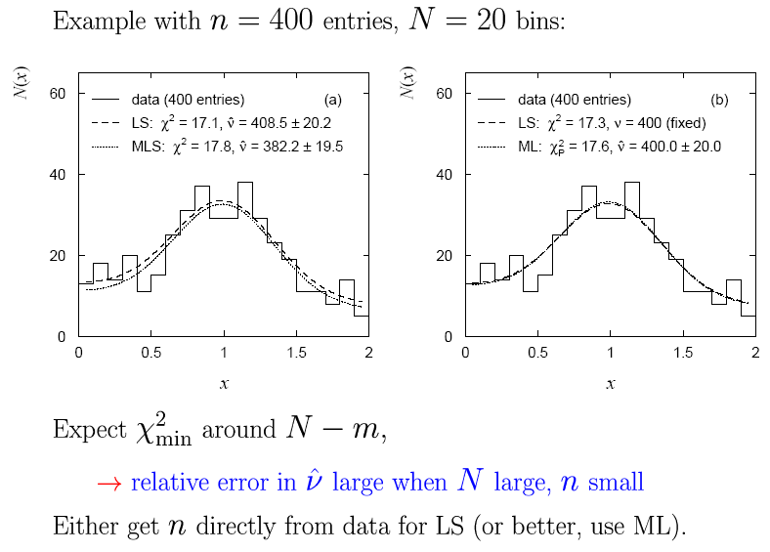
LS normalization example

Slide 8
Statistical Data Analysis
Lecture 9-2
Goodness-of-fit from the likelihood ratio
Wilks’ theorem
MLE and goodness-of-fit all in one

Slide 9


Goodness of fit from the likelihood ratio
Suppose we model data using a likelihood L(μ) that depends on N
parameters μ = (μ₁,..., μ_{Ν}). Define the statistic
⌃
where μ is the ML estimator for μ. Value of t_{μ} reflects agreement
between hypothesized μ and the data.
Good agreement means μ ≈ μ, so t_{μ} is small;
Larger t_{μ} means less compatibility between data and μ.
⌃
Quantify “goodness of fit” with p-value:
need this pdf

Slide 10
Likelihood ratio (2)
Now suppose the parameters μ = (μ₁,..., μ_{Ν}) can be determined by
another set of parameters θ = (θ₁,..., θ_{M}), with M < N.
Want to test hypothesis that the true model is somewhere in the subspace μ = μ(θ) versus the alternative of the full parameter space μ. Generalize the LR test statistic to be
fit M parameters
fit N parameters
To get p-value, need pdf f (t_{μ}|μ(θ)).

Slide 11
Wilks’ Theorem
Wilks’ Theorem: if the hypothesized μ_{i}(θ), i = 1,...,N, are true for some choice of the parameters θ = (θ₁,..., θ_{M}), then in the large sample limit (and provided regularity conditions are satisfied)
MLE of (θ₁,..., θ_{M})
follows a chi-square distribution for N – M degrees of freedom.
MLE of (μ₁,..., μ_{Ν})
The regularity conditions include: the model in the numerator of the likelihood ratio is “nested” within the one in the denominator, i.e., μ(θ) is a special case of μ = (μ₁,..., μ_{Ν}).
Proof boils down to having all estimators ~ Gaussian.

Slide 12




Goodness of fit with Gaussian data
Suppose the data are N independent Gaussian distributed values:
want to estimate
known
N measurements and N parameters ( = “saturated model”)
Likelihood:
Log-likelihood:
ML estimators:

Slide 13
Likelihood ratio for Gaussian data
Now suppose μ = μ(θ), e.g., in an LS fit with μ_{i}(θ) = μ(x_{i}; θ).
The goodness-of-fit statistic for the test of the hypothesis
μ(θ) becomes
chi-square pdf for N-M degrees of freedom
Here t_{μ} is the same as χ ²_{min} from an LS fit.
So Wilks’ theorem formally states the property that we claimed
for the minimized chi-squared from an LS fit with N measurements and M fitted parameters.

Slide 14



Likelihood ratio for Poisson data
Suppose the data are a set of values n = (n₁,..., n_{Ν}), e.g., the
numbers of events in a histogram with N bins.
Assume n_{i} ~ Poisson(ν_{i}), i = 1,..., N, all independent.
First (for LR denominator) treat ν = (ν₁,..., ν_{Ν}) as all adjustable:
Likelihood:
Log-likelihood:
ML estimators:

Slide 15
Goodness of fit with Poisson data (2)
For LR numerator find ν(θ) with M fitted parameters θ = (θ₁,..., θ_{M}):
if n_{i} = 0, skip term
Wilks’ theorem: in large-sample limit
Exact in large sample limit; in practice good approximation for
surprisingly small n_{i} (~several).
As before use t_{ν} to get p-value of ν(θ),
independent of θ

Slide 16





Goodness of fit with multinomial data
Similar if data n = (n₁,..., n_{Ν}) follow multinomial distribution:
E.g. histogram with N bins but fix:
Log-likelihood:
ML estimators:
(Only N−1 independent; one
is n_{tot} minus sum of rest.)

Slide 17
Goodness of fit with multinomial data (2)
The likelihood ratio statistics become:
if n_{i} = 0, skip term
Wilks: in large sample limit
One less degree of freedom than in Poisson case because
effectively only N−1 parameters fitted in denominator of LR.

Slide 18


Estimators and g.o.f. all at once
Evaluate numerators with θ (not its estimator); if any n_{i} = 0, omit the corresponding log terms:
(Poisson)
(Multinomial)
These are equal to the corresponding −2 ln L(θ) plus terms not
depending on θ, so minimizing them gives the usual ML
estimators for θ.
The minimized value gives the statistic t_{ν}, so we get
goodness-of-fit for free.

Slide 19
Examples of ML/LS fits
Unbinned maximum likelihood (mlFit.py, minimize negLogL)
No useful measure
of goodness-of-fit
from unbinned ML.

Slide 20
Examples of ML/LS fits
Least Squares fit (histFit.py, minimize chi2LS)
χ ²_{min} = 32.7
n_{dof} = 38
p = 0.71
Many bins with few entries, LS not expected to be reliable.

Slide 21
Examples of ML/LS fits
Multinomial maximum likelihood fit (histFit.py, minimize chi2M)
χ ²_{min} = 35.3
n_{dof} = 37
p = 0.55
Essentially same result
as unbinned ML.

Slide 22
Statistical Data Analysis
Lecture 9-3
Interval estimation
Confidence interval from inverting a test
Example: limits on mean of Gaussian

Slide 23
Confidence intervals by inverting a test
In addition to a ‘point estimate’ of a parameter we should report
an interval reflecting its statistical uncertainty.
Confidence intervals for a parameter θ can be found by
defining a test of the hypothesized value θ (do this for all θ):
Specify values of the data that are ‘disfavoured’ by θ
(critical region) such that P(data in critical region|θ) ≤ α
for a prespecified α, e.g., 0.05 or 0.1.
If data observed in the critical region, reject the value θ.
Now invert the test to define a confidence interval as:
set of θ values that are not rejected in a test of size α
(confidence level CL is 1− α).

Slide 24
Relation between confidence interval and p-value
Equivalently we can consider a significance test for each
hypothesized value of θ, resulting in a p-value, p_{θ}.
If p_{θ} ≤ α, then we reject θ.
The confidence interval at CL = 1 – α consists of those values of
θ that are not rejected.
E.g. an upper limit on θ is the greatest value for which p_{θ} > α.
In practice find by setting p_{θ} = α and solve for θ.
For a multidimensional parameter space θ = (θ₁,... θ_{M}) use same idea – result is a confidence “region” with boundary determined by p_{θ} = α.

Slide 25
Coverage probability of confidence interval
If the true value of θ is rejected, then it’s not in the confidence interval. The probability for this is by construction (equality for continuous data):
P(reject θ|θ) ≤ α = type-I error rate
Therefore, the probability for the interval to contain or “cover” θ is
P(conf. interval “covers” θ|θ) ≥ 1 – α
This assumes that the set of θ values considered includes the true value, i.e., it assumes the composite hypothesis P(x|H,θ).

Slide 26


Example: upper limit on mean of Gaussian
When we test the parameter, we should take the critical region to maximize the power with respect to the relevant alternative(s).
Example: x ~ Gauss(μ, σ) (take σ known)
Test H₀ : μ = μ₀ versus the alternative H₁ : μ < μ₀
→ Put w_{μ} at region of x-space
characteristic of low μ (i.e. at low x)
Equivalently, take the p-value to be

Slide 27
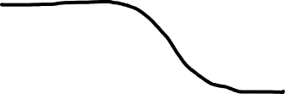
Upper limit on Gaussian mean (2)
To find confidence interval, repeat for all μ₀, i.e., set p_{μ0} = α and solve for μ₀ to find the interval’s boundary
This is an upper limit on μ, i.e., higher μ have even lower p-value and are in even worse agreement with the data.
Usually use Φ⁻¹(α) = −Φ⁻¹(1−α) so as to express the upper limit as x_{obs} plus a positive quantity. E.g. for α = 0.05, Φ⁻¹(1−0.05) = 1.64.

Slide 28

Upper limit on Gaussian mean (3)
μ_{up} = the hypothetical value of μ such that there is only a probability α to find x < x_{obs}.

Slide 29

1- vs. 2-sided intervals
Now test: H₀ : μ = μ₀ versus the alternative H₁ : μ ≠ μ₀
I.e. we consider the alternative to μ₀ to include higher and lower values, so take critical region on both sides:
Result is a “central” confidence interval [μ_{lo}, μ_{up}]:
E.g. for
Note upper edge of two-sided interval is higher (i.e. not as tight
of a limit) than obtained from the one-sided test.

Slide 30
On the meaning of a confidence interval
Often we report the confidence interval [a,b] together with the point estimate as an “asymmetric error bar”, e.g.,
E.g. (at CL = 1 – α = 68.3%):
Does this mean P(80.00 < θ < 80.56) = 68.3%? No, not for a frequentist confidence interval. The parameter θ does not fluctuate upon repetition of the measurement; the endpoints of the interval do, i.e., the endpoints of the interval fluctuate (they are functions of data):

Slide 31
Statistical Data Analysis
Lecture 9-4
Confidence intervals from the likelihood function

Slide 32




Approximate confidence intervals/regions
from the likelihood function
Suppose we test parameter value(s) θ = (θ₁, ..., θ_{n}) using the ratio
Lower λ(θ) means worse agreement between data and hypothesized θ. Equivalently, usually define
so higher t_{θ} means worse agreement between θ and the data.
p-value of θ therefore
need pdf

Slide 33




Confidence region from Wilks’ theorem
Wilks’ theorem says (in large-sample limit and provided
certain conditions hold...)
chi-square dist. with # d.o.f. =
# of components in θ = (θ₁, ..., θ_{n}).
Assuming this holds, the p-value is
← set equal to α
To find boundary of confidence region set p_{θ} = α and solve for t_{θ}:
Recall also

Slide 34




Confidence region from Wilks’ theorem (cont.)
i.e., boundary of confidence region in θ space is where
For example, for 1 – α = 68.3% and n = 1 parameter,
and so the 68.3% confidence level interval is determined by
Same as recipe for finding the estimator’s standard deviation, i.e.,
is a 68.3% CL confidence interval.

Slide 35
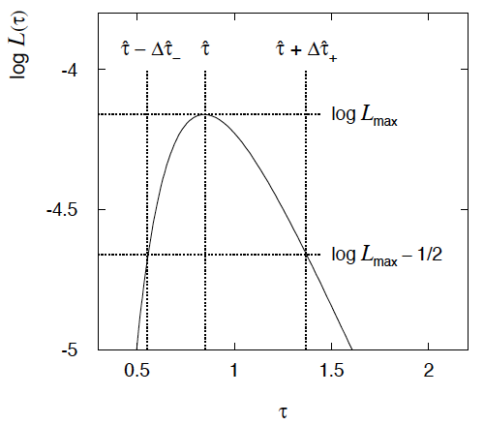

Example of interval from ln L(θ)
For n=1 parameter, CL = 0.683, Q_{α} = 1.
Our exponential
example, now with
only n = 5 events.
Can report ML estimate
with approx. confidence
interval from ln L_{max} – 1/2
as “asymmetric error bar”:

Slide 36

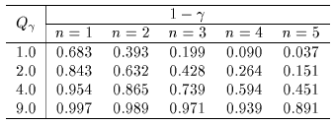

Multiparameter case
For increasing number of parameters, CL = 1 – α decreases for
confidence region determined by a given

Slide 37
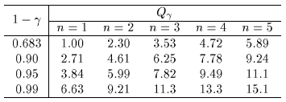
Multiparameter case (cont.)
Equivalently, Q_{α} increases with n for a given CL = 1 – α.

Slide 38
Example: 2 parameter fit:
Example from problem sheet 8, i.i.d. sample of size 200
x ~
Here fit two
parameters:
θ and ξ.

Slide 39
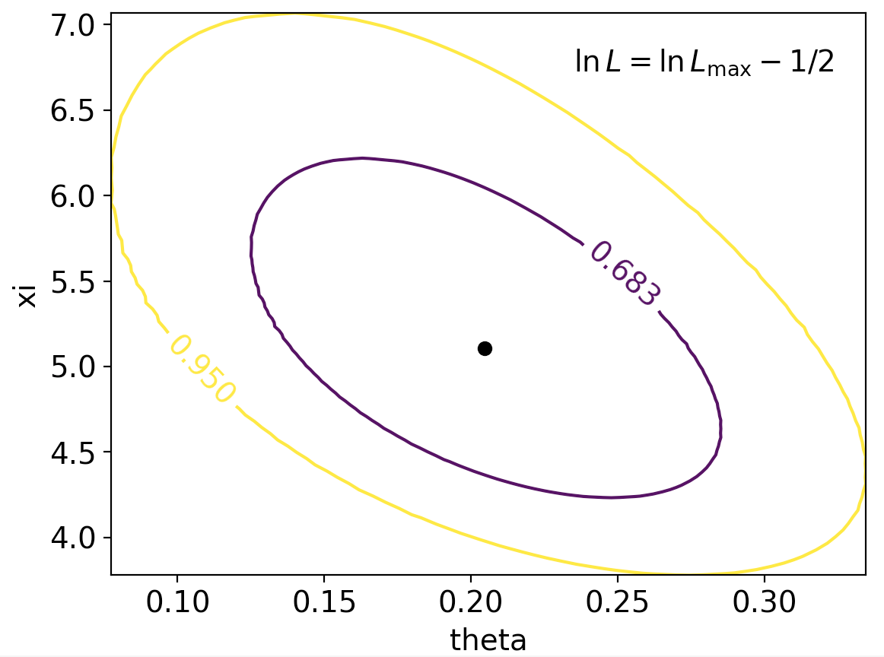
Example: 2 parameter fit:
In iminuit v2, user can set CL = 1 − α

Slide 40
Extra slides

Slide 41
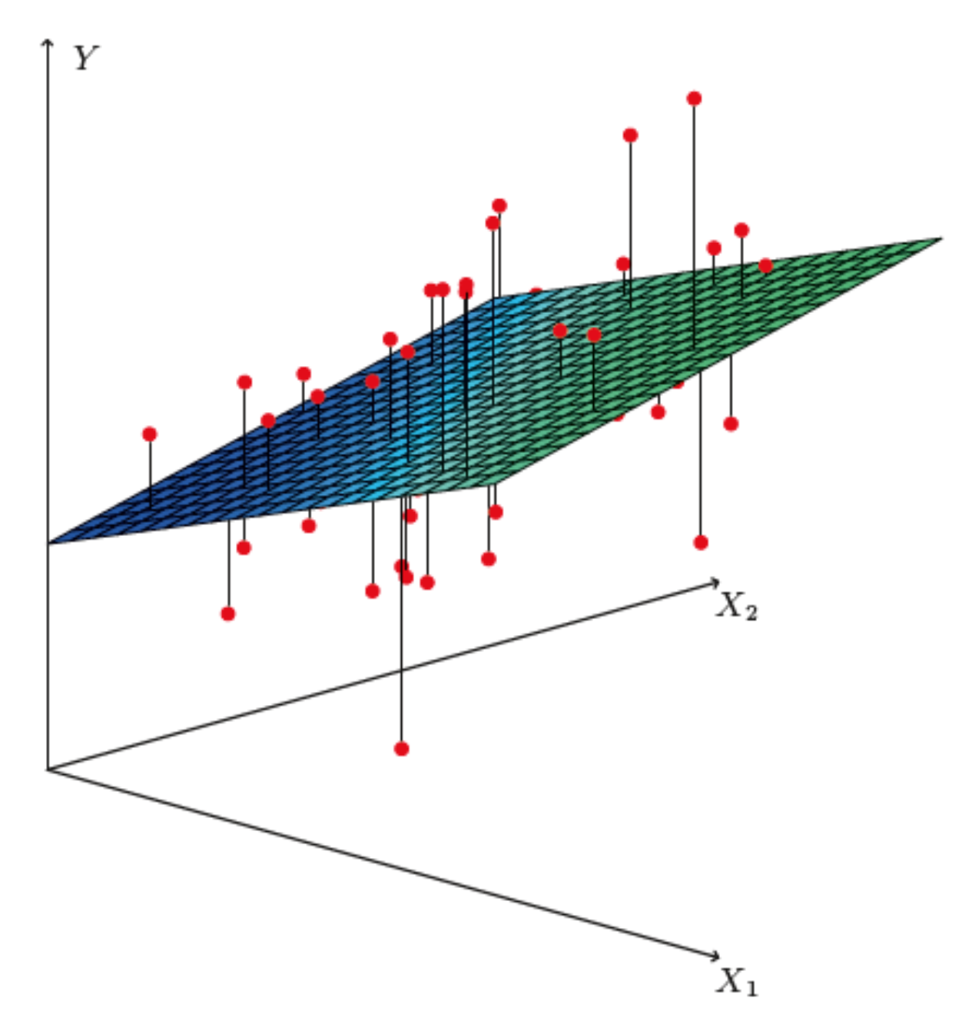
http://www-bcf.usc.edu/~gareth/ISL/
Brief intro to multiple regression
Multiple regression* can be seen as an extension of curve fitting to the case where the variable x is replaced by a multi-dimensional x = (x₁,...,x_{n}), e.g., fitting a surface. Here suppose the data are points (x_{i}, y_{i}), i = 1,...,N (no error bars) and x is usually a random variable, often called the explanatory or predictor variable.
Equivalently, we can view it as an extension to classification with
the discrete class label y = 0, 1 replaced by a continuous target y (and in this context x can also be called the feature vector).
*Note the term ”multivariate” regression refers to a vector target variable y; here we treat only scalar y.

Slide 42

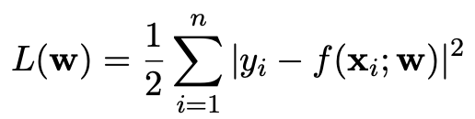
Target (fit) function and loss function
As in the case of curve fitting, we assume some parametric function
of x that represents the mean of the target variable
where w is a vector of adjustable parameters (“weights”).
Suppose we have training data consisting of (x_{i}, y_{i}), i = 1,...,N.
Use these to determine the weights by minimizing a loss function
(analogous to the χ²), e.g.,

Slide 43
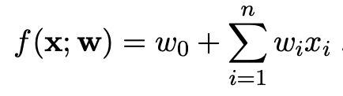
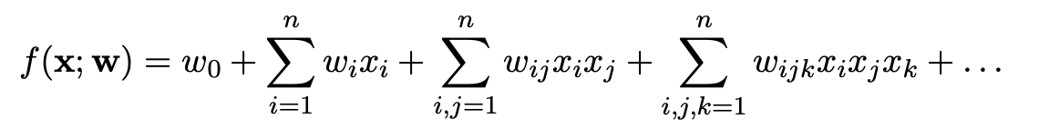
http://www-bcf.usc.edu/~gareth/ISL/
Linear regression
In linear regression, the fit function is of the form
i.e. the problem is equivalent to an unweighted least-squares fit of a (hyper-)plane:
Can be generalized to a nonlinear surface with higher order terms,

Slide 44
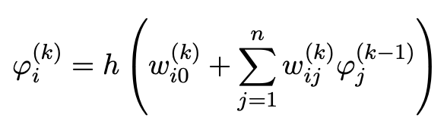
Nonlinear regression
Other examples of nonlinear regression include:
MLP (multilayer perceptron) regression
Boosted decision tree regression
Support vector regression
For MLP regression, as with classification, regard the feature vector as the layer k = 0; i.e., φ_{i}⁽⁰⁾ = x_{i}.
The ith node of hidden layer k is
where h is the activation function (tanh, relu, sigmoid,...).

Slide 45
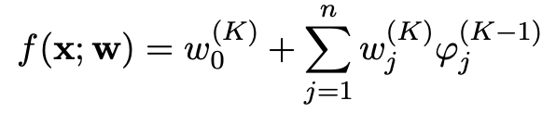
MLP Regression (cont.)
For the final layer (k=K), in MLP regression (in contrast to classification), one omits the activation function, i.e.,
where φ_{j}^{(K−1)} = are the nodes of the last hidden layer (k = K−1).
For info on other types of multiple regression see, e.g.,
http://www-bcf.usc.edu/~gareth/ISL/
and the scikit-learn documentation.

Slide 46
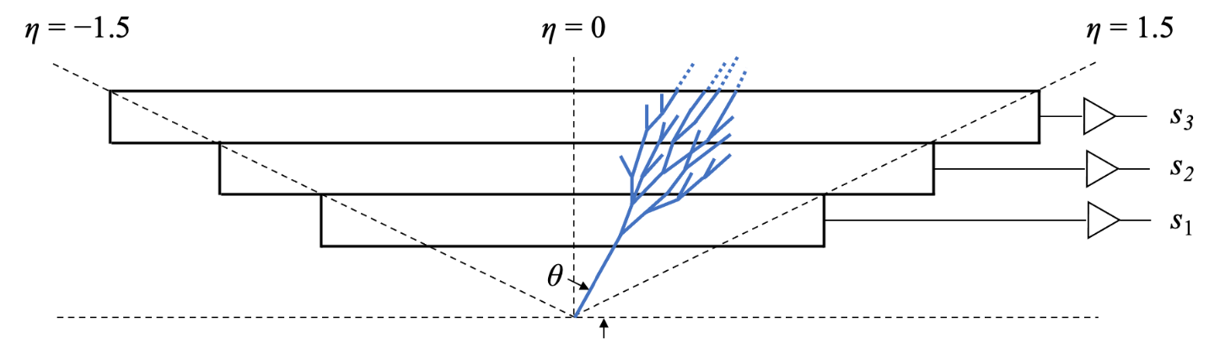
Multiple regression example
Suppose particles with different energies E and angles θ (or equivalently η = − ln tan(θ/2) ) enter a calorimeter and create a particle showers that gives signals in three layers, s₁, s₂ and s₃, as well as an estimate of η.
Some of the energy leaks through, with increased leakage for higher energy and more oblique angles (higher η).
The goal is to estimate the target y_{i} = E_{i} given feature vectors
x_{i} = (η, s₁, s₂,s₃)_{i} for i = 1,...,N training events.

Slide 47

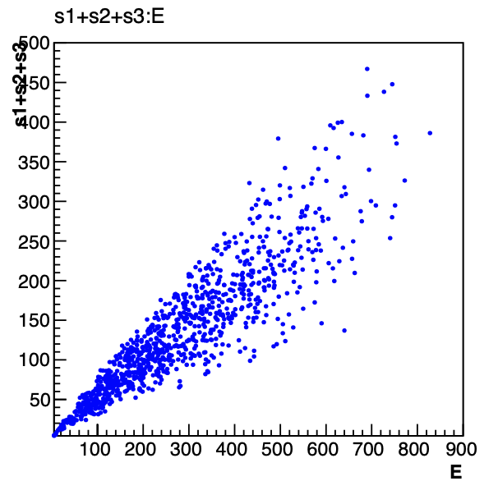
Energy estimate from sum of signals
Naively, one could try just summing the signals:
Gives very poor resolution
because the particles have a
distribution of energies and
angles and hence differing amounts of the energy leak through undetected.

Slide 48
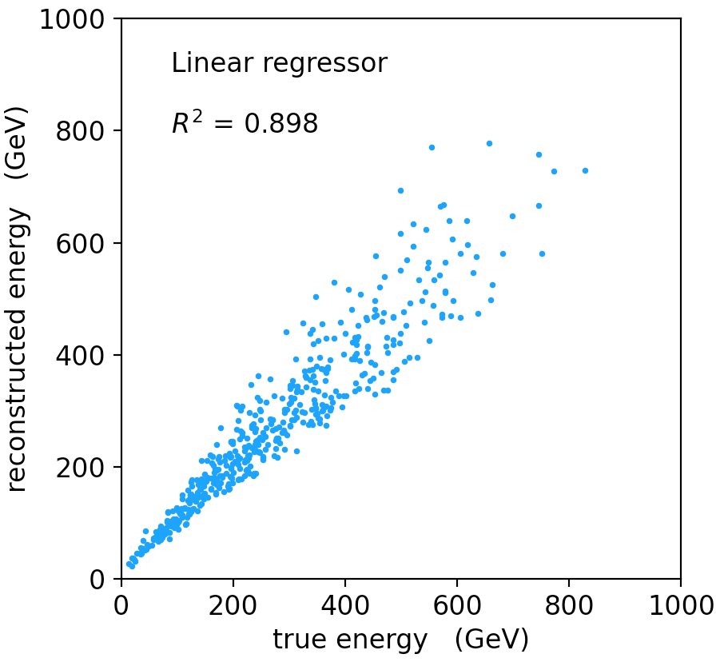
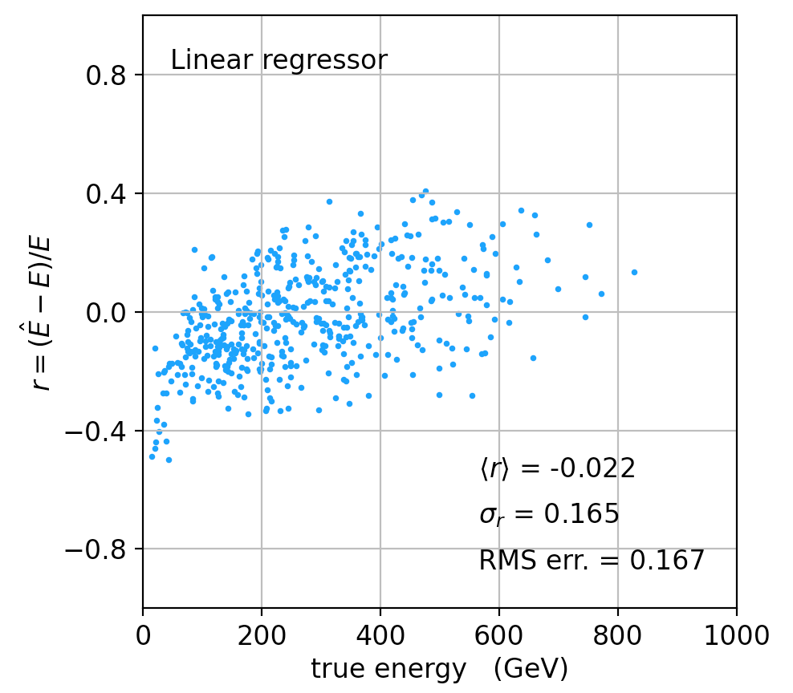
Linear regression
See MVRegressor.py, here using
regr = linear_model.LinearRegression()
regr.fit(X_train, y_train)
Average relative resolution 16.7%.

Slide 49
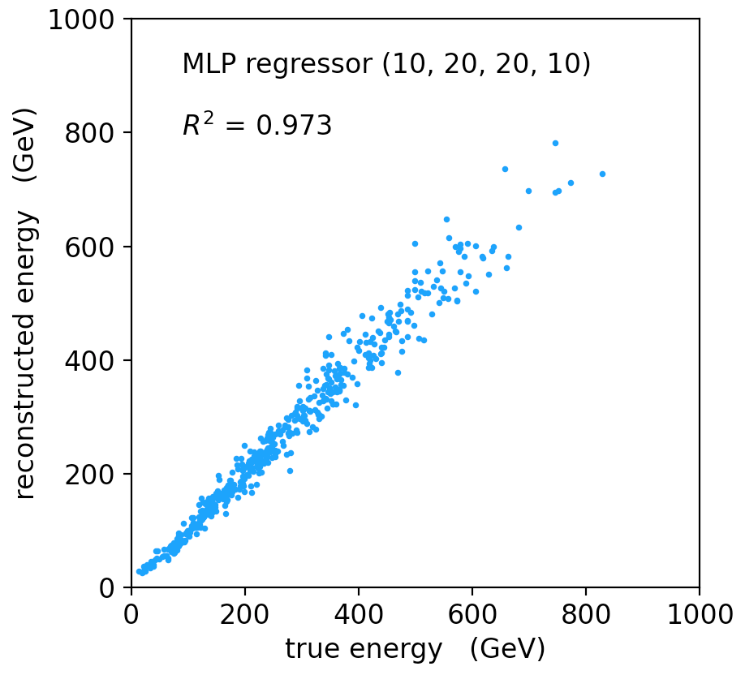
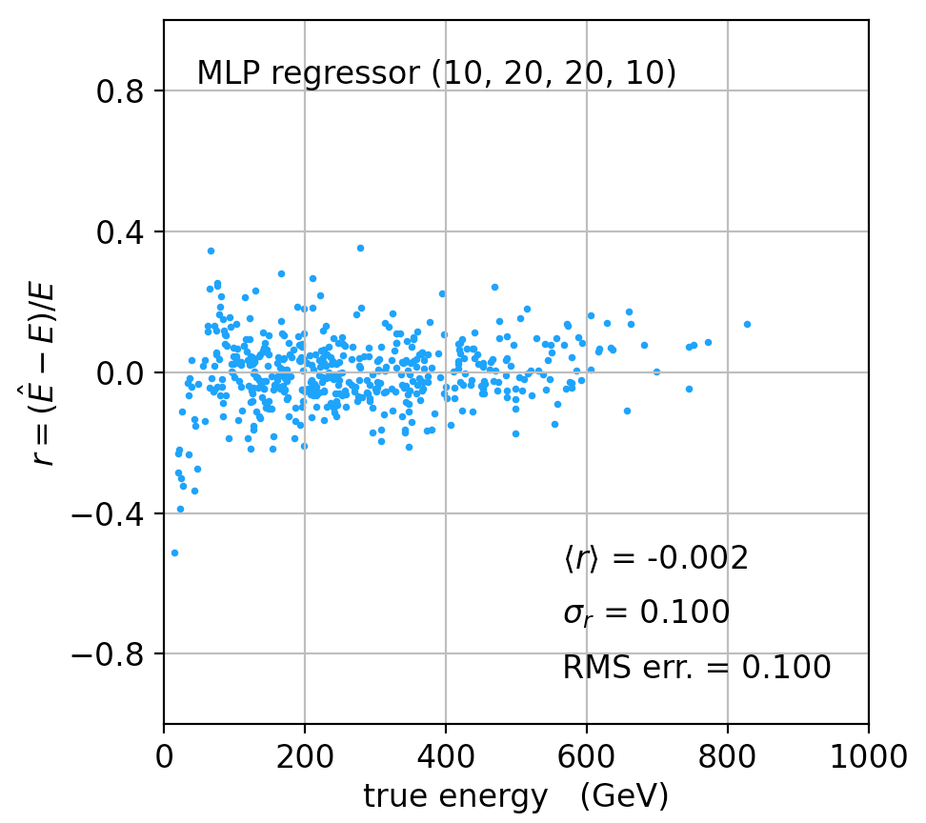
MLP Regression
regr = MLPRegressor(hidden_layer_sizes=(10,20,20,10), activation='relu'
regr.fit(X_train, y_train)
Better resolution (10%), here significant bias at low energies.

Slide 50
Refinements for multiple regression
One can try many improvements:
Scaling of predictor and target variables, e.g., standardize to zero mean and unit variance.
Use cross-validation to assess accuracy (and hence use entire sample of events for training.
Try different loss functions.
Try different regression algorithms (ridge regression, lasso, decision tree, support vector regression,...).
Some simple code using scikit-learn and a short write-up (from a year-3 project) is on the course webpage.

Slide 51
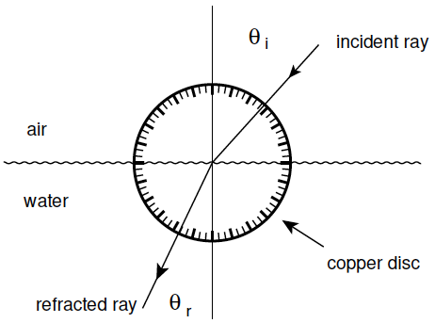
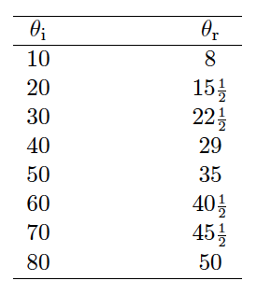
LS example: refraction data from Ptolemy
Astronomer Claudius Ptolemy obtained data on refraction of
light by water in around 140 A.D.:
Angles of incidence and
refraction (degrees)
Suppose the angle of incidence is set with negligible error, and
the measured angle of refraction has a standard deviation of ½°.

Slide 52



Laws of refraction
A commonly used law of refraction was
,
although it is reported that Ptolemy preferred
.
The law of refraction discovered by Ibn Sahl in 984 (and rediscovered by Snell in 1621) is
.
where r = n_{r}/n_{i} is the ratio of indices of refraction of the two media.

Slide 53
LS fit: θ_{r} = αθ_{i}
p = 6.7 ⨉ 10⁻²⁶

Slide 54
LS fit: θ_{r} = αθ_{i} − βθ_{i}²
p = 1.0

Slide 55
LS fit: Snell’s Law
p = 0.051
Fitted index of refraction of water r = 1.3116 ± 0.0056 found not quite compatible with currently known value 1.330.

