Slide 1


Statistical Data Analysis 2022/23
Lecture Week 11
London Postgraduate Lectures on Particle Physics
University of London MSc/MSci course PH4515
Glen Cowan
Physics Department
Royal Holloway, University of London
g.cowan@rhul.ac.uk
www.pp.rhul.ac.uk/~cowan
Course web page via RHUL moodle (PH4515) and also
www.pp.rhul.ac.uk/~cowan/stat_course.html

Slide 2
Statistical Data Analysis
Lecture 11-1
Bayesian model selection
Bayes factors

Slide 3
Bayesian model selection
Fundamentally the probability of a hypothesis H_{i} in the Bayesian approach is given by its posterior probability given the data: P(H_{i}|x).
Finding this requires assignment of prior probabilities to all hypotheses that are considered.
We can give the posterior odds (ratio of probabilities) for any pair of hypotheses H_{i} and H_{j} (use Bayes’ theorem; factors of P(x) cancel):
posterior odds
Bayes factor
prior odds
See: Kass and Raftery, Bayes Factors, J. Am Stat. Assoc 90 (1995) 773.

Slide 4
The Bayes factor
The Bayes factor B_{ij} is the likelihood ratio of the two hypotheses:
= posterior odds if one takes
prior odds equal to one.
The Bayes factor is regarded as measuring the weight of
evidence of the data in support of H_{i} over H_{j}. and can be used much like a p-value (or Z value).
The Jeffreys scale, analogous to the 5σ rule in Particle Physics:
B₁₀ Evidence against H₀
--------------------------------------------
1 to 3 Not worth more than a bare mention
3 to 20 Positive
20 to 150 Strong
> 150 Very strong

Slide 5
Marginal likelihood (evidence)
If the model H_{i} contains internal parameters θ_{i}, then these must be characterized by a prior pdf π_{i}(θ_{i} |H_{i}) and marginalized:
This is called the “marginal likelihood” or “evidence” of H_{i}.
It is independent of the overall prior probability of H_{i}
but it depends on the prior pdf for the model’s internal
parameters θ_{i} :

Slide 6
Bayes factor for models with internal parameters
The Bayes factor is thus the ratio of marginal likelihoods for the two models:
Simplifying the notation, the numerator and denominator are both of the form
For high-dimensional θ these integrals can be very difficult to compute (more on this later).

Slide 7

Priors for Bayes factors
Prior pdfs for the marginal likelihoods used in Bayes factors
cannot be improper, i.e., they cannot be defined only up to an arbitrary normalization constant, in which case B_{ij} would not be well defined.
Suppose we try to take a ”non-informative” prior to be constant
out to some large cut-off, in the hope that the Bayes factor will decouple from it:
In such cases we find that the Bayes factor remains sensitive to the cut-off even for a → ∞.
So all priors used for Bayes factors must reflect a meaningful degrees of uncertainty about the parameters.

Slide 8
Bayes factor for Poisson counting experiment
Suppose n ~ Poisson(s + b) with b known. We want to compare
The likelihoods of H₀ and H₁ are

Slide 9
Bayes factor for Poisson counting experiment (2)
Suppose the prior pdf for the parameter s in H₁ is:
(0 ≤ s ≤ s_{max})
The posterior probability for s given n is, assuming H₁,
(0 ≤ s ≤ s_{max})
γ = lower
incomplete
gamma
function

Slide 10
Bayes factor for Poisson counting experiment (3)
In the limit s_{max} → ∞ this goes to
where
is the lower incomplete gamma function.
Thus the posterior pdf for s given n under assumption of H₁
decouples from s_{max} in the limit s_{max} → ∞, and hence we
can use this limiting case e.g. for finding an upper limit (credibility interval) for s.

Slide 11
Bayes factor for Poisson counting experiment (4)
The hypothesis H₀ has no internal parameters so its marginal likelihood is simply m₀ = L(n| H₀).
The marginal likelihood of H₁ is

Slide 12
Bayes factor for Poisson counting experiment (5)
So the Bayes factor is
Example: b = 2, n = 8
As s_{max} increases the data start to favour H₁.
As s_{max} increases further, the larger volume of H₁’s parameter space penalizes it (Ockham’s razor).

Slide 13

Ockham

Slide 14
Statistical Data Analysis
Lecture 11-2
Numerical determination of Bayes factors

Slide 15
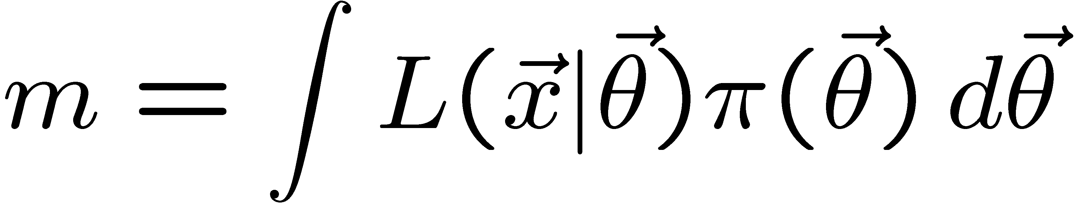
Numerical determination of Bayes factors
Both numerator and denominator of B_{ij} are of the form
‘marginal likelihood’
Various ways to compute these, e.g., using sampling of the posterior pdf (which we can do with MCMC).
Harmonic Mean (and improvements)
Importance sampling
Parallel tempering (~thermodynamic integration)
Nested Sampling (MultiNest), ...

Slide 16

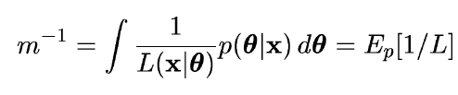
Harmonic mean estimator
E.g., consider only one model and write Bayes theorem as:
π(θ) is normalized to unity so integrate both sides,
posterior
expectation
Therefore sample θ from the posterior via MCMC and estimate m
with one over the average of 1/L (the harmonic mean of L).
Called the “worst Monte Carlo method ever”
https://radfordneal.wordpress.com/2008/08/17/the-harmonic-mean-of-the-likelihood-worst-monte-carlo-method-ever/

Slide 17

Improvements to harmonic mean estimator
The harmonic mean estimator is numerically very unstable;
formally infinite variance (!). A variant (cf. Gelfand and Dey):
Rearrange Bayes thm; multiply
both sides by arbitrary pdf f (θ):
Integrate over θ :
Improved convergence if tails of f (θ) fall off faster than L(x|θ)π(θ)
Note harmonic mean estimator is special case f (θ) = π(θ).
.

Slide 18



Adaptive Harmonic Mean Integration
A. Caldwell et al., International Journal of Modern Physics A Vol. 35, No. 24 (2020) 2050142
Want to compute
(Ω = support of f)
E.g. f (λ) = L(λ) π(λ) = unnormalized target density; we can sample from this with MCMC.
Define integral over subvolume Δ of Ω with volume V_{Δ}

Slide 19
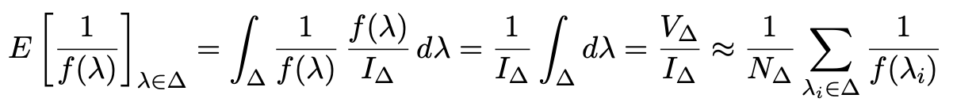
Adaptive Harmonic Mean Integration (2)
If f (λ) not small in Δ, then we can find I_{Δ} from harmonic mean:
Sample λ from f (λ) using MCMC, estimate r = I_{Δ}/I with fraction of points found in Δ:
Use these to estimate I:
“The task of estimating our integral, therefore reduces to choosing one or several
subspaces ∆ — typically small regions around local modes of f (λ). The full space
Ω over which the integration ought to be performed can be large or even inﬁnite,
while this does not aﬀect the outcome of our integral estimate.”
A. Caldwell et al., IJMP A Vol. 35, No. 24 (2020) 2050142

Slide 20

A. Caldwell et al., IJMP A Vol. 35, No. 24 (2020) 2050142
Adaptive Harmonic Mean Integration (3)
Testing AHMI with multimodal multidimensional Cauchy pdf
Challenging pdf because of long tails.
Good results for up to 7 dimensions for MCMC sample size of 10⁶.
Software: Bayesian Analysis Toolkit
https://github.com/bat/BAT.jl

Slide 21
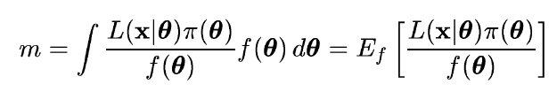
Importance sampling
Need pdf f (θ) which we can evaluate at arbitrary θ and also
sample with MC.
The marginal likelihood can be written
Sample θ ~ f (θ), compute average of L(x|θ) π(θ) / f (θ).
Best convergence when f (θ) approximates shape of L(x|θ)π(θ).
Use for f (θ) e.g. multivariate Gaussian with mean and covariance
estimated from posterior.

Slide 22
Nested sampling
J. Skilling, Bayesian Analysis, No. 4, pp. 833-860 (2006)
We want to compute
Can add up portions of X (equivalently, θ) space in any order. Use
X near 1 means low λ, all of
θ space included.
Write inverse function as
so that the desired result is
Elements of θ space are sorted
by decreasing likelihood.

Slide 23
J. Skilling, Bayesian Analysis, No. 4, pp. 833-860 (2006)
Nested sampling (2)
The evidence Z
is the area under
the curve of L(X).
Computational challenge is to sample θ space from prior subject to constraint L(θ) > λ. Software: MultiNest
Farhan Feroz, Mike Hobson, Mon. Not. Roy. Astron. Soc., 384, 2, 449-463 (2008); arXiv:0704.3704,
F. Feroz, M.P. Hobson, M. Bridges, Mon. Not. Roy. Astron. Soc. 398: 1601-1614,2009; arXiv:0809.3437
F. Feroz, M.P. Hobson, E. Cameron, A.N. Pettitt, arXiv:1306.2144

Slide 24
Statistical Data Analysis
Lecture 11-3
Statistical models with uncertain error parameters (part 1)
“Errors on Errors”
The final two lectures constitute a “special seminar” on material that will not be on the exam.
Details in: G. Cowan, Statistical Models with Uncertain Error
Parameters, Eur. Phys. J. C (2019) 79:133, arXiv:1809.05778

Slide 25
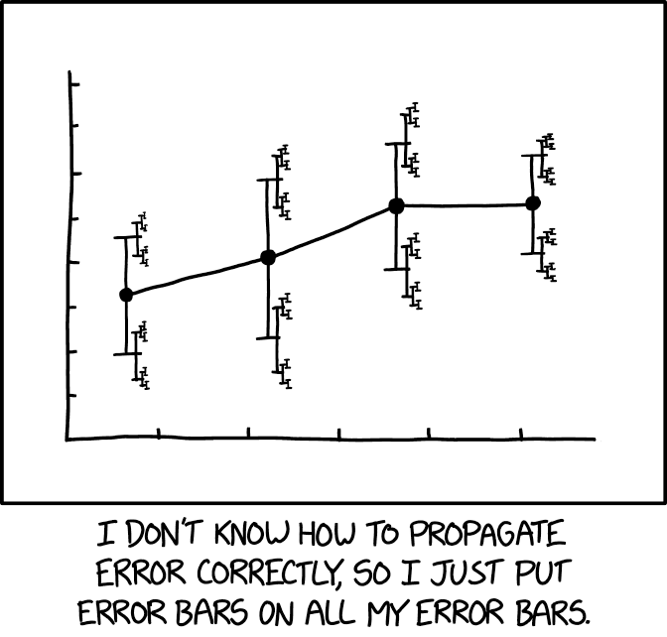
https://xkcd.com/2110/
Randall Munroe, xkcd.com

Slide 26
Errors on errors: the issue
The method of least squares requires the standard deviations of the measured quantities, but often these are poorly known.
The uncertainty (e.g. confidence interval) of an LS average does not reflect goodness of fit:
LS average of 9 ± 1 and 11 ± 1 is 10 ± 0.71
LS average of 5 ± 1 and 15 ± 1 is 10 ± 0.71
LS estimators are equivalent to maximum-likelihood assuming Gaussian distributed measurements; but the tails of a Gaussian fall off very fast, not always an appropriate model.
→ Outliers in LS average have very large influence.
Solution: incorporate the uncertainty in the standard deviations of the measurements into the analysis.

Slide 27



Formulation of the problem
Suppose measurements y have probability (density) P(y|μ,θ),
μ = parameters of interest
θ = nuisance parameters
To provide info on nuisance parameters, often treat their best
estimates u as indep. Gaussian distributed r.v.s., giving likelihood
or log-likelihood (up to additive const.)

Slide 28
Systematic errors and their uncertainty
Often the θ_{i} could represent a systematic bias and its best estimate u_{i} in the real measurement is zero.
The σ_{u,i} are the corresponding “systematic errors”.
Sometimes σ_{u,i} is well known, e.g., it is itself a statistical error known from sample size of a control measurement.
Other times the u_{i} are from an indirect measurement, Gaussian model approximate and/or the σ_{u,i} are not exactly known.
Or sometimes σ_{u,i} is at best a guess that represents an uncertainty in the underlying model (“theoretical error”).
In any case we can allow that the σ_{u,i} are not known in general with perfect accuracy.

Slide 29



Gamma model for variance estimates
Suppose we want to treat the systematic errors as uncertain,
so let the σ_{u,i} be adjustable nuisance parameters.
Suppose we have estimates s_{i} for σ_{u,i} or equivalently v_{i} = s_{i}², is an estimate of σ_{u,i}².
Model the v_{i} as independent and gamma distributed:
Set α and β so that they give desired mean and width for f (v):
E[v] = σ_{u}² = α/β,
r = 1/2√α ≈ relative “error on the error” = σ_{s}/E[s] .

Slide 30



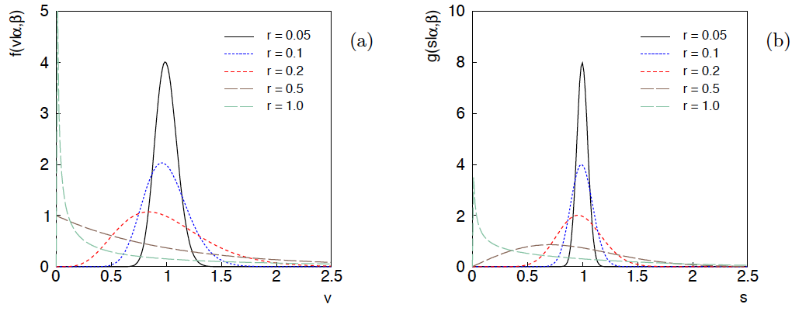
Distributions of v and s = √v
For α, β of gamma distribution,
relative “error on error”

Slide 31

Motivation for gamma model
If one were to have n independent observations u₁,..,u_{n}, with all
u ~ Gauss(θ, σ_{u}²), and we use the sample variance
to estimate σ_{u}², then (n−1)v/σ_{u}² follows a chi-square distribution
for n−1 degrees of freedom, which is a special case of the
gamma distribution (α = n/2, β = 1/2). (In general one doesn’t
have a sample of u_{i} values, but if this were to be how v was
estimated, the gamma model would follow.)
Furthermore choice of the gamma distribution for v allows one
to profile over the nuisance parameters σ_{u}² in closed form and
leads to a simple profile likelihood.

Slide 32
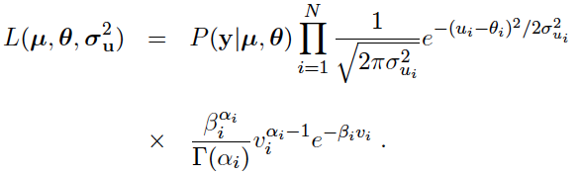
Likelihood for gamma error model
α_{i} = 1/4r_{i}²
β_{i} = α_{i}/σ_{ui}²
,
Treated like data: y₁,...,y_{L} (the primary measurements)
u₁,...,u_{N} (estimates of nuisance par.)
v₁,...,v_{N} (estimates of variances
of estimates of NP)
Adjustable parameters: μ₁,...,μ_{M} (parameters of interest)
θ₁,...,θ_{N} (nuisance parameters)
σ_{u,1},...,σ_{u,N} (sys. errors = std. dev. of
of NP estimates)
Fixed parameters: r₁,...,r_{N} (rel. err. in estimate of σ_{u,i})

Slide 33

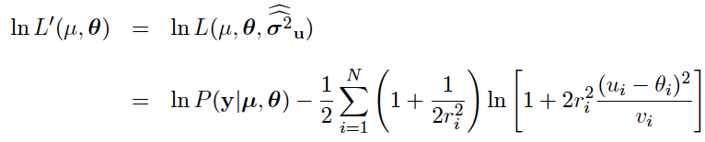
Profiling over systematic errors
We can profile over the σ_{u,i} in closed form
which gives the profile log-likelihood (up to additive const.)
In limit of small r_{i} and v_{i} → σ_{u,i}², the log terms revert back to the
quadratic form seen with known σ_{u,i}.

Slide 34




Equivalent likelihood from Student’s t
We can arrive at same likelihood by defining
Since u_{i} ~ Gauss and v_{i} ~ Gamma, z_{i} ~ Student’s t
with
Resulting likelihood same as profile Lʹ(μ,θ) from gamma model

Slide 35
Statistical Data Analysis
Lecture 11-4
Statistical models with uncertain error parameters (part 2)
Recall the profile likelihood from Lecture 11-3:

Slide 36
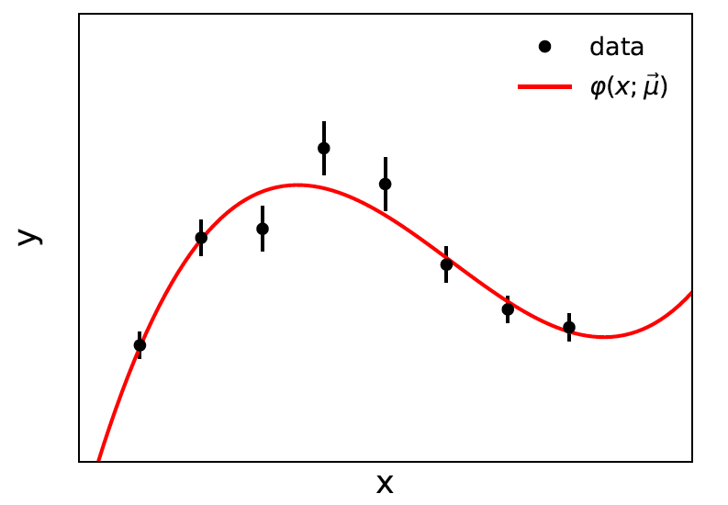


Curve fitting, averages
Suppose independent
y_{i} ~ Gauss, i = 1,...,N, with
(known).
μ are the parameters of interest in the fit function φ(x;μ),
θ are bias parameters constrained by control measurements
u_{i} ~ Gauss(θ_{i}, σ_{u,i}), so that if σ_{u,i} are known we have

Slide 37

Profiling over θ_{i} with known σ_{u,i}
Profiling over the bias parameters θ_{i} for known σ_{u,i} gives usual least-squares (BLUE)
Widely used technique for curve fitting in Particle Physics.
Generally in real measurement, u_{i} = 0.
Generalized to case of correlated y_{i} and u_{i} by summing
statistical and systematic covariance matrices.

Slide 38

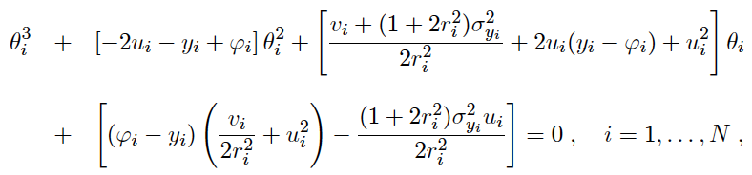
Curve fitting with uncertain σ_{u,i}
Suppose now σ_{u,i}² are adjustable parameters with gamma distributed estimates v_{i}.
Retaining the θ_{i} but profiling over σ_{u,i}² gives
Profiled values of θ_{i} from solution to cubic equations:

Slide 39


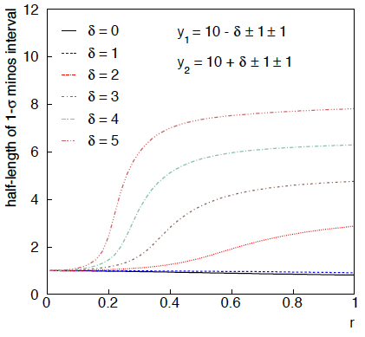
Example: average of two measurements
Approximate (”MINOS”) confidence interval based on
with
Increased discrepancy
between values to be
averaged gives larger
interval.
Interval length saturates
at ~level of absolute
discrepancy between
input values.
relative error
on sys. error

Slide 40
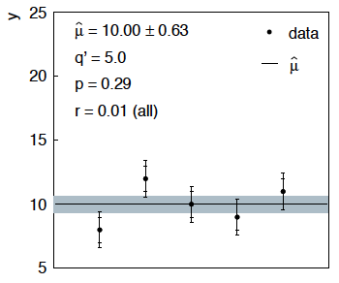
Sensitivity of average to outliers
Suppose we average 5 values, y = 8, 9, 10, 11, 12, all with
stat. and sys. errors of 1.0, and suppose negligible error on error
(here take r = 0.01 for all).
inner error bars
= σ_{y,i}
outer error bars
= (σ_{y,i}² + σ_{u,i}²)^{½}

Slide 41
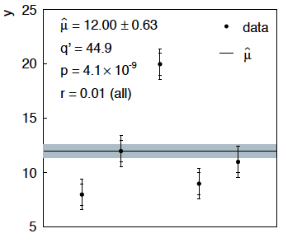
Sensitivity of average to outliers (2)
Now suppose the measurement at 10 had come out at 20:
“outlier”
Estimate pulled up to 12.0, size of confidence interval ~unchanged
(would be exactly unchanged with r → 0).

Slide 42
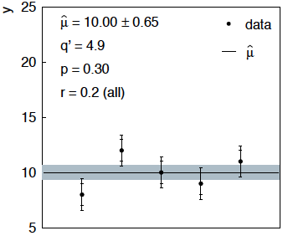
Average with all r = 0.2
If we assign to each measurement r = 0.2,
Estimate still at 10.00, size of interval moves 0.63 → 0.65

Slide 43
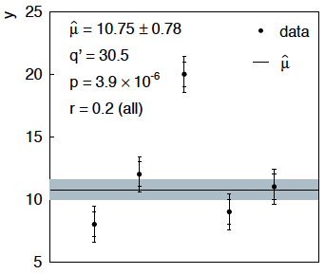
Average with all r = 0.2 with outlier
Same now with the outlier (middle measurement 10 → 20)
Estimate →10.75 (outlier pulls much less).
Half-size of interval → 0.78 (inflated because of bad g.o.f.).

Slide 44


Discussion / Conclusions
Gamma model for variance estimates gives confidence intervals
that increase in size when the data are internally inconsistent,
and gives decreased sensitivity to outliers (known property of
Student’s t based regression).
Equivalence with Student’s t model, ν = 1/2r² degrees of freedom.
Simple profile likelihood – quadratic terms replaced by logarithmic:

Slide 45
Discussion / Conclusions (2)
Asymptotics can break for increased error-on-error, may need
Bartlett correction, higher-order asymptotics or MC.*
Method assumes that meaningful r_{i} values can be assigned and is valuable when systematic errors are not well known but enough “expert knowledge” is available to do so.
Alternatively one could try to fit a global r to all systematic
errors, analogous to PDG scale factor method or meta-analysis
à la DerSimonian and Laird. (→ future work).
Could also use e.g. as “stress test” – crank up the r_{i} values until significance of result degrades and ask if you really trust the assigned systematic errors at that level.
* Ongoing studies with Enzo Canonero and Alessandra Brazzale

Slide 46
Extra Slides

Slide 47





Single-measurement model
As a simplest example consider
y ~ Gauss(μ, σ²),
v ~ Gamma(α, β),
Test values of μ with t_{μ} = -2 ln λ(μ) with

Slide 48
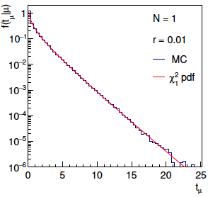
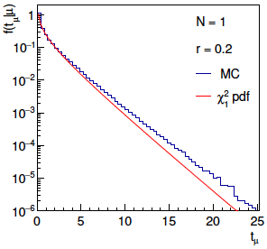
Distribution of t_{μ}
From Wilks’ theorem, in the asymptotic limit we should
find t_{μ} ~ chi-squared(1).
Here “asymptotic limit” means all estimators ~Gauss, which
means r → 0. For increasing r, clear deviations visible:

Slide 49
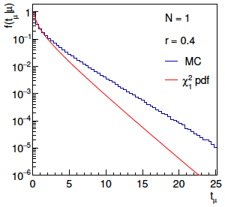
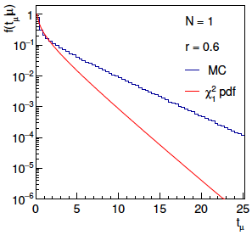
Distribution of t_{μ} (2)
For larger r, breakdown of asymptotics gets worse:
Values of r ~ several tenths are relevant so we cannot in general
rely on asymptotics to get confidence intervals, p-values, etc.

Slide 50

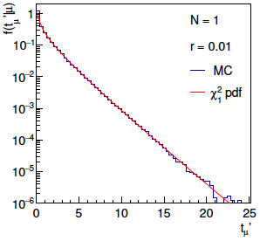
Bartlett corrections
One can modify t_{μ} defining
such that the new statistic’s distribution is better approximated
by chi-squared for n_{d} degrees of freedom (Bartlett, 1937).
For this example E[t_{μ}] ≈ 1 + 3r² + 2r⁴ works well:

Slide 51
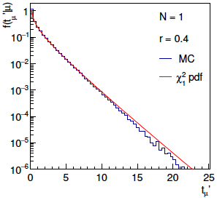
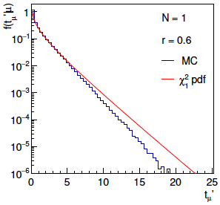
Bartlett corrections (2)
Good agreement for r ~ several tenths out to √t_{μ}ʹ ~ several, i.e.,
good for significances of several sigma:

Slide 52
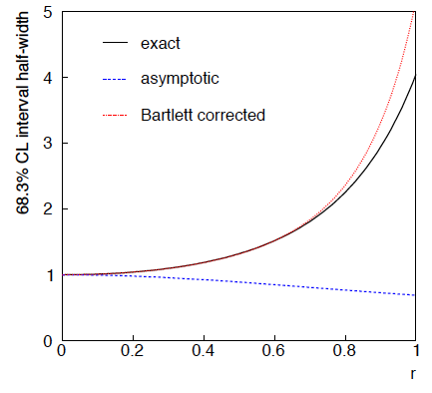
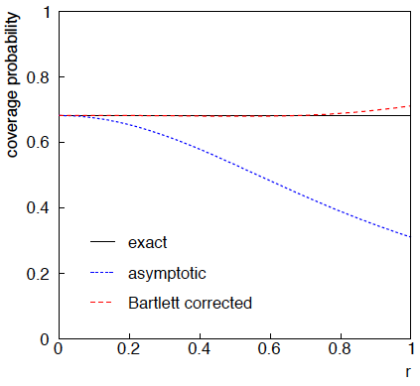
68.3% CL confidence interval for μ

Slide 53


Goodness of fit
Can quantify goodness of fit with statistic
where Lʹ (φ,θ) has an adjustable φ_{i} for each y_{i} (the saturated
model).
Asymptotically should have q ~ chi-squared(N−M).
For increasing r_{i}, may need Bartlett correction or MC.

Slide 54
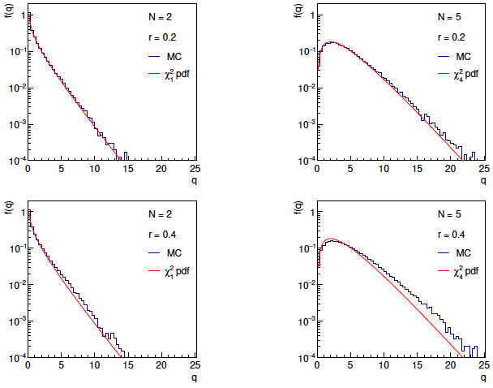
Distributions of q

Slide 55
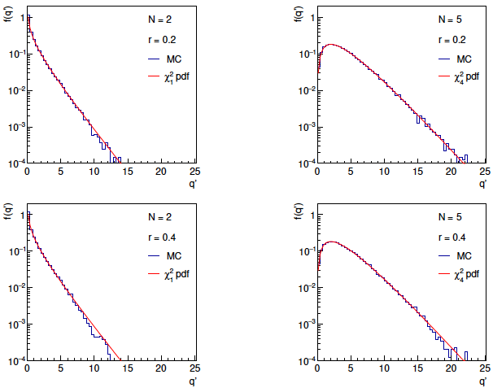
Distributions of Bartlett-corrected qʹ

Slide 56
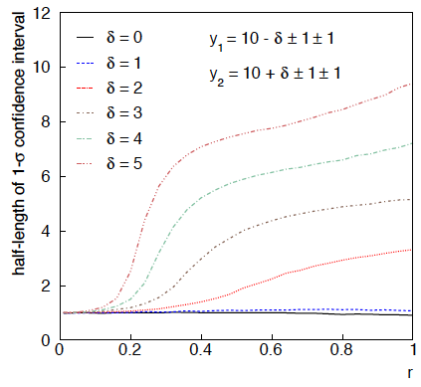
Same with interval from p_{μ} = α with nuisance parameters profiled at μ

Slide 57
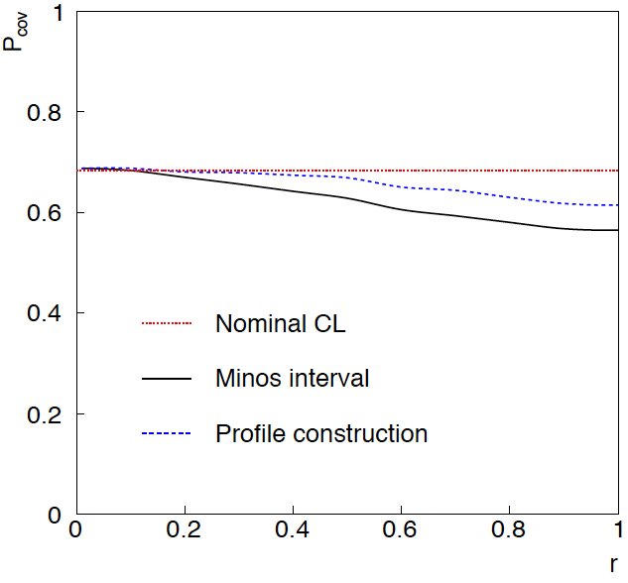
Coverage of intervals
Consider previous average of
two numbers but now generate
for i = 1, 2 data values
y_{i} ~ Gauss(μ, σ_{y,i})
u_{i} ~ Gauss(0, σ_{u,i})
v_{i} ~ Gamma(σ_{u,i}, r_{i})
σ_{y,i} = σ_{u,i} = 1
and look at the probability
that the interval covers the
true value of μ.
Coverage stays reasonable
to r ~ 0.5, even not bad
for Profile Construction
out to r ~ 1.

Slide 58



Naive approach to errors on errors
Naively one might think that the error on the error in the previous
example could be taken into account conservatively by inflating
the systematic errors, i.e.,
But this gives
without outlier (middle meas. 10)
with outlier (middle meas. 20)
So the sensitivity to the outlier is not reduced and the size of the
confidence interval is still independent of goodness of fit.

Slide 59

Correlated uncertainties
The phrase “correlated uncertainties” usually means that a single
nuisance parameter affects the distribution (e.g., the mean) of more
than one measurement.
For example, consider measurements y, parameters of interest μ,
nuisance parameters θ with
That is, the θ_{i} are defined here as contributing to a bias and
the (known) factors R_{ij} determine how much θ_{j} affects y_{i}.
As before suppose one has independent control measurements
u_{i}~ Gauss(θ_{i}, σ_{ui}).

Slide 60



Correlated uncertainties (2)
The total bias of y_{i} can be defined as
which can be estimated with
These estimators are correlated having covariance
In this sense the present method treats “correlated uncertainties”,
i.e., the control measurements u_{i} are independent, but nuisance
parameters affect multiple measurements, and thus bias estimates
are correlated.

