Slide 1


Statistical Data Analysis 2022/23
Lecture Week 2
London Postgraduate Lectures on Particle Physics
University of London MSc/MSci course PH4515
Glen Cowan
Physics Department
Royal Holloway, University of London
g.cowan@rhul.ac.uk
www.pp.rhul.ac.uk/~cowan
Course web page via RHUL moodle (PH4515) and also
www.pp.rhul.ac.uk/~cowan/stat_course.html

Slide 2
Statistical Data Analysis
Lecture 2-1
Functions of random variables
  Single variable, unique inverse
  Function without unique inverse
  Functions of several random variables

Slide 3


Functions of a random variable
A function of a random variable is itself a random variable.
Suppose x follows a pdf f (x)
Consider a function a(x)
What is the pdf g(a)?

Slide 4
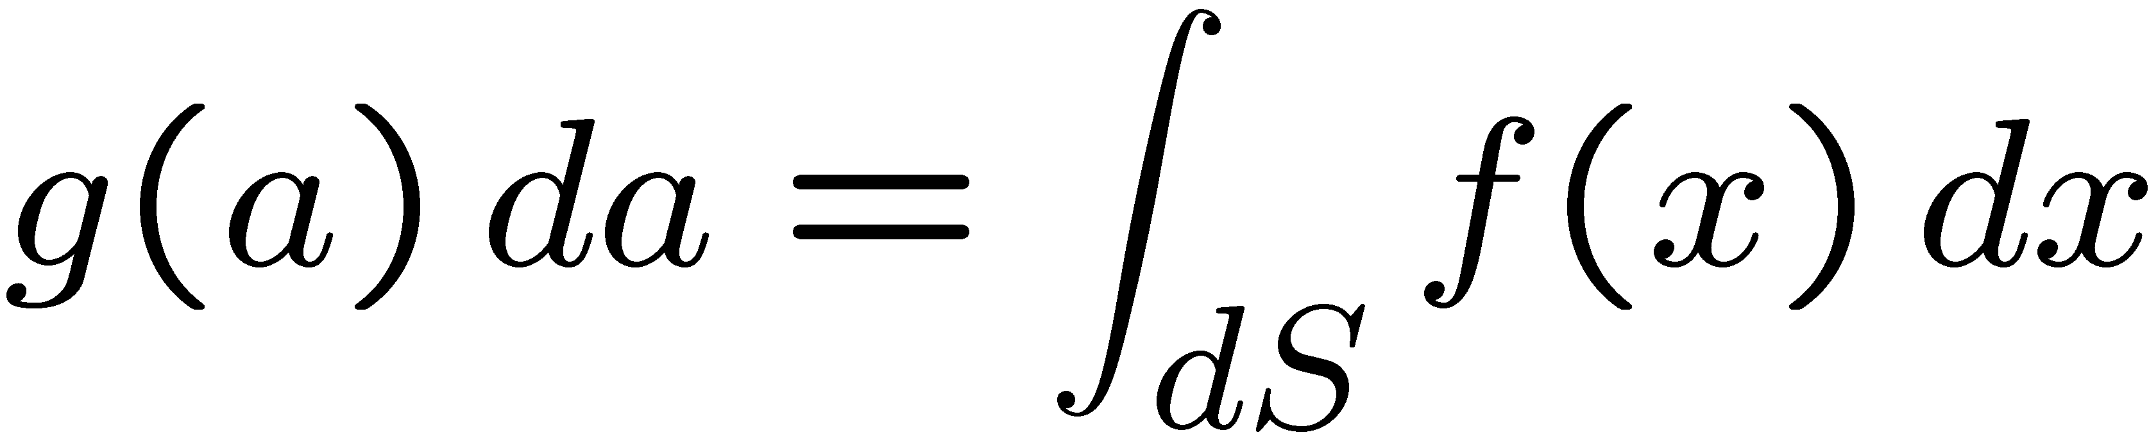
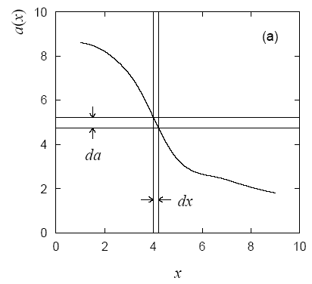
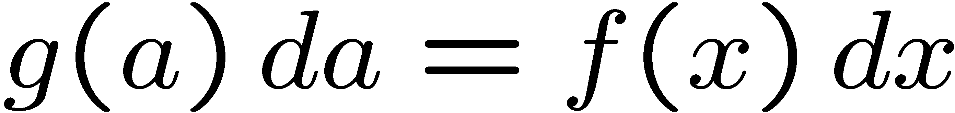
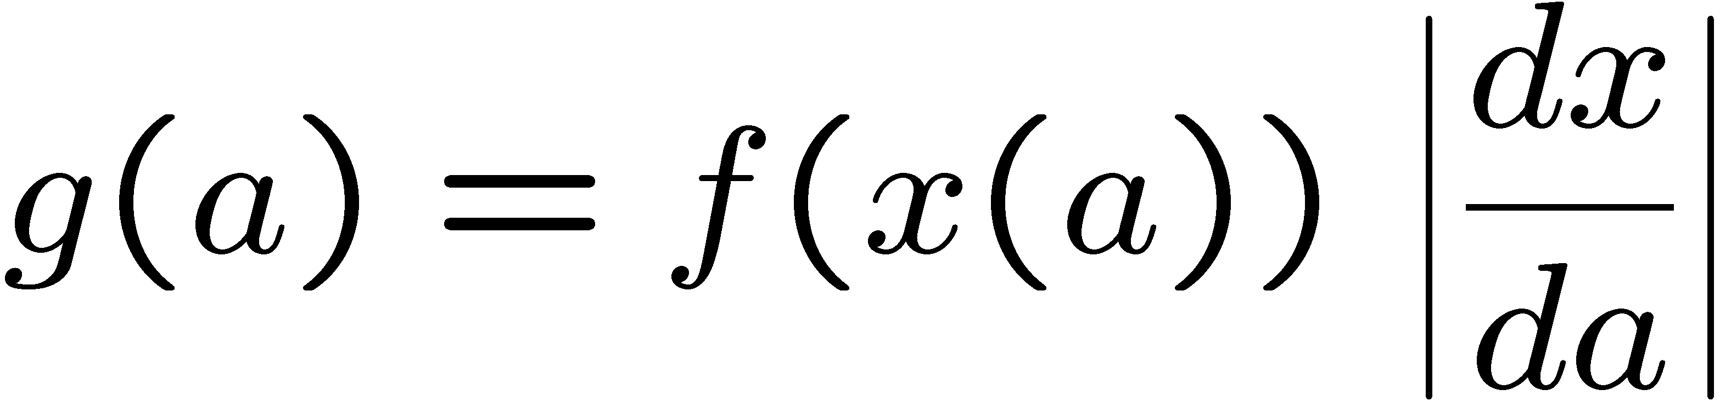
Function of a single random variable
General prescription:
dS = region of x space for which a is in [a, a+da].
For one-variable case with unique
inverse this is simply
→

Slide 5



Example: function with unique inverse

Slide 6
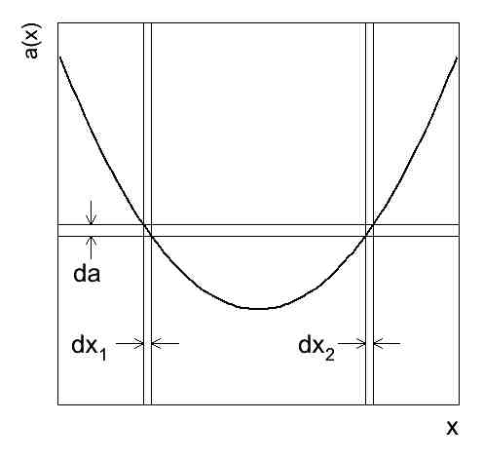
Functions without unique inverse
If inverse of a(x) not unique,
include all dx intervals in dS
which correspond to da:
x₁
x₂
Example:

Slide 7
Change of variable example (cont.)
Suppose the pdf of x is
and we consider the function
(so 0 ≤ a ≤ 1)
and the inverse has two parts:
To get the pdf of a we include the contributions from both parts:

Slide 8
Functions of more than one random variable
Consider a vector r.v. x = (x₁, ..., x_{n}) that follows f (x₁, ..., x_{n})
and consider a scalar function a(x).
The pdf of a is found from
dS = region of x-space between (hyper)surfaces defined by

Slide 9
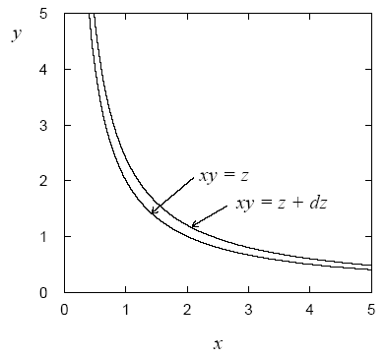
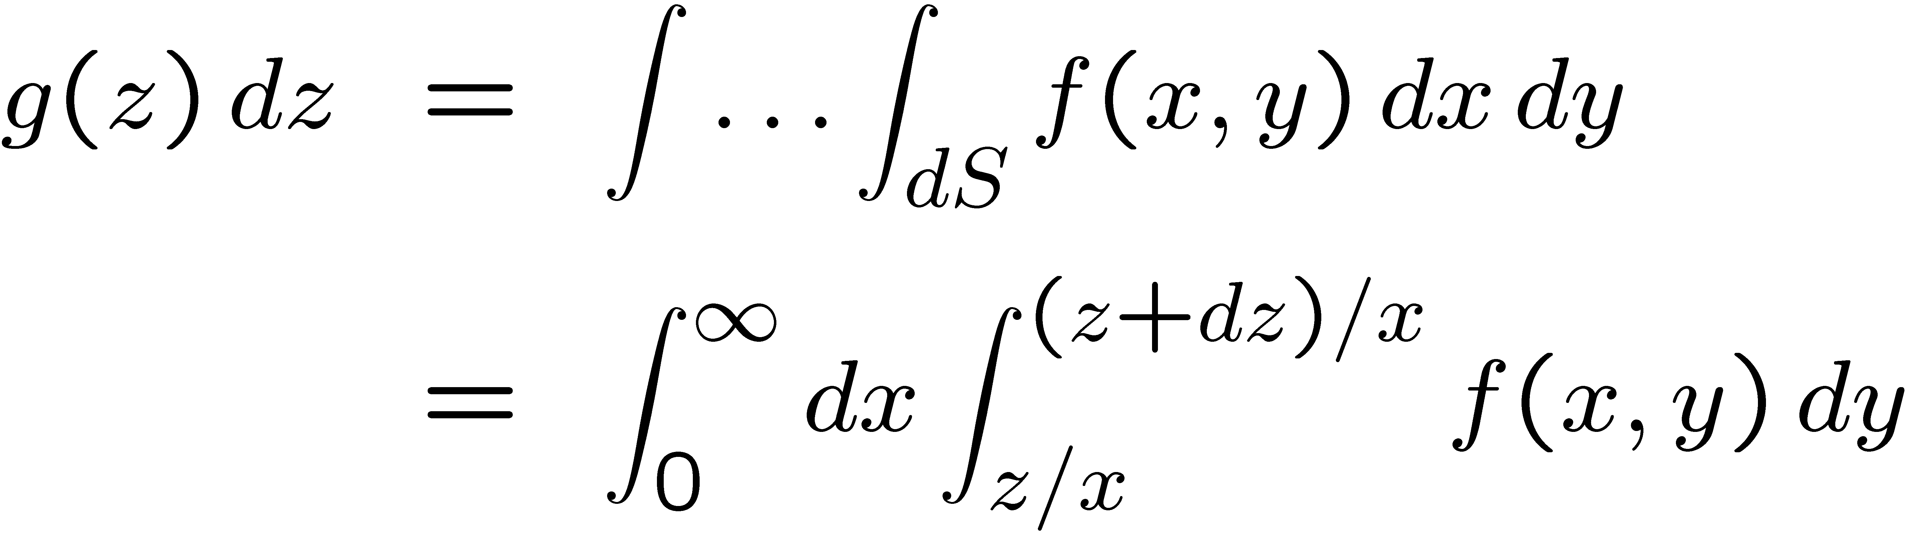
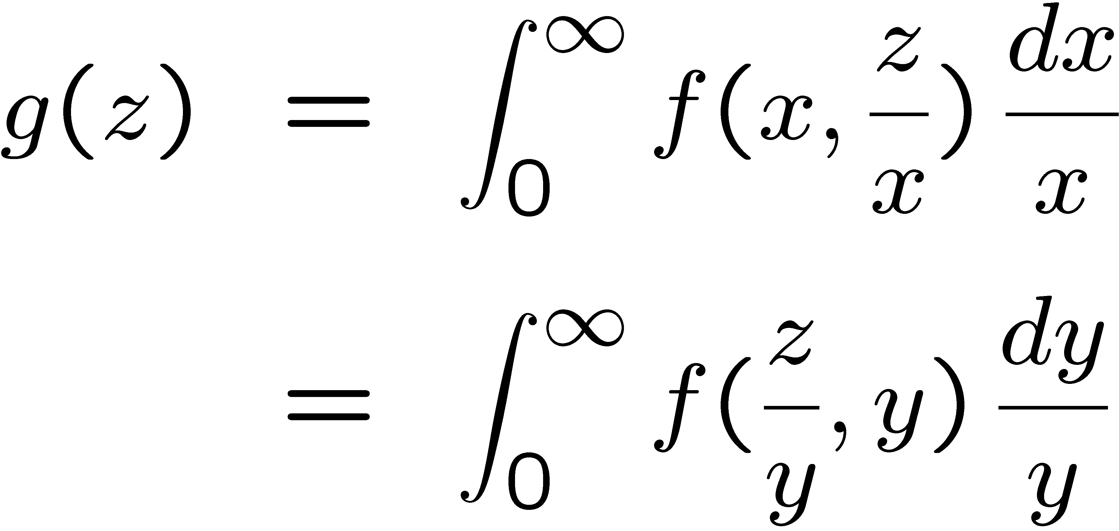
Functions of more than one r.v. (2)
Example: r.v.s x, y > 0 follow joint pdf f (x,y),
consider the function z = xy. What is g(z)?
→
(Mellin convolution)

Slide 10
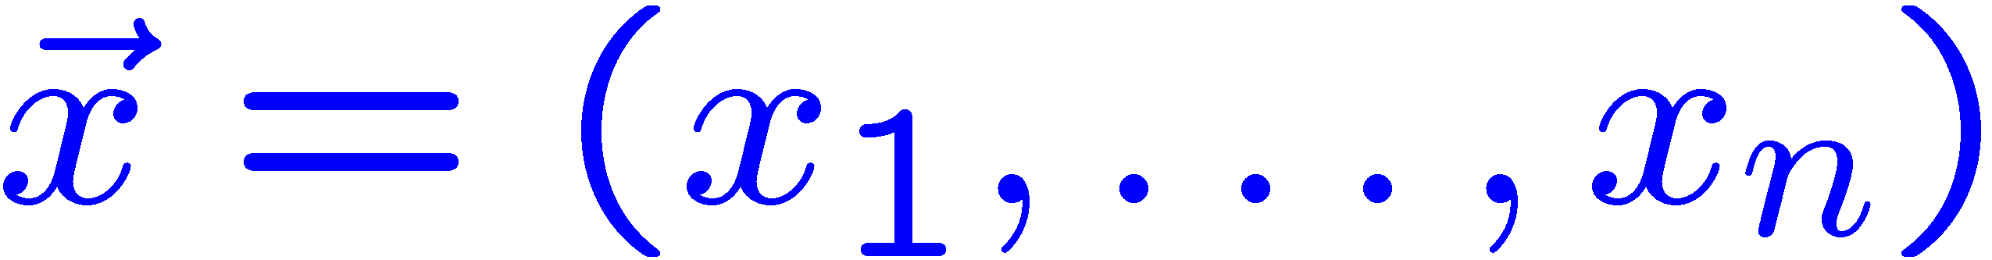

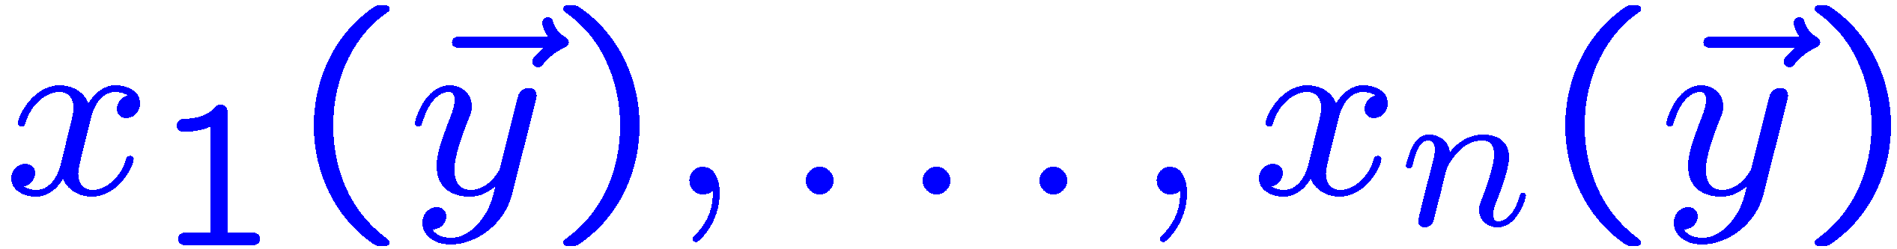
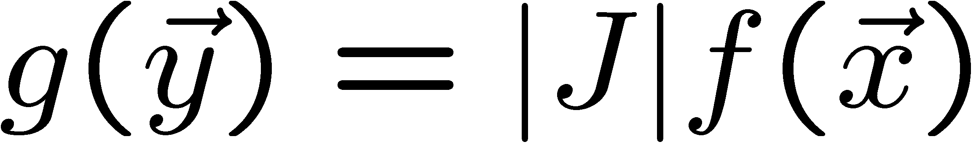
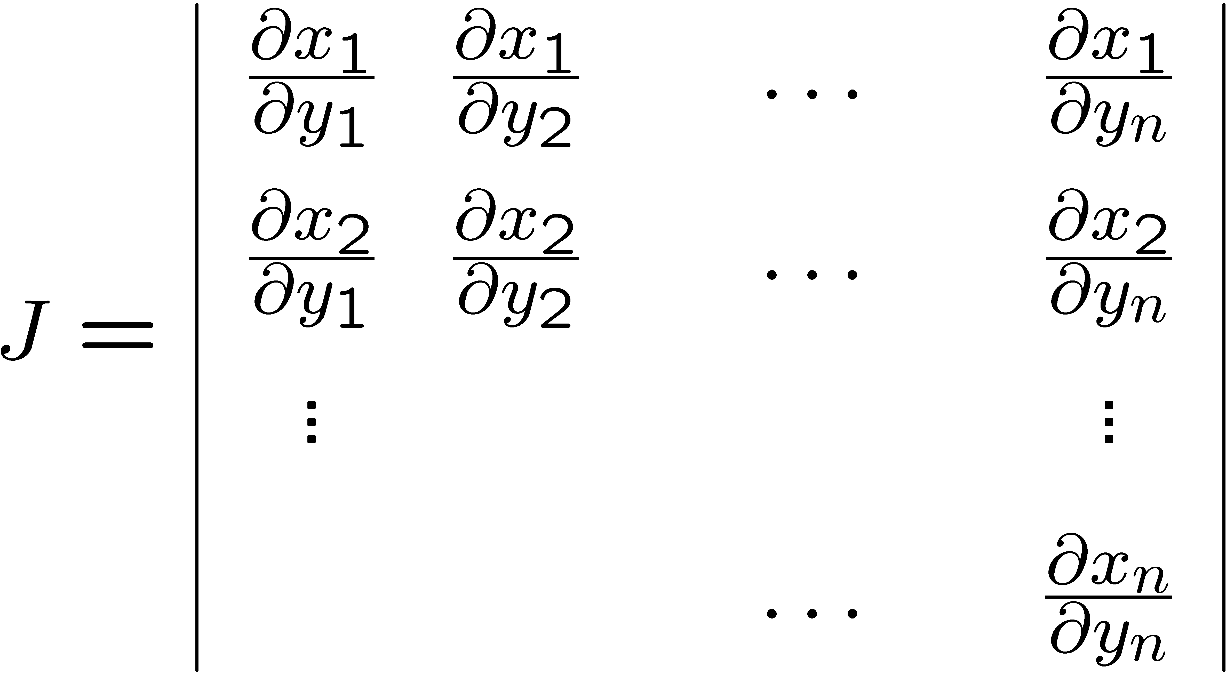
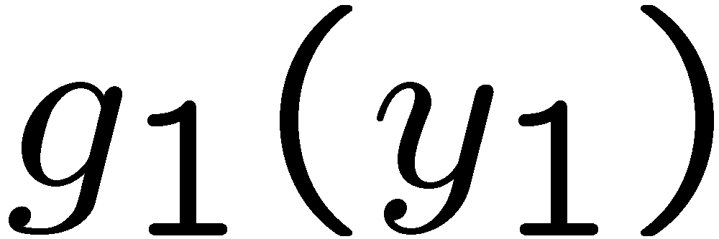
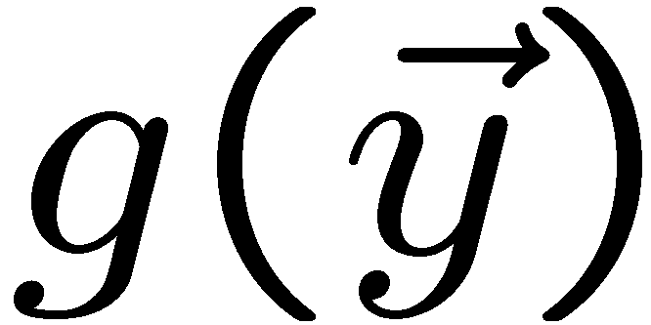
More on transformation of variables
Consider a random vector
with joint pdf
Form n linearly independent functions
for which the inverse functions
exist.
Then the joint pdf of the vector of functions is
where J is the
Jacobian determinant:
For e.g.
integrate
over the unwanted components.

Slide 11
Statistical Data Analysis
Lecture 2-2
Expectation values
Covariance and correlation

Slide 12
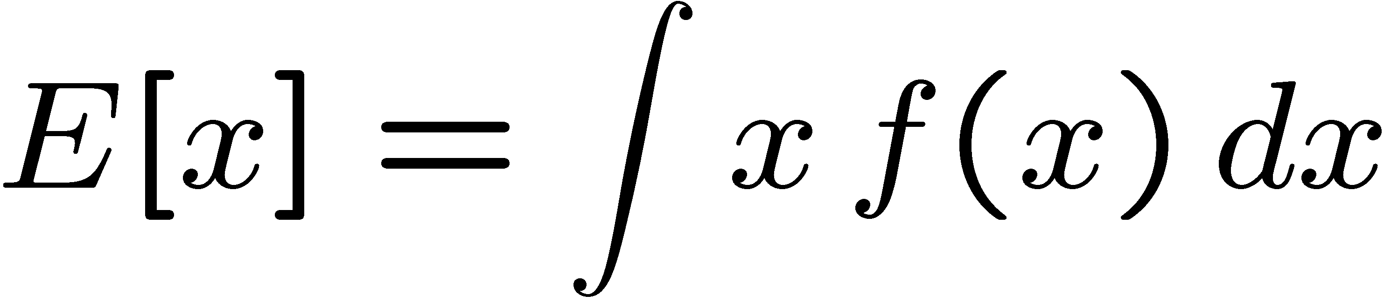

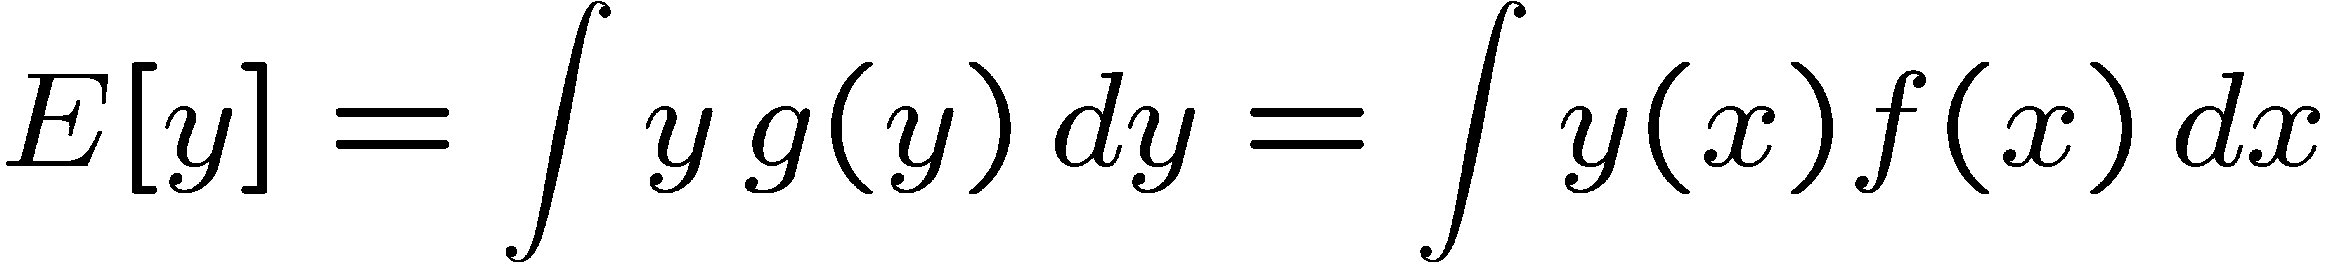

Expectation values
Consider continuous r.v. x with pdf f (x).
Define expectation (mean) value as
Notation (often): ~ “centre of gravity” of pdf.
For discrete r.v.s, replace integral by sum:
For a function y(x) with pdf g(y),
(equivalent)

Slide 13
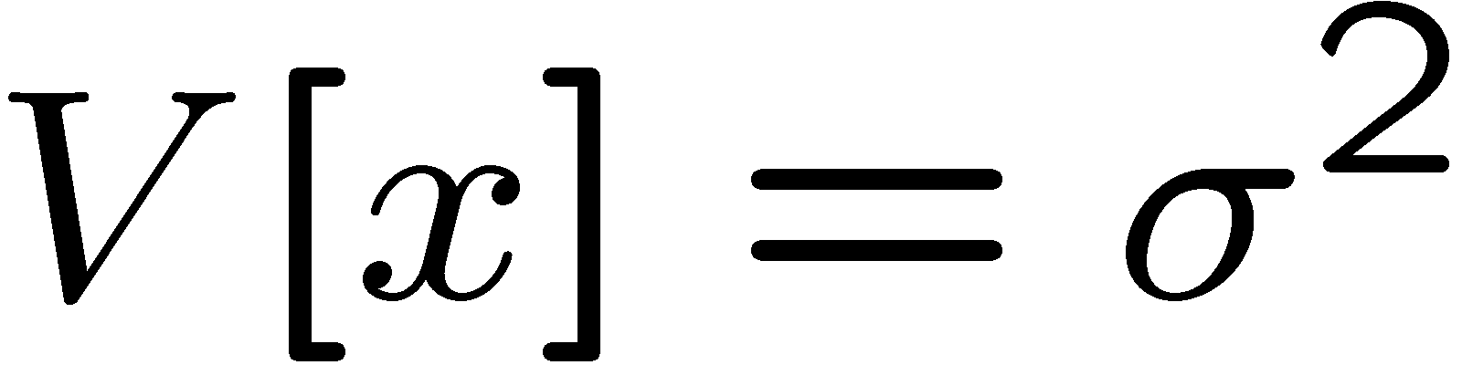
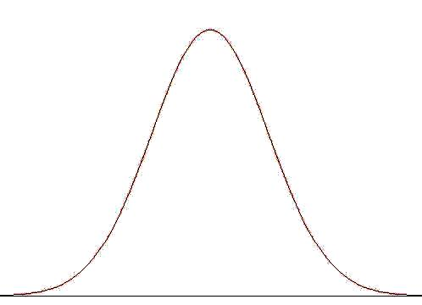
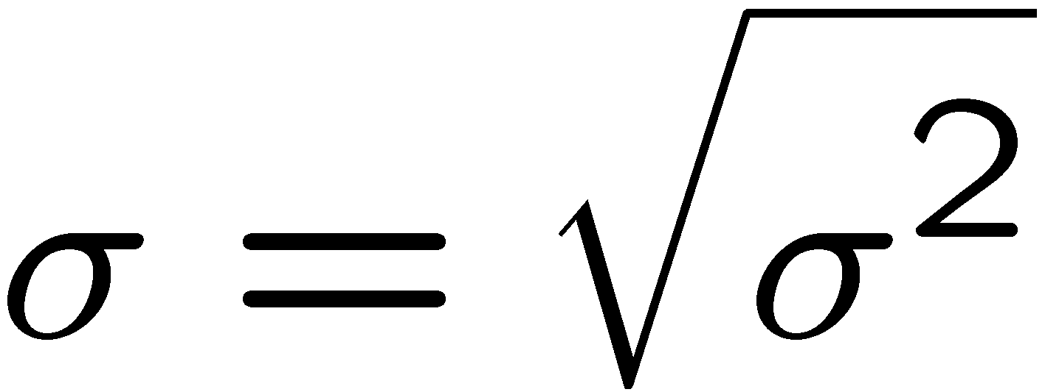


Variance, standard deviation
Variance:
Notation:
Standard deviation:
σ ~ width of pdf, same units as x.
Relation between σ and other measures of width, e.g.,
Full Width at Half Max (FWHM) depend on the pdf, e.g.,
FWHM = 2.35σ for Gaussian.

Slide 14
Moments of a distribution
Can characterize shape of a pdf with its moments:
= nth algebraic moment, e.g., μ’₁ = μ (the mean)
= nth central moment, e.g., μ₂ = σ ²
Zeroth moment = 1 (always). Higher moments may not exist.
3rd moment is a measure of “skewness”:

Slide 15
Expectation values – multivariate case
Suppose we have a 2-D joint pdf f (x,y).
By “expectation value of x” we mean:
Sometimes it is useful to consider e.g. the conditional expectation
value of x given y,

Slide 16
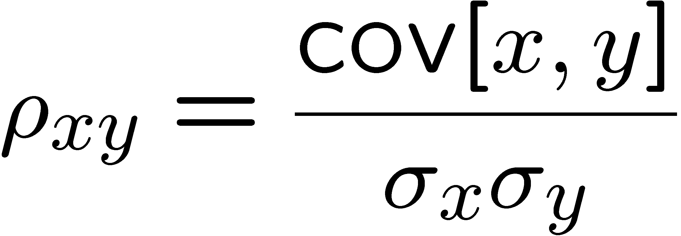
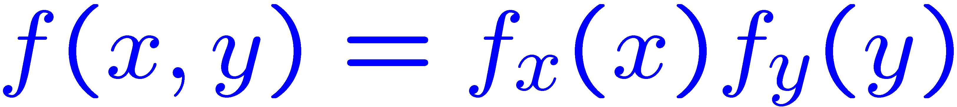
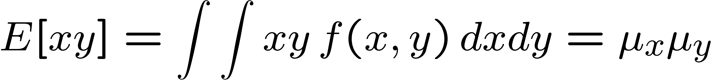

Covariance and correlation
Define covariance cov[x,y] (also use matrix notation V_{xy}) as
Correlation coefficient (dimensionless) defined as
Can show −1 ≤ ρ ≤ 1.
If x, y, independent, i.e.,
, then
→
x and y, ‘uncorrelated’
N.B. converse not always true.

Slide 17
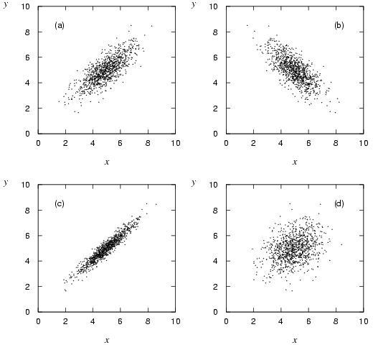
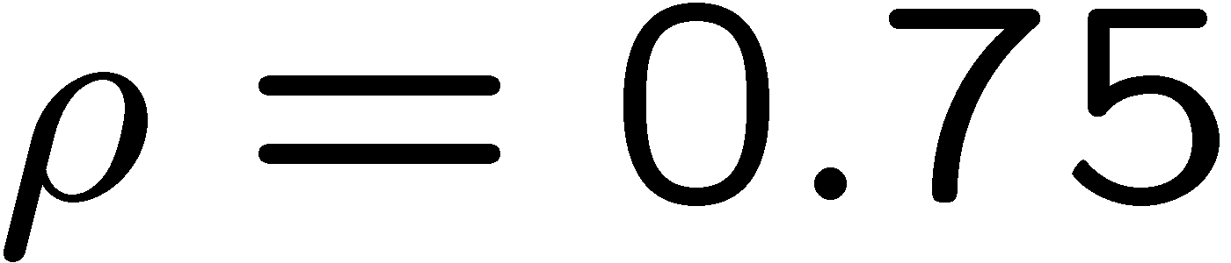
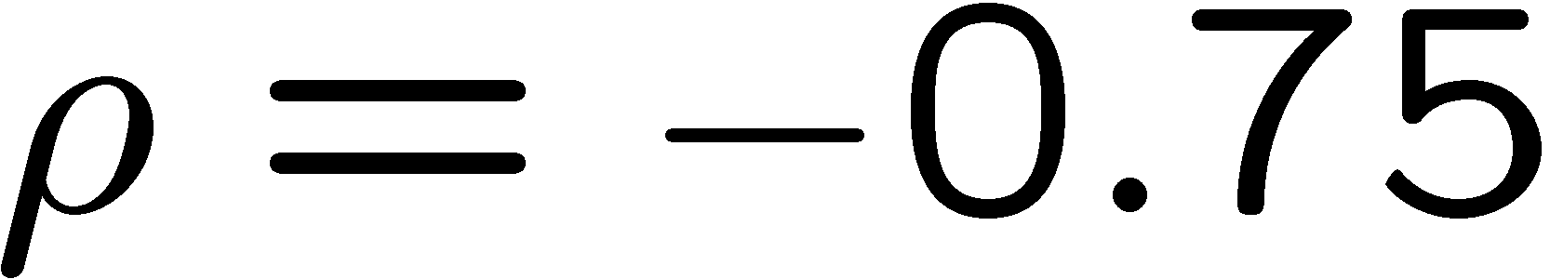
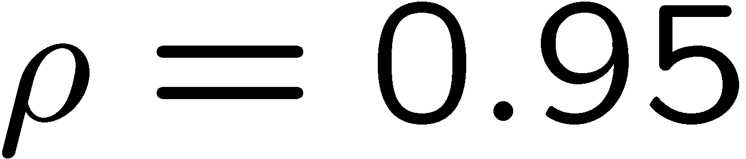
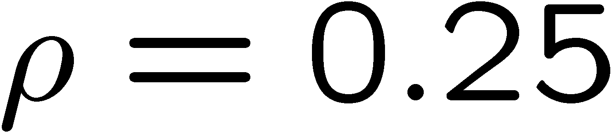
Correlation (cont.)

Slide 18
Covariance matrix
Suppose we have a set of n random variables, say, x₁,..., x_{n}.
We can write the covariance of each pair as an n x n matrix:
Covariance matrix is:
symmetric,
diagonal = variances,
positive semi-definite:

Slide 19
Correlation matrix
Closely related to the covariance matrix is the n x n matrix of correlation coefficients:
By construction, diagonal
elements are ρ_{ii} = 1

Slide 20





Correlation vs. independence
Consider a joint pdf such as:
I.e. here f (−x,y) = f (x,y)
Because of the symmetry, we have E[x] = 0 and also
and so ρ = 0, the two variables x and y are uncorrelated.
But f (y|x) clearly depends on x, so x and y are not independent.
Uncorrelated: the joint density of x and y is not tilted.
Independent: imposing x does not affect conditional pdf of y.

Slide 21
Statistical Data Analysis
Lecture 2-3
Error propagation
  goal: find variance of a function
  derivation of formula
  limitations
  special cases

Slide 22



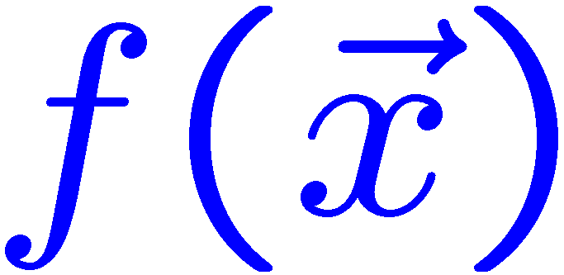

Error propagation
Suppose we measure a set of values
and we have the covariances
which quantify the measurement errors in the x_{i}.
Now consider a function
What is the variance of
The hard way: use joint pdf
to find the pdf
then from g(y) find V[y] = E[y²] − (E[y])².
Often not practical,
may not even be fully known.

Slide 23
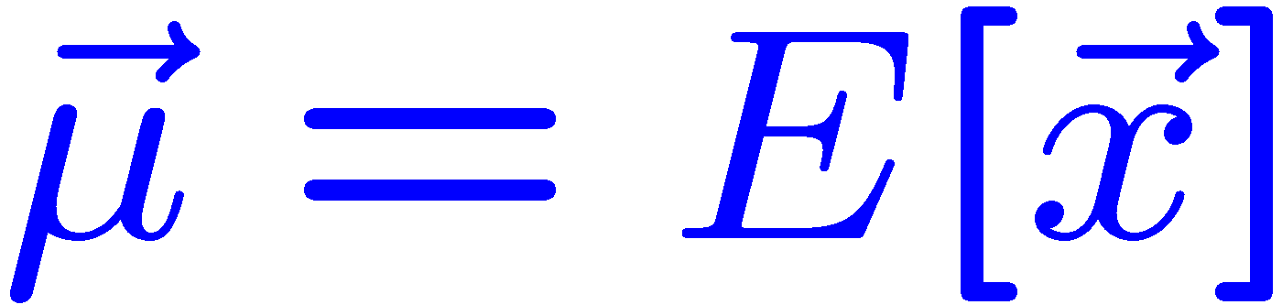
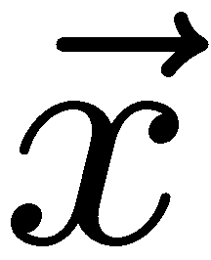
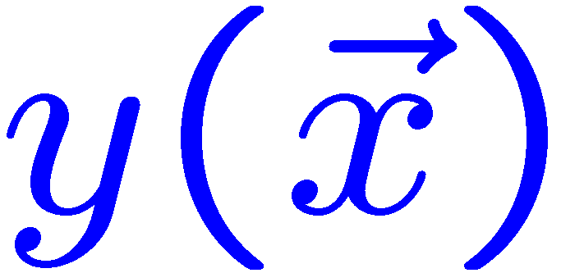

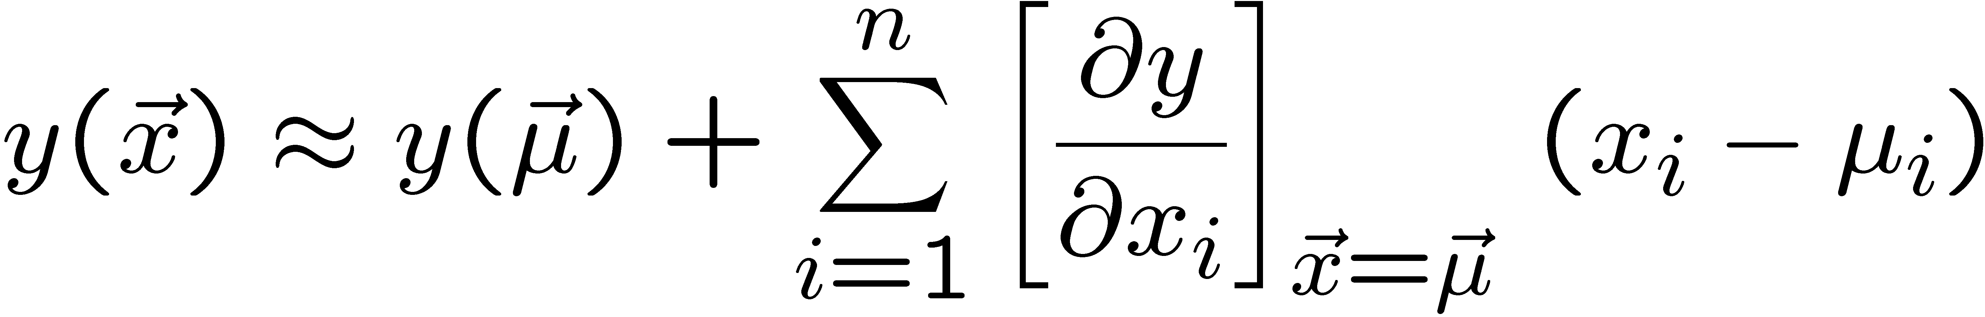
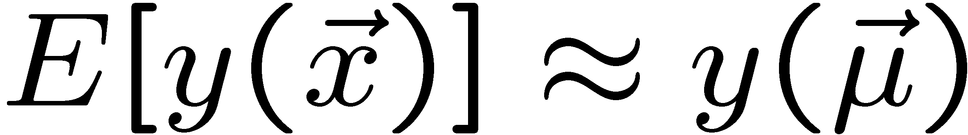

Error propagation formula (1)
Suppose we had
in practice only estimates given by the measured
Expand
to 1st order in a Taylor series about
To find V[y] we need E[y²] and E[y].
since

Slide 24
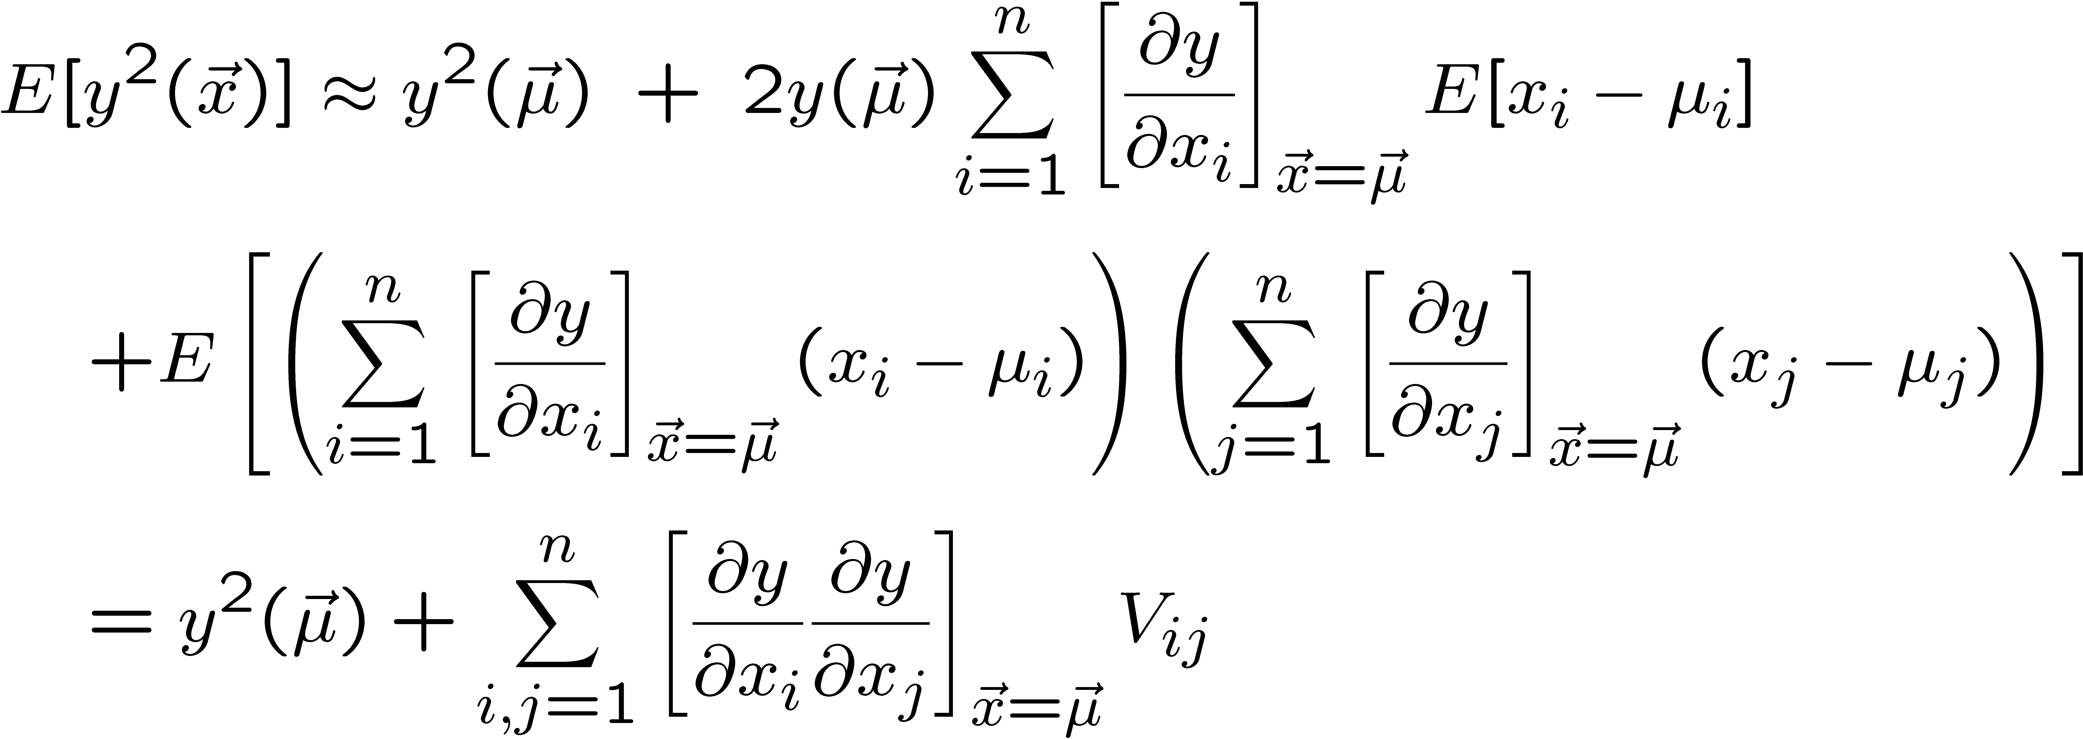
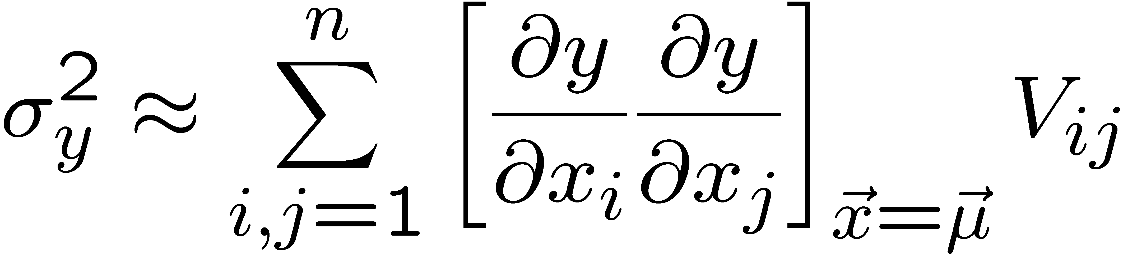
Error propagation formula (2)
Putting the ingredients together gives the variance of

Slide 25
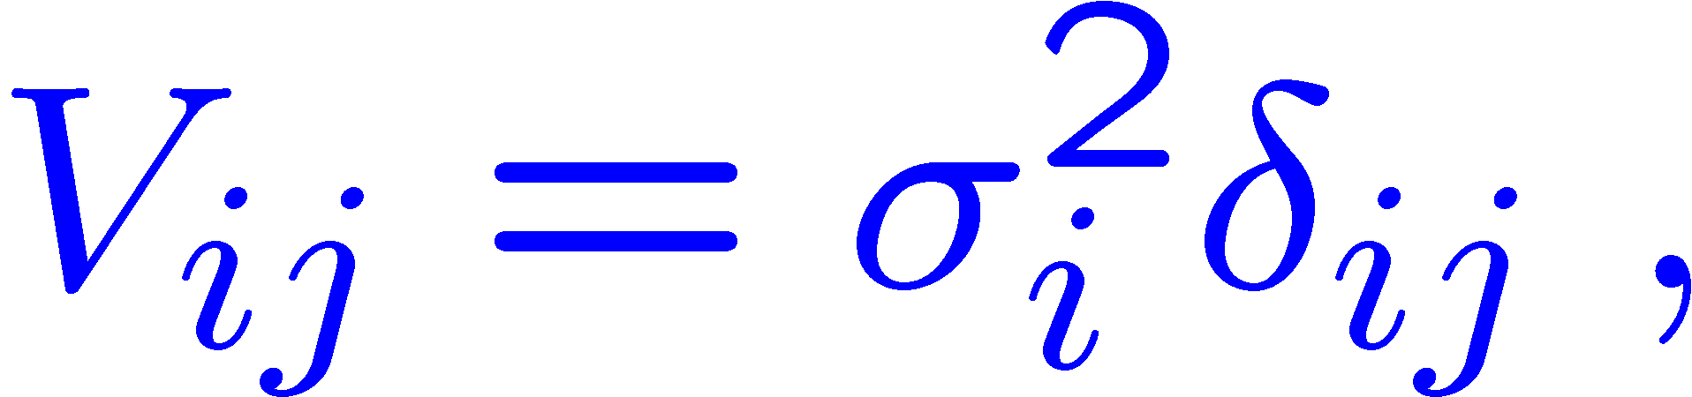
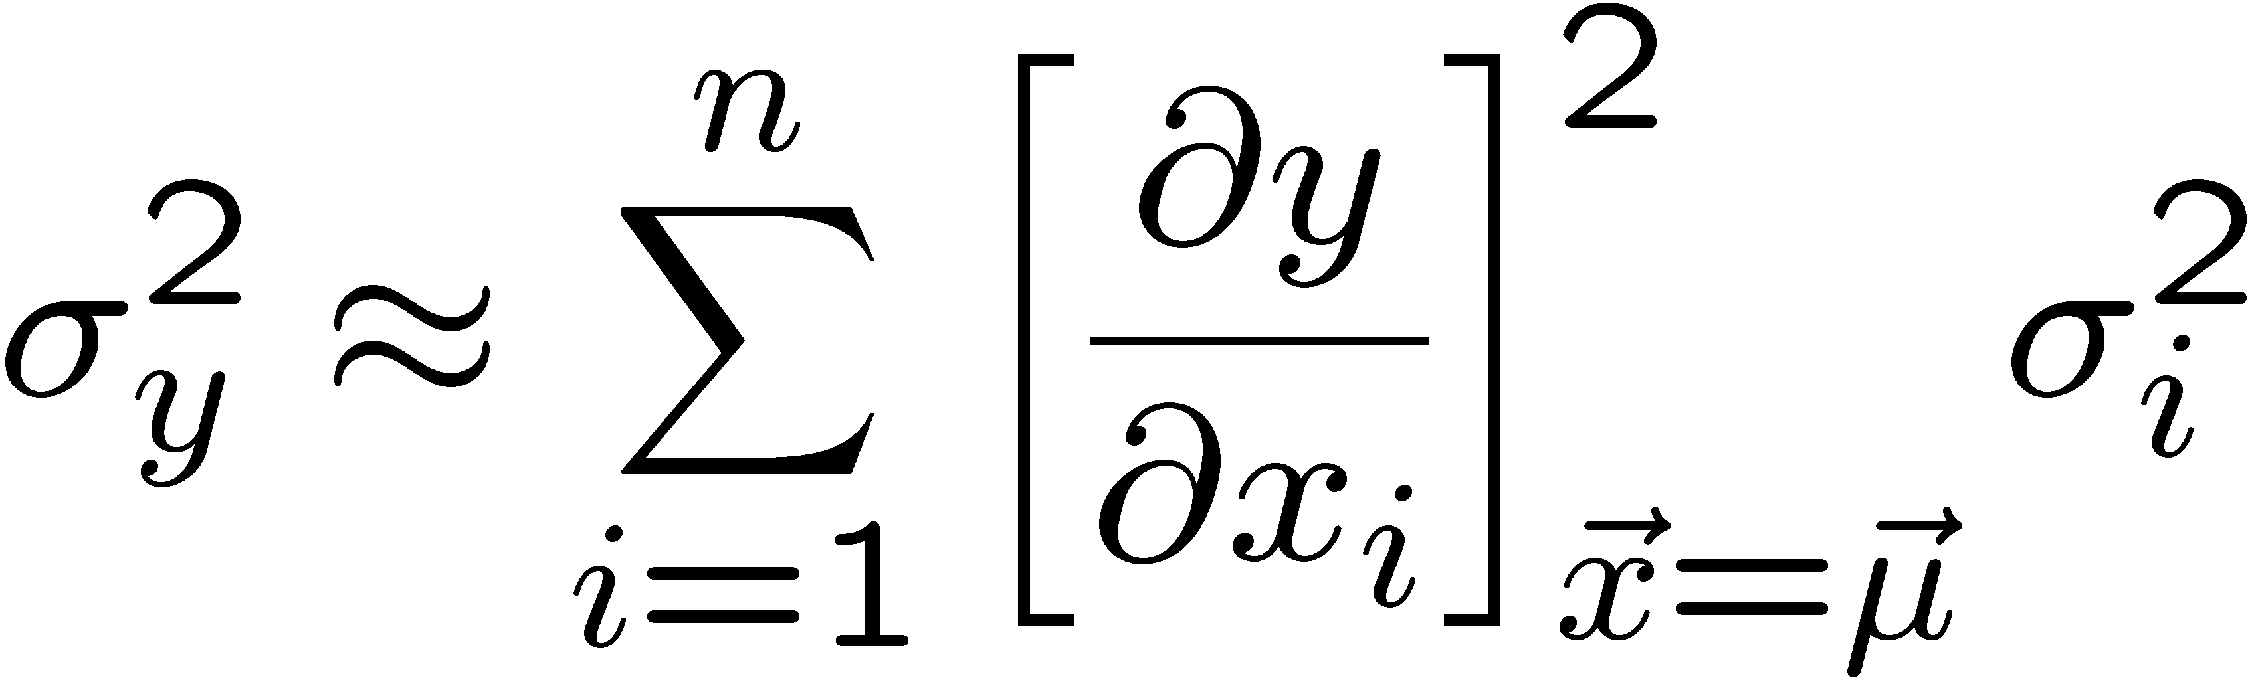
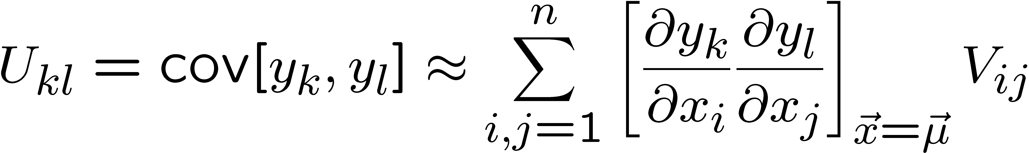
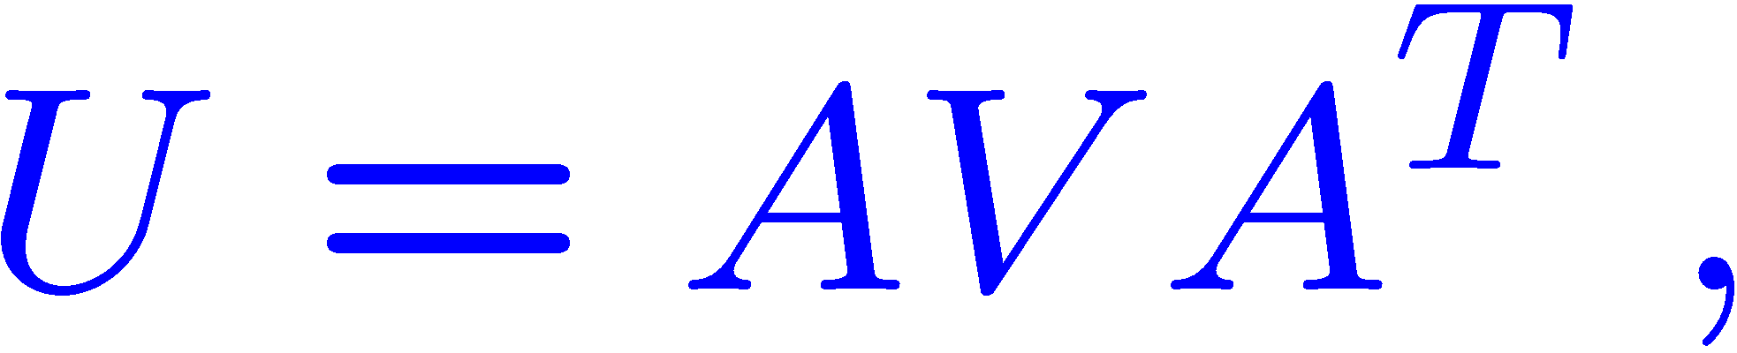
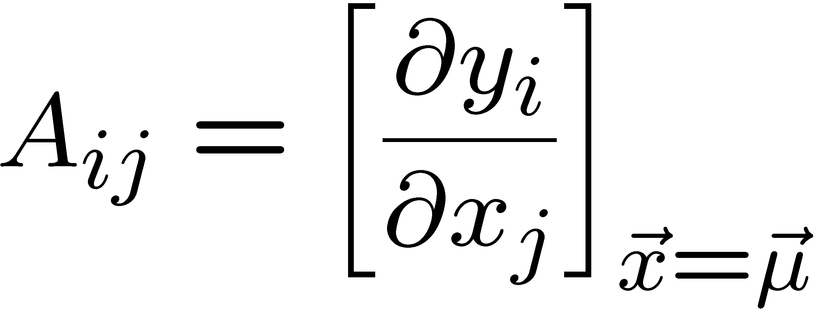
Error propagation formula (3)
If the x_{i} are uncorrelated, i.e.,
then this becomes
Similar for a set of m functions
or in matrix notation
where

Slide 26
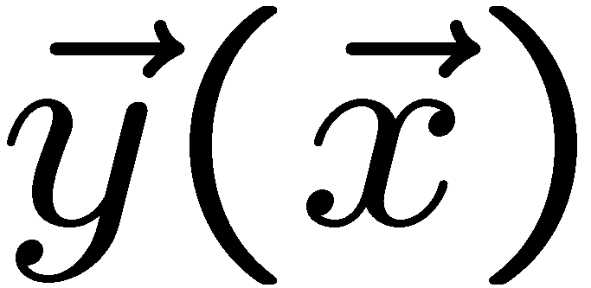
Error propagation – limitations
y(x)
The ‘error propagation’ formulae tell us the
covariances of a set of functions
in terms of
the covariances of the original variables.
σ_{y}
x
σ_{x}
Limitations: exact only if
linear.
y(x)
Approximation breaks down if function
nonlinear over a region comparable
in size to the σ_{i}.
?
x
σ_{x}
N.B. We have said nothing about the exact pdf of the x_{i},
e.g., it doesn’t have to be Gaussian.

Slide 27
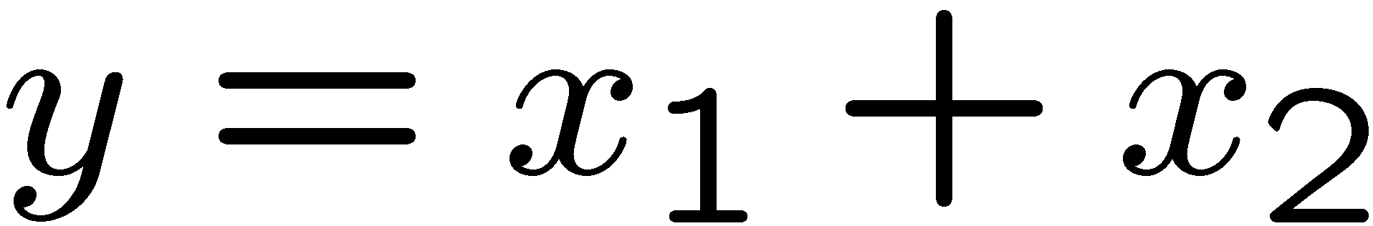
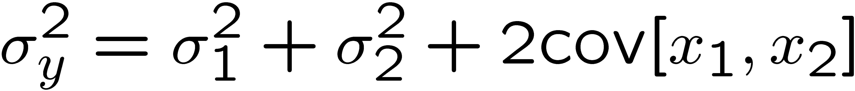
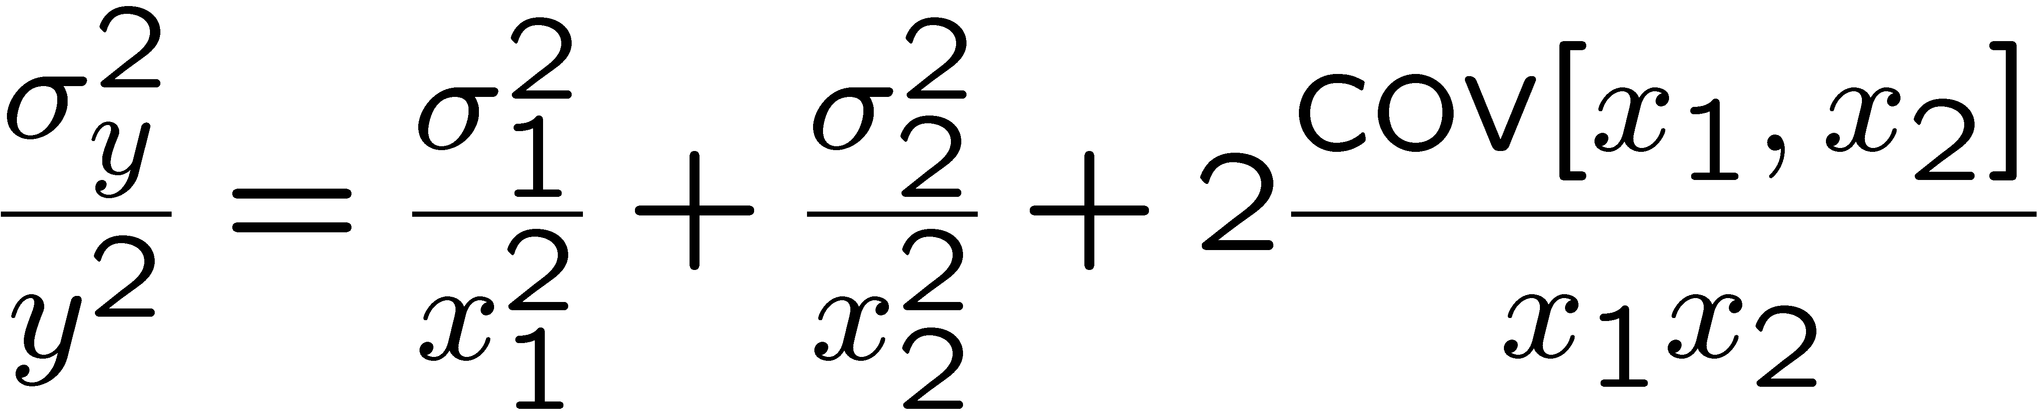


Error propagation − special cases
→
→
That is, if the x_{i} are uncorrelated:
add errors quadratically for the sum (or difference),
add relative errors quadratically for product (or ratio).
But correlations can change this completely...

Slide 28

Error propagation − special cases (2)
Consider
with
Now suppose ρ = 1. Then
i.e. for 100% correlation, error in difference → 0.

Slide 29
Statistical Data Analysis
Lectures 2-4 through 3-2 intro
We will now run through a short catalog of probability functions
and pdfs.
For each (usually) show expectation value, variance,
a plot and discuss some properties and applications.
See also chapter on probability from pdg.lbl.gov
For a more complete catalogue see e.g. the handbook on
statistical distributions by Christian Walck from
staff.fysik.su.se/~walck/suf9601.pdf

Slide 30
Some distributions
Distribution/pdf Example use in Particle Physics
Binomial Branching ratio
Multinomial Histogram with fixed N
Poisson Number of events found
Uniform Monte Carlo method
Exponential Decay time
Gaussian Measurement error
Chi-square Goodness-of-fit
Cauchy Mass of resonance
Landau Ionization energy loss
Beta Prior pdf for efficiency
Gamma Sum of exponential variables
Student’s t Resolution function with adjustable tails

Slide 31
Statistical Data Analysis
Lecture 2-4
Discrete probability distributions
  binomial
  multinomial
  Poisson

Slide 32
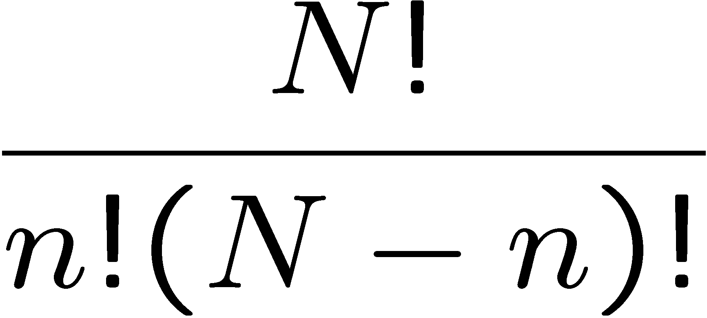
Binomial distribution
Consider N independent experiments (Bernoulli trials):
outcome of each is ‘success’ or ‘failure’,
probability of success on any given trial is p.
Define discrete r.v. n = number of successes (0 ≤ n ≤ N).
Probability of a specific outcome (in order), e.g. ‘ssfsf’ is
But order not important; there are
ways (permutations) to get n successes in N trials, total
probability for n is sum of probabilities for each permutation.

Slide 33
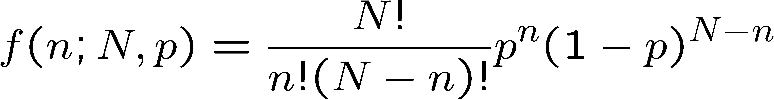
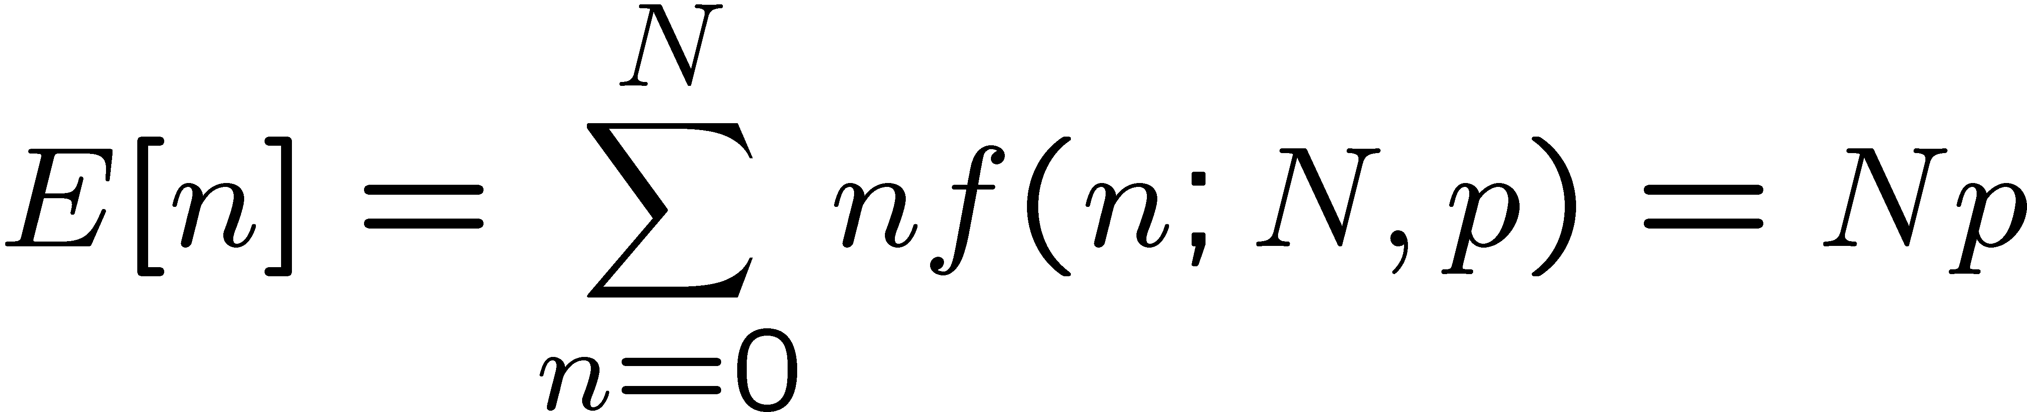
Binomial distribution (2)
The binomial distribution is therefore
random
variable
parameters
For the expectation value and variance we find:

Slide 34
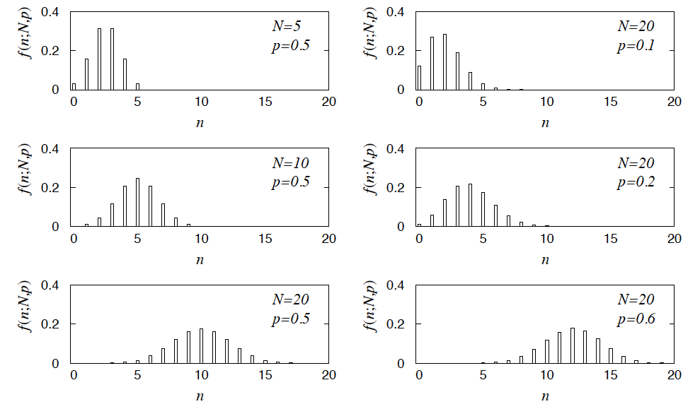
Binomial distribution (3)
Binomial distribution for several values of the parameters:
Example: observe N decays of W±, the number n of which are
W→μν is a binomial r.v., p = branching ratio.

Slide 35
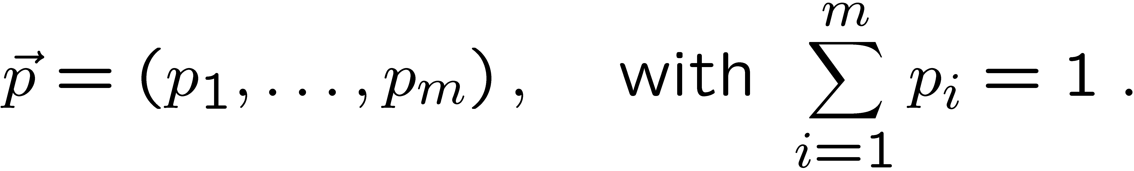
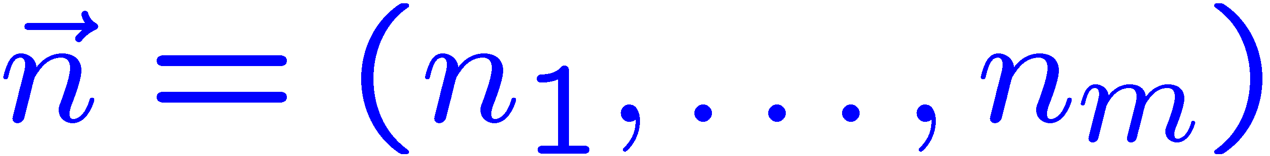

Multinomial distribution
Like binomial but now m outcomes instead of two, probabilities are
For N trials we want the probability to obtain:
n₁ of outcome 1,
n₂ of outcome 2,
⠇
n_{m} of outcome m.
This is the multinomial distribution for

Slide 36

Multinomial distribution (2)
Now consider outcome i as ‘success’, all others as ‘failure’.
→ all n_{i} individually binomial with parameters N, p_{i}
for all i
One can also find the covariance to be
Example:
represents a histogram
with m bins, N total entries, all entries independent.

Slide 37



Poisson distribution
Consider binomial n in the limit
→ n follows the Poisson distribution:
Example: number of scattering events
n with cross section σ found for a fixed
integrated luminosity, with

Slide 38
Extra slides

Slide 39


Example of Poisson distribution: death by horse kick
In the 19th century the Prussian army carefully recorded the number
of cavalry officers killed each year by horse kick.
Number of times per year officer gets near horse = N (very large)
Probability per time of getting killed = p (very small)
Number of deaths in a year n ~ Poisson with mean ν = Np.
Ladislaus von Bortkiewicz, Das Gesetz der kleinen Zahlen [The law of small numbers] (Leipzig, Germany: B.G. Teubner, 1898).

