Slide 1


Statistical Data Analysis 2022/23
Lecture Week 4
London Postgraduate Lectures on Particle Physics
University of London MSc/MSci course PH4515
Glen Cowan
Physics Department
Royal Holloway, University of London
g.cowan@rhul.ac.uk
www.pp.rhul.ac.uk/~cowan
Course web page via RHUL moodle (PH4515) and also
www.pp.rhul.ac.uk/~cowan/stat_course.html

Slide 2
Statistical Data Analysis
Lecture 4-1
Frequentist statistical tests
  Hypotheses
  Definition of a test
    critical region
    size
    power
  Type-I, Type-II errors

Slide 3
Hypotheses
A hypothesis H specifies the probability for the data, i.e., the
outcome of the observation, here symbolically: x.
x could be uni-/multivariate, continuous or discrete.
E.g. write x ~ P (x|H).
x could represent e.g. observation of a single object,
a single event, or an entire “experiment”.
Possible values of x form the sample space S (or “data space”).
Simple (or “point”) hypothesis: P (x|H) completely specified.
Composite hypothesis: H contains unspecified parameter(s).
P (x|H) is also called the likelihood of the hypothesis H, often written L(H) if we want to emphasize just the dependence on H.

Slide 4
Definition of a test
Goal is to make some statement based on the observed data x about the validity of the possible hypotheses (here, “accept or reject”).
Consider a simple hypothesis H₀ (the “null”) and an alternative H₁.
A test of H₀ is defined by specifying a critical region W of the
sample (data) space S such that there is no more than some (small) probability α, assuming H₀ is correct, to observe the data there, i.e.,
P(x ∈ W | H₀ ) ≤ α
α is called the size of the test,
prespecified equal to some small
value, e.g., 0.05.
If x is observed in the critical
region, reject H₀.
S
W

Slide 5



Definition of a test (2)
But in general there are an infinite number of possible critical regions that give the same size α.
Use the alternative hypothesis H₁ to motivate where to place the critical region.
Roughly speaking, place the critical region where there is a low
probability (α) to be found if H₀ is true, but high if H₁ is true:

Slide 6

Obvious where to put W?
In the 1930s there were great debates as to the role of the alternative hypothesis.
Fisher held that one could test a hypothesis H₀ without reference to an alternative.
Suppose, e.g., H₀ predicts that x (suppose positive) usually comes out low. High values of x are less characteristic of H₀, so if a high value is observed, we should reject H₀, i.e., we put W at high x:
If we see x here, reject H₀.

Slide 7


Or not so obvious where to put W?
But what if the only relevant alternative to H₀ is H₁ as below:
Here high x is more characteristic of H₀ and not like what we expect from H₁. So better to put W at low x.
Neyman and Pearson argued that “less characteristic of H₀” is well defined only when taken to mean “more characteristic of some relevant alternative H₁”.

Slide 8
Type-I, Type-II errors
Rejecting the hypothesis H₀ when it is true is a Type-I error.
The maximum probability for this is the size of the test:
P(x ∈ W | H₀ ) ≤ α
But we might also accept H₀ when it is false, and an alternative
H₁ is true.
This is called a Type-II error, and occurs with probability
P(x ∈ S − W | H₁ ) = β
One minus this is called the power of the test with respect to
the alternative H₁:
Power = 1 − β

Slide 9

Rejecting a hypothesis
Note that rejecting H₀ is not necessarily equivalent to the
statement that we believe it is false and H₁ true. In frequentist
statistics only associate probability with outcomes of repeatable
observations (the data).
In Bayesian statistics, probability of the hypothesis (degree
of belief) would be found using Bayes’ theorem:
which depends on the prior probability π(H).
What makes a frequentist test useful is that we can compute
the probability to accept/reject a hypothesis assuming that it
is true, or assuming some alternative is true.

Slide 10
Statistical Data Analysis
Lecture 4-2
Particle Physics example for statistical tests
Statistical tests to select objects/events

Slide 11


Example setting for statistical tests: the Large Hadron Collider
Counter-rotating proton beams
in 27 km circumference ring
pp centre-of-mass energy 14 TeV
Detectors at 4 pp collision points:
ATLAS
CMS
LHCb (b physics)
ALICE (heavy ion physics)
general purpose

Slide 12


The ATLAS detector
3000 physicists
38 countries
183 universities/labs
25 m diameter
46 m length
7000 tonnes
~10⁸ electronic channels

Slide 13
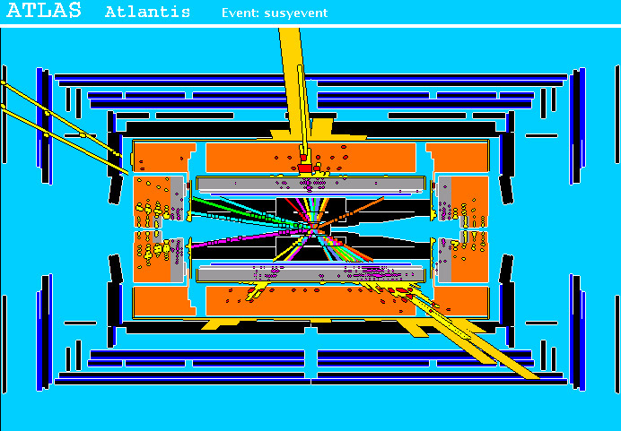
A simulated SUSY event
high p_{T}
muons
high p_{T} jets
of hadrons
p
p
missing transverse energy

Slide 14
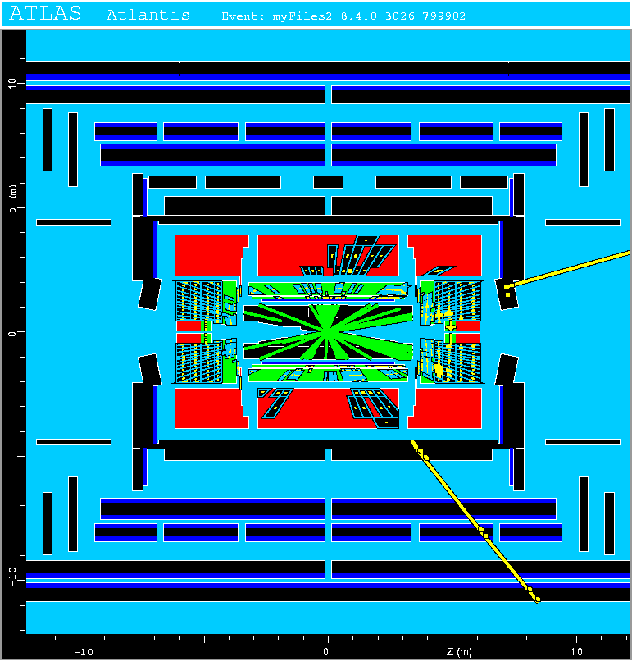
Background events
This event from Standard
Model ttbar production also
has high p_{T} jets and muons,
and some missing transverse
energy.
→ can easily mimic a
signal event.

Slide 15


Classification viewed as a statistical test
Suppose events come in two possible types:
s (signal) and b (background)
For each event, test hypothesis that it is background, i.e., H₀ = b.
Carry out test on many events, each is either of type s or b, i.e., here the hypothesis is the “true class label”, which varies randomly from event to event, so we can assign to it a frequentist probability.
Select events for which where H₀ is rejected as “candidate events of type s”. Equivalent Particle Physics terminology:
background efficiency
signal efficiency

Slide 16
Example of a test for classification
Suppose we can measure for
each event a quantity x, where
with 0 ≤ x ≤ 1.
For each event in a mixture of signal (s) and background (b) test
H₀ : event is of type b
using a critical region W of the form: W = { x : x ≤ x_{c} }, where
x_{c} is a constant that we choose to give a test with the desired size α.

Slide 17
Classification example (2)
Suppose we want α = 10⁻⁴. Require:
and therefore
For this test (i.e. this critical region W), the power with respect to the signal hypothesis (s) is
Note: the optimal size and power is a separate question that will depend on goals of the subsequent analysis.

Slide 18
Classification example (3)
Suppose that the prior probabilities for an event to be of type s or b are:
π_{s} = 0.001
π_{b} = 0.999
The “purity” of the selected signal sample (events where b hypothesis rejected) is found using Bayes’ theorem:

Slide 19
Classification example (4)
Suppose an individual event is observed at x = 0.1. What is the probability that this event is background?
(Here nothing to do with the test using x ≤ x_{c} , just an illustration
of Bayes’ theorem.)

Slide 20
Statistical Data Analysis
Lecture 4-3
Hypothesis test for classification
Test statistic to define critical region
Neyman-Pearson lemma

Slide 21


Classifying fish
You scoop up fish which are of two types:
Sea
Bass
Cod
You examine the fish with automatic sensors and for each one
you measure a set of features:
x₁ = length x₄ = area of fins
x₂ = width x₅ = mean spectral reflectance
x₃ = weight x₆ = ...
These constitute the “feature vector” x = (x₁,..., x_{n}).
In addition you hire a fish expert to identify the “true class label”
y = 0 or 1 (i.e., 0 = sea bass, 1 = cod) for each fish. We thus obtain “training data”: (x, y)₁, (x, y)₂, ..., (x, y)_{N} .

Slide 22
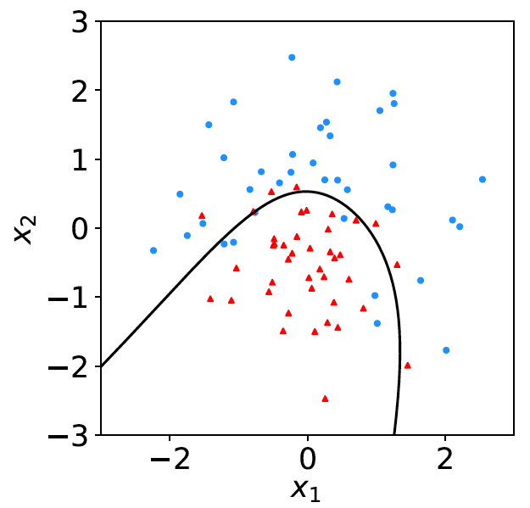
Distributions of the features
If we consider only two
features x = (x₁, x₂), we can
display the results in a scatter
plot (red: y = 0, blue: y = 1).
Goal is to determine a decision boundary, so that, without the help of the fish expert, we can classify new fish by seeing where their measured features lie relative to the boundary.
Same idea in multi-dimensional feature space, but cannot represent as 2-D plot. Decision boundary is n-dim. hypersurface.

Slide 23
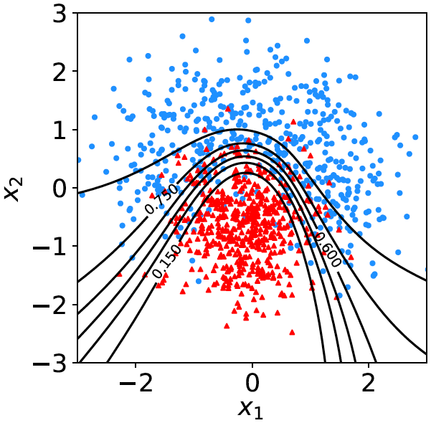

Decision function, test statistic
A surface in an n-dimensional
space can be described by
scalar
function
constant
Different values of the constant
t_{c} result in a family of surfaces.
Problem is reduced to finding
the best decision function or test statistic t (x).

Slide 24
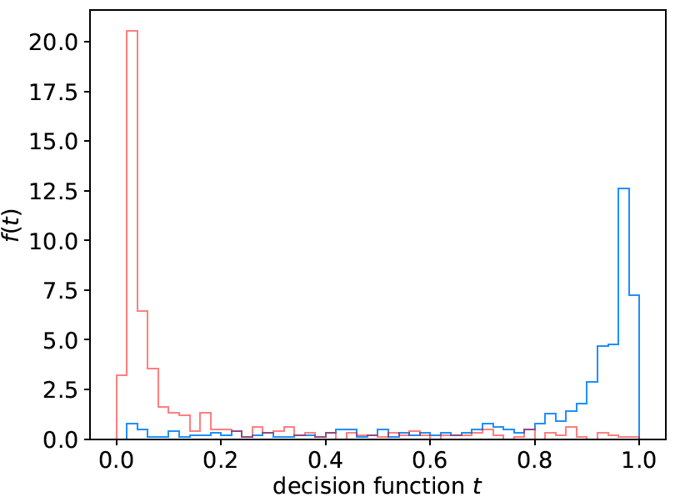
Distribution of t(x)
By forming a test statistic t(x), the boundary of the critical region in the n-dimensional x-space is determined by a single single value t_{c}.
f (t|H₀)
f (t|H₁)
t_{c}
W

Slide 25
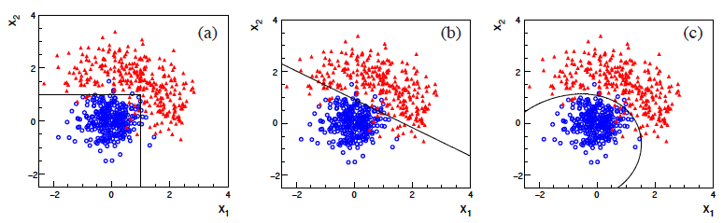
Types of decision boundaries
So what is the optimal boundary for the critical region, i.e., what
is the optimal test statistic t(x)?
First find best t(x), later address issue of optimal size of test.
Remember x-space can have many dimensions.
“cuts”
linear
non-linear

Slide 26
Test statistic based on likelihood ratio
How can we choose a test’s critical region in an ‘optimal way’?
Neyman-Pearson lemma states:
For a test of H₀ of size α, to get the highest power with respect to the
alternative H₁ we need for all x in the critical region W
”likelihood
ratio (LR)”
inside W and ≤ c_{α} outside, where c_{α} is a constant chosen to give a test of the desired size.
Equivalently, optimal scalar test statistic is
N.B. any monotonic function of this is leads to the same test.

Slide 27




Proof of Neyman-Pearson Lemma
Consider a critical region W and suppose the LR satisfies the criterion of the Neyman-Pearson lemma:
P(x|H₁)/P(x|H₀) ≥ c_{α} for all x in W,
P(x|H₁)/P(x|H₀) ≤ c_{α} for all x not in W.
W
Try to change this into a different critical region W′ retaining the same size α, i.e.,
δW₊
To do so add a part δW₊, but to keep the size α, we need to remove a part δW₋, i.e.,
W′
δW₋

Slide 28
Proof of Neyman-Pearson Lemma (2)
δW₊
But we are supposing the LR is higher for all x in δW₋ removed than for the x in δW₊ added, and therefore
W′
δW₋
The right-hand sides are equal and therefore

Slide 29
Proof of Neyman-Pearson Lemma (3)
We have
δW₊
W′
Note W and δW₊ are disjoint, and W′ and δW₋ are disjoint, so by Kolmogorov’s 3rd axiom,
δW₋
Therefore

Slide 30
Proof of Neyman-Pearson Lemma (4)
And therefore
i.e. the deformed critical region W′ cannot have higher power than the original one that satisfied the LR criterion of the Neyman-Pearson lemma.

Slide 31
Statistical Data Analysis
Lecture 4-4
Why the Neyman-Pearson lemma usually doesn’t help us
Strategies for multivariate analysis
Linear discriminant analysis

Slide 32

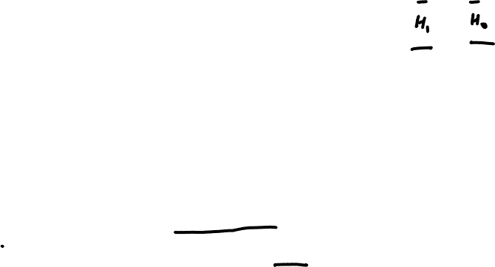
Neyman-Pearson doesn’t usually help
We usually don’t have explicit formulae for the pdfs f (x|s), f (x|b), so for a given x we can’t evaluate the likelihood ratio
Instead we may have Monte Carlo models for signal and background processes, so we can produce simulated data:
generate x ~ f (x|s) → x₁,..., x_{N}
generate x ~ f (x|b) → x₁,..., x_{N}
This gives samples of “training data” with events of known type.
Can be expensive (1 fully simulated LHC event ~ 1 CPU minute).

Slide 33
How is it we don’t have f (x|H)?
In a Monte Carlo simulation of a complex process, the fundamental hypothesis does not predict the pdf for the finally measured variables x but rather for some intermediate set of ”latent” variables, say, z₁.
So in step 1 we sample z₁ ~ f (z₁|H), followed by many further intermediate steps:
z₂ ~ f (z₂|z₁)
z₃ ~ f (z₃|z₂)
⠇
x ~ f (x|z_{n})
So even though H is fully defined and we can generate x according to it, the formula for f (x|H) is an enormous integral that we cannot compute:
See, e.g., Kyle Cranmer, Johann Brehmer, Gilles Louppe, The frontier of simulation-based inference,
arXiv:1911.01429 [stat.ML], PNAS doi.org/10.1073/pnas.1912789117

Slide 34
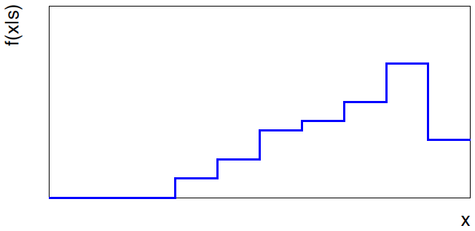
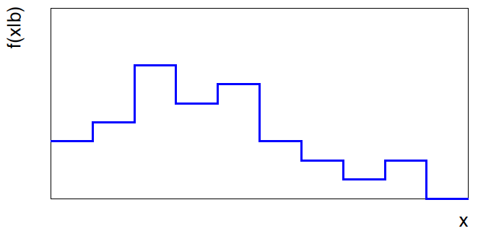


Approximate LR from histograms
Want t(x) = f (x|s)/ f(x|b) for x here
One possibility is to generate
MC data and construct
histograms for both
signal and background.
Use (normalized) histogram
values to approximate LR:
N(x|s)
N (x|s) ≈ f (x|s)
x
N(x|b)
N (x|b) ≈ f (x|b)
Can work well for single
variable.
x

Slide 35
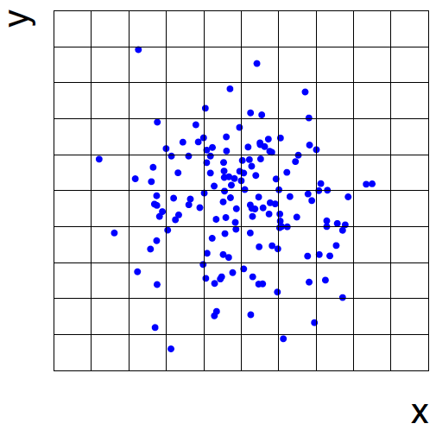
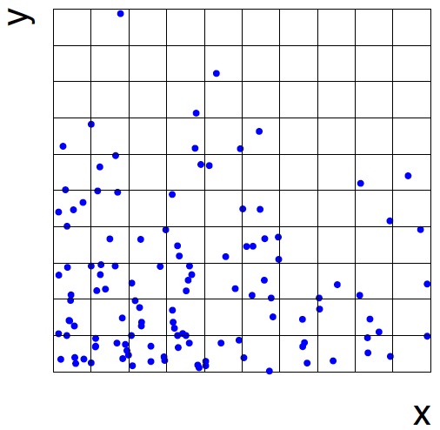
Approximate LR from 2D-histograms
Suppose problem has 2 variables. Try using 2-D histograms:
x₂
x₂
signal
back-
ground
x₁
x₁
Approximate pdfs using N (x₁,x₂|s), N (x₁,x₂|b) in corresponding cells.
But if we want M bins for each variable, then in n-dimensions we
have M^{n} cells; can’t generate enough training data to populate.
→ Histogram method usually not usable for n > 1 dimension.

Slide 36
Strategies for multivariate analysis
Neyman-Pearson lemma gives optimal answer, but cannot be
used directly, because we usually don’t have f (x|s), f (x|b).
Histogram method with M bins for n variables requires that
we estimate M^{n} parameters (the values of the pdfs in each cell),
so this is rarely practical.
A compromise solution is to assume a certain functional form
for the test statistic t (x) with fewer parameters; determine them
(using MC) to give best separation between signal and background.
Alternatively, try to estimate the probability densities f (x|s) and
f (x|b) (with something better than histograms) and use the
estimated pdfs to construct an approximate likelihood ratio.

Slide 37
Multivariate methods (Machine Learning)
Many new (and some old) methods:
Fisher discriminant
Neural networks
Kernel density methods
Support Vector Machines
Decision trees
Boosting
Bagging

Slide 38
Resources on multivariate methods
C.M. Bishop, Pattern Recognition and Machine Learning, Springer, 2006
T. Hastie, R. Tibshirani, J. Friedman, The Elements of Statistical Learning, 2nd ed., Springer, 2009
Gareth James, Daniela Witten, Trevor Hastie and Robert Tibshirani, An Introduction to Statistical Learning, Springer, 2017, faculty.marshall.usc.edu/gareth-james/ISL/
Ilya Narsky and Frank C. Porter, Statistical Analysis Techniques in Particle Physics, Wiley, 2014.
朱永生 （编著），实验数据多元统计分析， 科学出版社， 北京，2009。

Slide 39
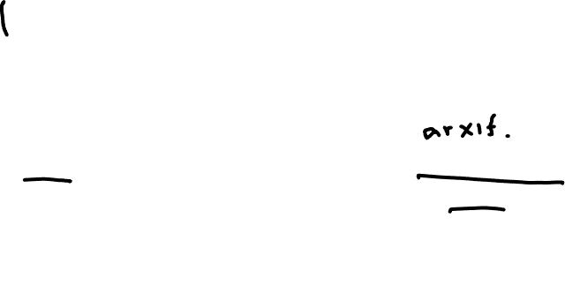
Software
Rapidly growing area of development – two important resources:
scikit-learn
Python-based tools for Machine Learning
scikit-learn.org
Large user community
TMVA, Höcker, Stelzer, Tegenfeldt, Voss, Voss, physics/0703039
From tmva.sourceforge.net, also distributed with ROOT
Variety of classifiers
Good manual, widely used in HEP

Slide 40

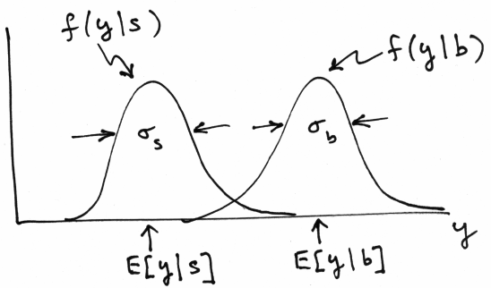
Linear test statistic
Suppose there are n input variables: x = (x₁,..., x_{n}).
Consider a linear function:
For a given choice of the coefficients w = (w₁,..., w_{n}) we will
get pdfs f (y|s) and f (y|b) :

Slide 41





Linear test statistic
Fisher: to get large difference between means and small widths
for f (y|s) and f (y|b), maximize the difference squared of the
expectation values divided by the sum of the variances:
Setting ∂J / ∂w_{i} = 0 gives:
,

Slide 42

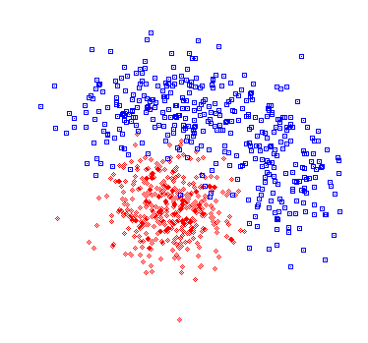



The Fisher discriminant
The resulting coefficients w_{i} define a Fisher discriminant.
Coefficients defined up to multiplicative constant; can also
add arbitrary offset, i.e., usually define test statistic as
Boundaries of the test’s
critical region are surfaces
of constant y(x), here linear
(hyperplanes):

Slide 43
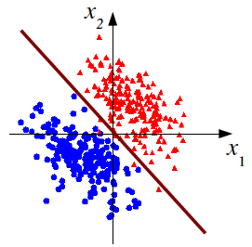

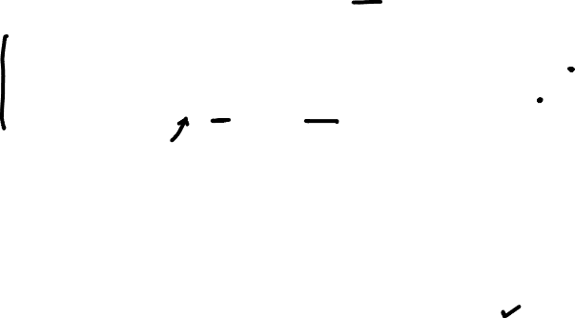
Fisher discriminant for Gaussian data
Suppose the pdfs of the input variables, f (x|s) and f (x|b), are both
multivariate Gaussians with same covariance but different means:
f (x|s) = Gauss(μ_{s}, V)
Same covariance
V_{ij} = cov[x_{i}, x_{j}]
f (x|b) = Gauss(μ_{b}, V)
In this case it can be shown
that the Fisher discriminant is
i.e., it is a monotonic function of the likelihood ratio and thus
leads to the same critical region. So in this case the Fisher
discriminant provides an optimal statistical test.

Slide 44
Extra slides

Slide 45
Choosing a critical region
To construct a test of a hypothesis H₀, we can ask what are the
relevant alternatives for which one would like to have a high power.
Maximize power wrt H₁ = maximize probability to
reject H₀ if H₁ is true.
Often such a test has a high power not only with respect to a
specific point alternative but for a class of alternatives.
E.g., using a measurement x ~ Gauss (μ, σ) we may test
H₀ : μ = μ₀ versus the composite alternative H₁ : μ > μ₀
We get the highest power with respect to any μ > μ₀ by taking
the critical region x ≥ x_{c} where the cut-off x_{c} is determined by
the significance level such that
α = P(x ≥x_{c}|μ₀).

Slide 46
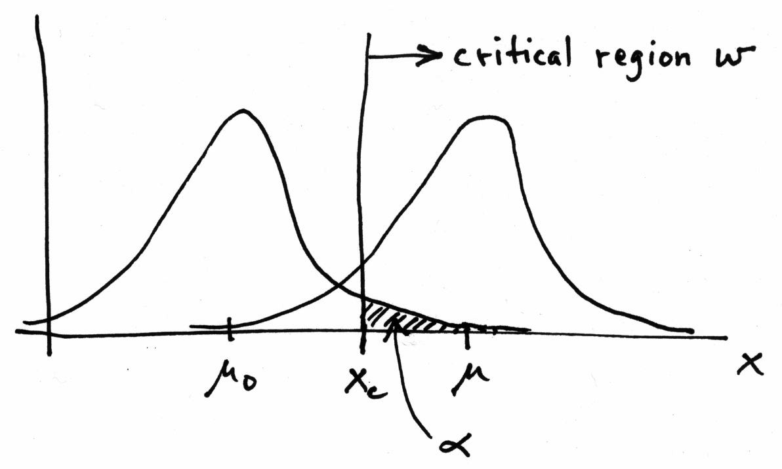


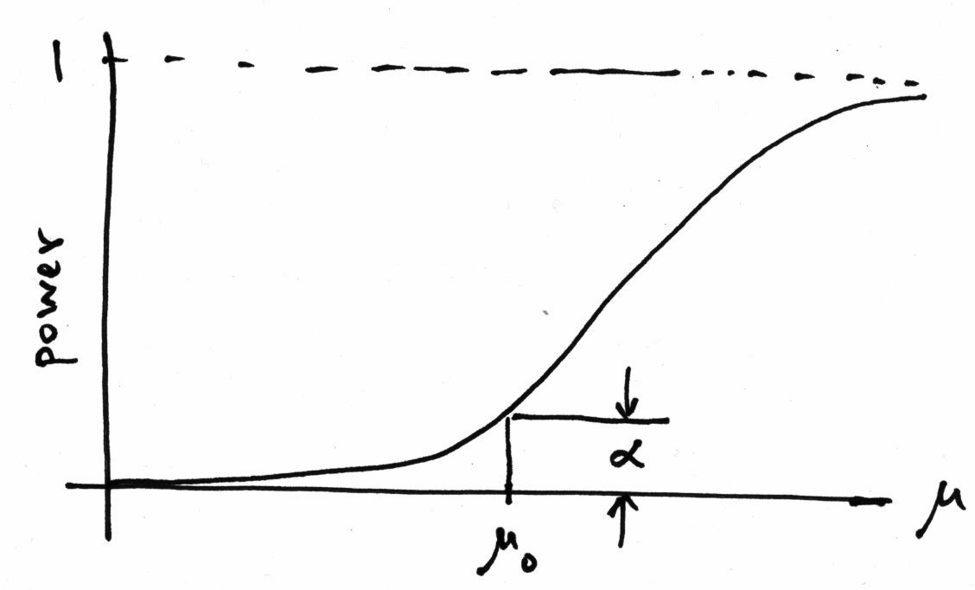


Τest of μ = μ₀ vs. μ > μ₀ with x ~ Gauss(μ,σ)
Standard Gaussian
cumulative distribution
Standard Gaussian quantile

Slide 47
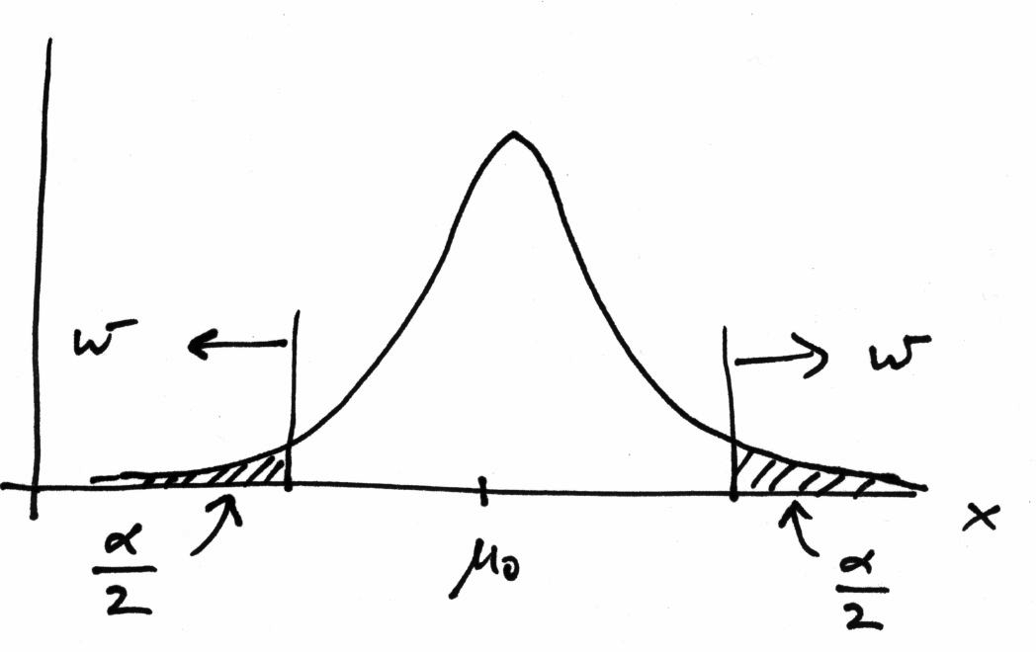
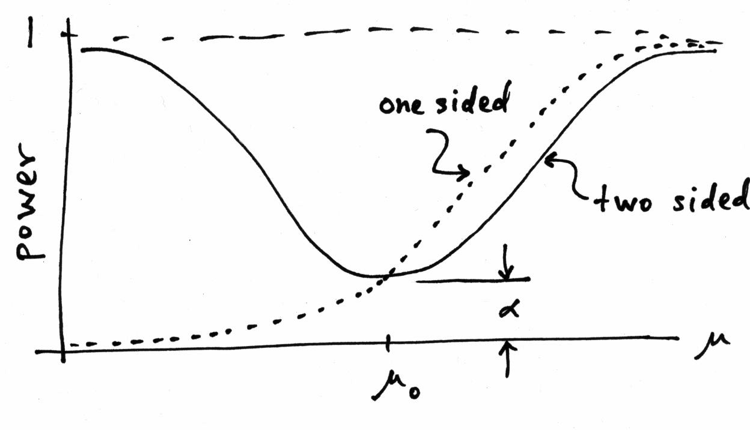
Choice of critical region based on power (3)
But we might consider μ < μ₀ as well as μ > μ₀ to be viable alternatives, and choose the critical region to contain both high and low x (a two-sided test).
New critical region now
gives reasonable power
for μ < μ₀, but less power
for μ > μ₀ than the original
one-sided test.

Slide 48
No such thing as a model-independent test
In general we cannot find a single critical region that gives the
maximum power for all possible alternatives (no “Uniformly
Most Powerful” test).
In HEP we often try to construct a test of
H₀ : Standard Model (or “background only”, etc.)
such that we have a well specified “false discovery rate”,
α = Probability to reject H₀ if it is true,
and high power with respect to some interesting alternative,
H₁ : SUSY, Z′, etc.
But there is no such thing as a “model independent” test. Any
statistical test will inevitably have high power with respect to
some alternatives and less power with respect to others.

