Slide 1


Statistical Data Analysis
and Anomalies in Particle Physics and Astrophysics
Lecture 2
4th KMI School
Nagoya University
15-17 December 2022
https://www.kmi.nagoya-u.ac.jp/workshop/kmi-school-2022/
Glen Cowan
Physics Department
Royal Holloway, University of London
g.cowan@rhul.ac.uk
www.pp.rhul.ac.uk/~cowan

Slide 2
Outline
Lecture 1: Probability, Bayes vs. Frequentist
Frequentist parameter estimation
Hypothesis tests
→ Lecture 2: p-values
Confidence limits
Systematic uncertainties
Bayesian parameter estimation
Lecture 3: Significance, sensitivity
Bayes factors
Models for anomalies

Slide 3
Testing significance / goodness-of-fit
Suppose hypothesis H predicts pdf f (x|H) for a set of
observations x = (x₁,...x_{n}).
We observe a single point in this space: x_{obs}.
How can we quantify the level of compatibility between the data and the predictions of H?
x_{j}
x_{obs}
Decide what part of
the data space represents equal or less compatibility with H than does the point x_{obs}. (Not unique!)
ω> = { x : x “more
compatible” with H }
ω≤ = { x : x “less
or eq. compatible”
with H }
x_{i}

Slide 4
p-values
Express level of compatibility between data and hypothesis (sometimes ‘goodness-of-fit’) by giving the p-value for H:
= probability, under assumption of H, to observe data with equal or lesser compatibility with H relative to the data we got.
= probability, under assumption of H, to observe data as discrepant with H as the data we got or more so.
Basic idea: if there is only a very small probability to find data
with even worse (or equal) compatibility, then H is “disfavoured by the data”.
If the p-value is below a user-defined threshold α (e.g. 0.05) then H is rejected (equivalent to hypothesis test of size α as seen earlier).

Slide 5

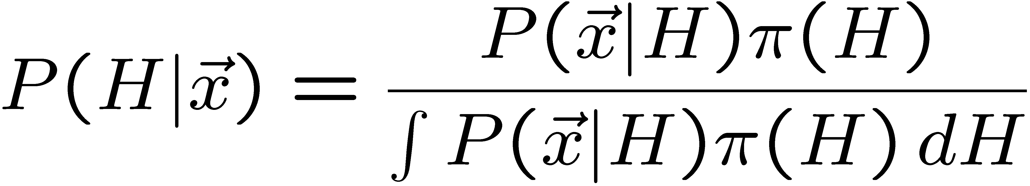
p-value of H is not P(H)
The p-value of H is not the probability that H is true!
In frequentist statistics we don’t talk about P(H) (unless H
represents a repeatable observation).
If we do define P(H), e.g., in Bayesian statistics as a degree of belief, then we need to use Bayes’ theorem to obtain
where π(H) is the prior probability for H.
For now stick with the frequentist approach;
result is p-value, regrettably easy to misinterpret as P(H).

Slide 6

The Poisson counting experiment
Suppose we do a counting experiment and observe n events.
Events could be from signal process or from background –
we only count the total number.
Poisson model:
s = mean (i.e., expected) # of signal events
b = mean # of background events
Goal is to make inference about s, e.g.,
test s = 0 (rejecting H₀ ≈ “discovery of signal process”)
test all non-zero s (values not rejected = confidence interval)
In both cases need to ask what is relevant alternative hypothesis.

Slide 7
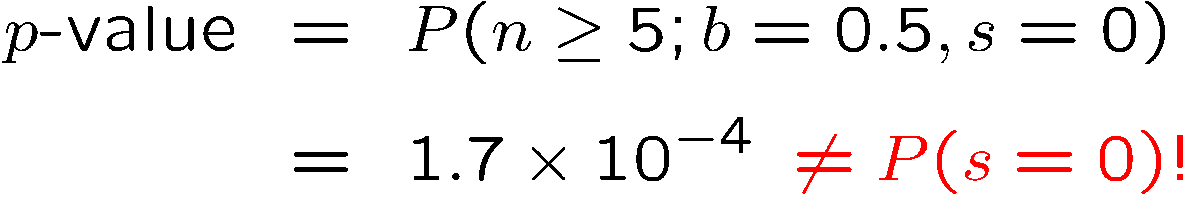
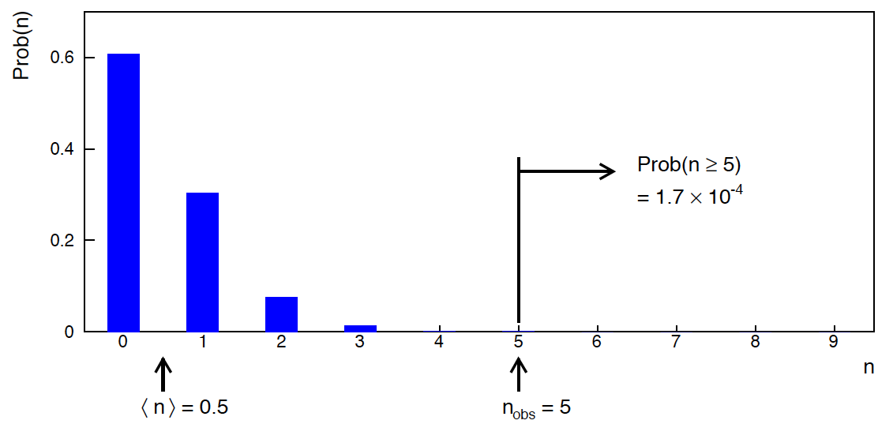
Poisson counting experiment: discovery p-value
Suppose b = 0.5 (known), and we observe n_{obs} = 5.
Should we claim evidence for a new discovery?
Give p-value for hypothesis s = 0, suppose relevant alt. is s > 0.

Slide 8
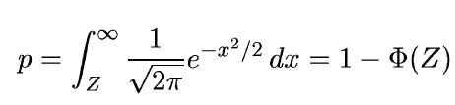
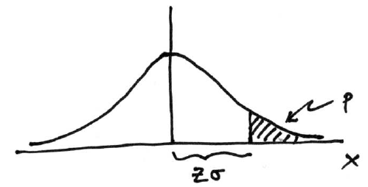

Significance from p-value
Often define significance Z as the number of standard deviations
that a Gaussian variable would fluctuate in one direction
to give the same p-value.
in ROOT:
p = 1 - TMath::Freq(Z)
Z = TMath::NormQuantile(1-p)
in python (scipy.stats):
p = 1 - norm.cdf(Z) = norm.sf(Z)
Z = norm.ppf(1-p)
Result Z is a “number of sigmas”. Note this does not mean that
the original data was Gaussian distributed.

Slide 9

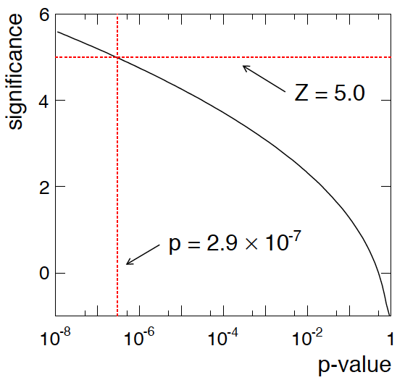
Poisson counting experiment: discovery significance
Equivalent significance for p = 1.7 × 10⁻⁴:
Often claim discovery if Z > 5 (p < 2.9 × 10⁻⁷, i.e., a “5-sigma effect”)
In fact this tradition should be revisited: p-value intended to quantify probability of a signal-like fluctuation assuming background only; not intended to cover, e.g., hidden systematics, plausibility signal model, compatibility of data with signal, “look-elsewhere effect”
(~multiple testing), etc.

Slide 10
Confidence intervals by inverting a test
In addition to a ‘point estimate’ of a parameter we should report
an interval reflecting its statistical uncertainty.
Confidence intervals for a parameter θ can be found by
defining a test of the hypothesized value θ (do this for all θ):
Specify values of the data that are ‘disfavoured’ by θ
(critical region) such that P(data in critical region|θ) ≤ α
for a prespecified α, e.g., 0.05 or 0.1.
If data observed in the critical region, reject the value θ.
Now invert the test to define a confidence interval as:
set of θ values that are not rejected in a test of size α
(confidence level CL is 1− α).

Slide 11
Relation between confidence interval and p-value
Equivalently we can consider a significance test for each
hypothesized value of θ, resulting in a p-value, p_{θ}.
If p_{θ} ≤ α, then we reject θ.
The confidence interval at CL = 1 – α consists of those values of
θ that are not rejected.
E.g. an upper limit on θ is the greatest value for which p_{θ} > α.
In practice find by setting p_{θ} = α and solve for θ.
For a multidimensional parameter space θ = (θ₁,... θ_{M}) use same idea – result is a confidence “region” with boundary determined by p_{θ} = α.

Slide 12
Coverage probability of confidence interval
If the true value of θ is rejected, then it’s not in the confidence interval. The probability for this is by construction (equality for continuous data):
P(reject θ|θ) ≤ α = type-I error rate
Therefore, the probability for the interval to contain or “cover” θ is
P(conf. interval “covers” θ|θ) ≥ 1 – α
This assumes that the set of θ values considered includes the true value, i.e., it assumes the composite hypothesis P(x|H,θ).

Slide 13



Frequentist upper limit on Poisson parameter
Consider again the case of observing n ~ Poisson(s + b).
Suppose b = 4.5, n_{obs} = 5. Find upper limit on s at 95% CL.
Relevant alternative is s = 0 (critical region at low n)
p-value of hypothesized s is P(n ≤ n_{obs}; s, b)
Upper limit s_{up} at CL = 1 – α found from

Slide 14
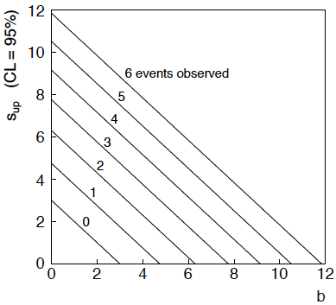
n ~ Poisson(s+b): frequentist upper limit on s
For low fluctuation of n, formula can give negative result for s_{up}; i.e. confidence interval is empty; all values of s ≥ 0 have p_{s} ≤ α.

Slide 15
Limits near a boundary of the parameter space
Suppose e.g. b = 2.5 and we observe n = 0.
If we choose CL = 0.9, we find from the formula for s_{up}
Physicist:
We already knew s ≥ 0 before we started; can’t use negative
upper limit to report result of expensive experiment!
Statistician:
The interval is designed to cover the true value only 90%
of the time — this was clearly not one of those times.
Not uncommon dilemma when testing parameter values for which
one has very little experimental sensitivity, e.g., very small s.

Slide 16
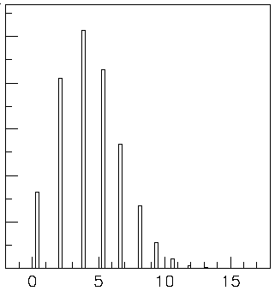

Expected limit for s = 0
Physicist: I should have used CL = 0.95 — then s_{up} = 0.496
Even better: for CL = 0.917923 we get s_{up} = 10⁻⁴ !
Reality check: with b = 2.5, typical Poisson fluctuation in n is
at least √2.5 = 1.6. How can the limit be so low?
Look at the mean limit for the
no-signal hypothesis (s = 0)
(sensitivity).
Distribution of 95% CL limits
with b = 2.5, s = 0.
Mean upper limit = 4.44

Slide 17
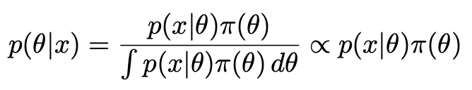
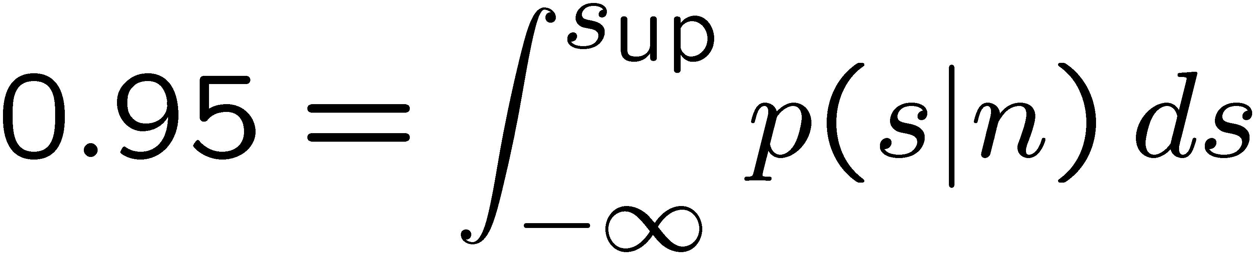
The Bayesian approach to limits
In Bayesian statistics need to start with ‘prior pdf’ π(θ), this
reflects degree of belief about θ before doing the experiment.
Bayes’ theorem tells how our beliefs should be updated in
light of the data x:
Integrate posterior pdf p(θ|x) to give interval with any desired
probability content.
For e.g. n ~ Poisson(s+b), 95% CL upper limit on s from

Slide 18
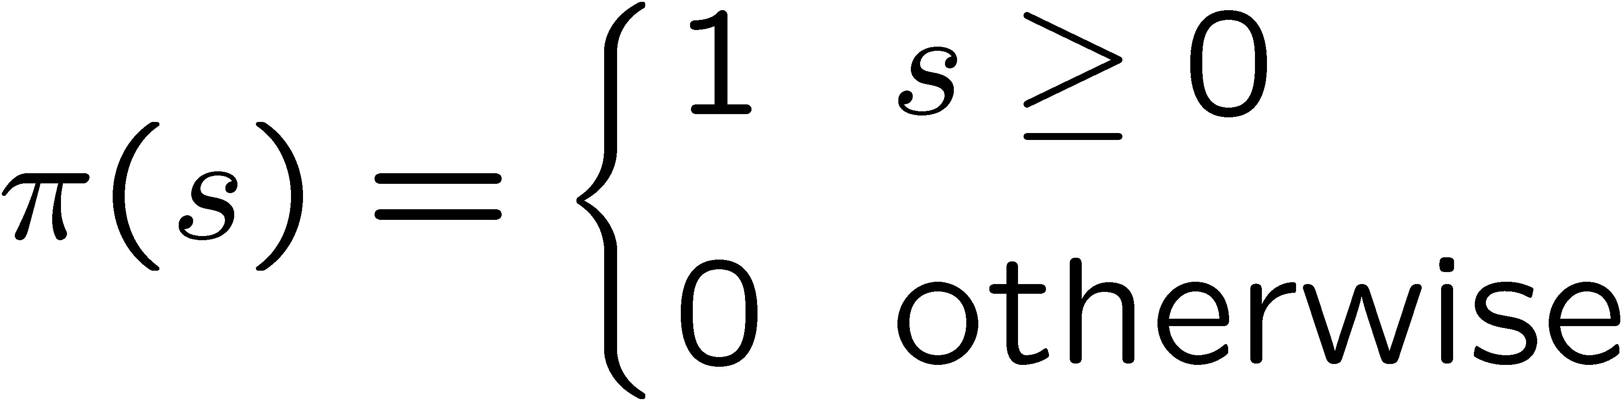
Bayesian prior for Poisson parameter
Include knowledge that s ≥ 0 by setting prior π(s) = 0 for s < 0.
Could try to reflect ‘prior ignorance’ with e.g.
Not normalized; can be OK provided p(n|s) dies off quickly for large s.
Not invariant under change of parameter — if we had used instead a flat prior for a nonlinear function of s, then this would imply a non-flat prior for s.
Doesn’t really reflect a reasonable degree of belief, but often used as a point of reference; or viewed as a recipe for producing an interval whose frequentist properties can be studied (e.g., coverage probability, which will depend on true s).

Slide 19
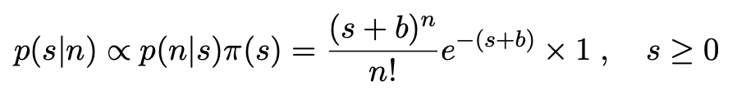


Bayesian upper limit with flat prior for s
Put Poisson likelihood and flat prior into Bayes’ theorem:
Normalize to unit area:
upper incomplete
gamma function
Upper limit s_{up} determined by

Slide 20


Bayesian interval with flat prior for s
Solve to find limit s_{up}:
where
For special case b = 0, Bayesian upper limit with flat prior
numerically same as one-sided frequentist case (‘coincidence’).

Slide 21
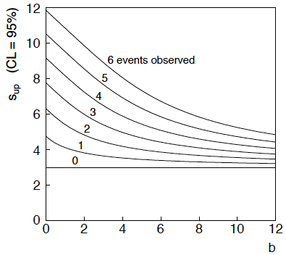
Bayesian interval with flat prior for s
For b > 0 Bayesian limit is everywhere greater than the (one sided) frequentist upper limit.
Never goes negative. Doesn’t depend on b if n = 0.

Slide 22




Approximate confidence intervals/regions
from the likelihood function
Suppose we test parameter value(s) θ = (θ₁, ..., θ_{N}) using the ratio
Lower λ(θ) means worse agreement between data and hypothesized θ. Equivalently, usually define
so higher t_{θ} means worse agreement between θ and the data.
p-value of θ therefore
need pdf

Slide 23




Confidence region from Wilks’ theorem
Wilks’ theorem says (in large-sample limit and provided
certain conditions hold...)
chi-square dist. with # d.o.f. =
# of components in θ = (θ₁, ..., θ_{N}).
Assuming this holds, the p-value is
← set equal to α
To find boundary of confidence region set p_{θ} = α and solve for t_{θ}:
Recall also

Slide 24




Confidence region from Wilks’ theorem (cont.)
i.e., boundary of confidence region in θ space is where
For example, for 1 – α = 68.3% and n = 1 parameter,
and so the 68.3% confidence level interval is determined by
Same as recipe for finding the estimator’s standard deviation, i.e.,
is a 68.3% CL confidence interval.

Slide 25
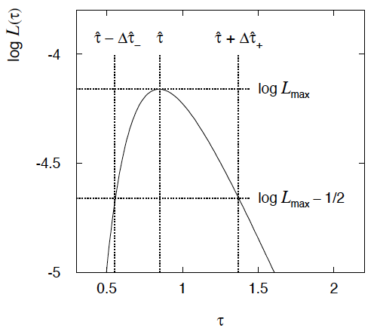

Example of interval from ln L(θ)
For N=1 parameter, CL = 0.683, Q_{α} = 1.
Our exponential
example, now with
only n = 5 events.
Can report ML estimate
with approx. confidence
interval from ln L_{max} – 1/2
as “asymmetric error bar”:

Slide 26

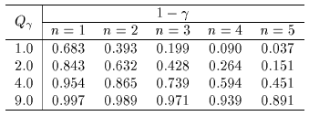

Multiparameter case
For increasing number of parameters, CL = 1 – α decreases for
confidence region determined by a given
← # of par.

Slide 27
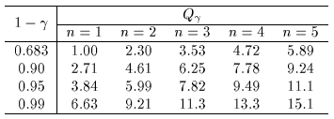
Multiparameter case (cont.)
Equivalently, Q_{α} increases with n for a given CL = 1 – α.
← # of par.

Slide 28



Systematic uncertainties and nuisance parameters
P (x|μ)
In general, our model of the data is not perfect:
model:
truth:
x
Can improve model by including
additional adjustable parameters.
Nuisance parameter ↔ systematic uncertainty. Some point in the
parameter space of the enlarged model should be “true”.
Presence of nuisance parameter decreases sensitivity of analysis
to the parameter of interest (e.g., increases variance of estimate).

Slide 29
Profile Likelihood
Suppose we have a likelihood L(μ,θ) = P(x|μ,θ) with N parameters of interest μ = (μ₁,..., μ_{N}) and M nuisance parameters θ = (θ₁,..., θ_{M}). The “profiled” (or “constrained”) values of θ are:
and the profile likelihood is:
The profile likelihood depends only on the parameters of interest; the nuisance parameters are replaced by their profiled values.
The profile likelihood can be used to obtain confidence intervals/regions for the parameters of interest in the same way as one would for all of the parameters from the full likelihood.

Slide 30
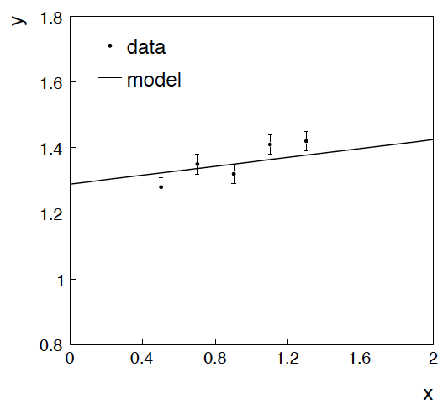
Example: fitting a straight line
Data:
Model: y_{i} independent and all follow y_{i} ~ Gauss(μ(x_{i} ), σ_{i} )
assume x_{i} and σ_{i} known.
Goal: estimate θ₀
Here suppose we don’t care
about θ₁ (example of a
“nuisance parameter”)

Slide 31
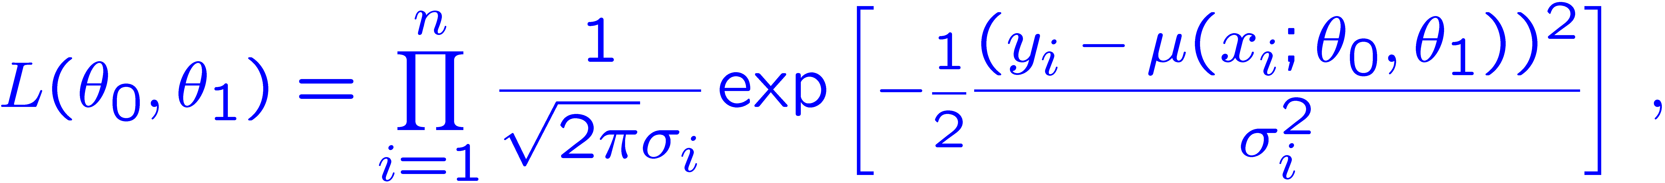
Maximum likelihood fit with Gaussian data
In this example, the y_{i} are assumed independent, so the
likelihood function is a product of Gaussians:
Maximizing the likelihood is here equivalent to minimizing
i.e., for Gaussian data, ML same as Method of Least Squares (LS)

Slide 32
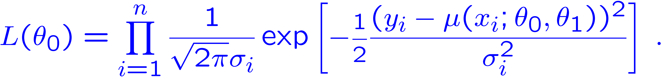
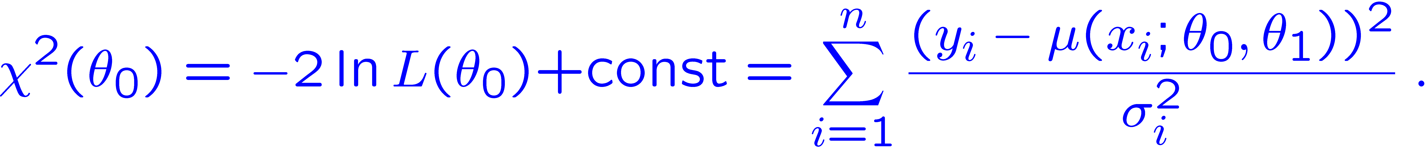
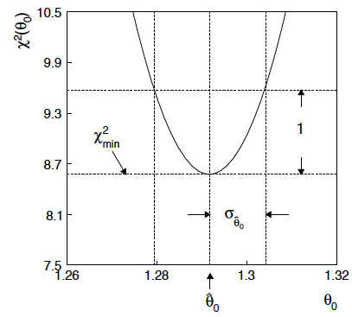
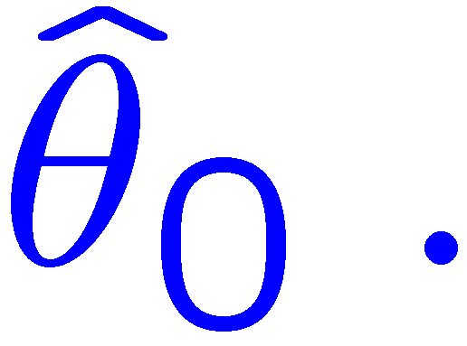
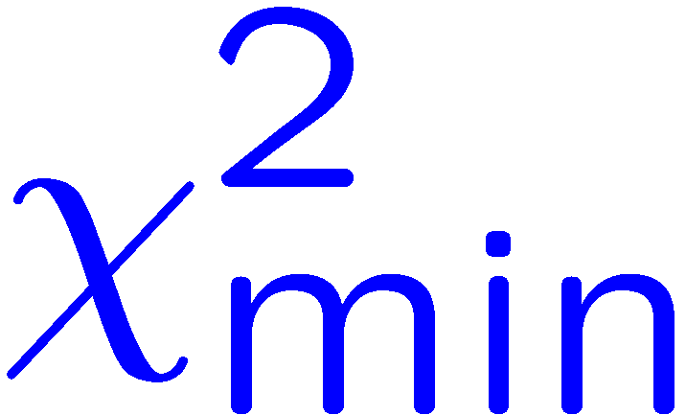
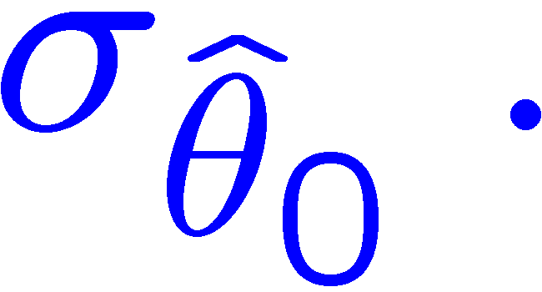
θ₁ known a priori
For Gaussian y_{i}, ML same as LS
Minimize χ² → estimator
Come up one unit from
to find

Slide 33
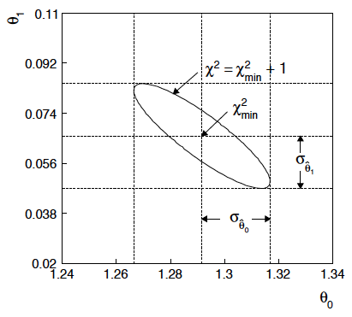
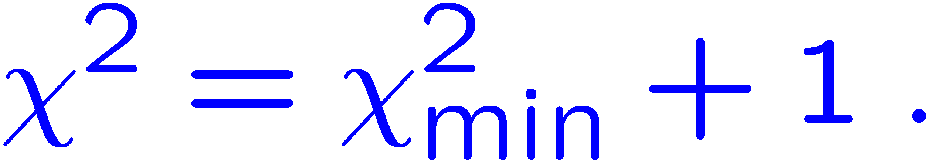
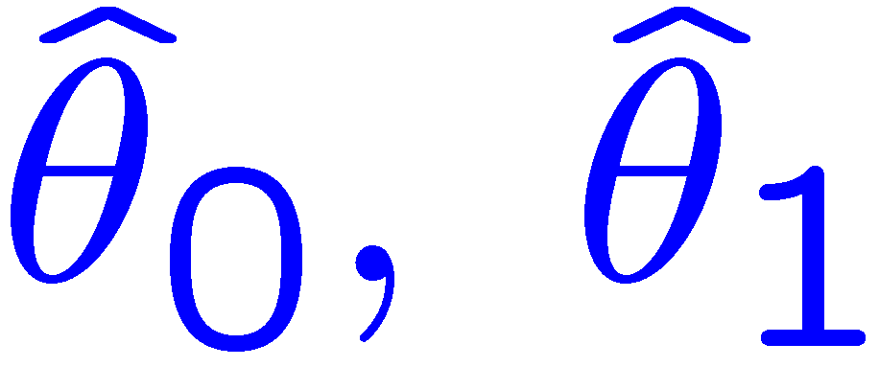
ML (or LS) fit of θ₀ and θ₁
Standard deviations from
tangent lines to contour
Correlation between
causes errors
to increase.

Slide 34


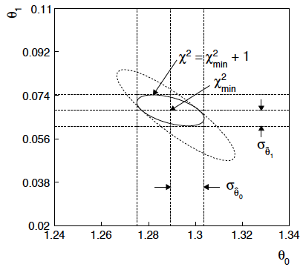
If we have a measurement t₁ ~ Gauss (θ₁, σ_{t1})
The information on θ₁
improves accuracy of

Slide 35
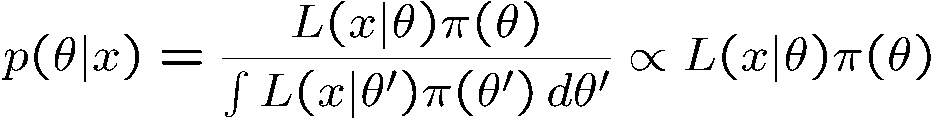
Reminder of Bayesian approach
In Bayesian statistics we can associate a probability with
a hypothesis, e.g., a parameter value θ.
Interpret probability of θ as ‘degree of belief’ (subjective).
Need to start with ‘prior pdf’ π(θ), this reflects degree
of belief about θ before doing the experiment.
Our experiment has data x, → likelihood L(x|θ).
Bayes’ theorem tells how our beliefs should be updated in
light of the data x:
Posterior pdf p(θ|x) contains all our knowledge about θ.

Slide 36
Bayesian approach: y_{i} ~ Gauss(μ(x_{i}; θ₀, θ₁), σ_{i})
We need to associate prior probabilities with θ₀ and θ₁, e.g.,
← suppose knowledge of θ₀ has no influence on knowledge of θ₁
← ‘non-informative’, in any
case much broader than L(θ₀)
prior after t₁,
before y
Ur = “primordial”
prior
Likelihood for control
measurement t₁

Slide 37
Bayesian example: y_{i} ~ Gauss(μ(x_{i}; θ₀, θ₁), σ_{i})
Putting the ingredients into Bayes’ theorem gives:
posterior ∝ likelihood ✕ prior
Note here the likelihood only reflects the measurements y.
The information from the control measurement t₁ has been put into the prior for θ₁.
We would get the same result using the likelihood P(y,t|θ₀,θ₁) and the constant “Ur-prior” for θ₁.

Slide 38
Marginalizing the posterior pdf
We then integrate (marginalize) p(θ₀, θ₁ | y) to find p(θ₀ | y):
In this example we can do the integral (rare). We find
(same as for MLE)
For this example, numbers come out same as in frequentist approach, but interpretation different.

Slide 39
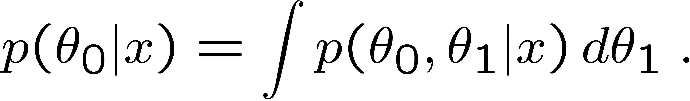
Marginalization with MCMC
Bayesian computations involve integrals like
often high dimensionality and impossible in closed form,
also impossible with ‘normal’ acceptance-rejection Monte Carlo.
Markov Chain Monte Carlo (MCMC) has revolutionized
Bayesian computation.
MCMC (e.g., Metropolis-Hastings algorithm) generates
correlated sequence of random numbers:
cannot use for many applications, e.g., detector MC;
effective stat. error greater than if all values independent .
Basic idea: sample multidimensional θ but look only at distribution of parameters of interest.

Slide 40
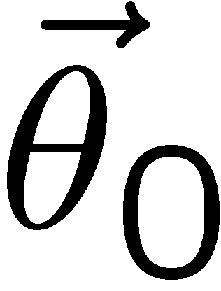
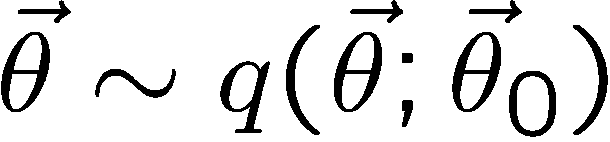
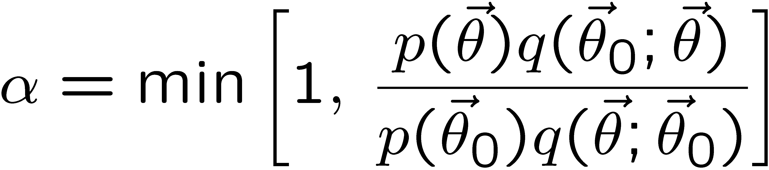
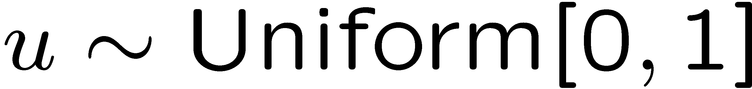
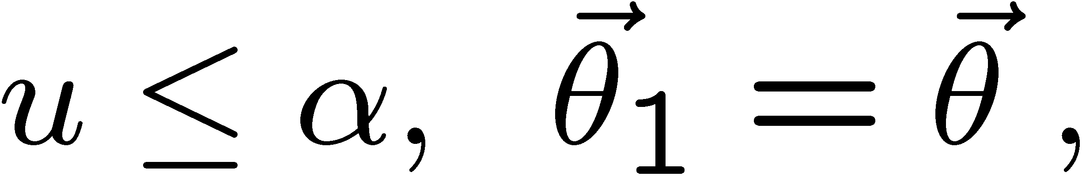
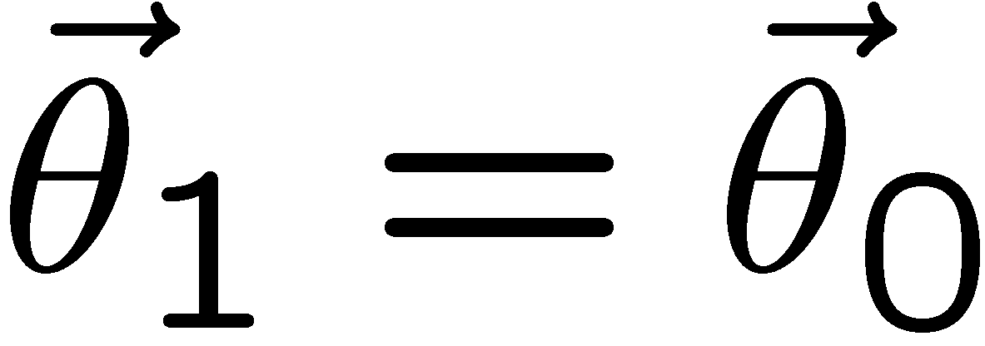
MCMC basics: Metropolis-Hastings algorithm
Goal: given an n-dimensional pdf p(θ) up to a proportionality constant, generate a sequence of points θ₁ , θ₂ , θ₃ ,...
Proposal density q(θ; θ₀ )
e.g. Gaussian centred
about θ₀
1) Start at some point
2) Generate
3) Form test ratio
4) Generate
5) If
move to proposed point
else
old point repeated
6) Iterate

Slide 41
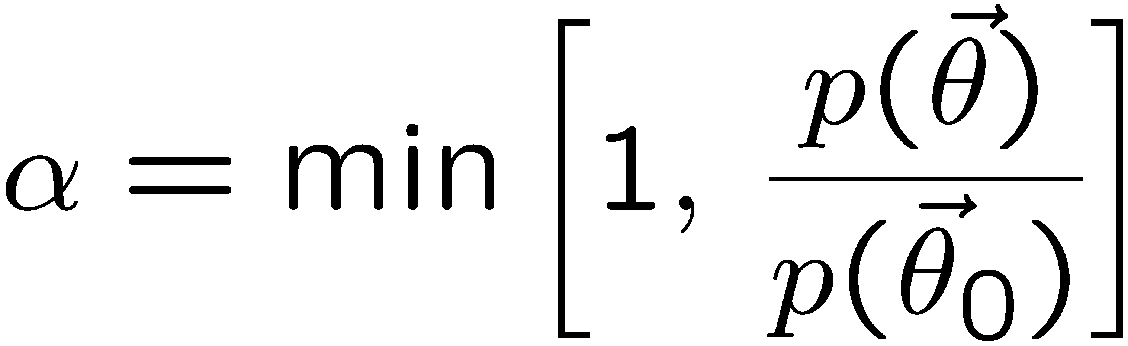
Metropolis-Hastings (continued)
This rule produces a correlated sequence of points (note how
each new point depends on the previous one).
Still works if p(θ) is known only as a proportionality, which is
usually what we have from Bayes’ theorem: p(θ|x) ∝ p(x|θ) π(θ).
The proposal density can be (almost) anything, but choose
so as to minimize autocorrelation. Often take proposal
density symmetric: q(θ; θ₀ ) = q(θ₀; θ )
Test ratio is (Metropolis-Hastings):
I.e. if the proposed step is to a point of higher p(θ), take it;
if not, only take the step with probability p(θ)/p(θ₀).
If proposed step rejected, repeat the current point.

Slide 42
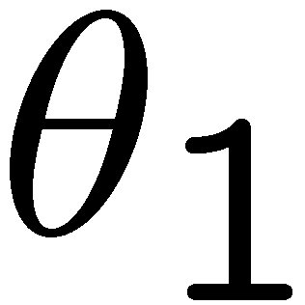
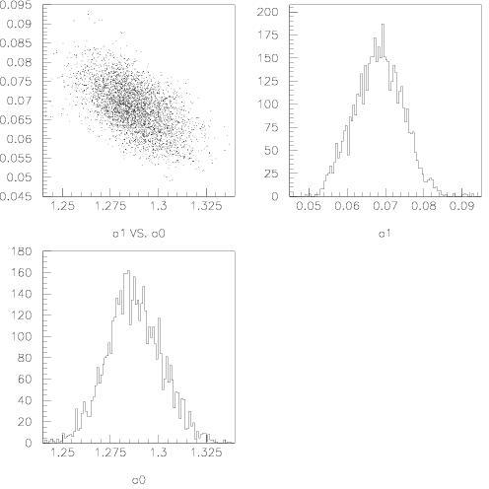
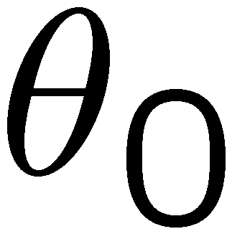
Example: posterior pdf from MCMC
Sample the posterior pdf from previous example with MCMC:
Normalized histogram of θ₀ gives its marginal posterior pdf:

Slide 43
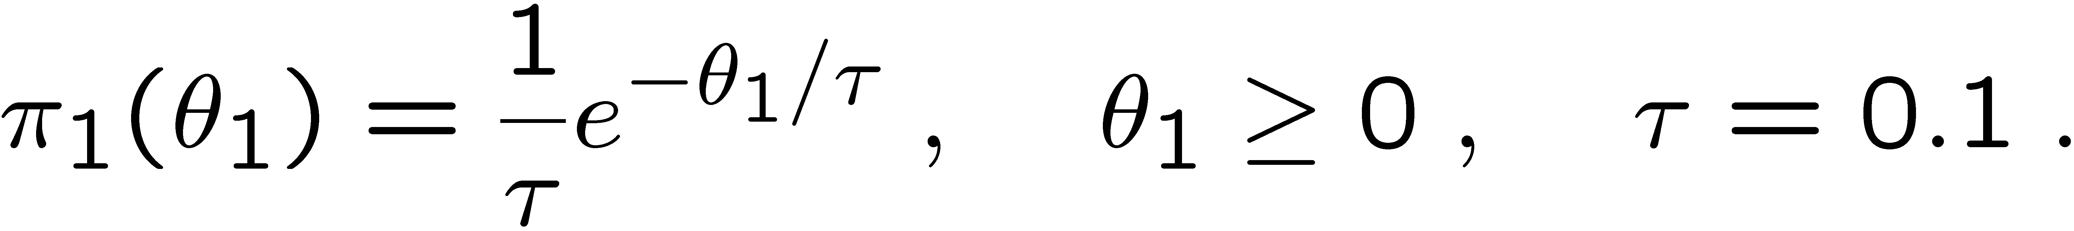
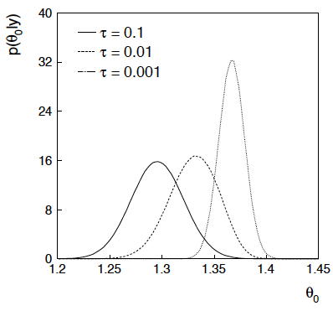
Bayesian method with alternative priors
Suppose we don’t have a previous measurement of θ₁ but rather,
an “expert” says it should be positive and not too much greater than 0.1 or so, i.e., something like
From this we obtain (numerically) the posterior pdf for θ₀:
This summarizes all
knowledge about θ₀.
Look also at result from
variety of priors.

Slide 44
Extra slides

Slide 45
Priors from formal rules
Last time we took the prior for a Poisson mean to be constant to reflect a lack of prior knowledge; we noted this was not invariant under change of parameter.
Because of difficulties in encoding a vague degree of belief
in a prior, one often attempts to derive the prior from formal rules,
e.g., to satisfy certain invariance principles or to provide maximum
information gain for a certain set of measurements.
Often called “objective priors”
Form basis of Objective Bayesian Statistics
The priors do not reflect a degree of belief (but might represent
possible extreme cases).
In Objective Bayesian analysis, can use the intervals in a
frequentist way, i.e., regard Bayes’ theorem as a recipe to produce
an interval with a given coverage probability.

Slide 46
Priors from formal rules (cont.)
For a review of priors obtained by formal rules see, e.g.,
Formal priors have not been widely used in Particle Physics, but there has been interest in this direction, especially the reference priors of Bernardo and Berger; see e.g.
L. Demortier, S. Jain and H. Prosper, Reference priors for high
energy physics, Phys. Rev. D 82 (2010) 034002, arXiv:1002.1111.
D. Casadei, Reference analysis of the signal + background model
in counting experiments, JINST 7 (2012) 01012; arXiv:1108.4270.

Slide 47

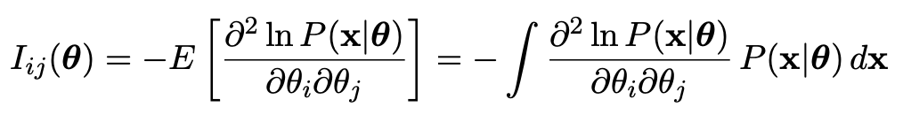
Jeffreys prior
According to Jeffreys’ rule, take prior according to
where
is the Fisher information matrix.
One can show that this leads to inference that is invariant under
a transformation of parameters in the following sense:
Start with the Jeffreys prior for θ: π_{θ}(θ) ~ √(det I(θ))
Use it in Bayes’ theorem to find:

Slide 48
Jeffreys prior (2)
Now consider a function η(θ). The posterior for η is
Alternatively, start with η and use its Jeffreys’ prior:
Use this in Bayes’ theorem:
One can show that Jeffreys’ prior results in the same P(η|x) in both cases. For details (single-parameter case) see:
http://www.pp.rhul.ac.uk/~cowan/stat/notes/JeffreysInvariance.pdf

Slide 49
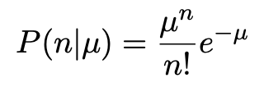
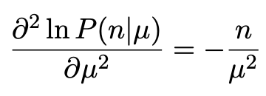
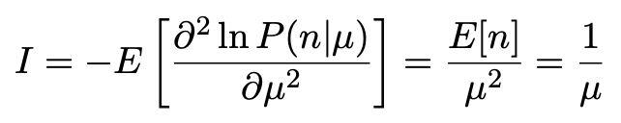

Jeffreys prior for Poisson mean
Suppose n ~ Poisson(μ). To find the Jeffreys’ prior for μ,
So e.g. for μ = s + b, this means the prior π(s) ~ 1/√(s + b), which depends on b. But this is not designed as a degree of belief about s.

Slide 50
Posterior pdf for Poisson mean
From Bayes’ theorem,
Flat, π(μ) = const.
Jeffreys, π(μ) ~ 1/√μ
In both cases, posterior is special case of gamma distribution.

Slide 51
Upper limit for Poisson mean
To find upper limit at CL = 1−α, solve
Jeffreys prior:
= 7.03
n=3,
CL=0.95
Flat prior:
= 7.75
where P⁻¹ is the inverse of the normalized lower incomplete gamma function (see scipy.special)

Slide 52




Profiling
The lnL = lnL_{max} – ½ contour in the (θ₀, θ₁) plane is a confidence region at CL = 39.3%.
Furthermore if one wants to know only about, say, θ₀, then the
interval in θ₀ corresponding to lnL = lnL_{max} – ½ is a confidence interval at CL = 68.3% (i.e., ±1 std. dev.).
I.e., form the interval for θ₀ using
where θ₁ is replaced by its “profiled” value

Slide 53
Profile Likelihood
Suppose we have a likelihood L(μ,θ) = P(x|μ,θ) with N parameters of interest μ = (μ₁,..., μ_{N}) and M nuisance parameters θ = (θ₁,..., θ_{M}). The “profiled” (or “constrained”) values of θ are:
and the profile likelihood is:
The profile likelihood depends only on the parameters of interest; the nuisance parameters are replaced by their profiled values.
The profile likelihood can be used to obtain confidence intervals/regions for the parameters of interest in the same way as one would for all of the parameters from the full likelihood.

Slide 54
Profile Likelihood Ratio – Wilks theorem
Goal is to test/reject regions of μ space (param. of interest).
Rejecting a point μ should mean p_{μ} ≤ α for all possible values of the nuisance parameters θ.
Test μ using the “profile likelihood ratio”:
Let t_{μ} = −2 ln λ(μ). Wilks’ theorem says in large-sample limit:
where the number of degrees of freedom is the number of
parameters of interest (components of μ). So p-value for μ is

Slide 55
Profile Likelihood Ratio – Wilks theorem (2)
If we have a large enough data sample to justify use of the
asymptotic chi-square pdf, then if μ is rejected, it is rejected for any values of the nuisance parameters.
The recipe to get confidence regions/intervals for the parameters of interest at CL = 1 – α is thus the same as before, simply use the profile likelihood:
where the number of degrees of freedom N for the chi-square quantile is equal to the number of parameters of interest.
If the large-sample limit is not justified, then use e.g. Monte Carlo to get distribution of t_{μ}.

Slide 56

Profile construction (“hybrid resampling”)
Approximate procedure is to reject θ if p_{θ} ≤ α where
the p-value is computed assuming the value of the nuisance
parameter that best fits the data for the specified θ :
“double hat” notation means
value of parameter that maximizes
likelihood for the given θ.
The resulting confidence interval will have the correct coverage
for the points
.
Elsewhere it may under- or overcover, but this is usually as good
as we can do (check with MC if crucial or small sample problem).

Slide 57

“Hybrid frequentist-Bayesian” method
Alternatively, suppose uncertainty in ν is characterized by
a Bayesian prior π(ν).
Can use the marginal likelihood to model the data:
This does not represent what the data distribution would
be if we “really” repeated the experiment, since then ν would
not change.
But the procedure has the desired effect. The marginal likelihood
effectively builds the uncertainty due to ν into the model.
Use this now to compute (frequentist) p-values → the model
being tested is in effect a weighted average of models.

