Slide 1


Statistical Data Analysis
and Anomalies in Particle Physics and Astrophysics
Lecture 3
4th KMI School
Nagoya University
15-17 December 2022
https://www.kmi.nagoya-u.ac.jp/workshop/kmi-school-2022/
Glen Cowan
Physics Department
Royal Holloway, University of London
g.cowan@rhul.ac.uk
www.pp.rhul.ac.uk/~cowan

Slide 2
Outline
Lecture 1: Probability, Bayes vs. Frequentist
Frequentist parameter estimation
Hypothesis tests
Lecture 2: p-values
Confidence limits
Systematic uncertainties
Bayesian parameter estimation
→ Lecture 3: Significance, sensitivity
Bayes factors
Models for anomalies

Slide 3




Expected discovery significance for counting
experiment with background uncertainty
I. Discovery sensitivity for counting experiment with b known:
(a)
(b) Profile likelihood
ratio test & Asimov:
II. Discovery sensitivity with uncertainty in b, σ_{b}:
(a)
(b) Profile likelihood ratio test & Asimov:

Slide 4


Counting experiment with known background
Count a number of events n ~ Poisson(s+b), where
s = expected number of events from signal,
b = expected number of background events.
To test for discovery of signal compute p-value of s = 0 hypothesis,
Usually convert to equivalent significance:
where Φ is the standard Gaussian cumulative distribution, e.g.,
Z > 5 (a 5 sigma effect) means p < 2.9 ×10⁻⁷.
To characterize sensitivity to discovery, give expected (mean
or median) Z under assumption of a given s.

Slide 5



s/√b for expected discovery significance
For large s + b, n → x ~ Gaussian(μ,σ) , μ = s + b, σ = √(s + b).
For observed value x_{obs}, p-value of s = 0 is Prob(x > x_{obs} | s = 0),:
Significance for rejecting s = 0 is therefore
Expected (median) significance assuming signal rate s is

Slide 6



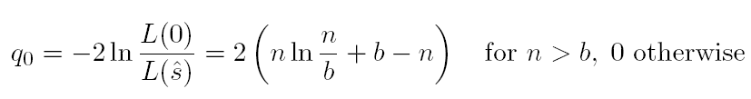
Better approximation for significance
Poisson likelihood for parameter s is
For now
no nuisance
params.
To test for discovery use profile likelihood ratio:
So the likelihood ratio statistic for testing s = 0 is

Slide 7


Approximate Poisson significance (continued)
For sufficiently large s + b, (use Wilks’ theorem),
To find median[Z|s], let n → s + b (i.e., the Asimov data set):
This reduces to s/√b for s << b.

Slide 8
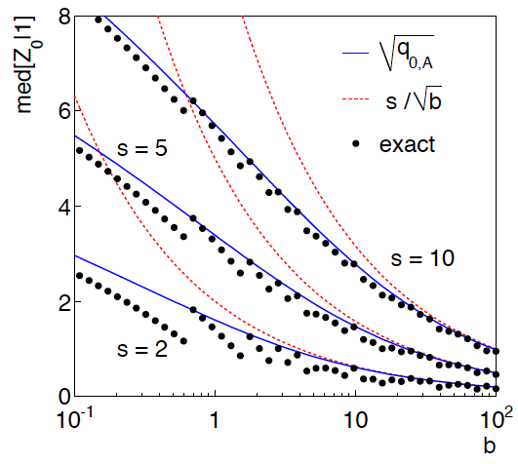
n ~ Poisson(s+b), median significance,
assuming s, of the hypothesis s = 0
CCGV, EPJC 71 (2011) 1554, arXiv:1007.1727
“Exact” values from MC,
jumps due to discrete data.
Asimov √q_{0,A} good approx.
for broad range of s, b.
s/√b only good for s ≪ b.

Slide 9

Extending s/√b to case where b uncertain
The intuitive explanation of s/√b is that it compares the signal,
s, to the standard deviation of n assuming no signal, √b.
Now suppose the value of b is uncertain, characterized by a
standard deviation σ_{b}.
A reasonable guess is to replace √b by the quadratic sum of
√b and σ_{b}, i.e.,
This has been used to optimize some analyses e.g. where
σ_{b} cannot be neglected.

Slide 10


Profile likelihood with b uncertain
This is the well studied “on/off” problem: Cranmer 2005;
Cousins, Linnemann, and Tucker 2008; Li and Ma 1983,...
Measure two Poisson distributed values:
n ~ Poisson(s+b) (primary or “search” measurement)
m ~ Poisson(τb) (control measurement, τ known)
The likelihood function is
Use this to construct profile likelihood ratio (b is nuisance
parameter):

Slide 11
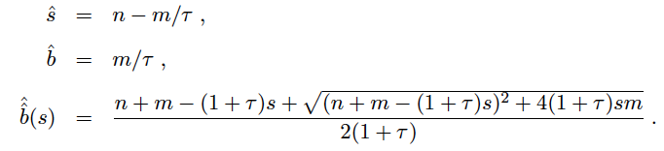

Ingredients for profile likelihood ratio
To construct profile likelihood ratio from this need estimators:
and in particular to test for discovery (s = 0),

Slide 12



Asymptotic significance
Use profile likelihood ratio for q₀, and then from this get discovery
significance using asymptotic approximation (Wilks’ theorem):
Essentially same as in:

Slide 13



Asimov approximation for median significance
To get median discovery significance, replace n, m by their
expectation values assuming background-plus-signal model:
n → s + b
m → τb
ˆ
Or use the variance of b = m/τ,
, to eliminate τ:

Slide 14

Limiting cases
Expanding the Asimov formula in powers of s/b and
σ_{b}²/b (= 1/τ) gives
So the “intuitive” formula can be justified as a limiting case
of the significance from the profile likelihood ratio test evaluated
with the Asimov data set.

Slide 15
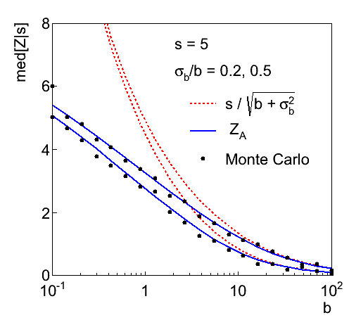
Testing the formulae: s = 5

Slide 16
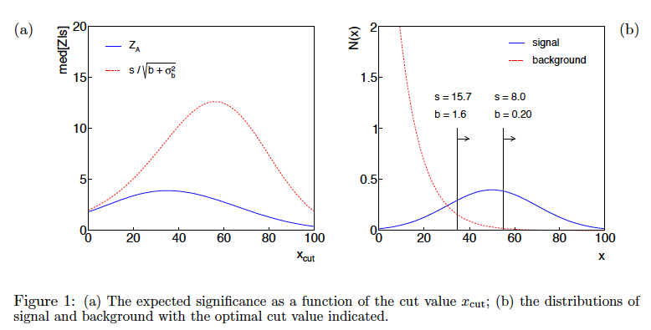
Using sensitivity to optimize a cut

Slide 17
Bayesian model selection
Fundamentally the probability of a hypothesis H_{i} in the Bayesian approach is given by its posterior probability given the data: P(H_{i}|x).
Finding this requires assignment of prior probabilities to all hypotheses that are considered.
We can give the posterior odds (ratio of probabilities) for any pair of hypotheses H_{i} and H_{j} (use Bayes’ theorem; factors of P(x) cancel):
posterior odds
Bayes factor
prior odds
See: Kass and Raftery, Bayes Factors, J. Am Stat. Assoc 90 (1995) 773.

Slide 18
The Bayes factor
The Bayes factor B_{ij} is the likelihood ratio of the two hypotheses:
= posterior odds if one takes
prior odds equal to one.
The Bayes factor is regarded as measuring the weight of
evidence of the data in support of H_{i} over H_{j}. and can be used much like a p-value (or Z value).
The Jeffreys scale, analogous to the 5σ rule in Particle Physics:
B₁₀ Evidence against H₀
--------------------------------------------
1 to 3 Not worth more than a bare mention
3 to 20 Positive
20 to 150 Strong
> 150 Very strong

Slide 19
Marginal likelihood (evidence)
If the model H_{i} contains internal parameters θ_{i}, then these must be characterized by a prior pdf π_{i}(θ_{i} |H_{i}) and marginalized:
This is called the “marginal likelihood” or “evidence” of H_{i}.
It is independent of the overall prior probability of H_{i}
but it depends on the prior pdf for the model’s internal
parameters θ_{i} :

Slide 20
Bayes factor for models with internal parameters
The Bayes factor is thus the ratio of marginal likelihoods for the two models:
Simplifying the notation, the numerator and denominator are both of the form
For high-dimensional θ these integrals can be very difficult to compute (more on this later).

Slide 21

Priors for Bayes factors
Prior pdfs for the marginal likelihoods used in Bayes factors
cannot be improper, i.e., they cannot be defined only up to an arbitrary normalization constant, in which case B_{ij} would not be well defined.
Suppose we try to take a ”non-informative” prior to be constant
out to some large cut-off, in the hope that the Bayes factor will decouple from it:
In such cases we find that the Bayes factor remains sensitive to the cut-off even for a → ∞.
So all priors used for Bayes factors must reflect a meaningful degrees of uncertainty about the parameters.

Slide 22
Bayes factor for Poisson counting experiment
Suppose n ~ Poisson(s + b) with b known. We want to compare
The likelihoods of H₀ and H₁ are

Slide 23
Bayes factor for Poisson counting experiment (2)
Suppose the prior pdf for the parameter s in H₁ is:
(0 ≤ s ≤ s_{max})
The posterior probability for s given n is, assuming H₁,
(0 ≤ s ≤ s_{max})
γ = lower
incomplete
gamma
function

Slide 24
Bayes factor for Poisson counting experiment (3)
In the limit s_{max} → ∞ this goes to
where
is the lower incomplete gamma function.
Thus the posterior pdf for s given n under assumption of H₁
decouples from s_{max} in the limit s_{max} → ∞, and hence we
can use this limiting case e.g. for finding an upper limit (credibility interval) for s.

Slide 25
Bayes factor for Poisson counting experiment (4)
The hypothesis H₀ has no internal parameters so its marginal likelihood is simply m₀ = L(n| H₀).
The marginal likelihood of H₁ is

Slide 26
Bayes factor for Poisson counting experiment (5)
So the Bayes factor is
Example: b = 2, n = 8
As s_{max} increases the data start to favour H₁.
As s_{max} increases further, the larger volume of H₁’s parameter space penalizes it (Ockham’s razor).

Slide 27
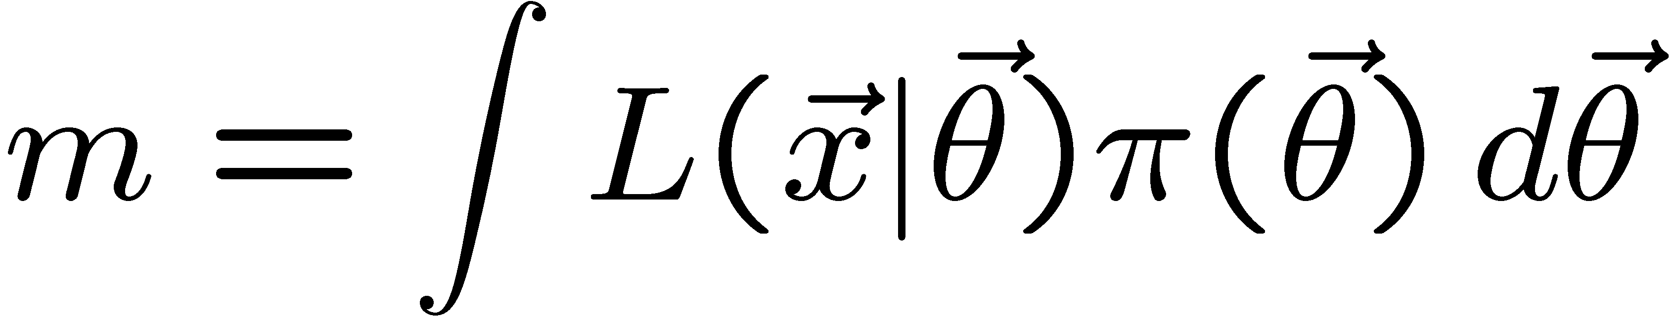
Numerical determination of Bayes factors
Both numerator and denominator of B_{ij} are of the form
‘marginal likelihood’
Various ways to compute these, e.g., using sampling of the posterior pdf (which we can do with MCMC).
Harmonic Mean (and improvements)
Importance sampling
Parallel tempering (~thermodynamic integration)
Nested Sampling (MultiNest), ...

Slide 28
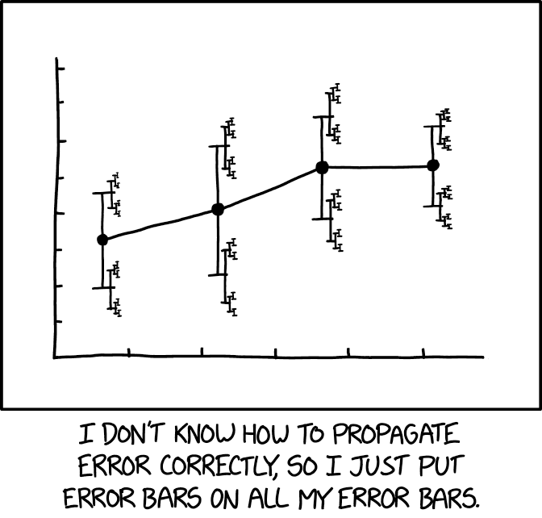
”Errors on errors”
The uncertainties on estimated systematic errors (“errors on errors”) can in general play an important role in many analyses, see:
G. Cowan, Statistical Models with Uncertain Error Parameters, Eur. Phys. J. C (2019) 79:133, arXiv:1809.05778
https://xkcd.com/2110/
It turns out that models that use
errors on errors have qualitatively
new, interesting, desirable features:
Sensitivity to outliers reduced.
Confidence intervals sensitive to goodness of fit.
Effect on goodness of fit, p-values, significance.

Slide 29
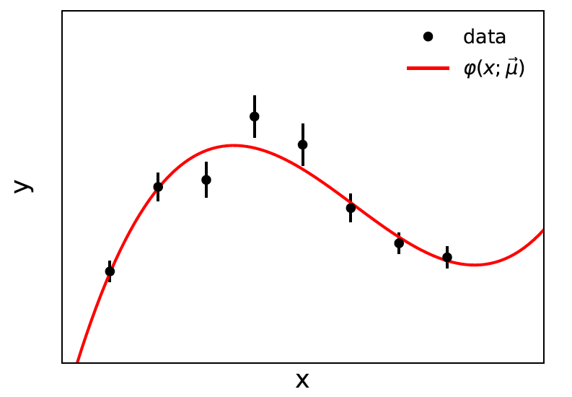
Prototype example: curve fitting, averages
Suppose independent
y_{i} ~ Gauss, i = 1,...,N, with
μ = (μ₁,..., μ_{M}) are M parameters in the fit function φ(x;μ).
If we take the σ_{i} as known, we have the usual log-likelihood
which leads to the Least Squares estimators for μ.

Slide 30
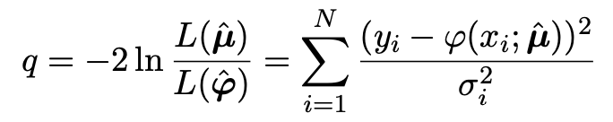
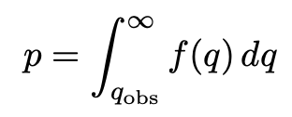

Goodness of fit for Least Squares
In the least-squares approach, the statistic
Likelihood of saturated model L(φ₁,..., φ_{N})
provides a measure of goodness of fit. The p-value of the
composite hypothesis φ(x_{i};μ) is
If the y_{i} ~ Gauss(φ(x_{i};μ), σ_{i}) then f (q) is chi-squared for N−M degrees
of freedom, independent of μ (Wilks).
Special case: φ(x_{i};μ) = μ, i.e., test if the y_{i} have a common mean μ
→ q ~ chi-square(N−1) →

Slide 31
What if the σ_{i} are not known?
The LS approach assumes that the standard deviations σ_{i} of the measurements are known.
σ_{i} = statistical error, usually well estimated from sample size.
σ_{i} = systematic error:
related to stat. error of control measurement – well estimated
related to size of MC event sample – well estimated
systematic uncertainty from modelling of experiment – could be poorly estimated
reflects uncertainty resulting from some mathematical approximation (theory error) – could be poorly estimated
In general, we should allow that the σ_{i} may not be exactly known.

Slide 32
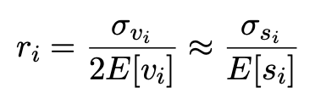
Gamma Variance Model
G. Cowan, EPJC (2019) 79:133
If the σ_{i}² are uncertain, we can take them as adjustable parameters.
The estimated variances v_{i} = s_{i}² are modeled as gamma distributed.
The likelihood becomes
Want
→

Slide 33
Profile log-likelihood
One can profile over the σ_{i}² in close form.
The log-profile-likelihood is
Quadratic terms replace by sum of logs.
Equivalent to replacing Gauss pdf for y_{i} by Student’s t, ν_{dof} = 1/2r_{i}²
Simple program for Student’s t average: stave.py
http://www.pp.rhul.ac.uk/~cowan/stat/stave/

Slide 34
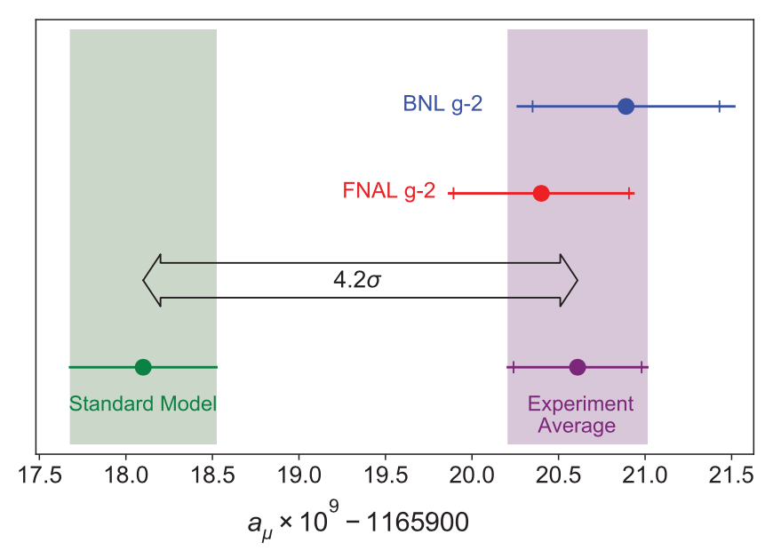
Application to the muon g − 2 anomaly
The recently measured muon g − 2 (ave. of 2006, 2021) disagrees with the Standard Model prediction with a significance of 4.2σ.
Muon g-2 Collab., PRL 126, 141801 (2021)
Discrepancy significantly
reduced by 2021 lattice-based prediction of Borsanyi et al. (BMW).
Current goal is to investigate sensitivity of significance to error assumptions, so for now focus on the 4.2σ problem.

Slide 35



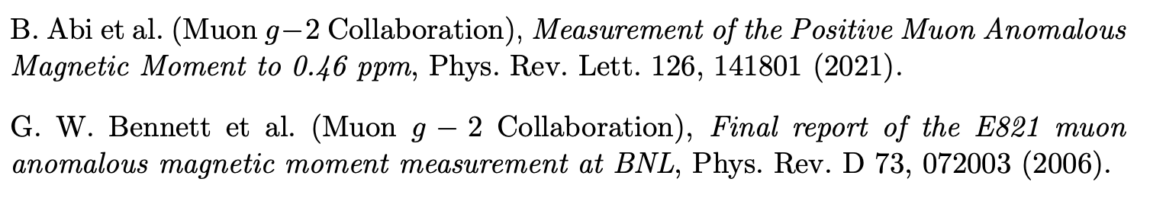

Muon g − 2 ingredients
Using
the ingredients of the 4.2σ effect are:
(ave. of BNL 2006 and FNAL 2021)
0.37 (stat.) ± 0.17 (sys.)
(SM pred. by Muon g −2 theory initiative)
0.40 (Had. Vac. Pol.) ± 0.18 (Had. Light-by-Light)

Slide 36
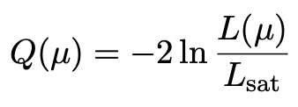
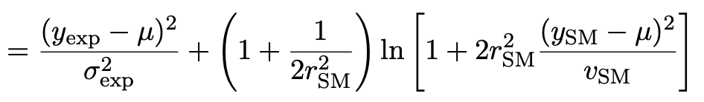
Suppose σ_{SM} uncertain
Suppose measurement errors well known, but that the SM theory
error σ_{SM} (estimated 0.43) could be uncertain.
This is the largest systematic and probably hardest to estimate.
Treat estimate v_{SM} = (0.43)² of variance σ²_{SM} as gamma distributed, width from relative uncertainty parameter r_{SM}.
Maximum-likelihood for mean from minimum of

Slide 37

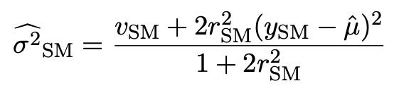
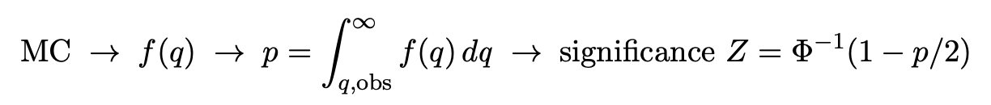
p-value/significance of common-mean hypothesis
Significance (goodness of fit) from
Because of non-quadratic term in Q(μ), distribution of q departs from chi-square(1) for increasing r_{SM}.
Best to get distribution of q from Monte Carlo (and speed up with Bartlett correction – see EPJC (2019) 79:133).
For r_{SM} > 0 distribution of q depends on σ²_{SM}. For MC use Maximum-Likelihood estimate (“profile construction”):
# of sigmas

Slide 38
Significance of discrepancy versus r_{SM}
Naive model: use least squares but let σ_{SM} → (1 + r_{SM}) σ_{SM}
Gamma variance model gives greater decrease in significance for r_{SM} ≳ 0.2, e.g., 3.1σ for r_{SM} = 0.3, 2.0σ for r_{SM} = 0.6.

Slide 39
Significance of discrepancy versus r_{SM}
Establishing 4σ effect requires r_{SM} ≲ 0.3 even if nominal exp.
and SM uncertainties become half of present values.

Slide 40
Discussion on muon g−2
Including uncertainties on estimates of uncertainties can have large effect on hypothesis test, esp. for high significance.
To establish e.g. a 5σ effect it is crucial to have both:
small uncertainties
accurate estimates of those uncertainties (~ 20% level)
This is ultimately because the tails of the Gaussian fall off so quickly.
Gamma Variance Model ~ Student’s t likelihood with ν = 1/2r² degrees of freedom → longer tails than Gaussian.
Ongoing discussion with Bogdan Malaescu of Muon g-2 Theory Initiative on the HVP uncertainty, see, e.g.,
B. Malaescu et al., https://indico.him.uni-mainz.de/event/11/contributions/80/attachments/50/51/amuWorkshop_Correlations_Malaescu.pdf
M. Davier et al., Eur. Phys. J. C 80 (2020) 241 , arXiv:1908.00921

Slide 41
Discussion on Gamma Variance Model
Other features of Gamma Variance Model (see EPJC (2019) 79:133 and the extra slides)
averages/fits become less sensitive to outliers;
confidence intervals linked to goodness of fit;
straightforward to include multiple correlated error sources.
But... is part of the reason for requiring 5σ for discovery not to account for uncertainties in assigned errors? Is there a trade-off between “errors on errors” and the requirement for discovery?
Best to have most realistic model. If the estimated errors are indeed uncertain, this should be reflected in the model.
Bottom line – it is very difficult to establish convincing evidence for a new physics if relevant uncertainties are estimated in an ad hoc way. We need robust procedures for their assignment.

Slide 42
Finally
Three lectures only enough for a brief discussion of:
Parameter estimation
Hypothesis tests (→ path to Machine Learning)
Limits (confidence intervals/regions)
Systematics (nuisance parameters)
Bayesian methods, MCMC
A bit beyond... (“errors on errors”)
Final thought: once the basic formalism is fixed, most of the
work focuses on writing down the likelihood, e.g., P(x|θ), and
including in it enough parameters to adequately describe the data (true for both Bayesian and frequentist approaches) so often best to invest most of your time with it.

Slide 43
Extra Slides

Slide 44

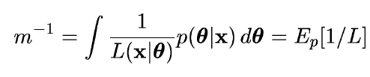
Harmonic mean estimator
E.g., consider only one model and write Bayes theorem as:
π(θ) is normalized to unity so integrate both sides,
posterior
expectation
Therefore sample θ from the posterior via MCMC and estimate m
with one over the average of 1/L (the harmonic mean of L).
Called the “worst Monte Carlo method ever”
https://radfordneal.wordpress.com/2008/08/17/the-harmonic-mean-of-the-likelihood-worst-monte-carlo-method-ever/

Slide 45

Improvements to harmonic mean estimator
The harmonic mean estimator is numerically very unstable;
formally infinite variance (!). A variant (cf. Gelfand and Dey):
Rearrange Bayes thm; multiply
both sides by arbitrary pdf f (θ):
Integrate over θ :
Improved convergence if tails of f (θ) fall off faster than L(x|θ)π(θ)
Note harmonic mean estimator is special case f (θ) = π(θ).
.

Slide 46



Adaptive Harmonic Mean Integration
A. Caldwell et al., International Journal of Modern Physics A Vol. 35, No. 24 (2020) 2050142
Want to compute
(Ω = support of f)
E.g. f (λ) = L(λ) π(λ) = unnormalized target density; we can sample from this with MCMC.
Define integral over subvolume Δ of Ω with volume V_{Δ}

Slide 47
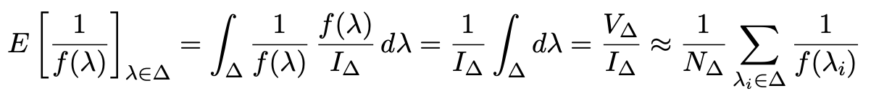
Adaptive Harmonic Mean Integration (2)
If f (λ) not small in Δ, then we can find I_{Δ} from harmonic mean:
Sample λ from f (λ) using MCMC, estimate r = I_{Δ}/I with fraction of points found in Δ:
Use these to estimate I:
“The task of estimating our integral, therefore reduces to choosing one or several
subspaces ∆ — typically small regions around local modes of f (λ). The full space
Ω over which the integration ought to be performed can be large or even inﬁnite,
while this does not aﬀect the outcome of our integral estimate.”
A. Caldwell et al., IJMP A Vol. 35, No. 24 (2020) 2050142

Slide 48

A. Caldwell et al., IJMP A Vol. 35, No. 24 (2020) 2050142
Adaptive Harmonic Mean Integration (3)
Testing AHMI with multimodal multidimensional Cauchy pdf
Challenging pdf because of long tails.
Good results for up to 7 dimensions for MCMC sample size of 10⁶.
Software: Bayesian Analysis Toolkit
https://github.com/bat/BAT.jl

Slide 49
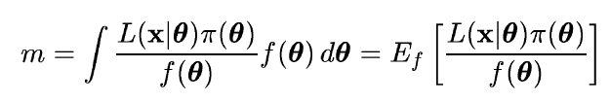
Importance sampling
Need pdf f (θ) which we can evaluate at arbitrary θ and also
sample with MC.
The marginal likelihood can be written
Sample θ ~ f (θ), compute average of L(x|θ) π(θ) / f (θ).
Best convergence when f (θ) approximates shape of L(x|θ)π(θ).
Use for f (θ) e.g. multivariate Gaussian with mean and covariance
estimated from posterior.

Slide 50
Nested sampling
J. Skilling, Bayesian Analysis, No. 4, pp. 833-860 (2006)
We want to compute
Can add up portions of X (equivalently, θ) space in any order. Use
X near 1 means low λ, all of
θ space included.
Write inverse function as
so that the desired result is
Elements of θ space are sorted
by decreasing likelihood.

Slide 51
J. Skilling, Bayesian Analysis, No. 4, pp. 833-860 (2006)
Nested sampling (2)
The evidence Z
is the area under
the curve of L(X).
Computational challenge is to sample θ space from prior subject to constraint L(θ) > λ. Software: MultiNest
Farhan Feroz, Mike Hobson, Mon. Not. Roy. Astron. Soc., 384, 2, 449-463 (2008); arXiv:0704.3704,
F. Feroz, M.P. Hobson, M. Bridges, Mon. Not. Roy. Astron. Soc. 398: 1601-1614,2009; arXiv:0809.3437
F. Feroz, M.P. Hobson, E. Cameron, A.N. Pettitt, arXiv:1306.2144

Slide 52
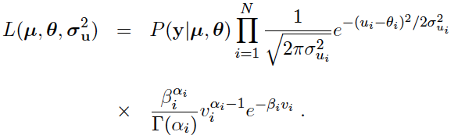
Full likelihood for gamma variance model
α_{i} = 1/4r_{i}²
β_{i} = α_{i}/σ_{ui}²
,
Treated like data: y₁,...,y_{L} (the primary measurements)
u₁,...,u_{N} (estimates of nuisance par.)
v₁,...,v_{N} (estimates of variances
of estimates of NP)
Adjustable parameters: μ₁,...,μ_{M} (parameters of interest)
θ₁,...,θ_{N} (nuisance parameters)
σ_{u,1},...,σ_{u,N} (sys. errors = std. dev. of
of NP estimates)
Fixed parameters: r₁,...,r_{N} (rel. err. in estimate of σ_{u,i})

Slide 53
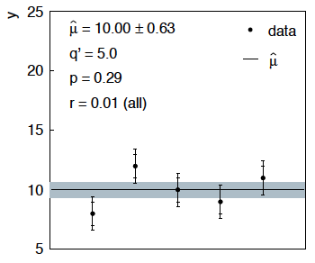
Sensitivity of average to outliers
Suppose we average 5 values, y = 8, 9, 10, 11, 12, all with
stat. and sys. errors of 1.0, and suppose negligible error on error
(here take r = 0.01 for all).
inner error bars
= σ_{y,i}
outer error bars
= (σ_{y,i}² + σ_{u,i}²)^{½}

Slide 54
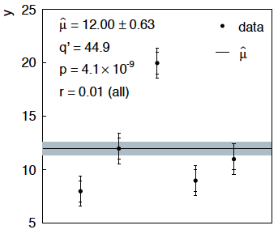
Sensitivity of average to outliers (2)
Now suppose the measurement at 10 had come out at 20:
“outlier”
Estimate pulled up to 12.0, size of confidence interval ~unchanged
(would be exactly unchanged with r → 0).

Slide 55
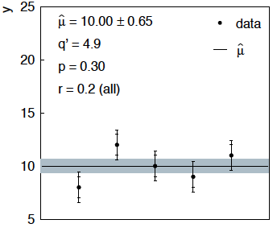
Average with all r = 0.2
If we assign to each measurement r = 0.2,
Estimate still at 10.00, size of interval moves 0.63 → 0.65

Slide 56
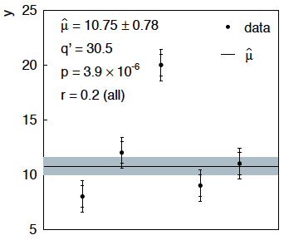
Average with all r = 0.2 with outlier
Same now with the outlier (middle measurement 10 → 20)
Estimate →10.75 (outlier pulls much less).
Half-size of interval → 0.78 (inflated because of bad g.o.f.).

Slide 57



Naive approach to errors on errors
Naively one might think that the error on the error in the previous
example could be taken into account conservatively by inflating
the systematic errors, i.e.,
But this gives
without outlier (middle meas. 10)
with outlier (middle meas. 20)
So the sensitivity to the outlier is not reduced and the size of the
confidence interval is still independent of goodness of fit.

Slide 58

Correlated uncertainties
The phrase “correlated uncertainties” usually means that a single
nuisance parameter affects the distribution (e.g., the mean) of more
than one measurement.
For example, consider measurements y, parameters of interest μ,
nuisance parameters θ with
That is, the θ_{i} are defined here as contributing to a bias and
the (known) factors R_{ij} determine how much θ_{j} affects y_{i}.
As before suppose one has independent control measurements
u_{i}~ Gauss(θ_{i}, σ_{ui}).

Slide 59



Correlated uncertainties (2)
The total bias of y_{i} can be defined as
which can be estimated with
These estimators are correlated having covariance
In this sense the present method treats “correlated uncertainties”,
i.e., the control measurements u_{i} are independent, but nuisance
parameters affect multiple measurements, and thus bias estimates
are correlated.

