Slide 1


Parameter Estimation
Hands-on Session
INFN School of Statistics
Paestum, 15-20 May 2022
https://agenda.infn.it/event/28039/
Glen Cowan
Physics Department
Royal Holloway, University of London
g.cowan@rhul.ac.uk
www.pp.rhul.ac.uk/~cowan

Slide 2
Introduction and materials
The exercises for parameter estimation are at (linked also to indico)
https://www.pp.rhul.ac.uk/~cowan/stat/paestum/exercises
The exercise and are described in the file fitting_exercises.pdf.
There are both python and ROOT/C++ versions.
For python, you need python 3 and install iminuit from https://pypi.org/project/iminuit/ with pip install iminuit
For ROOT you should have version 6 and C++ installed with a “cern-like” (e.g., lxplus) setup.

Slide 3
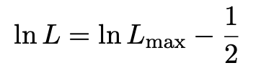
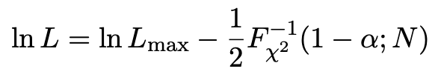

Comment on the lnL = lnL_{max} – ½ contour
In the lectures, we saw that the standard deviations of fitted parameters are found from the tanget lines (planes) to the contour
A similar procedure can be used to find a “confidence region” in the parameter space that will cover the true parameter with probability CL = 1 – α (the “confidence level). This uses the contour
, N = number of parameters
If you want the contour lnL = lnL_{max} – ½ in iminuit, you need to choose CL (= 1 – α) such that Fχ²⁻¹(1 – α,N) = 1, i.e.,

Slide 4
Solutions
1a) Running the program mlFit.py produces the following plots:
A fit of the pdf:

Slide 5
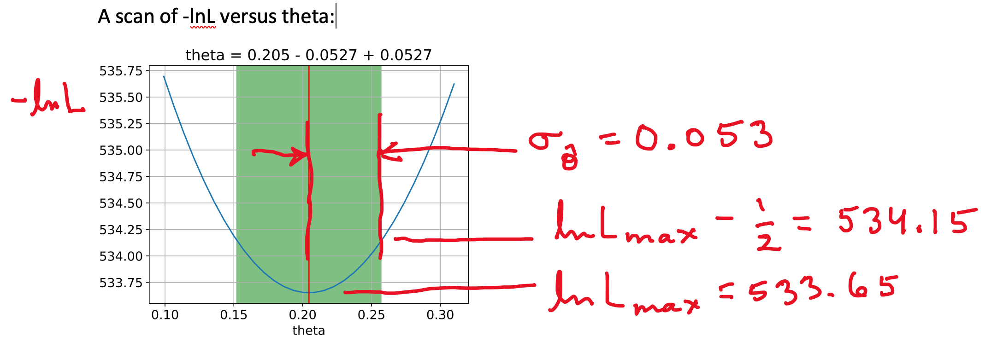

Slide 6
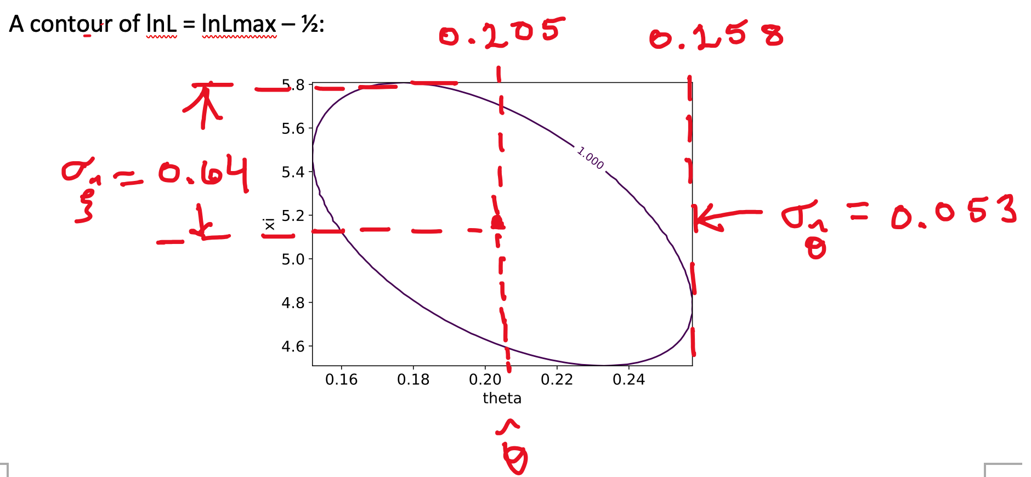

Slide 7
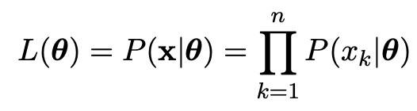
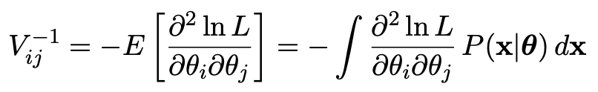
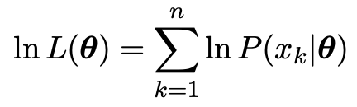
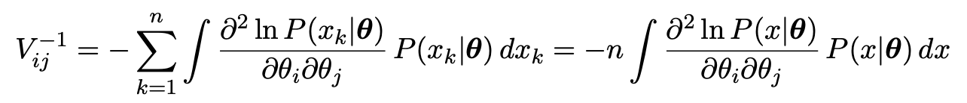

1b) Assume i.i.d. data sample, so
Assume inverse covariance from Fisher Information (large sample):
Since
we find
But V⁻¹V = I so if V⁻¹ ∝ n, then V ∝ 1/n, and so from the square roots of the diagonal elements

Slide 8
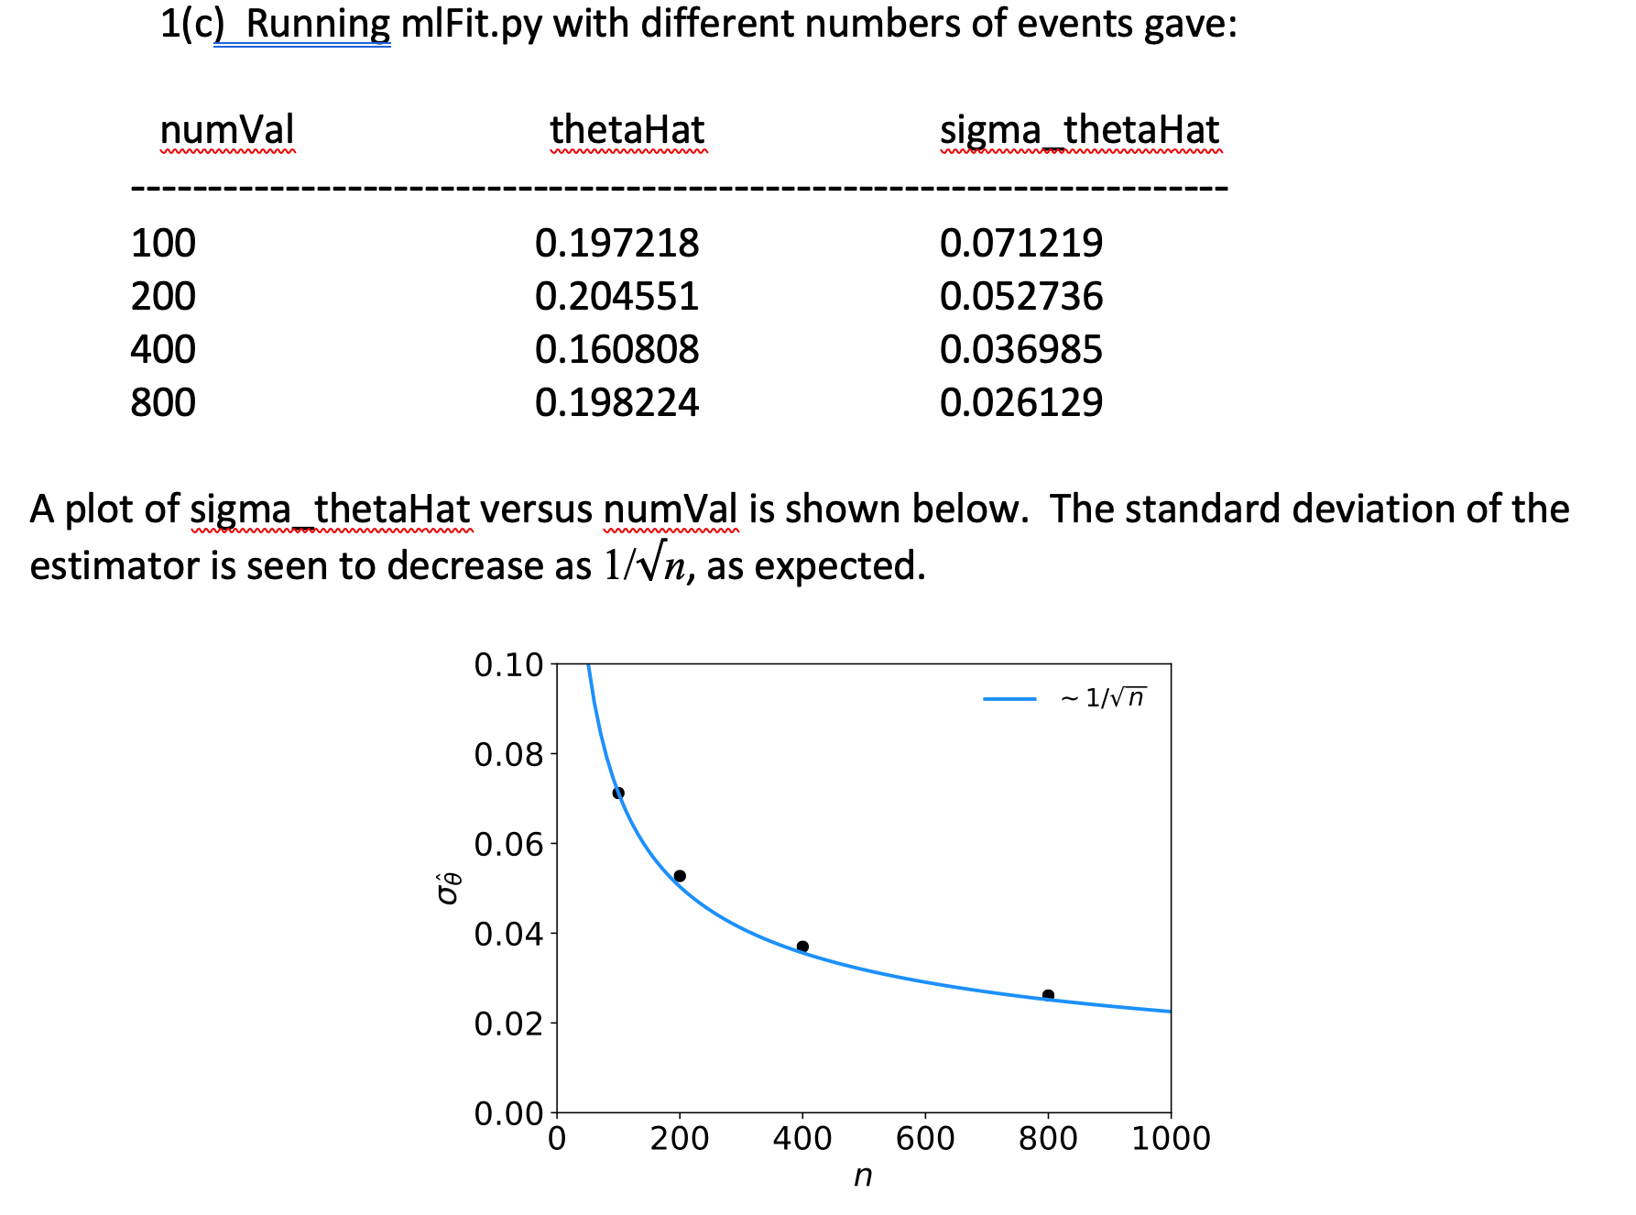

Slide 9
