Slide 1
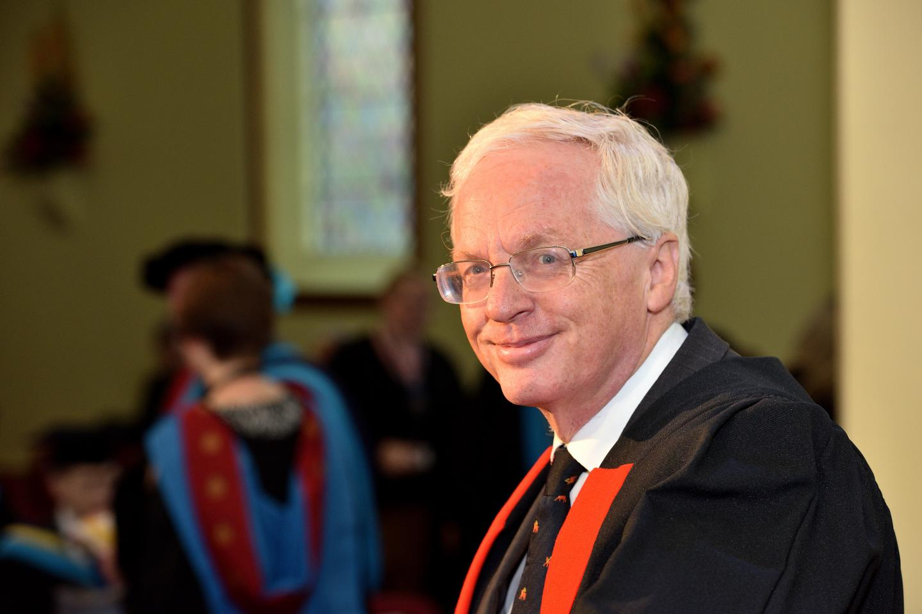
Professor Roger Barlow
PhD Cambridge
Particle Physics on TASSO, JADE, OPAL, BaBar, LHCb
Professor at Manchester, Huddersfield
Founder of Cockroft Institute, ThorEA Organisation
2023 IoP Lise Meitner Prize for contributions to physics outreach and education, including founding in 1997 of Particle Physics Masterclasses
https://news.cision.com/university-of-huddersfield/i/emeritus-professor-roger-barlow,c3145812

Slide 2
