Slide 1
PH3010 / Advanced Skills
Introduction to Machine Learning
Glen D. Cowan
RHUL Physics

Slide 2
Outline
Part 1:
What Machine Learning is and how it can be applied
Classification of two types of “events”
Linear classifiers: Fisher Discriminant
Part 2:
Nonlinear classifiers: Neural Networks
Software for Machine Learning: scikit-learn
Exercises
Part 3 (extension):
Multiple regression

Slide 3
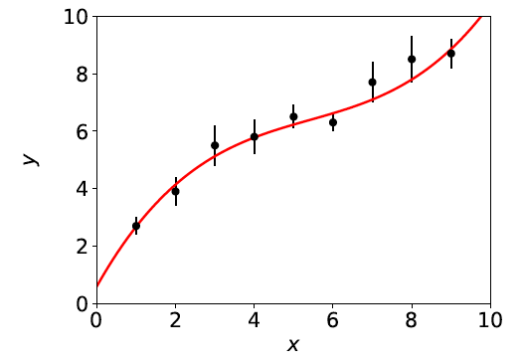
What Machine Learning is
The term Machine Learning (ML) refers to algorithms that “learn
from data” and make predictions based on what has been learned.
In its simplest sense, “learning” means the algorithm contains adjustable parameters whose values are estimated using data.
Formally, curve fitting can be seen as Machine Learning.
Hypothesized curve:
Values of parameters are “learned”
from the data.
Fitted curve can make predictions
at x values of future measurements.

Slide 4
More general Machine Learning
But generally ML refers to situations in which:
the hypothesized model is very general (e.g., not just
a polynomial) and contains many adjustable parameters;
the quantity we want to predict could depend on many
variables, e.g., not just x but a vector x = (x₁,...,x_{n}).
ML can be seen as a part of or related to:
Artificial Intelligence
Pattern Recognition
Statistical Learning
Multivariate Analysis
Development from (mainly) Computer Science, (also) Statistics;
sometimes “Data Science” used to refer to all of above.

Slide 5
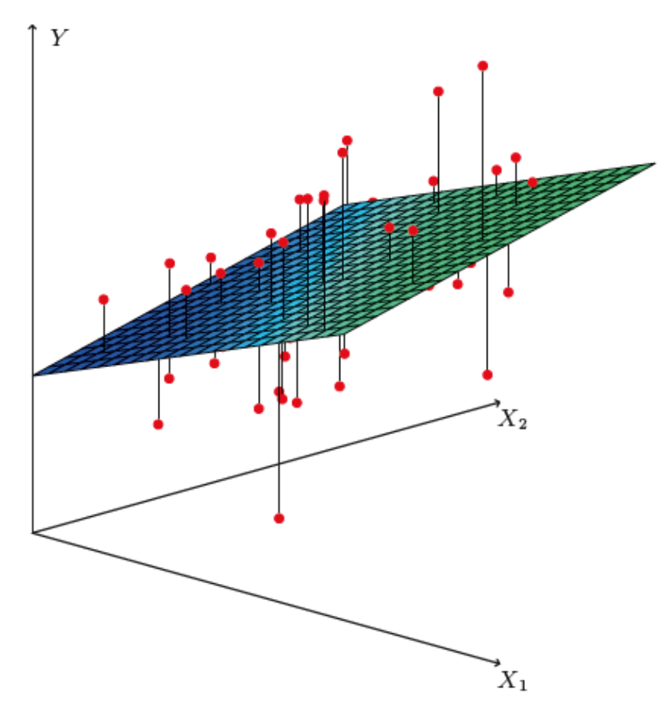
Curve fitting → regression
The generalisation of curve fitting with a multidimensional control
variable x → x = (x₁,..., x_{n}) is called multiple regression.
The data consist of sets of points (x_{i}, y_{i}), where now x_{i} is a
multidimensional vector, and usually the y_{i} does not come with
an error bar.
Goal is to predict the expected y value for a new x.
https://web.stanford.edu/~hastie/ISLR2/ISLRv2_website.pdf
E.g. in two dimensions,
multiple regression means
fitting a surface f (x₁, x₂)
to data points (x_{1,i}, x_{2,i}, y_{i}):

Slide 6
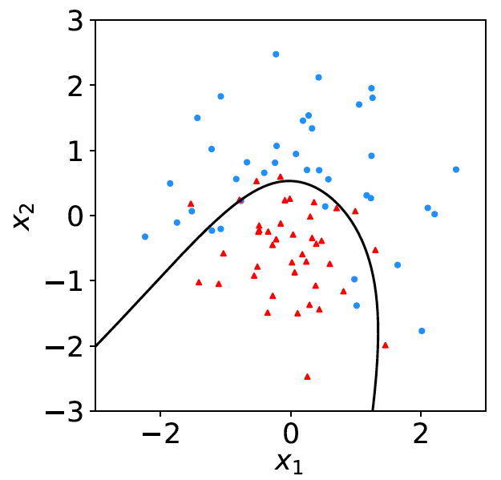
Classification
A related type of ML algorithm is called classification: the data consist of points (x_{i}, y_{i}), where now y_{i} is discrete class label,
(e.g., 0 or 1, red or blue, etc.).
Learning based on events with known y_{i} = supervised learning.
Goal is to create a decision boundary in x-space so as to predict the class y of a new instance of x.
blue = class 1
decision boundary
red = class 0

Slide 7
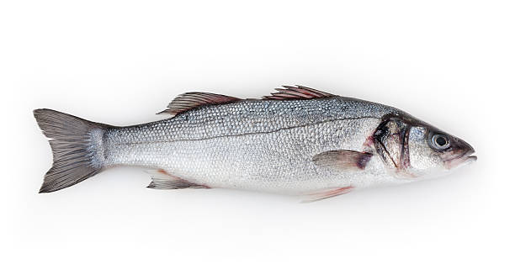
Example of classification: Industrial Fishing
You scoop up fish which are of two types:
Sea
Bass
Cod
You examine the fish with automatic sensors and for each one
you measure a set of features:
x₁ = length x₄ = area of fins
x₂ = width x₅ = mean spectral reflectance
x₃ = weight x₆ = ...
These constitute the “feature vector” x = (x₁,..., x_{n}).
In addition you hire a fish expert to identify the “true class label”
y = 0 or 1 (i.e., 0 =sea bass, 1 = cod) for each fish.

Slide 8
Distributions of the features
If we consider only two
features x = (x₁, x₂), we can
display the results in a scatter
plot (red: y = 0, blue: y = 1).
Goal is to determine a decision boundary, so that, without the help of the fish expert, we can classify new fish by seeing where their measured features lie relative to the boundary.
Same idea in multi-dimensional feature space, but cannot represent as 2-D plot. Decision boundary is n-dim. hypersurface.

Slide 9
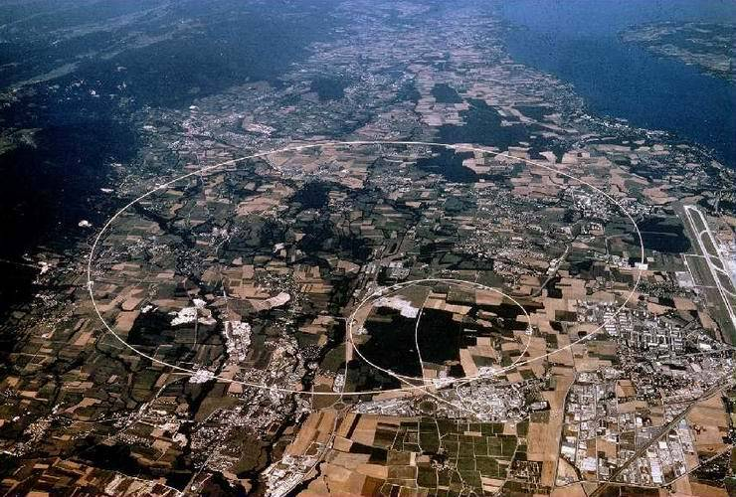
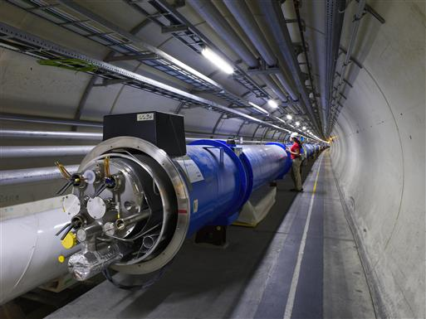
Example use of Machine Learning: Particle Physics at the LHC
Counter-rotating proton beams
in 27 km circumference ring
pp centre-of-mass energy 14 TeV
Detectors at 4 pp collision points:
ATLAS
CMS
LHCb (b physics)
ALICE (heavy ion physics)
general purpose

Slide 10
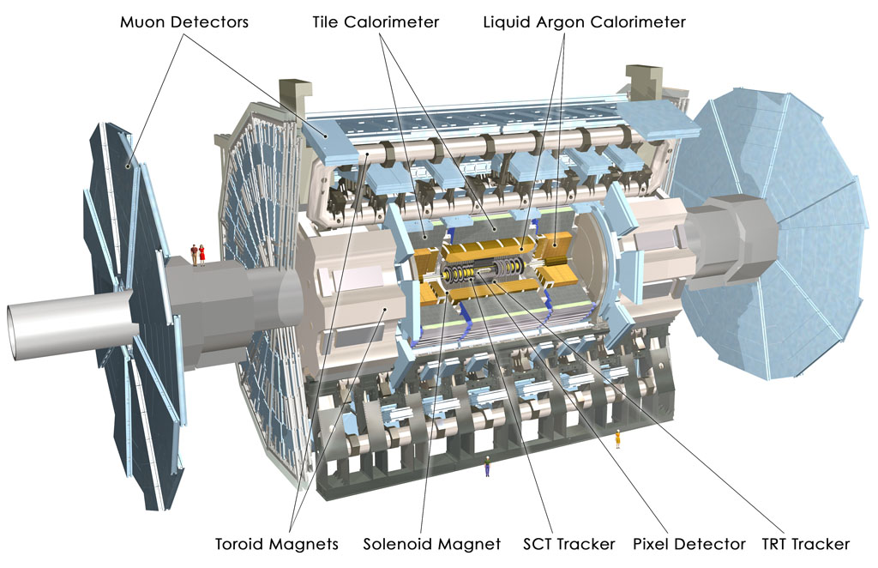
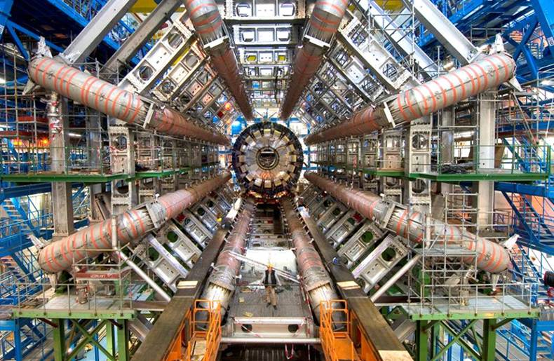
The ATLAS Detector at the LHC
3000 physicists
37 countries
167 universities/labs
25 m diameter
46 m length
7000 tonnes
~10⁸ electronic channels

Slide 11
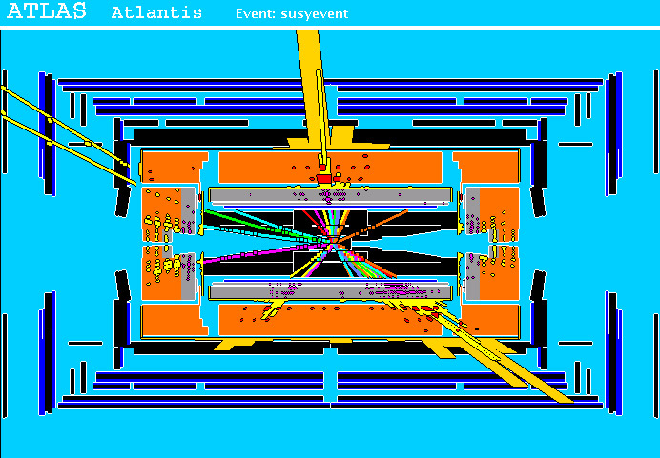
A simulated proton-proton collision
from supersymmetry (“signal”)
high p_{T}
muons
high p_{T} jets
of hadrons
p
p
missing transverse energy

Slide 12
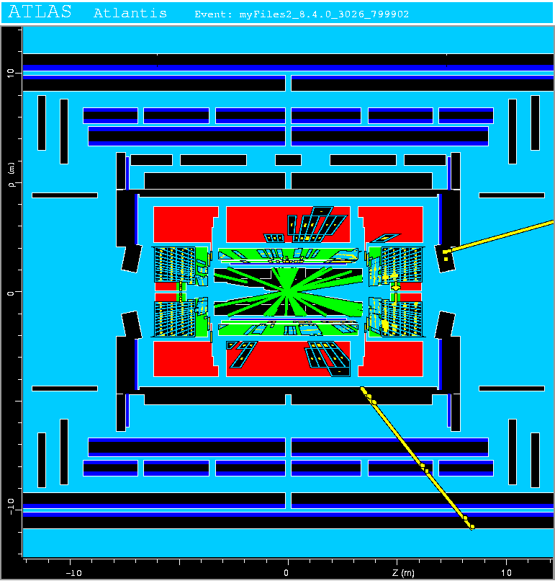
A simulated proton-proton collision from production of top quarks (“background”)
This event has features
similar to what we hope
to see in supersymmetric
events, and thus constitutes
a “background” that can
mimic the “signal”.

Slide 13
Classification of proton-proton collisions
Proton-proton collisions can be considered to come in two classes:
signal (the kind of event we’re looking for, y = 1)
background (the kind that mimics signal, y = 0)
For each collision (event), we measure a collection of features:
x₁ = energy of muon x₄ = missing transverse energy
x₂ = angle between jets x₅ = invariant mass of muon pair
x₃ = total jet energy x₆ = ...
The real events don’t come with true class labels, but computer-simulated events do. So we can have a set of simulated events that consist of a feature vector x and true class label y (0 for background, 1 for signal):
(x, y)₁, (x, y)₂, ..., (x, y)_{N}
The simulated events are called “training data”.

Slide 14
What is the best decision boundary?
“cuts”
linear
nonlinear

Slide 15
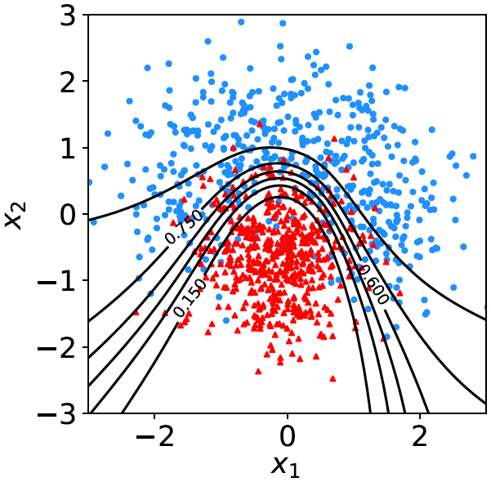
What is the best decision function?
A surface in an n-dimensional
space can be described by
scalar
function
constant
Different values of the constant
t_{c} result in a family of surfaces.
Problem is reduced to finding
the best decision function t (x).

Slide 16
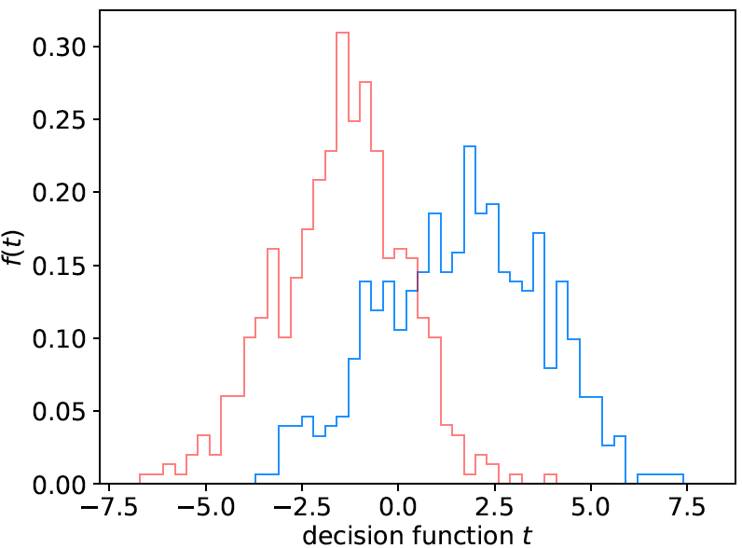
Linear decision boundary
A simple Ansatz is to try a
decision function of the form
where the coefficients w₁,..., w_{n} are constants (or “weights”) we
need to determine using the training data.
A given choice of the weights
fixes the function t (x).
Look at the training events
from the two classes, for
each evaluate t (x) and enter
into a histogram.
Goal is to maximize the
“separation” between the
two distributions.
back-
ground
signal

Slide 17
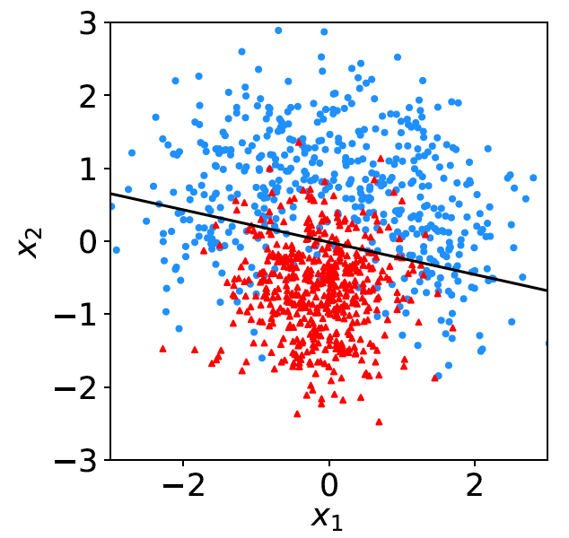
Fisher discriminant
Using a particular definition of what constitutes “best separation”
due to R. Fisher one obtains a Fisher discriminant:

Slide 18
Outline
Part 1:
What Machine Learning is and how it can be applied
Classification of two types of “events”
Linear classifiers: Fisher Discriminant
Part 2:
Nonlinear classifiers: Neural Networks
Software for Machine Learning: scikit-learn
Exercises
Part 3 (extension):
Multiple regression

Slide 19
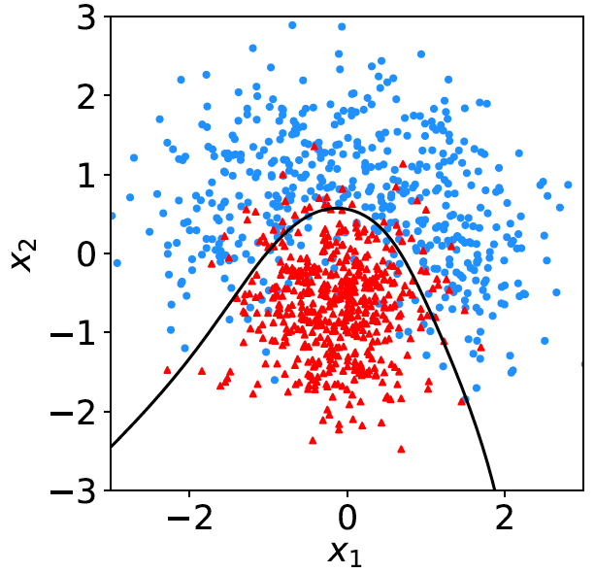
Nonlinear decision boundaries
From the scatter plot below it’s clear that some nonlinear boundary
would be better than a linear one:
And to have a nonlinear boundary, the decision function t (x) must be nonlinear in x.

Slide 20
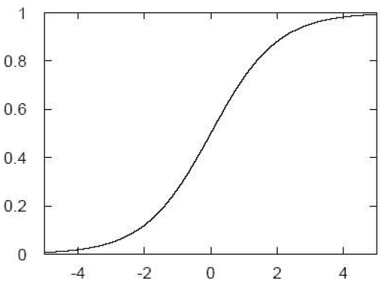
Neural Networks
A simple nonlinear decision function can be constructed as
where h is called the “activation function”. For this one
can use, e.g., a logistic sigmoid function,
u

Slide 21
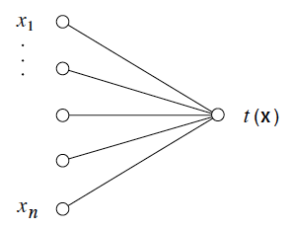
Single Layer Perceptron
In this form, the decision
function is called a
Single Layer Perceptron –
the simplest example of a
Neural Network.
output node
input layer
But the surface described by t (x) = t_{c} is the same as by
So here we still have a linear decision boundary.

Slide 22
Multilayer Perceptron
The Single Layer Perceptron can be generalized by defining
first a set of functions φ_{i}(x), with i = 1,..., m:
The φ_{i}(x) are then treated as if they were the input variables, in
a perceptron, i.e., the decision function (output node) is

Slide 23
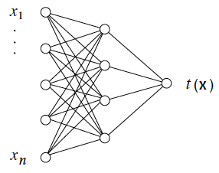
Multilayer Perceptron (2)
output node
hidden layer with m nodes
φ₁(x),..., φ_{m}(x)
input
layer
Each line in the graph represents one of the weights w_{ij}^{(k)},
which must be adjusted using the training data.

Slide 24
Training a Neural Network
To train the network (i.e., determine the best values for the
weights), define a loss function, e.g.,
where w represents the set of all weights, the sum is over the
set of training events, and y_{i} is the (numeric) true class label
of each event (0 or 1).
The optimal values of the weights are found by minimizing
E(w) with respect to the weights (non-trivial algorithms:
backpropagation, stochastic gradient descent,...).
The desired result for an event with feature vector x is:
if the event is of type 0, want t (x) ~ 0,
if the event is of type 1, want t (x) ~ 1.

Slide 25
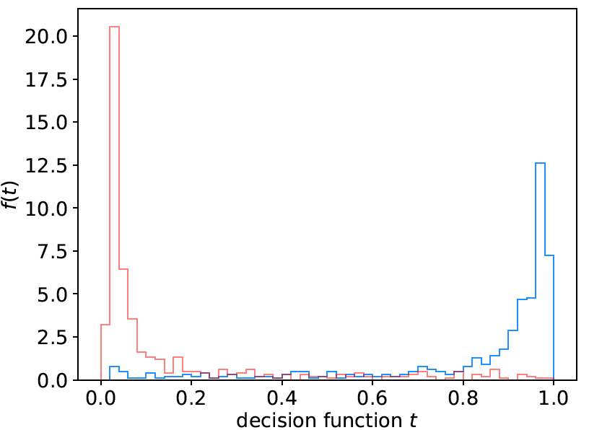
Distribution of neural net output
Degree of separation between classes now much better than
with linear decision function:
back-
ground
signal

Slide 26
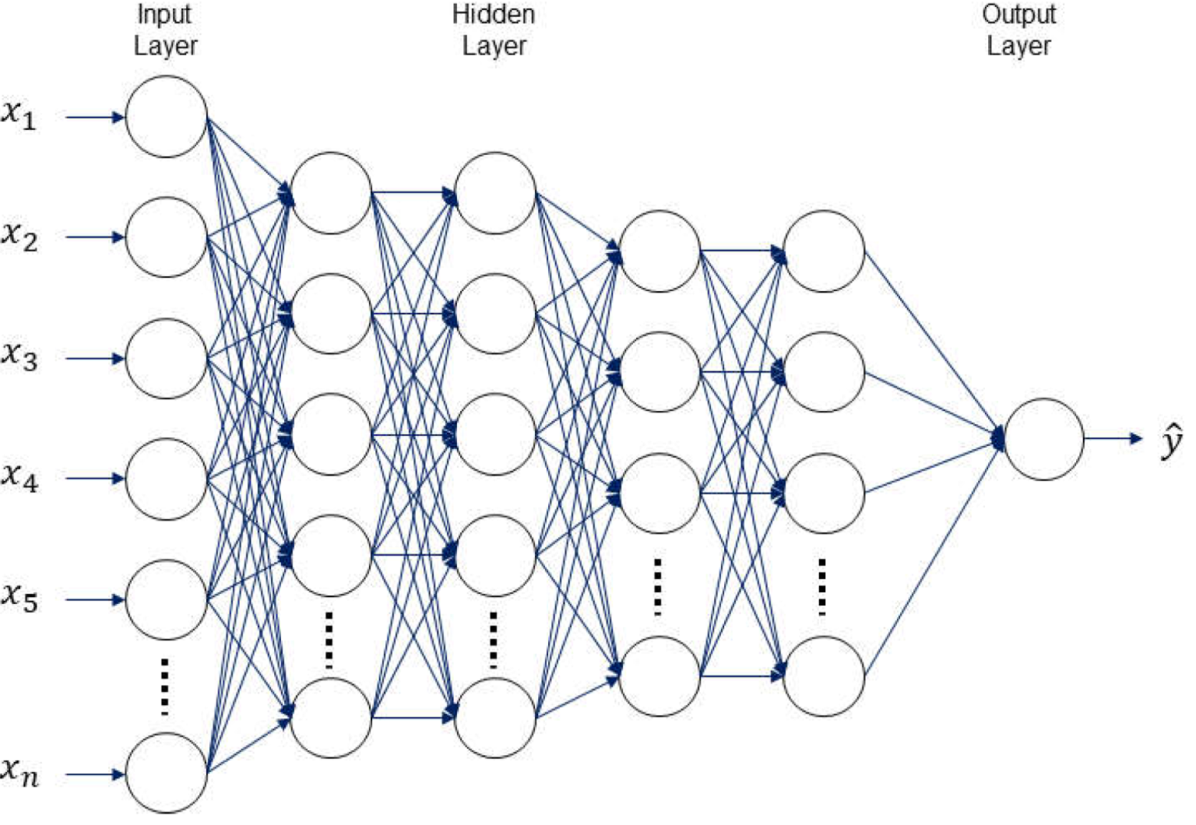
H.I. Kim and K.Y. Han, Water 2020, 12(3), 899
Deep Neural Networks
The multilayer perceptron can be generalized to have an arbitrary number of hidden layers, with an arbitrary number of nodes in each (= “network architecture”).
A “deep” network has several (or many) hidden layers:
“Deep Learning” is a very recent and active field of research.

Slide 27
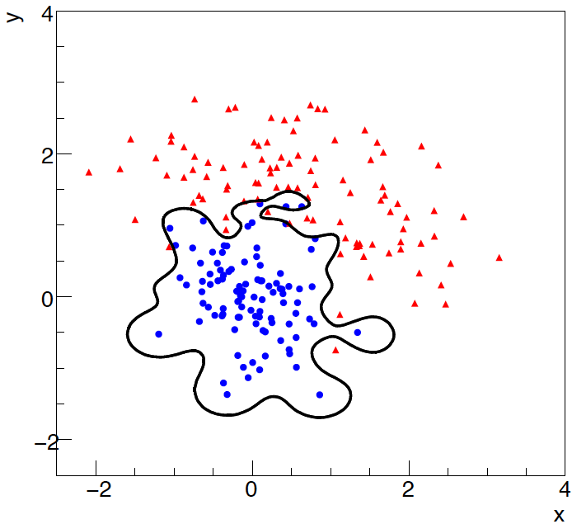
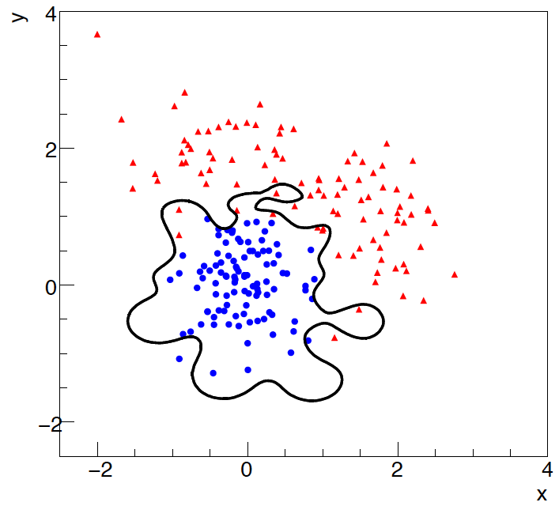
Overtraining
Including more parameters in a classifier makes its decision boundary
increasingly flexible, e.g., more nodes/layers for a neural network.
A “flexible” classifier may conform too closely to the training points;
the same boundary will not perform well on an independent test
data sample (→ “overtraining”).
training sample
independent test sample

Slide 28
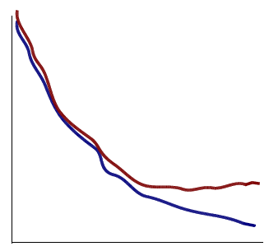
Monitoring overtraining
If we monitor the fraction of misclassified events (or similar, e.g.,
loss function E(w)) for test and training samples, it will usually
decrease for both as the boundary is made more flexible:
optimum at minimum of
error rate for test sample
error
rate
increase in error rate
indicates overtraining
test sample
training sample
complexity/flexibility (e.g., number
of nodes/layers in MLP)

Slide 29
Other types of classifiers
We have seen only two types of classifiers:
Linear (Fisher discriminant)
Neural Network
There are many others:
Support Vector Machine
Boosted Decision Tree
K-Nearest Neighbour
...
The field is rapidly developing with advances, e.g., that allow one
to use feature vectors of very high dimension, such as the pixels
of an image.
→ face/handwriting recognition, driverless cars...

Slide 30
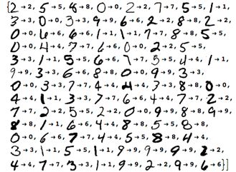
https://www.wolfram.com/mathematica/new-in-10/highly-automated-machine-learning/
Machine Learning for handwriting recognition
Initial feature vector = set of pixel values of an image

Slide 31
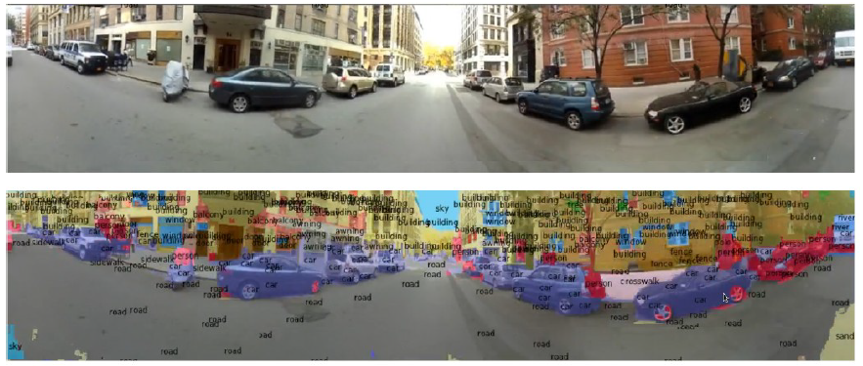
Y. LeCun
Scene parsing/labeling with Convolutional Neural Nets
See Deep Learning and the Future of AI, seminar at CERN by
Yann LeCun: https://indico.cern.ch/event/510372/

Slide 32
Software for Machine Learning
We will practice ML with the Python package scikit-learn
scikit-learn.org ← software, docs, example code
scikit-learn built on NumPy, SciPy and matplotlib, so you need
import scipy as sp
import numpy as np
import matplotlib
import matplotlib.pyplot as plt
and then you import the needed classifier(s), e.g.,
from sklearn.neural_network import MLPClassifier
For a list of the various classifiers in scikit-learn see the docs
on scikit-learn.org, also a very useful sample program:
http://scikit-learn.org/stable/auto_examples/classification/plot_classifier_comparison.html

Slide 33
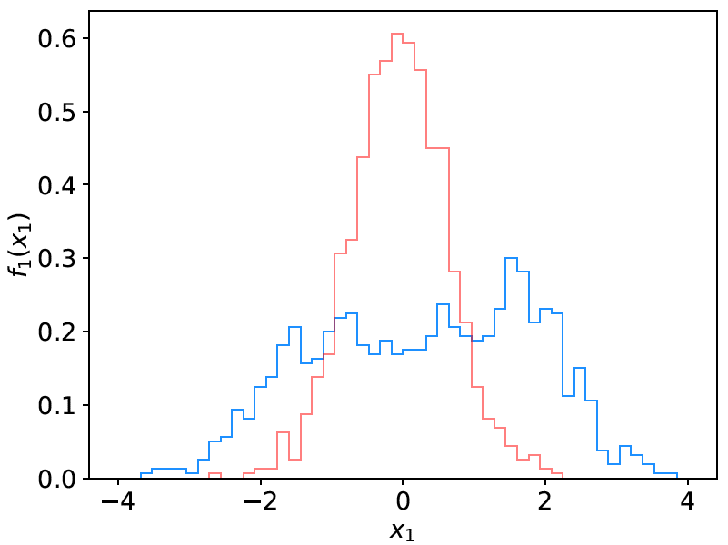
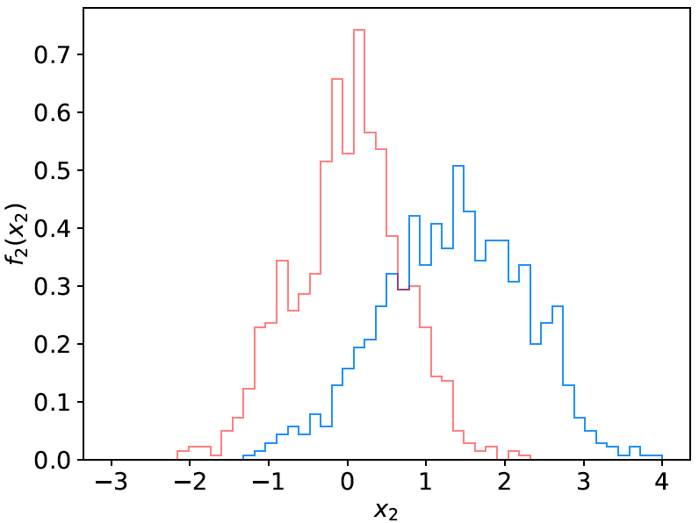
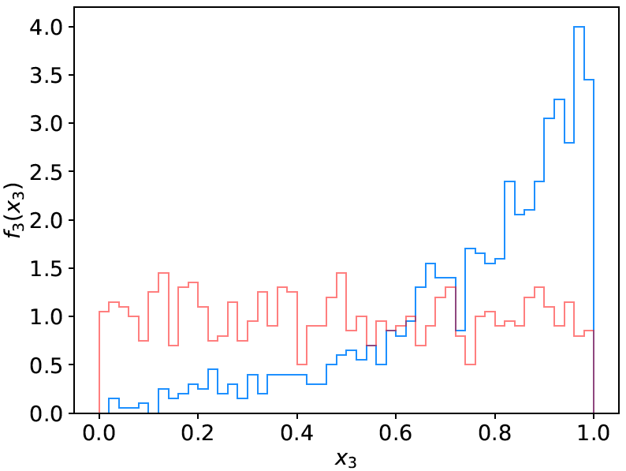
Example: the data
We will do an example with data corresponding to events
of two types: signal (y = 1, blue) and background (y = 0, red).
Each event is characterised by 3 quantities: x = (x₁, x₂, x₃).
Components are correlated.
Suppose we have 1000 events each of signal and background.

Slide 34
Reading in the data
scikit-learn wants the data in the form of numpy arrays:
# read the data in from files,
# assign target values 1 for signal, 0 for background
sigData = np.loadtxt('signal.txt')
nSig = sigData.shape[0]
sigTargets = np.ones(nSig)
bkgData = np.loadtxt('background.txt')
nBkg = bkgData.shape[0]
bkgTargets = np.zeros(nBkg)
# concatenate arrays into data X and targets y
# split into two parts: use one for training, the other for testing
X = np.concatenate((sigData,bkgData),0)[:,0:2] # for now, only use x1, x2
y = np.concatenate((sigTargets, bkgTargets))
# split data into training and testing samples
X_train, X_test, y_train, y_test = train_test_split(X, y, test_size=0.5,
random_state=1)

Slide 35
Create, train, evaluate the classifier
Create an instance of the MLP (multilayer perceptron) class
and “train”, i.e., adjust the values of the weights to minimise
the loss function.
Here we request 3 hidden layers with 10 nodes each:
# create classifier object and train
clf = MLPClassifier(hidden_layer_sizes=(10,10,10), activation='tanh',
max_iter=2000, random_state=6)
clf.fit(X_train, y_train)
Use test data to see what fraction of events are correctly classified
(default takes threshold of 0.5 for decision function)
# evaluate its accuracy (= 1 – error rate) using the test data
y_pred = clf.predict(X_test)
print(metrics.accuracy_score(y_test, y_pred))

Slide 36
Evaluating the decision function
So now for an arbitrary point (x₁, x₂) in the feature space,
we can evaluate the decision:
xt = np.array([0.37, 2.46]).reshape((1,-1)) # input is numpy array
t = clf.predict_proba(xt)[0, 1]
Or we may have an array of points in x-space, so we can
get an array of probabilities:
t = clf.predict_proba(X_test)[:, 1] # returns prob to be of type y=1
Can get this separately for the signal and background events
and make histograms (see sample code).
Note for most other classifiers, the decision function is called
decision_function – use this instead of predict_proba.

Slide 37
Exercises
Run the program simpleClassifier.py and describe the output.
It is set up to use at first only the first two components, x₁ and x₂,
so that the results can be displayed as a scatter plot.
Change program to use all three input variables by removing
the line X = X[:,0:2] and you will have to side-step the code that
makes the scatter plot.
Change numbers of hidden layers and nodes – try to find the
maximum possible classification accuracy.
For 1 hidden layer e.g., with 10 nodes: hidden_layer_sizes=(10,) .
Note if the number of requested layers/nodes gets too large, it will
not be possible to train (find the minimum of the loss function).
For the best architecture that you find, use the test sample to produce a histogram of the network output (see sample code).

Slide 38
Exercises (continued)
By looking at the scikit-learn documentation and the sample
program plot_classifier_comparison mentioned above, implement a linear classifier (class LinearDiscriminantAnalysis) using all three input variables.
Make a histogram of the classifier output; compare its performance to your best neural network.
By consulting the documentation and sample program, implement at least one of:
K-Nearest Neighbor Classifier (KNeighborsClassifier).
Support Vector Machine (SVC)
Boosted Decision Tree (AdaBoostClassifier)
Write up the ML exercises as a single section of your project
report.

Slide 39
Resources on Machine Learning
Mini-intro to ML included in PH4515 Statistical Data Analysis
Course in our CS Dept., CS3920/CS4920 (also KCL Maths).
Online courses, e.g., K. Markham, Introduction to machine
learning with scikit-learn (also on youtube):
www.dataschool.io/machine-learning-with-scikit-learn/
Many online courses, tutorials – worth a look but often very
qualitative and/or approach from computer science angle.
More python software (very rapid development):
pandas, seaborn, tensorflow, keras, theano,..
Gareth James, Daniela Witten, Trevor Hastie and Robert Tibshirani,
An Introduction to Statistical Learning with Applications in R
www-bcf.usc.edu/~gareth/ISL/
https://youtu.be/5N9V07EIfIg

Slide 40
Outline
Part 1:
What Machine Learning is and how it can be applied
Classification of two types of “events”
Linear classifiers: Fisher Discriminant
Part 2:
Nonlinear classifiers: Neural Networks
Software for Machine Learning: scikit-learn
Exercises
Part 3 (extension):
Multiple regression

Slide 41
http://www-bcf.usc.edu/~gareth/ISL/
Brief intro to multiple regression
Multiple regression* can be seen as an extension of curve fitting to the case where the variable x is replaced by a multi-dimensional x = (x₁,...,x_{n}), e.g., fitting a surface. Here suppose the data are points (x_{i}, y_{i}), i = 1,...,N (no error bars) and x is usually a random variable, often called the explanatory or predictor variable.
Equivalently, we can view it as an extension to classification with
the discrete class label y = 0, 1 replaced by a continuous target y (and in this context x can also be called the feature vector).
*Note the term ”multivariate” regression refers to a vector target variable y; here we treat only scalar y.

Slide 42
Target (fit) function and loss function
As in the case of curve fitting, we assume some parametric function
of x that represents the mean of the target variable
where w is a vector of adjustable parameters (“weights”).
Suppose we have training data consisting of (x_{i}, y_{i}), i = 1,...,N.
Use these to determine the weights by minimizing a loss function
(analogous to the χ²), e.g.,

Slide 43
http://www-bcf.usc.edu/~gareth/ISL/
Linear regression
In linear regression, the fit function is of the form
i.e. the problem is equivalent to an unweighted least-squares fit of a (hyper-)plane:
Can be generalized to a nonlinear surface with higher order terms,

Slide 44
Nonlinear regression
Other examples of nonlinear regression include:
MLP (multilayer perceptron) regression
Boosted decision tree regression
Support vector regression
For MLP regression, as with classification, regard the feature vector as the layer k = 0; i.e., φ_{i}⁽⁰⁾ = x_{i}.
The ith node of hidden layer k is
where h is the activation function (tanh, relu, sigmoid,...).

Slide 45
MLP Regression (cont.)
For the final layer (k=K), in MLP regression (in contrast to classification), one omits the activation function, i.e.,
where φ_{j}^{(K−1)} = are the nodes of the last hidden layer (k = K−1).
For info on other types of multiple regression see, e.g.,
http://www-bcf.usc.edu/~gareth/ISL/
and the scikit-learn documentation.

Slide 46
Multiple regression example
Suppose particles with different energies E and angles θ (or equivalently η = − ln tan(θ/2) ) enter a calorimeter and create a particle showers that gives signals in three layers, s₁, s₂ and s₃, as well as an estimate of η.
Some of the energy leaks through, with increased leakage for higher energy and more oblique angles (higher η).
The goal is to estimate the target y_{i} = E_{i} given feature vectors
x_{i} = (η, s₁, s₂,s₃)_{i} for i = 1,...,N training events.

Slide 47
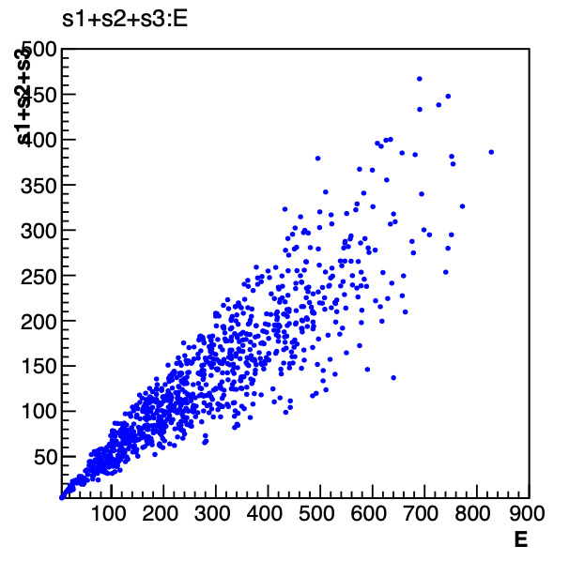
Energy estimate from sum of signals
Naively, one could try just summing the signals:
Gives very poor resolution
because the particles have a
distribution of energies and
angles and hence differing amounts of the energy leak through undetected.

Slide 48
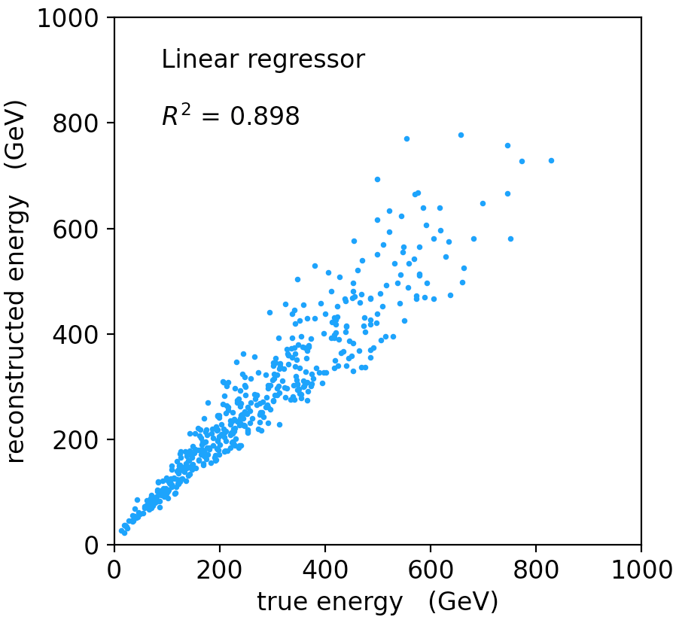
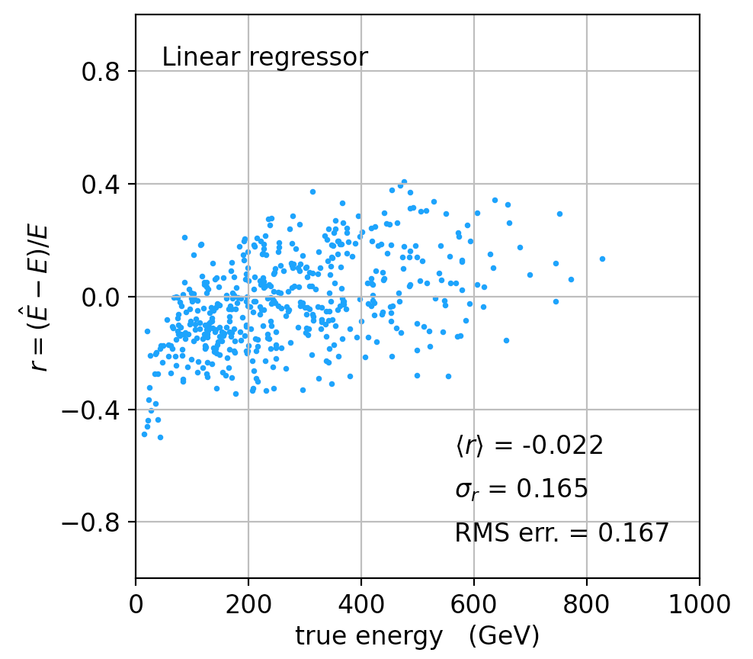
Linear regression
See MVRegressor.py, here using
regr = linear_model.LinearRegression()
regr.fit(X_train, y_train)
Average relative resolution 16.7%.

Slide 49
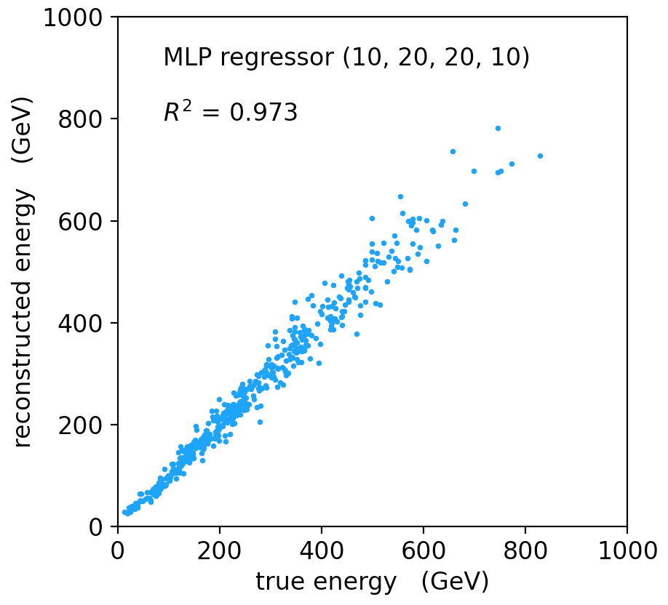
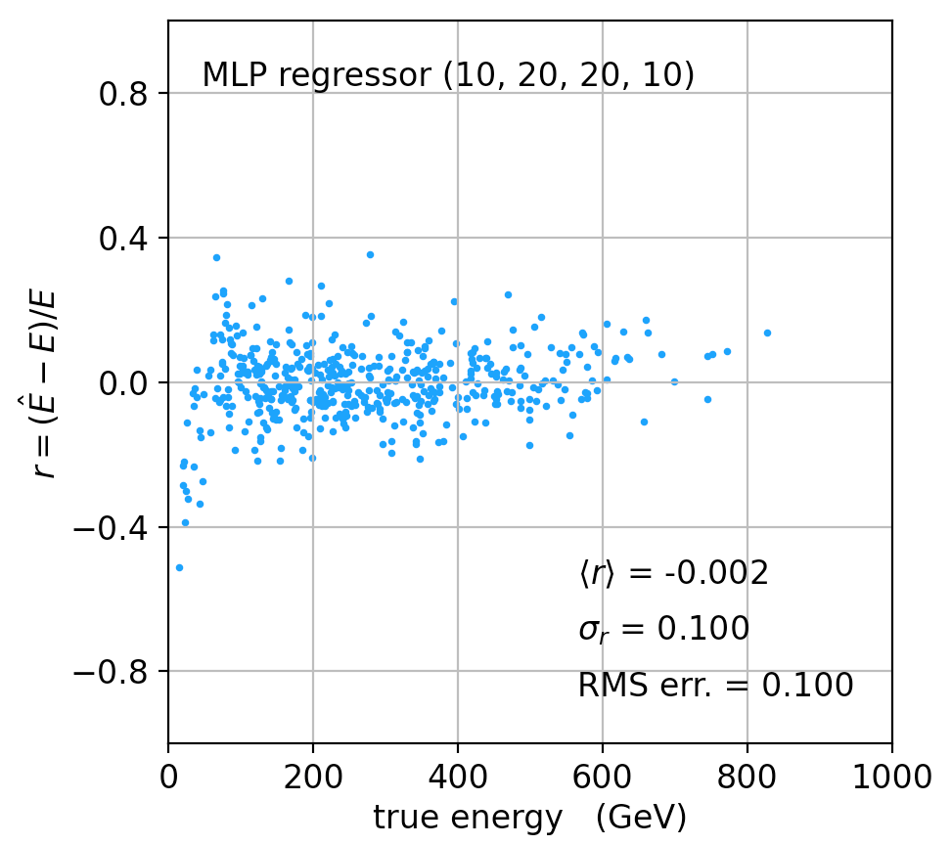
MLP Regression
regr = MLPRegressor(hidden_layer_sizes=(10,20,20,10), activation='relu'
regr.fit(X_train, y_train)
Better resolution (10%), here significant bias at low energies.

Slide 50
Refinements for multiple regression
One can try many improvements:
Scaling of predictor and target variables, e.g., standardize to zero mean and unit variance.
Use cross-validation to assess accuracy (and hence use entire sample of events for training.
Try different loss functions.
Try different regression algorithms (ridge regression, lasso, decision tree, support vector regression,...).
Some simple code using scikit-learn and a short write-up (from a year-3 project) is on the course webpage.

