Slide 1
Aachen Online Statistics School
GDC Lecture 2: Frequentist probability and confidence intervals
RWTH Aachen (online)
13-17 March 2023
https://indico.desy.de/event/37562/
Glen Cowan
Physics Department
Royal Holloway, University of London
g.cowan@rhul.ac.uk
www.pp.rhul.ac.uk/~cowan

Slide 2
Outline of GDC lectures
Tue. 14.3 Probability (Bayes vs. Frequentist) Bayesian parameter and interval estimation
→ Wed. 15.3 Frequentist confidence regions and intervals
Thu. 16.3 Python software for frequentist and Bayesian confidence regions.
Fri. 17.3 Searches and discoveries using likelihoods

Slide 3
Review of p-values
Suppose hypothesis H predicts pdf f (x|H) for a set of
observations x = (x₁,...x_{n}).
We observe a single point in this space: x_{obs}.
How can we quantify the level of compatibility between the data and the predictions of H?
x_{j}
x_{obs}
Decide what part of
the data space represents equal or less compatibility with H than does the point x_{obs}. (Not unique!)
ω> = { x : x “more
compatible” with H }
ω≤ = { x : x “less
or eq. compatible”
with H }
x_{i}

Slide 4
p-values
Express level of compatibility between data and hypothesis (sometimes ‘goodness-of-fit’) by giving the p-value for H:
= probability, under assumption of H, to observe data with equal or lesser compatibility with H relative to the data we got.
= probability, under assumption of H, to observe data as discrepant with H as the data we got or more so.
Basic idea: if there is only a very small probability to find data
with even worse (or equal) compatibility, then H is “disfavoured by the data”.
If the p-value is below a user-defined threshold α (e.g. 0.05) then H is rejected – equivalent to hypothesis test of size α.

Slide 5
Confidence interval from p-values
We can define a p-value for all hypothesized values of θ.
Then the confidence region at confidence level CL = 1− α is
the set of θ values for which p_{θ} > α.
or equivalently
the set of θ values that are not rejected in a test of size α
(confidence level CL is 1− α).
E.g. an upper limit on θ is the greatest value for which p_{θ} > α.
In practice find by setting p_{θ} = α and solve for θ.
For a multidimensional parameter space θ = (θ₁,... θ_{M}) use same idea – result is a confidence “region” with boundary determined by p_{θ} = α.

Slide 6
Coverage probability of confidence interval
If the true value of θ is rejected, then it’s not in the confidence interval. The probability for this is by construction (equality for continuous data):
P(reject θ|θ) ≤ α = type-I error rate
Therefore, the probability for the interval to contain or “cover” θ is
P(conf. interval “covers” θ|θ) ≥ 1 – α
This assumes that the set of θ values considered includes the true value, i.e., it assumes the composite hypothesis P(x|H,θ).

Slide 7
Example: upper limit on mean of Gaussian
When we test the parameter, we should take the critical region to maximize the power with respect to the relevant alternative(s).
Example: x ~ Gauss(μ, σ) (take σ known)
Test H₀ : μ = μ₀ versus the alternative H₁ : μ < μ₀
→ Put w_{μ} at region of x-space
characteristic of low μ (i.e. at low x)
Equivalently, take the p-value to be

Slide 8
Upper limit on Gaussian mean (2)
To find confidence interval, repeat for all μ₀, i.e., set p_{μ0} = α and solve for μ₀ to find the interval’s boundary
This is an upper limit on μ, i.e., higher μ have even lower p-value and are in even worse agreement with the data.
Usually use Φ⁻¹(α) = −Φ⁻¹(1−α) so as to express the upper limit as x_{obs} plus a positive quantity. E.g. for α = 0.05, Φ⁻¹(1−0.05) = 1.64.

Slide 9
Upper limit on Gaussian mean (3)
μ_{up} = the hypothetical value of μ such that there is only a probability α to find x < x_{obs}.

Slide 10
1- vs. 2-sided intervals
Now test: H₀ : μ = μ₀ versus the alternative H₁ : μ ≠ μ₀
I.e. we consider the alternative to μ₀ to include higher and lower values, so take critical region on both sides:
Result is a “central” confidence interval [μ_{lo}, μ_{up}]:
E.g. for
Note upper edge of two-sided interval is higher (i.e. not as tight
of a limit) than obtained from the one-sided test.

Slide 11
Approximate confidence intervals/regions from the likelihood function
Suppose we test parameter value(s) θ = (θ₁, ..., θ_{N}) using the ratio
Lower λ(θ) means worse agreement between data and hypothesized θ. Equivalently, usually define
so higher t_{θ} means worse agreement between θ and the data.
p-value of θ therefore
need pdf

Slide 12
Confidence region from Wilks’ theorem
Wilks’ theorem says (in large-sample limit and provided
certain conditions hold...)
chi-square dist. with # d.o.f. =
# of components in θ = (θ₁, ..., θ_{N}).
Assuming this holds, the p-value is
← set equal to α
To find boundary of confidence region set p_{θ} = α and solve for t_{θ}:
Recall also

Slide 13
Confidence region from Wilks’ theorem (cont.)
i.e., boundary of confidence region in θ space is where
For example, for 1 – α = 68.3% and n = 1 parameter,
and so the 68.3% confidence level interval is determined by
Same as recipe for finding the estimator’s standard deviation, i.e.,
is a 68.3% CL confidence interval.

Slide 14
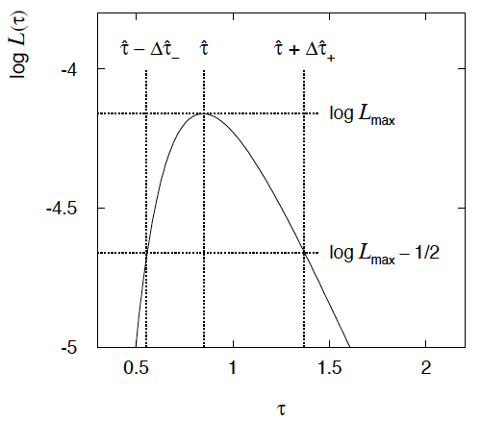
Example of interval from ln L(θ)
For N=1 parameter, CL = 0.683, Q_{α} = 1.
From exponential
example, n = 5 events.
Can report ML estimate
with approx. confidence
interval from ln L_{max} – 1/2
as “asymmetric error bar”:

Slide 15
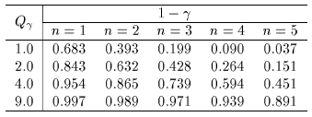
Multiparameter case
For increasing number of parameters, CL = 1 – α decreases for
confidence region determined by a given
← # of par.

Slide 16
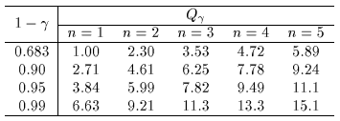
Multiparameter case (cont.)
Equivalently, Q_{α} increases with n for a given CL = 1 – α.
← # of par.

Slide 17
Systematic uncertainties and nuisance parameters
P (x|μ)
In general, our model of the data is not perfect:
model:
truth:
x
Can improve model by including
additional adjustable parameters.
Nuisance parameter ↔ systematic uncertainty. Some point in the
parameter space of the enlarged model should be “true”.
Presence of nuisance parameter decreases sensitivity of analysis
to the parameter of interest (e.g., increases variance of estimate).

Slide 18
Profile Likelihood
Suppose we have a likelihood L(μ,θ) = P(x|μ,θ) with N parameters of interest μ = (μ₁,..., μ_{N}) and M nuisance parameters θ = (θ₁,..., θ_{M}). The “profiled” (or “constrained”) values of θ are:
and the profile likelihood is:
The profile likelihood depends only on the parameters of interest; the nuisance parameters are replaced by their profiled values.
The profile likelihood can be used to obtain confidence intervals/regions for the parameters of interest in the same way as one would for all of the parameters from the full likelihood.

Slide 19
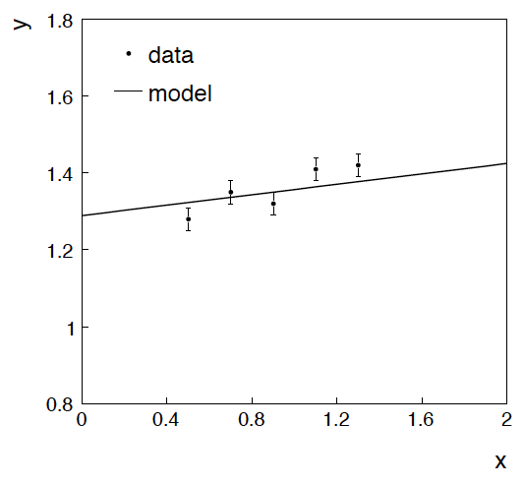
Example: fitting a straight line
Data:
Model: y_{i} independent and all follow y_{i} ~ Gauss(μ(x_{i} ), σ_{i} )
assume x_{i} and σ_{i} known.
Goal: estimate θ₀
Here suppose we don’t care
about θ₁ (example of a
“nuisance parameter”)

Slide 20
Maximum likelihood fit with Gaussian data
In this example, the y_{i} are assumed independent, so the
likelihood function is a product of Gaussians:
Maximizing the likelihood is here equivalent to minimizing
i.e., for Gaussian data, ML same as Method of Least Squares (LS)

Slide 21
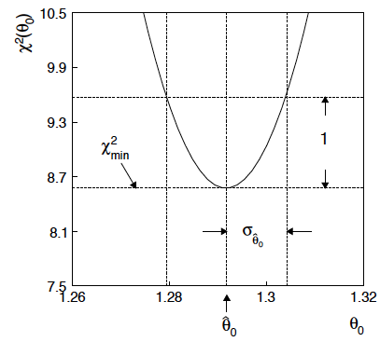
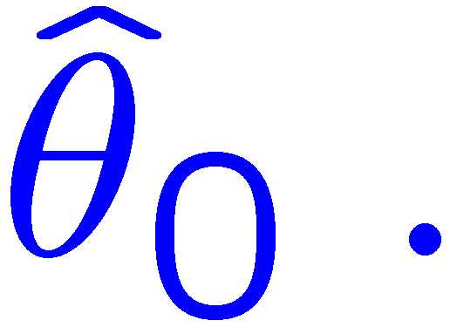
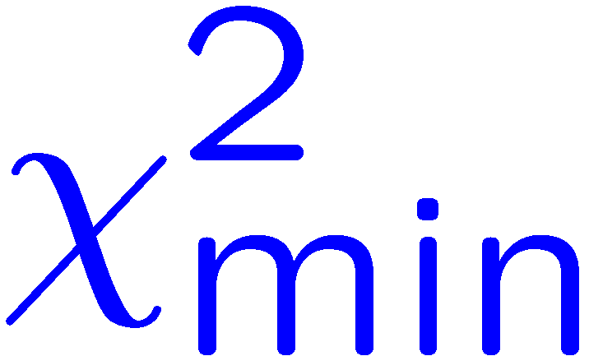
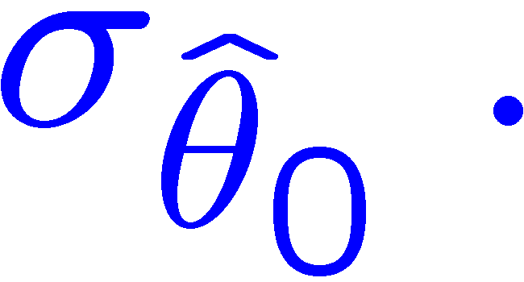
θ₁ known a priori
For Gaussian y_{i}, ML same as LS
Minimize χ² → estimator
Come up one unit from
to find

Slide 22
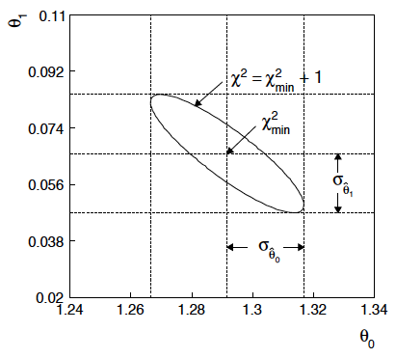
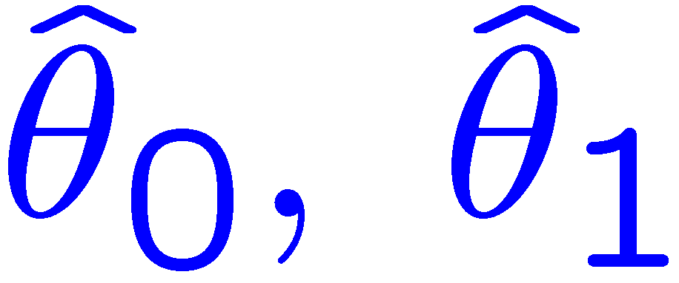
ML (or LS) fit of θ₀ and θ₁
Standard deviations from
tangent lines to contour
Correlation between
causes errors
to increase.

Slide 23
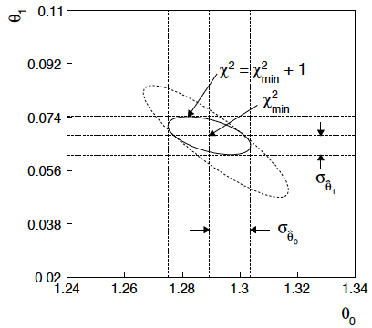
Including the measurement t₁ ~ Gauss (θ₁, σ_{t1})
The information on θ₁improves accuracy of
Here the contour corresponds to lnL = lnL_{max} – ½ , so:
The 2-parameter region corresponds to CL = 0.393.
The interval for θ₀ is a conf. interval with CL = 0.683.

Slide 24
Profiling
The lnL = lnL_{max} – ½ contour in the (θ₀, θ₁) plane is a confidence region at CL = 39.3%.
Furthermore if one wants to know only about, say, θ₀, then the
interval in θ₀ corresponding to lnL = lnL_{max} – ½ is a confidence interval at CL = 68.3% (i.e., ±1 std. dev.).
I.e., form the interval for θ₀ using
where θ₁ is replaced by its “profiled” value

Slide 25
Profile Likelihood Ratio – Wilks theorem
Goal is to test/reject regions of μ space (param. of interest).
Rejecting a point μ should mean p_{μ} ≤ α for all possible values of the nuisance parameters θ.
Test μ using the “profile likelihood ratio”:
Let t_{μ} = −2 ln λ(μ). Wilks’ theorem says in large-sample limit:
where the number of degrees of freedom is the number of
parameters of interest (components of μ). So p-value for μ is

Slide 26
Profile Likelihood Ratio – Wilks theorem (2)
If we have a large enough data sample to justify use of the
asymptotic chi-square pdf, then if μ is rejected, it is rejected for any values of the nuisance parameters.
The recipe to get confidence regions/intervals for the parameters of interest at CL = 1 – α is thus the same as before, simply use the profile likelihood:
where the number of degrees of freedom N for the chi-square quantile is equal to the number of parameters of interest.
If the large-sample limit is not justified, then use e.g. Monte Carlo to get distribution of t_{μ}.

Slide 27
Summing up...
In Frequentist statistics, probability only associated with data (and functions thereof).
Parameter estimation boils down to finding functions of the data (estimators) that are themselves random variables, having a mean, standard deviation, etc.
p-value of H = P(data as ”extreme” as what we saw or more so | H)
Confidence intervals = set of parameter values with p-value < α.
Designed to ”cover” a parameter with a given probability (the intervals are random, not the parameter).
Wilks’ theorem allows one to find approximate confidence intervals (and multi-param. regions) directly from the likelihood.

Slide 28
Extra slides

Slide 29
p-value of H is not P(H)
The p-value of H is not the probability that H is true!
In frequentist statistics we don’t talk about P(H) (unless H
represents a repeatable observation).
If we do define P(H), e.g., in Bayesian statistics as a degree of belief, then we need to use Bayes’ theorem to obtain
where π(H) is the prior probability for H.
For now stick with the frequentist approach;
result is p-value, regrettably easy to misinterpret as P(H).

Slide 30
Using a p-value to define test of H₀
One can show that under assumption of a hypothesis H₀, its
p-value, p₀, follows a uniform distribution in [0,1].
So the probability to find p₀ less than a given α is
So we can define the critical region of a test of H₀ with size α as the set of data space where p₀ ≤ α .
Formally the p-value relates only to H₀, but the resulting test will
have a given power with respect to a given alternative H₁.

Slide 31
Frequentist upper limit on Poisson parameter
Consider again the case of observing n ~ Poisson(s + b).
Suppose b = 4.5, n_{obs} = 5. Find upper limit on s at 95% CL.
Relevant alternative is s = 0 (critical region at low n)
p-value of hypothesized s is P(n ≤ n_{obs}; s, b)
Upper limit s_{up} at CL = 1 – α found from

Slide 32
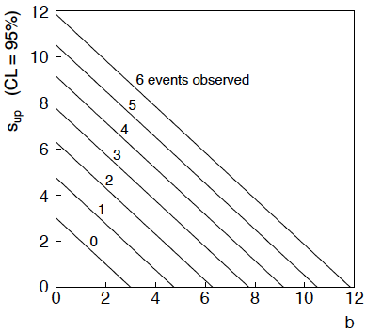
n ~ Poisson(s+b): frequentist upper limit on s
For low fluctuation of n, formula can give negative result for s_{up}; i.e. confidence interval is empty; all values of s ≥ 0 have p_{s} ≤ α.

Slide 33
Limits near a boundary of the parameter space
Suppose e.g. b = 2.5 and we observe n = 0.
If we choose CL = 0.9, we find from the formula for s_{up}
Physicist:
We already knew s ≥ 0 before we started; can’t use negative
upper limit to report result of expensive experiment!
Statistician:
The interval is designed to cover the true value only 90%
of the time — this was clearly not one of those times.
Not uncommon dilemma when testing parameter values for which
one has very little experimental sensitivity, e.g., very small s.

Slide 34
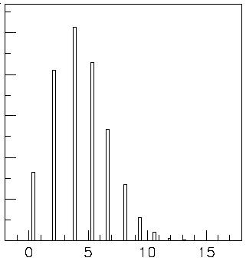
Expected limit for s = 0
Physicist: I should have used CL = 0.95 — then s_{up} = 0.496
Even better: for CL = 0.917923 we get s_{up} = 10⁻⁴ !
Reality check: with b = 2.5, typical Poisson fluctuation in n is
at least √2.5 = 1.6. How can the limit be so low?
Look at the mean limit for the
no-signal hypothesis (s = 0)
(sensitivity).
Distribution of 95% CL limits
with b = 2.5, s = 0.
Mean upper limit = 4.44

