Slide 1


Parameter Estimation
Lecture 1
INFN School of Statistics
Caserta, 14-19 June 2026
https://agenda.infn.it/event/46370/
Glen Cowan
Physics Department
Royal Holloway, University of London
g.cowan@rhul.ac.uk
www.pp.rhul.ac.uk/~cowan

Slide 2
Outline
Lecture 1: Introduction, Maximum Likelihood
Lecture 2: Least squares, Bayesian approach, confidence intervals
For some slides/links with exercises and code you can see:
https://www.pp.rhul.ac.uk/~cowan/stat/exercises/cowan_stat_exercises.pdf
https://www.pp.rhul.ac.uk/~cowan/stat/exercises/cowan_stat_exercises_full.pdf
Most material here is taken from the University of London course:
https://www.pp.rhul.ac.uk/~cowan/stat_course.html

Slide 3
Parameter Estimation 1-1
Introduction to (frequentist) parameter estimation
The method of Maximum Likelihood
MLE for exponential distribution

Slide 4
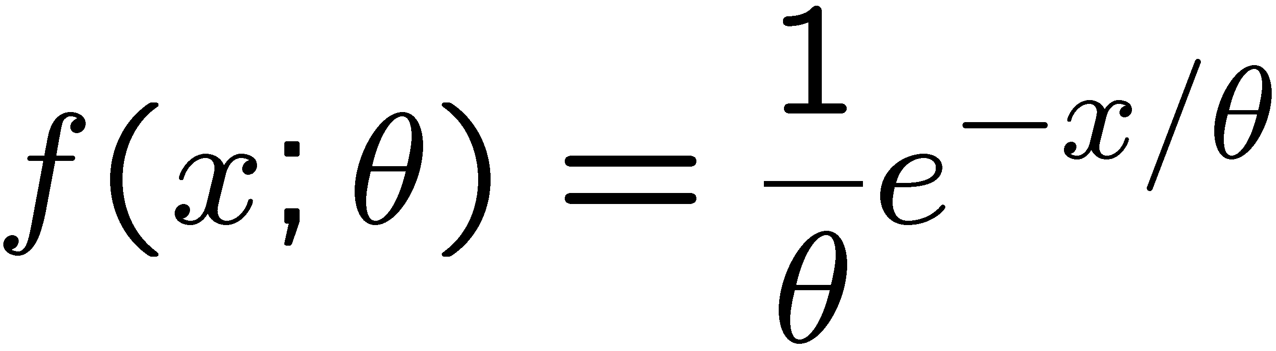
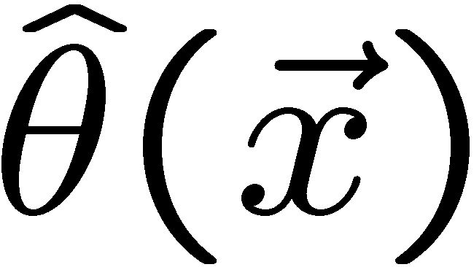
Frequentist parameter estimation
The parameters of a pdf are any constants that characterize it,
i.e., θ indexes a
set of hypotheses.
r.v.
parameter
Suppose we have a sample of observed values: x = (x₁, ..., x_{n})
We want to find some function of the data to estimate the
parameter(s):
← estimator written with a hat
Sometimes we say ‘estimator’ for the function of x₁, ..., x_{n};
‘estimate’ for the value of the estimator with a particular data set.

Slide 5
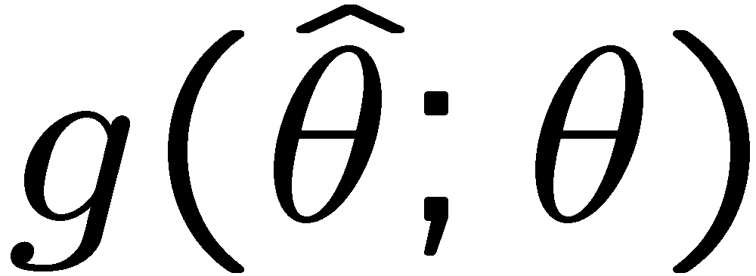
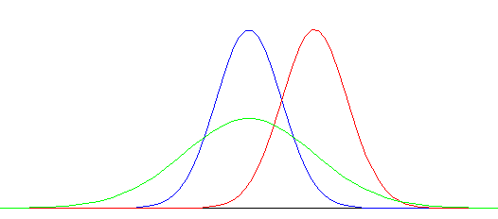
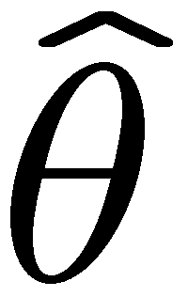
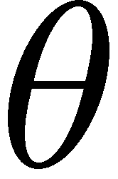
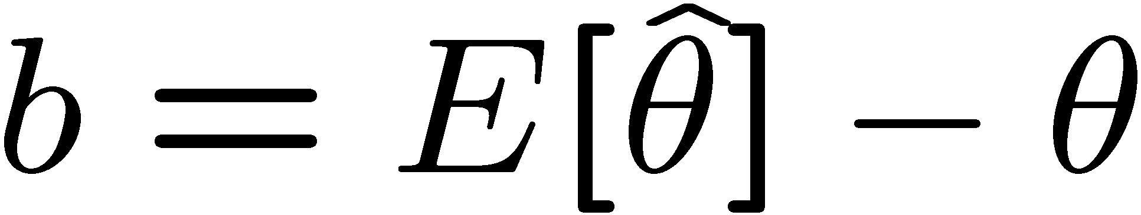
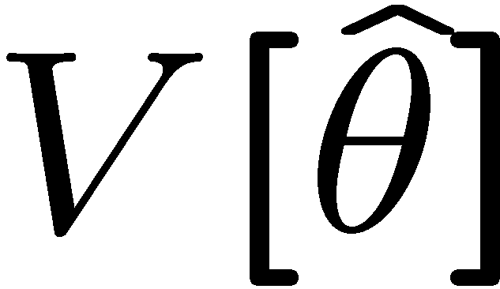
Properties of estimators
If we were to repeat the entire measurement, the estimates
from each would follow a pdf:
best
large
variance
biased
We want small (or zero) bias (systematic error):
→ average of repeated measurements should tend to true value.
And we want a small variance (statistical error):
→ small bias & variance are in general conflicting criteria

Slide 6

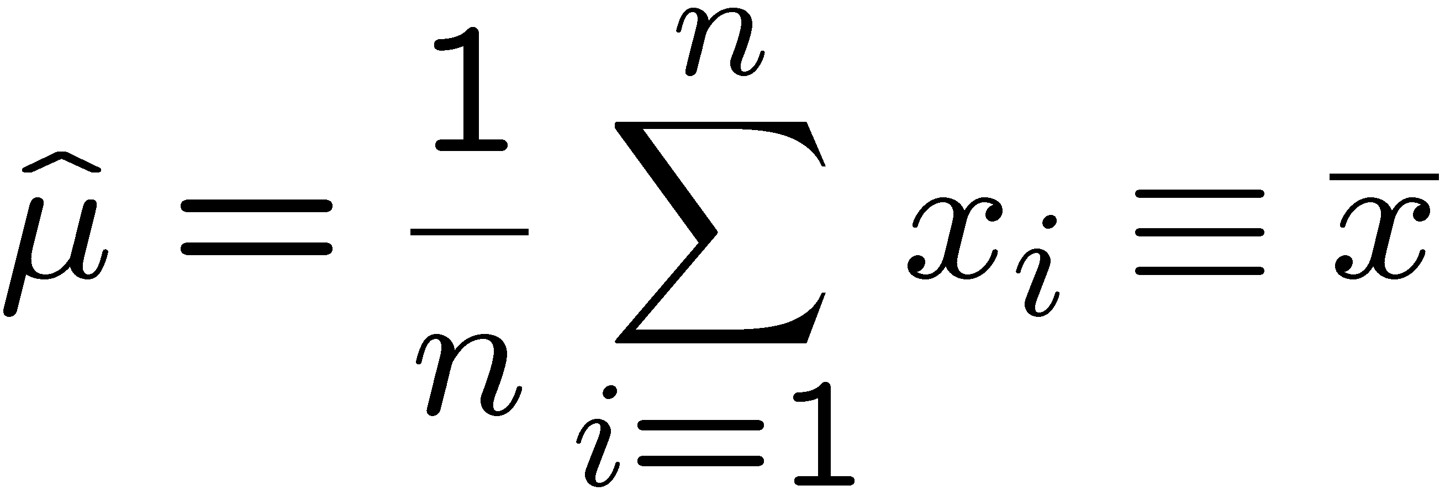
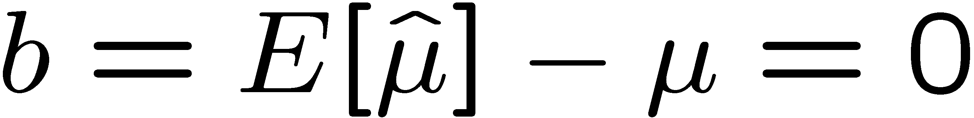
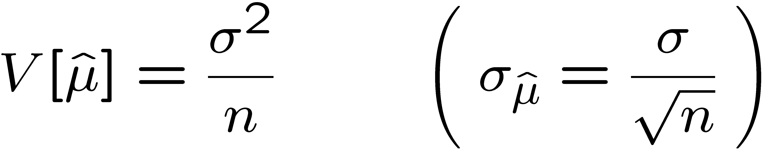
An estimator for the mean (expectation value)
Parameter:
Suppose we have a sample of n independent values x₁,...,x_{n}.
Estimator:
(‘sample mean’)
We find:

Slide 7

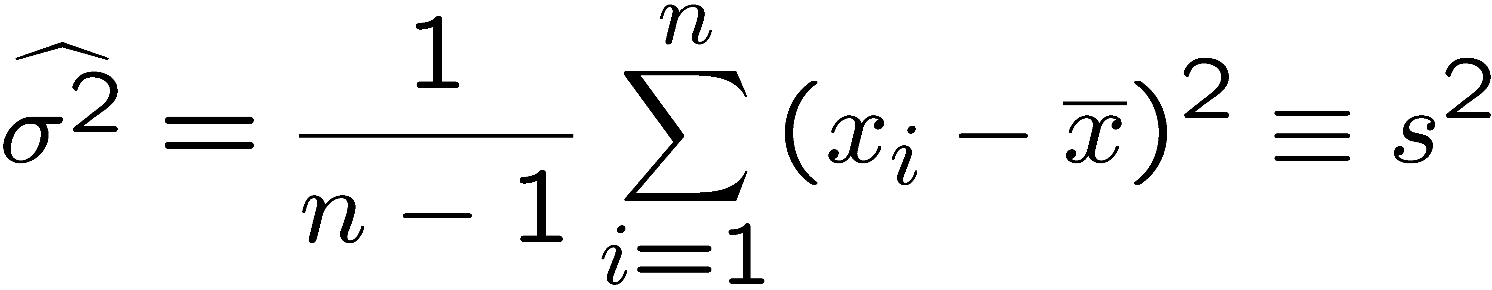
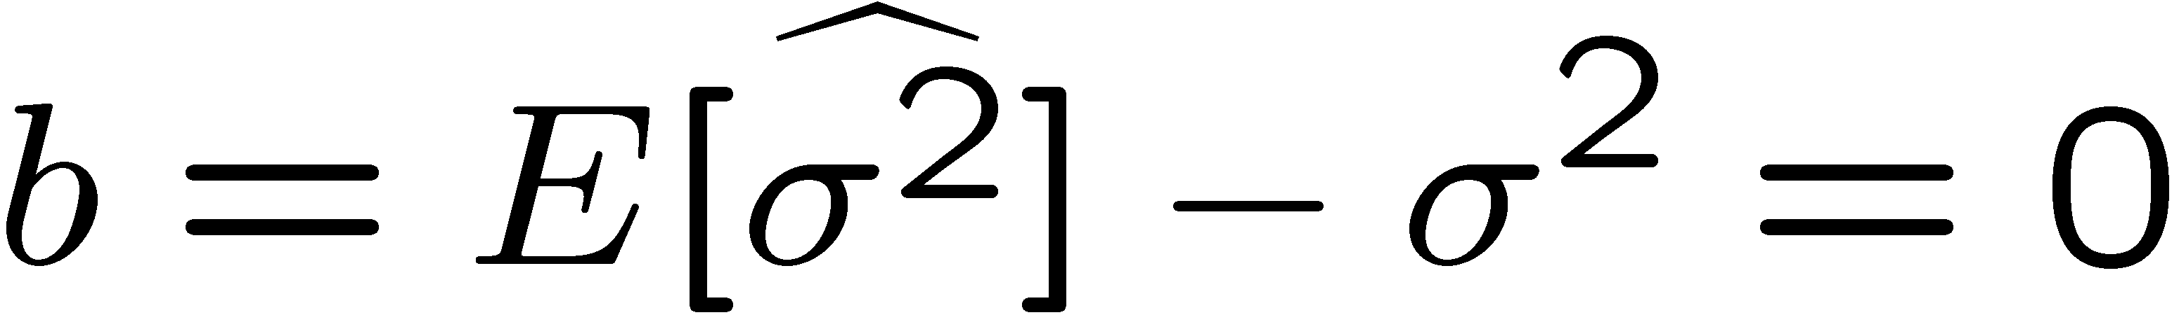
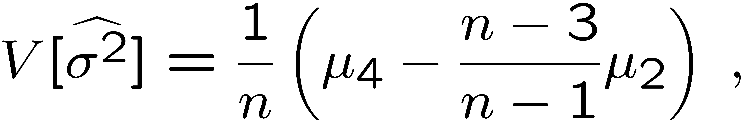
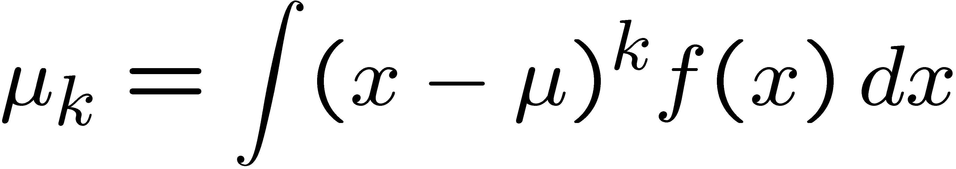
An estimator for the variance
Parameter:
Estimator:
(‘sample
variance’)
We find:
(factor of n-1 makes this so)
where

Slide 8


The likelihood function
Suppose the entire result of an experiment (set of measurements)
is a collection of numbers x, and suppose the joint pdf for
the data x is a function that depends on a set of parameters θ:
Now evaluate this function with the data obtained and
regard it as a function of the parameter(s). This is the likelihood function:
(x constant)

Slide 9
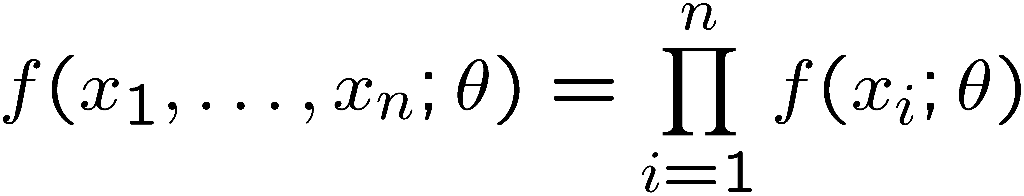
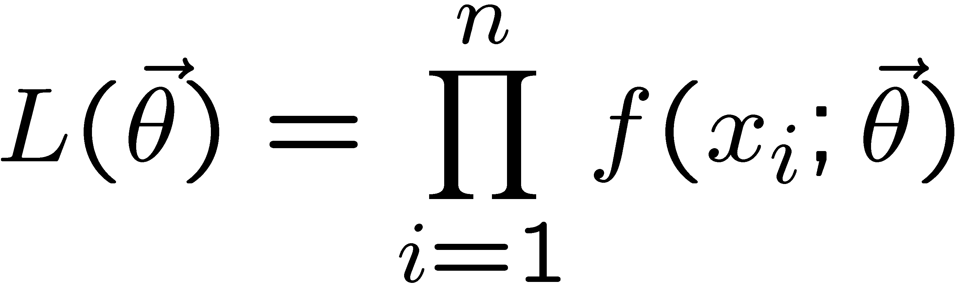
The likelihood function for i.i.d.*. data
* i.i.d. = independent and identically distributed
Consider n independent observations of x: x₁, ..., x_{n}, where
x follows f (x; θ). The joint pdf for the whole data sample is:
In this case the likelihood function is
(x_{i} constant)

Slide 10
Maximum Likelihood Estimators (MLEs)
We define the maximum likelihood estimators or MLEs to be
the parameter values for which the likelihood is maximum.
Maximizing L equivalent
to maximizing log L
Could have multiple maxima (take highest).
MLEs not guaranteed to have any ‘optimal’ properties, (but in practice they’re very good).

Slide 11
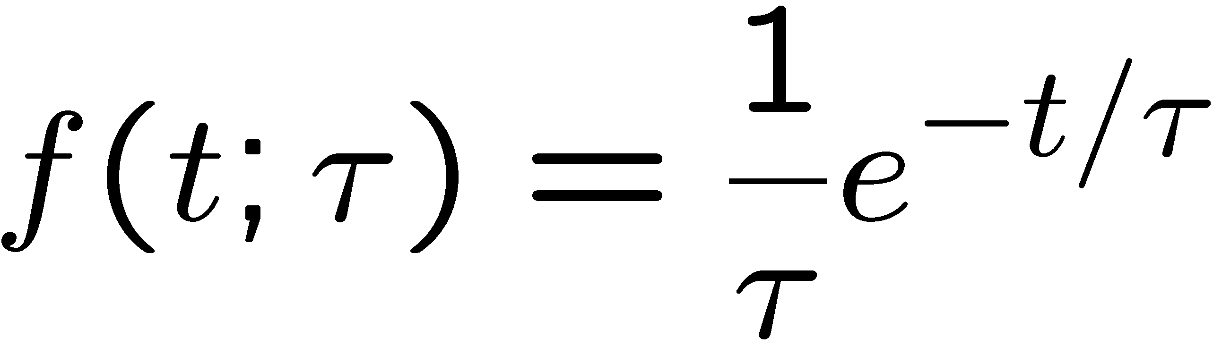
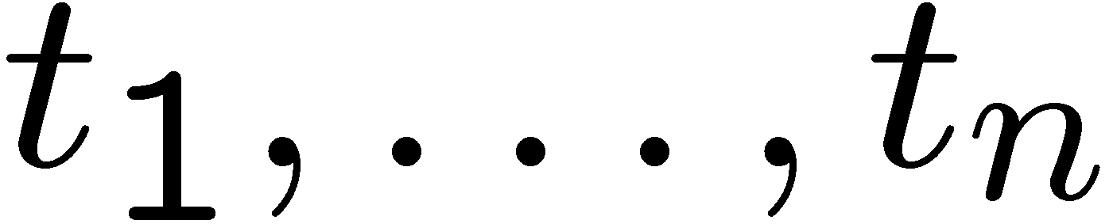
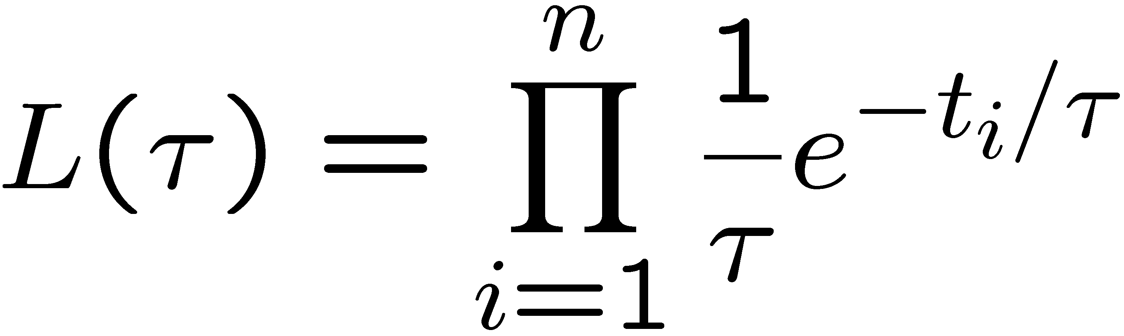
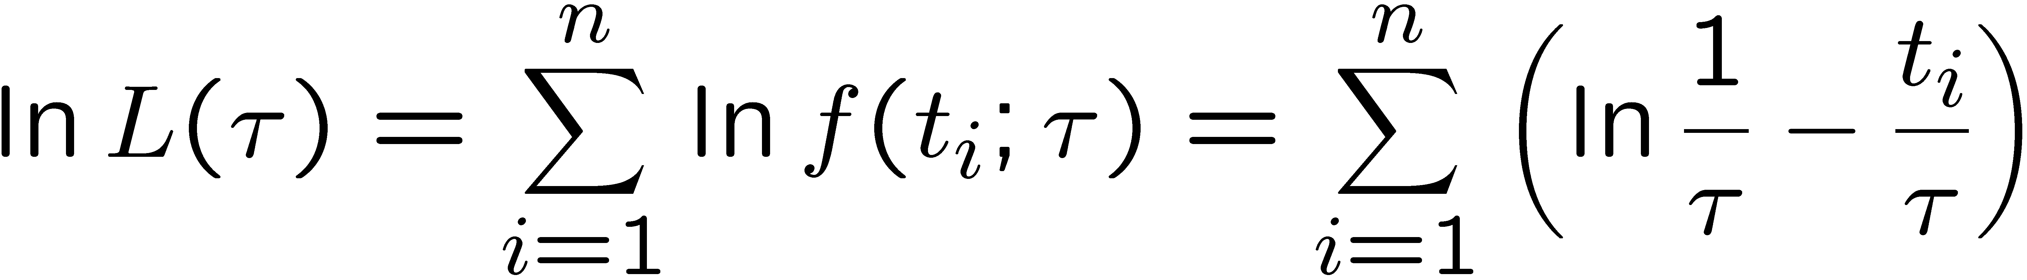
MLE example: parameter of exponential pdf
Consider exponential pdf,
and suppose we have i.i.d. data,
The likelihood function is
The value of τ for which L(τ) is maximum also gives the
maximum value of its logarithm (the log-likelihood function):

Slide 12
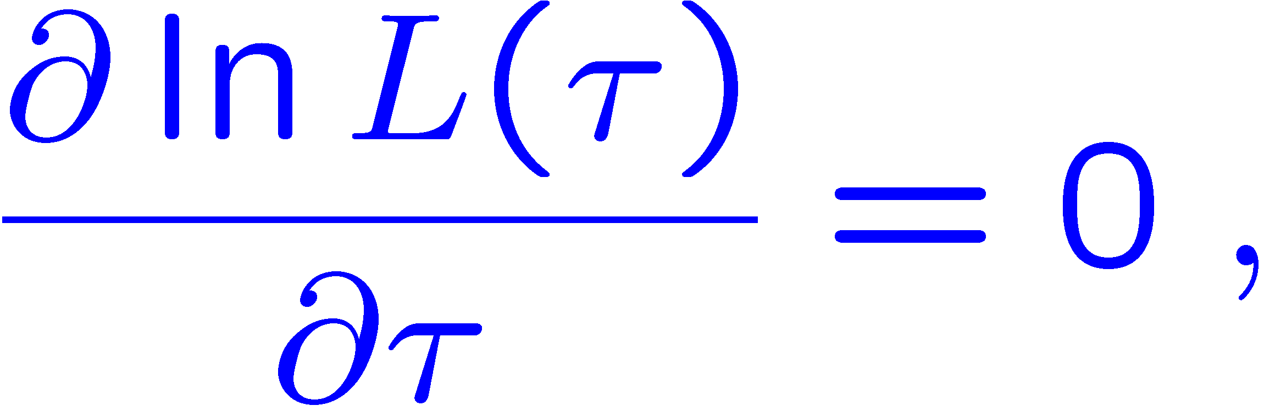
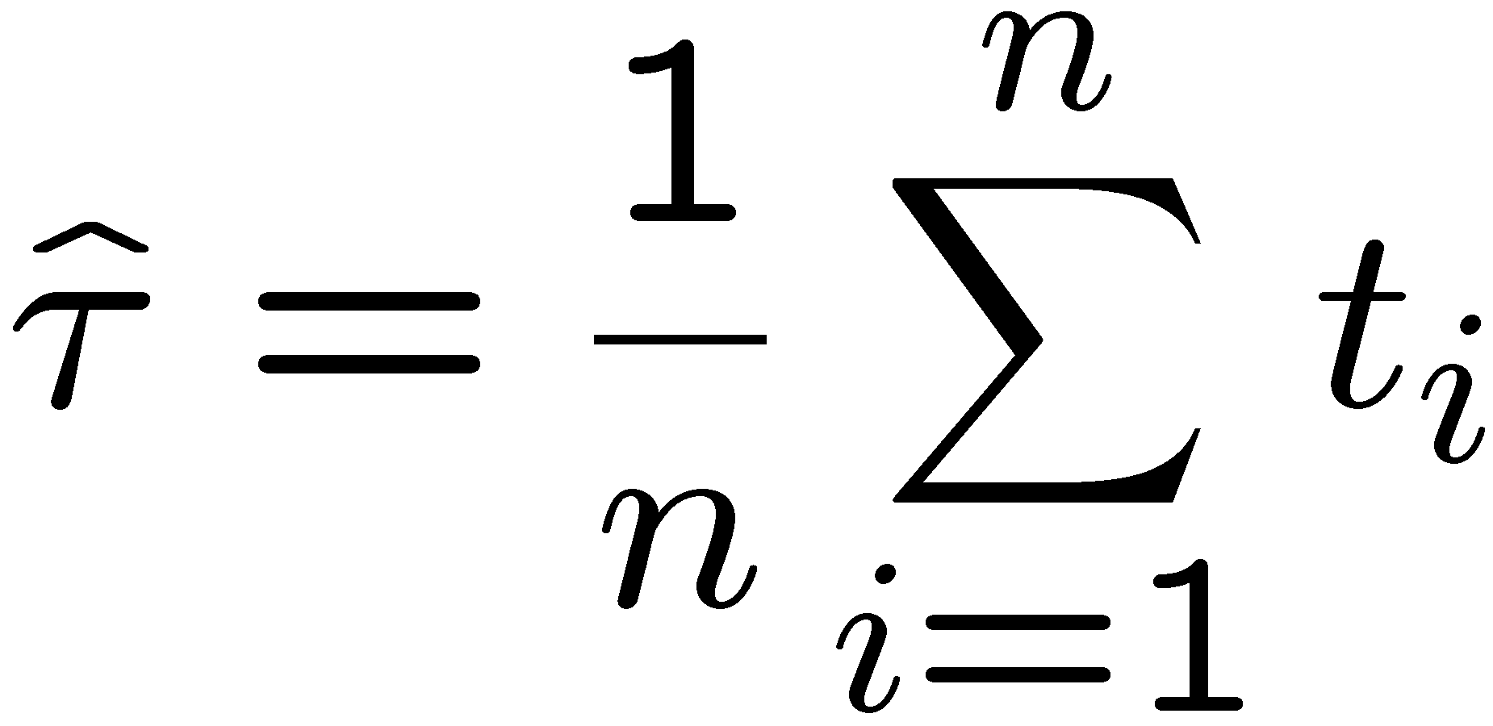
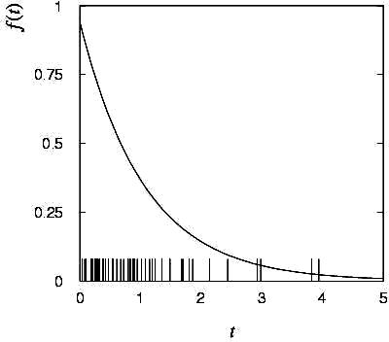
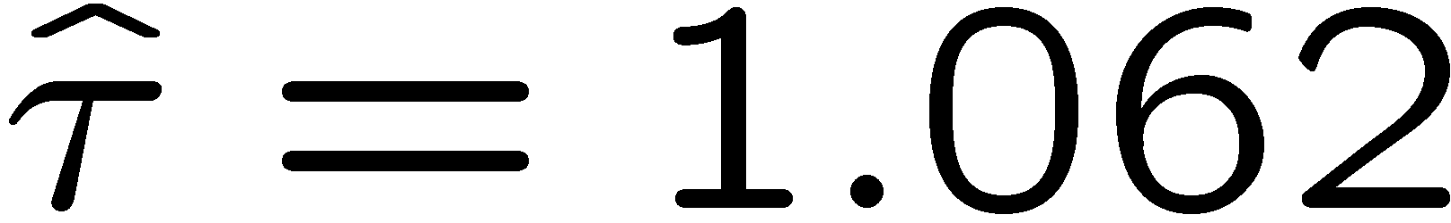
MLE example: parameter of exponential pdf (2)
Find its maximum by setting
→
Monte Carlo test:
generate 50 values
using τ = 1:
We find the ML estimate:

Slide 13






MLE example: parameter of exponential pdf (3)
For the exponential distribution one has for mean, variance:
For the MLE
we therefore find
→
→

Slide 14
Large-sample (asymptotic) properties of MLEs
Suppose we have an i.i.d. data sample of size n: x₁,...,x_{n}
In the large-sample (or “asymptotic”) limit (n → ∞) and assuming regularity conditions one can show that the likelihood and MLE have several important properties.
The regularity conditions include:
the boundaries of the data space cannot depend on the parameter;
the parameter cannot be on the edge of the parameter space;
ln L(θ) must be differentiable;
the only solution to 𝜕ln L/𝜕θ = 0 is θ.
^
In the slides immediately following the properties are shown without proof for a single parameter; the corresponding properties hold also for the multiparameter case, θ = (θ₁,..., θ_{m}).

Slide 15
log-likelihood becomes quadratic
The likelihood function becomes Gaussian in shape, i.e. the log-likelihood becomes quadratic (parabolic).
The MLE becomes increasingly precise as the (log)-likelihood becomes more tightly concentrated about its peak,
but L(θ) = P(x|θ) is the probability for x, not a pdf for θ.

Slide 16
The MLE converges to the true parameter value
In the large-sample limit, the MLE converges in probability
to the true parameter value.
That is, for any ε > 0,
The MLE is said to be consistent.

Slide 17
MLE is asymptotically unbiased
In general the MLE can be biased, but in the large-sample limit, this bias goes to zero:
(Recall for the exponential parameter we found the bias was
identically zero regardless of the sample size n.)

Slide 18
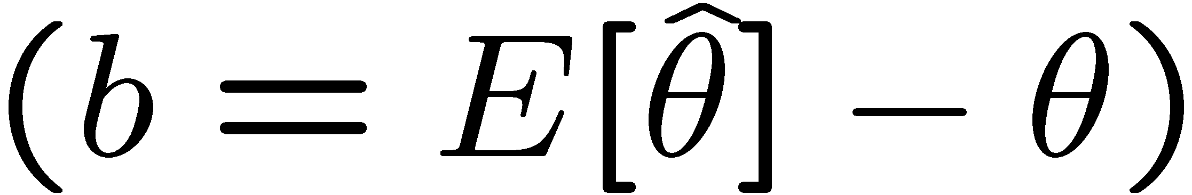
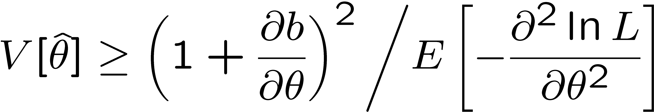
The information inequality
The information inequality (RCF) sets a lower bound on the
variance of any estimator (not only MLE). For a single parameter:
= MVB (Minimum
Variance Bound)
where
Proof in Exercise 6.6 of SDA, http://www.pp.rhul.ac.uk/~cowan/sda/prob/prob_6.pdf
“Efficiency” of an estimator = MVB / actual variance.
An estimator whose variance equals the MVB is said to be efficient.

Slide 19
The MLE’s variance approaches the MVB
In the large-sample limit, the variance of the MLE approaches the minimum-variance bound, i.e., the information inequality becomes an equality (and bias goes to zero):
The MLE is said to be asymptotically efficient.

Slide 20
The MLE’s distribution becomes Gaussian
In the large-sample limit, the pdf of the MLE becomes Gaussian,
where
is the minimum variance bound (note bias is zero).
For example, exponential MLE with sample size n = 100.
Note that for exponential, MLE is arithmetic average, so Gaussian MLE seen to stem from Central Limit Theorem.

Slide 21
Distribution of MLE of exponential parameter

Slide 22
Parameter Estimation 1-2
Finding the variance of MLEs
Information inequality for multiple parameters

Slide 23
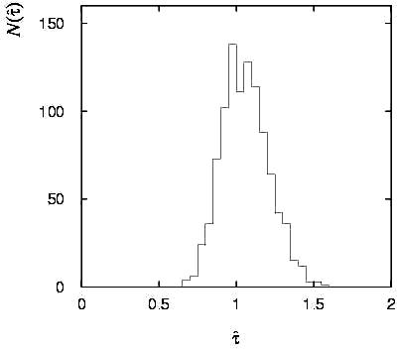
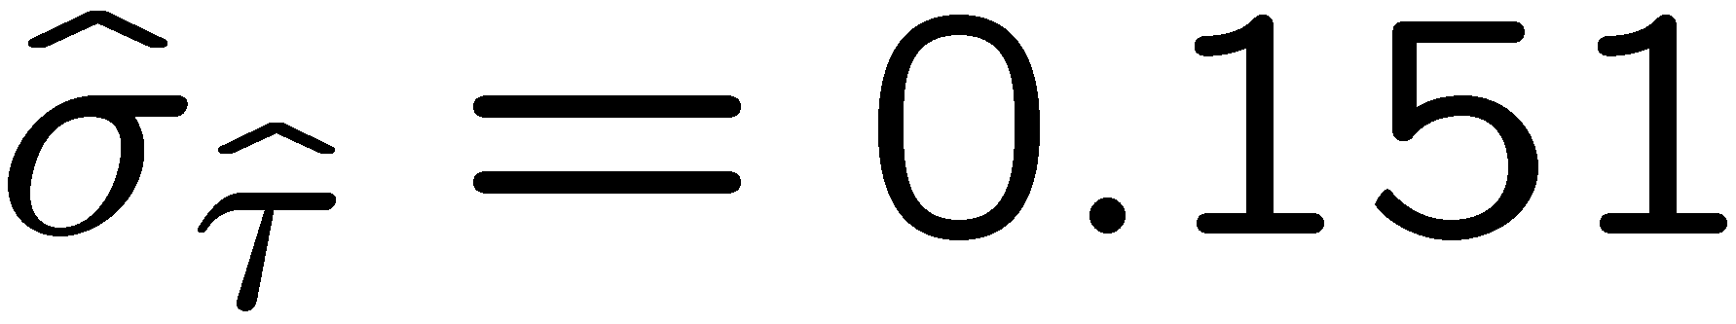
Variance of estimators: Monte Carlo method
Having estimated our parameter we now need to report its
‘statistical error’, using e.g. the estimator’s standard deviation, or (co)variance.
It is usually not possible to do this with an exact calculation.
Another way is to simulate the entire experiment many times with a Monte Carlo program (use ML estimate for MC).
For exponential example (n=50), from sample variance of estimates we find:

Slide 24
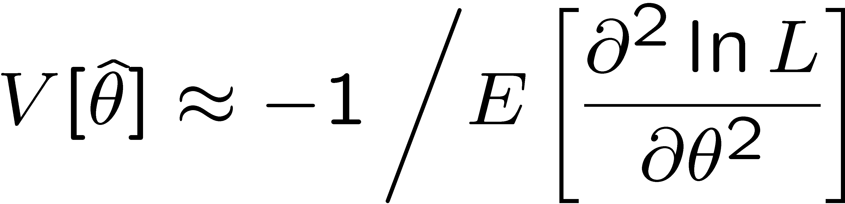
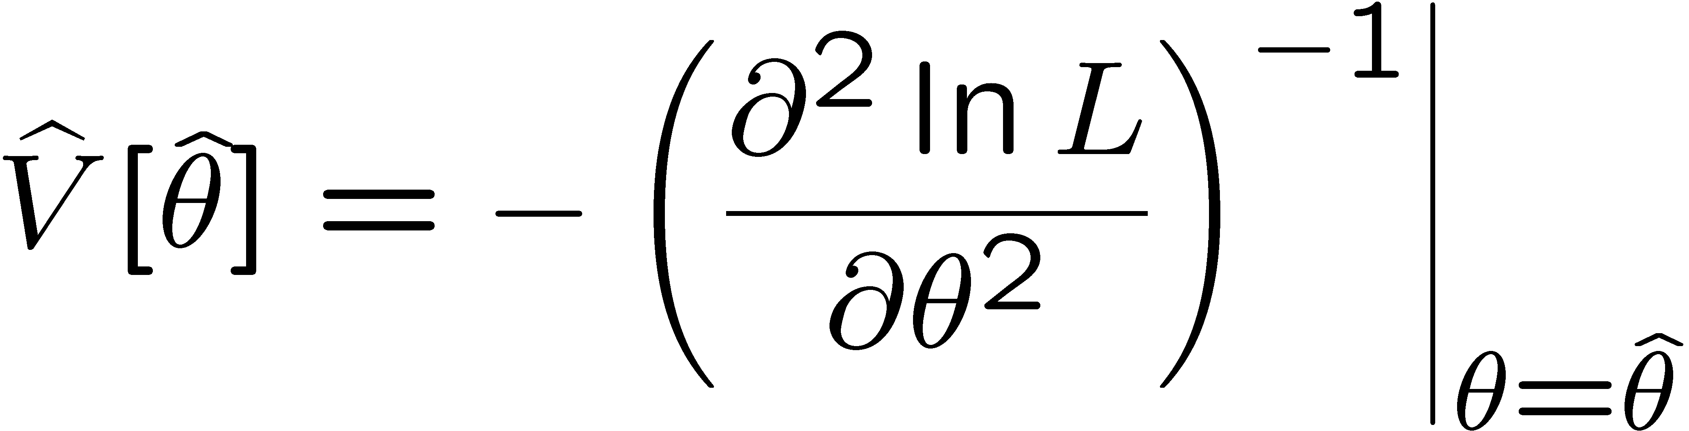
Variance of estimators from information inequality
Recall the information inequality (RCF) sets a lower bound on the
variance of any estimator (not only MLE):
MVB
Often the bias b is small, and equality either holds exactly or
is a good approximation (e.g. large data sample limit). Then,
Estimate this using the 2nd derivative of ln L at its maximum:

Slide 25
MVB for MLE of exponential parameter
Find
We found for the exponential parameter the MLE
and we showed b = 0, hence 𝜕b/𝜕τ = 0.
We find
and since E[t_{i}] = τ for all i,
,
and therefore
.
So here the MLE is efficient.

Slide 26
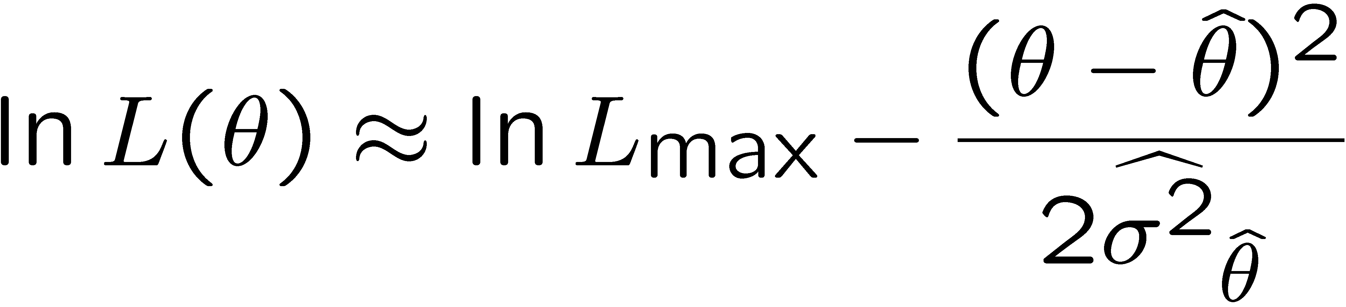
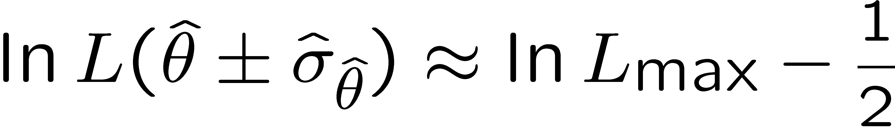
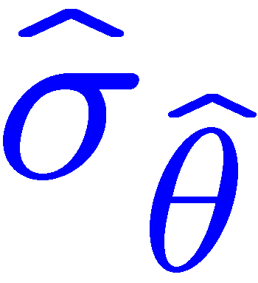

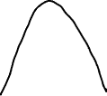
Variance of estimators: graphical method
Expand ln L (θ) about its maximum:
First term is ln L_{max}, second term is zero, for third term use
information inequality (assume equality):
→ to get
, change θ away from
until ln L decreases by 1/2.

Slide 27
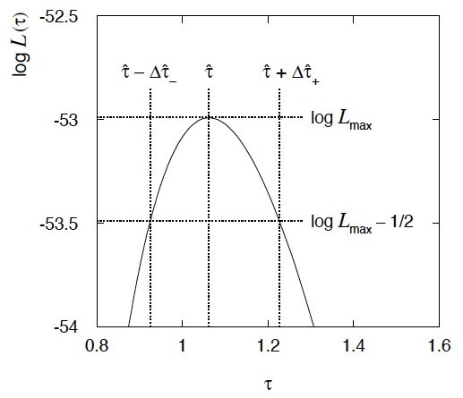
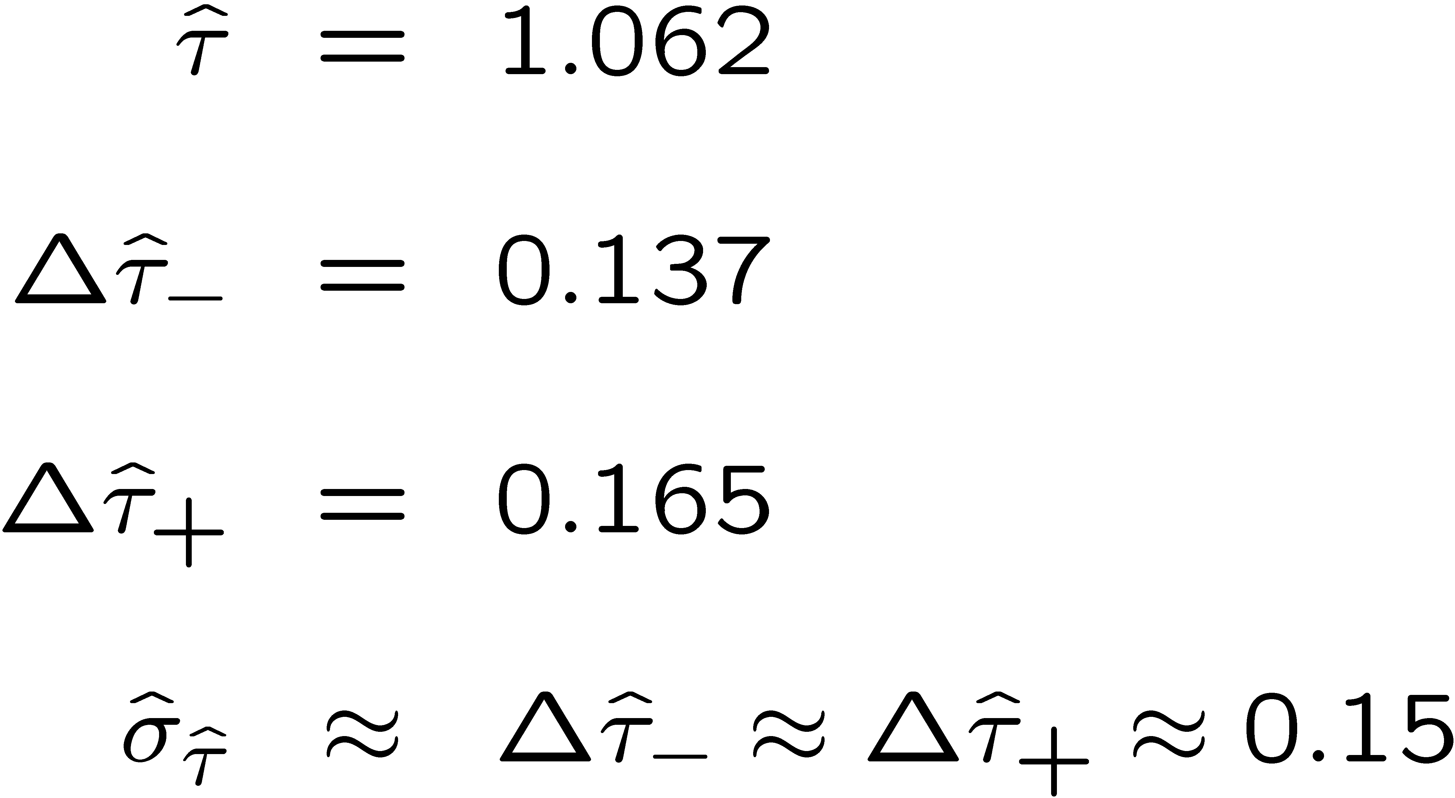
Example of variance by graphical method
ML example with exponential:
Not quite parabolic ln L since finite sample size (n = 50).

Slide 28
Parameter Estimation 1-3
Information inequality for multiple parameters
Numerical example of 2-D MLE
The ln L = ln L_{max} – ½ contour
MLE for function of a parameter
Relation between MLE and Bayesian estimator

Slide 29
Information inequality for N parameters
Suppose we have estimated N parameters θ = (θ₁,...,θ_{N})
The Fisher information matrix is
^
and the covariance matrix of estimators θ is
The information inequality states that the matrix
is positive semi-definite:
z^{T}Mz ≥ 0 for all z ≠ 0, diagonal elements ≥ 0

Slide 30
Information inequality for N parameters (2)
In practice the inequality is ~always used in the large-sample limit:
bias → 0
inequality → equality, i.e, M = 0, and therefore V = I⁻¹
That is,
This can be estimated from data using
Find the matrix V⁻¹ numerically (or with automatic differentiation),
then invert to get the covariance matrix of the estimators

Slide 31
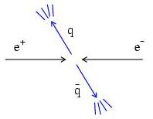
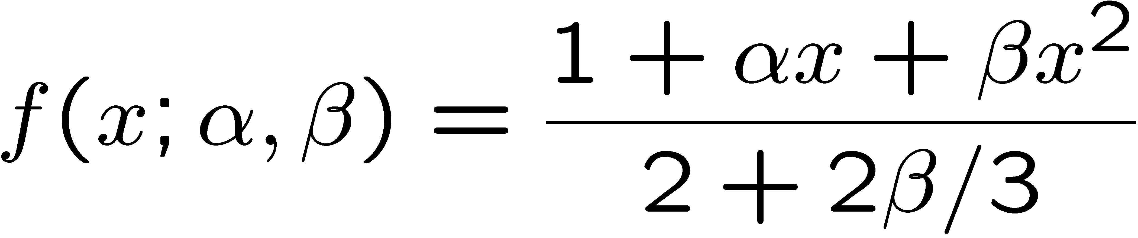
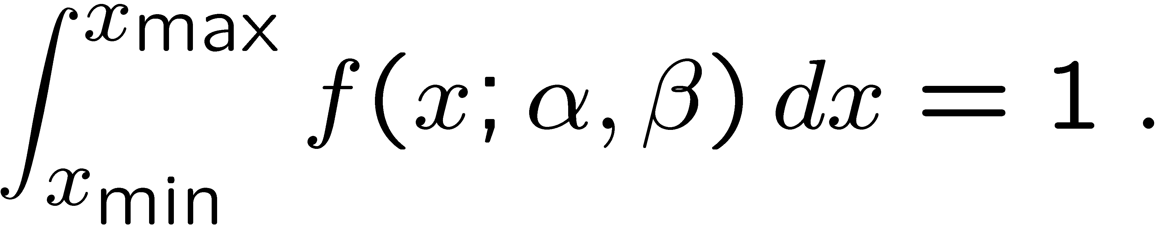
Example of ML with 2 parameters
Consider a scattering angle distribution with x = cos θ,
or if x_{min} < x < x_{max}, need to normalize so that
Example: α = 0.5, β = 0.5, x_{min} = -0.95, x_{max} = 0.95, generate n = 2000 events with Monte Carlo.
need to find maximum
numerically

Slide 32
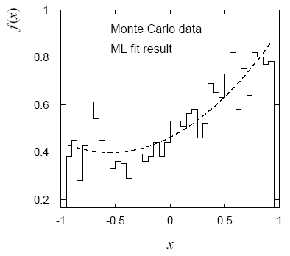
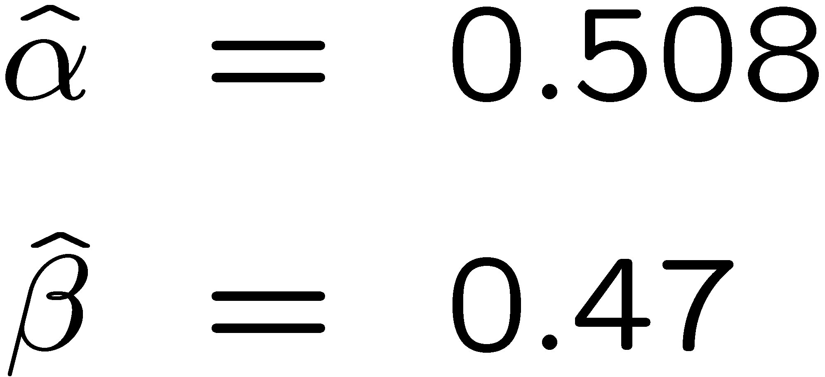
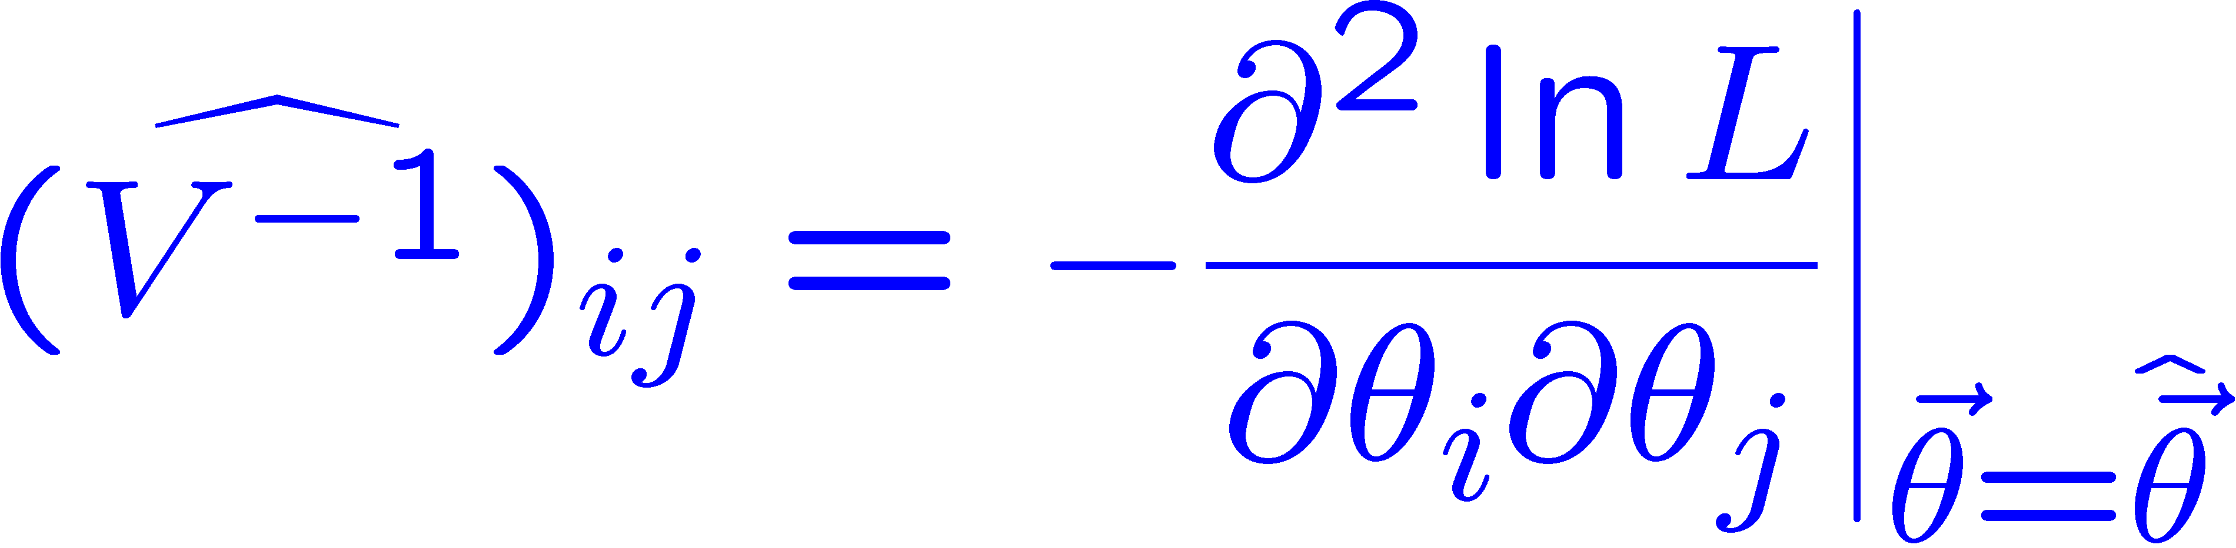
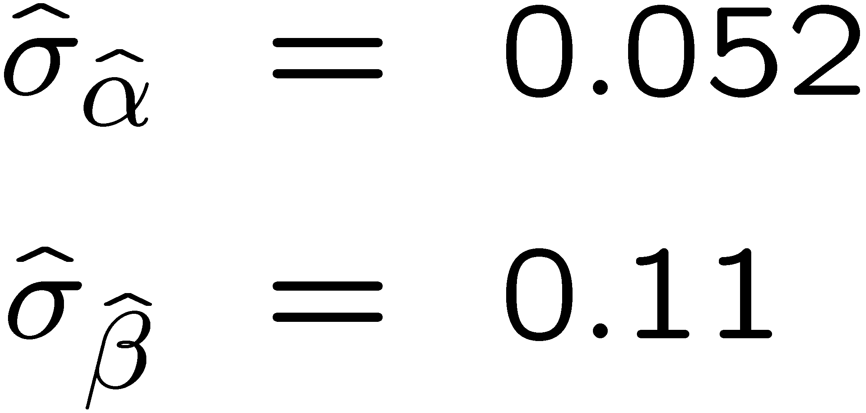
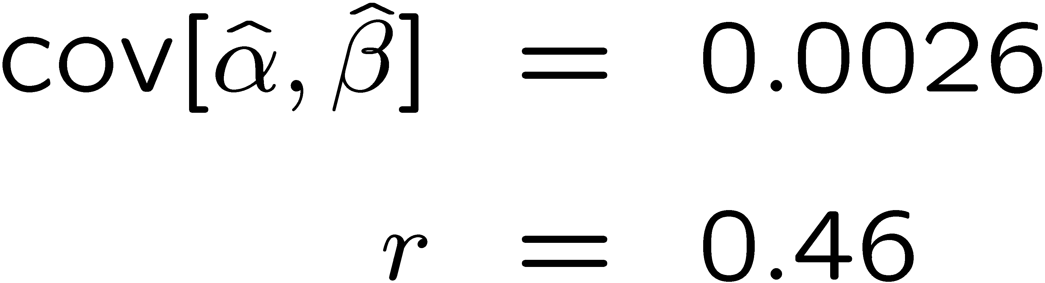
Example of ML with 2 parameters: fit result
Finding maximum of ln L(α, β) numerically gives
N.B. No binning of data for fit,
but can compare to histogram for
goodness-of-fit (e.g. ‘visual’ or χ²).
(Co)variances from
= correlation coefficient

Slide 33
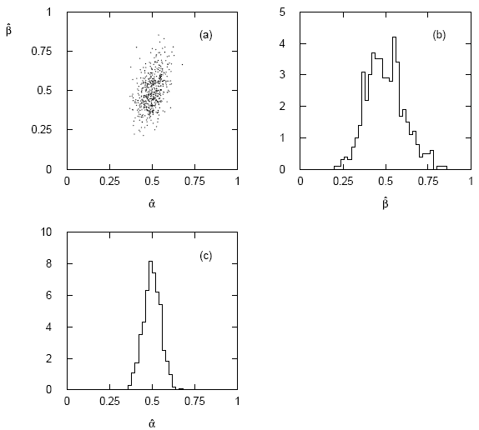




Two-parameter fit: MC study
Repeat ML fit with 500 experiments, all with n = 2000 events:
Estimates average to ~true values;
(Co)variances close to previous estimates;
marginal pdfs approximately Gaussian.

Slide 34
Multiparameter graphical method for variances
Expand ln L(θ) to 2nd order about MLE:
ln L_{max}
zero
relate to covariance matrix of MLEs using information (in)equality.
Result:
So the surface
corresponds to
, which is the equation of a (hyper-) ellipse.

Slide 35



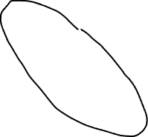
Multiparameter graphical method (2)
Distance from MLE to tangent planes gives standard deviations.

Slide 36
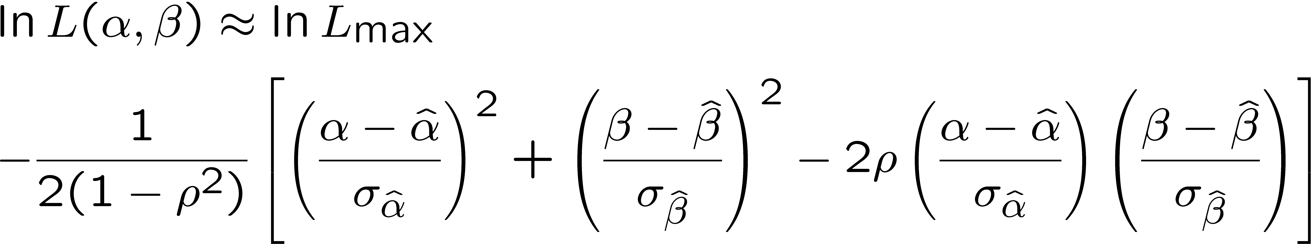
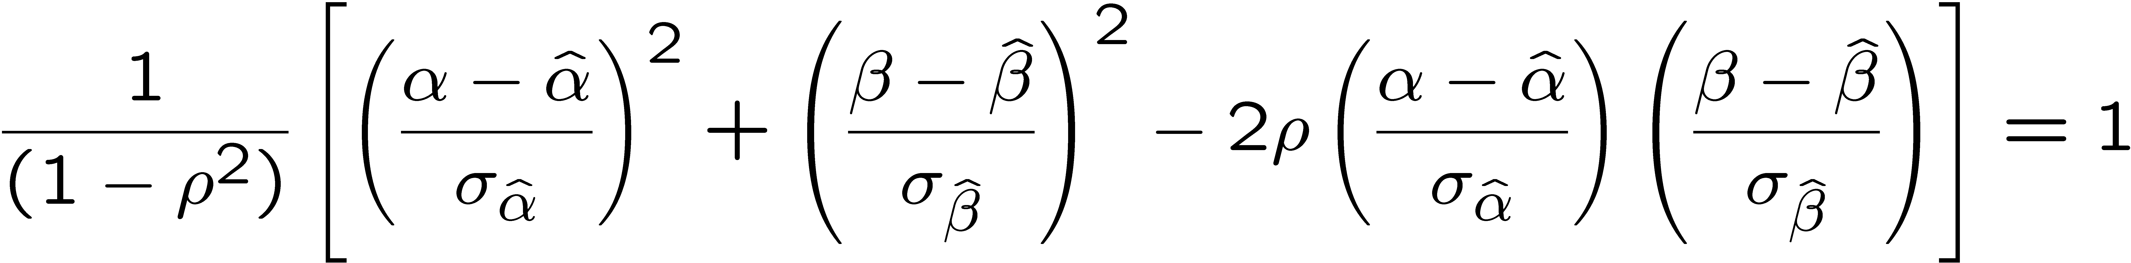
The ln L_{max} − 1/2 contour for two parameters
For large n, ln L takes on quadratic form near maximum:
The contour
is an ellipse:

Slide 37
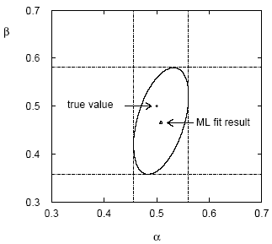

(Co)variances from ln L contour
The α, β plane for the first
MC data set
→ Tangent lines to contours give standard deviations.
→ Angle of ellipse φ related to correlation:

Slide 38
Functions of maximum-likelihood estimators
Suppose likelihood has a parameter θ.
Define a new parameter α given by function α = a(θ).
What is the MLE of α?
For now suppose a(θ) has a unique inverse, so θ = a⁻¹(α).
The likelihood is L(θ) = L(a⁻¹(α)).
The maximum of the likelihood is L_{max} = L(θ).
So to maximize L, find α ≡ α such that
^
^
MLE of a function is the function of the MLE.
If function many-to-one, some complications but related recipe.
Very useful result.

Slide 39





Functions of MLEs: exponential example
Suppose we had written the exponential pdf as
i.e., we use λ = 1/τ. What is the MLE estimator for λ?
For the decay constant we have
Caveat:
is biased, even though
is unbiased.
Can show
(bias →0 for n →∞)
In general MLE for a function of an unbiased estimator stays unbiased only for a linear function.

Slide 40

Relationship between ML and Bayesian estimators
Recall the Bayesian approach:
Both θ and x are random variables.
Use subjective probability for hypotheses (θ);
before experiment, knowledge summarized by prior pdf π(θ);
use Bayes’ theorem to update prior in light of data:
Posterior pdf (conditional pdf for θ given x)

Slide 41



ML and Bayesian estimators (2)
Purist Bayesian: p(θ | x) contains all knowledge about θ.
Pragmatist Bayesian: p(θ | x) could be a complicated function,
→ summarize using an estimator
Take mode of p(θ | x), (could also use e.g. expectation value)
What do we use for π(θ)?
No golden rule (subjective!), often represent ‘prior ignorance’ by π(θ) = constant, in which case

Slide 42
ML and Bayesian estimators (3)
Note π_{θ}(θ) = const. cannot be normalized – “improper prior”.
Can be allowed for some problems; prior always appears multiplied
by likelihood, so product L(θ)π_{θ}(θ) can result in normalizable posterior probability.
But... we could have used a different parameter, e.g., λ= 1/θ,
and if prior π_{θ}(θ) is constant, then π_{λ}(λ) is not:
Maybe we know say we nothing about λ, so take π_{λ}(λ) = const.
Then
‘Complete prior ignorance’ is not well defined.

Slide 43
Priors from formal rules
Because of difficulties in encoding a vague degree of belief
in a prior, one often attempts to derive the prior from formal rules,
e.g., to satisfy certain invariance principles or to provide maximum
information gain for a certain set of measurements.
Often called “objective priors”
Form basis of Objective Bayesian Statistics
The priors do not reflect a degree of belief (but might represent
possible extreme cases).
In a Subjective Bayesian analysis, using objective priors can be an
important part of the sensitivity analysis.

Slide 44
Priors from formal rules (cont.)
In Objective Bayesian analysis, can use the intervals in a
frequentist way, i.e., regard Bayes’ theorem as a recipe to produce
an interval with certain coverage properties. For a review see:
Formal priors have not been widely used in HEP, but there is
recent interest in this direction; see e.g.
L. Demortier, S. Jain and H. Prosper, Reference priors for high
energy physics, Phys. Rev. D 82:034002 (2010); arxiv:1002.1111

Slide 45


Jeffreys’ prior
According to Jeffreys’ rule, take prior according to
where
is the Fisher information matrix.
One can show that this leads to inference that is invariant under
a transformation of parameters.
For a Gaussian mean, the Jeffreys’ prior is constant; for a Poisson
mean μ it is proportional to 1/√μ.

Slide 46


“Invariance of inference” with Jeffreys’ prior
Suppose we have a parameter θ, to which we assign a prior π_{θ}(θ).
An experiment gives data x, modeled by L(θ) = P(x|θ).
Bayes’ theorem then tells us the posterior for θ:
Now consider a function η(θ), and we want the posterior P(η|x).
This must follow from the usual rules of transformation of random variables:

Slide 47

“Invariance of inference” with Jeffreys’ prior (2)
Alternatively, we could have just starting with η as the parameter
in our model, and written down a prior pdf π_{η}(η).
Using it, we express the likelihood as L(η) = P(x|η) and write Bayes’
theorem as
If the priors really express our degree of belief, then they must
be related by the usual laws of probability π_{η}(η) = π_{θ}(θ(η)) |dθ/dη|,
and in this way the two approaches lead to the same result.
But if we choose the priors according to “formal rules”, then this is
not guaranteed. For the Jeffrey’s prior, however, it does work!
Using π_{θ}(θ) ∝√I(θ) and transforming to find P(η|x) leads to
the same as using π_{η}(η) ∝√I(η) directly with Bayes’ theorem.

Slide 48




Jeffreys’ prior for Poisson mean
Suppose n ~ Poisson(μ). To find the Jeffreys’ prior for μ,
So e.g. for μ = s + b, this means the prior π(s) ~ 1/√(s + b), which depends on b. But this is not designed as a degree of belief about s.

Slide 49

Posterior pdf for Poisson mean
From Bayes’ theorem,
Flat, π(μ) = const.
mode = n
Jeffreys, π(μ) ~ 1/√μ
In both cases, posterior is special case of gamma distribution.
mode = n – ½

Slide 50
Parameter Estimation 1
Extra Slides
Extended maximum likelihood
Maximum likelihood with a histogram of data
Relationship between MLE and Bayesian estimator
Further examples

Slide 51


Extended ML
We observe n independent values of x ~ f (x;θ).
Suppose we regard n not as fixed, but as a Poisson r.v., mean ν.
Result of experiment defined as: n, x₁, ..., x_{n}.
P(n, x) = P(n) P(x|n), so the (extended) likelihood function is:
Suppose theory gives ν = ν(θ), then the log-likelihood is
where C represents terms not depending on θ.

Slide 52



Extended ML (2)
Example: expected number of events
where the total cross section σ(θ) is predicted as a function of
the parameters of a theory, as is the distribution of a variable x.
Extended MLE uses information both from the number of events n as well as the observed values of x.
→ smaller errors for (compared to using x alone).
If ν does not depend on θ but remains a free parameter,
extended ML gives:

Slide 53





ML with binned data
Often put data into a histogram:
Hypothesis specifies
where
If we model the data as multinomial (n_{tot} constant),
then the log-likelihood function is:

Slide 54



Example with binned data
Previous example with exponential, now put data into histogram:
Binning results in loss of information, increased std. dev. of MLE.
Limit of zero bin width → usual unbinned MLE.
If n_{i} treated as Poisson, we get extended log-likelihood:

Slide 55

MLE for number of taxis
The number plate of taxis in every canton in Switzerland ends with a number N from 1 to N_{tot}, where N_{tot} is the total number of taxis.
Model the probability for observing plate number N with

Slide 56
MLE for N_{tot}
Suppose you observe one taxi at random with plate number N.
The likelihood function is
which is maximized for
The expectation value and bias of the MLE are
For better estimators, see similar problem with tanks in WW2:
https://en.wikipedia.org/wiki/German_tank_problem
E.g. the minimum-variance unbiased estimator is:

Slide 57
Cheap estimator for mass of W boson
The Particle Physics community has spent huge sums trying to
estimate the mass of the W boson with the smallest possible
statistical and systematic uncertainty.
Here is an estimator with zero statistical uncertainty. And it’s free!
Here is its sampling distribution:
Does this violate the information
inequality?

Slide 58

Cheap estimator for mass of W boson (2)
This estimator’s bias is
Note current best estimate of M_{W} is 80.379±0.012 GeV, so the numerical
value of the bias may be fairly small.
But we have
and so
So the information inequality is still satisfied.

Slide 59



Extended ML example
Consider two types of events (e.g., signal and background) each
of which predict a given pdf for the variable x: f_{s}(x) and f_{b}(x).
We observe a mixture of the two event types, signal fraction = θ,
expected total number = ν, observed total number = n.
Let
goal is to estimate μ_{s}, μ_{b}.
→

Slide 60



Extended ML example (2)
Monte Carlo example
with combination of
exponential and Gaussian:
Maximize log-likelihood in
terms of μ_{s} and μ_{b}:
Here errors reflect total Poisson
fluctuation as well as that in
proportion of signal/background.

Slide 61


Example of MLE: parameters of Gaussian pdf
Consider independent x₁, ..., x_{n}, with x_{i} ~ Gauss(μ, σ²)
The log-likelihood function is

Slide 62



Example of ML: parameters of Gaussian pdf (2)
Set derivatives with respect to μ, σ² to zero and solve,
We already know that the estimator for μ is unbiased.
But we find, however,
so the MLE for
σ² has a bias, but b → 0 for n → ∞. Recall, however, that
is an unbiased estimator for σ². Usually not important whether one uses s² or the MLE to estimate σ².

Slide 63
Example of ML: parameters of Gaussian pdf (3)
Use 2nd derivatives of ln L to find covariance.

Slide 64
Example of ML: parameters of Gaussian pdf (4)
So the Fisher information matrix is
Invert to find covariance matrix
That is,
From error prop.,

Slide 65
Upper limit for Poisson mean
To find upper limit at CL = 1−α, solve
Jeffreys prior:
= 7.03
n=3,
CL=0.95
Flat prior:
= 7.75
where P⁻¹ is the inverse of the normalized lower incomplete gamma function (see scipy.special)

