Slide 1


Statistics for Particle Physicists
Lecture 1: Introduction, Probability
Summer Student Lectures
CERN
8 – 11 July 2025
https://indico.cern.ch/event/1508891/timetable/
Glen Cowan
Physics Department
Royal Holloway, University of London
g.cowan@rhul.ac.uk
www.pp.rhul.ac.uk/~cowan

Slide 2
Outline
Lecture 1: Introduction, probability,
Lecture 2: Parameter estimation
Lecture 3: Hypothesis tests
Lecture 4: Systematic uncertainties, further examples
Almost everything is a subset of the University of London course:
http://www.pp.rhul.ac.uk/~cowan/stat_course.html

Slide 3
Theory ↔ Statistics ↔ Experiment
Theory (model, hypothesis):
Experiment (observation):
+ response of measurement
apparatus
= model prediction
data
Uncertainty enters
on many levels
→ quantify with
probability

Slide 4
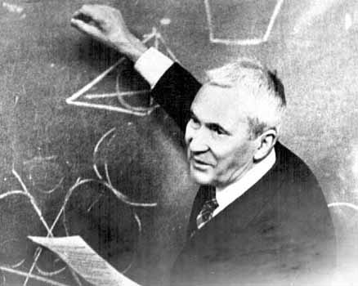

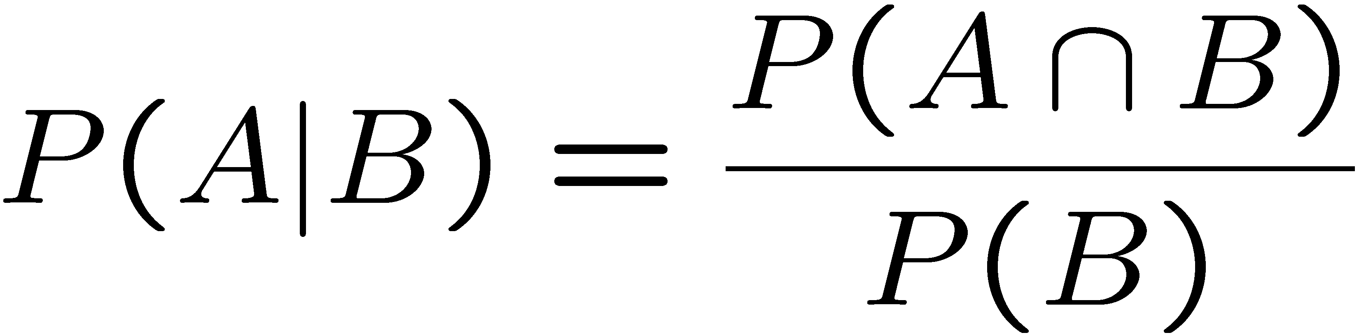
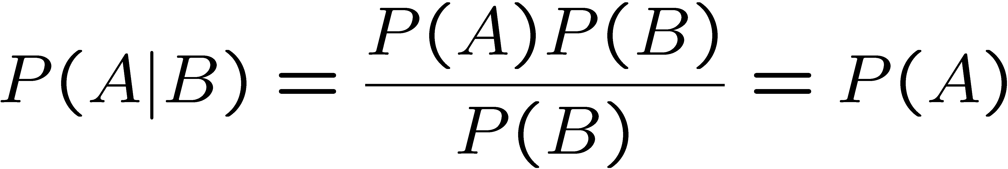
A definition of probability
Consider a set S with subsets A, B, ...
Kolmogorov
axioms (1933)
Also define conditional
probability of A given B:
Subsets A, B independent if:
If A, B independent,

Slide 5
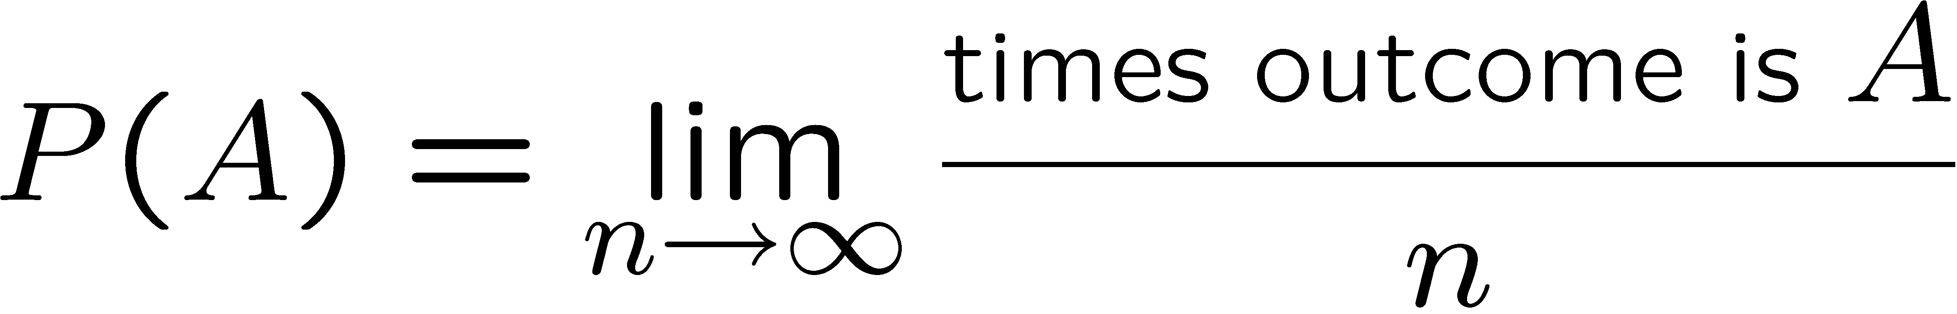
Interpretation of Probability
I. Relative frequency (→ “frequentist statistics”)
A, B, ... are outcomes of a repeatable experiment
cf. quantum mechanics, particle scattering, radioactive decay...
II. Subjective probability (→ “Bayesian statistics”)
A, B, ... are hypotheses (statements that are true or false)
• Both interpretations consistent with Kolmogorov axioms.
• In particle physics frequency interpretation often most useful, but subjective probability can provide more natural treatment of non-repeatable phenomena: systematic uncertainties, probability that magnetic monopoles exist,...

Slide 6
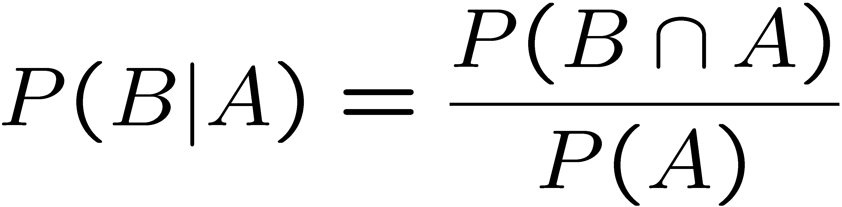
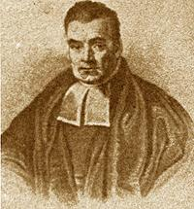
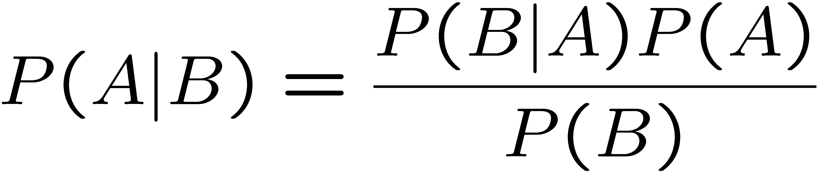
Bayes’ theorem
From the definition of conditional probability we have
and
but
, so
Bayes’ theorem
Bayes’
theorem
First published (posthumously) by the
Reverend Thomas Bayes (1702−1761)
An essay towards solving a problem in the doctrine of chances, Philos. Trans. R. Soc. 53 (1763) 370

Slide 7
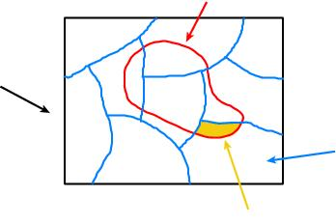
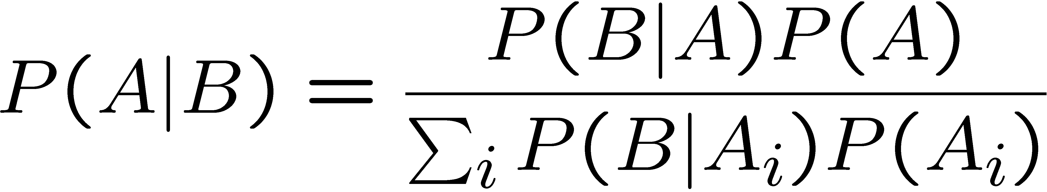
The law of total probability
B
Consider a subset B of
the sample space S,
S
divided into disjoint subsets A_{i}
such that ∪_{i} A_{i} = S,
A_{i}
B ∩ A_{i}
→
→
→
law of total probability
Bayes’ theorem becomes

Slide 8



An example using Bayes’ theorem
Suppose the probability (for anyone) to have a disease D is:
← prior probabilities, i.e.,
before any test carried out
Consider a test for the disease: result is + or −
← probabilities to (in)correctly
identify a person with the disease
← probabilities to (in)correctly
identify a healthy person
Suppose your result is +. How worried should you be?

Slide 9
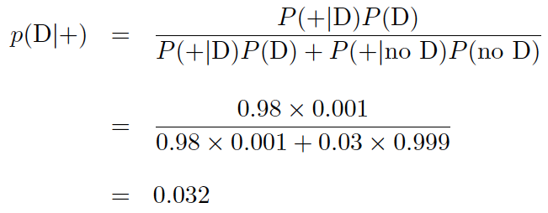
Bayes’ theorem example (cont.)
The probability to have the disease given a + result is
← posterior probability
i.e. you’re probably OK!
Your viewpoint: my degree of belief that I have the disease is 3.2%.
Your doctor’s viewpoint: 3.2% of people like this have the disease.

Slide 10
Frequentist Statistics − general philosophy
In frequentist statistics, probabilities are associated only with
the data, i.e., outcomes of repeatable observations (shorthand: x).
Probability = limiting frequency
Probabilities such as
P (string theory is true),
P (0.117 < α_{s} < 0.119),
P (Biden wins in 2024),
etc. are either 0 or 1, but we don’t know which.
The tools of frequentist statistics tell us what to expect, under
the assumption of certain probabilities, about hypothetical
repeated observations.
Preferred theories (models, hypotheses, ...) are those that predict a high probability for data “like” the data observed.

Slide 11
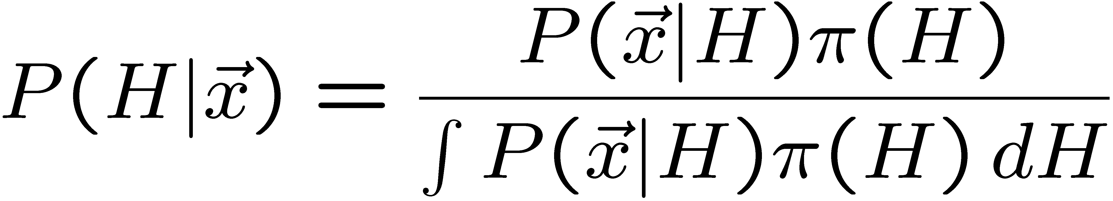
Bayesian Statistics − general philosophy
In Bayesian statistics, use subjective probability for hypotheses:
probability of the data assuming
hypothesis H (the likelihood)
prior probability, i.e.,
before seeing the data
posterior probability, i.e.,
after seeing the data
normalization involves sum
over all possible hypotheses
Bayes’ theorem has an “if-then” character: If your prior
probabilities were π(H), then it says how these probabilities
should change in the light of the data.
No general prescription for priors (subjective!)

Slide 12
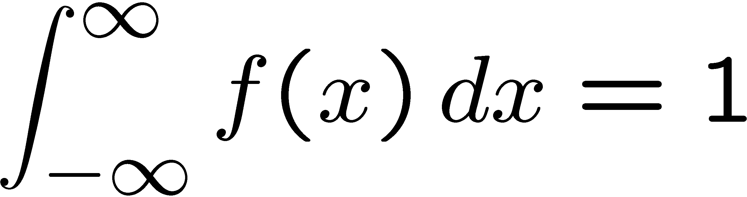
Random variables and probability density functions
A random variable is a numerical characteristic assigned to an element of the sample space; can be discrete or continuous.
Suppose outcome of experiment is continuous value x
→ f (x) = probability density function (pdf)
x must be somewhere

Slide 13

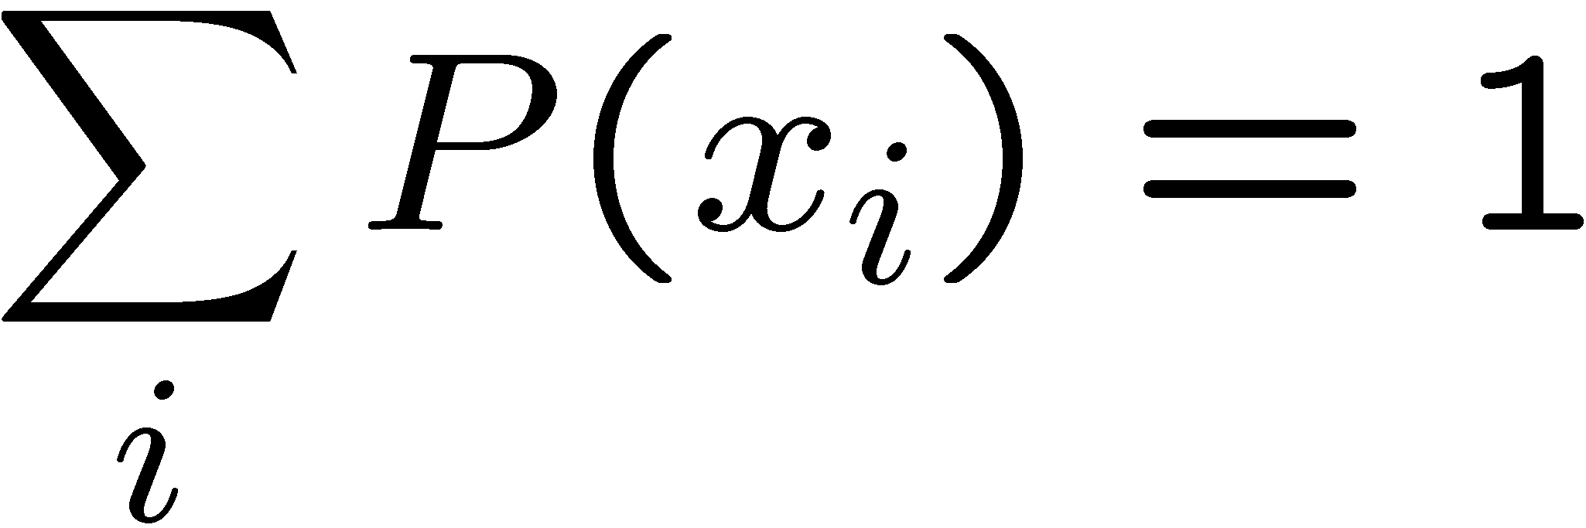
Probability mass function
For discrete outcome x_{i} with e.g. i = 1, 2, ... we have
probability (mass) function
x must take on one of its possible values

Slide 14
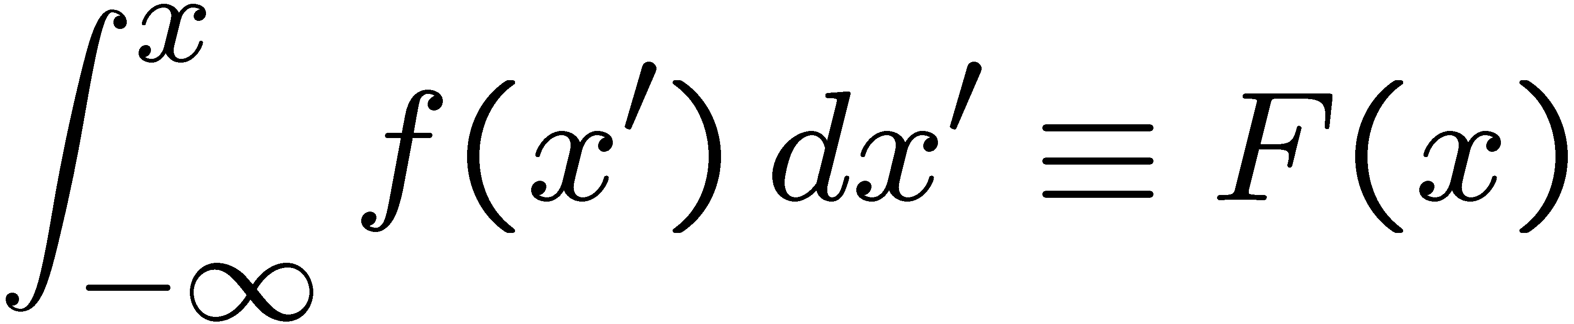
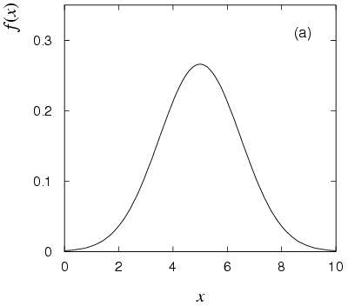
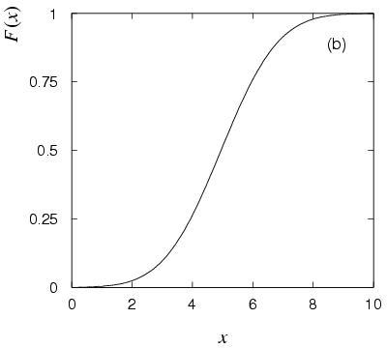
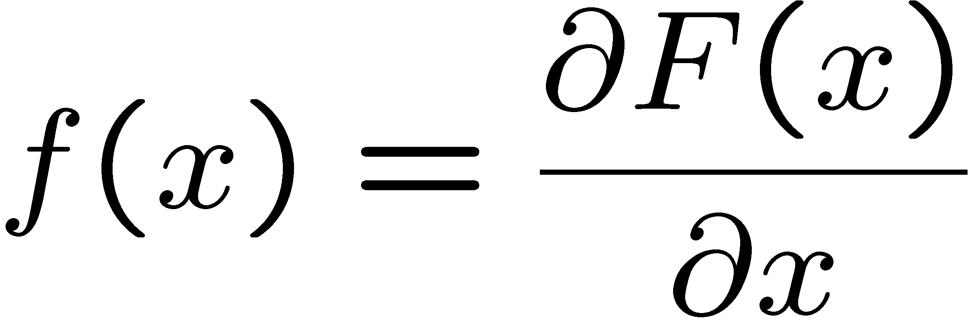
Cumulative distribution function
Probability to have outcome less than or equal to x is
cumulative distribution function
Alternatively define pdf with

Slide 15
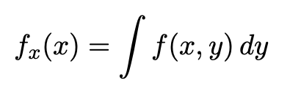
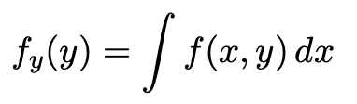
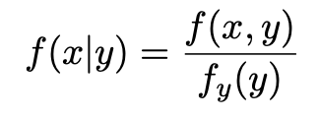
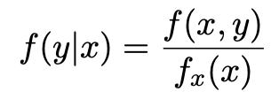
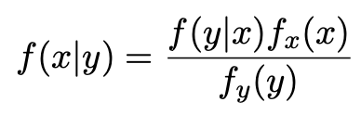
Some other pdfs
Joint pdf, e.g., f (x,y)
Marginal pdfs
Conditional pdfs
Bayes’ theorem:

Slide 16
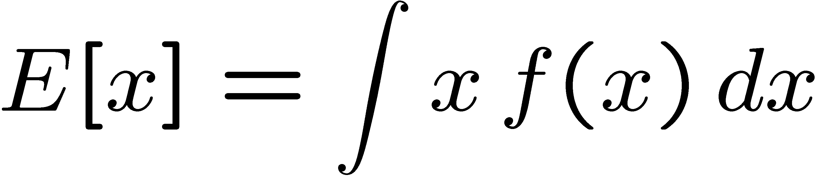

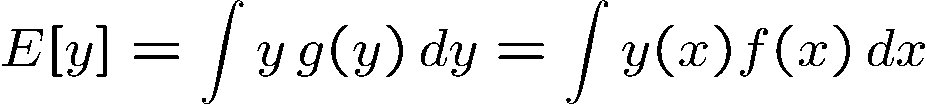

Expectation values
Consider continuous r.v. x with pdf f (x).
Define expectation (mean) value as
Notation (often): ~ “centre of gravity” of pdf.
For discrete r.v.s, replace integral by sum:
For a function y(x) with pdf g(y),
(equivalent)

Slide 17
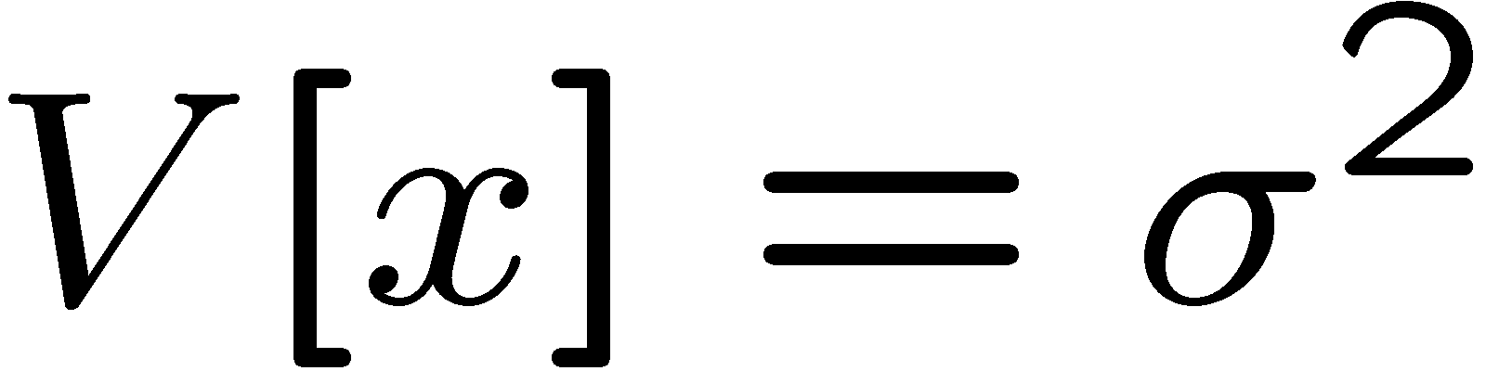
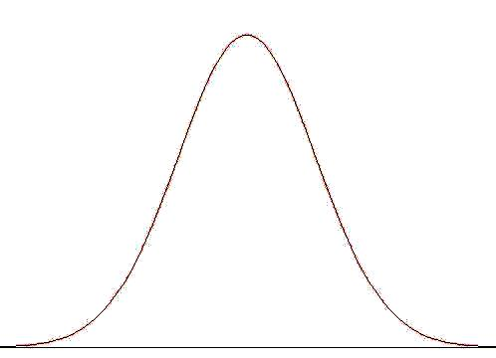
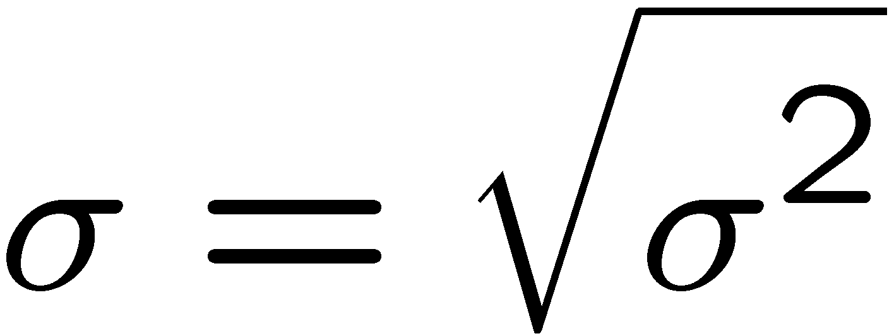


Variance, standard deviation
Variance:
Notation:
Standard deviation:
σ ~ width of pdf, same units as x.
Relation between σ and other measures of width, e.g.,
Full Width at Half Max (FWHM) depend on the pdf, e.g.,
FWHM = 2.35σ for Gaussian.

Slide 18
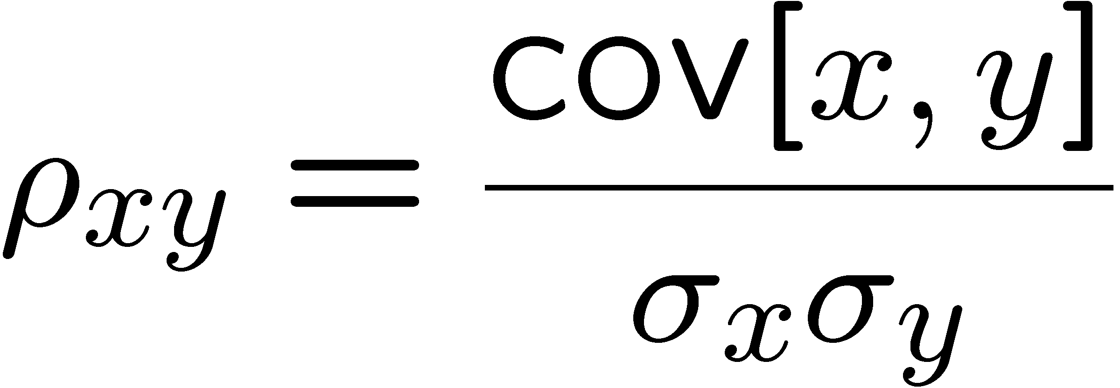

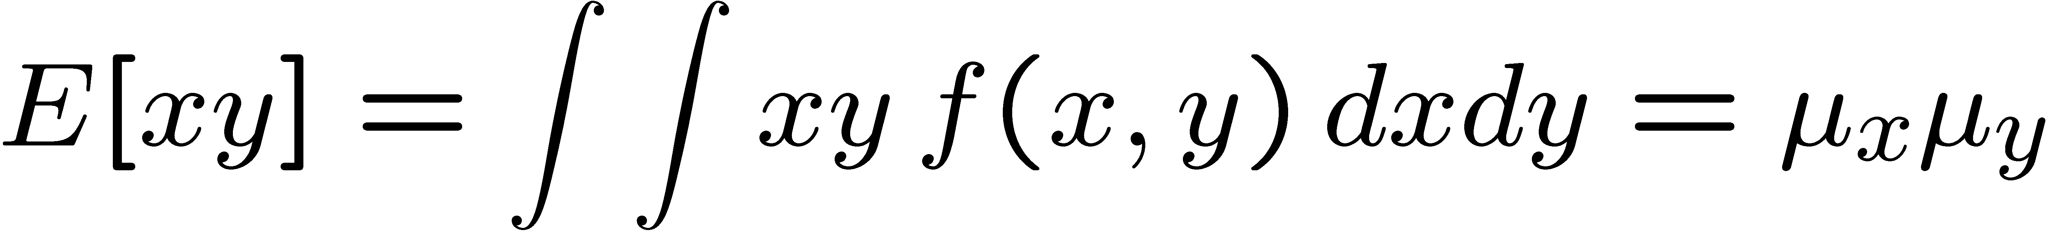

Covariance and correlation
Define covariance cov[x,y] (also use matrix notation V_{xy}) as
Correlation coefficient (dimensionless) defined as
Can show −1 ≤ ρ ≤ 1.
If x, y, independent, i.e.,
, then
→
x and y, ‘uncorrelated’
N.B. converse not always true.

Slide 19
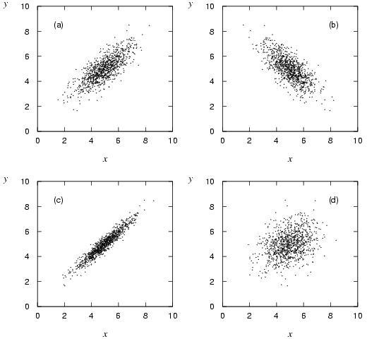




Correlation (cont.)

Slide 20
Covariance matrix
Suppose we have a set of n random variables, say, x₁,..., x_{n}.
We can write the covariance of each pair as an n x n matrix:
Covariance matrix is:
symmetric,
diagonal = variances,
positive semi-definite:

Slide 21
Correlation matrix
Closely related to the covariance matrix is the n x n matrix of correlation coefficients:
By construction, diagonal
elements are ρ_{ii} = 1

Slide 22
Some distributions (see extra slides)
Distribution/pdf Example use in Particle Physics
Binomial Branching ratio
Multinomial Histogram with fixed N
Poisson Number of events found
Uniform Monte Carlo method
Exponential Decay time
Gaussian Measurement error
Chi-square Goodness-of-fit
Cauchy Mass of resonance
Landau Ionization energy loss
Beta Prior pdf for efficiency
Gamma Sum of exponential variables
Student’s t Resolution function with adjustable tails

Slide 23
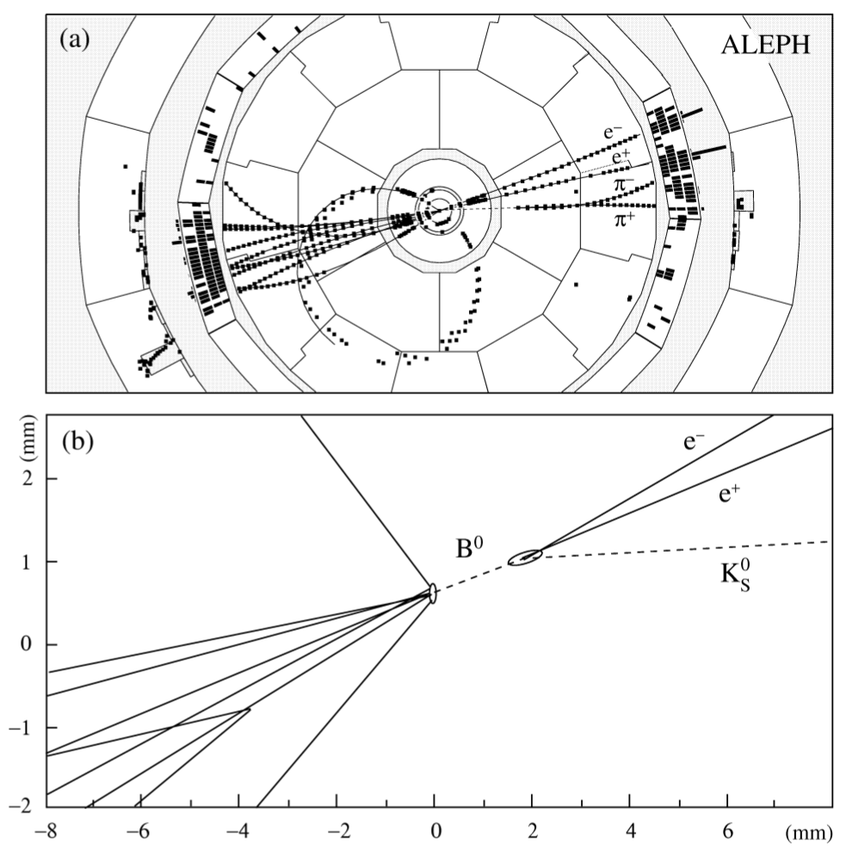
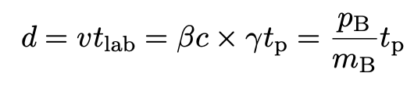
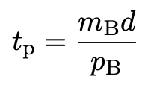
Example: decay of an unstable particle
As an example that we’ll use to illustrate several statistical methods, consider measuring the proper decay time of an unstable particle such as a B meson:
Measure flight distance d and momentum p of decay products of B meson with mass m_{B}.
These are related to the proper decay time t_{p} (time in B rest frame) by
so

Slide 24
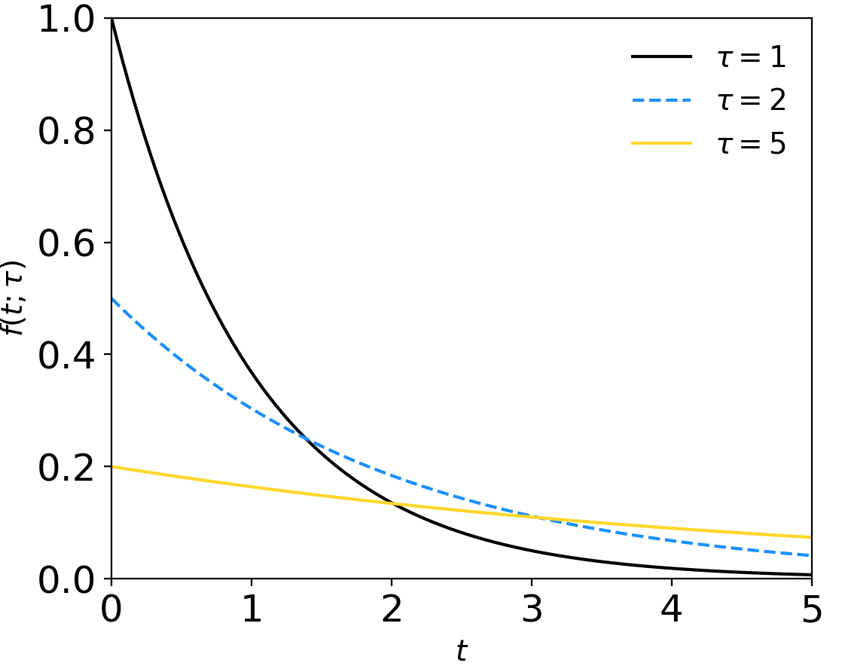

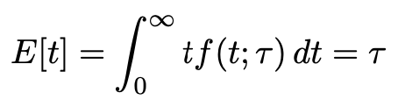

Exponential pdf for proper decay time
We can model t as following an exponential pdf:
random
variable
parameter
We can show (exercise) that the mean and variance of t are:

Slide 25
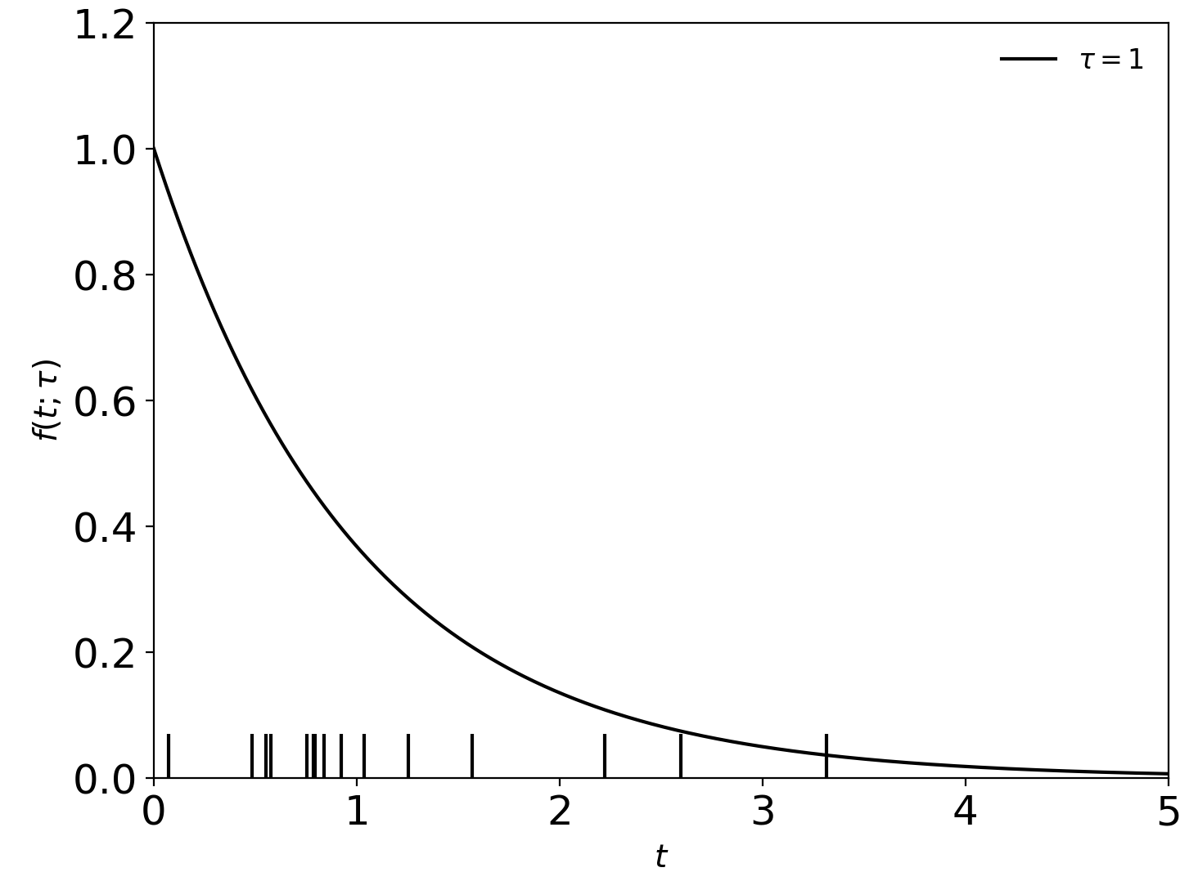
Example: statistics with exponentially distributed data
Coming up later in the week:
Suppose the experiment is repeated n times giving data: t₁,..., t_{n}.
observed values
Using the data values, estimate the mean lifetime τ.
Quantify the statistical uncertainty in the estimate.
Report upper/lower limits on the the mean lifetime.

Slide 26
Extra slides

Slide 27
Some statistics books, papers, etc.
G. Cowan, Statistical Data Analysis, Clarendon, Oxford, 1998
R.J. Barlow, Statistics: A Guide to the Use of Statistical Methods in the Physical Sciences, Wiley, 1989
Ilya Narsky and Frank C. Porter, Statistical Analysis Techniques in Particle Physics, Wiley, 2014.
Luca Lista, Statistical Methods for Data Analysis in Particle Physics, Springer, 2017.
L. Lyons, Statistics for Nuclear and Particle Physics, CUP, 1986
F. James., Statistical and Computational Methods in Experimental Physics, 2nd ed., World Scientific, 2006
S. Brandt, Statistical and Computational Methods in Data Analysis, Springer, New York, 1998.
S. Navas et al. (Particle Data Group), Phys. Rev. D 110, 030001 (2024); pdg.lbl.gov sections on probability, statistics, MC, ML.

Slide 28





Correlation vs. independence
Consider a joint pdf such as:
I.e. here f (−x,y) = f (x,y)
Because of the symmetry, we have E[x] = 0 and also
and so ρ = 0, the two variables x and y are uncorrelated.
But f (y|x) clearly depends on x, so x and y are not independent.
Uncorrelated: the joint density of x and y is not tilted.
Independent: imposing x does not affect conditional pdf of y.

Slide 29
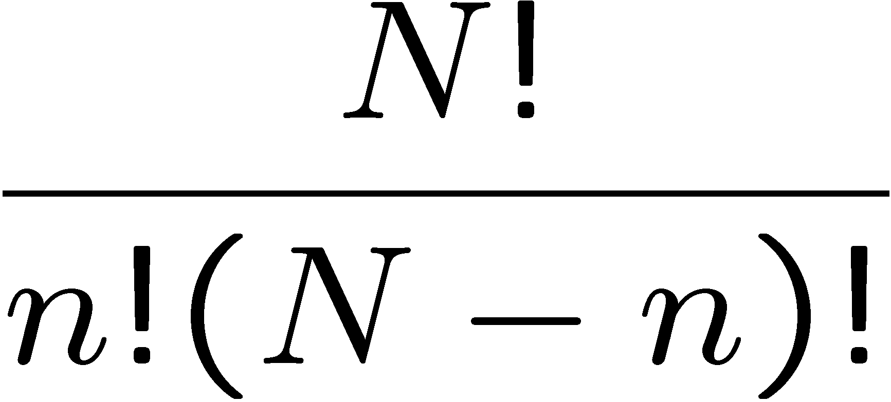
Binomial distribution
Consider N independent experiments (Bernoulli trials):
outcome of each is ‘success’ or ‘failure’,
probability of success on any given trial is p.
Define discrete r.v. n = number of successes (0 ≤ n ≤ N).
Probability of a specific outcome (in order), e.g. ‘ssfsf’ is
But order not important; there are
ways (permutations) to get n successes in N trials, total
probability for n is sum of probabilities for each permutation.

Slide 30
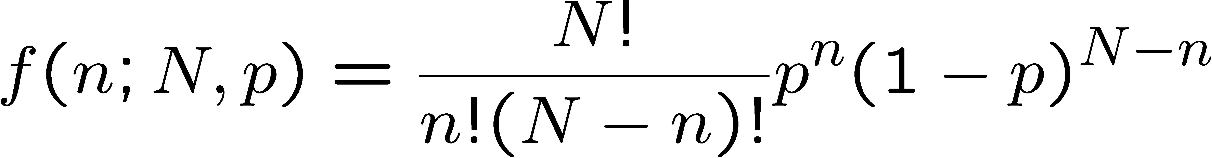
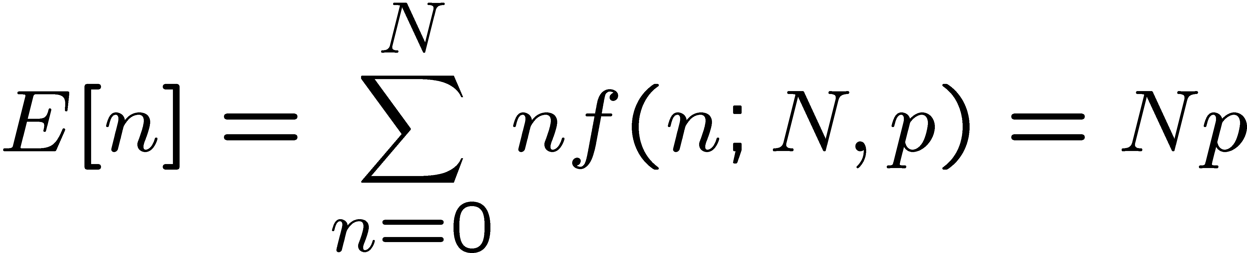
Binomial distribution (2)
The binomial distribution is therefore
random
variable
parameters
For the expectation value and variance we find:

Slide 31
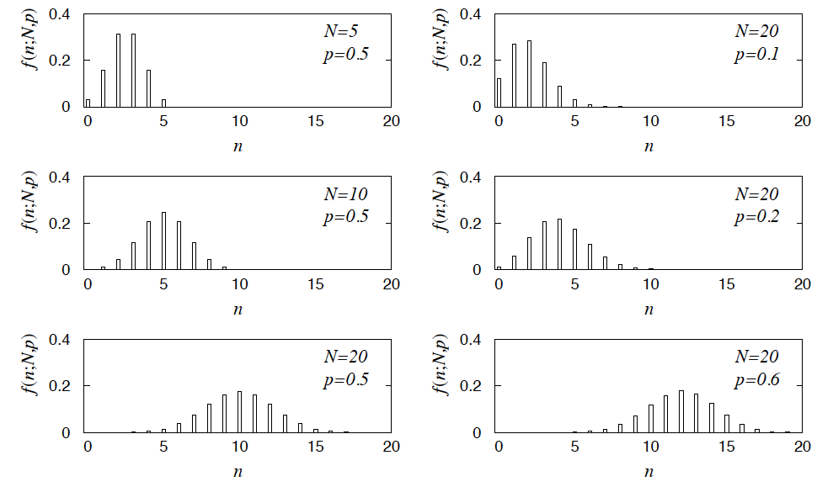
Binomial distribution (3)
Binomial distribution for several values of the parameters:
Example: observe N decays of W±, the number n of which are
W→μν is a binomial r.v., p = branching ratio.

Slide 32
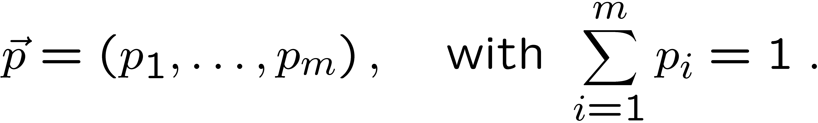
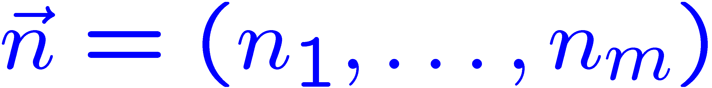
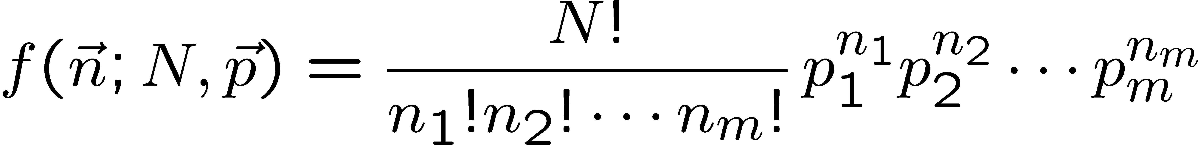
Multinomial distribution
Like binomial but now m outcomes instead of two, probabilities are
For N trials we want the probability to obtain:
n₁ of outcome 1,
n₂ of outcome 2,
⠇
n_{m} of outcome m.
This is the multinomial distribution for

Slide 33

Multinomial distribution (2)
Now consider outcome i as ‘success’, all others as ‘failure’.
→ all n_{i} individually binomial with parameters N, p_{i}
for all i
One can also find the covariance to be
Example:
represents a histogram
with m bins, N total entries, all entries independent.

Slide 34
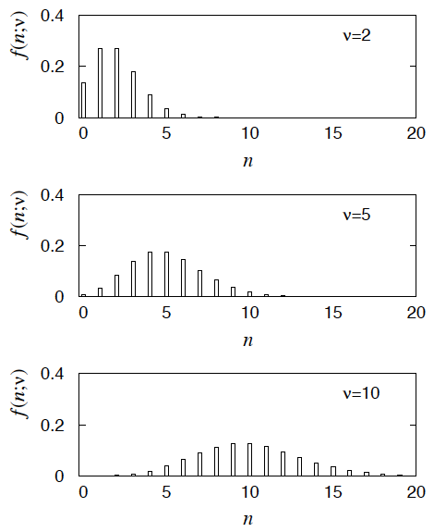
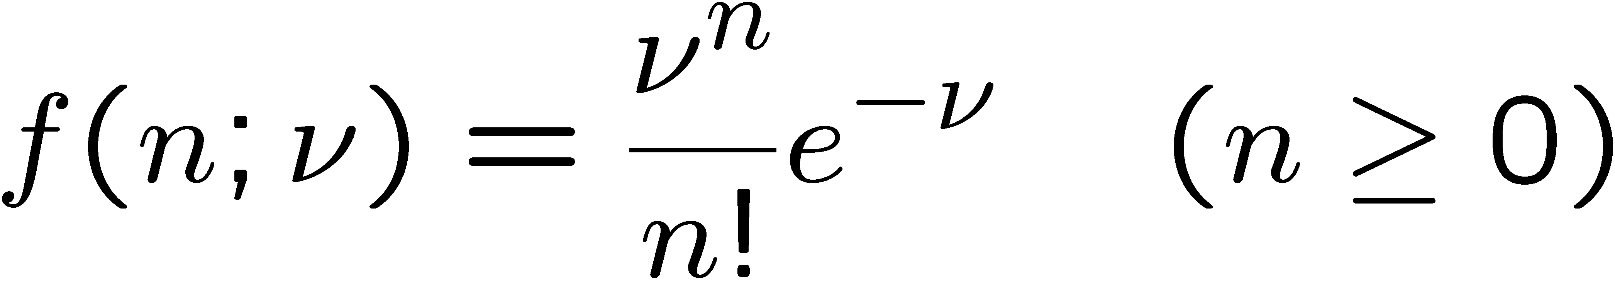

Poisson distribution
Consider binomial n in the limit
→ n follows the Poisson distribution:
Example: number of scattering events
n with cross section σ found for a fixed
integrated luminosity, with

Slide 35
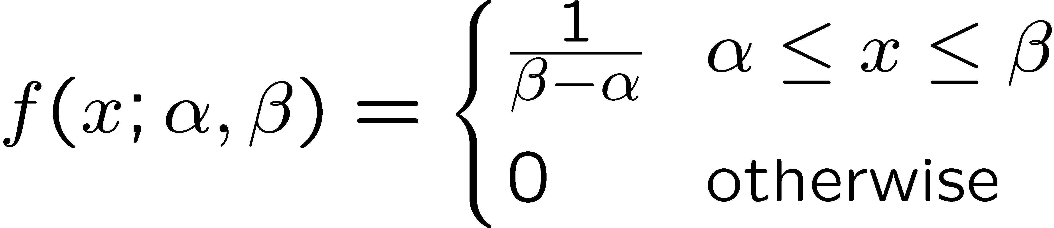
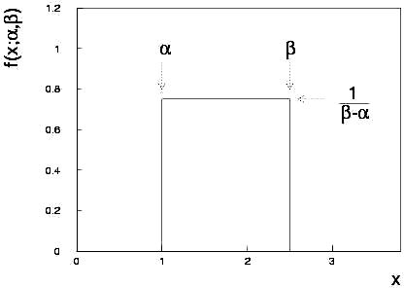
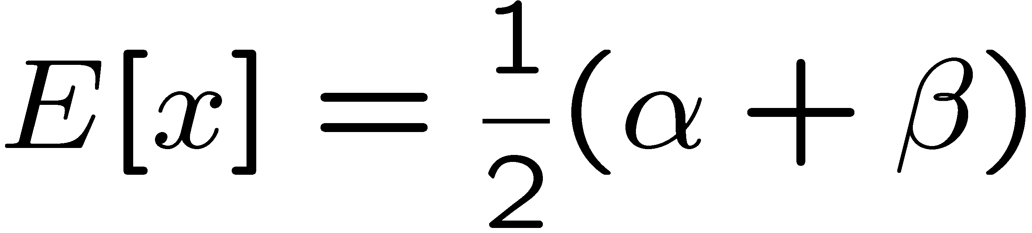
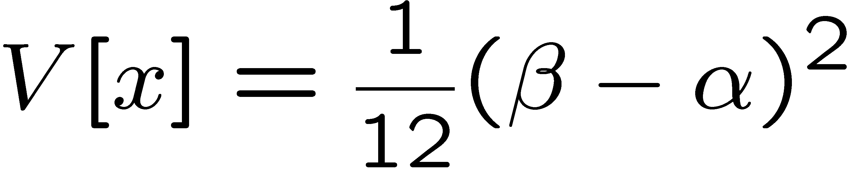
Uniform distribution
Consider a continuous r.v. x with −∞ < x < ∞ . Uniform pdf is:
Notation: x follows a uniform distribution between α and β
write as: x ~ U[α,β]

Slide 36
Uniform distribution (2)
Very often used with α = 0, β = 1 (e.g., Monte Carlo method).
For any r.v. x with pdf f (x), cumulative distribution F(x), the function y = F(x) is uniform in [0,1]:
because f (x) = dF/dx = dy/dx

Slide 37
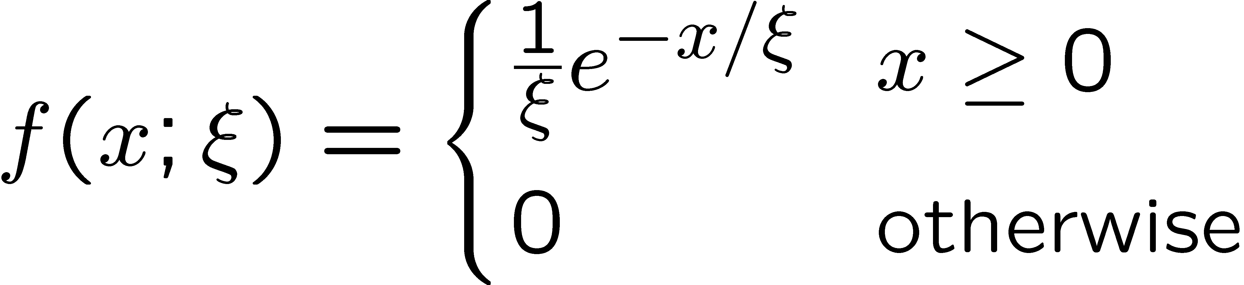



Exponential distribution
The exponential pdf for the continuous r.v. x is defined by:

Slide 38

Exponential distribution (2)
Example: proper decay time t of an unstable particle
(τ = mean lifetime)
Lack of memory (unique to exponential):
Question for discussion:
A cosmic ray muon is created 30 km high in the atmosphere, travels to sea level and is stopped in a block of scintillator, giving a start signal at t₀. At a time t it decays to an electron giving a stop signal. What is distribution of the difference between stop and start times, i.e., the pdf of t – t₀ given t > t₀?

Slide 39




Gaussian (normal) distribution
The Gaussian (normal) pdf for a continuous r.v. x is defined by:
N.B. often μ, σ² denote
mean, variance of any
r.v., not only Gaussian.

Slide 40

Standardized random variables
If a random variable y has pdf f (y) with mean μ and std. dev. σ,
then the standardized variable
has the pdf
has mean of zero and standard deviation of 1.
Often work with the standard Gaussian distribution (μ = 0. σ = 1)
using notation:
Then e.g. y = μ + σ x follows

Slide 41




Multivariate Gaussian distribution
Multivariate Gaussian pdf for the vector
are column vectors,
are transpose (row) vectors,
Marginal pdf of each x_{i} is Gaussian with mean μ_{i}, standard deviation σ_{i} = √V_{ii} .

Slide 42


https://en.wikipedia.org/wiki/Multivariate_normal_distribution
Two-dimensional Gaussian distribution
where ρ = cov[x₁, x₂]/(σ₁σ₂)
is the correlation coefficient.

Slide 43



Chi-square (χ²) distribution
The chi-square pdf for the continuous r.v. z (z ≥ 0) is defined by
n = 1, 2, ... = number of ‘degrees of
freedom’ (dof)
For independent Gaussian x_{i}, i = 1, ..., n, means μ_{i}, variances σ_{i}²,
follows χ² pdf with n dof.
Example: goodness-of-fit test variable especially in conjunction
with method of least squares.

Slide 44


Cauchy (Breit-Wigner) distribution
The Breit-Wigner pdf for the continuous r.v. x is defined by
(Γ = 2, x₀ = 0 is the Cauchy pdf.)
E[x] not well defined, V[x] → ∞.
x₀ = mode (most probable value)
Γ = full width at half maximum
Example: mass of resonance particle, e.g. ρ, K*, φ⁰, ...
Γ = decay rate (inverse of mean lifetime)

Slide 45





Landau distribution
For a charged particle with β = ν /c traversing a layer of matter
of thickness d, the energy loss Δ follows the Landau pdf:
Δ
β
+ - + -
- + - +
d
L. Landau, J. Phys. USSR 8 (1944) 201; see also
W. Allison and J. Cobb, Ann. Rev. Nucl. Part. Sci. 30 (1980) 253.

Slide 46

Landau distribution (2)
Long ‘Landau tail’
→ all moments ∞
Mode (most probable
value) sensitive to β ,
→ particle i.d.

Slide 47




Beta distribution
Often used to represent pdf
of continuous r.v. nonzero only
between finite limits, e.g.,
y = a₀ + a₁x, a₀ ≤ y ≤ a₀ + a₁

Slide 48




Gamma distribution
Often used to represent pdf
of continuous r.v. nonzero only
in [0,∞].
Also e.g. sum of n exponential
r.v.s or time until nth event
in Poisson process ~ Gamma

Slide 49




Student's t distribution
ν = number of degrees of freedom
(not necessarily integer)
ν = 1 gives Cauchy,
ν → ∞ gives Gaussian.

Slide 50
Student's t distribution (2)
If x ~ Gaussian with μ = 0, σ² = 1, and
z ~ χ² with n degrees of freedom, then
t = x / (z/n)^{1/2} follows Student's t with ν = n.
This arises in problems where one forms the ratio of a sample
mean to the sample standard deviation of Gaussian r.v.s.
The Student's t provides a bell-shaped pdf with adjustable
tails, ranging from those of a Gaussian, which fall off very
quickly, (ν → ∞, but in fact already very Gauss-like for
ν = two dozen), to the very long-tailed Cauchy (ν = 1).
Developed in 1908 by William Gosset, who worked under
the pseudonym "Student" for the Guinness Brewery.
Notes:
here

