Slide 1
Statistics for Particle Physicists
Lecture 2: Parameter Estimation
Summer Student Lectures
CERN
8 – 11 July 2025
https://indico.cern.ch/event/1508891/timetable/
Glen Cowan
Physics Department
Royal Holloway, University of London
g.cowan@rhul.ac.uk
www.pp.rhul.ac.uk/~cowan

Slide 2
Outline
Lecture 1: Introduction, probability,
Lecture 2: Parameter estimation
See exercises on fitting with iminuit here
and on least squares with curve_fit here.
Lecture 3: Hypothesis tests
Lecture 4: Systematic uncertainties, further examples

Slide 3
Hypothesis, likelihood
Suppose the entire result of an experiment (set of measurements) is a collection of numbers x.
A (simple) hypothesis is a rule that assigns a probability to each possible data outcome:
= the likelihood of H
Often we deal with a family of hypotheses labeled by one or
more undetermined parameters (a composite hypothesis):
= the “likelihood function”
Note:
1) For the likelihood we treat the data x as fixed.
2) The likelihood function L(θ) is not a pdf for θ.

Slide 4
The likelihood function for i.i.d.* data
* i.i.d. = independent and identically distributed
Consider n independent observations of x: x₁, ..., x_{n}, where
x follows f (x; θ). The joint pdf for the whole data sample is:
In this case the likelihood function is
(x_{i} constant)

Slide 5
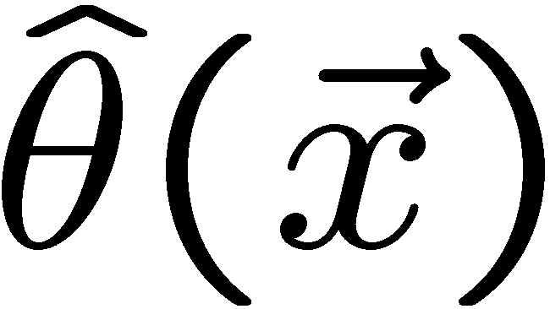
Parameter estimation
The parameters of a pdf are any constants that characterize it,
i.e., θ indexes a
set of hypotheses.
r.v.
parameter
Suppose we have a sample of observed values: x = (x₁, ..., x_{n})
We want to find some function of the data to estimate the
parameter(s):
← estimator written with a hat
Sometimes we say ‘estimator’ for the function of x₁, ..., x_{n};
‘estimate’ for the value of the estimator with a particular data set.

Slide 6
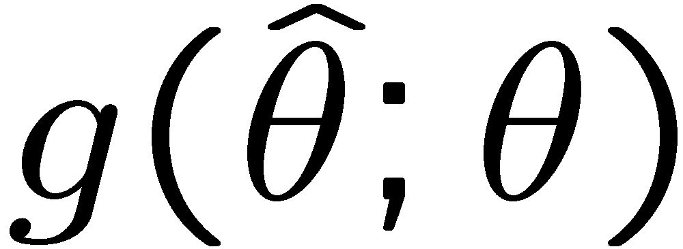
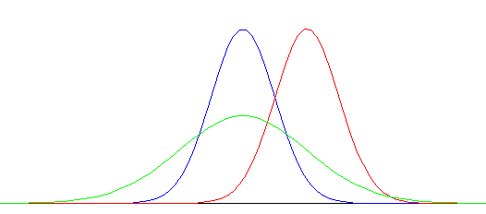
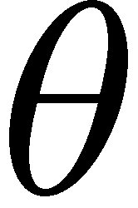
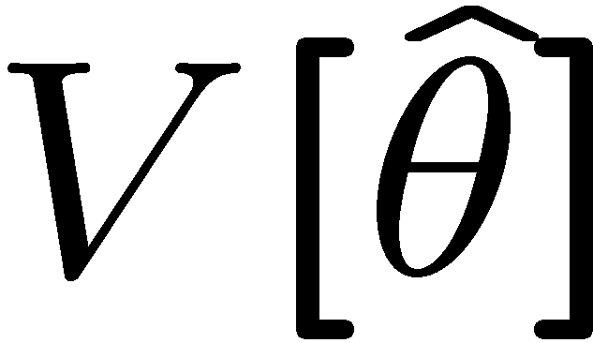
Properties of estimators
If we were to repeat the entire measurement, the estimates
from each would follow a pdf:
best
large
variance
biased
We want small (or zero) bias (systematic error):
→ average of repeated measurements should tend to true value.
And we want a small variance (statistical error):
→ small bias & variance are in general conflicting criteria

Slide 7
Maximum Likelihood Estimators (MLEs)
We define the maximum likelihood estimators or MLEs to be
the parameter values for which the likelihood is maximum.
Maximizing L equivalent to maximizing log L
Could have multiple maxima (take highest).
MLEs not guaranteed to have any ‘optimal’ properties, (but in practice they’re very good).

Slide 8
MLE example: parameter of exponential pdf
Consider exponential pdf,
and suppose we have i.i.d. data,
The likelihood function is
The value of τ for which L(τ) is maximum also gives the
maximum value of its logarithm (the log-likelihood function):

Slide 9
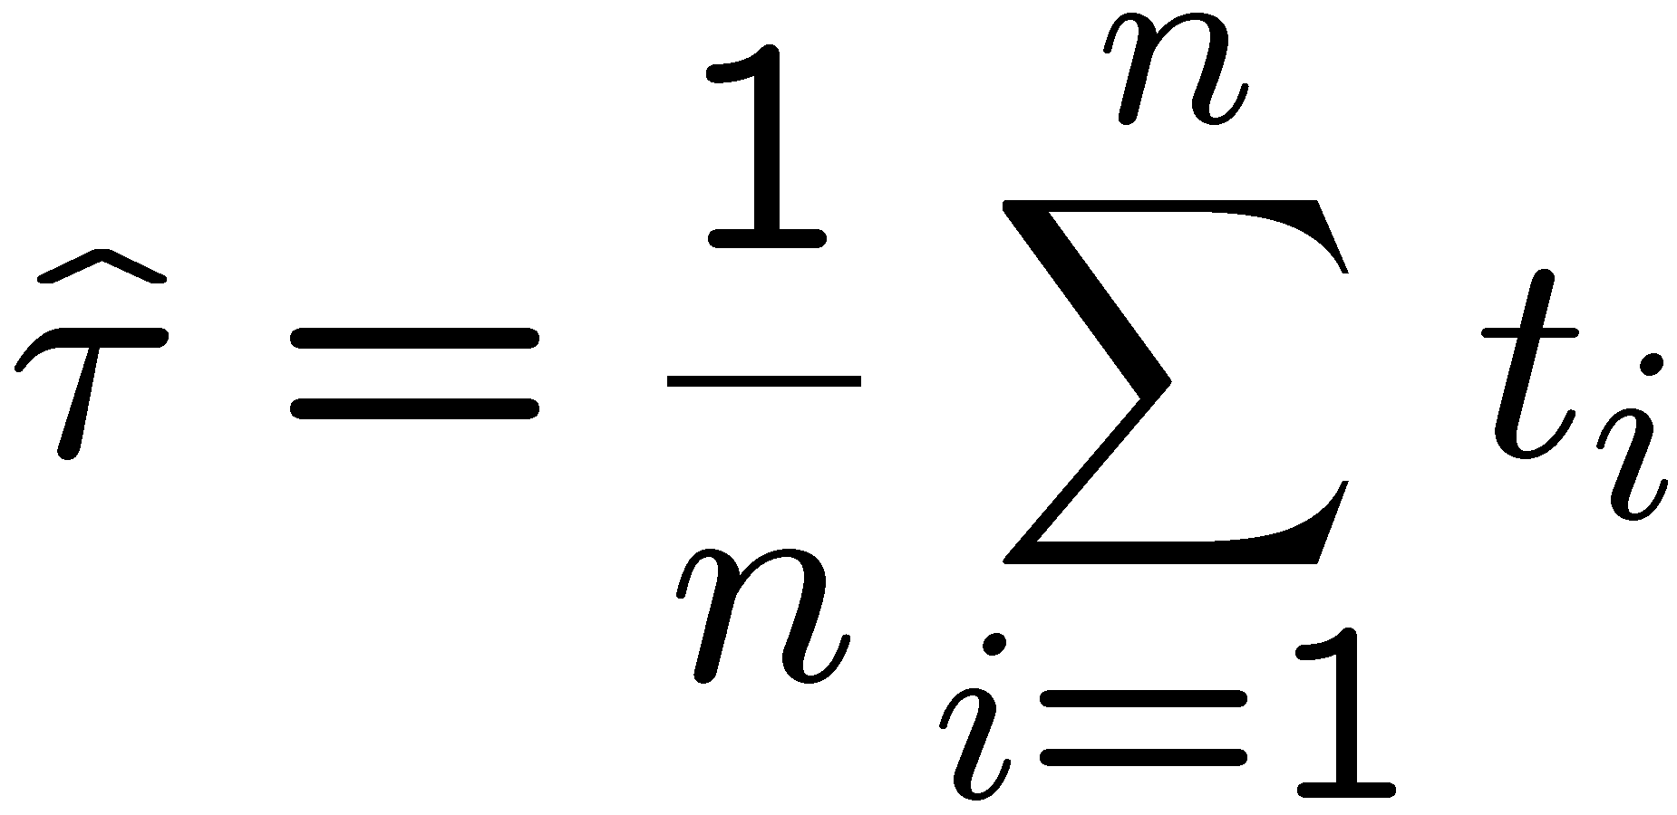
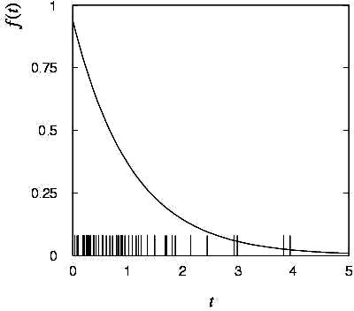
MLE example: parameter of exponential pdf (2)
Find its maximum by setting
→
Monte Carlo test:
generate 50 values
using τ = 1:
We find the ML estimate:

Slide 10
MLE example: parameter of exponential pdf (3)
For the exponential distribution one has for mean, variance:
For the MLE
we therefore find
→
→

Slide 11
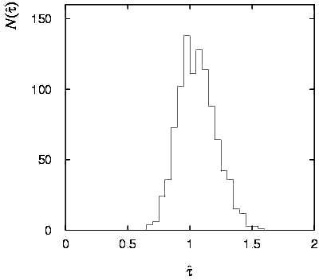
Variance of estimators: Monte Carlo method
Having estimated our parameter we now need to report its
‘statistical error’, i.e., how widely distributed would estimates
be if we were to repeat the entire measurement many times.
One way to do this would be to simulate the entire experiment
many times with a Monte Carlo program (use ML estimate for MC).
For exponential example, from
sample variance of estimates
we find:
Note distribution of estimates is roughly
Gaussian − (almost) always true for
ML in large sample limit.

Slide 12
Variance of estimators from information inequality
The information inequality (RCF) sets a lower bound on the
variance of any estimator (not only ML):
Minimum Variance
Bound (MVB)
Often the bias b is small, and equality either holds exactly or
is a good approximation (e.g. large data sample limit). Then,
Estimate this using the 2nd derivative of ln L at its maximum:

Slide 13
MVB for MLE of exponential parameter
Find
We found for the exponential parameter the MLE
and we showed b = 0, hence 𝜕b/𝜕τ = 0.
We find
and since E[t_{i}] = τ for all i,
,
and therefore
.
(Here MLE is “efficient”).

Slide 14
Variance of estimators: graphical method
Expand ln L(θ) about its maximum:
First term is ln L_{max}, second term is zero, for third term use
information inequality (assume equality):
i.e.,
→ to get
, change θ away from
until ln L decreases by 1/2.

Slide 15
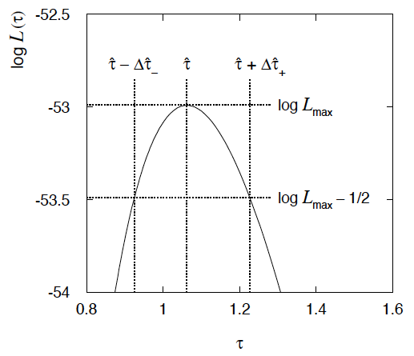
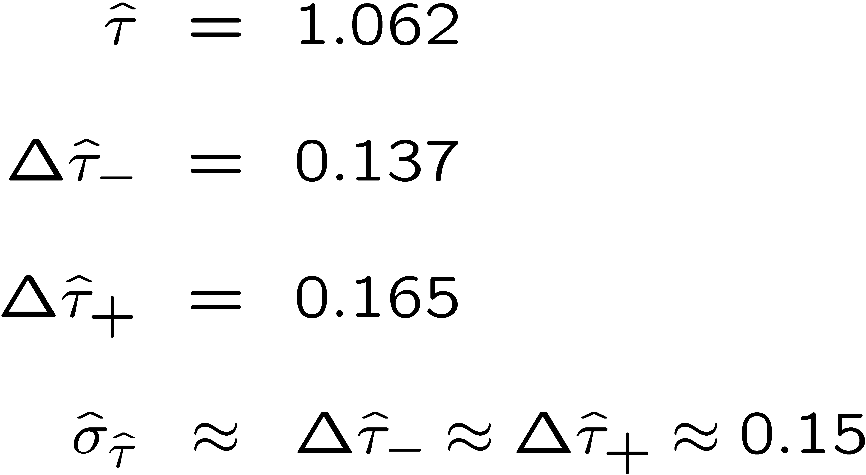
Example of variance by graphical method
ML example with exponential:
Not quite parabolic ln L since finite sample size (n = 50).

Slide 16
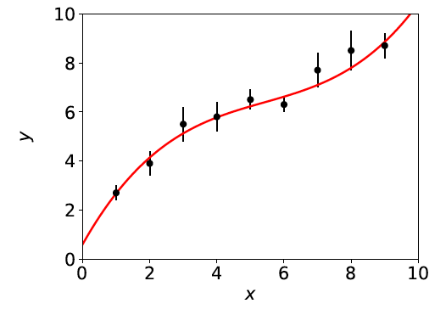
Curve fitting
Consider N independent measured values y_{i}, i = 1,.., N.
Each y_{i} has a standard deviation σ_{i}, and is measured at a value x_{i} of a control variable x known with negligible uncertainty:
μ(x; θ)
y_{i} ± σ_{i}
The goal is to find a curve μ(x; θ) that passes “close to” the data points (more formally: want E[y_{i}] = μ(x_{i}; θ)).
Suppose the functional form of μ(x; θ) is given; goal is to estimate its parameters θ (= “curve fitting”).

Slide 17
Gaussian likelihood function → LS estimators
Suppose the measurements y₁, ..., y_{N}, are independent Gaussian r.v.s with means E[y_{i}] = μ(x_{i}; θ) and variances V[y_{i}] = σ_{i}² , so the the likelihood function is
The log-likelihood function is therefore
So maximizing the likelihood is equivalent to minimizing
^
The minimum of χ ²(θ) defines the least squares (LS) estimators θ.

Slide 18
Information inequality for N parameters
Suppose we have estimated N parameters θ = (θ₁,...,θ_{N})
The Fisher information matrix is
^
and the covariance matrix of estimators θ is
The information inequality states that the matrix
is positive semi-definite:
z^{T}Mz ≥ 0 for all z ≠ 0, diagonal elements ≥ 0

Slide 19
Information inequality for N parameters (2)
In practice the inequality is ~always used in the large-sample limit:
bias → 0
inequality → equality, i.e, M = 0, and therefore V⁻¹ = I
That is,
This can be estimated from data using
Find the matrix V⁻¹ numerically (or with automatic differentiation),
then invert to get the covariance matrix of the estimators

Slide 20
Variance of LS estimators for Gaussian data
If y_{i} ~ Gauss, then we found
To the extent this (approximately) holds, we can use
and so we estimate the inverse covariance matrix with
and invert to estimate the covariance matrix U.
For Gaussian data with the linear LS problem, U is the minimum variance bound (the LS estimators are unbiased and efficient).

Slide 21
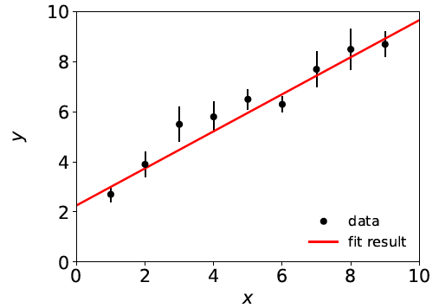
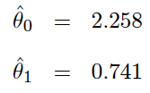
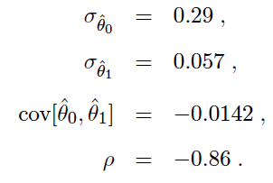
Covariance from derivatives of χ²(θ)
This is what programs like curve_fit and MINUIT do (derivatives computed numerically). Example with straight-line fit gives:
,

Slide 22
The contour χ ²(θ) = χ ²_{min} + 1
If μ(x; θ) is linear in the parameters, then χ²(θ) is quadratic:
Standard deviations from
tangents to (hyper-) planes of
(corresponds to
ln L(θ) = ln L_{max} – ½)

Slide 23
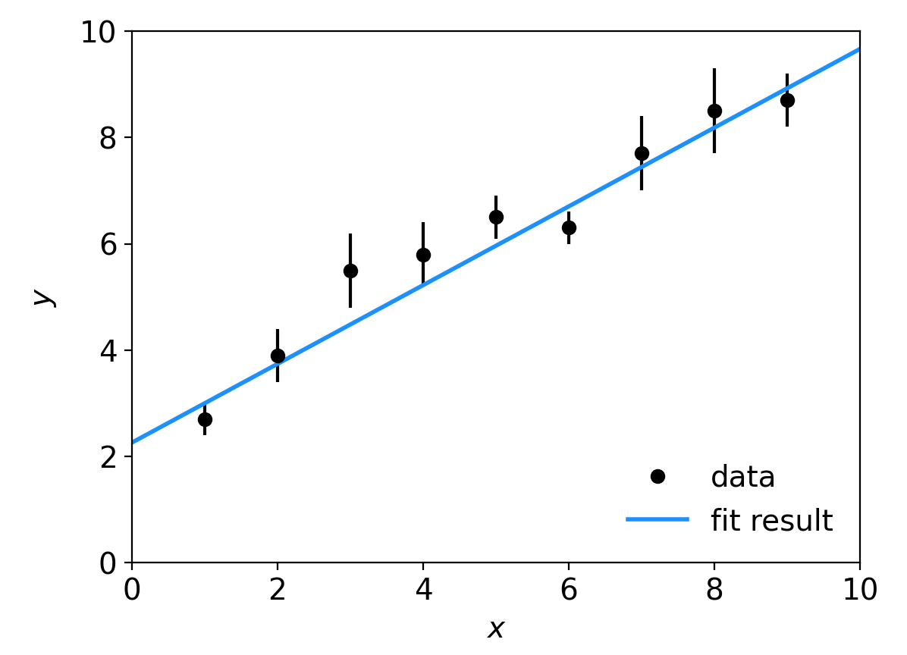
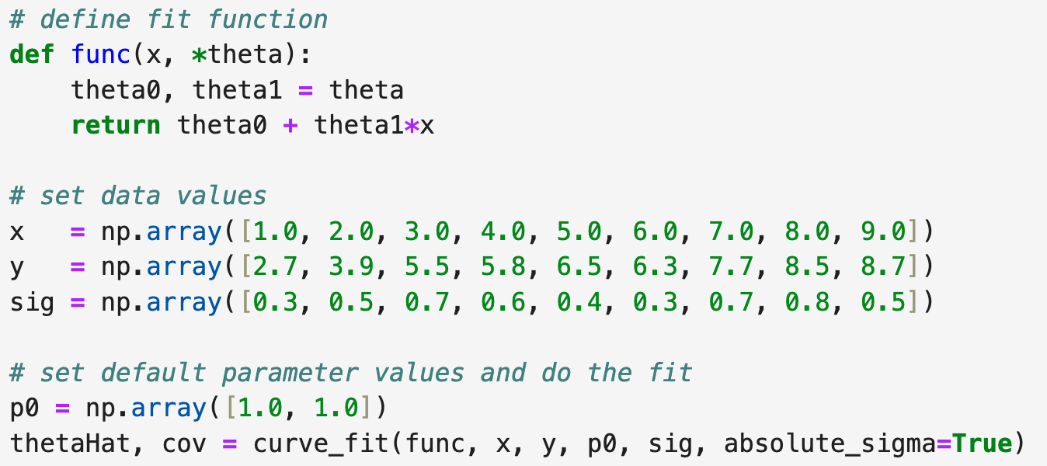
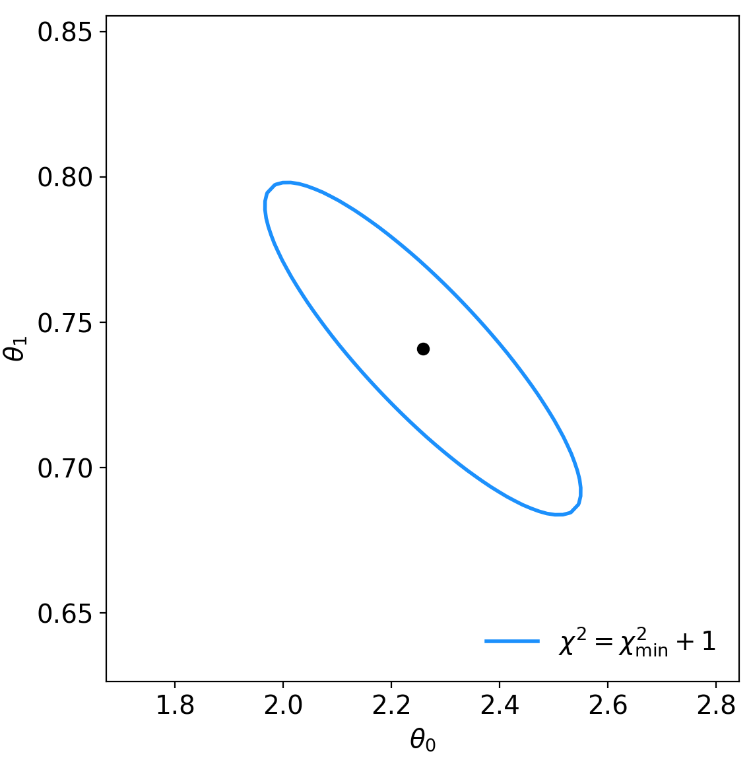
Example code (1)
Simple version: lineFit.py uses scipy.optimize.curve_fit:

Slide 24
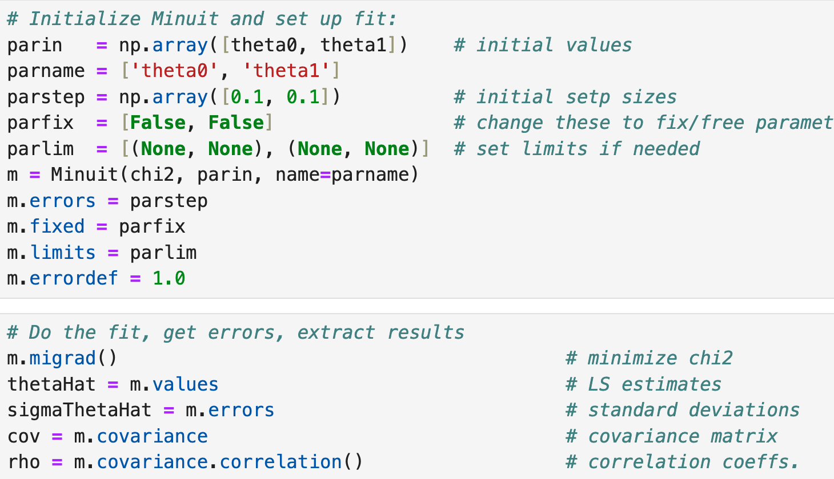
Example code (2)
Better version: lsFit.py uses iminuit:
← install with: pip install iminuit

Slide 25
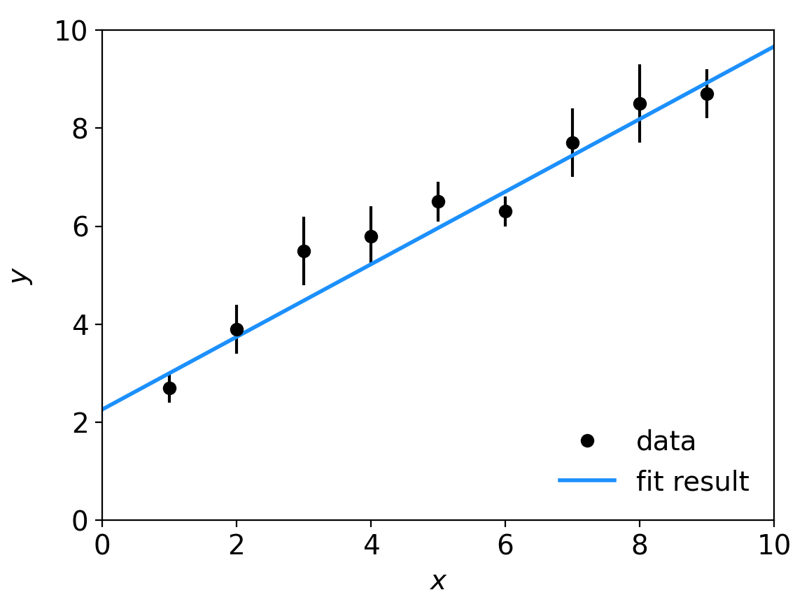
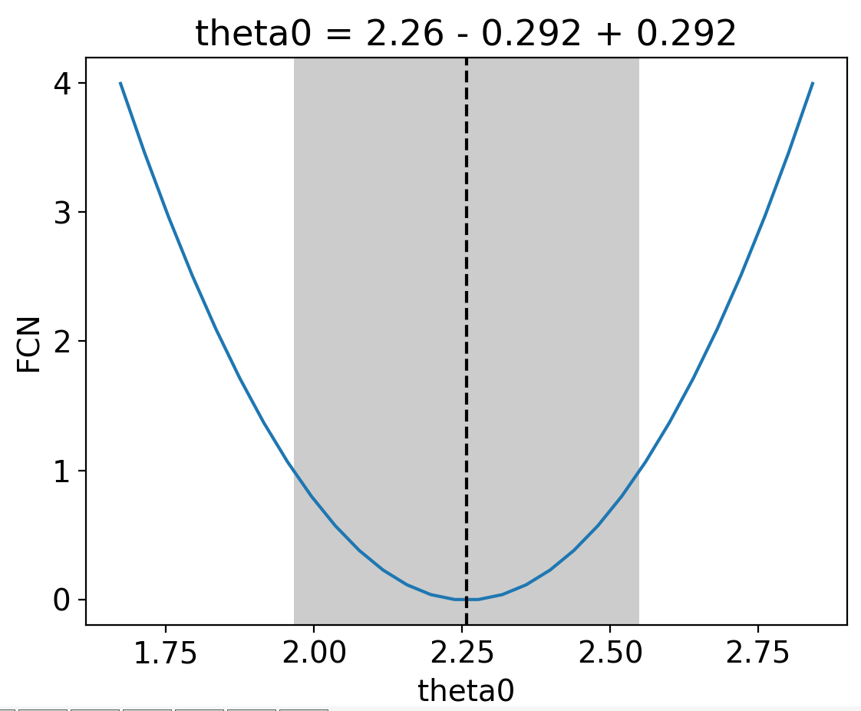
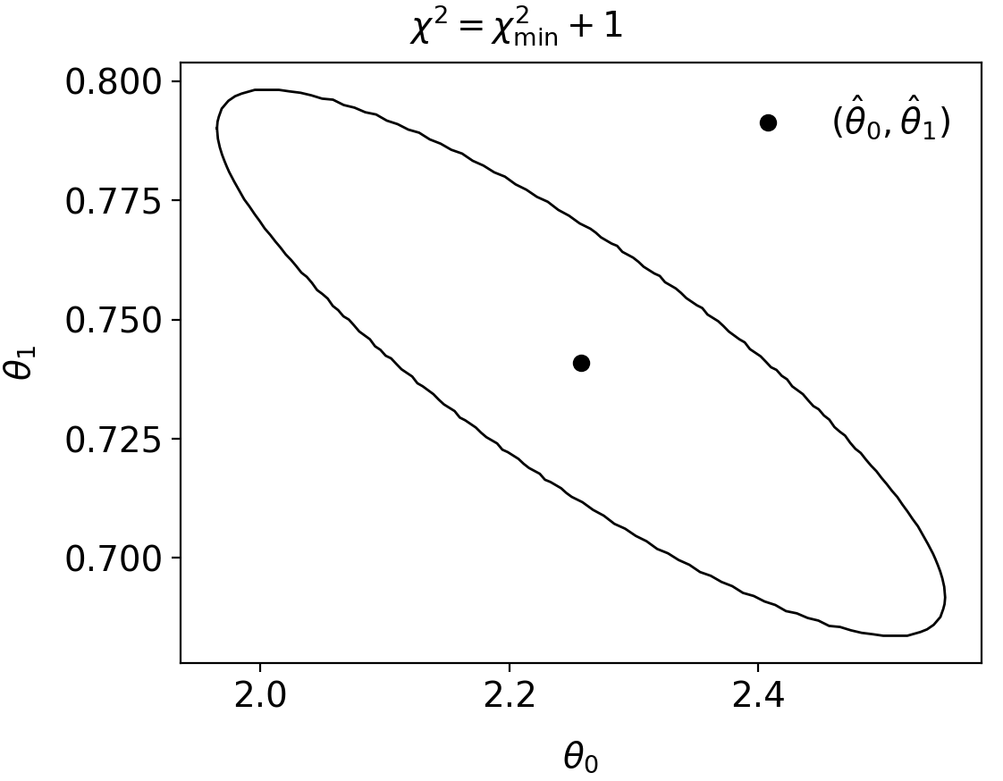
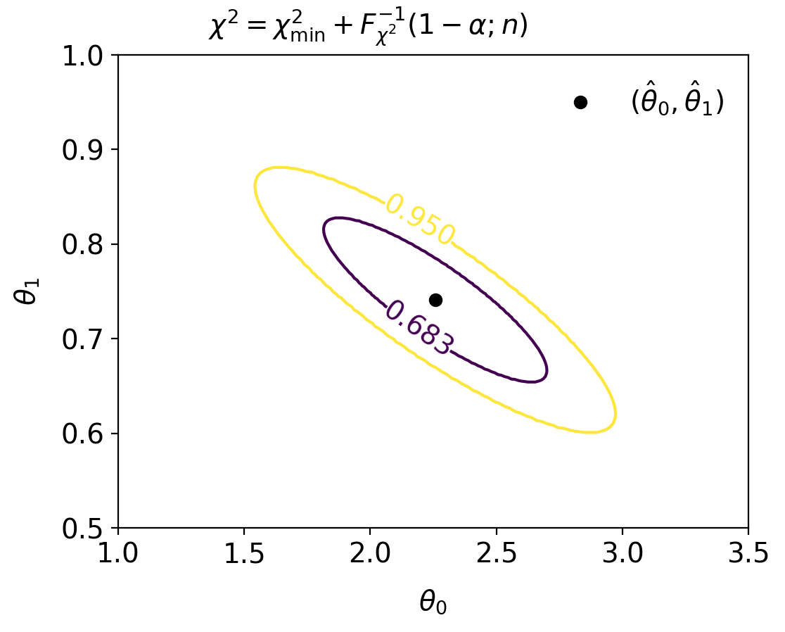
Example code (3)
iminuit provides detailed control of fit, diagnostic plots, etc.

Slide 26
Extra slides

Slide 27
LS with correlated measurements
If y ~ multivariate Gaussian with covariance matrix V_{ij} = cov[y_{i},y_{j}]
where μ^{T} = (μ(x₁),...,μ(x_{N})), then maximizing the likelihood is equivalent to minimizing

Slide 28
LS with correlated measurements (2)
For the special case of a diagonal covariance matrix, i.e., uncorrelated measurements. Then
→
V ⁻¹_{ij} = δ_{ij} /σ_{i}², carry out one of the sums, χ ²(θ) same as before:

