Slide 1


Statistics for Particle Physicists
Lecture 4: Systematic uncertainties, etc.
Summer Student Lectures
CERN
8 – 10 July 2026
https://indico.cern.ch/event/1616585/timetable/
Glen Cowan
Physics Department
Royal Holloway, University of London
g.cowan@rhul.ac.uk
www.pp.rhul.ac.uk/~cowan

Slide 2
Outline
Lecture 1: Introduction, probability,
Lecture 2: Parameter estimation
Lecture 3: Hypothesis tests
Lecture 4: Systematic uncertainties and further examples

Slide 3




moved from Lecture 3
Approximate confidence intervals/regions
from the likelihood function
Suppose we test parameter value(s) θ = (θ₁, ..., θ_{n}) using the ratio
Lower λ(θ) means worse agreement between data and hypothesized θ. Equivalently, usually define
so higher t_{θ} means worse agreement between θ and the data.
p-value of θ therefore
need pdf

Slide 4
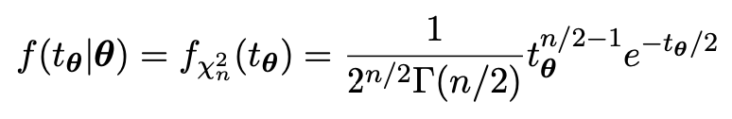



moved from Lecture 3
Confidence region from Wilks’ theorem
Wilks’ theorem says (in large-sample limit and provided
certain conditions hold...)
chi-square dist. with # d.o.f. = # of components in θ = (θ₁, ..., θ_{n}).
Assuming this holds, the p-value is
← set equal to α
To find boundary of confidence region set p_{θ} = α and solve for t_{θ}:
Recall also

Slide 5




moved from Lecture 3
Confidence region from Wilks’ theorem (cont.)
i.e., boundary of confidence region in θ space is where
For example, for 1 – α = 68.3% and n = 1 parameter,
and so the 68.3% confidence level interval is determined by
Same as recipe for finding the estimator’s standard deviation, i.e.,
is a 68.3% CL confidence interval.

Slide 6
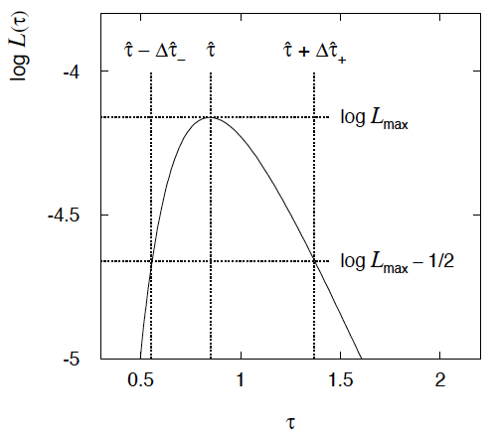

moved from Lecture 3
Example of interval from ln L(θ)
For n=1 parameter, CL = 0.683, Q_{α} = 1.
Our exponential
example, now with
only n = 5 events.
Can report ML estimate
with approx. confidence
interval from ln L_{max} – 1/2
as “asymmetric error bar”:

Slide 7



Systematic uncertainties and nuisance parameters
P (x|μ)
In general, our model of the data is not perfect:
model:
truth:
x
Can improve model by including
additional adjustable parameters.
Nuisance parameter ↔ systematic uncertainty. Some point in the
parameter space of the enlarged model should be “true”.
Presence of nuisance parameter decreases sensitivity of analysis
to the parameter of interest (e.g., increases variance of estimate).

Slide 8
Profile Likelihood
Suppose we have a likelihood L(μ,θ) = P(x|μ,θ) with N parameters of interest μ = (μ₁,..., μ_{N}) and M nuisance parameters θ = (θ₁,..., θ_{M}). The “profiled” (or “constrained”) values of θ are:
and the profile likelihood is:
The profile likelihood depends only on the parameters of interest; the nuisance parameters are replaced by their profiled values.
The profile likelihood can be used to obtain confidence intervals/regions for the parameters of interest in the same way as one would for all of the parameters from the full likelihood.

Slide 9
Profile Likelihood Ratio – Wilks theorem
Goal is to test/reject regions of μ space (param. of interest).
Rejecting a point μ should mean p_{μ} ≤ α for all possible values of the nuisance parameters θ.
Test μ using the “profile likelihood ratio”:
Let t_{μ} = −2 ln λ(μ). Wilks’ theorem says in large-sample limit:
where the number of degrees of freedom is the number of
parameters of interest (components of μ). So p-value for μ is

Slide 10
Profile Likelihood Ratio – Wilks theorem (2)
If we have a large enough data sample to justify use of the
asymptotic chi-square pdf, then if μ is rejected, it is rejected for any values of the nuisance parameters.
The recipe to get confidence regions/intervals for the parameters of interest at CL = 1 – α is thus the same as before, simply use the profile likelihood:
where the number of degrees of freedom N for the chi-square quantile is equal to the number of parameters of interest.
If the large-sample limit is not justified, then use e.g. Monte Carlo to get distribution of t_{μ}.

Slide 11
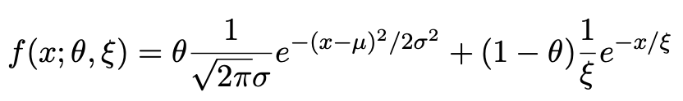
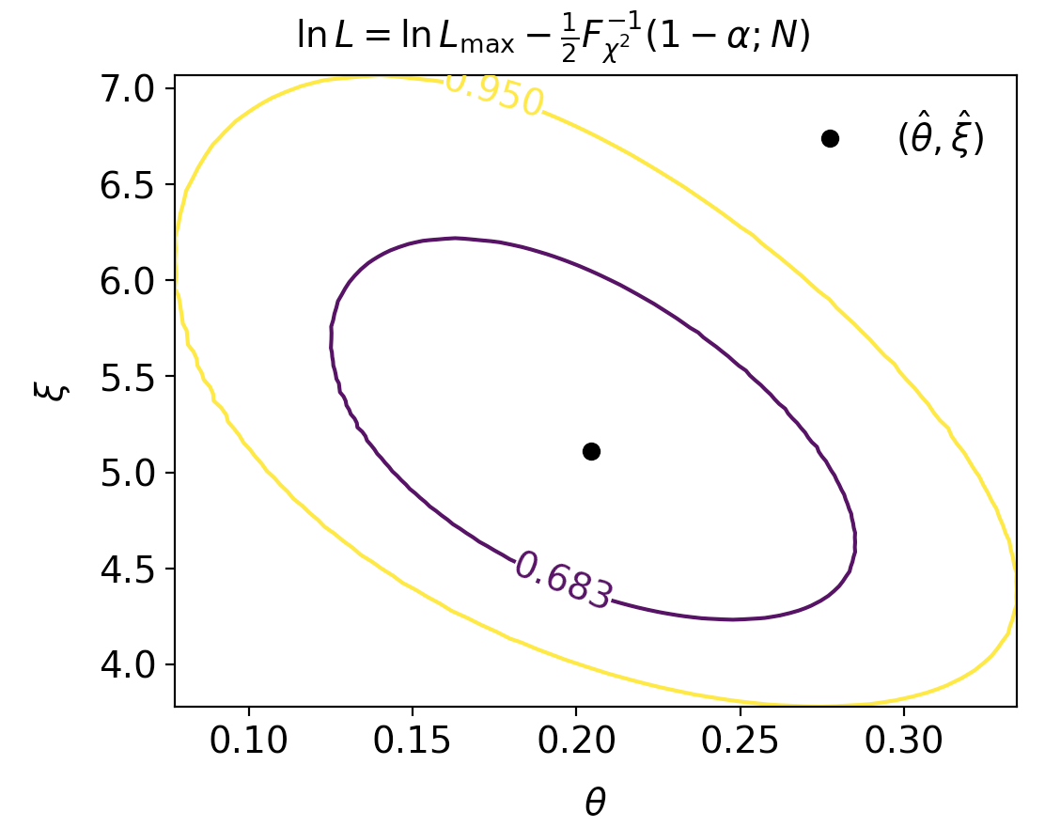
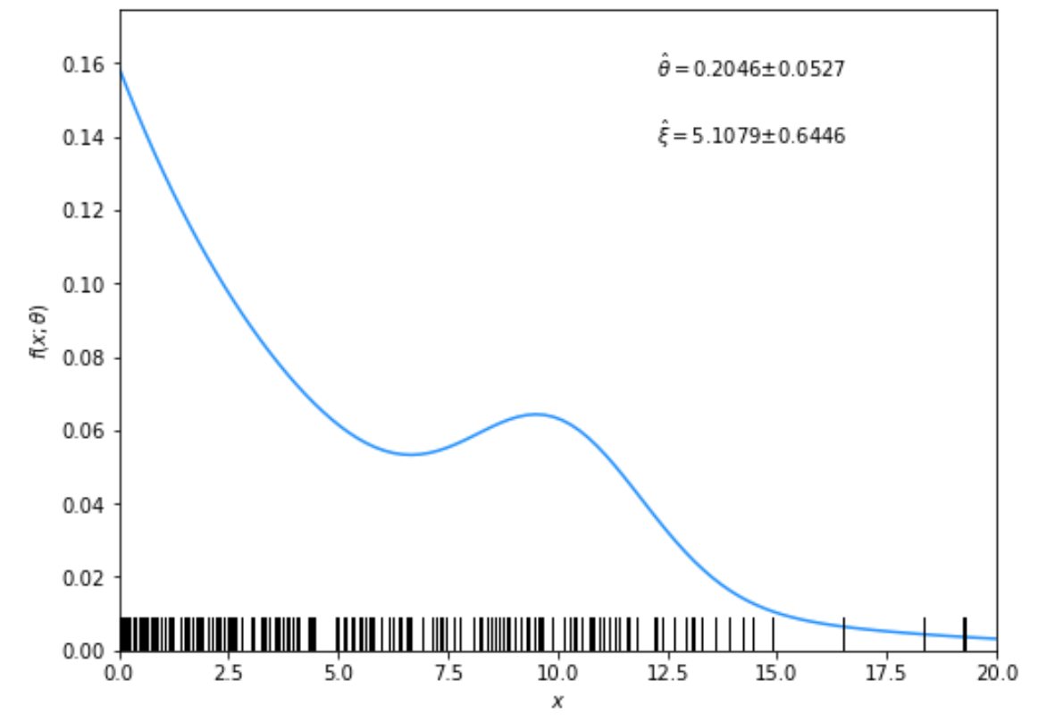
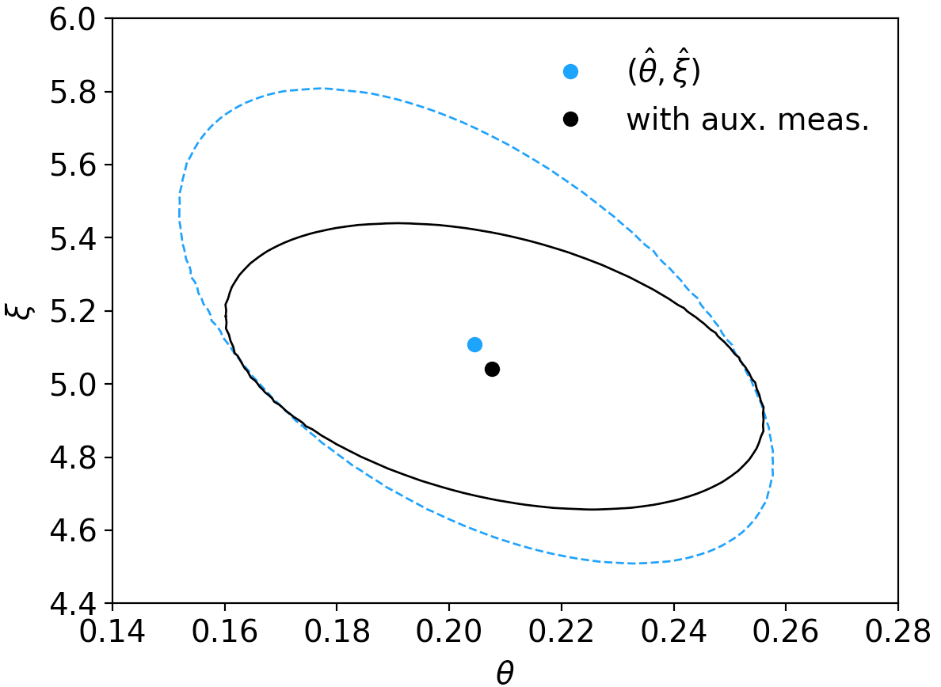
Example: mlFit.py
→ i.i.d. sample, n = 200
Fit results, confidence regions,... (see https://www.pp.rhul.ac.uk/~cowan/stat/exercises/cowan_stat_exercises.pdf and links therein)

Slide 12
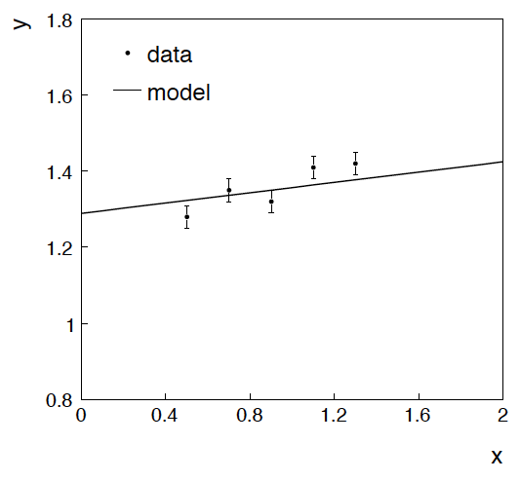
Example: fitting a straight line
Data:
Model: y_{i} independent and all follow y_{i} ~ Gauss(μ(x_{i} ), σ_{i} )
assume x_{i} and σ_{i} known.
Goal: estimate θ₀
Here suppose we don’t care
about θ₁ (example of a
“nuisance parameter”)

Slide 13
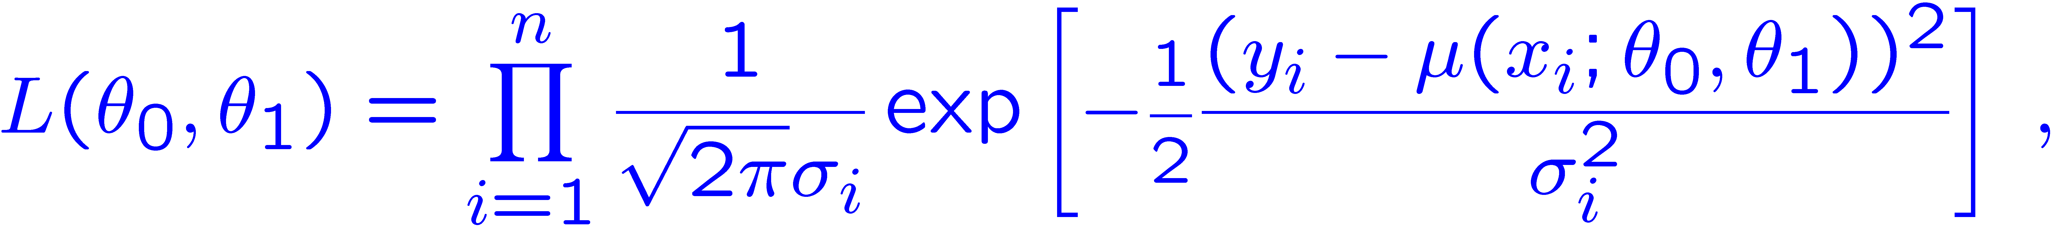
Maximum likelihood fit with Gaussian data
In this example, the y_{i} are assumed independent, so the
likelihood function is a product of Gaussians:
Maximizing the likelihood is here equivalent to minimizing
i.e., for Gaussian data, ML same as Method of Least Squares (LS)

Slide 14
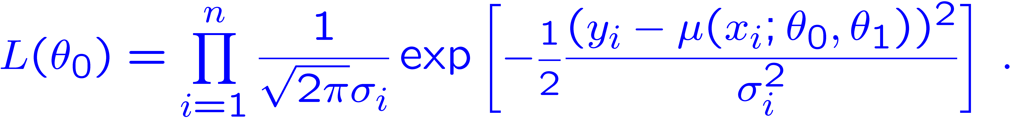
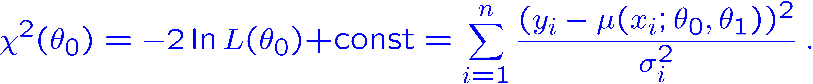
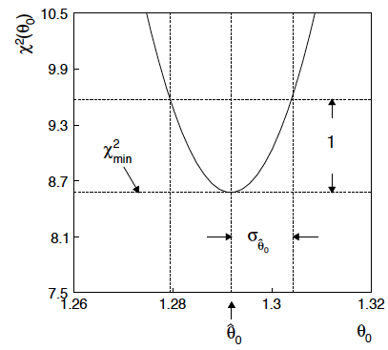
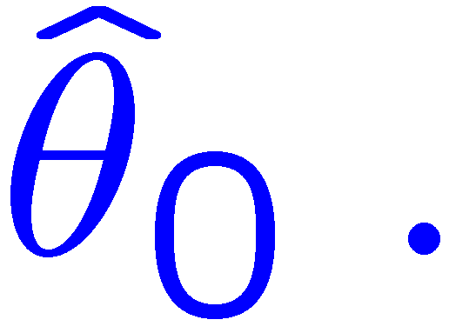
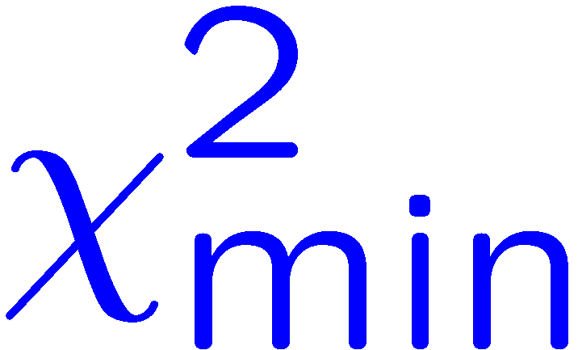
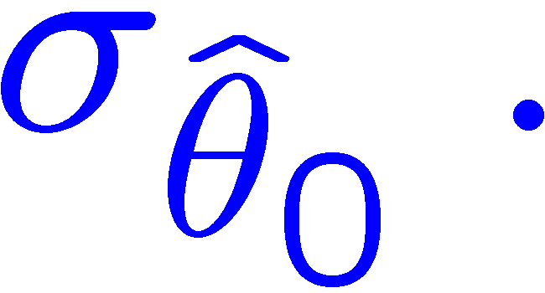
θ₁ known a priori
For Gaussian y_{i}, ML same as LS
Minimize χ² → estimator
Come up one unit from
to find

Slide 15
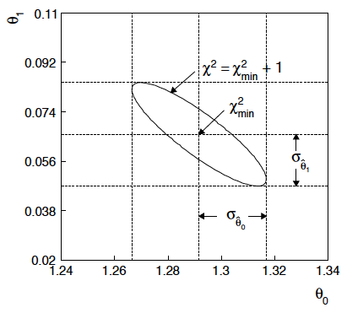
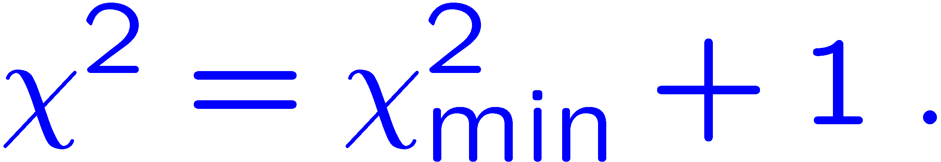
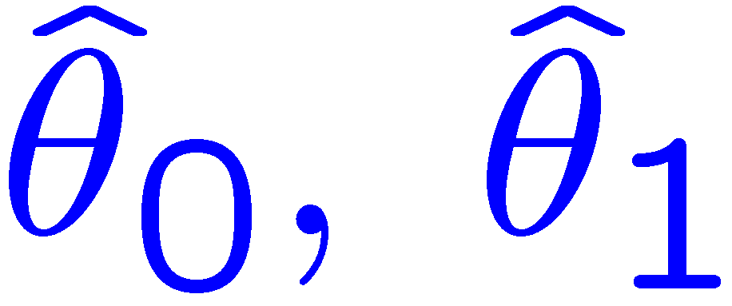
ML (or LS) fit of θ₀ and θ₁
Standard deviations from
tangent lines to contour
Correlation between
causes errors
to increase.

Slide 16


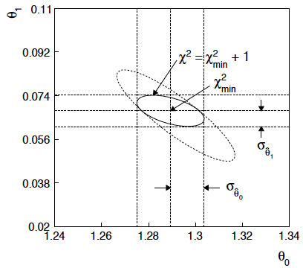
If we have a measurement t₁ ~ Gauss (θ₁, σ_{t1})
The information on θ₁
improves accuracy of

Slide 17
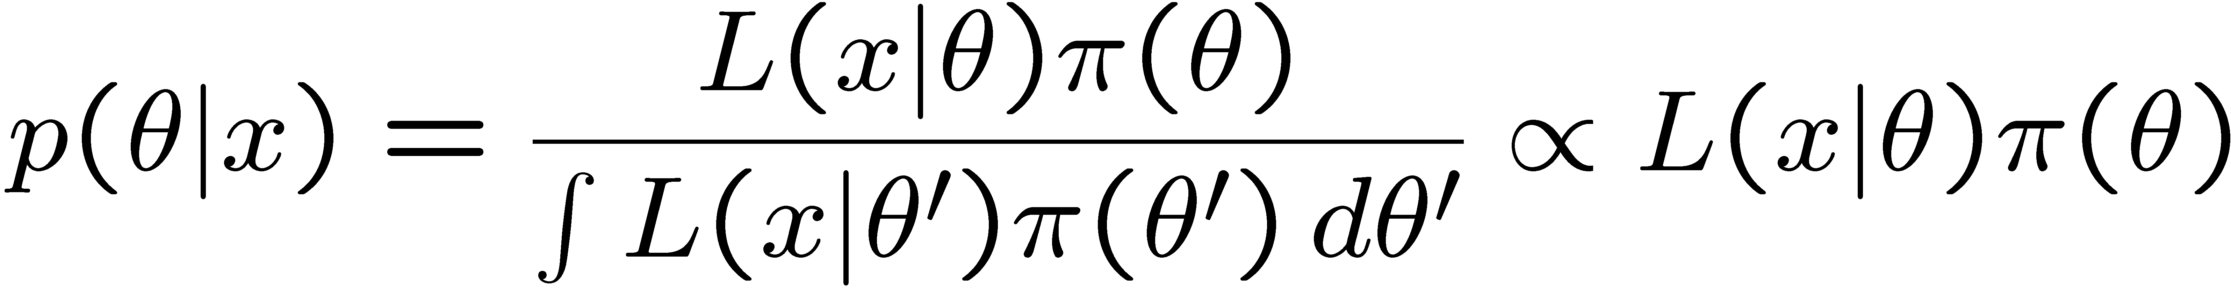
Reminder of Bayesian approach
In Bayesian statistics we can associate a probability with
a hypothesis, e.g., a parameter value θ.
Interpret probability of θ as ‘degree of belief’ (subjective).
Need to start with ‘prior pdf’ π(θ), this reflects degree
of belief about θ before doing the experiment.
Our experiment has data x, → likelihood L(x|θ).
Bayes’ theorem tells how our beliefs should be updated in
light of the data x:
Posterior pdf p(θ|x) contains all our knowledge about θ.

Slide 18
Bayesian approach: y_{i} ~ Gauss(μ(x_{i}; θ₀, θ₁), σ_{i})
We need to associate prior probabilities with θ₀ and θ₁, e.g.,
← suppose knowledge of θ₀ has no influence on knowledge of θ₁
← ‘non-informative’, in any
case much broader than L(θ₀)
prior after t₁,
before y
Ur = “primordial”
prior
Likelihood for control
measurement t₁

Slide 19
Bayesian example: y_{i} ~ Gauss(μ(x_{i}; θ₀, θ₁), σ_{i})
Putting the ingredients into Bayes’ theorem gives:
posterior ∝ likelihood ✕ prior
Note here the likelihood only reflects the measurements y.
The information from the control measurement t₁ has been put into the prior for θ₁.
We would get the same result using the likelihood P(y,t|θ₀,θ₁) and the constant “Ur-prior” for θ₁.

Slide 20
Marginalizing the posterior pdf
We then integrate (marginalize) p(θ₀, θ₁ | y) to find p(θ₀ | y):
In this example we can do the integral (rare). We find
(same as for MLE)
For this example, numbers come out same as in frequentist approach, but interpretation different.

Slide 21
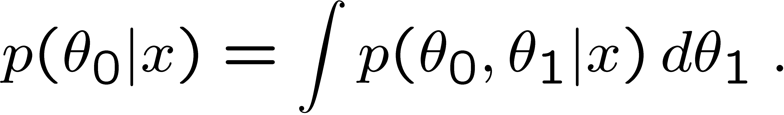
Marginalization with MCMC
Bayesian computations involve integrals like
often high dimensionality and impossible in closed form,
also impossible with ‘normal’ acceptance-rejection Monte Carlo.
Markov Chain Monte Carlo (MCMC) has revolutionized
Bayesian computation.
MCMC (e.g., Metropolis-Hastings algorithm) generates
correlated sequence of random numbers:
cannot use for many applications, e.g., detector MC;
effective stat. error greater than if all values independent .
Basic idea: sample multidimensional θ but look only at distribution of parameters of interest.

Slide 22
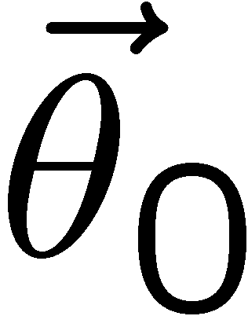
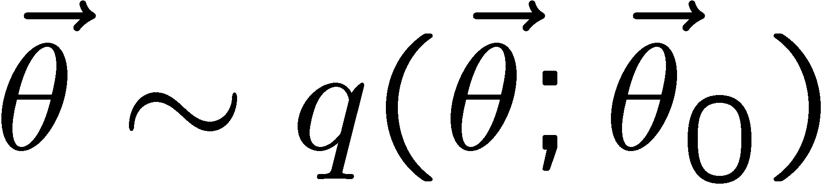
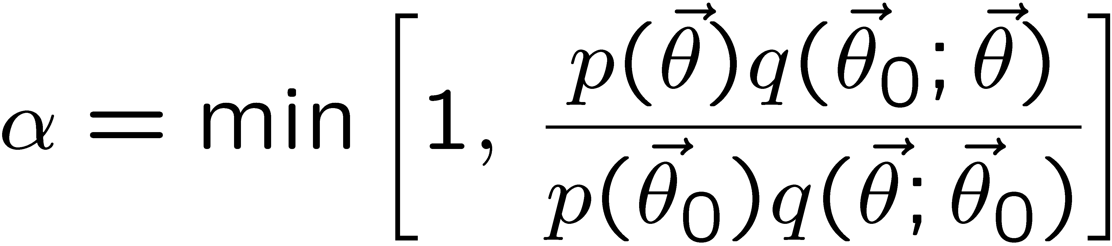
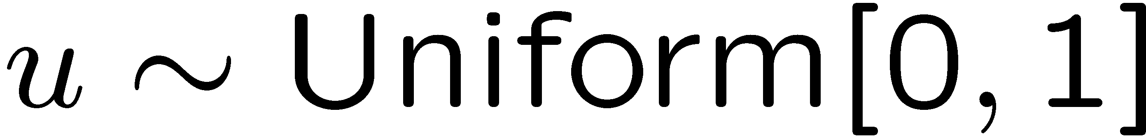
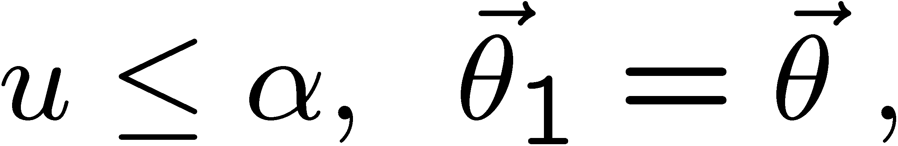
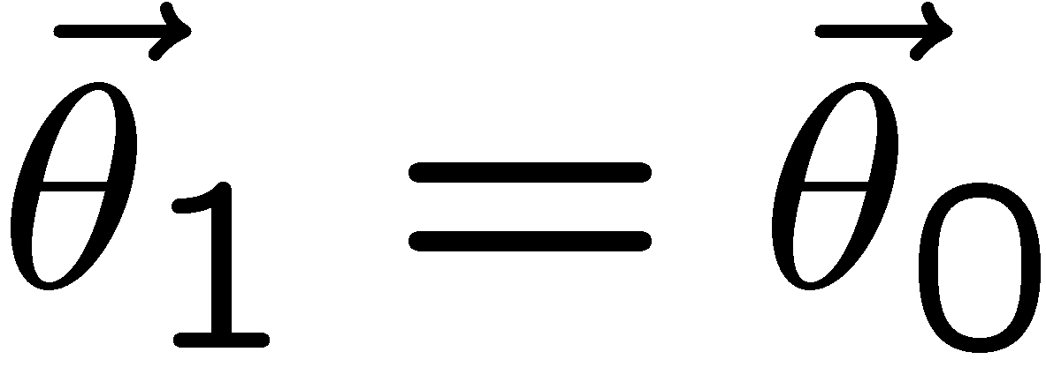
MCMC basics: Metropolis-Hastings algorithm
Goal: given an n-dimensional pdf p(θ) up to a proportionality constant, generate a sequence of points θ₁ , θ₂ , θ₃ ,...
Proposal density q(θ; θ₀ )
e.g. Gaussian centred
about θ₀
1) Start at some point
2) Generate
3) Form test ratio
4) Generate
5) If
move to proposed point
else
old point repeated
6) Iterate

Slide 23
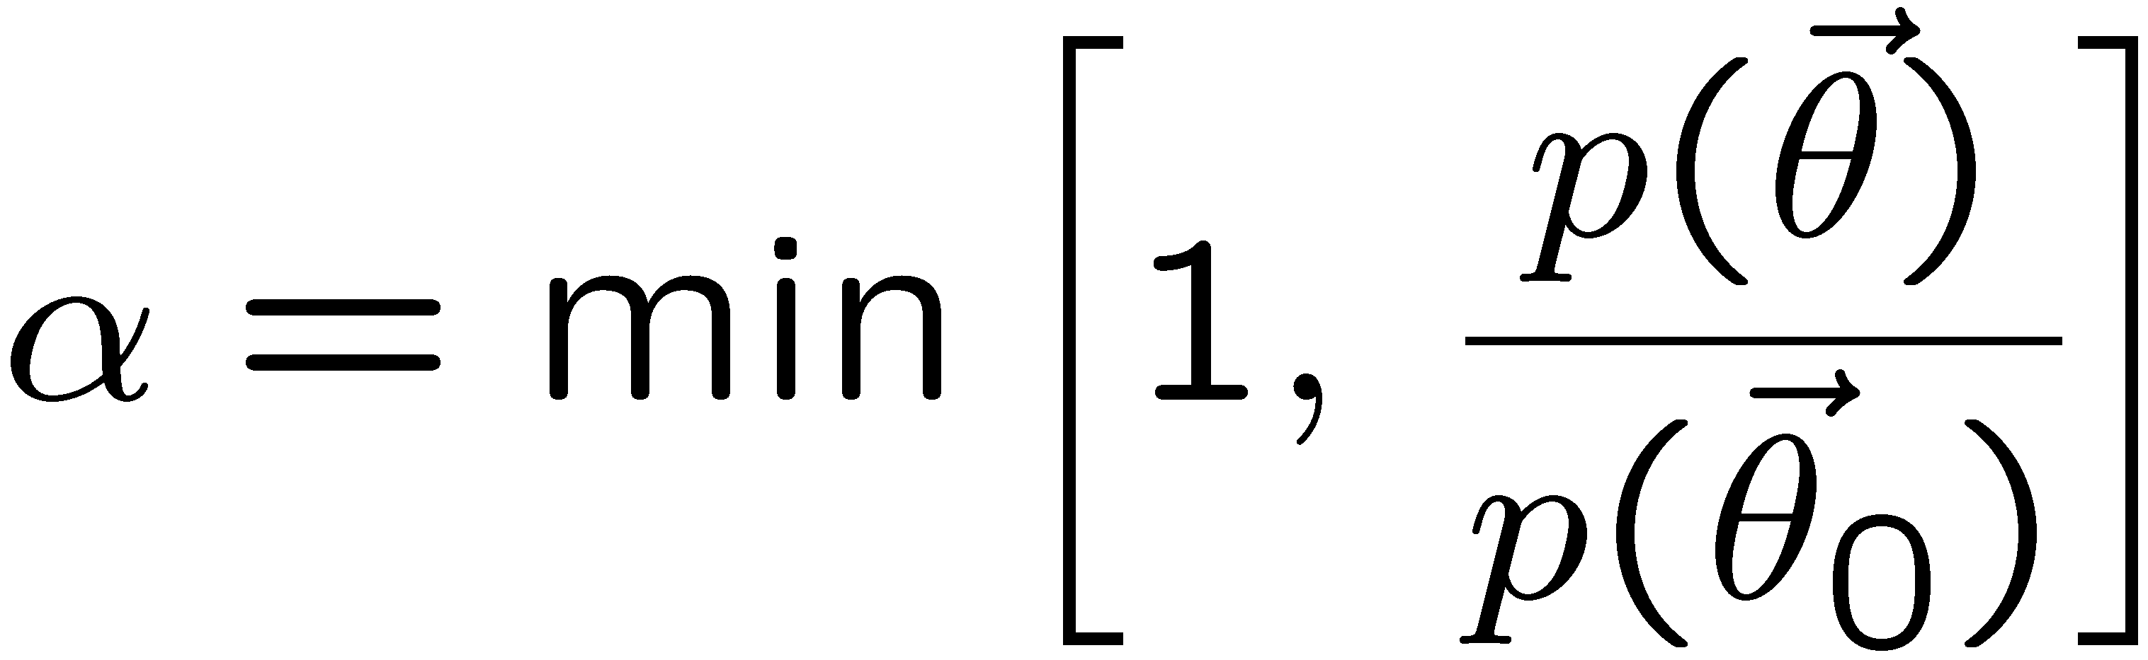
Metropolis-Hastings (continued)
This rule produces a correlated sequence of points (note how
each new point depends on the previous one).
Still works if p(θ) is known only as a proportionality, which is
usually what we have from Bayes’ theorem: p(θ|x) ∝ p(x|θ) π(θ).
The proposal density can be (almost) anything, but choose
so as to minimize autocorrelation. Often take proposal
density symmetric: q(θ; θ₀ ) = q(θ₀; θ )
Test ratio is (Metropolis-Hastings):
I.e. if the proposed step is to a point of higher p(θ), take it;
if not, only take the step with probability p(θ)/p(θ₀).
If proposed step rejected, repeat the current point.

Slide 24

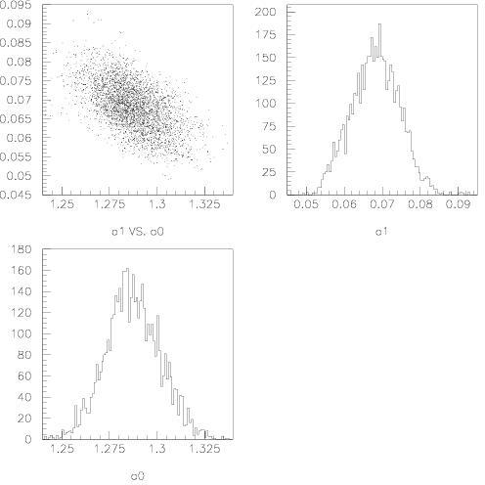
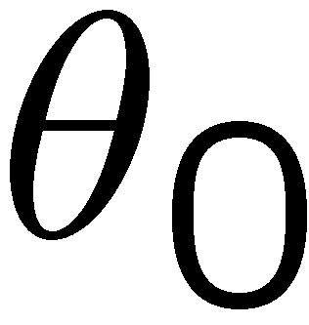
Example: posterior pdf from MCMC
Sample the posterior pdf from previous example with MCMC:
Normalized histogram of θ₀ gives its marginal posterior pdf:

Slide 25
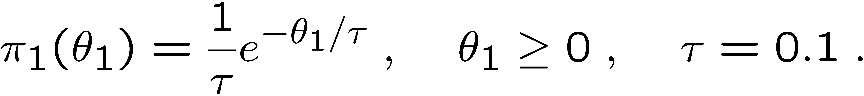
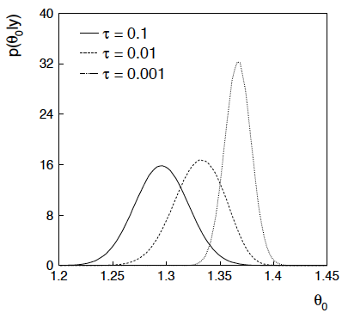
Bayesian method with alternative priors
Suppose we don’t have a previous measurement of θ₁ but rather,
an “expert” says it should be positive and not too much greater than 0.1 or so, i.e., something like
From this we obtain (numerically) the posterior pdf for θ₀:
This summarizes all
knowledge about θ₀.
Look also at result from
variety of priors.

Slide 26
Finally
Four lectures only enough for a brief introduction to:
Probability, frequentist & Bayesian approaches
Parameter estimation, maximum likelihood
Hypothesis tests, p-values, limits
Fitting with systematic uncertainties, frequentist vs. Bayesian
Many other important areas:
Statistics of Machine Learning,...
Profile likelihood ratio tests, asymptotics,...
Please take a look at the exercises in the extra slides and
https://www.pp.rhul.ac.uk/~cowan/stat/exercises/cowan_stat_exercises.pdf
that contain simple python programs for least squares, hypothesis tests, maximum likelihood and Bayesian fitting – enjoy!

Slide 27
Extra slides

Slide 28
Examples of maximum likelihood and confidence regions
The materials for this tutorial can be found on
https://www.pp.rhul.ac.uk/~cowan/stat/exercises/fitting/
The exercise and are described in the file ml_fit_exericise.pdf.
The exercises for parameter estimation are done with the program mlFit.py (or with jupyter mlFit.ipynb).
The exercise does an unbinned maximum-likelihood fit and analysis of the uncertainties.
In addition there is a program histFit.py that does the same analysis but with histogram data (look at this later).
These need the iminuit package (usually “pip install iminuit”)

Slide 29
Gaussian signal on exponential background
Consider a pdf for continuous random variable x, (truncate and renormalize in 0 ≤ x ≤ x_{max})
θ = parameter of interest ,
gives signal rate.
Depending on context, take ξ, μ, σ as nuisance parameters or fixed.
Generate i.i.d. sample x₁,..., x_{n}.
Estimate θ (and other params.)

Slide 30
A quick look at mlFit.py
# Example of maximum-likelihood fit with iminuit version 2.
# pdf is a mixture of Gaussian (signal) and exponential (background),
# truncated in [xMin,xMax].
# G. Cowan / RHUL Physics / December 2022
import numpy as np
import scipy.stats as stats
from scipy.stats import truncexpon
from scipy.stats import truncnorm
from scipy.stats import chi2
import iminuit
from iminuit import Minuit
import matplotlib.pyplot as plt
from matplotlib import container
plt.rcParams["font.size"] = 14
print("iminuit version:", iminuit.__version__) # need 2.x
# define pdf and generate data
np.random.seed(seed=1234567) # fix random seed
theta = 0.2 # fraction of signal
mu = 10. # mean of Gaussian
sigma = 2. # std. dev. of Gaussian
xi = 5. # mean of exponential
xMin = 0.
xMax = 20.

Slide 31
Define the fit function
def f(x, par):
theta = par[0]
mu = par[1]
sigma = par[2]
xi = par[3]
fs = stats.truncnorm.pdf(x, a=(xMin-mu)/sigma, b=(xMax-mu)/sigma, loc=mu, scale=sigma)
fb = stats.truncexpon.pdf(x, b=(xMax-xMin)/xi, loc=xMin, scale=xi)
return theta*fs + (1-theta)*fb
Generate the data
numVal = 200
xData = np.empty([numVal])
for i in range (numVal):
r = np.random.uniform();
if r < theta:
xData[i] = stats.truncnorm.rvs(a=(xMin-mu)/sigma, b=(xMax-mu)/sigma,
loc=mu, scale=sigma)
else:
xData[i] = stats.truncexpon.rvs(b=(xMax-xMin)/xi, loc=xMin, scale=xi)

Slide 32
Set up the fit
# Function to be minimized is negative log-likelihood
def negLogL(par):
pdf = f(xData, par)
return -np.sum(np.log(pdf))
# Initialize Minuit and set up fit:
parin = np.array([theta, mu, sigma, xi]) # initial values (here = true values)
parname = ['theta', 'mu', 'sigma', 'xi']
parname_latex = [r'$\theta$', r'$\mu$', r'$\sigma$', r'$\xi$']
parstep = np.array([0.1, 1., 1., 1.]) # initial setp sizes
parfix = [False, True, True, False] # change these to fix/free params
parlim = [(0.,1), (None, None), (0., None), (0., None)] # set limits
m = Minuit(negLogL, parin, name=parname)
m.errors = parstep
m.fixed = parfix
m.limits = parlim
m.errordef = 0.5 # errors from lnL = lnLmax - 0.5

Slide 33
Do the fit, get errors, extract results
# Do the fit, get errors, extract results
m.migrad() # minimize -logL
MLE = m.values # max-likelihood estimates
sigmaMLE = m.errors # standard deviations
cov = m.covariance # covariance matrix
rho = m.covariance.correlation() # correlation coeffs.
print(r"par index, name, estimate, standard deviation:")
for i in range(m.npar):
if not m.fixed[i]:
print("{:4d}".format(i), "{:<10s}".format(m.parameters[i]), " = ",
"{:.6f}".format(MLE[i]), " +/- ", "{:.6f}".format(sigmaMLE[i]))
print()
print(r"free par indices, covariance, correlation coeff.:")
for i in range(m.npar):
if not(m.fixed[i]):
for j in range(m.npar):
if not(m.fixed[j]):
print(i, j, "{:.6f}".format(cov[i,j]), "{:.6f}".format(rho[i,j]))
Make some plots...

Slide 34
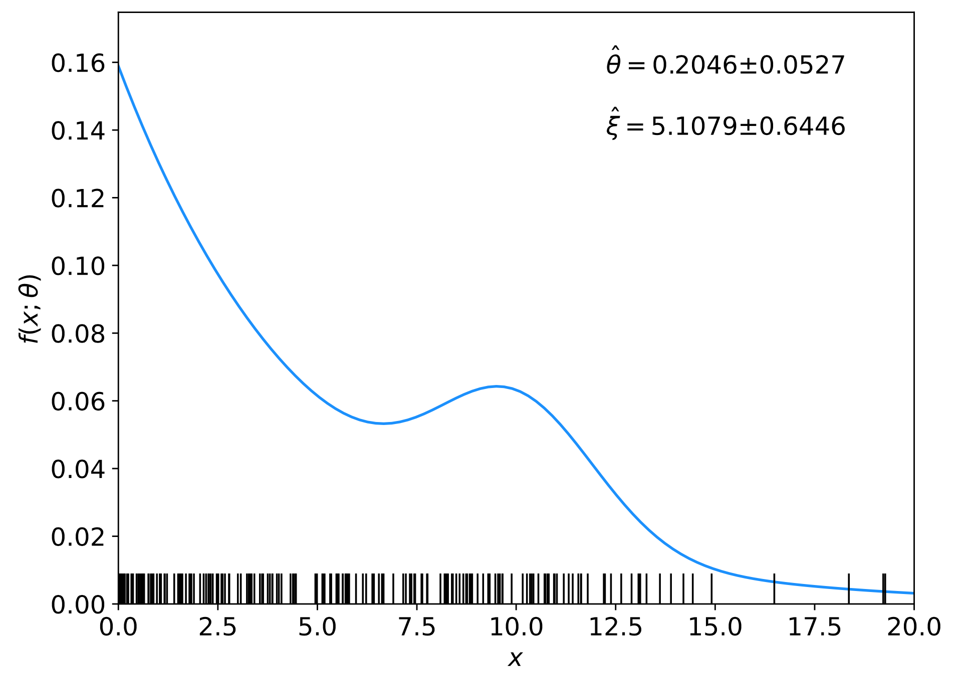
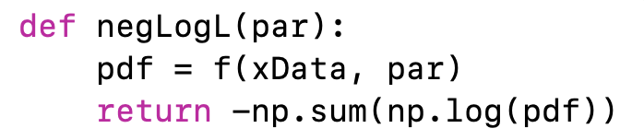
Comments on using iminuit
In our earlier iminuit example mlFit.py, the only argument of the log-likelihood function was the parameter array, and the data array xData entered as global (usually not a good idea):
⠇

Slide 35
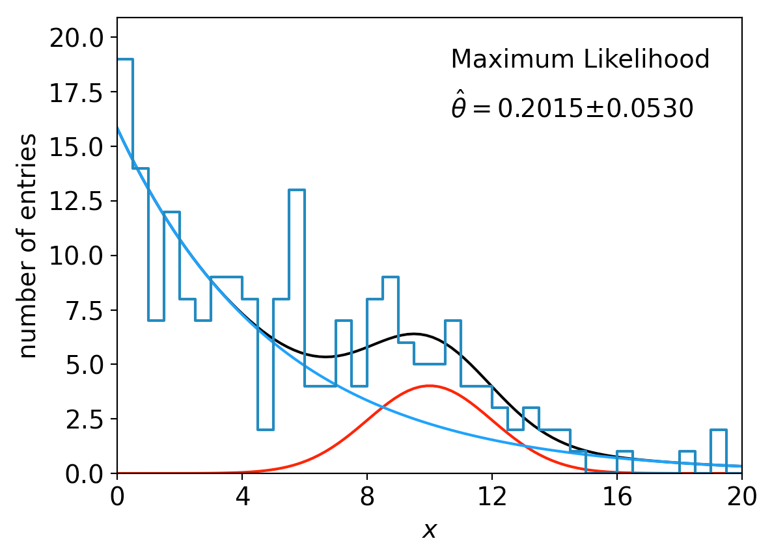
lnL in a class, binned data,...
Sometimes it is convenient to have the function being minimized as a method of a class. An example of this is shown in the program histFit.py, which does the same fit as in mlFit.py but with a histogram of the data:

Slide 36
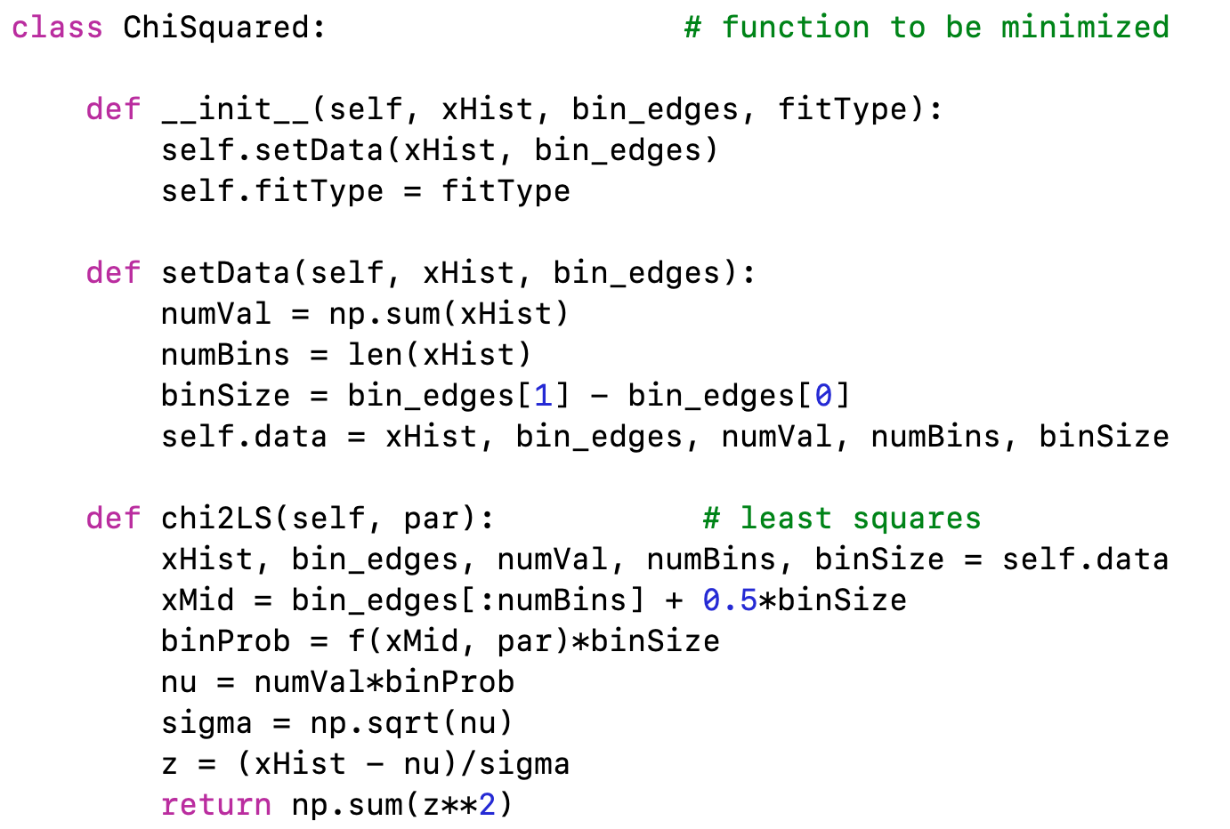
A look at histFit.py
The global data can be avoided if we make the objective function a method of a class:

Slide 37
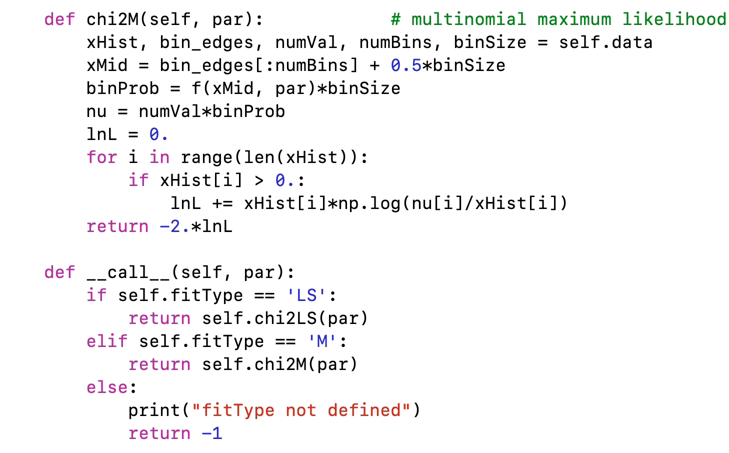
class ChiSquared (continued)

Slide 38
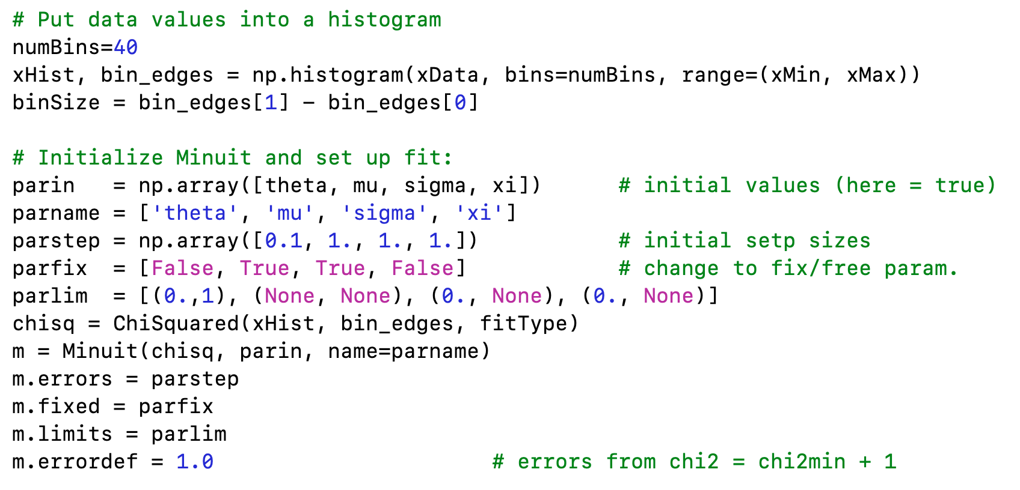
Using the ChiSquared class

Slide 39
Example of Bayesian parameter estimation
The exercise is described
https://www.pp.rhul.ac.uk/~cowan/stat/exercises/bayesFit/
in the file bayes_fit_exercise.pdf.
The program is in bayesFit.py or bayesFit.ipynb.
This exercise treats the same fitting problem as seen with maximum likelihood, here using the Bayesian approach.
Bayes’ theorem is used to find the posterior pdf for the parameters, and these are summarized using the posterior mode (MAP estimators).
The posterior pdf is marginalized over the nuisance parameters using Markov Chain Monte Carlo.

Slide 40
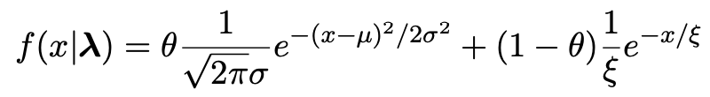
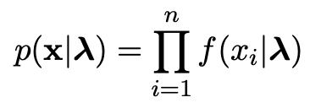

Gaussian signal on exponential background
Same pdf as from mlFit.py (see tutorial 1) with n = 400 independent values of x from
Posterior pdf for parameters λ = (θ, μ, σ, ξ) from Bayes theorem,
where
At first take prior pdf constant for all parameters subject to 0 ≤ θ ≤ 1, σ > 0, ξ > 0 (later try different priors).

Slide 41
Data and MAP estimates
Maximize posterior with minuit (minimize – ln p(λ|x)).
Standard deviations from minuit correspond to approximating posterior as Gaussian near its peak.
Here priors constant so
MAP estimates same as MLE, covariance matrix
V_{ij} = cov[θ_{i}, θ_{j}] also same.

Slide 42
A look at bayesFit.py
Find maximum of posterior with iminuit (minimize – ln p(λ|x)), similar to maximum likelihood:
# Negative log-likelihood
def negLogL(par):
fx = f(xData, par)
return -np.sum(np.log(fx))
# Prior pdf
def prior(par):
theta = par[0]
mu = par[1]
sigma = par[2]
xi = par[3]
pi_theta = 1. if theta >= 0. and theta <= 1. else 0.
pi_mu = 1. if mu >= 0. else 0.
pi_sigma = 1. if sigma > 0. else 0.
pi_xi = 1. if xi > 0. else 0.
piArr = np.array([pi_theta, pi_mu, pi_sigma, pi_xi])
pi = np.product(piArr[np.array(parfix) == False]) # exclude fixed par
return pi
# Negative log of posterior pdf
def negLogPost(par):
return negLogL(par) - np.log(prior(par))
minimize with iminuit

Slide 43
Metropolis-Hastings algorithm in bayesFit.py
# Iterate with Metropolis-Hastings algorithm
chain = [np.array(MAP)] # start point is MAP estimate
numIterate = 10000
numBurn = 100
numAccept = 0
print("Start MCMC iterations: ", end="")
while len(chain) < numIterate:
par = chain[-1]
log_post = -negLogL(par) + np.log(prior(par))
par_prop = np.random.multivariate_normal(par, cov_prop)
if prior(par_prop) <= 0:
chain.append(chain[-1]) # never accept if prob<=0.
else:
log_post_prop = -negLogL(par_prop) + np.log(prior(par_prop))
alpha = np.exp(log_post_prop - log_post)
u = np.random.uniform(0, 1)
if u <= alpha:
chain.append(par_prop)
numAccept += 1
else:
chain.append(chain[-1])
if len(chain)%(numIterate/100) == 0:
print(".", end="", flush=True)
chain = np.array(chain)
Try increasing number of iterations (10k runs in about 20 s).

Slide 44
MCMC trace plots
Take θ as parameter of interest, rest are nuisance parameters.
Marginalize by sampling posterior pdf with Metropolis-Hastings.
Gaussian proposal pdf, covariance U = sV,
s = (2.38)²/N_{par} = 1.41, gives acceptance
probability ~ 0.24.
Here 10 000 iterations (should use more).

Slide 45

Marginal distributions
MAP estimates shown with vertical bars
Note long tails.
Interpretation: data distribution can be approximated by Gaussian term only, (θ large, μ small) with large width (σ ~ 4-8) and a narrow exponential (ξ ~ 1-3).

Slide 46
Correlation plots and marginal distributions
Estimates/intervals for theta:
MCMC acceptance fraction = 0.3737
Posterior mode (MAP estimate) = 0.197936
Posterior mean = 0.351234
Posterior median = 0.250764
MAP +/- sigmaMAP (from minuit) = [0.140056, 0.255816]
Posterior mean +/- sigmaMCMC = [0.118503, 0.583964]
68.3% central credible interval = [0.158557, 0.685847]
68.3% HPD interval = [0.093997, 0.392642]

Slide 47
Correlation plots and marginal distributions using auxiliary measurement for ξ
Estimates/intervals for theta:
MCMC acceptance fraction = 0.3516
Posterior mode (MAP estimate) = 0.200077
Posterior mean = 0.224898
Posterior median = 0.212835
MAP +/- sigmaMAP (from minuit) = [0.149282, 0.250873]
Posterior mean +/- sigmaMCMC = [0.148481, 0.301314]
68.3% central credible interval = [0.156736, 0.291246]
68.3% HPD interval = [0.137607, 0.267077]

