Slide 1


CLs, Power-Constrained Limits, etc.
Hands-on PhD School on Astroparticle Physics
Gran Sasso, Italy
11 September 2025
https://agenda.infn.it/event/44808/
Glen Cowan
Physics Department
Royal Holloway, University of London
g.cowan@rhul.ac.uk
www.pp.rhul.ac.uk/~cowan

Slide 2
Outline
Confidence intervals from inversion of a test (review)
The problem of spurious exclusion and previous solutions (CLs)
Power Constrained Limits (PCL) (see CCGV arXiv:1105.3166)
PCL for upper limit based on a Gaussian measurement
Distribution of upper limit and choice of minimum power
Treatment of nuisance parameters
Issues concerning negatively biased relevant subsets
Summary and conclusions

Slide 3

Reminder about statistical tests
Consider test of a parameter μ, e.g., proportional to cross section.
Result of measurement is a set of numbers x.
To define test of μ, specify critical region w_{μ}, such that probability
to find x ∈ w_{μ} is not greater than α (the size or significance level):
(Must use inequality since x may be discrete, so there may not
exist a subset of the data space with probability of exactly α.)
Often use, e.g., α = 0.05.
If observe x ∈ w_{μ}, reject μ.

Slide 4

Test statistics and p-values
Often construct a test statistic, q_{μ}, which reflects the level
of agreement between the data and the hypothesized value μ.
For examples of statistics based on profile likelihood ratio, see e.g.,
CCGV EPJC 71 (2011) 1554, arXiv:1007.1727 (the “Asimov” paper).
Usually define q_{μ} such that higher values represent increasing
incompatibility with the data, so that the p-value of μ is:
observed value of q_{μ}
pdf of q_{μ} assuming μ
Equivalent formulation of test: reject μ if p_{μ} < α.

Slide 5
Confidence interval from inversion of a test
Carry out a test of size α for all values of μ.
The values that are not rejected constitute a confidence interval
for μ at confidence level CL = 1 – α.
The confidence interval will by construction contain the
true value of μ with probability of at least 1 – α.
Can give upper limit μ_{up}, i.e., the largest value of μ
not rejected, i.e., the upper edge of the confidence interval.
The interval (and limit) depend on the choice of the test, which is
often based on considerations of power.

Slide 6


Power of a statistical test
But where to define critical region? Usually put this where the
test has a high power with respect to an alternative hypothesis μ′.
The power M of the test of μ with respect to the alternative μ′ is
the probability to reject μ if μ′ is true:
E.g., for an upper limit, maximize the power with respect to
the alternative consisting of μ′ < μ.
Other types of tests not based directly on power (e.g., likelihood
ratio).

Slide 7
Choice of test for limits
Often we want to ask what values of μ can be excluded on
the grounds that the data are more compatible with a lower value of μ (the alternative).
The critical region to test μ thus contains low values of the data.
→ One-sided (e.g., upper) limit.
In other cases we want to exclude μ on the grounds that some other measure of incompatibility between it and the data exceeds some threshold (e.g., likelihood ratio wrt two-sided alternative).
The critical region can contain both high and low data values.
→ Two-sided or unified (Feldman-Cousins) intervals.

Slide 8
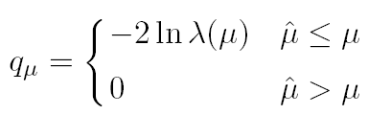
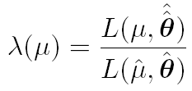



Test statistic for upper limits
For purposes of setting an upper limit on μ use
where
I.e. for purposes of setting an upper limit, one does not regard
an upwards fluctuation of the data as representing incompatibility
with the hypothesized μ.
From observed q_{μ} find p-value:
Large sample approximation:
95% CL upper limit on μ is highest value for which p-value is
not less than 0.05.

Slide 9
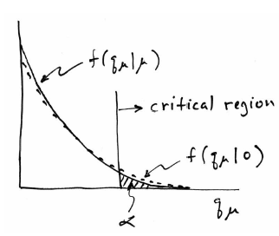
Low sensitivity to μ
It can be that the effect of a given hypothesized μ is very small
relative to the background-only (μ = 0) prediction.
This means that the distributions f (q_{μ}|μ) and f (q_{μ}|0) will be
almost the same:

Slide 10
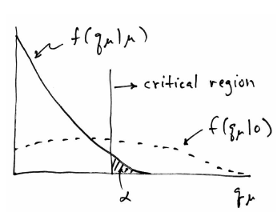
Having sufficient sensitivity
In contrast, having sensitivity to μ means that the distributions
f (q_{μ}|μ) and f (q_{μ}|0) are more separated:
That is, the power (probability to reject μ if μ = 0) is substantially
higher than α. We use this power as a measure of the sensitivity.

Slide 11
Spurious exclusion
Consider again the case of low sensitivity. By construction the probability to reject μ if μ is true is α (e.g., 5%).
And the probability to reject μ if μ = 0 (the power) is only slightly greater than α.
This means that with probability of around α = 5% (slightly higher), one excludes hypotheses to which one has essentially no sensitivity (e.g., m_{H} = 1000 TeV).
“Spurious exclusion”

Slide 12
Some ways of addressing spurious exclusion
The problem of excluding parameter values to which one has
no sensitivity known for a long time; see e.g.,
In the 1990s this was re-examined for the LEP Higgs search by
Alex Read and others
and led to the “CL_{s}” procedure for upper limits.
Unified intervals (F-C) also effectively reduce spurious exclusion by
the particular choice of critical region.

Slide 13
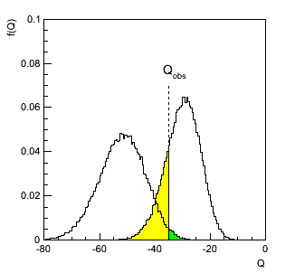
The CL_{s} procedure
In the usual formulation of CL_{s}, one tests both the μ = 0 (b) and
μ = 1 (s+b) hypotheses with the same statistic Q = −2ln L_{s+b}/L_{b}:
f (Q|b)
f (Q| s+b)
p_{s+b}
p_{b}

Slide 14
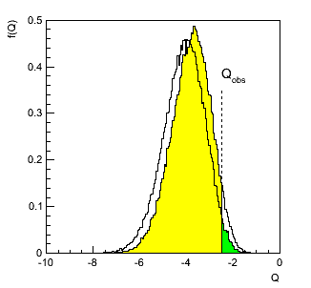
The CL_{s} procedure (2)
As before, “low sensitivity” means the distributions of Q under
b and s+b are very close:
f (Q|b)
f (Q|s+b)
p_{b}
p_{s+b}

Slide 15
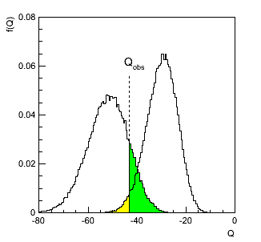



The CL_{s} procedure (3)
The CL_{s} solution (A. Read et al.) is to base the test not on
the usual p-value (CL_{s+b}), but rather to divide this by CL_{b}
(one minus the p-value of the b-only hypothesis, i.e.,
Define:
f (q|s+b)
f (q|b)
1-CL_{b}
= p_{b}
CL_{s+b}
= p_{s+b}
Reject s+b
hypothesis if:
Reduces “effective” p-value when the two
distributions become close (prevents
exclusion if sensitivity is low).

Slide 16
Feldman-Cousins unified intervals
The initial motivation for Feldman-Cousins (unified) confidence
intervals was to eliminate null intervals.
The F-C limits are based on a likelihood ratio for a test of μ
with respect to the alternative consisting of all other allowed values of μ (not just, say, lower values).
The interval’s upper edge is higher than the limit from the one-sided test, and lower values of μ may be excluded as well. A substantial downward fluctuation in the data gives a low (but nonzero) limit.
This means that when a value of μ is excluded, it is because
there is a probability α for the data to fluctuate either high or low
in a manner corresponding to less compatibility as measured by
the likelihood ratio.

Slide 17


Power Constrained Limits (PCL)
CL_{s} has been criticized because the coverage probability of the
upper limit is greater than the nominal CL = 1 - α by an amount
that is not readily apparent (but can be computed).
Therefore we have proposed an alternative method for protecting
against exclusion with little/no sensitivity, by regarding a value of
μ to be excluded if:
Here the measure of sensitivity is the power of the test of μ
with respect to the alternative μ = 0:

Slide 18


Constructing PCL
First compute the distribution under assumption of the
background-only (μ = 0) hypothesis of the “usual” upper limit μ_{up}
with no power constraint.
The power of a test of μ with respect to μ = 0 is the fraction of
times that μ is excluded (μ_{up} < μ):
Find the smallest value of μ (μ_{min}), such that the power is at
least equal to the threshold M_{min}.
The Power-Constrained Limit is:

Slide 19


PCL for upper limit with Gaussian measurement
Suppose ~ Gauss(μ, σ), goal is to set upper limit on μ.
Define critical region for test of μ as
inverse of standard Gaussian cumulative distribution
This gives (unconstrained) upper limit:

Slide 20


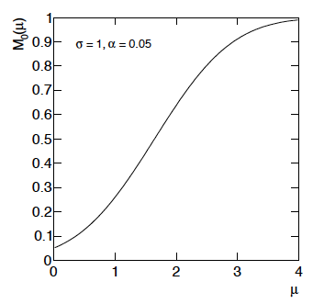
Power M₀(μ) for Gaussian measurement
The power of the test of μ with respect to the alternative μ′ = 0 is:
standard Gaussian
cumulative distribution

Slide 21



^
Spurious exclusion when μ fluctuates down
Requiring the power be at least M_{min}
implies that the smallest μ to which one is sensitive is
If one were to use the unconstrained limit, values of μ at or
below μ_{min} would be excluded if
That is, one excludes μ < μ_{min} when the unconstrained limit
fluctuates too far downward.

Slide 22

Choice of minimum power
Choice of M_{min} is convention. Formally it should be large relative
to α (5%). Earlier we have proposed
because in Gaussian example this means that one applies the
power constraint if the observed limit fluctuates down by one
standard deviation.
In fact the distribution of μ_{up} is often roughly Gaussian, so we
call this a “1σ” (downward) fluctuation and use M_{min} = 0.16
regardless of the exact distribution of μ_{up}.
For the Gaussian example, this gives μ_{min} = 0.64σ, i.e., the lowest
limit is similar to the intrinsic resolution of the measurement (σ).

Slide 23
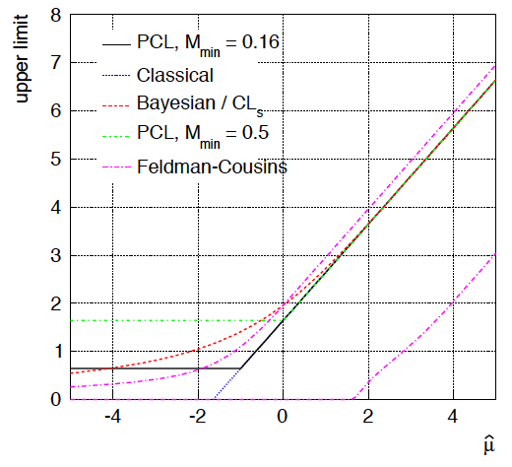
Upper limits for Gaussian problem

Slide 24
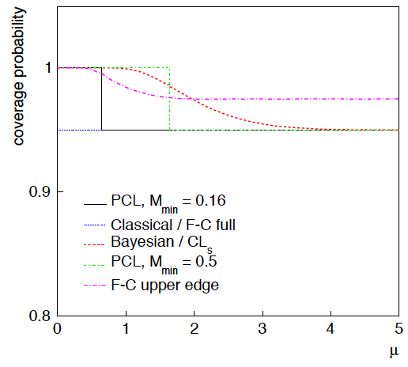
Coverage probability for Gaussian problem

Slide 25
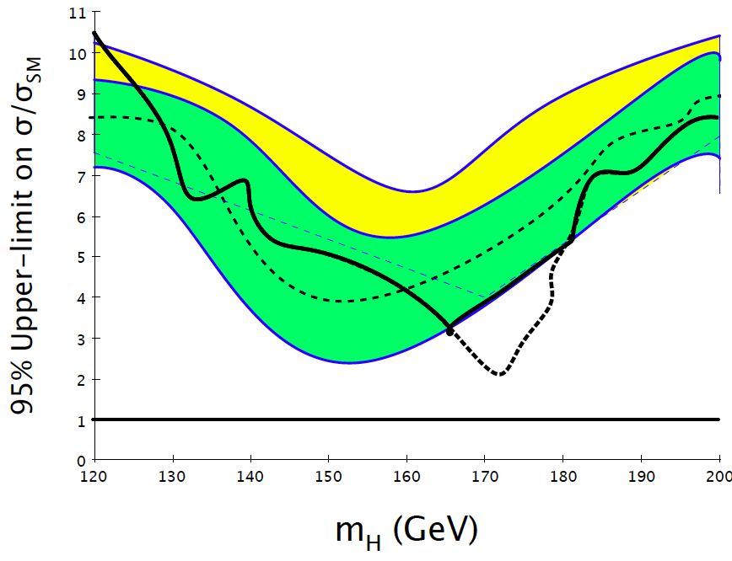
PCL as a function of, e.g., m_{H}
PCL
Here power below
threshold; do not
exclude.

Slide 26
Some reasons to consider increasing M_{min}
M_{min} is supposed to be “substantially” greater than α (5%).
So M_{min} = 16% is fine for 1 – α = 95%, but if we ever want
1 – α = 90%, then 16% is not “large” compared to 10%;
μ_{min} = 0.28σ starts to look small relative to the intrinsic resolution of the measurement. Not an issue if we stick to 95% CL.
PCL with M_{min} = 16% is often substantially lower than CLs.
This is because of the conservatism of CLs (see coverage).
But goal is not to get a lower limit per se, rather
to use a test with higher power in those regions where one feels there is enough sensitivity to justify exclusion and
to allow for easy communication of coverage (95% for μ ≥ μ_{min}; 100% otherwise).

Slide 27
Aggressive conservatism
It could be that owing to practical constraints, certain systematic
uncertainties are over-estimated in an analysis; this could
be justified by wanting to be conservative.
The consequence of this will be that the ±1 sigma bands of
the unconstrained limit are broader than they otherwise would be.
If the unconstrained limit fluctuates low, it could be that the
PCL limit, constrained at the -1sigma band, is lower than it
would be had the systematics been estimated correctly.
conservative = aggressive
If the power constraint M_{min} is at 50%, then by inflating the
systematics the median of the unconstrained limit is expected to
move less, and in any case upwards, i.e., it will lead to a less
strong limit (as one would expect from “conservatism”).

Slide 28
A few further considerations
Obtaining PCL requires the distribution of unconstrained limits,
from which one finds the M_{min} (16%, 50%) percentile.
In some analyses this can entail calculational issues that
are expected to be less problematic for M_{min} = 50% than for 16%.
Analysts produce anyway the median limit, even in absence of
the error bands, so with M_{min} = 50% the burden on the analyst is
reduced somewhat (but one would still want the error bands).
We therefore recently proposed moving M_{min} to 50%.

Slide 29
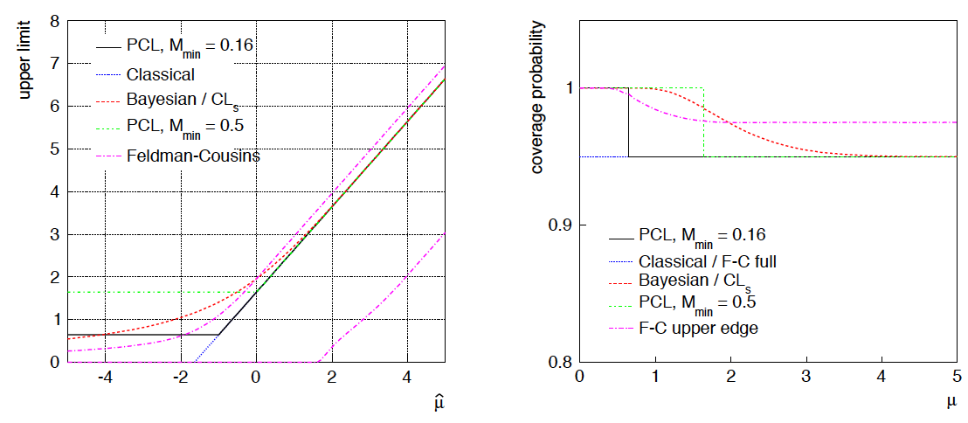
PCL with M_{min} = 0.16, 0.50 (and other limits)
With M_{min} = 50%, power constraint is applied half the time.
This is somewhat contrary to the original spirit of preventing a
“lucky” fluctuation from leading to a limit that is small compared
to the intrinsic resolution of the measurement.
But PCL still lower than CLs most of the time (e.g., x > -0.4).

Slide 30

Treatment of nuisance parameters
In most problems, the data distribution is not uniquely specified
by μ but contains nuisance parameters θ.
This makes it more difficult to construct an (unconstrained)
interval with correct coverage probability for all values of θ,
so sometimes approximate methods used (“profile construction”).
More importantly for PCL, the power M₀(μ) can depend on θ.
So which value of θ to use to define the power?
Since the power represents the probability to reject μ if the
true value is μ = 0, to find the distribution of μ_{up} we take the
values of θ that best agree with the data for μ = 0:
May seem counterintuitive, since the measure of sensitivity
now depends on the data. We are simply using the data to choose
the most appropriate value of θ where we quote the power.

Slide 31
Negatively Biased Relevant Subsets
Consider again x ~ Gauss(μ, σ) and use this to find limit for μ.
We can find the conditional probability for the limit to cover μ
given x in some restricted range, e.g., x < c for some constant c.
This conditional coverage probability may be greater or less than
1 – α for different values of μ (the value of which is unkown).
But suppose that the conditional coverage is less than 1 – α for
all values of μ. The region of x where this is true is a
Negatively Biased Relevant Subset.
Recent studies by Bob Cousins (CMS) and
Ofer Vitells (ATLAS) related to earlier publications,
especially, R. Buehler, Ann. Math. Sci., 30 (4) (1959) 845.

Slide 32
Betting Games
So what’s wrong if the limit procedure has NBRS?
Suppose you observe x, construct the confidence interval and assert
that an interval thus constructed covers the true value of the
parameter with probability 1 – α .
This means you should be willing to accept a bet at odds α : 1 – α
that the interval covers the true parameter value.
Suppose your opponent accepts the bet if x is in the NBRS, and
declines the bet otherwise. On average, you lose, regardless of
the true (and unknown) value of μ.
With the “naive” unconstrained limit, if your opponent only accepts
the bet when x < –1.64σ, (all values of μ excluded) you always lose!
(Recall the unconstrained limit based on the likelihood ratio never
excludes μ = 0, so if that value is true, you do not lose.)

Slide 33

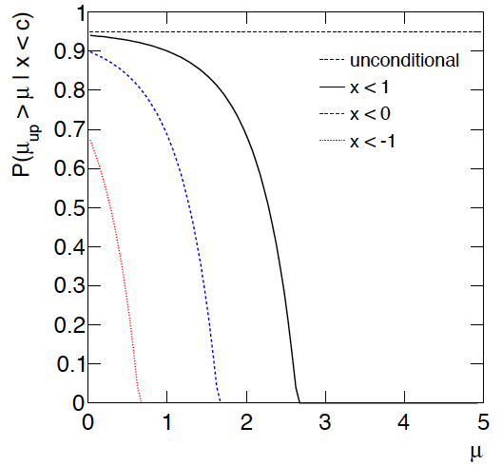
NBRS for unconstrained upper limit
For the unconstrained upper limit (i.e., CL_{s+b}) the conditional
probability for the limit to cover μ given x < c is:
Maximum wrt μ is less than 1-α → Negatively biased relevant subsets.
N.B. μ = 0 is never excluded for unconstrained limit based on likelihood-ratio test, so at that point coverage = 100%, hence no NBRS.
← 1 - α

Slide 34
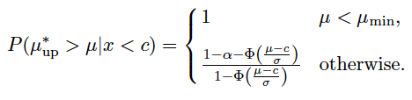
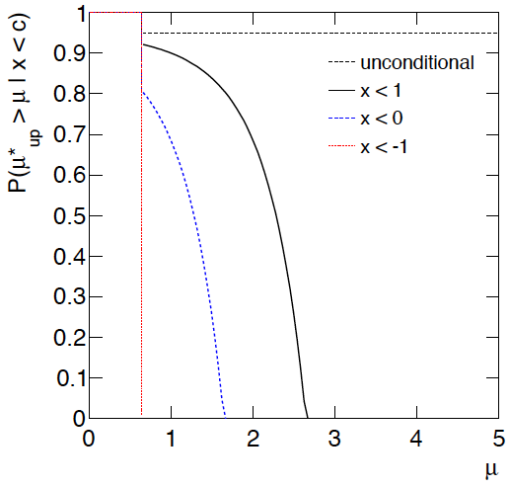
(Adapted) NBRS for PCL
For PCL, the conditional probability to cover μ given x < c is:
Coverage goes to 100% for μ <μ_{min}, therefore no NBRS.
Note one does not have max conditional coverage ≥ 1−α for all μ > μ_{min} (“adapted conditional coverage”). But if one conditions on μ, no limit would satisfy this.
← 1−α

Slide 35
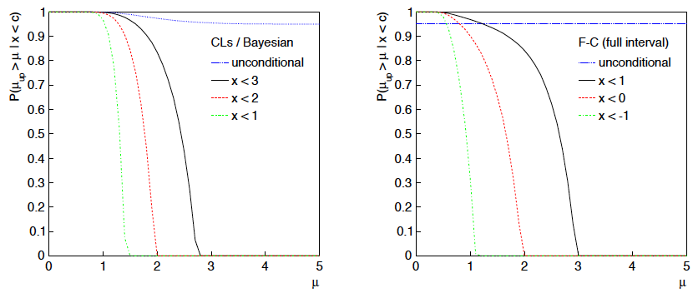
Conditional coverage for CLs, F-C

Slide 36
Summary and conclusions
With a “usual” confidence limit, a large downward fluctuation
can lead to exclusion of parameter values to which one has
little or no sensitivity (will happen 5% of the time).
PCL solves this problem by separating the parameter space into
regions within which one has/hasn’t sufficient sensitivity as given
by the probability to reject μ if background-only model is true.
Recommendation for ATLAS: power M₀(μ) ≥ 0.5.
Within region with sufficient sensitivity, an upper limit can be set
with a one-sided test (highest power) and exact 1 – α coverage.
It is important to report both the constrained and unconstrained
limits, so one can see where the power constraint comes into play.
Procedure easily adapted to problems with nuisance parameters
(quote power at estimated values of nuisance parameters for μ = 0).

