Slide 1



Statistics for Particle Physics
Lecture 2: Frequentist Parameter Estimation
Terascale Statistics School
https://indico.desy.de/event/51468/
DESY, Hamburg
23-27 Feb 2026
Glen Cowan
Physics Department
Royal Holloway, University of London
g.cowan@rhul.ac.uk
www.pp.rhul.ac.uk/~cowan

Slide 2
Outline
Lectures/tutorials from me:
1) Monday 16:00 Hypothesis testing
→ 2) Tuesday 9:00 Frequentist parameter estimation
Tuesday 11:00
3) Tuesday 14:00 Confidence limits
Tuesday 16:00
4) Wednesday 9:00 Bayesian parameter estimation
5) Wednesday 14:00 Errors on errors

Slide 3
Parameter Estimation 2-1
Introduction to (frequentist) parameter estimation
The method of Maximum Likelihood
MLE for exponential distribution

Slide 4
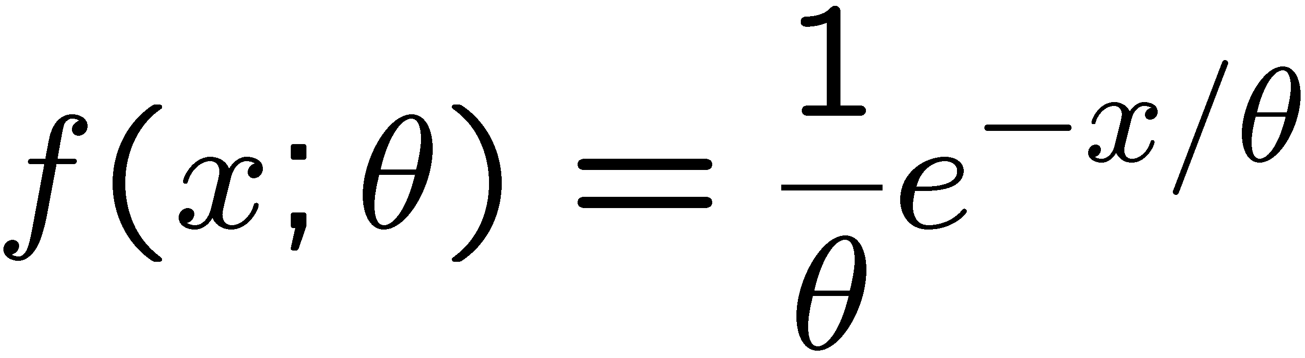
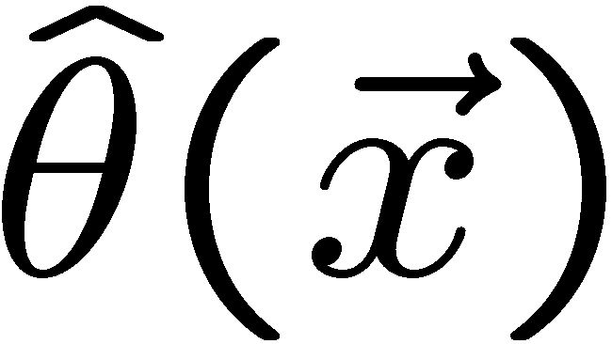
Frequentist parameter estimation
The parameters of a pdf are any constants that characterize it,
i.e., θ indexes a
set of hypotheses.
r.v.
parameter
Suppose we have a sample of observed values: x = (x₁, ..., x_{n})
We want to find some function of the data to estimate the
parameter(s):
← estimator written with a hat
Sometimes we say ‘estimator’ for the function of x₁, ..., x_{n};
‘estimate’ for the value of the estimator with a particular data set.

Slide 5
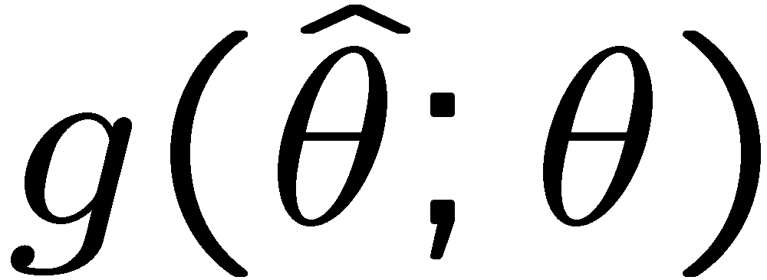
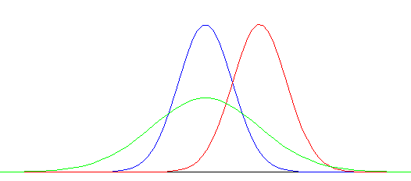
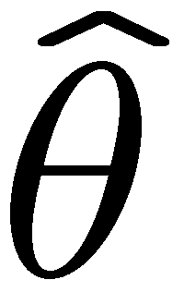
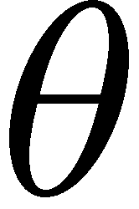
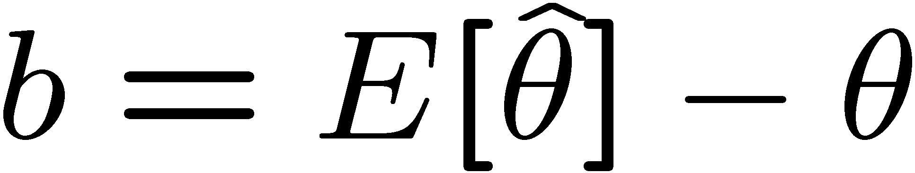
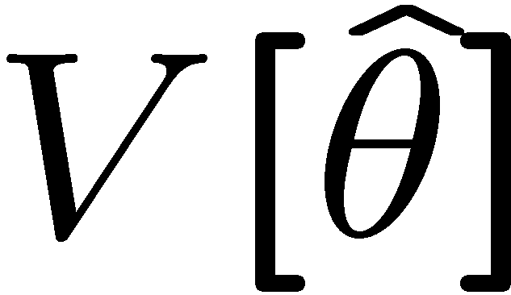
Properties of estimators
If we were to repeat the entire measurement, the estimates
from each would follow a pdf:
best
large
variance
biased
We want small (or zero) bias (systematic error):
→ average of repeated measurements should tend to true value.
And we want a small variance (statistical error):
→ small bias & variance are in general conflicting criteria

Slide 6

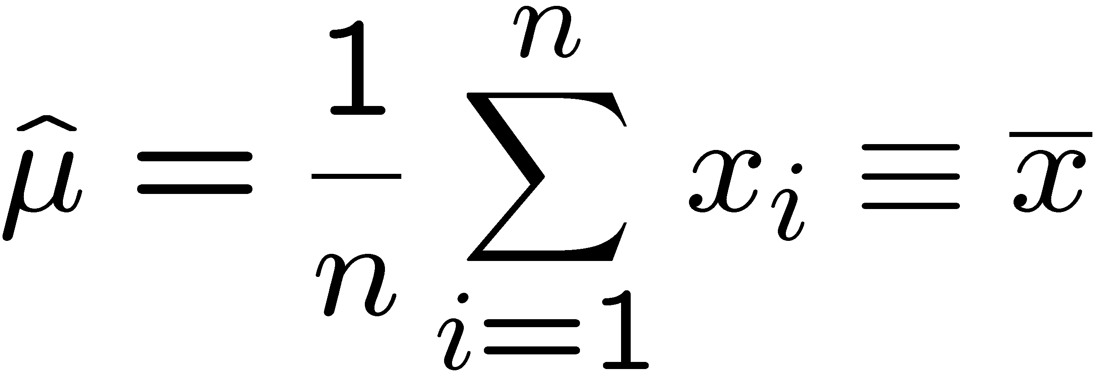
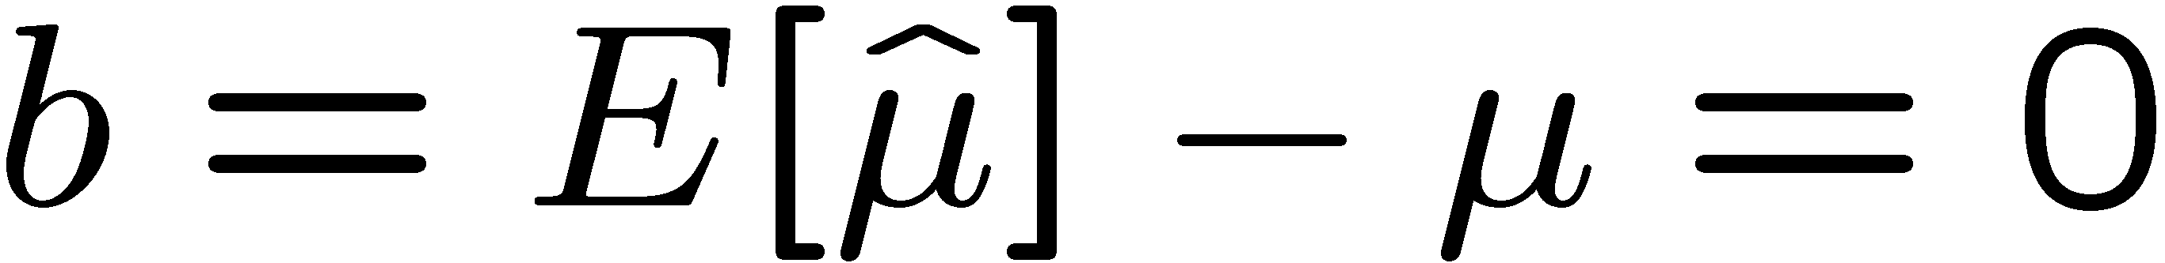
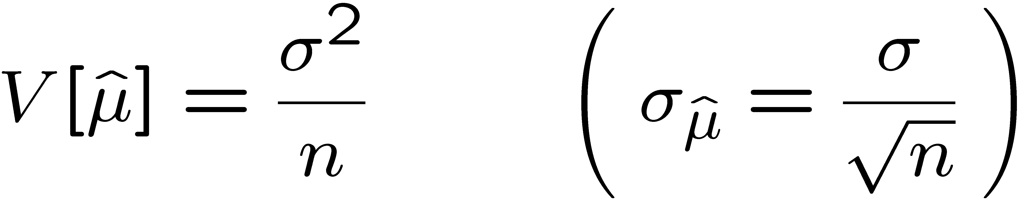
An estimator for the mean (expectation value)
Parameter:
Suppose we have a sample of n independent values x₁,...,x_{n}.
Estimator:
(‘sample mean’)
We find:

Slide 7

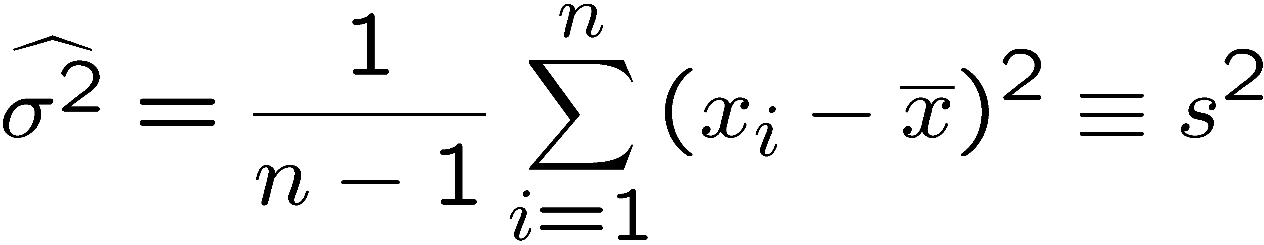
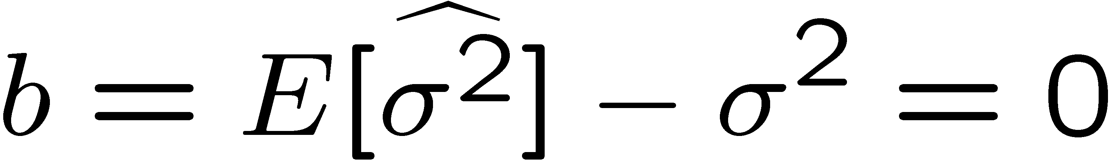
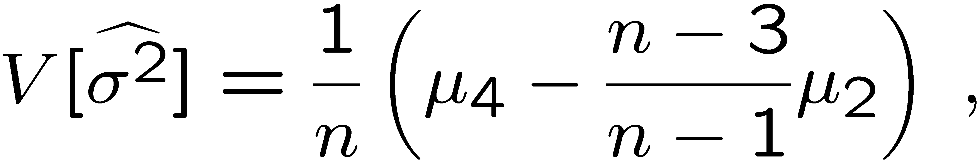
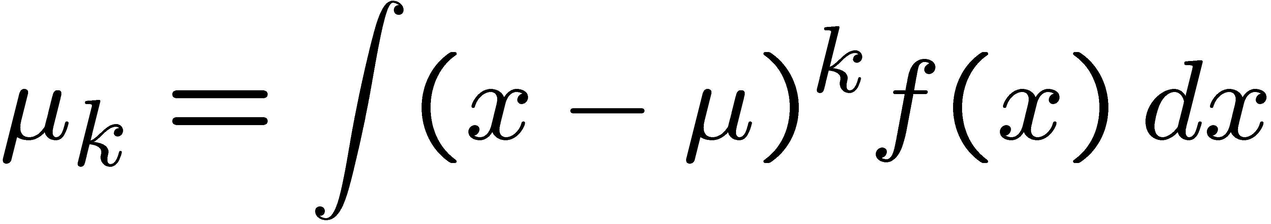
An estimator for the variance
Parameter:
Estimator:
(‘sample
variance’)
We find:
(factor of n-1 makes this so)
where

Slide 8


The likelihood function
Suppose the entire result of an experiment (set of measurements)
is a collection of numbers x, and suppose the joint pdf for
the data x is a function that depends on a set of parameters θ:
Now evaluate this function with the data obtained and
regard it as a function of the parameter(s). This is the likelihood function:
(x constant)

Slide 9
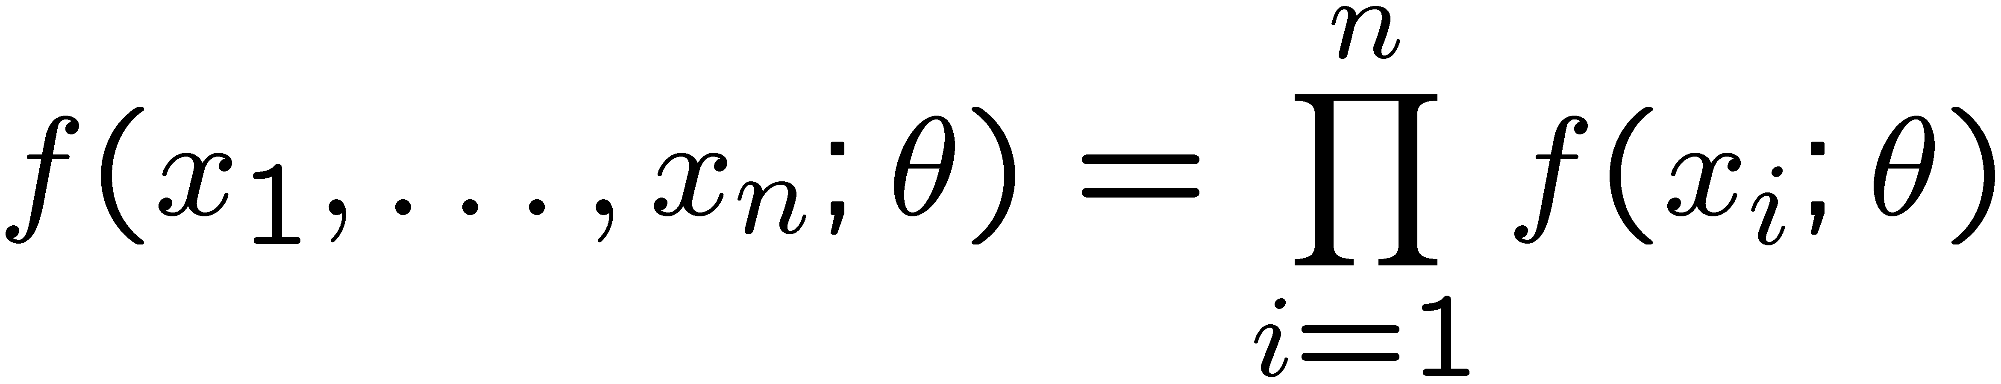
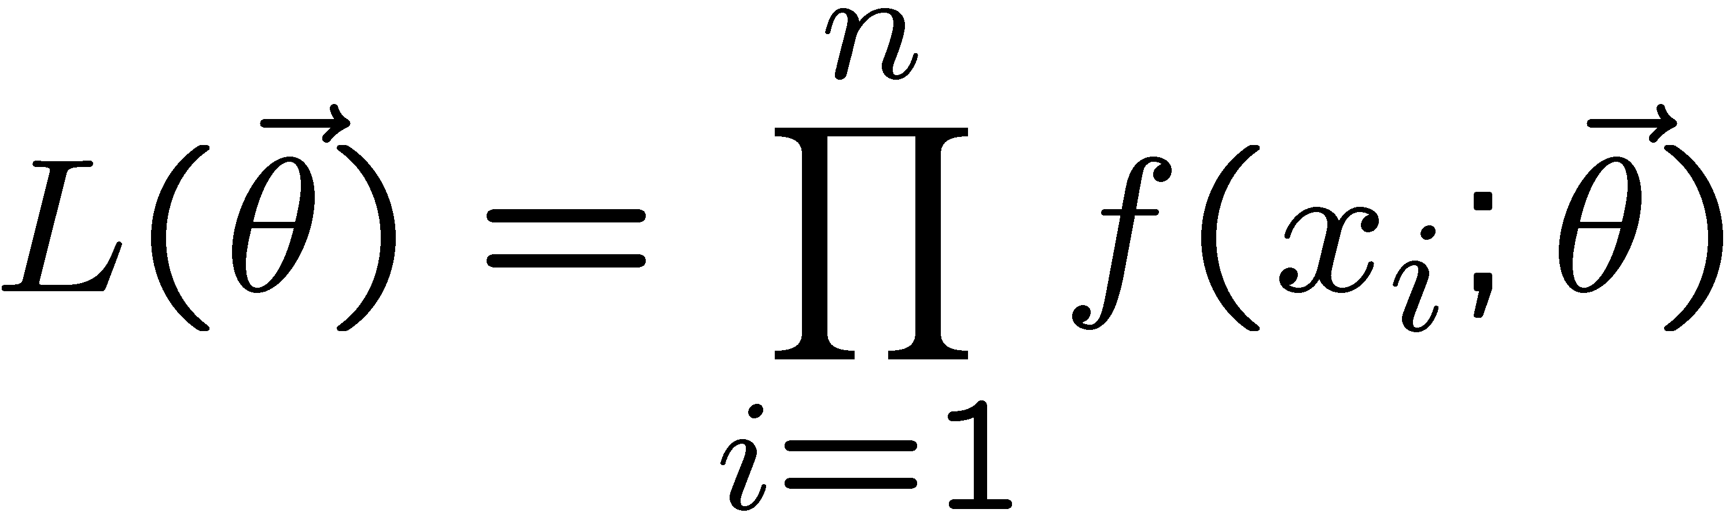
The likelihood function for i.i.d.*. data
* i.i.d. = independent and identically distributed
Consider n independent observations of x: x₁, ..., x_{n}, where
x follows f (x; θ). The joint pdf for the whole data sample is:
In this case the likelihood function is
(x_{i} constant)

Slide 10
Maximum Likelihood Estimators (MLEs)
We define the maximum likelihood estimators or MLEs to be
the parameter values for which the likelihood is maximum.
Maximizing L equivalent
to maximizing log L
Could have multiple maxima (take highest).
MLEs not guaranteed to have any ‘optimal’ properties, (but in practice they’re very good).

Slide 11
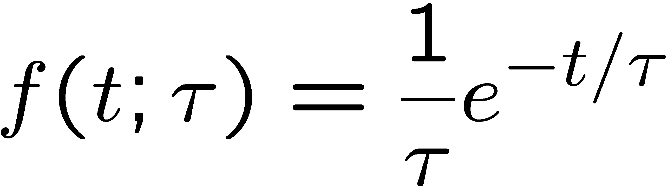
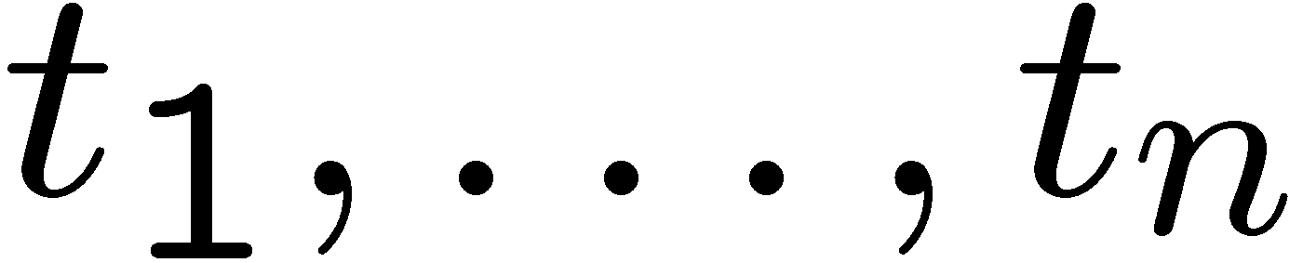
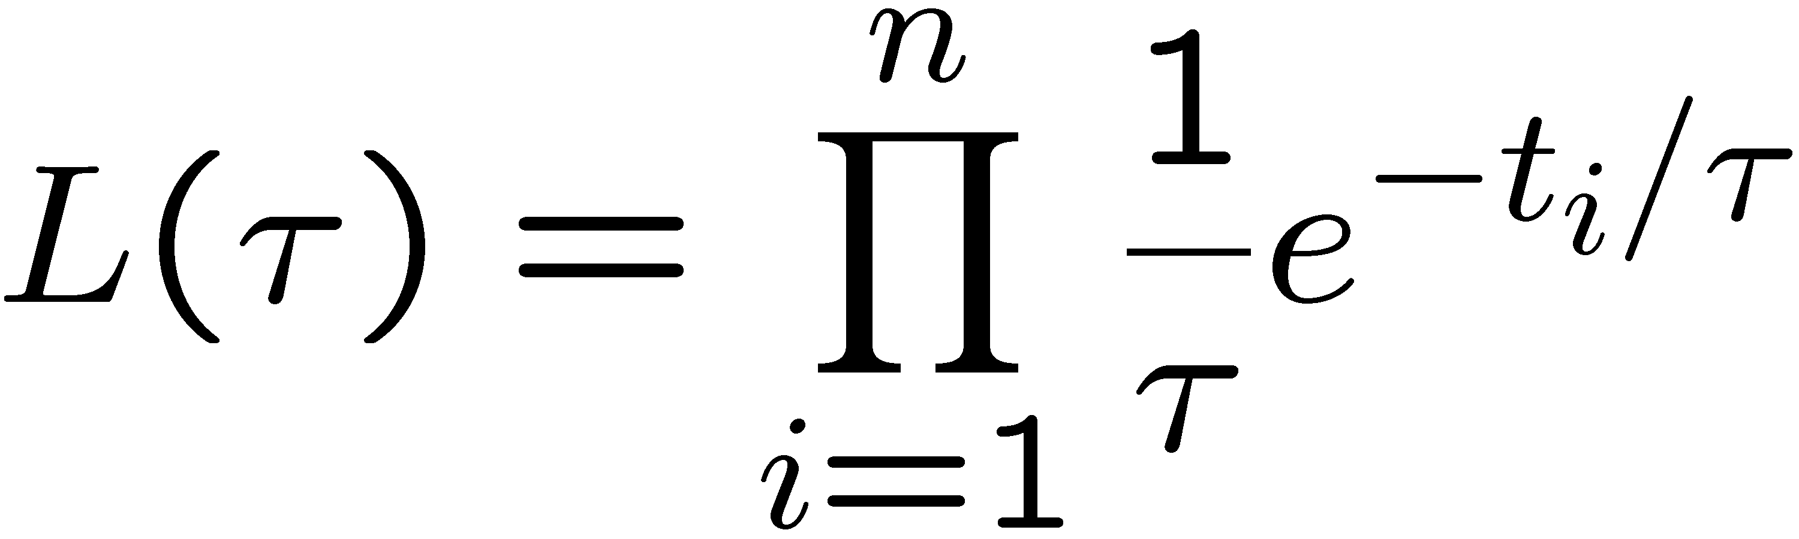
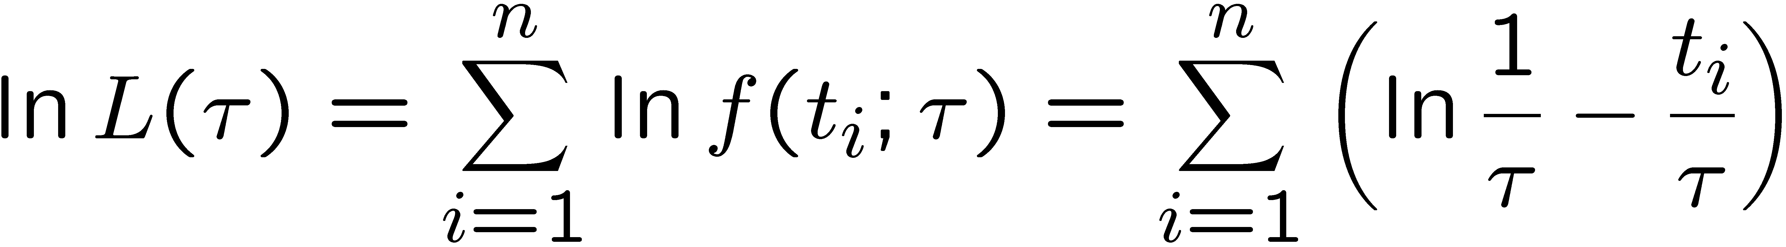
MLE example: parameter of exponential pdf
Consider exponential pdf,
and suppose we have i.i.d. data,
The likelihood function is
The value of τ for which L(τ) is maximum also gives the
maximum value of its logarithm (the log-likelihood function):

Slide 12
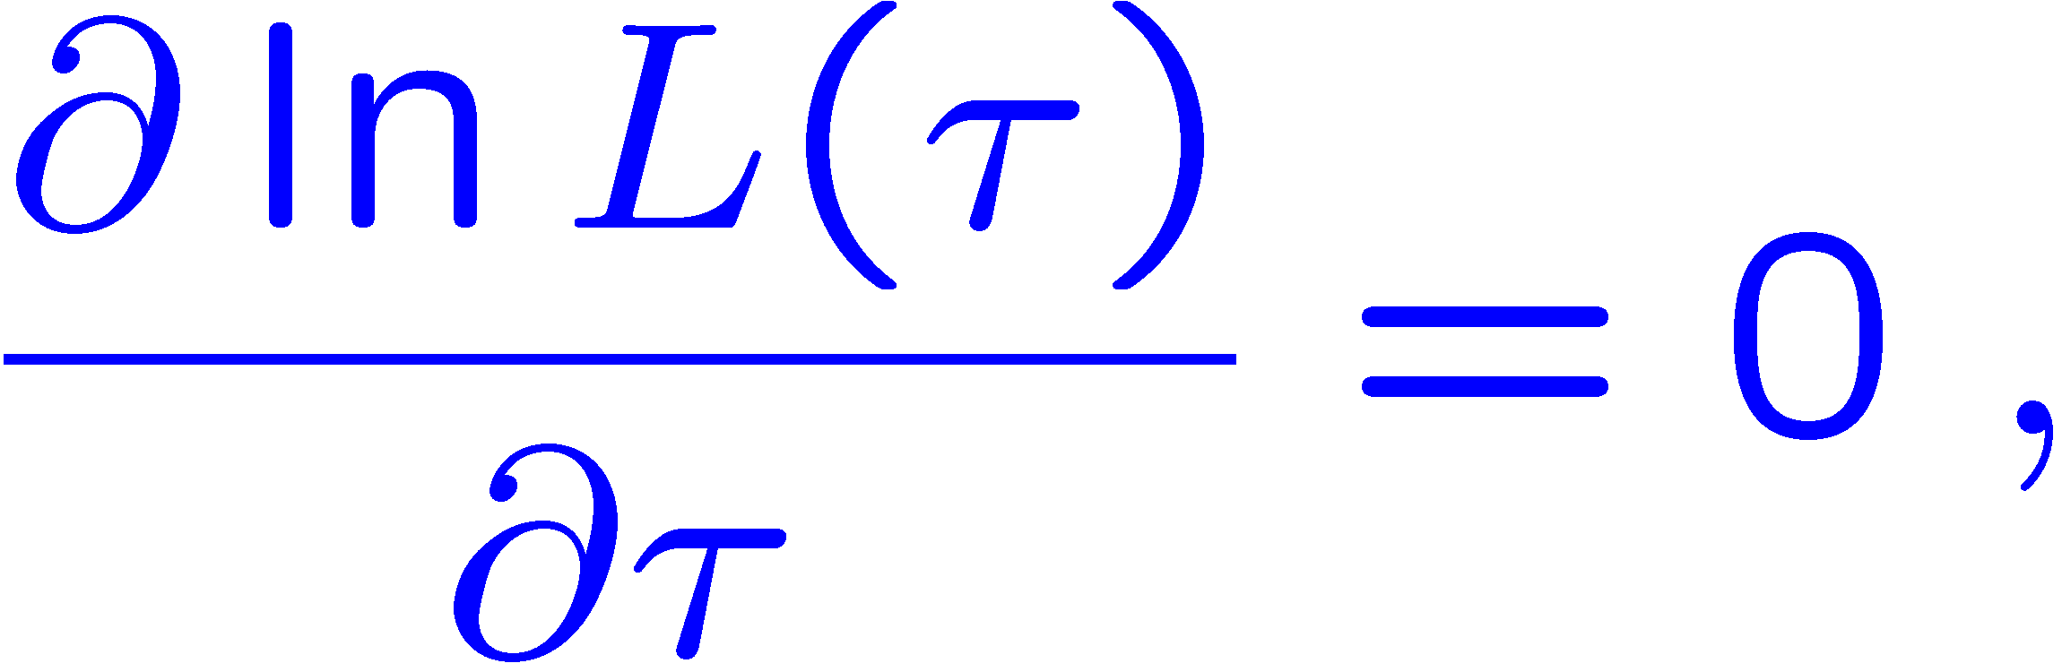
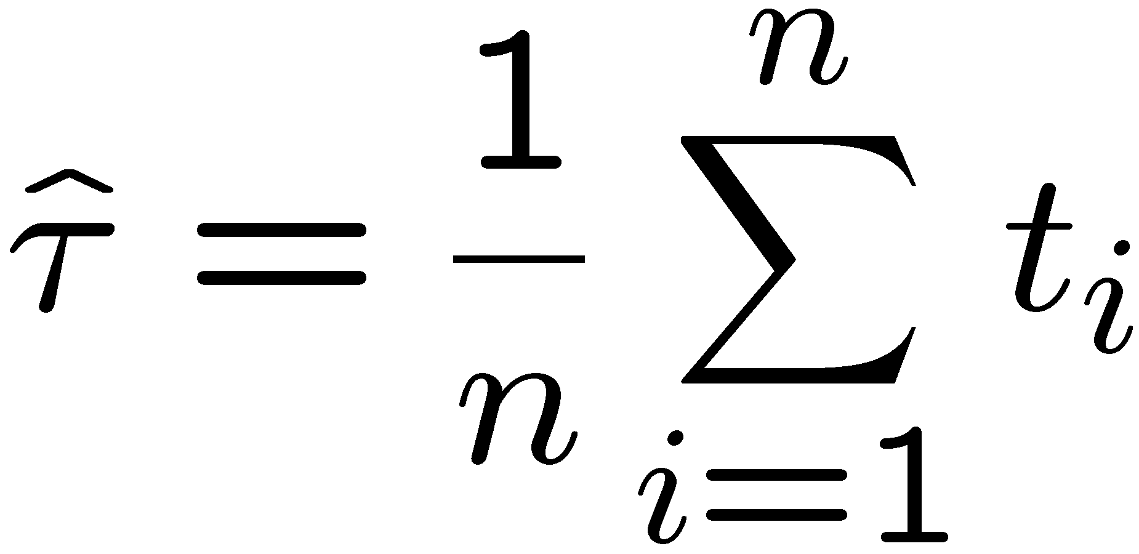
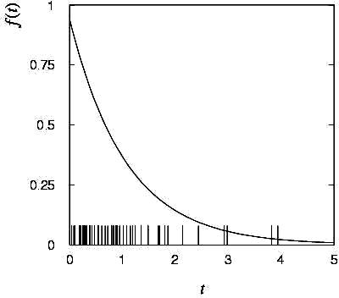
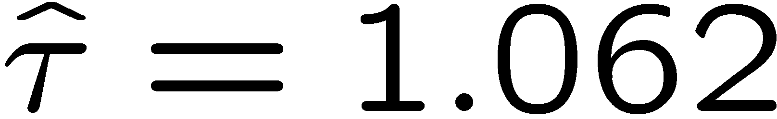
MLE example: parameter of exponential pdf (2)
Find its maximum by setting
→
Monte Carlo test:
generate 50 values
using τ = 1:
We find the ML estimate:

Slide 13






MLE example: parameter of exponential pdf (3)
For the exponential distribution one has for mean, variance:
For the MLE
we therefore find
→
→

Slide 14
Large-sample (asymptotic) properties of MLEs
Suppose we have an i.i.d. data sample of size n: x₁,...,x_{n}
In the large-sample (or “asymptotic”) limit (n → ∞) and assuming regularity conditions one can show that the likelihood and MLE have several important properties.
The regularity conditions include:
the boundaries of the data space cannot depend on the parameter;
the parameter cannot be on the edge of the parameter space;
ln L(θ) must be differentiable;
the only solution to 𝜕ln L/𝜕θ = 0 is θ.
^
In the slides immediately following the properties are shown without proof for a single parameter; the corresponding properties hold also for the multiparameter case, θ = (θ₁,..., θ_{m}).

Slide 15
log-likelihood becomes quadratic
The likelihood function becomes Gaussian in shape, i.e. the log-likelihood becomes quadratic (parabolic).
The MLE becomes increasingly precise as the (log)-likelihood becomes more tightly concentrated about its peak,
but L(θ) = P(x|θ) is the probability for x, not a pdf for θ.

Slide 16
The MLE converges to the true parameter value
In the large-sample limit, the MLE converges in probability
to the true parameter value.
That is, for any ε > 0,
The MLE is said to be consistent.

Slide 17
MLE is asymptotically unbiased
In general the MLE can be biased, but in the large-sample limit, this bias goes to zero:
(Recall for the exponential parameter we found the bias was
identically zero regardless of the sample size n.)

Slide 18
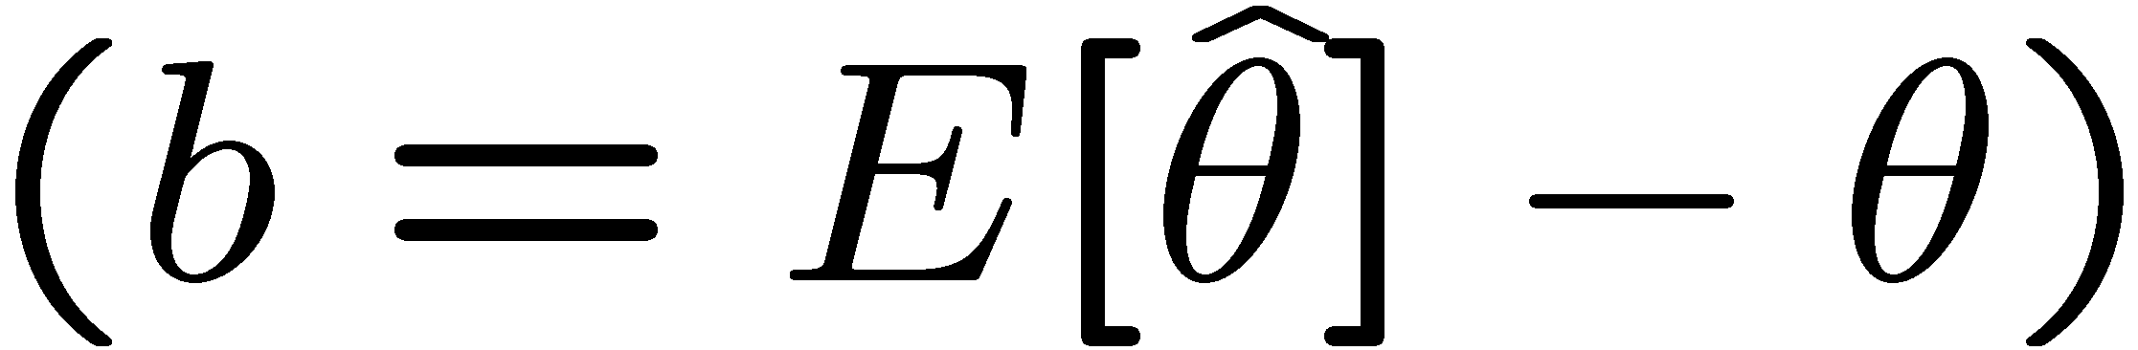
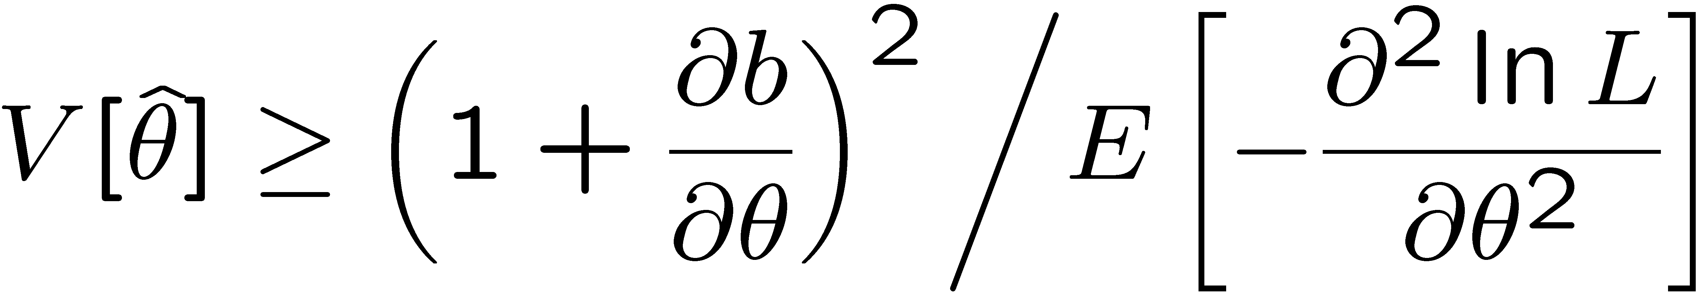
The information inequality
The information inequality (RCF) sets a lower bound on the
variance of any estimator (not only MLE). For a single parameter:
= MVB (Minimum
Variance Bound)
where
Proof in Exercise 6.6 of SDA, http://www.pp.rhul.ac.uk/~cowan/sda/prob/prob_6.pdf
“Efficiency” of an estimator = MVB / actual variance.
An estimator whose variance equals the MVB is said to be efficient.

Slide 19
The MLE’s variance approaches the MVB
In the large-sample limit, the variance of the MLE approaches the minimum-variance bound, i.e., the information inequality becomes an equality (and bias goes to zero):
The MLE is said to be asymptotically efficient.

Slide 20
The MLE’s distribution becomes Gaussian
In the large-sample limit, the pdf of the MLE becomes Gaussian,
where
is the minimum variance bound (note bias is zero).
For example, exponential MLE with sample size n = 100.
Note that for exponential, MLE is arithmetic average, so Gaussian MLE seen to stem from Central Limit Theorem.

Slide 21
Distribution of MLE of exponential parameter

Slide 22
Parameter Estimation 2-2
Finding the variance of MLEs
Information inequality for multiple parameters

Slide 23
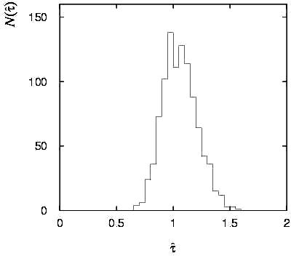
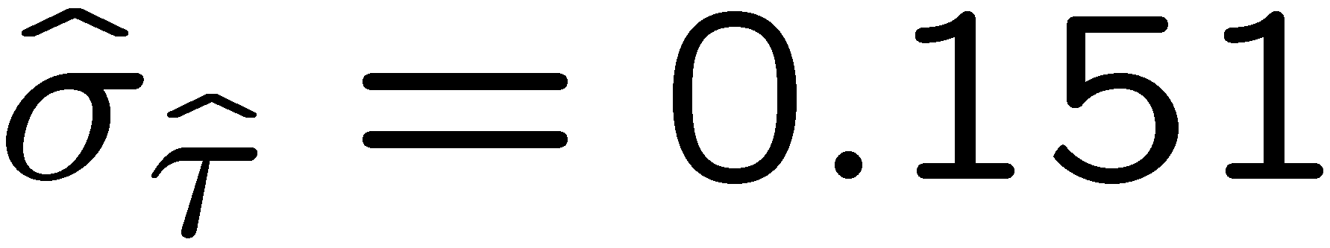
Variance of estimators: Monte Carlo method
Having estimated our parameter we now need to report its
‘statistical error’, using e.g. the estimator’s standard deviation, or (co)variance.
It is usually not possible to do this with an exact calculation.
Another way is to simulate the entire experiment many times with a Monte Carlo program (use ML estimate for MC).
For exponential example (n=50), from sample variance of estimates we find:

Slide 24
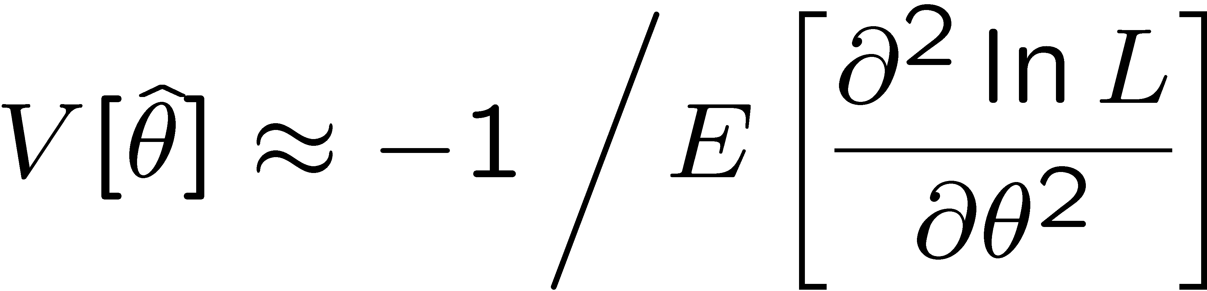
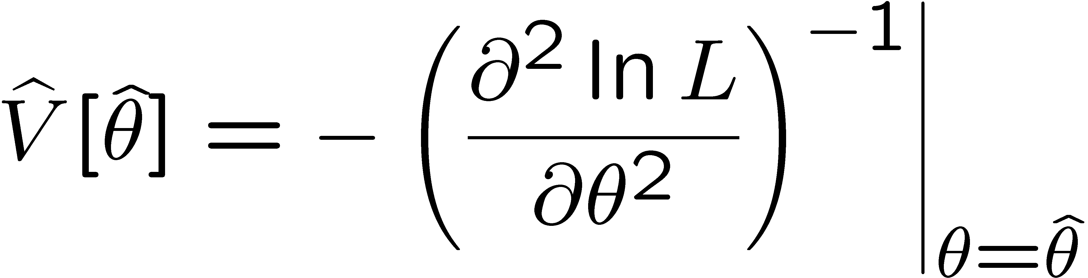
Variance of estimators from information inequality
Recall the information inequality (RCF) sets a lower bound on the
variance of any estimator (not only MLE):
MVB
Often the bias b is small, and equality either holds exactly or
is a good approximation (e.g. large data sample limit). Then,
Estimate this using the 2nd derivative of ln L at its maximum:

Slide 25
MVB for MLE of exponential parameter
Find
We found for the exponential parameter the MLE
and we showed b = 0, hence 𝜕b/𝜕τ = 0.
We find
and since E[t_{i}] = τ for all i,
,
and therefore
.
So here the MLE is efficient.

Slide 26
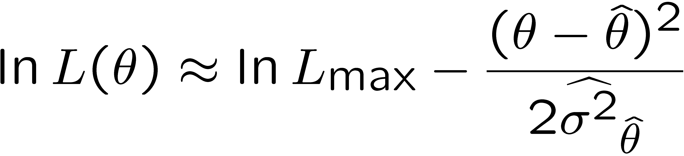
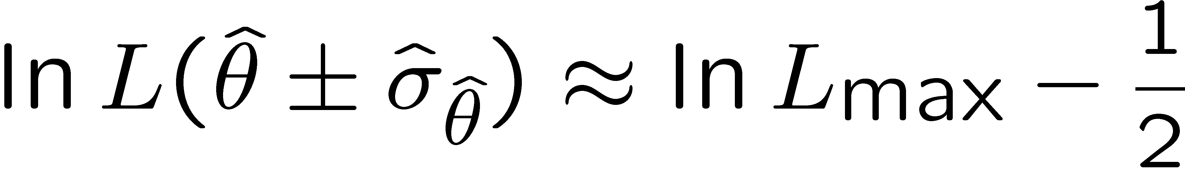
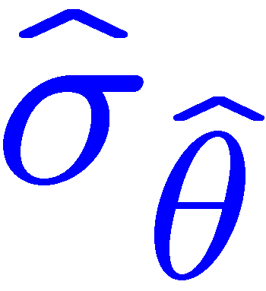

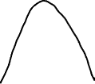
Variance of estimators: graphical method
Expand ln L (θ) about its maximum:
First term is ln L_{max}, second term is zero, for third term use
information inequality (assume equality):
→ to get
, change θ away from
until ln L decreases by 1/2.

Slide 27
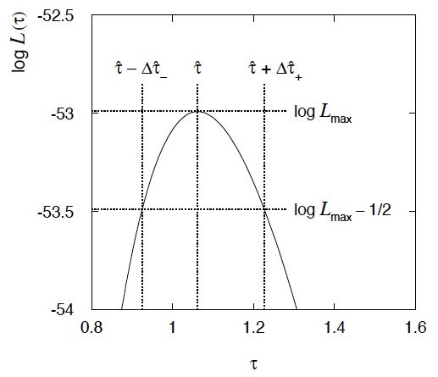
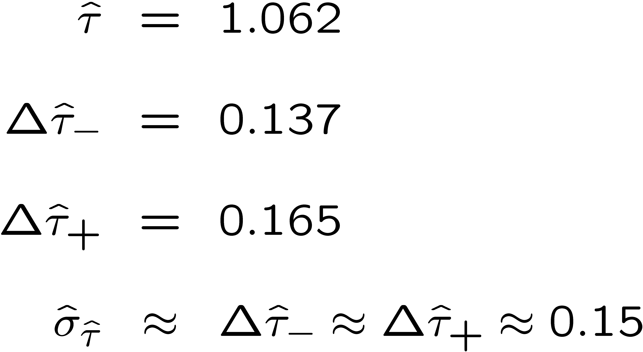
Example of variance by graphical method
ML example with exponential:
Not quite parabolic ln L since finite sample size (n = 50).

Slide 28
Parameter Estimation 2-3
Information inequality for multiple parameters
Numerical example of 2-D MLE
The ln L = ln L_{max} – ½ contour
MLE for function of a parameter
Relation between MLE and Bayesian estimator

Slide 29
Information inequality for N parameters
Suppose we have estimated N parameters θ = (θ₁,...,θ_{N})
The Fisher information matrix is
^
and the covariance matrix of estimators θ is
The information inequality states that the matrix
is positive semi-definite:
z^{T}Mz ≥ 0 for all z ≠ 0, diagonal elements ≥ 0

Slide 30
Information inequality for N parameters (2)
In practice the inequality is ~always used in the large-sample limit:
bias → 0
inequality → equality, i.e, M = 0, and therefore V = I⁻¹
That is,
This can be estimated from data using
Find the matrix V⁻¹ numerically (or with automatic differentiation),
then invert to get the covariance matrix of the estimators

Slide 31
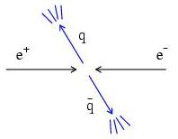
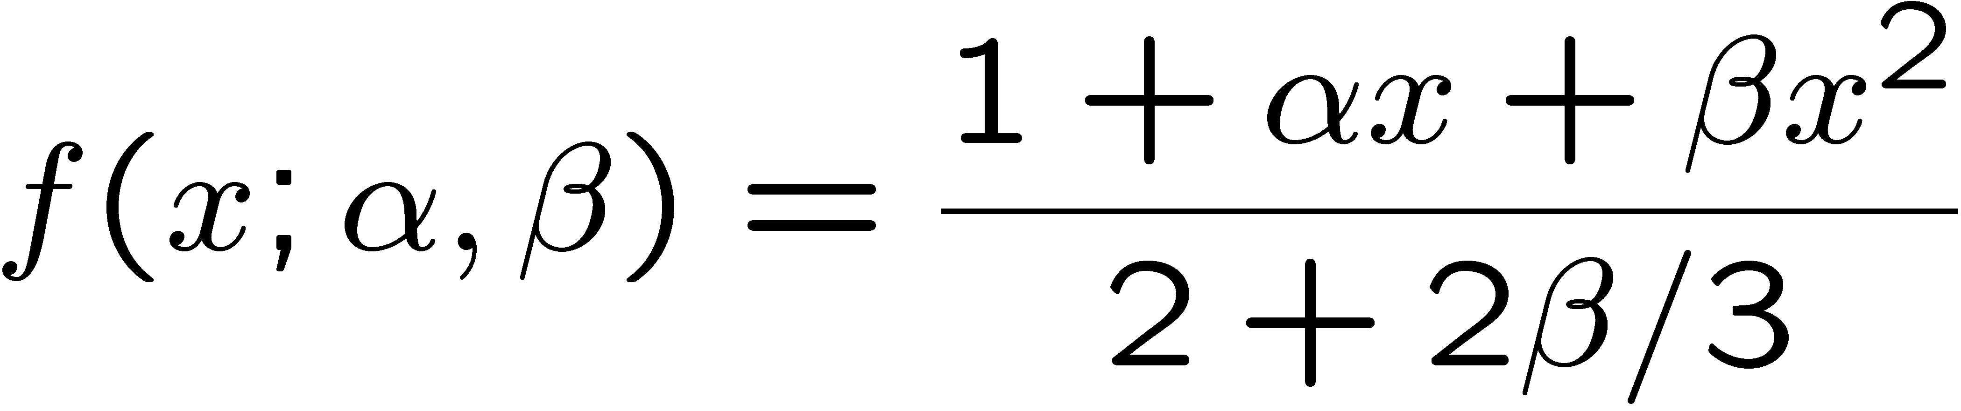
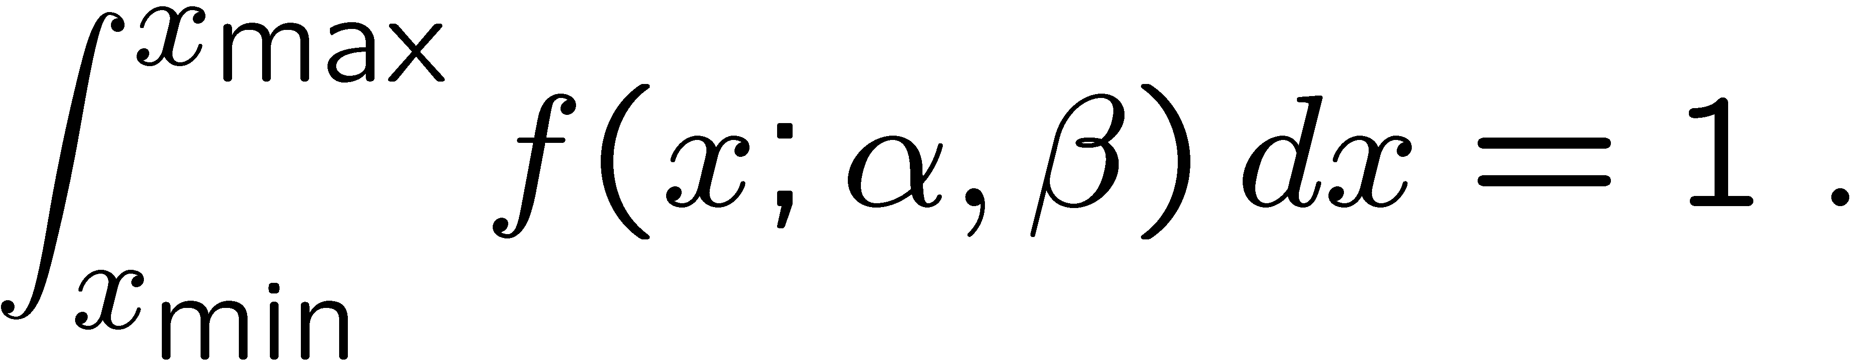
Example of ML with 2 parameters
Consider a scattering angle distribution with x = cos θ,
or if x_{min} < x < x_{max}, need to normalize so that
Example: α = 0.5, β = 0.5, x_{min} = −0.95, x_{max} = 0.95, generate n = 2000 events with Monte Carlo.
need to find maximum
numerically

Slide 32
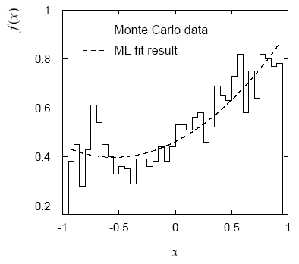
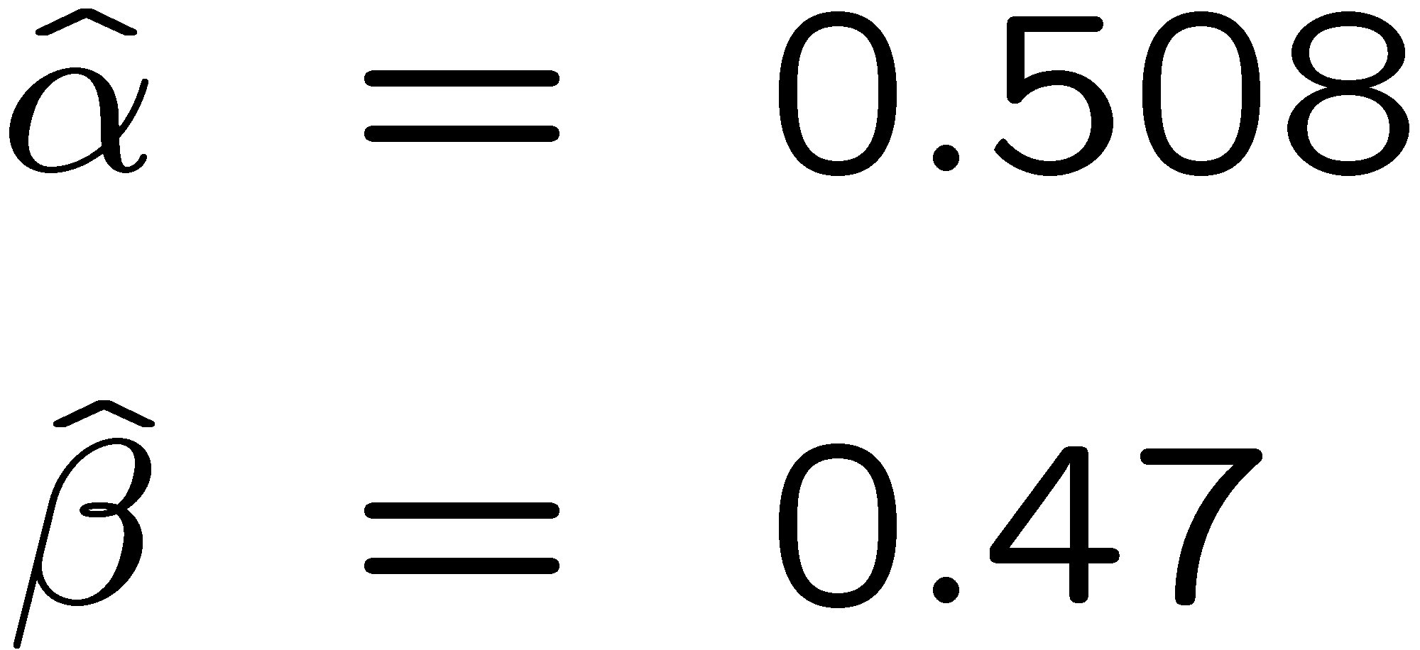
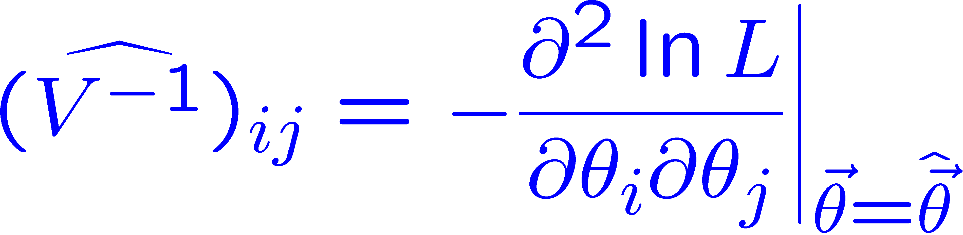
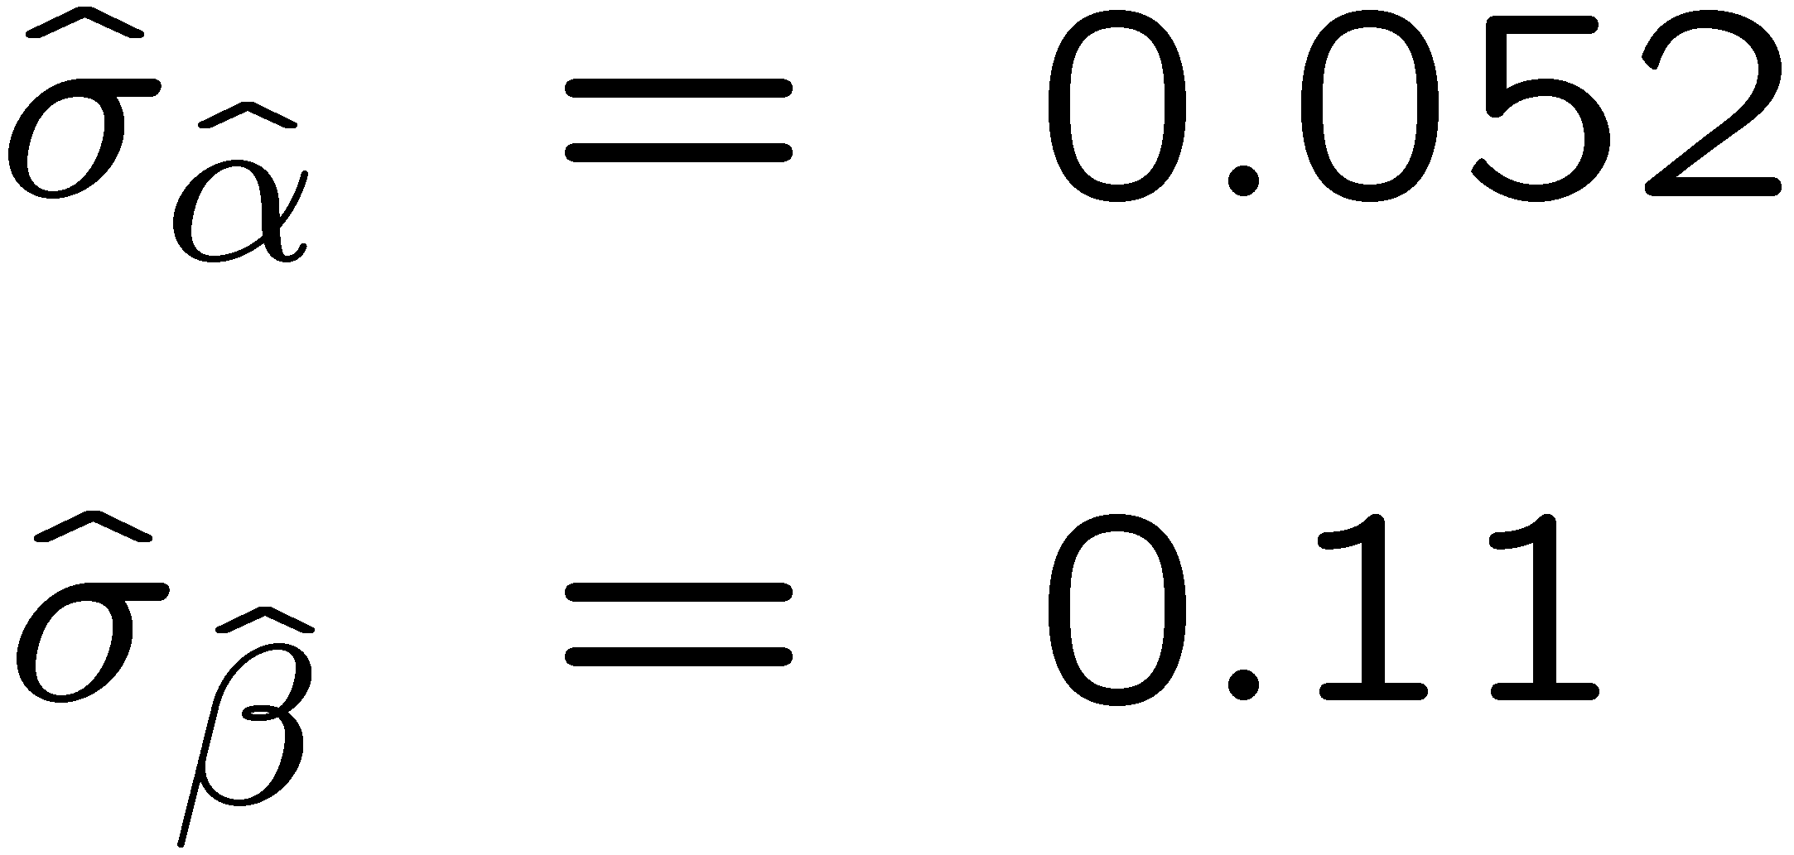
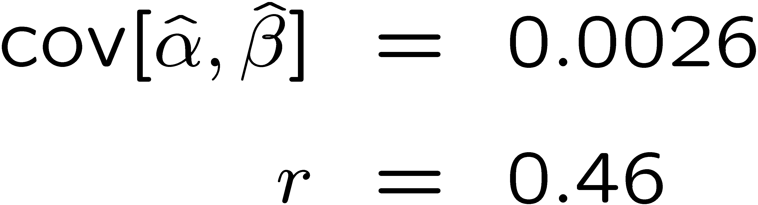
Example of ML with 2 parameters: fit result
Finding maximum of ln L(α, β) numerically gives
N.B. No binning of data for fit,
but can compare to histogram for
goodness-of-fit (e.g. ‘visual’ or χ²).
(Co)variances from
= correlation coefficient

Slide 33
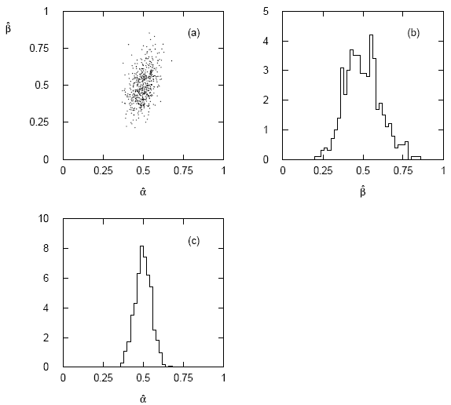




Two-parameter fit: MC study
Repeat ML fit with 500 experiments, all with n = 2000 events:
Estimates average to ~true values;
(Co)variances close to previous estimates;
marginal pdfs approximately Gaussian.

Slide 34
Multiparameter graphical method for variances
Expand ln L(θ) to 2nd order about MLE:
ln L_{max}
zero
relate to covariance matrix of MLEs using information (in)equality.
Result:
So the surface
corresponds to
, which is the equation of a (hyper-) ellipse.

Slide 35



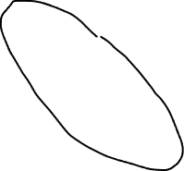
Multiparameter graphical method (2)
Distance from MLE to tangent planes gives standard deviations.

Slide 36
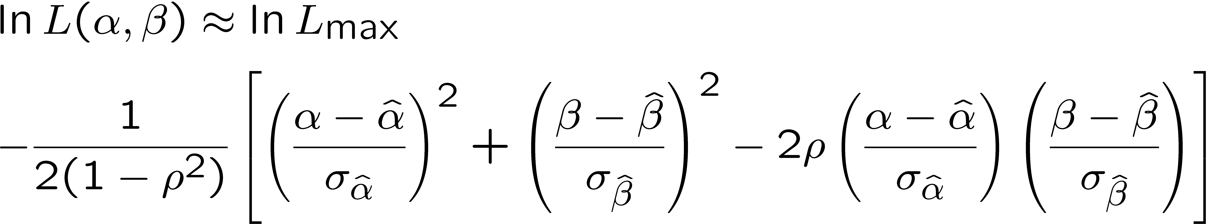
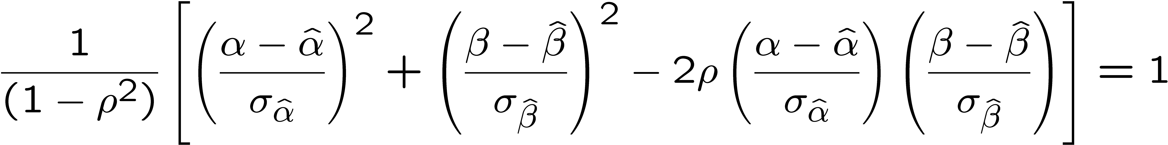
The ln L_{max} − 1/2 contour for two parameters
For large n, ln L takes on quadratic form near maximum:
The contour
is an ellipse:

Slide 37
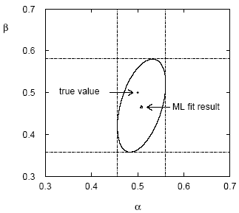

(Co)variances from ln L contour
The α, β plane for the first
MC data set
→ Tangent lines to contours give standard deviations.
→ Angle of ellipse φ related to correlation:

Slide 38
Functions of maximum-likelihood estimators
Suppose likelihood has a parameter θ.
Define a new parameter α given by function α = a(θ).
What is the MLE of α?
Suppose a(θ) has a unique inverse, so θ = a⁻¹(α).
The likelihood is L(θ) = L(a⁻¹(α)).
The maximum of the likelihood is L_{max} = L(θ).
So to maximize L, find α ≡ α such that
^
^
MLE of a function is the function of the MLE.
Very useful result.

Slide 39





Functions of MLEs: exponential example
Suppose we had written the exponential pdf as
i.e., we use λ = 1/τ. What is the MLE estimator for λ?
For the decay constant we have
Caveat:
is biased, even though
is unbiased.
Can show
(bias →0 for n →∞)
In general MLE for a function of an unbiased estimator stays unbiased only for a linear function.

Slide 40
Parameter Estimation 2-4
The method of Least Squares (LS)
LS from maximum likelihood
LS with correlated measurements

Slide 41

Curve fitting: basic idea
Consider N independent measured values y_{i}, i = 1,.., N.
Each y_{i} has a standard deviation σ_{i}, and is measured at a value x_{i} of a control variable x known with negligible uncertainty:
μ(x; θ)
y_{i} ± σ_{i}
Suppose the functional form of μ(x; θ) is given; goal is to estimate its parameters θ .

Slide 42
Gaussian likelihood function → LS estimators
Suppose the measurements y₁, ..., y_{N}, are independent Gaussian r.v.s with means E[y_{i}] = μ(x_{i}; θ) and variances V[y_{i}] = σ_{i}² , so the the likelihood function is
The log-likelihood function is therefore
So maximizing the likelihood is equivalent to minimizing
^
The minimum of χ ²(θ) defines the least squares (LS) estimators θ.

Slide 43
ML ↔︎ LS
So least-squares (LS) estimators same as maximum likelihood (ML) when the measurements are y_{i} ~ Gauss(μ(x_{i}; θ), σ_{i}).
Note that the y_{i} here are independent but not identically distributed. Do not confuse this case with our previous example of an i.i.d. sample with x_{i} ~ Gauss(μ, σ).
If the y_{i} are not Gaussian distributed the minimum of χ ²(θ) still defines the LS estimators. But for most applications in practice the y_{i} are at least approximately Gaussian (a consequence of the Central Limit Theorem).
Often minimize χ²(θ), numerically (e.g. programs like curve_fit or MINUIT).

Slide 44
LS with correlated measurements
If y ~ multivariate Gaussian with covariance matrix V_{ij} = cov[y_{i},y_{j}]
where μ^{T} = (μ(x₁),...,μ(x_{N})), then maximizing the likelihood is equivalent to minimizing

Slide 45
LS with correlated measurements (2)
For the special case of a diagonal covariance matrix, i.e., uncorrelated measurements. Then
→
V ⁻¹_{ij} = δ_{ij} /σ_{i}², carry out one of the sums, χ ²(θ) same as before:

Slide 46
Variance of LS estimators for Gaussian data
If y_{i} ~ Gauss, then we found
To the extent this (approximately) holds, we can use
and so we estimate the inverse covariance matrix with
and invert to estimate the covariance matrix U.
For Gaussian data with the linear LS problem, U is the minimum variance bound (the LS estimators are unbiased and efficient).

Slide 47




Covariance from derivatives of χ²(θ)
This is what programs like curve_fit and MINUIT do (derivatives computed numerically). Example with straight-line fit gives:
,

Slide 48




The contour χ ²(θ) = χ ²_{min} + 1
If μ(x; θ) is linear in the parameters, then χ²(θ) is quadratic:
Standard deviations from
tangents to (hyper-) planes of
(corresponds to
ln L(θ) = ln L_{max} – ½)

Slide 49
Statistical Data Analysis
Lecture 2-5
Goodness of fit from χ ²_{min}
Example of least-squares fit

Slide 50

A “good” fit
In an earlier example we fitted data that were reasonably well described by a straight line:

Slide 51

A “bad” fit
But what if a straight-line fit looks like this:
Test hypothesized form of fit function with p-value, if this is below some (user-defined) threshold, reject the hypothesis and try some other function, e.g. a polynomial of higher order.

Slide 52


Goodness-of-fit from χ ²_{min}
The value of the χ² at its minimum is a measure of the level
of agreement between the data and fitted curve:
It can therefore be used as a goodness-of-fit statistic t(y) to
test the hypothesized functional form μ(x; θ).
The p-value of the hypothesized functional form is
= the probability, under assumption of μ(x; θ), to get a χ²_{min} as high as the one we got or higher.

Slide 53

Distribution of χ ²_{min}
One can show that if the data follow y ~ Gauss(μ(x; θ),σ), i.e., if the fit function is correct for some θ, then the statistic t = χ²_{min} follows the chi-square pdf,
where the number of degrees of freedom is
n_{d} = number of data points - number of fitted parameters
Note that the composite hypothesis with E[y] = μ(x; θ) is only fully specified when we fix θ.
So the p-value is in principle a function of θ, and we should only reject μ(x; θ) if p ≤ α for all θ.
But here the pdf of our statistic χ²_{min} is independent of θ, so whatever we get for p holds for any θ.

Slide 54
The “chi-square per degree of freedom”
Recall also the chi-square pdf has an expectation value equal to the number of degrees of freedom, so
χ²_{min} ~ n_{d} → fit is “good”
χ²_{min} ≫ n_{d} → fit is “bad”
χ²_{min} ≪ n_{d} → fit is better than what one would expect given
fluctuations that should be present in the data.
Often this is done using the ratio χ²_{min}/n_{d}, i.e. fit is good if
the “chi-square per degree of freedom” comes out not much
greater than 1.
But, best to quote both χ²_{min} and n_{d}, not just their ratio, since e.g.
χ²_{min} = 15, n_{d} = 10 → p-value = 0.13
χ²_{min} = 150 n_{d} = 100 → p-value = 0.00090

Slide 55

p-value for the “good” fit
N = 9 data points, m = 2 fitted parameters,
χ²_{min} /n_{dof} = 8.2/7 = 1.2
χ²_{min} = 8.2
p-value
= 0.32
If the straight-line hypothesis is true, expect equal or worse
agreement almost 1/3 of the time (i.e. our result is not unusual).

Slide 56
p-value for the “bad” fit
N = 9 data points, m = 2 fitted parameters,
χ²_{min} /n_{dof} = 20.9/7 = 3.0
χ²_{min} = 20.9
p-value
= 0.0039
So is the straight-line hypothesis correct? It could be, but if
so we would expect a χ²_{min} as high as observed or higher
only 4 times out of a thousand.

Slide 57


A better fit
If we decide the agreement between data and hypothesis is
not good enough (exact threshold is a subjective choice), we can
try a different model, e.g., a 2nd order polynomial:
χ²_{min} = 3.5 for n_{dof} = 6
χ²_{min} /n_{dof} = 0.58
p-value = 0.75

Slide 58

Goodness-of-fit vs. statistical errors
If the fit is “bad”, something is “wrong” and you may expect large statistical errors for the fitted parameters (std. devs. of estimators). This is not the case.
The statistical errors say how much the parameter estimates should fluctuate when repeating the experiment. This is not the same as the degree to which the fit function can describe the data.
If the hypothesized μ(x; θ) is not correct, e.g., the true hypothesis below is curved, not a straight line, then the fitted parameters will have some systematic error – a more complex question that we will take up later.

Slide 59
Extra Slides

Slide 60
LS with histogram data
The fit function in an LS fit is not a pdf, but it could be proportional to one, e.g., when we fit the “envelope” of a histogram.
Suppose for example, we have an i.i.d. data sample of n values x₁,..., x_{n} sampled from a pdf f (x;θ). Goal is to estimate θ.
Instead of using all n values, put them in a histogram with N bins, i.e., y_{i} = number of entries in bin i: y = (y₁,..., y_{N}).
The model predicts mean values:
bin centre
bin width

Slide 61
LS with histogram data (2)
The usual models:
for fixed sample size n, take y ~ multinomial,
if n not fixed, y_{i} ~ Poisson(μ_{i})
Suppose that the expected number of entries in each μ_{i} are all ≫ 1 and probability to be in any individual bin p_{i} ≪ 1, one can show
→ y_{i} indep. and ~ Gauss with σ_{i} ≈ √μ_{i}. (→ σ_{i} depends on θ).
The (log-) likelihood functions are then

Slide 62
LS with histogram data (3)
Still define the least-squares estimators to minimize
No longer equivalent to maximum likelihood (equal for μ_{i} ≫ 1 ).
Two possibilities for σ_{i}:
σ_{i} = √μ_{i}(θ) (LS method)
σ_{i} = √y_{i} (Modified LS method)
Modified LS can be easier computationally but not defined if
any y_{i} = 0.
For either method, χ ²_{min} ~ chi-square pdf for μ_{i} ≫ 1, but this breaks down for when the μ_{i} are not large.

Slide 63


Comments on using iminuit
In our earlier iminuit example mlFit.py, the only argument of the log-likelihood function was the parameter array, and the data array xData entered as global (usually not a good idea):
⠇

Slide 64

lnL in a class, binned data,...
Sometimes it is convenient to have the function being minimized as a method of a class. An example of this is shown in the program histFit.py, which does the same fit as in mlFit.py but with a histogram of the data:

Slide 65

Commentary on histFit.py
The global data can be avoided if we make the objective function a method of a class:

Slide 66

class ChiSquared (continued)

Slide 67

Using the ChiSquared class
For full program see
https://www.pp.rhul.ac.uk/~cowan/stat/exercises/fitting/python/

Slide 68
History
Least Squares fitting also called “regression”
F. Galton, Regression towards mediocrity in hereditary
stature, The Journal of the Anthropological Institute of Great
Britain and Ireland. 15: 246–263 (1886).
Developed earlier by Laplace and Gauss:
C.F. Gauss, Theoria Motus Corporum Coelestium in Sectionibus
Conicis Solem Ambentium, Hamburgi Sumtibus Frid. Perthes et
H. Besser Liber II, Sectio II (1809);
C.F. Gauss, Theoria Combinationis Observationum Erroribus
Minimis Obnoxiae, pars prior (15.2.1821) et pars posterior
(2.2.1823), Commentationes Societatis Regiae Scientiarium
Gottingensis Recectiores Vol. V (MDCCCXXIII).

Slide 69
Linear LS Problem
Suppose the fit function is linear in the parameters θ^{T} = (θ₁,..., θ_{Μ}),
where the a_{i}(x) are a set of linearly independent basis functions,
and write μ^{T}(θ) = (μ(x₁; θ),..., μ(x_{N}; θ)) .
Define N⨉M matrix A_{ij} = a_{j}(x_{i}), so μ(θ) = Aθ.
To find the LS estimators minimize:

Slide 70
Linear LS Problem (2)
Set derivatives with respect to θ_{i} to zero,
Solve system of M linear equations to find the LS estimators,
Note that the estimators are linear functions of the measured y_{i}.

Slide 71
Bias of LS estimators
By hypothesis E[y] = μ = Aθ so for the linear problem, the LS estimators are unbiased:
For the general nonlinear problem the LS estimators can have
a bias.

Slide 72
Variance of LS estimators for linear problem
For the linear LS problem, the variance can be found using
error propagation. Using
We find
Since the estimators are linear in the y_{i}, error propagation gives an exact result.

Slide 73
Cheap estimator for mass of W boson
The Particle Physics community has spent huge sums trying to
estimate the mass of the W boson with the smallest possible
statistical and systematic uncertainty.
Here is an estimator with zero statistical uncertainty. And it’s free!
Here is its sampling distribution:
Does this violate the information
inequality?

Slide 74

Cheap estimator for mass of W boson (2)
This estimator’s bias is
Note current best estimate of M_{W} is 80.379±0.012 GeV, so the numerical
value of the bias may be fairly small.
But we have
and so
So the information inequality is still satisfied.

Slide 75


Example of MLE: parameters of Gaussian pdf
Consider independent x₁, ..., x_{n}, with x_{i} ~ Gauss(μ, σ²)
The log-likelihood function is

Slide 76



Example of ML: parameters of Gaussian pdf (2)
Set derivatives with respect to μ, σ² to zero and solve,
We already know that the estimator for μ is unbiased.
But we find, however,
so the MLE for
σ² has a bias, but b → 0 for n → ∞. Recall, however, that
is an unbiased estimator for σ². Usually not important whether one uses s² or the MLE to estimate σ².

Slide 77
Example of ML: parameters of Gaussian pdf (3)
Use 2nd derivatives of ln L to find covariance.

