Slide 1



Statistics for Particle Physics
Lecture 3: Confidence Limits
Terascale Statistics School
https://indico.desy.de/event/51468/
DESY, Hamburg
23-27 Feb 2026
Glen Cowan
Physics Department
Royal Holloway, University of London
g.cowan@rhul.ac.uk
www.pp.rhul.ac.uk/~cowan

Slide 2
Outline
Lectures/tutorials from me:
1) Monday 16:00 Hypothesis testing
2) Tuesday 9:00 Frequentist parameter estimation
Tuesday 11:00
→ 3) Tuesday 14:00 Confidence limits
Tuesday 16:00
4) Wednesday 9:00 Bayesian parameter estimation
5) Wednesday 14:00 Errors on errors

Slide 3
Statistical Data Analysis
Lecture 3-1
Interval estimation
Confidence interval from inverting a test
Example: limits on mean of Gaussian

Slide 4
Confidence intervals by inverting a test
In addition to a ‘point estimate’ of a parameter we should report
an interval reflecting its statistical uncertainty.
Confidence intervals for a parameter θ can be found by
defining a test of the hypothesized value θ (do this for all θ):
Specify values of the data that are ‘disfavoured’ by θ
(critical region) such that P(data in critical region|θ) ≤ α
for a prespecified α, e.g., 0.05 or 0.1.
If data observed in the critical region, reject the value θ.
Now invert the test to define a confidence interval as:
set of θ values that are not rejected in a test of size α
(confidence level CL is 1− α).

Slide 5
Relation between confidence interval and p-value
Equivalently we can consider a significance test for each
hypothesized value of θ, resulting in a p-value, p_{θ}.
If p_{θ} ≤ α, then we reject θ.
The confidence interval at CL = 1 – α consists of those values of
θ that are not rejected.
E.g. an upper limit on θ is the greatest value for which p_{θ} > α.
In practice find by setting p_{θ} = α and solve for θ.
For a multidimensional parameter space θ = (θ₁,... θ_{M}) use same idea – result is a confidence “region” with boundary determined by p_{θ} = α.

Slide 6
Coverage probability of confidence interval
If the true value of θ is rejected, then it’s not in the confidence interval. The probability for this is by construction (equality for continuous data):
P(reject θ|θ) ≤ α = type-I error rate
Therefore, the probability for the interval to contain or “cover” θ is
P(conf. interval “covers” θ|θ) ≥ 1 – α
This assumes that the set of θ values considered includes the true value, i.e., it assumes the composite hypothesis P(x|H,θ).

Slide 7


Example: upper limit on mean of Gaussian
When we test the parameter, we should take the critical region to maximize the power with respect to the relevant alternative(s).
Example: x ~ Gauss(μ, σ) (take σ known)
Test H₀ : μ = μ₀ versus the alternative H₁ : μ < μ₀
→ Put w_{μ} at region of x-space
characteristic of low μ (i.e. at low x)
Equivalently, take the p-value to be

Slide 8
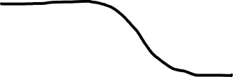
Upper limit on Gaussian mean (2)
To find confidence interval, repeat for all μ₀, i.e., set p_{μ0} = α and solve for μ₀ to find the interval’s boundary
This is an upper limit on μ, i.e., higher μ have even lower p-value and are in even worse agreement with the data.
Usually use Φ⁻¹(α) = −Φ⁻¹(1−α) so as to express the upper limit as x_{obs} plus a positive quantity. E.g. for α = 0.05, Φ⁻¹(1−0.05) = 1.64.

Slide 9

Upper limit on Gaussian mean (3)
μ_{up} = the hypothetical value of μ such that there is only a probability α to find x < x_{obs}.

Slide 10

1- vs. 2-sided intervals
Now test: H₀ : μ = μ₀ versus the alternative H₁ : μ ≠ μ₀
I.e. we consider the alternative to μ₀ to include higher and lower values, so take critical region on both sides:
Result is a “central” confidence interval [μ_{lo}, μ_{up}]:
E.g. for
Note upper edge of two-sided interval is higher (i.e. not as tight
of a limit) than obtained from the one-sided test.

Slide 11
On the meaning of a confidence interval
Often we report the confidence interval [a,b] together with the point estimate as an “asymmetric error bar”, e.g.,
E.g. (at CL = 1 – α = 68.3%):
Does this mean P(80.00 < θ < 80.56) = 68.3%? No, not for a frequentist confidence interval. The parameter θ does not fluctuate upon repetition of the measurement; the endpoints of the interval do, i.e., the endpoints of the interval fluctuate (they are functions of data):

Slide 12



Frequentist upper limit on Poisson parameter
Consider again the case of observing n ~ Poisson(s + b).
Suppose b = 4.5, n_{obs} = 5. Find upper limit on s at 95% CL.
Relevant alternative is s = 0 (critical region at low n)
p-value of hypothesized s is P(n ≤ n_{obs}; s, b)
Upper limit s_{up} at CL = 1 – α found from

Slide 13
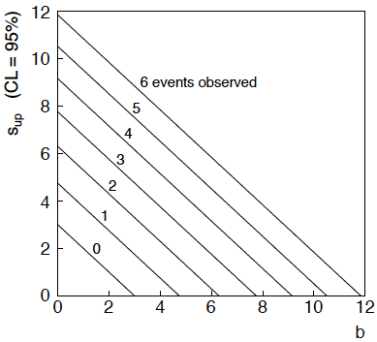
n ~ Poisson(s+b): frequentist upper limit on s
For low fluctuation of n, formula can give negative result for s_{up}; i.e. confidence interval is empty; all values of s ≥ 0 have p_{s} ≤ α.

Slide 14
Limits near a boundary of the parameter space
Suppose e.g. b = 2.5 and we observe n = 0.
If we choose CL = 0.9, we find from the formula for s_{up}
Physicist:
We already knew s ≥ 0 before we started; can’t use negative
upper limit to report result of expensive experiment!
Statistician:
The interval is designed to cover the true value only 90%
of the time — this was clearly not one of those times.
Not uncommon dilemma when testing parameter values for which
one has very little experimental sensitivity, e.g., very small s.

Slide 15
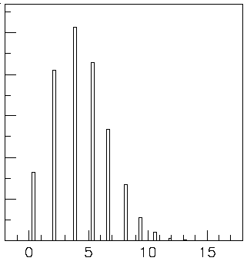

Expected limit for s = 0
Physicist: I should have used CL = 0.95 — then s_{up} = 0.496
Even better: for CL = 0.917923 we get s_{up} = 10⁻⁴ !
Reality check: with b = 2.5, typical Poisson fluctuation in n is
at least √2.5 = 1.6. How can the limit be so low?
Look at the mean limit for the
no-signal hypothesis (s = 0)
(sensitivity).
Distribution of 95% CL limits
with b = 2.5, s = 0.
Mean upper limit = 4.44

Slide 16

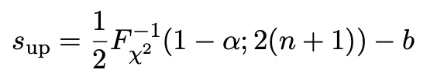
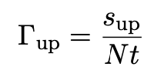
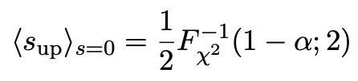
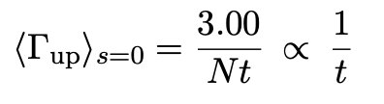





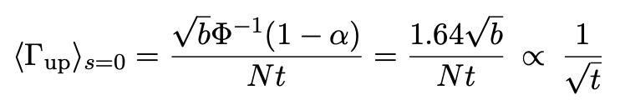
Background-free vs background dominated limits
For
→
Upper limit on the rate of a signal process is
targets
time
For b ≪ 1,
→
For b ≫ 1,
(1−α = 0.95)
,
,
→

Slide 17
Confidence Limits 3-2
Confidence intervals from the likelihood function

Slide 18




Approximate confidence intervals/regions
from the likelihood function
Suppose we test parameter value(s) θ = (θ₁, ..., θ_{N}) using the ratio
Lower λ(θ) means worse agreement between data and hypothesized θ. Equivalently, usually define
so higher t_{θ} means worse agreement between θ and the data.
p-value of θ therefore
need pdf

Slide 19




Confidence region from Wilks’ theorem
Wilks’ theorem says (in large-sample limit and provided
certain conditions hold...)
chi-square dist. with # d.o.f. =
# of components in θ = (θ₁, ..., θ_{N}).
Assuming this holds, the p-value is
← set equal to α
To find boundary of confidence region set p_{θ} = α and solve for t_{θ}:
Recall also

Slide 20




Confidence region from Wilks’ theorem (cont.)
i.e., boundary of confidence region in θ space is where
For example, for 1 – α = 68.3% and n = 1 parameter,
and so the 68.3% confidence level interval is determined by
Same as recipe for finding the estimator’s standard deviation, i.e.,
is a 68.3% CL conf. interval (in large sample limit).

Slide 21
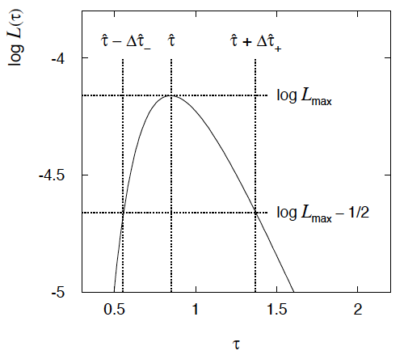

Example of interval from ln L(θ)
For N =1 parameter, CL = 0.683, Q_{α} = 1.
Our exponential
example, now with
only n = 5 events.
Can report ML estimate
with approx. confidence
interval from ln L_{max} – 1/2
as “asymmetric error bar”:

Slide 22

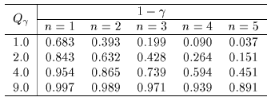

Multiparameter case
For increasing number of parameters, CL = 1 – α decreases for
confidence region determined by a given
← # of par.

Slide 23
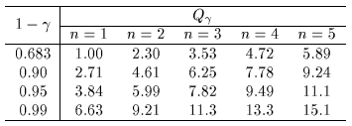
Multiparameter case (cont.)
Equivalently, Q_{α} increases with n for a given CL = 1 – α.
← # of par.

Slide 24
Example: 2 parameter fit:
Example from tutorial, i.i.d. sample of size 200
x ~
Here fit two
parameters:
θ and ξ.

Slide 25
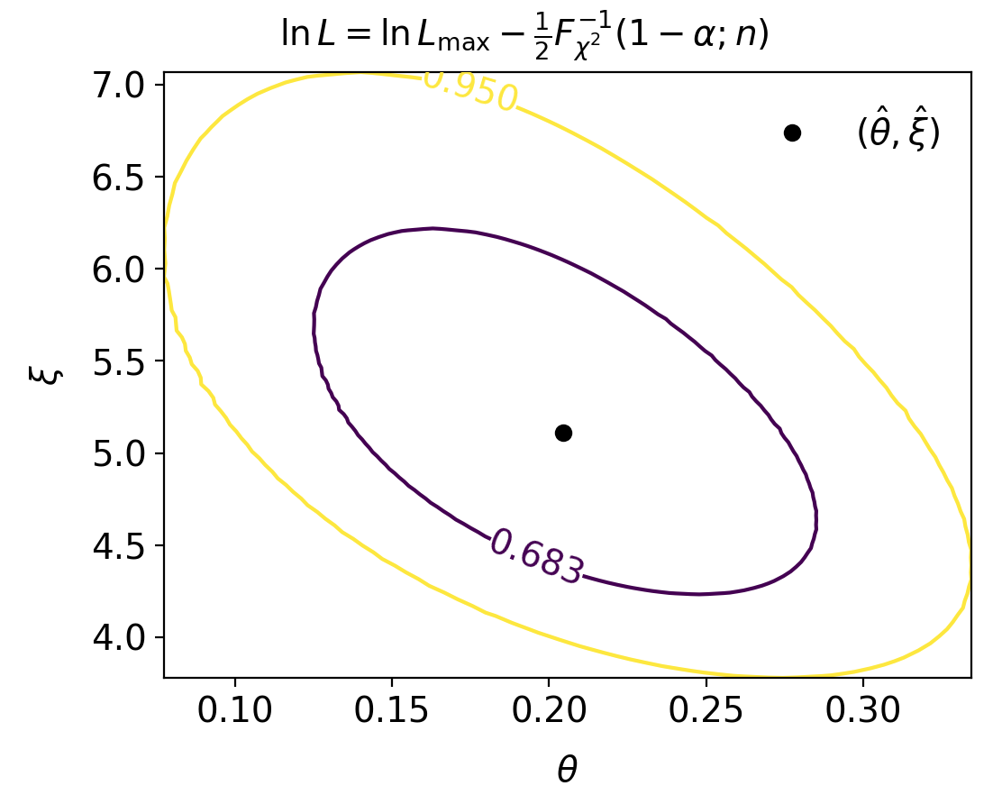
Example: 2 parameter fit:
In iminuit v2, user can set CL = 1 − α

Slide 26
Lecture 3-3
Nuisance parameters
Profile likelihood
Prototype search analysis

Slide 27



Systematic uncertainties and nuisance parameters
P (x|μ)
In general, our model of the data is not perfect:
model:
truth:
x
Can improve model by including
additional adjustable parameters.
Nuisance parameter ↔ systematic uncertainty. Some point in the
parameter space of the enlarged model should be “true”.
Presence of nuisance parameter decreases sensitivity of analysis
to the parameter of interest (e.g., increases variance of estimate).

Slide 28
Profile Likelihood
Suppose we have a likelihood L(μ,θ) = P(x|μ,θ) with N parameters of interest μ = (μ₁,..., μ_{N}) and M nuisance parameters θ = (θ₁,..., θ_{M}). The “profiled” (or “constrained”) values of θ are:
and the profile likelihood is:
The profile likelihood depends only on the parameters of interest; the nuisance parameters are replaced by their profiled values.
The profile likelihood can be used to obtain confidence intervals/regions for the parameters of interest in the same way as one would for all of the parameters from the full likelihood.

Slide 29
Profile Likelihood Ratio – Wilks theorem
Goal is to test/reject regions of μ space (param. of interest).
Rejecting a point μ should mean p_{μ} ≤ α for all possible values of the nuisance parameters θ.
Test μ using the “profile likelihood ratio”:
Let t_{μ} = −2 ln λ(μ). Wilks’ theorem says in large-sample limit:
where the number of degrees of freedom is the number of
parameters of interest (components of μ). So p-value for μ is

Slide 30
Profile Likelihood Ratio – Wilks theorem (2)
If we have a large enough data sample to justify use of the
asymptotic chi-square pdf, then if μ is rejected, it is rejected for any values of the nuisance parameters.
The recipe to get confidence regions/intervals for the parameters of interest at CL = 1 – α is thus the same as before, simply use the profile likelihood:
where the number of degrees of freedom N for the chi-square quantile is equal to the number of parameters of interest.
If the large-sample limit is not justified, then use e.g. Monte Carlo to get distribution of t_{μ}.

Slide 31
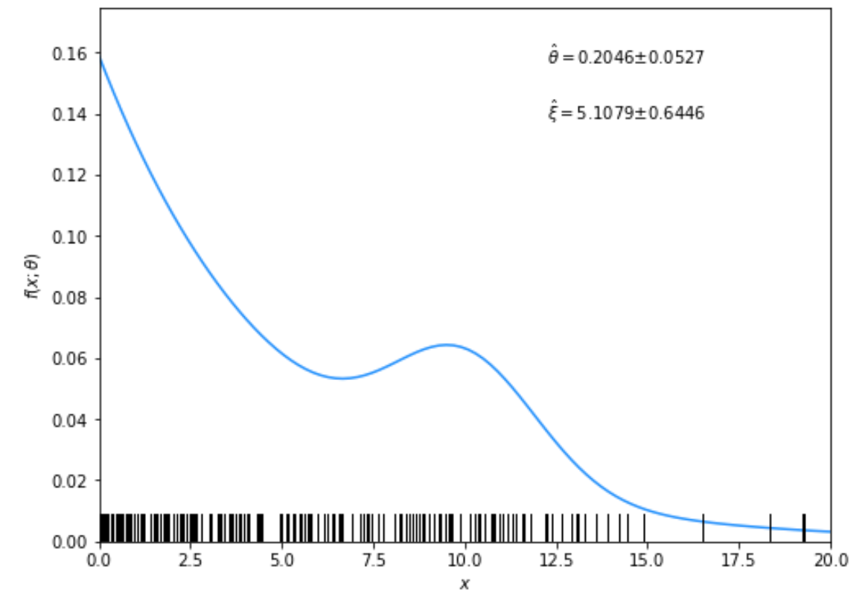
Example of profile likelihood: Solutions to exercises
1a) Running the program mlFit.py produces the following plots:
A fit of the pdf:

Slide 32
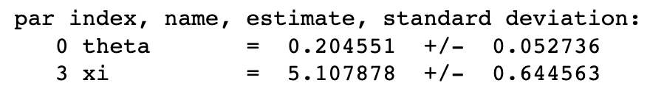
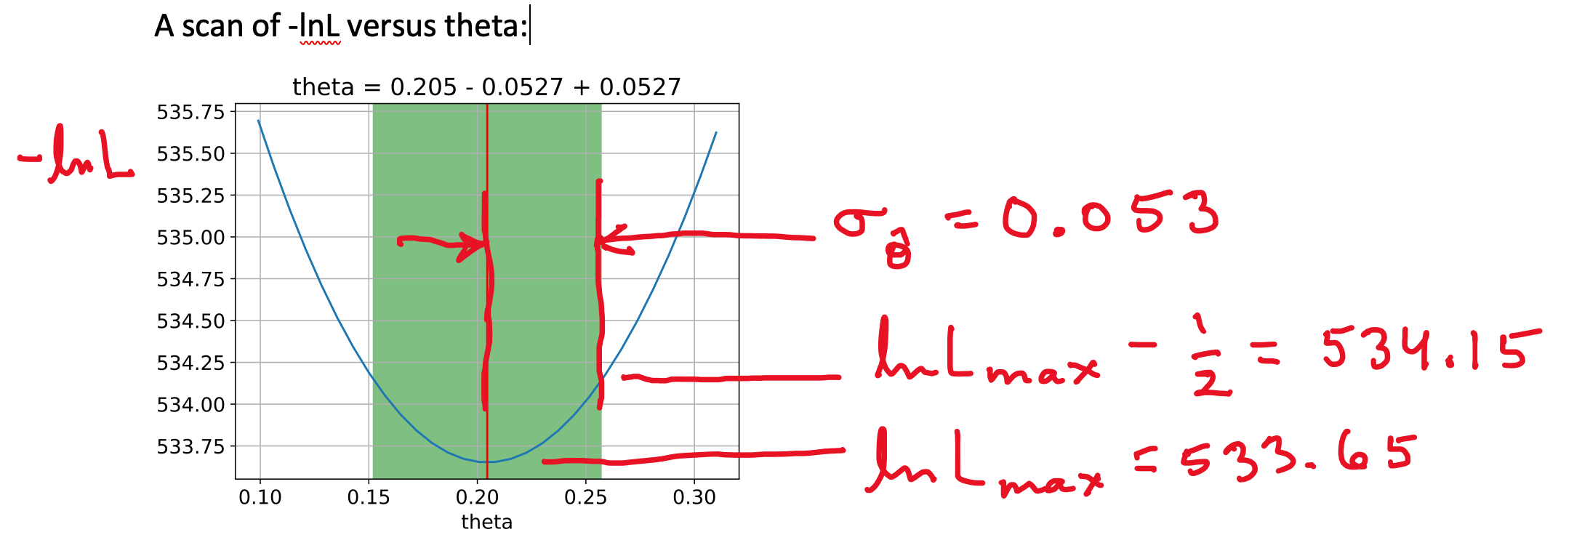
From running program:

Slide 33
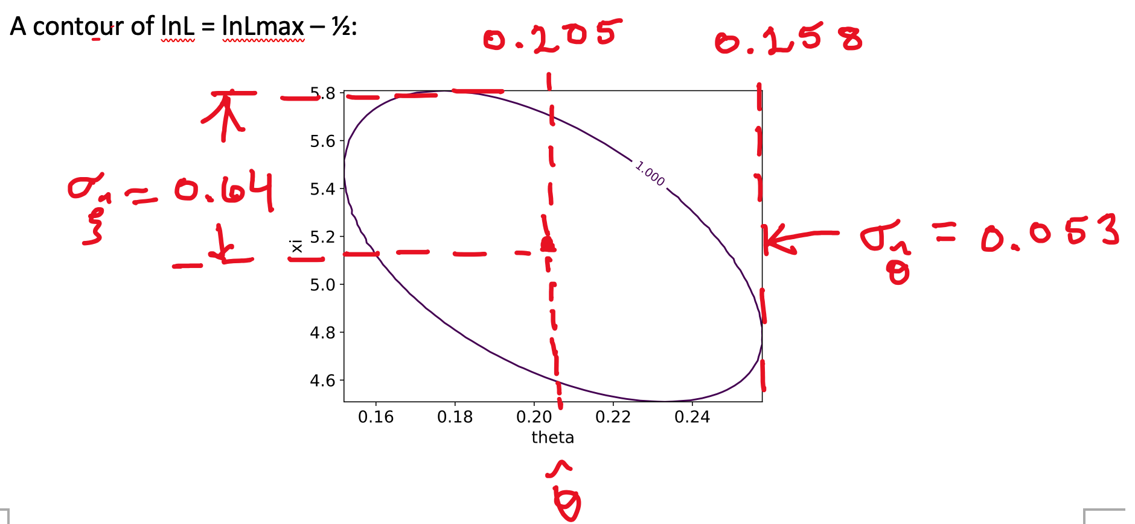

Slide 34




Prototype search analysis
Search for signal in a region of phase space; result is histogram
of some variable x giving numbers:
Assume the n_{i} are Poisson distributed with expectation values
strength parameter
where
signal
background

Slide 35


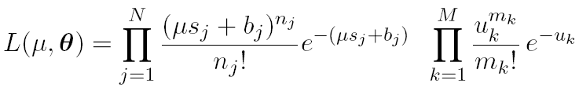
Prototype analysis (II)
Often also have a subsidiary measurement that constrains some
of the background and/or shape parameters:
Assume the m_{i} are Poisson distributed with expectation values
nuisance parameters (θ_{s}, θ_{b},b_{tot})
Likelihood function is

Slide 36
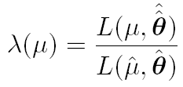
The profile likelihood ratio
Base significance test on the profile likelihood ratio:
maximizes L for
specified μ
maximize L
Define critical region of test of μ by the region of data space
that gives the lowest values of λ(μ).
Important advantage of profile LR is that its distribution becomes independent of nuisance parameters in large sample limit.

Slide 37
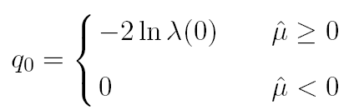
Test statistic for discovery
Suppose relevant alternative to background-only (μ = 0) is μ ≥ 0.
So take critical region for test of μ = 0 corresponding to high q₀
and > 0 (data characteristic for μ ≥ 0).
That is, to test background-only hypothesis define statistic
i.e. here only large (positive) observed signal strength is evidence against the background-only hypothesis.
Note that even though here physically μ ≥ 0, we allow
to be negative. In large sample limit its distribution becomes
Gaussian, and this will allow us to write down simple
expressions for distributions of our test statistics.

Slide 38


Cowan, Cranmer, Gross, Vitells, arXiv:1007.1727, EPJC 71 (2011) 1554
Distribution of q₀ in large-sample limit
Assuming approximations valid in the large sample (asymptotic)
limit, we can write down the full distribution of q₀ as
The special case μ′ = 0 is a “half chi-square” distribution:
In large sample limit, f (q₀|0) independent of nuisance parameters;
f (q₀|μ′) depends on nuisance parameters through σ.

Slide 39
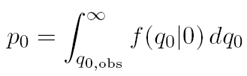
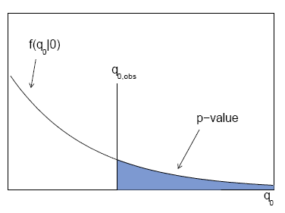

p-value for discovery
Large q₀ means increasing incompatibility between the data
and hypothesis, therefore p-value for an observed q_{0,obs} is
use e.g. asymptotic formula
From p-value get
equivalent significance,

Slide 40
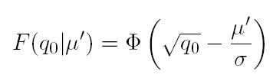



Cowan, Cranmer, Gross, Vitells, arXiv:1007.1727, EPJC 71 (2011) 1554
Cumulative distribution of q₀, significance
From the pdf, the cumulative distribution of q₀ is found to be
The special case μ′ = 0 is
The p-value of the μ = 0 hypothesis is
Therefore the discovery significance Z is simply

Slide 41
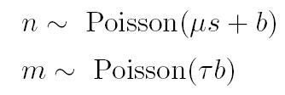
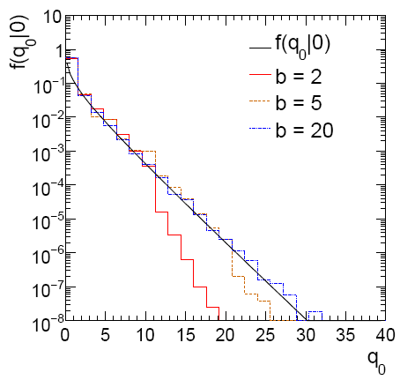
Cowan, Cranmer, Gross, Vitells, arXiv:1007.1727, EPJC 71 (2011) 1554
Monte Carlo test of asymptotic formula
μ = param. of interest
b = nuisance parameter
Here take s known, τ = 1.
Asymptotic formula is
good approximation to 5σ
level (q₀ = 25) already for
b ~ 20.

Slide 42
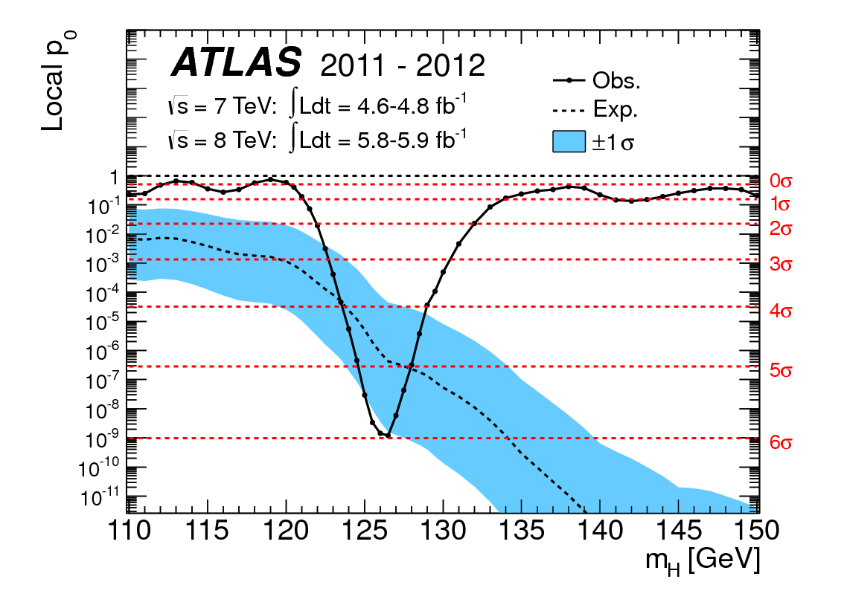
How to read the p₀ plot
The “local” p₀ means the p-value of the background-only
hypothesis obtained from the test of μ = 0 at each individual m_{H}, without any correct for the Look-Elsewhere Effect.
The “Expected” (dashed) curve gives the median p₀ under assumption of the SM Higgs (μ = 1) at each m_{H}.
ATLAS, Phys. Lett. B 716 (2012) 1-29
The blue band gives the
width of the distribution
(±1σ) of significances
under assumption of the
SM Higgs.

Slide 43
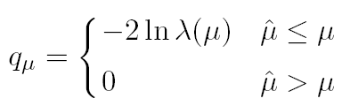



Cowan, Cranmer, Gross, Vitells, arXiv:1007.1727, EPJC 71 (2011) 1554
Test statistic for upper limits
For purposes of setting an upper limit on μ use
where
I.e. when setting an upper limit, an upwards fluctuation of the data
is not taken to mean incompatibility with the hypothesized μ :
From observed q_{μ} find p-value:
Large sample approximation:
To find upper limit at CL = 1−α, set p_{μ} = α and solve for μ.

Slide 44
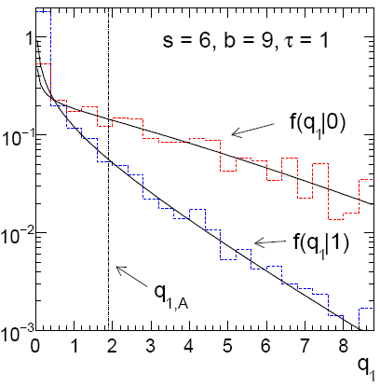
Cowan, Cranmer, Gross, Vitells, arXiv:1007.1727, EPJC 71 (2011) 1554
Monte Carlo test of asymptotic formulae
Consider again n ~ Poisson(μs + b), m ~ Poisson(τb)
Use q_{μ} to find p-value of hypothesized μ values.
E.g. f (q₁|1) for p-value of μ =1.
Typically interested in 95% CL, i.e., p-value threshold = 0.05, i.e.,
q₁ = 2.69 or Z₁ = √q₁ = 1.64.
Median[q₁ |0] gives “exclusion sensitivity”.
Here asymptotic formulae good
for s = 6, b = 9.

Slide 45
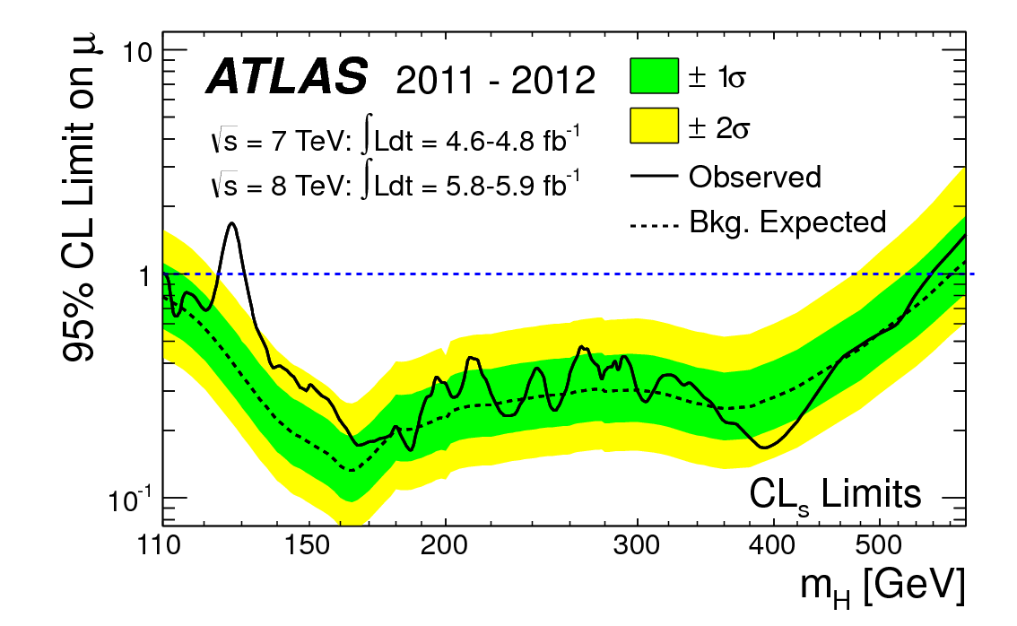
How to read the green and yellow limit plots
For every value of m_{H}, find the upper limit on μ.
Also for each m_{H}, determine the distribution of upper limits μ_{up} one would obtain under the hypothesis of μ = 0.
The dashed curve is the median μ_{up}, and the green (yellow) bands give the ± 1σ (2σ) regions of this distribution.
ATLAS, Phys. Lett. B 716 (2012) 1-29

Slide 46
Extra slides

Slide 47


Goodness of fit from the likelihood ratio
Suppose we model data using a likelihood L(μ) that depends on N
parameters μ = (μ₁,..., μ_{Ν}). Define the statistic
⌃
where μ is the ML estimator for μ. Value of t_{μ} reflects agreement
between hypothesized μ and the data.
Good agreement means μ ≈ μ, so t_{μ} is small;
Larger t_{μ} means less compatibility between data and μ.
⌃
Quantify “goodness of fit” with p-value:
need this pdf

Slide 48
Likelihood ratio (2)
Now suppose the parameters μ = (μ₁,..., μ_{Ν}) can be determined by
another set of parameters θ = (θ₁,..., θ_{M}), with M < N.
E.g., curve fit with μ_{i} = E[y_{i}] = μ (x_{i}; θ), i = 1,...,N, θ = (θ₁,..., θ_{M}).
Want to test hypothesis that the true model is somewhere in the subspace μ = μ(θ) versus the alternative of the full parameter space μ. Generalize the LR test statistic to be
fit M parameters
fit N parameters
To get p-value, need pdf f (t_{μ}|μ(θ)).

Slide 49
Wilks’ Theorem
Wilks’ Theorem: if the hypothesized μ_{i}(θ), i = 1,...,N, are true for some choice of the parameters θ = (θ₁,..., θ_{M}), then in the large sample limit (and provided regularity conditions are satisfied)
MLE of (θ₁,..., θ_{M})
follows a chi-square distribution for N – M degrees of freedom.
MLE of (μ₁,..., μ_{Ν})
The regularity conditions include: the model in the numerator of the likelihood ratio is “nested” within the one in the denominator, i.e., μ(θ) is a special case of μ = (μ₁,..., μ_{Ν}).
Proof boils down to having all estimators ~ Gaussian.

Slide 50
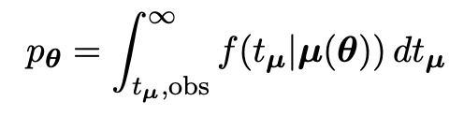

Wilks’ Theorem (2)
To find
e.g. with Monte Carlo we
would need to choose a point in θ space, then
But if we can use Wilks’, the chi-square dist. should hold for all θ.
The chi-square pdf for −2lnλ breaks down:
if the sample size is too small;
if the true value of a parameter is on the boundary of the
allowed parameter space;
if the model in the numerator is not a special case of the
denominator (models must be “nested”);
if variance of estimators of any components of μ too large (e.g., parameter refers to location of a feature not present in the null hypothesis, such as the position of a peak).

Slide 51




Goodness of fit with Gaussian data
Suppose the data are N independent Gaussian distributed values:
want to estimate
known
N measurements and N parameters ( = “saturated model”)
Likelihood:
Log-likelihood:
ML estimators:

Slide 52
Likelihood ratio for Gaussian data
Now suppose μ = μ(θ), e.g., in an LS fit with μ_{i}(θ) = μ(x_{i}; θ).
The goodness-of-fit statistic for the test of the hypothesis
μ(θ) becomes
chi-square pdf for N-M degrees of freedom
Here t_{μ} is the same as χ ²_{min} from an LS fit.
So Wilks’ theorem formally states the property that we claimed
for the minimized chi-squared from an LS fit with N measurements and M fitted parameters.

Slide 53



Likelihood ratio for Poisson data
Suppose the data are a set of values n = (n₁,..., n_{Ν}), e.g., the
numbers of events in a histogram with N bins.
Assume n_{i} ~ Poisson(ν_{i}), i = 1,..., N, all independent.
First (for LR denominator) use saturated model, i.e., treat
ν = (ν₁,..., ν_{Ν}) as all adjustable:
Likelihood:
Log-likelihood:
ML estimators:

Slide 54
Goodness of fit with Poisson data (2)
For LR numerator find ν(θ) with M fitted parameters θ = (θ₁,..., θ_{M}):
if n_{i} = 0, skip log term
Wilks’ theorem: in large-sample limit
Exact in large sample limit; in practice good approximation for
surprisingly small n_{i} (~several).
As before use t_{ν} to get p-value of ν(θ),
independent of θ

Slide 55





Goodness of fit with multinomial data
Similar if data n = (n₁,..., n_{Ν}) follow multinomial distribution:
E.g. histogram with N bins but fix:
Log-likelihood:
ML estimators:
(Only N−1 independent; one
is n_{tot} minus sum of rest.)

Slide 56
Goodness of fit with multinomial data (2)
The likelihood ratio statistics become:
if n_{i} = 0, skip term
Wilks: in large sample limit
One less degree of freedom than in Poisson case because
effectively only N−1 parameters fitted in denominator of LR.

Slide 57


Estimators and g.o.f. all at once
Evaluate numerators with θ (not its estimator); if any n_{i} = 0, omit the corresponding log terms:
(Poisson)
(Multinomial)
These are equal to the corresponding −2 ln L(θ) plus terms not
depending on θ, so minimizing them gives the usual ML
estimators for θ.
The minimized value gives the statistic t_{ν}, so we get
goodness-of-fit for free.

Slide 58
Examples of ML/LS fits
Unbinned maximum likelihood (mlFit.py, minimize negLogL)
No useful measure
of goodness-of-fit
from unbinned ML.

Slide 59
Examples of ML/LS fits
Least Squares fit (histFit.py, minimize chi2LS)
χ ²_{min} = 32.7
n_{dof} = 38
p = 0.71
Many bins with few entries, LS not expected to be reliable.

Slide 60
Examples of ML/LS fits
Multinomial maximum likelihood fit (histFit.py, minimize chi2M)
χ ²_{min} = 35.3
n_{dof} = 37
p = 0.55
Essentially same result
as unbinned ML.

Slide 61
Statistical Data Analysis
Lecture 9-3
Interval estimation
Confidence interval from inverting a test
Example: limits on mean of Gaussian

Slide 62
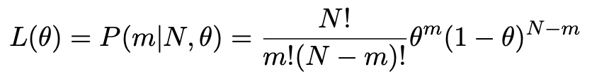

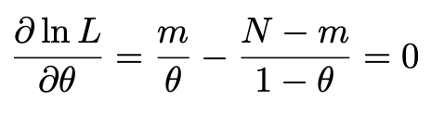
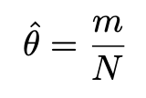


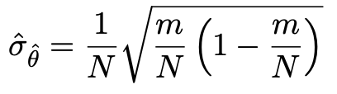
Example of upper limit for binomial parameter
Suppose m ~ Binomial(N,θ) with N trials (known)and success probability per trial θ (unknown). We observe a single value m.
The likelihood function is
so the log-likelihood is
Set its derivative to zero
to find the MLE
.
Since
→
→

Slide 63

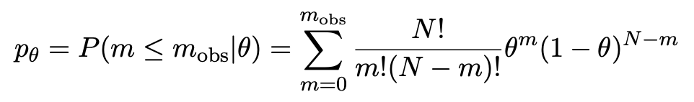

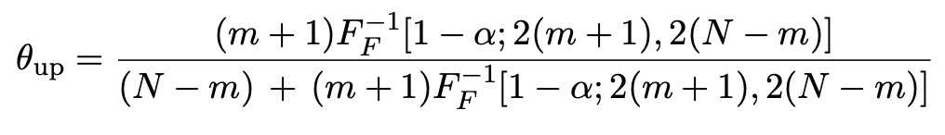
Limits on binomial parameter
To give the MLE and a 68.3% central confidence interval, it is
often sufficient to report .
Suppose we find m_{obs}.
To quantify how big θ could be, find upper limit at CL = 1−α = 95%.
Set
and solve for θ → θ_{up}.
Can be done in closed form; see PDG Eq. (40.83):
usually just
solve with computer
where F is the Fisher-Snedecor distribution .

Slide 64


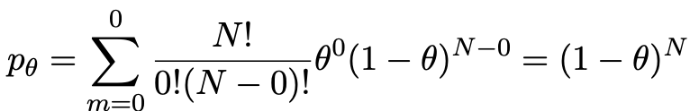


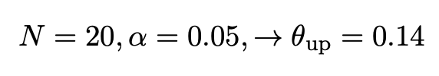
Upper limit for θ for m_{obs} = 0
Suppose we find m_{obs} = 0.
makes sense
not incorrect but does not provide a useful interval
For the p-value (for upper limit) we find
Set
and solving for θ gives the upper limit
For example,
at 95% CL.

Slide 65
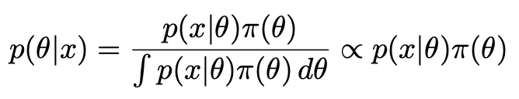
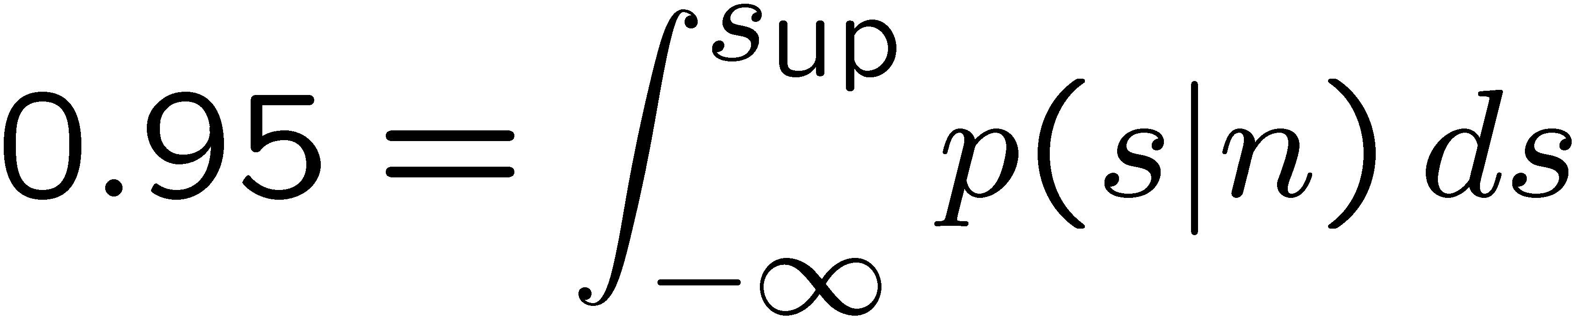
The Bayesian approach to limits
In Bayesian statistics need to start with ‘prior pdf’ π(θ), this
reflects degree of belief about θ before doing the experiment.
Bayes’ theorem tells how our beliefs should be updated in
light of the data x:
Integrate posterior pdf p(θ|x) to give interval with any desired
probability content.
For e.g. n ~ Poisson(s+b), 95% CL upper limit on s from

Slide 66
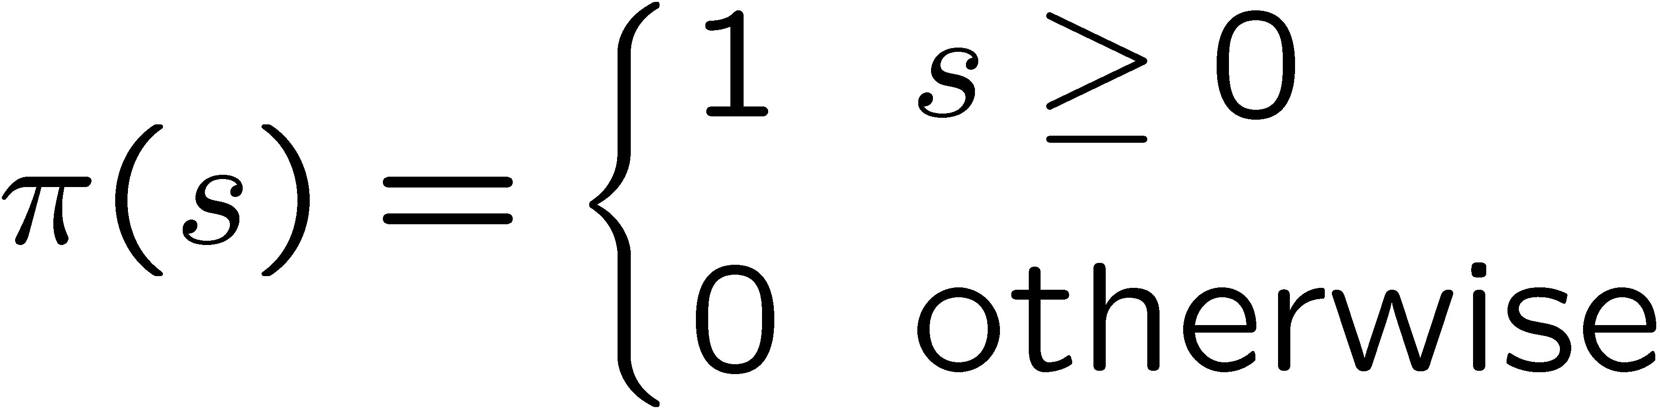
Bayesian prior for Poisson parameter
Include knowledge that s ≥ 0 by setting prior π(s) = 0 for s < 0.
Could try to reflect ‘prior ignorance’ with e.g.
Not normalized; can be OK provided p(n|s) dies off quickly for large s.
Not invariant under change of parameter — if we had used instead a flat prior for a nonlinear function of s, then this would imply a non-flat prior for s.
Doesn’t really reflect a reasonable degree of belief, but often used as a point of reference; or viewed as a recipe for producing an interval whose frequentist properties can be studied (e.g., coverage probability, which will depend on true s).

Slide 67
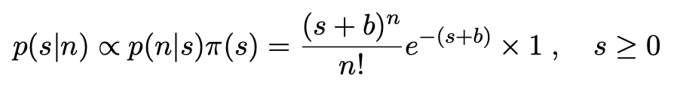


Bayesian upper limit with flat prior for s
Put Poisson likelihood and flat prior into Bayes’ theorem:
Normalize to unit area:
upper incomplete
gamma function
Upper limit s_{up} determined by

Slide 68


Bayesian interval with flat prior for s
Solve to find limit s_{up}:
where
For special case b = 0, Bayesian upper limit with flat prior
numerically same as one-sided frequentist case (‘coincidence’).

Slide 69
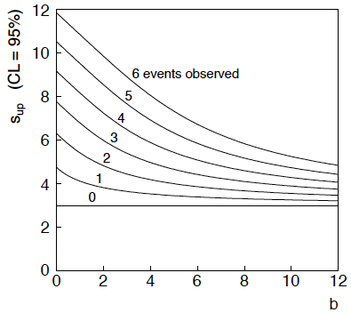
Bayesian interval with flat prior for s
For b > 0 Bayesian limit is everywhere greater than the (one sided) frequentist upper limit.
Never goes negative. Doesn’t depend on b if n = 0.

Slide 70


Sensitivity for Poisson counting experiment
Count a number of events n ~ Poisson(s+b), where
s = expected number of events from signal,
b = expected number of background events.
To test for discovery of signal compute p-value of s = 0 hypothesis,
Usually convert to equivalent significance:
where Φ is the standard Gaussian cumulative distribution, e.g.,
Z > 5 (a 5 sigma effect) means p < 2.9 ×10⁻⁷.
To characterize sensitivity to discovery, give expected (mean
or median) Z under assumption of a given s.

Slide 71



s/√b for expected discovery significance
For large s + b, n → x ~ Gaussian(μ,σ) , μ = s + b, σ = √(s + b).
For observed value x_{obs}, p-value of s = 0 is Prob(x > x_{obs} | s = 0),:
Significance for rejecting s = 0 is therefore
Expected (median) significance assuming signal rate s is

Slide 72



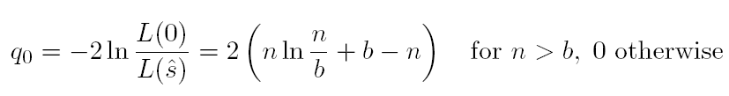
Better approximation for significance
Poisson likelihood for parameter s is
For now
no nuisance
params.
To test for discovery use profile likelihood ratio:
So the likelihood ratio statistic for testing s = 0 is

Slide 73


Approximate Poisson significance (continued)
For sufficiently large s + b, (use Wilks’ theorem),
To find median[Z|s], let n → s + b (i.e., the Asimov data set):
This reduces to s/√b for s << b.

Slide 74
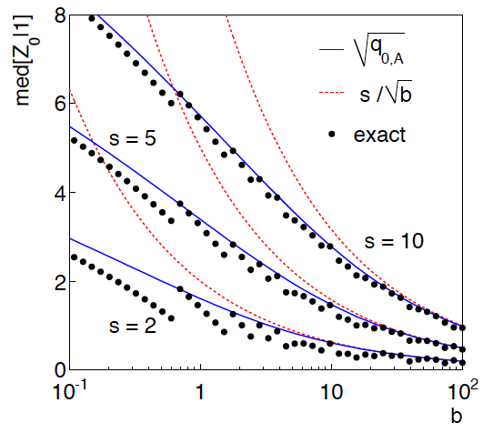
n ~ Poisson(s+b), median significance,
assuming s, of the hypothesis s = 0
CCGV, EPJC 71 (2011) 1554, arXiv:1007.1727
“Exact” values from MC,
jumps due to discrete data.
Asimov √q_{0,A} good approx.
for broad range of s, b.
s/√b only good for s ≪ b.

Slide 75

Extending s/√b to case where b uncertain
The intuitive explanation of s/√b is that it compares the signal,
s, to the standard deviation of n assuming no signal, √b.
Now suppose the value of b is uncertain, characterized by a
standard deviation σ_{b}.
A reasonable guess is to replace √b by the quadratic sum of
√b and σ_{b}, i.e.,
This has been used to optimize some analyses e.g. where
σ_{b} cannot be neglected.

Slide 76


Profile likelihood with b uncertain
This is the well studied “on/off” problem: Cranmer 2005;
Cousins, Linnemann, and Tucker 2008; Li and Ma 1983,...
Measure two Poisson distributed values:
n ~ Poisson(s+b) (primary or “search” measurement)
m ~ Poisson(τb) (control measurement, τ known)
The likelihood function is
Use this to construct profile likelihood ratio (b is nuisance
parameter):

Slide 77
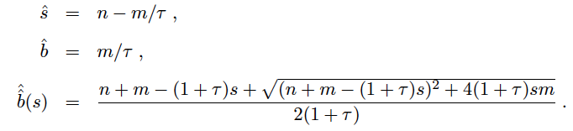

Ingredients for profile likelihood ratio
To construct profile likelihood ratio from this need estimators:
and in particular to test for discovery (s = 0),

Slide 78



Asymptotic significance
Use profile likelihood ratio for q₀, and then from this get discovery
significance using asymptotic approximation (Wilks’ theorem):
Essentially same as in:

Slide 79



Asimov approximation for median significance
To get median discovery significance, replace n, m by their
expectation values assuming background-plus-signal model:
n → s + b
m → τb
ˆ
Or use the variance of b = m/τ,
, to eliminate τ:

Slide 80

Limiting cases
Expanding the Asimov formula in powers of s/b and
σ_{b}²/b (= 1/τ) gives
So the “intuitive” formula can be justified as a limiting case
of the significance from the profile likelihood ratio test evaluated
with the Asimov data set.

Slide 81
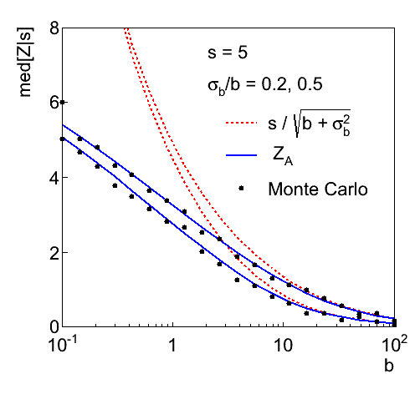
Testing the formulae: s = 5

Slide 82
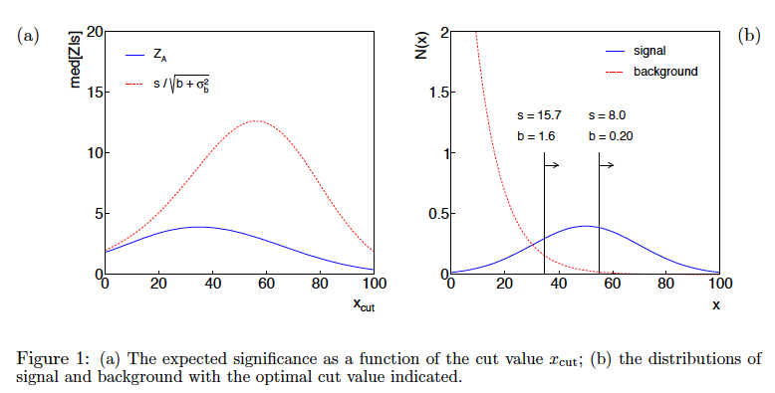
Using sensitivity to optimize a cut

