Slide 1
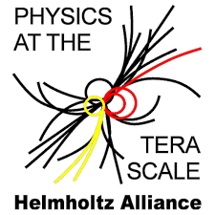


Statistics for Particle Physics
Lecture 4: Bayesian Parameter Estimation
Terascale Statistics School
https://indico.desy.de/event/51468/
DESY, Hamburg
23-27 Feb 2026
Glen Cowan
Physics Department
Royal Holloway, University of London
g.cowan@rhul.ac.uk
www.pp.rhul.ac.uk/~cowan

Slide 2
Outline
Lectures/tutorials from me:
1) Monday 16:00 Hypothesis testing
2) Tuesday 9:00 Frequentist parameter estimation
Tuesday 11:00
3) Tuesday 14:00 Confidence limits
Tuesday 16:00
→ 4) Wednesday 9:00 Bayesian parameter estimation
5) Wednesday 14:00 Errors on errors
More resources in the University of London course:
https://www.pp.rhul.ac.uk/~cowan/stat_course.html

Slide 3
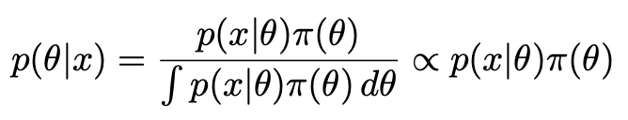
Reminder of Bayesian approach
In Bayesian statistics we can associate a probability with
a hypothesis, e.g., a parameter value θ.
Interpret probability of θ as ‘degree of belief’ (subjective).
Need to start with ‘prior pdf’ π(θ), this reflects degree
of belief about θ before doing the experiment.
Our experiment has data x, → likelihood p(x|θ).
Bayes’ theorem tells how our beliefs should be updated in
light of the data x:
Posterior pdf p(θ|x) contains all our knowledge about θ.

Slide 4
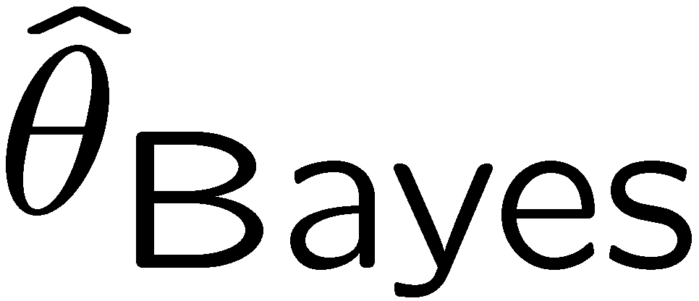
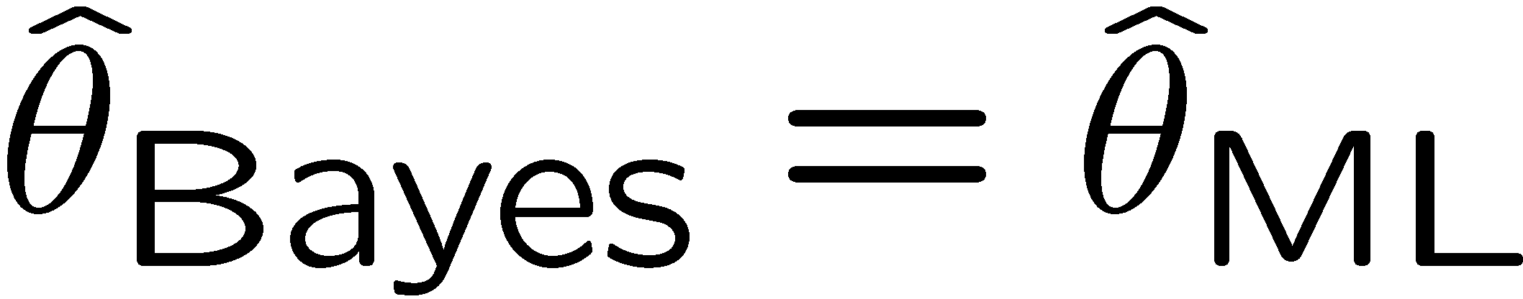

Relationship between ML and Bayesian estimators
Purist Bayesian: p(θ | x) contains all knowledge about θ.
Pragmatist Bayesian: p(θ | x) could be a complicated function,
→ summarize using an estimator
Take mode of p(θ | x), (could also use e.g. expectation value)
What do we use for π(θ)?
No golden rule (subjective!), often represent ‘prior ignorance’ by π(θ) = constant, in which case

Slide 5
ML and Bayesian estimators (2)
Note π_{θ}(θ) = const. cannot be normalized – “improper prior”.
Can be allowed for some problems; prior always appears multiplied
by likelihood, so product L(θ)π_{θ}(θ) can result in normalizable posterior probability.
But... we could have used a different parameter, e.g., λ= 1/θ,
and if prior π_{θ}(θ) is constant, then π_{λ}(λ) is not:
Maybe we know say we nothing about λ, so take π_{λ}(λ) = const.
Then
‘Complete prior ignorance’ is not well defined.

Slide 6
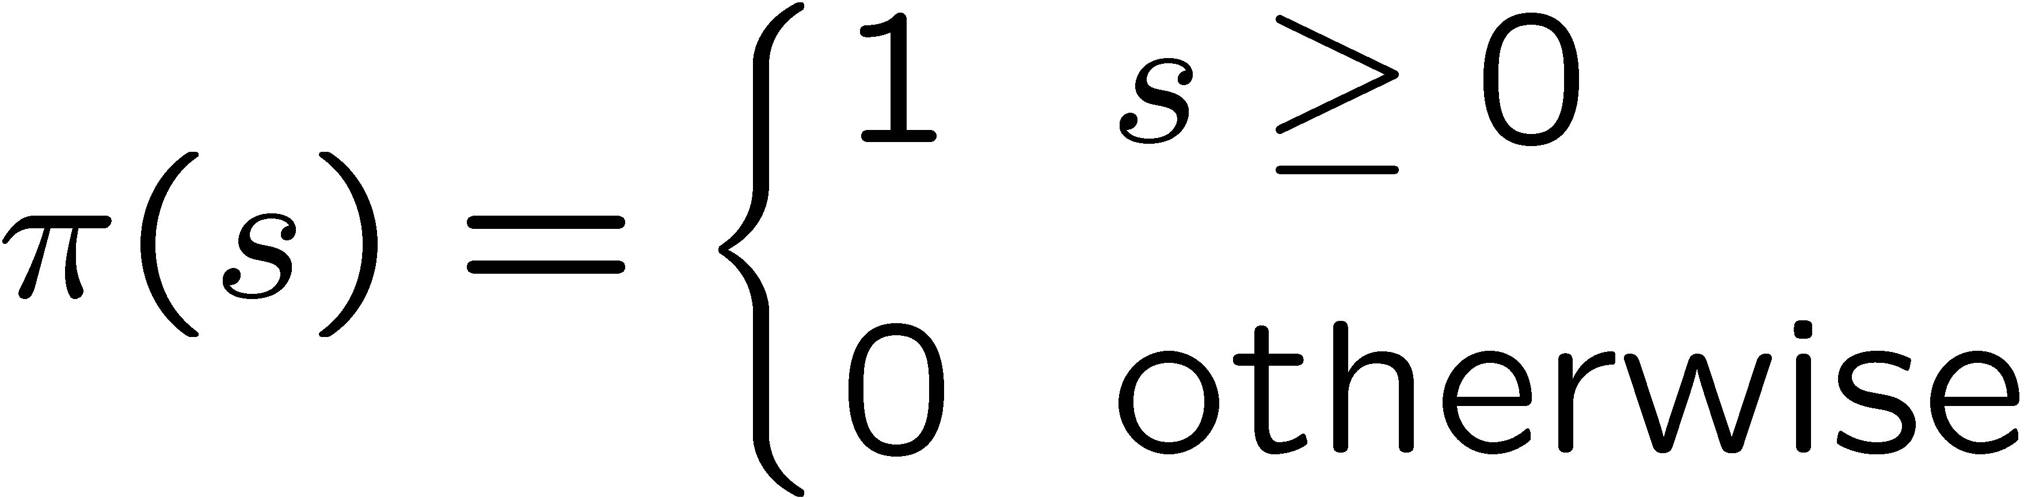
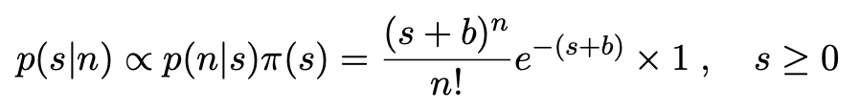


Bayesian upper limit for s with n ~ Poisson(s+b)
E.g., flat prior for s:
Put Poisson likelihood and flat prior into Bayes’ theorem:
Normalize to unit area:
upper incomplete
gamma function
Upper limit s_{up} determined by

Slide 7


Bayesian interval with flat prior for s
Solve to find limit s_{up}:
where
For special case b = 0, Bayesian upper limit with flat prior
numerically same as one-sided frequentist case (‘coincidence’).

Slide 8
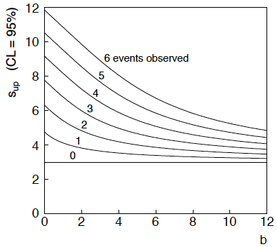
Bayesian interval with flat prior for s
For b > 0 Bayesian limit is everywhere greater than the (one sided) frequentist upper limit.
For b = 0 , Bayesian and frequentist upper limits come out equal.
Never goes negative.
Doesn’t depend on b if n = 0.

Slide 9
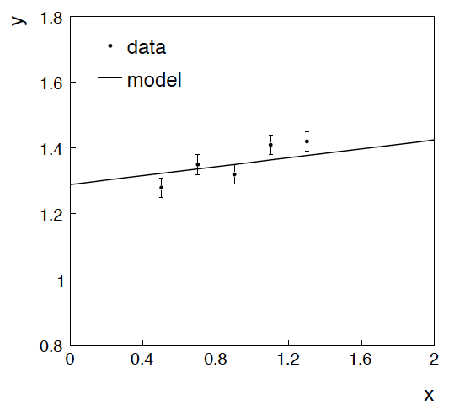
Example: fitting a straight line
Data:
Model: y_{i} independent and all follow y_{i} ~ Gauss(μ(x_{i} ), σ_{i} )
assume x_{i} and σ_{i} known.
Goal: estimate θ₀
Here suppose we don’t care
about θ₁ (example of a
“nuisance parameter”)

Slide 10
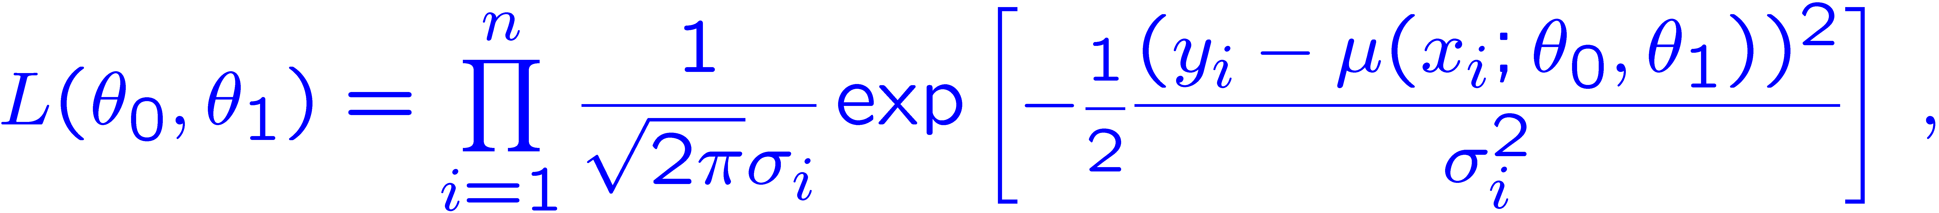
Maximum likelihood fit with Gaussian data
In this example, the y_{i} are assumed independent, so the
likelihood function is a product of Gaussians:
Maximizing the likelihood is here equivalent to minimizing
i.e., for Gaussian data, ML same as Method of Least Squares (LS)

Slide 11
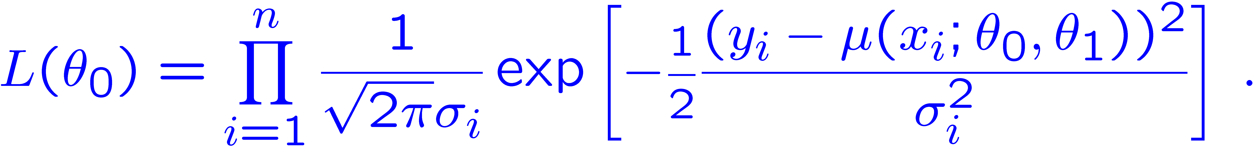
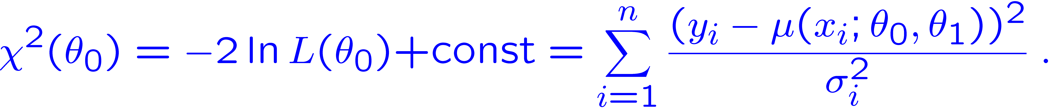
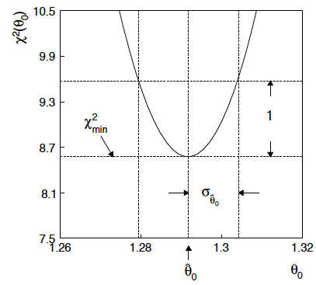
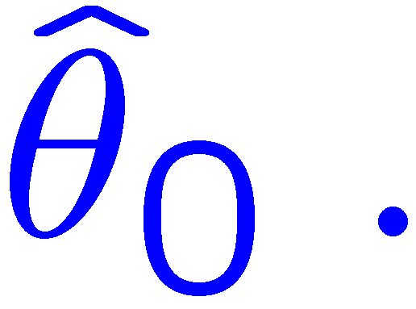
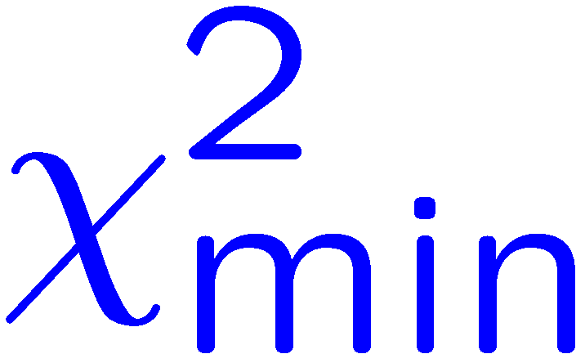
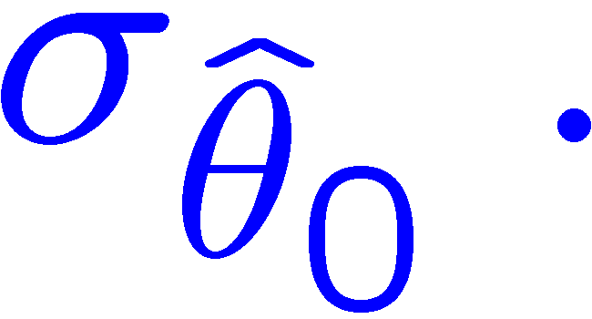
θ₁ known a priori
For Gaussian y_{i}, ML same as LS
Minimize χ² → estimator
Come up one unit from
to find

Slide 12
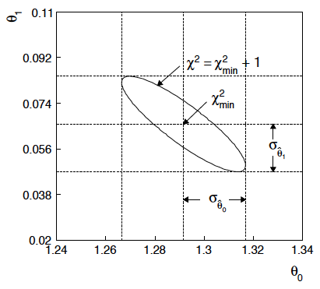
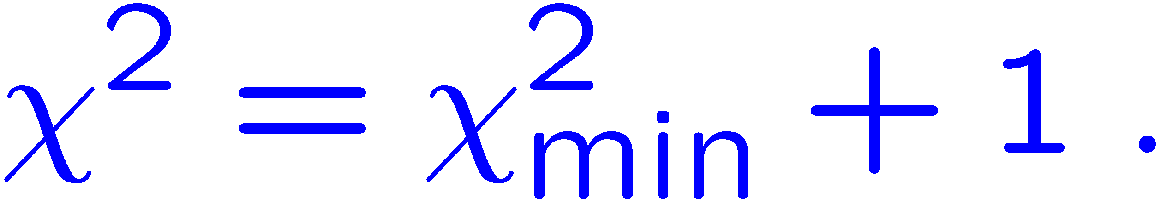
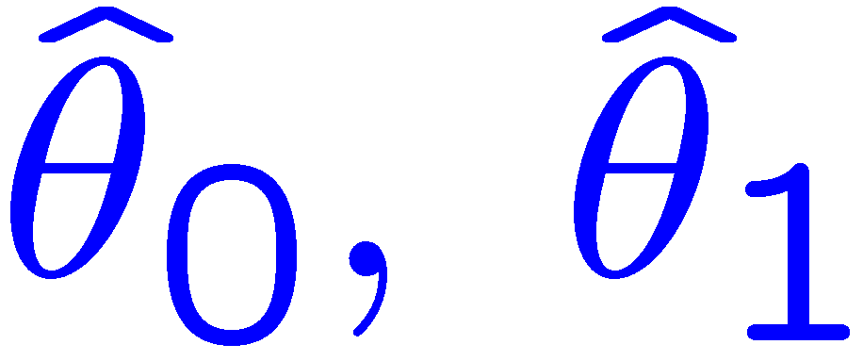
ML (or LS) fit of θ₀ and θ₁
Standard deviations from
tangent lines to contour
Correlation between
causes errors
to increase.

Slide 13


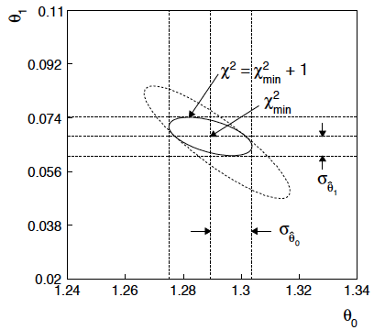
If we have a measurement t₁ ~ Gauss (θ₁, σ_{t1})
The information on θ₁
improves accuracy of

Slide 14
Bayesian approach: y_{i} ~ Gauss(μ(x_{i}; θ₀, θ₁), σ_{i})
We need to associate prior probabilities with θ₀ and θ₁, e.g.,
← suppose knowledge of θ₀ has no influence on knowledge of θ₁
← ‘non-informative’, in any
case much broader than L(θ₀)
prior after t₁,
before y
Ur = “primordial”
prior
Likelihood for control
measurement t₁

Slide 15
Bayesian example: y_{i} ~ Gauss(μ(x_{i}; θ₀, θ₁), σ_{i})
Putting the ingredients into Bayes’ theorem gives:
posterior ∝ likelihood ✕ prior
Note here the likelihood only reflects the measurements y.
The information from the control measurement t₁ has been put into the prior for θ₁.
We would get the same result using the likelihood P(y,t|θ₀,θ₁) and the constant “Ur-prior” for θ₁.
Here posterior only found as a proportionality.

Slide 16
Marginalizing the posterior pdf
We then integrate (marginalize) p(θ₀, θ₁ | y) to find p(θ₀ | y):
In this example we can do the integral (rare). We find
(same as for MLE)
For this example, numbers come out same as in frequentist approach, but interpretation different.

Slide 17
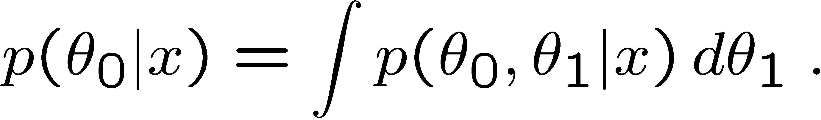
Marginalization with MCMC
Bayesian computations involve integrals like
often high dimensionality and impossible in closed form,
also impossible with ‘normal’ acceptance-rejection Monte Carlo.
Markov Chain Monte Carlo (MCMC) has revolutionized
Bayesian computation.
MCMC (e.g., Metropolis-Hastings algorithm) generates
correlated sequence of random numbers:
cannot use for many applications, e.g., detector MC;
effective stat. error greater than if all values independent .
Basic idea: sample multidimensional θ but look only at distribution of parameters of interest.

Slide 18
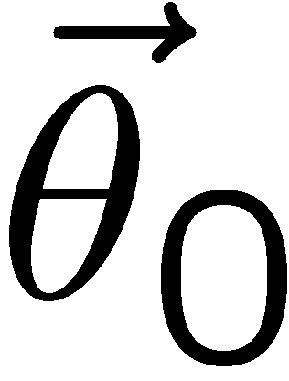
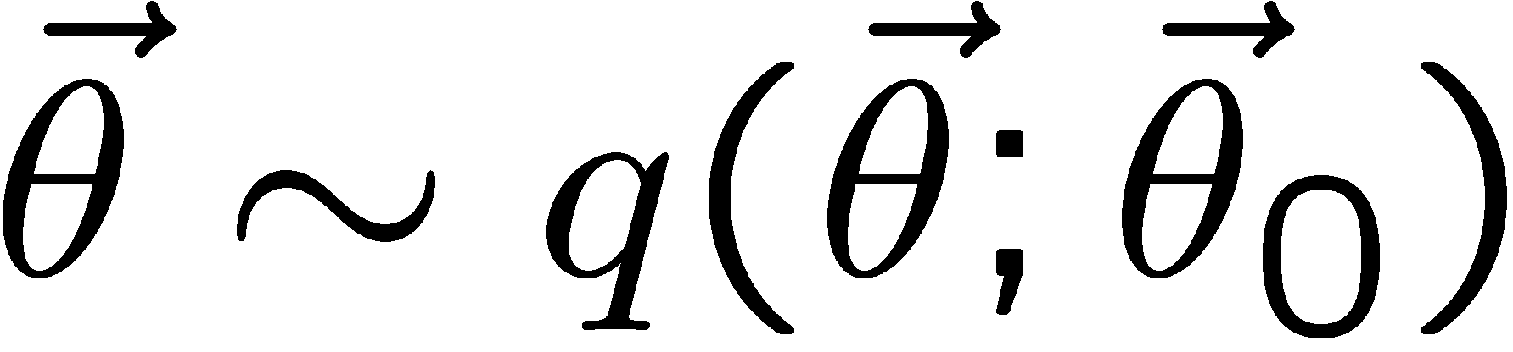
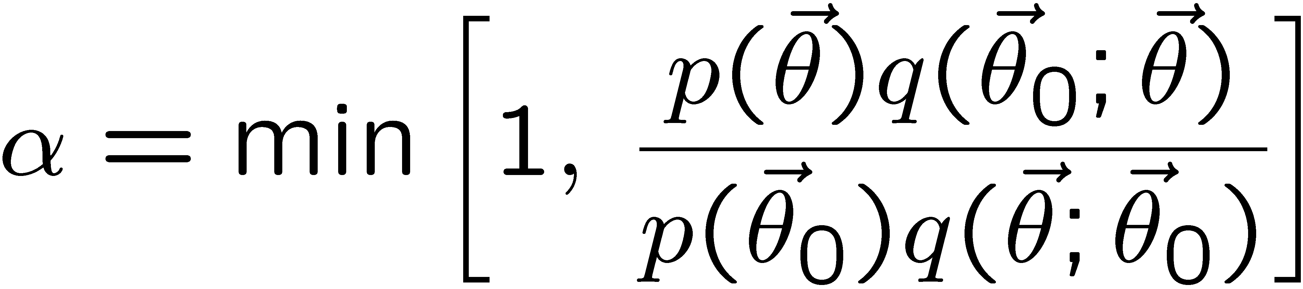
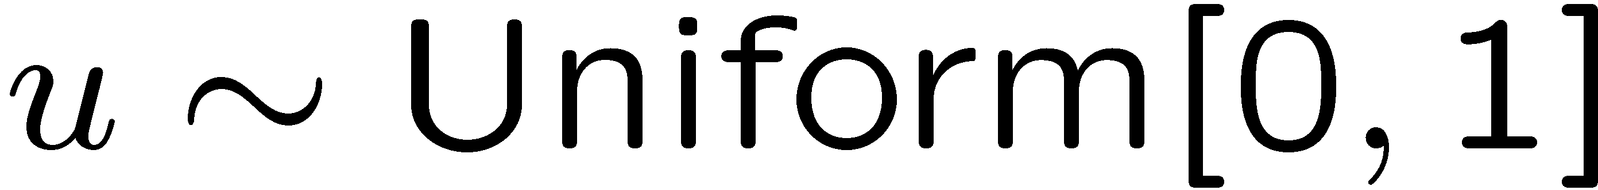
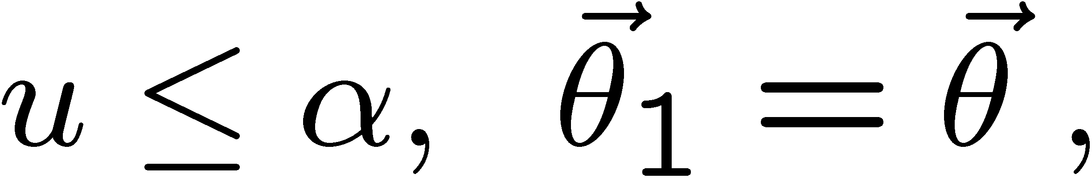
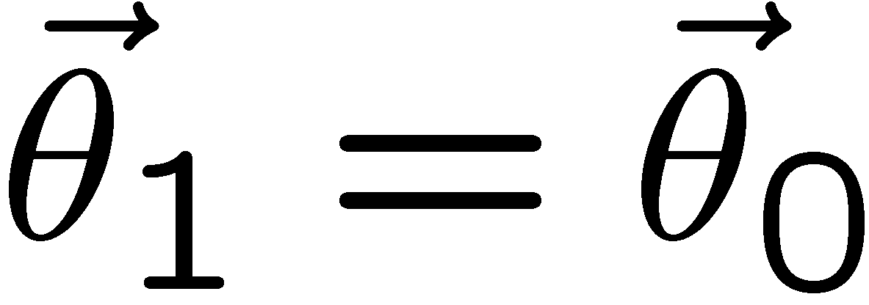
MCMC basics: Metropolis-Hastings algorithm
Goal: given an n-dimensional pdf p(θ) up to a proportionality constant, generate a sequence of points θ₁ , θ₂ , θ₃ ,...
Proposal density q(θ; θ₀ )
e.g. Gaussian centred
about θ₀
1) Start at some point
2) Generate
3) Form test ratio
4) Generate
5) If
move to proposed point
else
old point repeated
6) Iterate

Slide 19
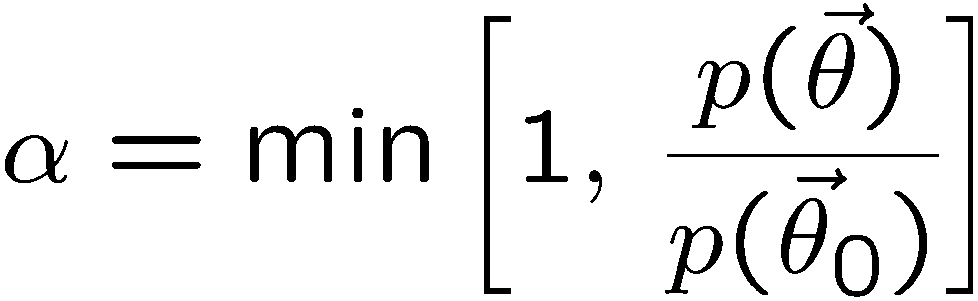
Metropolis-Hastings (continued)
This rule produces a correlated sequence of points (note how
each new point depends on the previous one).
Still works if p(θ) is known only as a proportionality, which is
usually what we have from Bayes’ theorem: p(θ|x) ∝ p(x|θ) π(θ).
The proposal density can be (almost) anything, but choose
so as to minimize autocorrelation. Often take proposal
density symmetric: q(θ; θ₀ ) = q(θ₀; θ )
Test ratio is (Metropolis-Hastings):
I.e. if the proposed step is to a point of higher p(θ), take it;
if not, only take the step with probability p(θ)/p(θ₀).
If proposed step rejected, repeat the current point.

Slide 20

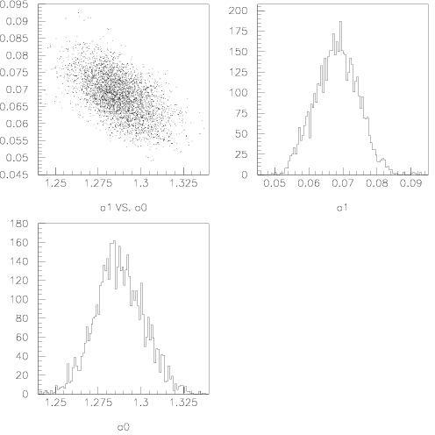
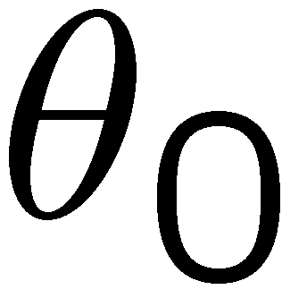
Example: posterior pdf from MCMC
Sample the posterior pdf from previous example with MCMC:
Normalized histogram of θ₀ gives its marginal posterior pdf:

Slide 21
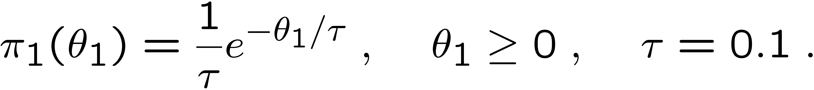
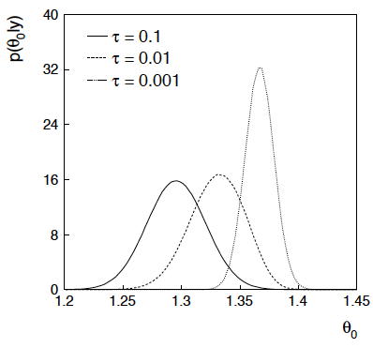
Bayesian method with alternative priors
Suppose we don’t have a previous measurement of θ₁ but rather,
an “expert” says it should be positive and not too much greater than 0.1 or so, i.e., something like
From this we obtain (numerically) the posterior pdf for θ₀:
This summarizes all
knowledge about θ₀.
Look also at result from
variety of priors.

Slide 22
Tutorial: Bayesian parameter estimation
The exercise is described
https://www.pp.rhul.ac.uk/~cowan/stat/exercises/bayesFit/
in the file bayes_fit_exercise.pdf.
The program is in bayesFit.py or bayesFit.ipynb.
This exercise treats the same fitting problem as seen with maximum likelihood, here using the Bayesian approach.
Bayes’ theorem is used to find the posterior pdf for the parameters, and these are summarized using the posterior mode (MAP estimators).
The posterior pdf is marginalized over the nuisance parameters using Markov Chain Monte Carlo.

Slide 23
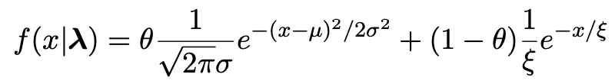
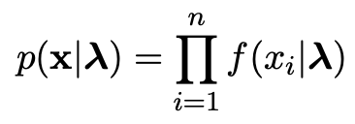

Gaussian signal on exponential background
Same pdf as from mlFit.py (see tutorial 1) with n = 400 independent values of x from
Posterior pdf for parameters λ = (θ, μ, σ, ξ) from Bayes theorem,
where
At first take prior pdf constant for all parameters subject to 0 ≤ θ ≤ 1, σ > 0, ξ > 0 (later try different priors).

Slide 24
Data and MAP estimates
Maximize posterior with minuit (minimize – ln p(λ|x)).
Standard deviations from minuit correspond to approximating posterior as Gaussian near its peak.
Here priors constant so
MAP estimates same as MLE, covariance matrix
V_{ij} = cov[θ_{i}, θ_{j}] also same.

Slide 25
A look at bayesFit.py
Find maximum of posterior with iminuit (minimize – ln p(λ|x)), similar to maximum likelihood:
# Negative log-likelihood
def negLogL(par):
fx = f(xData, par)
return -np.sum(np.log(fx))
# Prior pdf
def prior(par):
theta = par[0]
mu = par[1]
sigma = par[2]
xi = par[3]
pi_theta = 1. if theta >= 0. and theta <= 1. else 0.
pi_mu = 1. if mu >= 0. else 0.
pi_sigma = 1. if sigma > 0. else 0.
pi_xi = 1. if xi > 0. else 0.
piArr = np.array([pi_theta, pi_mu, pi_sigma, pi_xi])
pi = np.product(piArr[np.array(parfix) == False]) # exclude fixed par
return pi
# Negative log of posterior pdf
def negLogPost(par):
return negLogL(par) - np.log(prior(par))
minimize with iminuit

Slide 26
Metropolis-Hastings algorithm in bayesFit.py
# Iterate with Metropolis-Hastings algorithm
chain = [np.array(MAP)] # start point is MAP estimate
numIterate = 10000
numBurn = 100
numAccept = 0
print("Start MCMC iterations: ", end="")
while len(chain) < numIterate:
par = chain[-1]
log_post = -negLogL(par) + np.log(prior(par))
par_prop = np.random.multivariate_normal(par, cov_prop)
if prior(par_prop) <= 0:
chain.append(chain[-1]) # never accept if prob<=0.
else:
log_post_prop = -negLogL(par_prop) + np.log(prior(par_prop))
alpha = np.exp(log_post_prop - log_post)
u = np.random.uniform(0, 1)
if u <= alpha:
chain.append(par_prop)
numAccept += 1
else:
chain.append(chain[-1])
if len(chain)%(numIterate/100) == 0:
print(".", end="", flush=True)
chain = np.array(chain)
Try increasing number of iterations (10k runs in about 20 s).

Slide 27
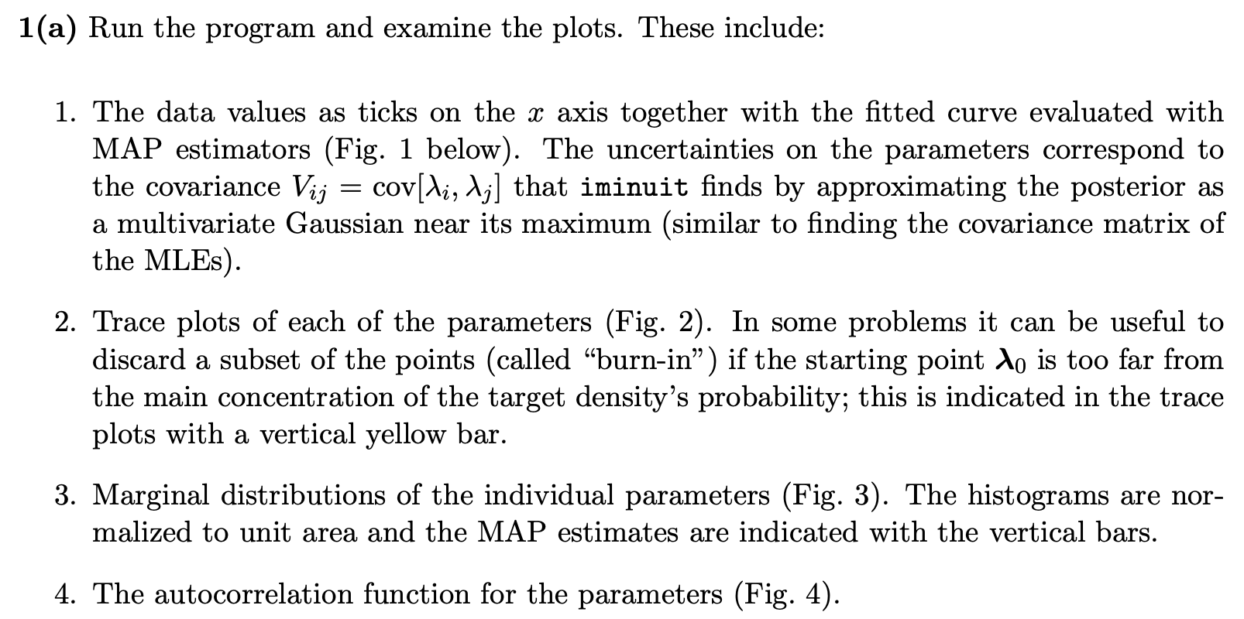
Exercises on Bayesian parameter estimation (a)
1a) Run bayesFit.py, look at the plots

Slide 28
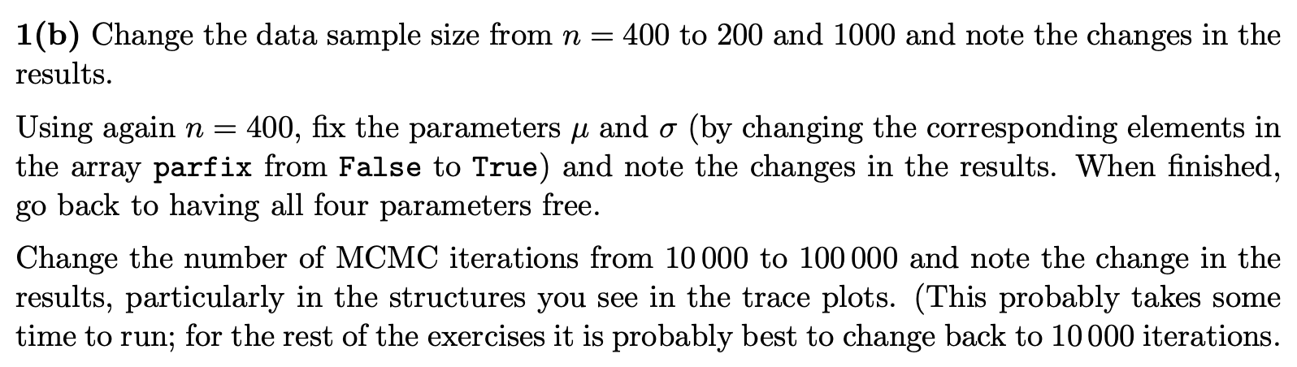
Exercises on Bayesian parameter estimation (b,c)
1b) Investigate effect of data sample size, fixing parameters and length of MCMC chains.
1c) Investigate changing the prior

Slide 29
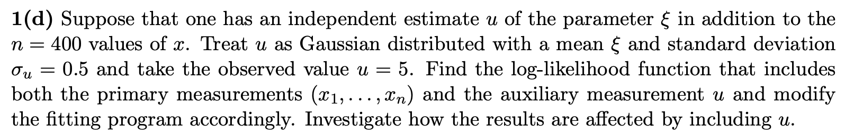
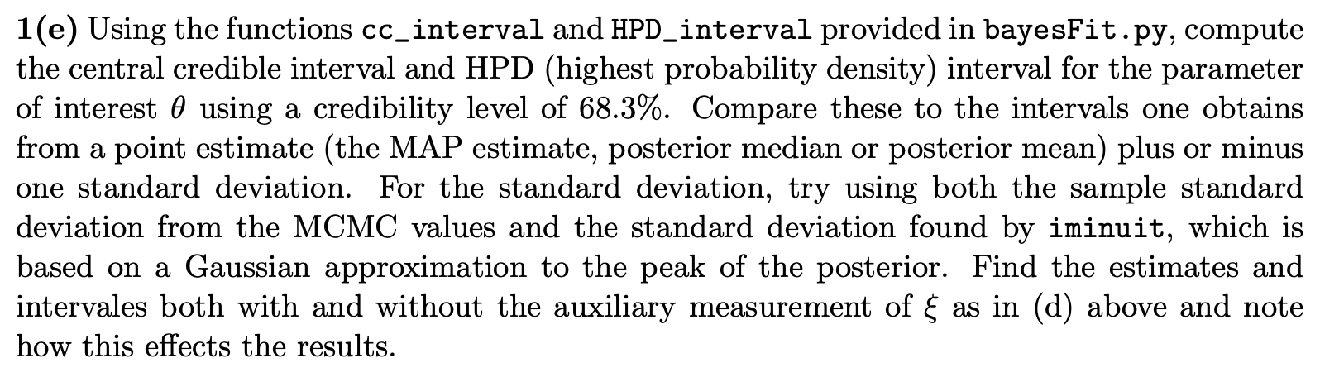
Exercises on Bayesian parameter estimation (d)
1d) Include auxiliary measurement to constrain ξ
1e) Investigate point and interval estimates for θ

Slide 30
MCMC trace plots
Take θ as parameter of interest, rest are nuisance parameters.
Marginalize by sampling posterior pdf with Metropolis-Hastings.
Gaussian proposal pdf, covariance U = sV,
s = (2.38)²/N_{par} = 1.41, gives acceptance
probability ~ 0.24.
Here 10 000 iterations (should use more).

Slide 31

Marginal distributions
MAP estimates shown with vertical bars
Note long tails.
Interpretation: data distribution can be approximated by Gaussian term only, (θ large, μ small) with large width (σ ~ 4-8) and a narrow exponential (ξ ~ 1-3).

Slide 32
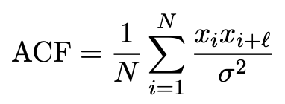
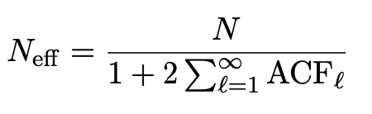
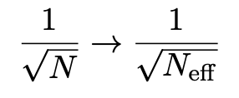
Autocorrelation versus lag
MCMC samples are not independent, autocorrelation function = correlation coefficient of sample x_{i} with x_{i+l} as a function of the lag, l, where x = any of θ, μ, σ, ξ minus its mean:
Effective sample size
In stat. error estimates

Slide 33
Ways to summarize the posterior
Point estimates:
Posterior mode (MAP, coincides with MLE for constant prior).
Posterior median (invariant under monotonic transformation of parameter).
Posterior mean; coincides with above in large-sample limit.
Intervals:
Highest Probability Density (HPD) interval, shortest for a given probability content, not invariant under param. trans.
Central credible intervals, equal upper and lower tail areas, e.g., α/2 for CL = 1 – α.
Point estimate +/- standard deviation, std. dev. from MCMC sample or by approximating core of posterior as Gaussian (from minuit); coincides with above in large-sample limit.

Slide 34
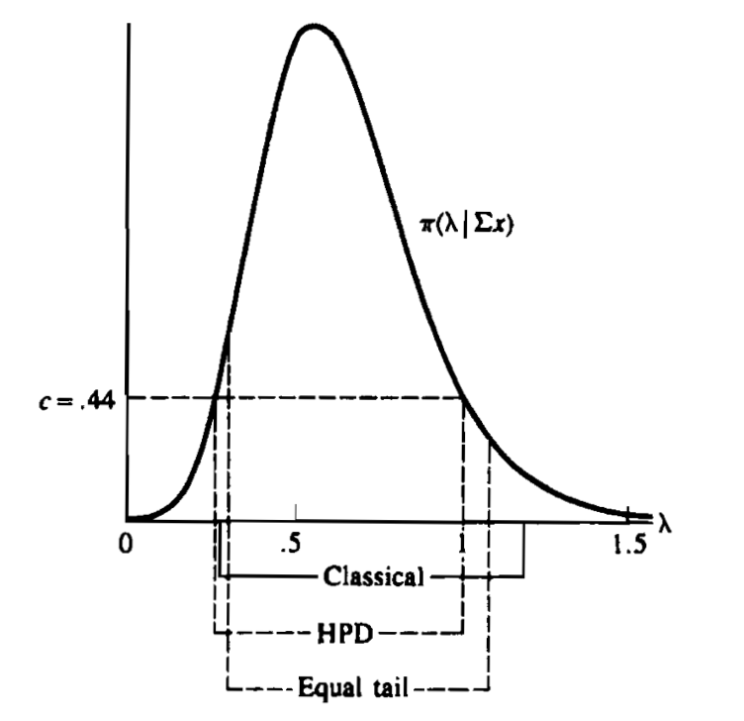
Types of intervals
HPD = Highest Posterior Density
Equal tail (central) from posterior
Classical (frequentist)
G. Casella and R. Berger, Statistical Inference, 2002

Slide 35
Extra Slides

Slide 36
Priors from formal rules
Because of difficulties in encoding a vague degree of belief
in a prior, one often attempts to derive the prior from formal rules,
e.g., to satisfy certain invariance principles or to provide maximum
information gain for a certain set of measurements.
Often called “objective priors”
Form basis of Objective Bayesian Statistics
The priors do not reflect a degree of belief (but might represent
possible extreme cases).
In a Subjective Bayesian analysis, using objective priors can be an
important part of the sensitivity analysis.

Slide 37
Priors from formal rules (cont.)
In Objective Bayesian analysis, can use the intervals in a
frequentist way, i.e., regard Bayes’ theorem as a recipe to produce
an interval with certain coverage properties. For a review see:
Formal priors have not been widely used in HEP, but there is
recent interest in this direction; see e.g.
L. Demortier, S. Jain and H. Prosper, Reference priors for high
energy physics, Phys. Rev. D 82:034002 (2010); arxiv:1002.1111

Slide 38


Jeffreys’ prior
According to Jeffreys’ rule, take prior according to
where
is the Fisher information matrix.
One can show that this leads to inference that is invariant under
a transformation of parameters.
For a Gaussian mean, the Jeffreys’ prior is constant; for a Poisson
mean μ it is proportional to 1/√μ.

Slide 39


“Invariance of inference” with Jeffreys’ prior
Suppose we have a parameter θ, to which we assign a prior π_{θ}(θ).
An experiment gives data x, modeled by L(θ) = P(x|θ).
Bayes’ theorem then tells us the posterior for θ:
Now consider a function η(θ), and we want the posterior P(η|x).
This must follow from the usual rules of transformation of random variables:

Slide 40

“Invariance of inference” with Jeffreys’ prior (2)
Alternatively, we could have just starting with η as the parameter
in our model, and written down a prior pdf π_{η}(η).
Using it, we express the likelihood as L(η) = P(x|η) and write Bayes’
theorem as
If the priors really express our degree of belief, then they must
be related by the usual laws of probability π_{η}(η) = π_{θ}(θ(η)) |dθ/dη|,
and in this way the two approaches lead to the same result.
But if we choose the priors according to “formal rules”, then this is
not guaranteed. For the Jeffrey’s prior, however, it does work!
Using π_{θ}(θ) ∝√I(θ) and transforming to find P(η|x) leads to
the same as using π_{η}(η) ∝√I(η) directly with Bayes’ theorem.

Slide 41
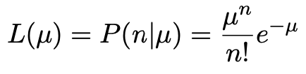

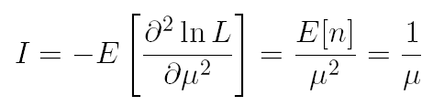

Jeffreys’ prior for Poisson mean
Suppose n ~ Poisson(μ). To find the Jeffreys’ prior for μ,
So e.g. for μ = s + b, this means the prior π(s) ~ 1/√(s + b), which depends on b. But this is not designed as a degree of belief about s.

Slide 42

Posterior pdf for Poisson mean
From Bayes’ theorem,
Flat, π(μ) = const.
mode = n
Jeffreys, π(μ) ~ 1/√μ
In both cases, posterior is special case of gamma distribution.
mode = n – ½

Slide 43
Upper limit for Poisson mean
To find upper limit at CL = 1−α, solve
Jeffreys prior:
= 7.03
n=3,
CL=0.95
Flat prior:
= 7.75
where P⁻¹ is the inverse of the normalized lower incomplete gamma function (see scipy.special)

