Slide 1


Statistics for Rare Event Searches
Lecture 1
Hands-on PhD School on Astroparticle Physics
Gran Sasso, Italy
11 September 2025
https://agenda.infn.it/event/44808/
Glen Cowan
Physics Department
Royal Holloway, University of London
g.cowan@rhul.ac.uk
www.pp.rhul.ac.uk/~cowan

Slide 2
Outline
→ Lecture 1: Introduction
Probability
Hypothesis tests
Parameter estimation
Confidence limits
Lecture 2: Systematic uncertainties
Prototype analysis
Experimental sensitivity
Almost everything is a subset of the University of London course:
http://www.pp.rhul.ac.uk/~cowan/stat_course.html

Slide 3
Theory ↔ Statistics ↔ Experiment
Theory (model, hypothesis):
Experiment (observation):
+ response of measurement
apparatus
= model prediction
data
Uncertainty enters
on many levels
→ quantify with
probability

Slide 4
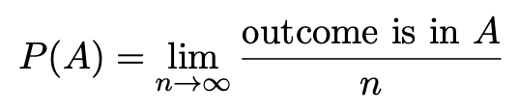

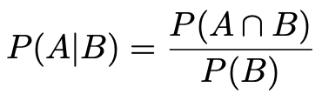

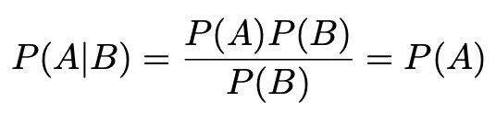
A quick review of probability
Frequentist (A = outcome of
repeatable observation)
Subjective (A = hypothesis)
Conditional probability:
E.g. rolling a die, outcome n = 1,2,...,6:
A and B are independent iff:
I.e. if A, B independent, then

Slide 5

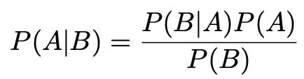
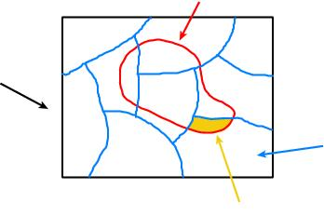
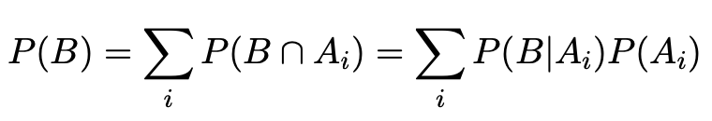
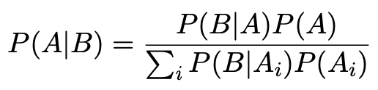
Bayes’ theorem
Use definition of conditional probability and
→
(Bayes’ theorem)
B
If set of all outcomes S = ∪_{i} A_{i}
with A_{i} disjoint, then law of total probability for P(B) says
S
A_{i}
B ∩ A_{i}
so that Bayes’ theorem becomes
Bayes’ theorem holds regardless of how probability is interpreted (frequency, degree of belief...).

Slide 6
Frequentist Statistics − general philosophy
In frequentist statistics, probabilities are associated only with
the data, i.e., outcomes of repeatable observations (shorthand: x).
Probability = limiting frequency
Probabilities such as
P (string theory is true),
P (0.117 < α_{s} < 0.119),
P (Whitmer wins in 2028),
etc. are either 0 or 1, but we don’t know which.
The tools of frequentist statistics tell us what to expect, under
the assumption of certain probabilities, about hypothetical
repeated observations.
Preferred theories (models, hypotheses, ...) are those that predict a high probability for data “like” the data observed.

Slide 7
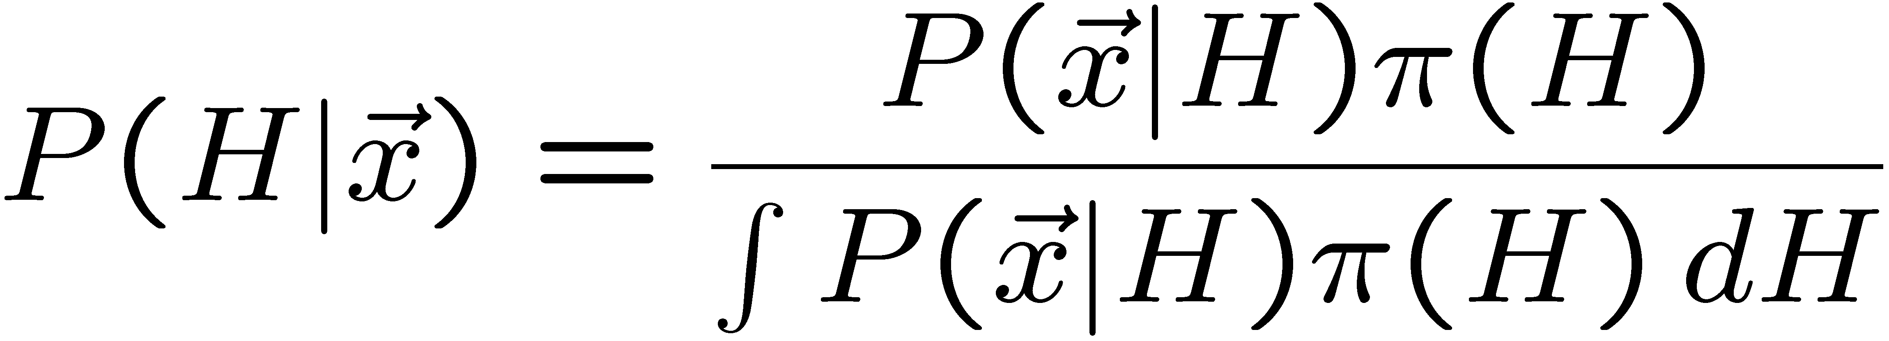
Bayesian Statistics − general philosophy
In Bayesian statistics, use subjective probability for hypotheses:
probability of the data assuming
hypothesis H (the likelihood)
prior probability, i.e.,
before seeing the data
posterior probability, i.e.,
after seeing the data
normalization involves sum
over all possible hypotheses
Bayes’ theorem has an “if-then” character: If your prior
probabilities were π(H), then it says how these probabilities
should change in the light of the data.
No general prescription for priors (subjective!)

Slide 8
Hypothesis, likelihood
Suppose the entire result of an experiment (set of measurements) is a collection of numbers x.
A (simple) hypothesis is a rule that assigns a probability to each possible data outcome:
= the likelihood of H
Often we deal with a family of hypotheses labeled by one or
more undetermined parameters (a composite hypothesis):
= the “likelihood function”
Note:
1) For the likelihood we treat the data x as fixed.
2) The likelihood function L(θ) is not a pdf for θ.

Slide 9
Frequentist hypothesis tests
Suppose a measurement produces data x; consider a hypothesis H₀
we want to test and alternative H₁
H₀, H₁ specify probability for x: P(x|H₀), P(x|H₁)
A test of H₀ is defined by specifying a critical region w of the
data space such that there is no more than some (small) probability
α, assuming H₀ is correct, to observe the data there, i.e.,
P(x ∈ w | H₀) ≤ α
Need inequality if data are
discrete.
α is called the size or
significance level of the test.
If x is observed in the
critical region, reject H₀.
data space Ω
critical region w

Slide 10



Definition of a test (2)
But in general there are an infinite number of possible critical regions that give the same size α.
Use the alternative hypothesis H₁ to motivate where to place the critical region.
Roughly speaking, place the critical region where there is a low
probability (α) to be found if H₀ is true, but high if H₁ is true:

Slide 11


Classification viewed as a statistical test
Suppose events come in two possible types:
s (signal) and b (background)
For each event, test hypothesis that it is background, i.e., H₀ = b.
Carry out test on many events, each is either of type s or b, i.e., here the hypothesis is the “true class label”, which varies randomly from event to event, so we can assign to it a frequentist probability.
Select events for which where H₀ is rejected as “candidate events of type s”. Equivalent Particle Physics terminology:
background efficiency
signal efficiency

Slide 12
Example of a test for classification
Suppose we can measure for
each event a quantity x, where
with 0 ≤ x ≤ 1.
For each event in a mixture of signal (s) and background (b) test
H₀ : event is of type b
using a critical region W of the form: W = { x : x ≤ x_{c} }, where
x_{c} is a constant that we choose to give a test with the desired size α.

Slide 13
Classification example (2)
Suppose we want α = 10⁻⁴. Require:
and therefore
For this test (i.e. this critical region W), the power with respect to the signal hypothesis (s) is
Note: the optimal size and power is a separate question that will depend on goals of the subsequent analysis.

Slide 14
Classification example (3)
Suppose that the prior probabilities for an event to be of type s or b are:
π_{s} = 0.001
π_{b} = 0.999
The “purity” of the selected signal sample (events where b hypothesis rejected) is found using Bayes’ theorem:

Slide 15
Testing significance / goodness-of-fit
Suppose hypothesis H predicts pdf f (x|H) for a set of
observations x = (x₁,...x_{n}).
We observe a single point in this space: x_{obs}.
How can we quantify the level of compatibility between the data and the predictions of H?
x_{j}
x_{obs}
Decide what part of
the data space represents equal or less compatibility with H than does the point x_{obs}. (Not unique!)
ω> = { x : x “more
compatible” with H }
ω≤ = { x : x “less
or eq. compatible”
with H }
x_{i}

Slide 16
p-values
Express level of compatibility between data and hypothesis (sometimes ‘goodness-of-fit’) by giving the p-value for H:
= probability, under assumption of H, to observe data with equal or lesser compatibility with H relative to the data we got.
= probability, under assumption of H, to observe data as discrepant with H as the data we got or more so.
Basic idea: if there is only a very small probability to find data
with even worse (or equal) compatibility, then H is “disfavoured by the data”.
If the p-value is below a user-defined threshold α (e.g. 0.05) then H is rejected (equivalent to hypothesis test of size α as seen earlier).

Slide 17

p-value of H is not P(H)
The p-value of H is not the probability that H is true!
In frequentist statistics we don’t talk about P(H) (unless H
represents a repeatable observation).
If we do define P(H), e.g., in Bayesian statistics as a degree of belief, then we need to use Bayes’ theorem to obtain
where π(H) is the prior probability for H.
For now stick with the frequentist approach;
result is p-value, regrettably easy to misinterpret as P(H).

Slide 18

The Poisson counting experiment
Suppose we do a counting experiment and observe n events.
Events could be from signal process or from background –
we only count the total number.
Poisson model:
s = mean (i.e., expected) # of signal events
b = mean # of background events
Goal is to make inference about s, e.g.,
test s = 0 (rejecting H₀ ≈ “discovery of signal process”)
test all non-zero s (values not rejected = confidence interval)
In both cases need to ask what is relevant alternative hypothesis.

Slide 19
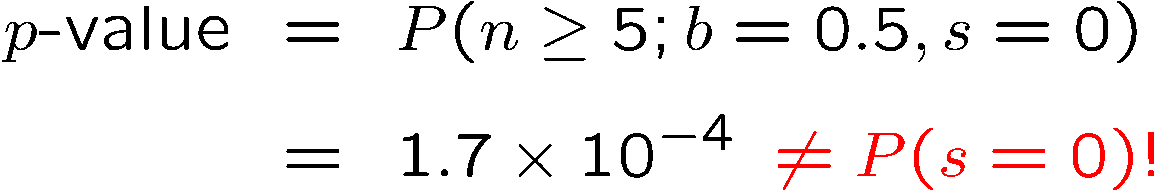
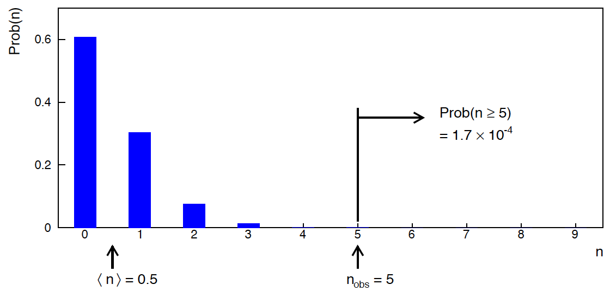
Poisson counting experiment: discovery p-value
Suppose b = 0.5 (known), and we observe n_{obs} = 5.
Should we claim evidence for a new discovery?
Give p-value for hypothesis s = 0, suppose relevant alt. is s > 0.

Slide 20
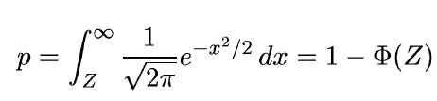
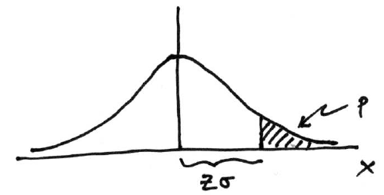

Significance from p-value
Often define significance Z as the number of standard deviations
that a Gaussian variable would fluctuate in one direction
to give the same p-value.
in ROOT:
p = 1 - TMath::Freq(Z)
Z = TMath::NormQuantile(1-p)
in python (scipy.stats):
p = 1 - norm.cdf(Z) = norm.sf(Z)
Z = norm.ppf(1-p)
Result Z is a “number of sigmas”. Note this does not mean that
the original data was Gaussian distributed.

Slide 21

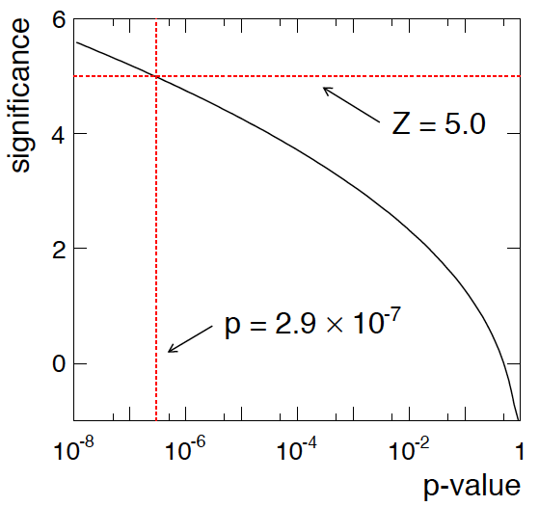
Poisson counting experiment: discovery significance
Equivalent significance for p = 1.7 × 10⁻⁴:
Often claim discovery if Z > 5 (p < 2.9 × 10⁻⁷, i.e., a “5-sigma effect”)
In fact this tradition should be revisited: p-value intended to quantify probability of a signal-like fluctuation assuming background only; not intended to cover, e.g., hidden systematics, plausibility signal model, compatibility of data with signal, “look-elsewhere effect”
(~multiple testing), etc.

Slide 22
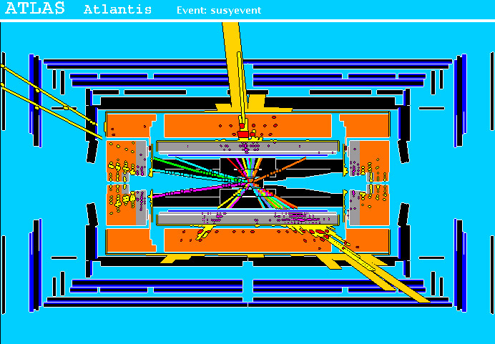
Particle Physics context for a hypothesis test
A simulated SUSY event (“signal”):
high p_{T}
muons
high p_{T} jets
of hadrons
p
p
missing transverse energy

Slide 23
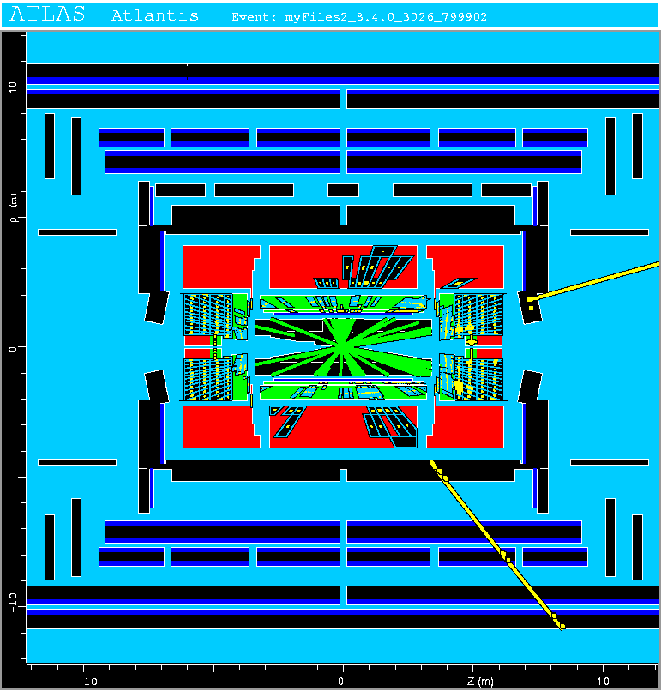
Background events
This event from Standard
Model ttbar production also
has high p_{T} jets and muons,
and some missing transverse
energy.
→ can easily mimic a
signal event.

Slide 24
Classification of measured events
Measured events can be considered to come in two classes:
signal (the kind of event we’re looking for, y = 1)
background (the kind that mimics signal, y = 0)
For each event we measure a collection of features:
x₁ = energy of muon x₄ = missing transverse energy
x₂ = angle between jets x₅ = invariant mass of muon pair
x₃ = total jet energy x₆ = ...
The real events don’t come with true class labels, but computer-simulated events do. So we can have a set of simulated events that consist of a feature vector x and true class label y (0 for background, 1 for signal):
(x, y)₁, (x, y)₂, ..., (x, y)_{N}
The simulated events are called “training data”.

Slide 25
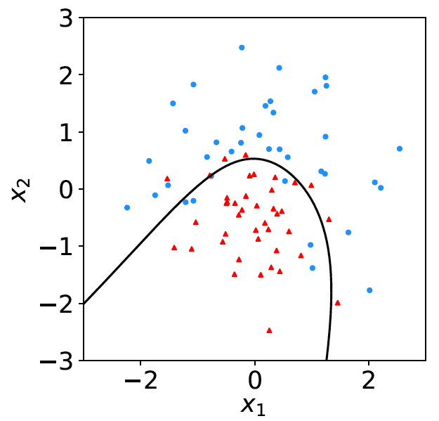
Distributions of the features
If we consider only two
features x = (x₁, x₂), we can
display the results in a scatter
plot (red: y = 0, blue: y = 1).
For real events, the dots are black (true type is not known).
For each real event test the hypothesis that it is background.
(Related to this: test that a sample of events is all background.)
The test’s critical region is defined by a “decision boundary” – without knowing the event type, we can classify them by seeing where their measured features lie relative to the boundary.

Slide 26
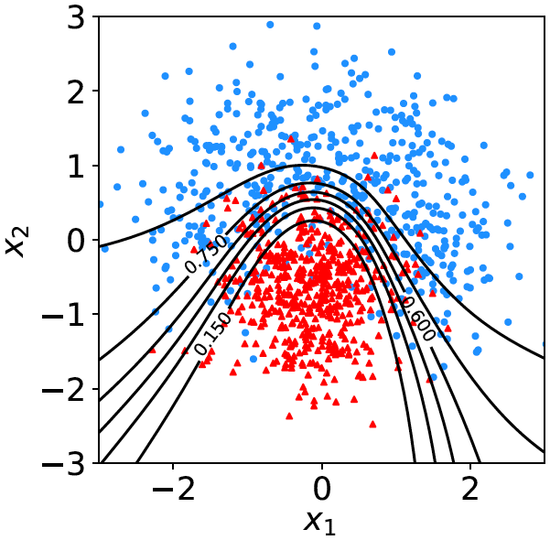

Decision function, test statistic
A surface in an n-dimensional
space can be described by
scalar
function
constant
Different values of the constant
t_{c} result in a family of surfaces.
Problem is reduced to finding
the best decision function or test statistic t (x).

Slide 27
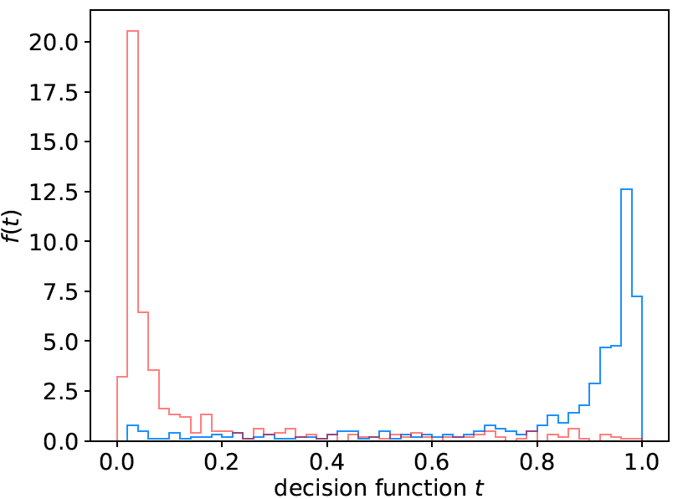
Distribution of t(x)
By forming a test statistic t(x), the boundary of the critical region in the n-dimensional x-space is determined by a single single value t_{c}.
f (t|H₀)
f (t|H₁)
t_{c}
W

Slide 28
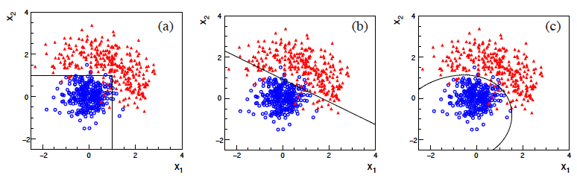
Types of decision boundaries
So what is the optimal boundary for the critical region, i.e., what
is the optimal test statistic t(x)?
First find best t(x), later address issue of optimal size of test.
Remember x-space can have many dimensions.
“cuts”
linear
non-linear

Slide 29
Test statistic based on likelihood ratio
How can we choose a test’s critical region in an ‘optimal way’, in particular if the data space is multidimensional?
Neyman-Pearson lemma states:
For a test of H₀ of size α, to get the highest power with respect to the
alternative H₁ we need for all x in the critical region W
”likelihood
ratio (LR)”
inside W and ≤ c_{α} outside, where c_{α} is a constant chosen to give a test of the desired size.
Equivalently, optimal scalar test statistic is
N.B. any monotonic function of this is leads to the same test.

Slide 30

Neyman-Pearson doesn’t usually help
We usually don’t have explicit formulae for the pdfs f (x|s), f (x|b), so for a given x we can’t evaluate the likelihood ratio
Instead we may have Monte Carlo models for signal and background processes, so we can produce simulated data:
generate x ~ f (x|s) → x₁,..., x_{N}
generate x ~ f (x|b) → x₁,..., x_{N}
This gives samples of “training data” with events of known type.
Use these to construct a statistic that is as close as possible to the optimal likelihood ratio (→ Machine Learning).

Slide 31
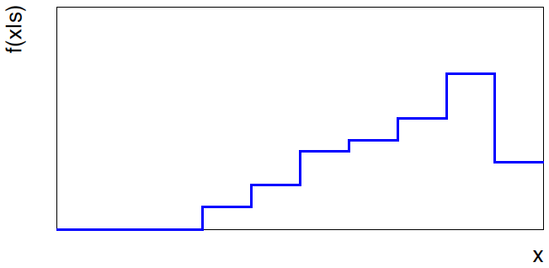
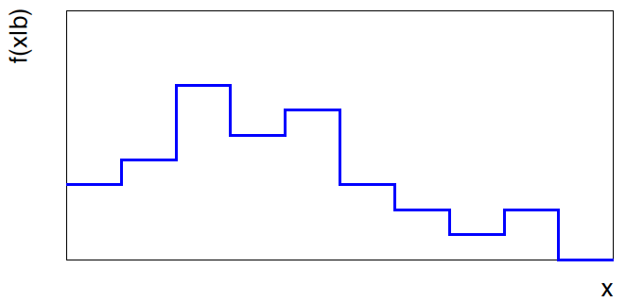


Approximate LR from histograms
Want t(x) = f (x|s)/ f(x|b) for x here
One possibility is to generate
MC data and construct
histograms for both
signal and background.
Use (normalized) histogram
values to approximate LR:
N(x|s)
N (x|s) ≈ f (x|s)
x
N(x|b)
N (x|b) ≈ f (x|b)
Can work well for single
variable.
x

Slide 32
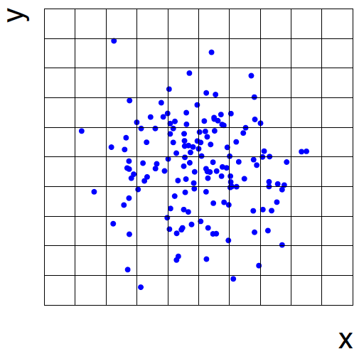
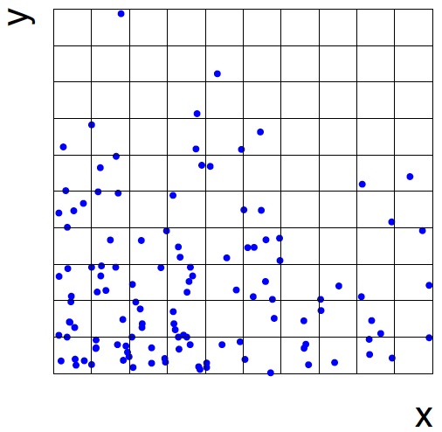
Approximate LR from 2D-histograms
Suppose problem has 2 variables. Try using 2-D histograms:
signal
back-
ground
Approximate pdfs using N (x,y|s), N (x,y|b) in corresponding cells.
But if we want M bins for each variable, then in n-dimensions we
have M^{n} cells; can’t generate enough training data to populate.
→ Histogram method usually not usable for n > 1 dimension.

Slide 33
Strategies for multivariate analysis
Neyman-Pearson lemma gives optimal answer, but cannot be
used directly, because we usually don’t have f (x|s), f (x|b).
Histogram method with M bins for n variables requires that
we estimate M^{n} parameters (the values of the pdfs in each cell),
so this is rarely practical.
A compromise solution is to assume a certain functional form
for the test statistic t (x) with fewer parameters; determine them
(using MC) to give best separation between signal and background.
Alternatively, try to estimate the probability densities f (x|s) and
f (x|b) (with something better than histograms) and use the
estimated pdfs to construct an approximate likelihood ratio.

Slide 34
Multivariate methods (Machine Learning)
Many new (and some old) methods:
Fisher discriminant
(Deep) Neural Networks
Kernel density methods
Support Vector Machines
Decision trees
Boosting, Boosting
ML → AI, beyond the scope of these lectures but useful to keep in mind the connection to statistics. Recommend (free online):
C.M. Bishop and H. Bishop, Deep Learning, https://www.bishopbook.com/
James, Witten, Hastie, Tibshirani & Taylor, An Introduction to Statistical Learning, https://www.statlearning.com/

Slide 35
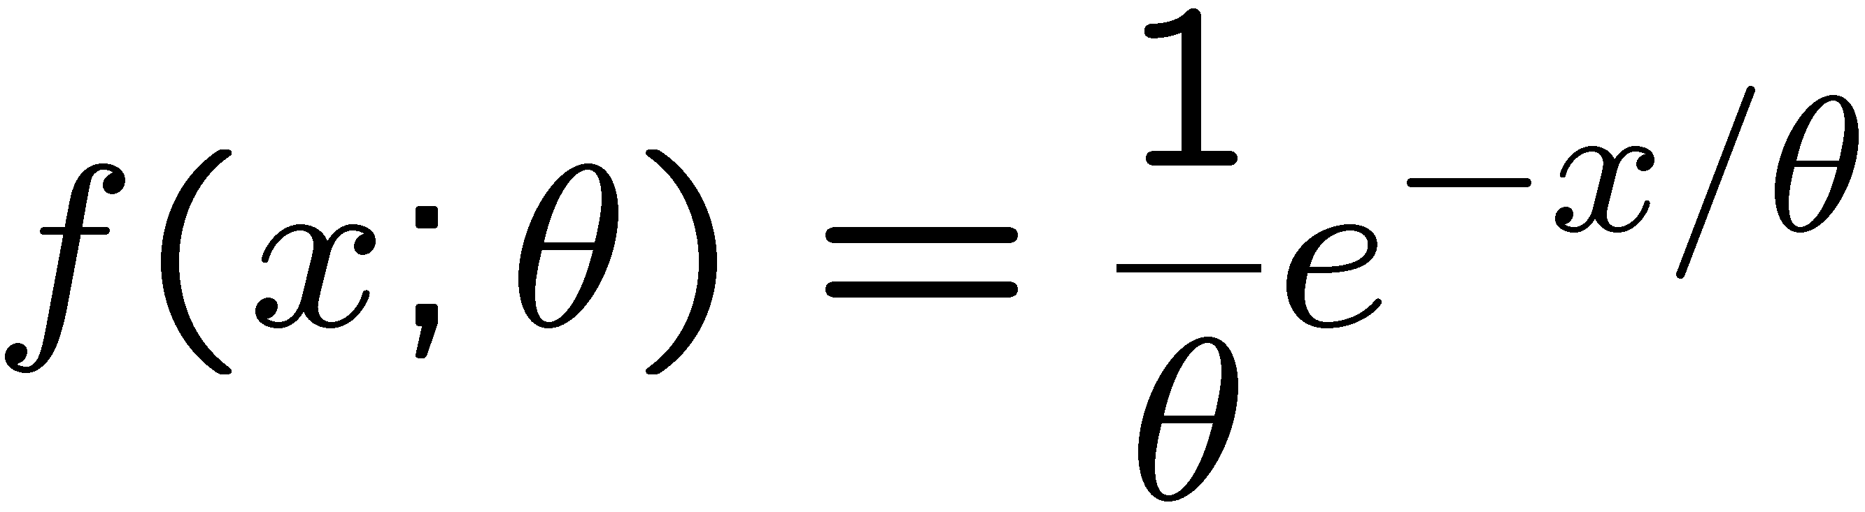
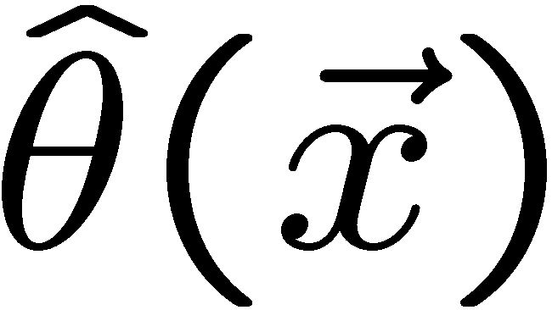
Parameter estimation
The parameters of a pdf are any constants that characterize it,
i.e., θ indexes a
set of hypotheses.
r.v.
parameter
Suppose we have a sample of observed values: x = (x₁, ..., x_{n})
We want to find some function of the data to estimate the
parameter(s):
← estimator written with a hat
Sometimes we say ‘estimator’ for the function of x₁, ..., x_{n};
‘estimate’ for the value of the estimator with a particular data set.

Slide 36
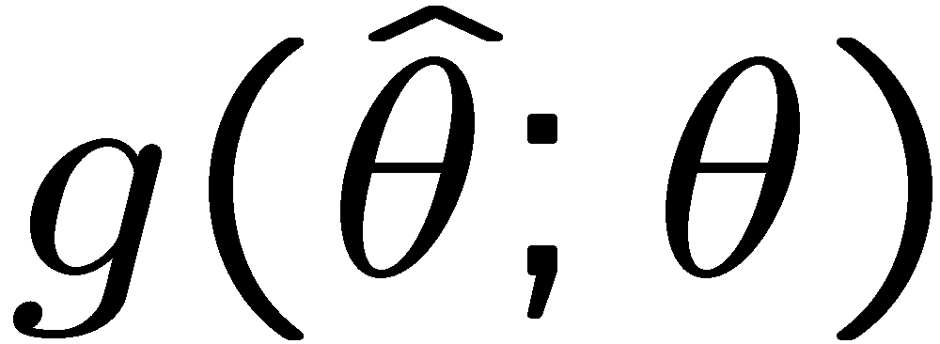
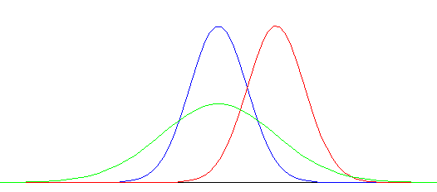


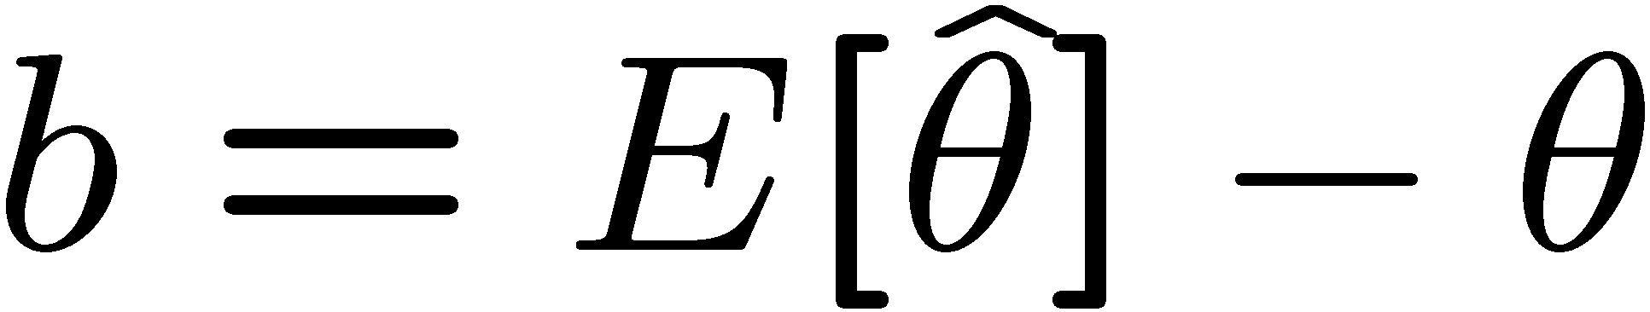

Properties of estimators
If we were to repeat the entire measurement, the estimates
from each would follow a pdf:
best
large
variance
biased
We want small (or zero) bias (systematic error):
→ average of repeated measurements should tend to true value.
And we want a small variance (statistical error):
→ small bias & variance are in general conflicting criteria

Slide 37
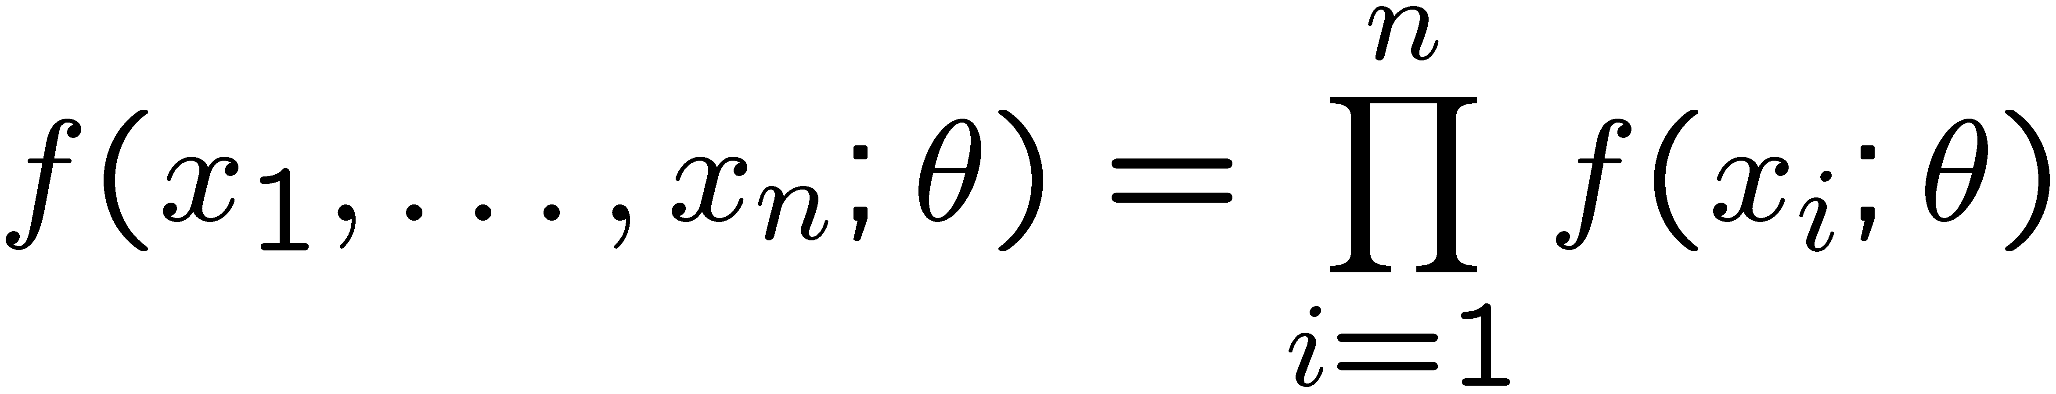
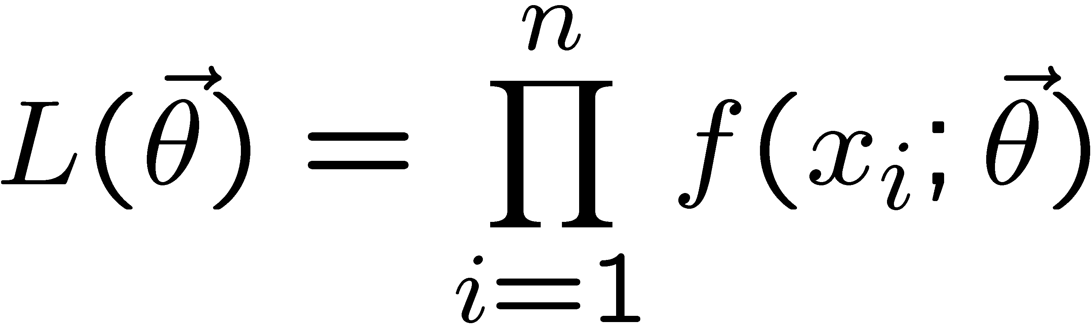
The likelihood function for i.i.d.* data
* i.i.d. = independent and identically distributed
Consider n independent observations of x: x₁, ..., x_{n}, where
x follows f (x; θ). The joint pdf for the whole data sample is:
In this case the likelihood function is
(x_{i} constant)

Slide 38
Maximum Likelihood Estimators (MLEs)
We define the maximum likelihood estimators or MLEs to be
the parameter values for which the likelihood is maximum.
Maximizing L equivalent to maximizing log L
Could have multiple maxima (take highest).
MLEs not guaranteed to have any ‘optimal’ properties, (but in practice they’re very good).

Slide 39
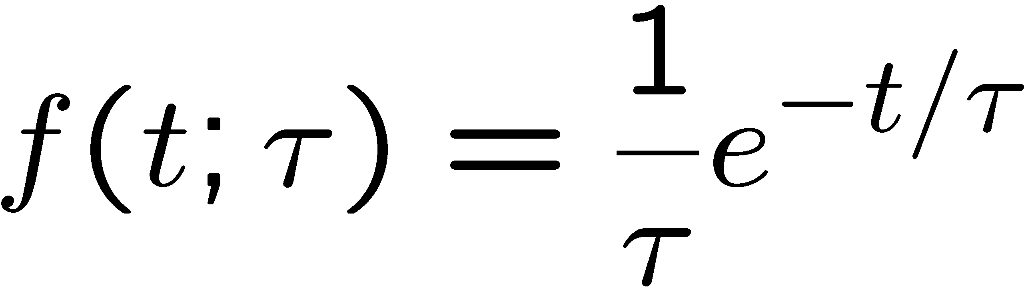
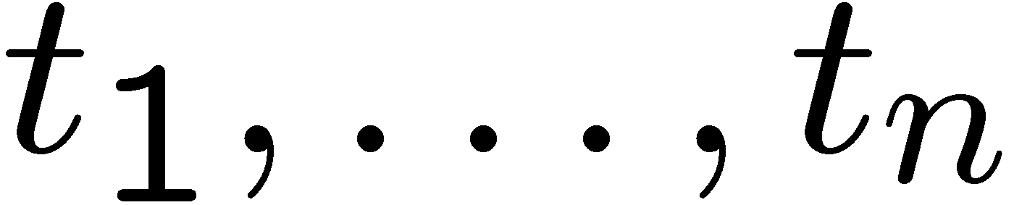
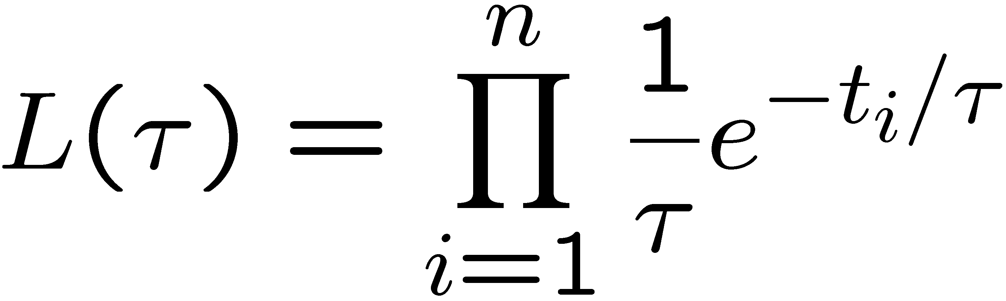
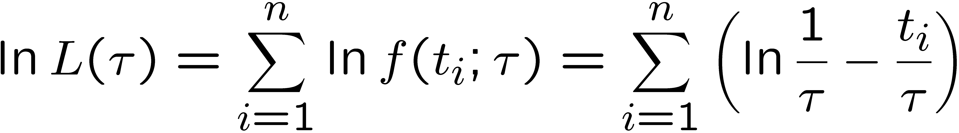
MLE example: parameter of exponential pdf
Consider exponential pdf,
and suppose we have i.i.d. data,
The likelihood function is
The value of τ for which L(τ) is maximum also gives the
maximum value of its logarithm (the log-likelihood function):

Slide 40
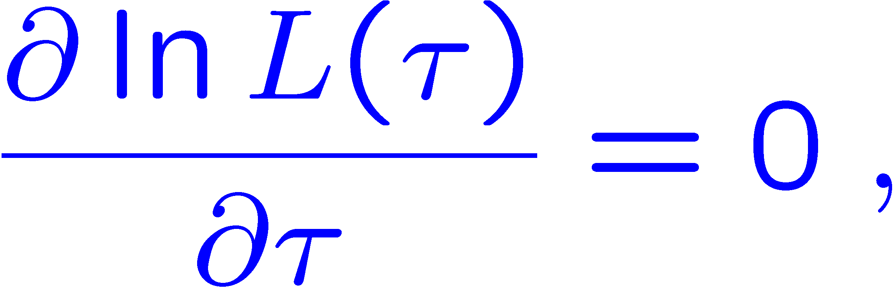
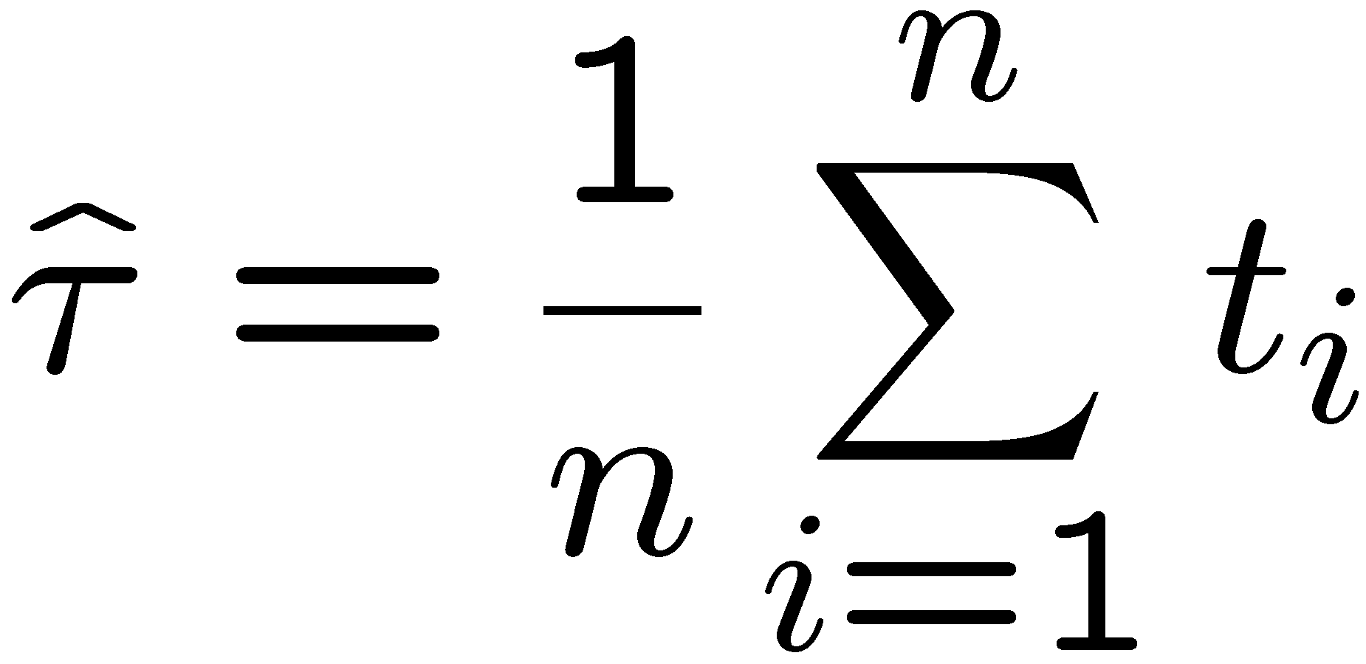
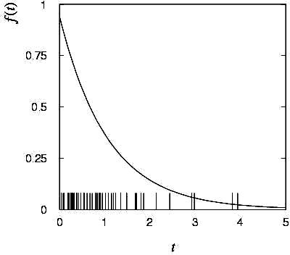

MLE example: parameter of exponential pdf (2)
Find its maximum by setting
→
Monte Carlo test:
generate 50 values
using τ = 1:
We find the ML estimate:

Slide 41






MLE example: parameter of exponential pdf (3)
For the exponential distribution one has for mean, variance:
For the MLE
we therefore find
→
→

Slide 42
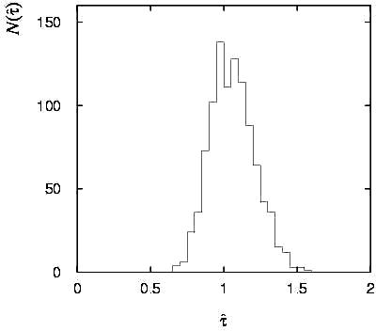

Variance of estimators: Monte Carlo method
Having estimated our parameter we now need to report its
‘statistical error’, i.e., how widely distributed would estimates
be if we were to repeat the entire measurement many times.
One way to do this would be to simulate the entire experiment
many times with a Monte Carlo program (use ML estimate for MC).
For exponential example, from
sample variance of estimates
we find:
Note distribution of estimates is roughly
Gaussian − (almost) always true for
ML in large sample limit.

Slide 43
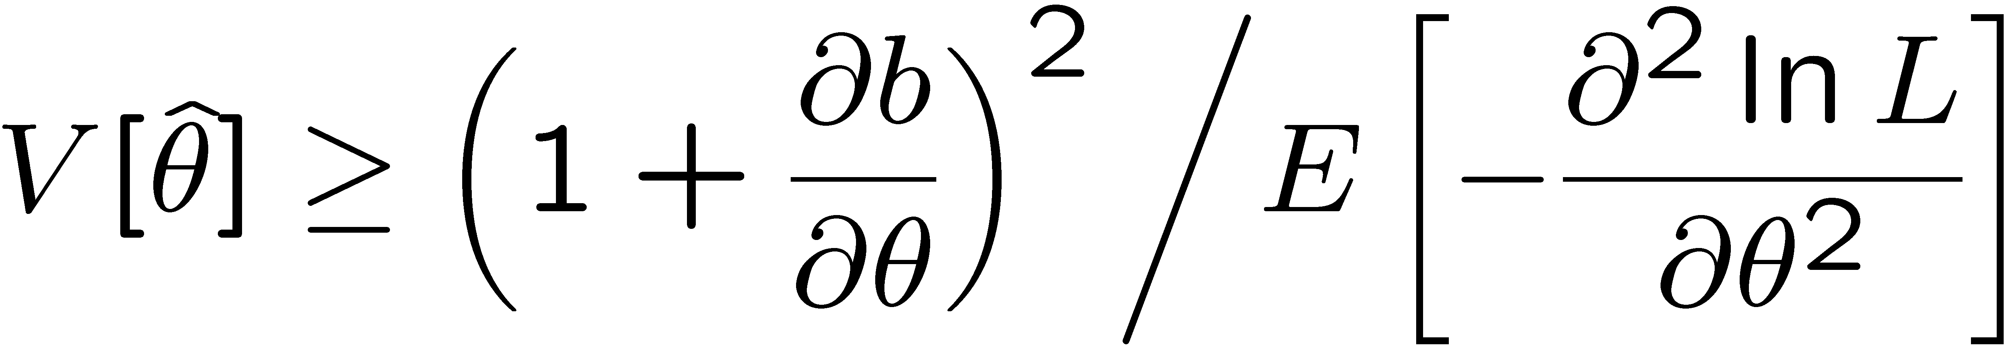
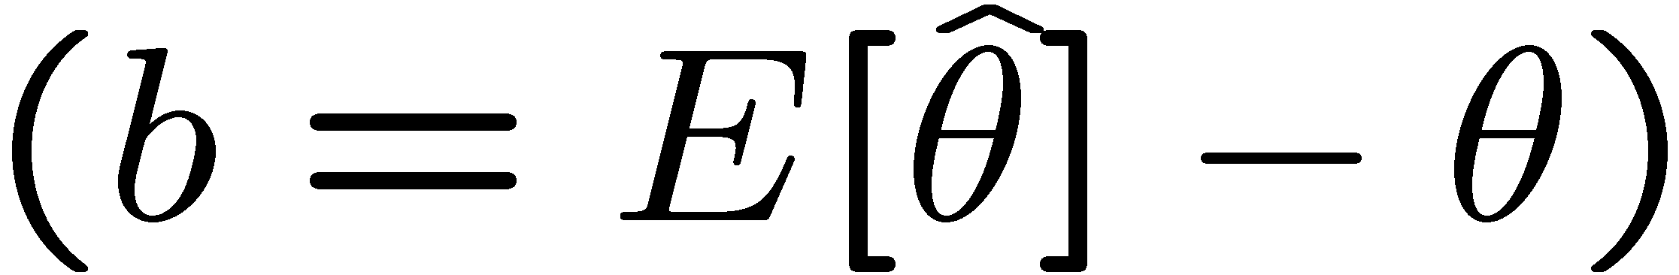
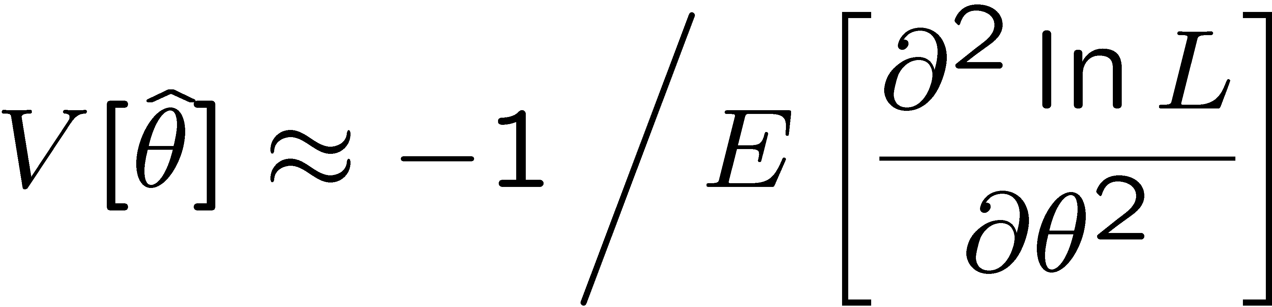
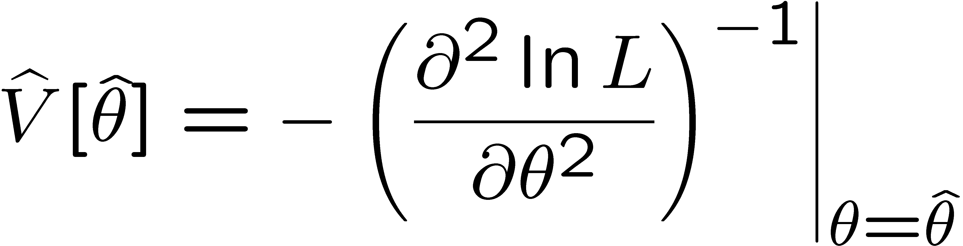
Variance of estimators from information inequality
The information inequality (RCF) sets a lower bound on the
variance of any estimator (not only ML):
Minimum Variance
Bound (MVB)
Often the bias b is small, and equality either holds exactly or
is a good approximation (e.g. large data sample limit). Then,
Estimate this using the 2nd derivative of ln L at its maximum:

Slide 44
MVB for MLE of exponential parameter
Find
We found for the exponential parameter the MLE
and we showed b = 0, hence 𝜕b/𝜕τ = 0.
We find
and since E[t_{i}] = τ for all i,
,
and therefore
.
(Here MLE is “efficient”).

Slide 45
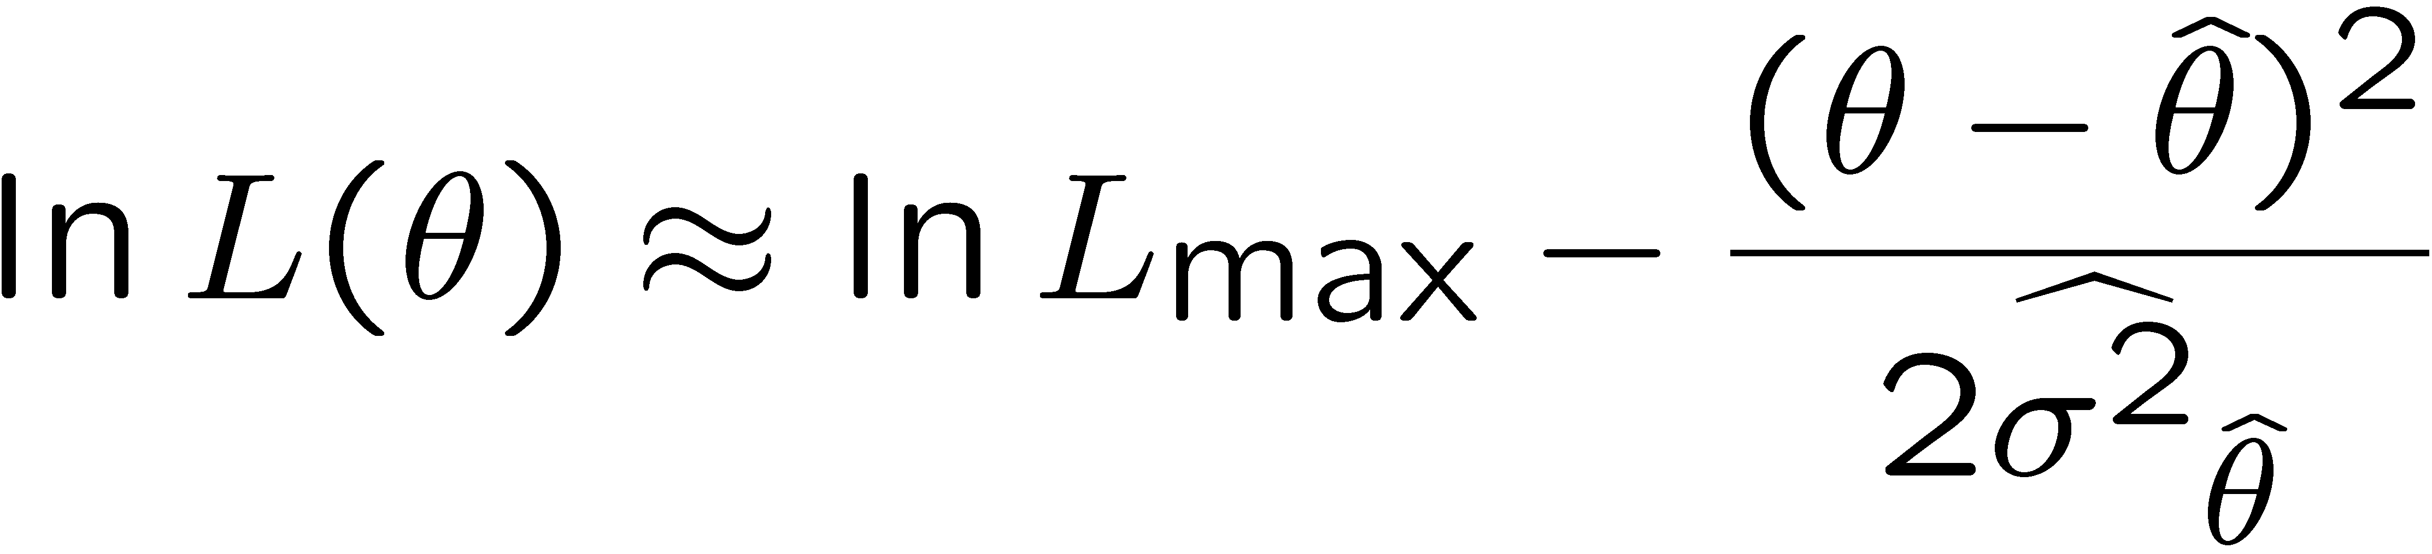
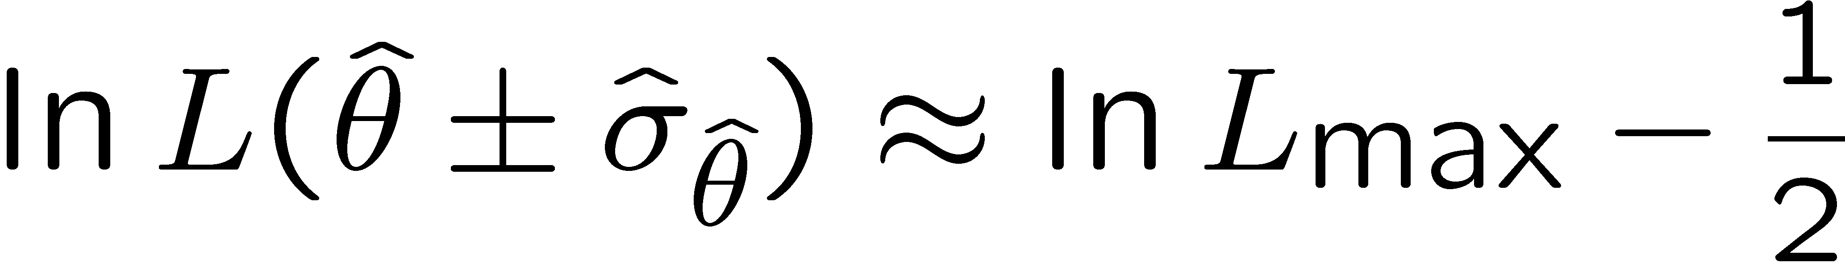


Variance of estimators: graphical method
Expand ln L(θ) about its maximum:
First term is ln L_{max}, second term is zero, for third term use
information inequality (assume equality):
i.e.,
→ to get
, change θ away from
until ln L decreases by 1/2.

Slide 46
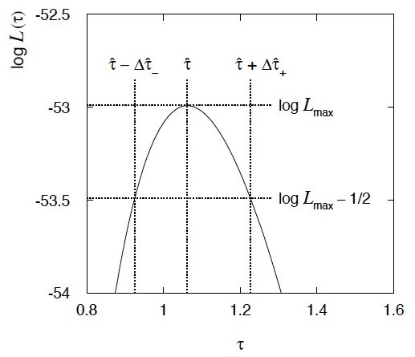
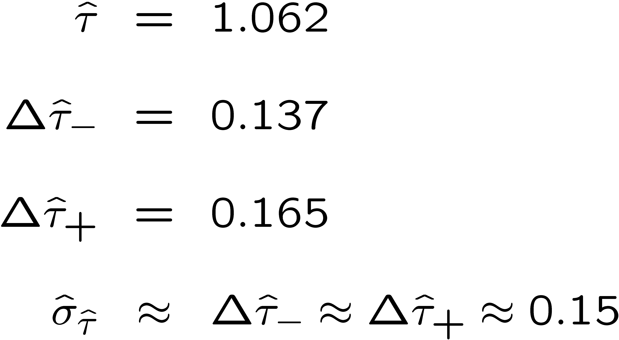
Example of variance by graphical method
ML example with exponential:
Not quite parabolic ln L since finite sample size (n = 50).

Slide 47
Information inequality for N parameters
Suppose we have estimated N parameters θ = (θ₁,...,θ_{N})
The Fisher information matrix is
^
and the covariance matrix of estimators θ is
The information inequality states that the matrix
is positive semi-definite:
z^{T}Mz ≥ 0 for all z ≠ 0, diagonal elements ≥ 0

Slide 48
Information inequality for N parameters (2)
In practice the inequality is ~always used in the large-sample limit:
bias → 0
inequality → equality, i.e, M = 0, and therefore V⁻¹ = I
That is,
This can be estimated from data using
Find the matrix V⁻¹ numerically (or with automatic differentiation),
then invert to get the covariance matrix of the estimators

Slide 49
Confidence intervals by inverting a test
In addition to a ‘point estimate’ of a parameter we should report
an interval reflecting its statistical uncertainty.
Confidence intervals for a parameter θ can be found by
defining a test of the hypothesized value θ (do this for all θ):
Specify values of the data that are ‘disfavoured’ by θ
(critical region) such that P(data in critical region|θ) ≤ α
for a prespecified α, e.g., 0.05 or 0.1.
If data observed in the critical region, reject the value θ.
Now invert the test to define a confidence interval as:
set of θ values that are not rejected in a test of size α
(confidence level CL is 1− α).

Slide 50
Relation between confidence interval and p-value
Equivalently we can consider a significance test for each
hypothesized value of θ, resulting in a p-value, p_{θ}.
If p_{θ} ≤ α, then we reject θ.
The confidence interval at CL = 1 – α consists of those values of
θ that are not rejected.
E.g. an upper limit on θ is the greatest value for which p_{θ} > α.
In practice find by setting p_{θ} = α and solve for θ.
For a multidimensional parameter space θ = (θ₁,... θ_{M}) use same idea – result is a confidence “region” with boundary determined by p_{θ} = α.

Slide 51
Coverage probability of confidence interval
If the true value of θ is rejected, then it’s not in the confidence interval. The probability for this is by construction (equality for continuous data):
P(reject θ|θ) ≤ α = type-I error rate
Therefore, the probability for the interval to contain or “cover” θ is
P(conf. interval “covers” θ|θ) ≥ 1 − α
This assumes that the set of θ values considered includes the true value, i.e., it assumes the composite hypothesis P(x|H,θ).

Slide 52



Frequentist upper limit on Poisson parameter
Consider again the case of observing n ~ Poisson(s + b).
Suppose b = 4.5, n_{obs} = 5. Find upper limit on s at 95% CL.
Relevant alternative is s = 0 (critical region at low n)
p-value of hypothesized s is P(n ≤ n_{obs}; s, b)
Upper limit s_{up} at CL = 1 – α found from

Slide 53
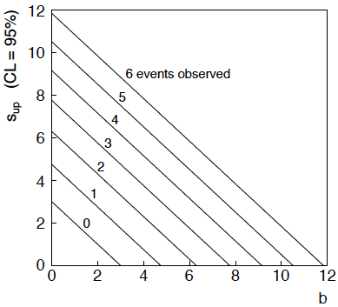
n ~ Poisson(s+b): frequentist upper limit on s
For low fluctuation of n, formula can give negative result for s_{up}; i.e. confidence interval is empty; all values of s ≥ 0 have p_{s} ≤ α.

Slide 54
Limits near a boundary of the parameter space
Suppose e.g. b = 2.5 and we observe n = 0.
If we choose CL = 0.9, we find from the formula for s_{up}
Physicist:
We already knew s ≥ 0 before we started; can’t use negative
upper limit to report result of expensive experiment!
Statistician:
The interval is designed to cover the true value only 90%
of the time — this was clearly not one of those times.
Not uncommon dilemma when testing parameter values for which
one has very little experimental sensitivity, e.g., very small s.

Slide 55
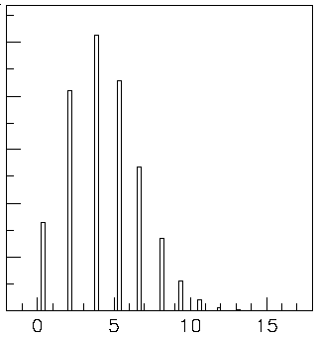

Expected limit for s = 0
Physicist: I should have used CL = 0.95 — then s_{up} = 0.496
Even better: for CL = 0.917923 we get s_{up} = 10⁻⁴ !
Reality check: with b = 2.5, typical Poisson fluctuation in n is
at least √2.5 = 1.6. How can the limit be so low?
Look at the mean limit for the
no-signal hypothesis (s = 0)
(sensitivity).
Distribution of 95% CL limits
with b = 2.5, s = 0.
Mean upper limit = 4.44

Slide 56

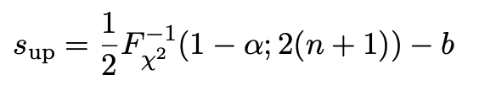
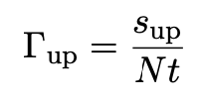








Background-free vs background dominated limits
For
→
Upper limit on the rate of a signal process is
targets
time
For b ≪ 1,
→
For b ≫ 1,
(1−α = 0.95)
,
,
→

Slide 57




Approximate confidence intervals/regions from the likelihood function
Suppose we test parameter value(s) θ = (θ₁, ..., θ_{n}) using the ratio
Lower λ(θ) means worse agreement between data and hypothesized θ. Equivalently, usually define
so higher t_{θ} means worse agreement between θ and the data.
p-value of θ therefore
need pdf

Slide 58




Confidence region from Wilks’ theorem
Wilks’ theorem says (in large-sample limit and provided
certain conditions hold...)
chi-square dist. with # d.o.f. =
# of components in θ = (θ₁, ..., θ_{n}).
Assuming this holds, the p-value is
← set equal to α
To find boundary of confidence region set p_{θ} = α and solve for t_{θ}:
Recall also

Slide 59




Confidence region from Wilks’ theorem (cont.)
i.e., boundary of confidence region in θ space is where
For example, for 1 – α = 68.3% and n = 1 parameter,
and so the 68.3% confidence level interval is determined by
Same as recipe for finding the estimator’s standard deviation, i.e.,
is a 68.3% CL confidence interval.

Slide 60


Example of interval from ln L(θ)
For n=1 parameter, CL = 0.683, Q_{α} = 1.
Our exponential
example, now with
only n = 5 events.
Can report ML estimate
with approx. confidence
interval from ln L_{max} – 1/2
as “asymmetric error bar”:

Slide 61



Multiparameter case
For increasing number of parameters, CL = 1 – α decreases for
confidence region determined by a given

Slide 62

Multiparameter case (cont.)
Equivalently, Q_{α} increases with n for a given CL = 1 – α.

Slide 63
Extra slides

Slide 64
Some statistics books, papers, etc.
G. Cowan, Statistical Data Analysis, Clarendon, Oxford, 1998
R.J. Barlow, Statistics: A Guide to the Use of Statistical Methods in the Physical Sciences, Wiley, 1989
Ilya Narsky and Frank C. Porter, Statistical Analysis Techniques in Particle Physics, Wiley, 2014.
Luca Lista, Statistical Methods for Data Analysis in Particle Physics, Springer, 2017.
L. Lyons, Statistics for Nuclear and Particle Physics, CUP, 1986
F. James., Statistical and Computational Methods in Experimental Physics, 2nd ed., World Scientific, 2006
S. Brandt, Statistical and Computational Methods in Data Analysis, Springer, New York, 1998.
S. Navas et al. (Particle Data Group), Phys. Rev. D 110, 030001 (2024); pdg.lbl.gov sections on probability, statistics, MC.

Slide 65




Proof of Neyman-Pearson Lemma
Consider a critical region W and suppose the LR satisfies the criterion of the Neyman-Pearson lemma:
P(x|H₁)/P(x|H₀) ≥ c_{α} for all x in W,
P(x|H₁)/P(x|H₀) ≤ c_{α} for all x not in W.
W
Try to change this into a different critical region W′ retaining the same size α, i.e.,
δW₊
To do so add a part δW₊, but to keep the size α, we need to remove a part δW₋, i.e.,
W′
δW₋

Slide 66
Proof of Neyman-Pearson Lemma (2)
δW₊
But we are supposing the LR is higher for all x in δW₋ removed than for the x in δW₊ added, and therefore
W′
δW₋
The right-hand sides are equal and therefore

Slide 67
Proof of Neyman-Pearson Lemma (3)
We have
δW₊
W′
Note W and δW₊ are disjoint, and W′ and δW₋ are disjoint, so by Kolmogorov’s 3rd axiom,
δW₋
Therefore

Slide 68
Proof of Neyman-Pearson Lemma (4)
And therefore
i.e. the deformed critical region W′ cannot have higher power than the original one that satisfied the LR criterion of the Neyman-Pearson lemma.

Slide 69
Large-sample (asymptotic) properties of MLEs
Suppose we have an i.i.d. data sample of size n: x₁,...,x_{n}
In the large-sample (or “asymptotic”) limit (n → ∞) and assuming regularity conditions one can show that the likelihood and MLE have several important properties.
The regularity conditions include:
the boundaries of the data space cannot depend on the parameter;
the parameter cannot be on the edge of the parameter space;
ln L(θ) must be differentiable;
the only solution to 𝜕ln L/𝜕θ = 0 is θ.
^
In the slides immediately following, the properties are shown without proof for a single parameter; the corresponding properties hold also for the multiparameter case, θ = (θ₁,..., θ_{m}).

Slide 70
log-likelihood becomes quadratic
The likelihood function becomes Gaussian in shape, i.e. the log-likelihood becomes quadratic (parabolic).
The MLE becomes increasingly precise as the (log)-likelihood becomes more tightly concentrated about its peak,
but L(θ) = P(x|θ) is the probability for x, not a pdf for θ.

Slide 71
The MLE converges to the true parameter value
In the large-sample limit, the MLE converges in probability
to the true parameter value.
That is, for any ε > 0,
The MLE is said to be consistent.

Slide 72
MLE is asymptotically unbiased
In general the MLE can be biased, but in the large-sample limit, this bias goes to zero:
(Recall for the exponential parameter we found the bias was
identically zero regardless of the sample size n.)

Slide 73
The MLE’s variance approaches the MVB
In the large-sample limit, the variance of the MLE approaches the minimum-variance bound, i.e., the information inequality becomes an equality (and bias goes to zero):
The MLE is said to be asymptotically efficient.

Slide 74
The MLE’s distribution becomes Gaussian
In the large-sample limit, the pdf of the MLE becomes Gaussian,
where
is the minimum variance bound (note bias is zero).
For example, exponential MLE with sample size n = 100.
Note that for exponential, MLE is arithmetic average, so Gaussian MLE seen to stem from Central Limit Theorem.

Slide 75
Distribution of MLE of exponential parameter

Slide 76
Multiparameter graphical method for variances
Expand ln L(θ) to 2nd order about MLE:
ln L_{max}
zero
relate to covariance matrix of MLEs using information (in)equality.
Result:
So the surface
corresponds to
, which is the equation of a (hyper-) ellipse.

Slide 77




Multiparameter graphical method (2)
Distance from MLE to tangent planes gives standard deviations.

Slide 78


The Bayesian approach to limits
In Bayesian statistics need to start with ‘prior pdf’ π(θ), this
reflects degree of belief about θ before doing the experiment.
Bayes’ theorem tells how our beliefs should be updated in
light of the data x:
Integrate posterior pdf p(θ|x) to give interval with any desired
probability content.
For e.g. n ~ Poisson(s+b), 95% CL upper limit on s from

Slide 79

Bayesian prior for Poisson parameter
Include knowledge that s ≥ 0 by setting prior π(s) = 0 for s < 0.
Could try to reflect ‘prior ignorance’ with e.g.
Not normalized; can be OK provided p(n|s) dies off quickly for large s.
Not invariant under change of parameter — if we had used instead a flat prior for a nonlinear function of s, then this would imply a non-flat prior for s.
Doesn’t really reflect a reasonable degree of belief, but often used as a point of reference; or viewed as a recipe for producing an interval whose frequentist properties can be studied (e.g., coverage probability, which will depend on true s).

Slide 80



Bayesian upper limit with flat prior for s
Put Poisson likelihood and flat prior into Bayes’ theorem:
Normalize to unit area:
upper incomplete
gamma function
Upper limit s_{up} determined by

Slide 81


Bayesian interval with flat prior for s
Solve to find limit s_{up}:
where
For special case b = 0, Bayesian upper limit with flat prior
numerically same as one-sided frequentist case (‘coincidence’).

Slide 82

Bayesian interval with flat prior for s
For b > 0 Bayesian limit is everywhere greater than the (one sided) frequentist upper limit.
For b = 0 , Bayesian and frequentist upper limits come out equal.
Never goes negative.
Doesn’t depend on b if n = 0.

