Slide 1


Statistics for Rare Event Searches
Lecture 2
Hands-on PhD School on Astroparticle Physics
Gran Sasso, Italy
11 September 2025
https://agenda.infn.it/event/44808/
Glen Cowan
Physics Department
Royal Holloway, University of London
g.cowan@rhul.ac.uk
www.pp.rhul.ac.uk/~cowan

Slide 2
Outline
Lecture 1: Introduction
Probability
Hypothesis tests
Parameter estimation
Confidence limits
→ Lecture 2: Systematic uncertainties
Prototype analysis
Experimental sensitivity
Almost everything is a subset of the University of London course:
http://www.pp.rhul.ac.uk/~cowan/stat_course.html

Slide 3



Systematic uncertainties and nuisance parameters
P (x|μ)
In general, our model of the data is not perfect:
model:
truth:
x
Can improve model by including
additional adjustable parameters.
Nuisance parameter ↔ systematic uncertainty. Some point in the
parameter space of the enlarged model should be “true”.
Presence of nuisance parameter decreases sensitivity of analysis
to the parameter of interest (e.g., increases variance of estimate).

Slide 4
Profile Likelihood
Suppose we have a likelihood L(μ,θ) = P(x|μ,θ) with N parameters of interest μ = (μ₁,..., μ_{N}) and M nuisance parameters θ = (θ₁,..., θ_{M}). The “profiled” (or “constrained”) values of θ are:
and the profile likelihood is:
The profile likelihood depends only on the parameters of interest; the nuisance parameters are replaced by their profiled values.
The profile likelihood can be used to obtain confidence intervals/regions for the parameters of interest in the same way as one would for all of the parameters from the full likelihood.

Slide 5
Profile Likelihood Ratio – Wilks theorem
Goal is to test/reject regions of μ space (param. of interest).
Rejecting a point μ should mean p_{μ} ≤ α for all possible values of the nuisance parameters θ.
Test μ using the “profile likelihood ratio”:
Let t_{μ} = −2 ln λ(μ). Wilks’ theorem says in large-sample limit:
where the number of degrees of freedom is the number of
parameters of interest (components of μ). So p-value for μ is

Slide 6
Profile Likelihood Ratio – Wilks theorem (2)
If we have a large enough data sample to justify use of the
asymptotic chi-square pdf, then if μ is rejected, it is rejected for any values of the nuisance parameters.
The recipe to get confidence regions/intervals for the parameters of interest at CL = 1 – α is thus the same as before, simply use the profile likelihood:
where the number of degrees of freedom N for the chi-square quantile is equal to the number of parameters of interest.
If the large-sample limit is not justified, then use e.g. Monte Carlo to get distribution of t_{μ}.

Slide 7




Prototype search analysis
Search for signal in a region of phase space; result is histogram
of some variable x giving numbers:
Assume the n_{i} are Poisson distributed with expectation values
strength parameter
where
signal
background

Slide 8


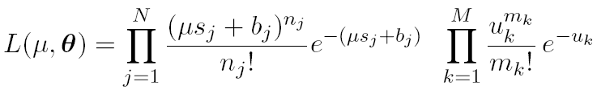
Prototype analysis (II)
Often also have a subsidiary measurement that constrains some
of the background and/or shape parameters:
Assume the m_{i} are Poisson distributed with expectation values
nuisance parameters (θ_{s}, θ_{b},b_{tot})
Likelihood function is

Slide 9
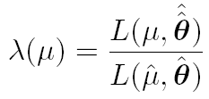
The profile likelihood ratio
Base significance test on the profile likelihood ratio:
maximizes L for
specified μ
maximize L
Define critical region of test of μ by the region of data space
that gives the lowest values of λ(μ).
Important advantage of profile LR is that its distribution becomes independent of nuisance parameters in large sample limit.

Slide 10
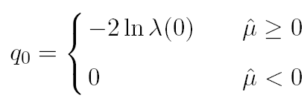
Test statistic for discovery
Suppose relevant alternative to background-only (μ = 0) is μ ≥ 0.
So take critical region for test of μ = 0 corresponding to high q₀
and > 0 (data characteristic for μ ≥ 0).
That is, to test background-only hypothesis define statistic
i.e. here only large (positive) observed signal strength is evidence against the background-only hypothesis.
Note that even though here physically μ ≥ 0, we allow
to be negative. In large sample limit its distribution becomes
Gaussian, and this will allow us to write down simple
expressions for distributions of our test statistics.

Slide 11


Cowan, Cranmer, Gross, Vitells, arXiv:1007.1727, EPJC 71 (2011) 1554
Distribution of q₀ in large-sample limit
Assuming approximations valid in the large sample (asymptotic)
limit, we can write down the full distribution of q₀ as
The special case μ′ = 0 is a “half chi-square” distribution:
In large sample limit, f (q₀|0) independent of nuisance parameters;
f (q₀|μ′) depends on nuisance parameters through σ.

Slide 12
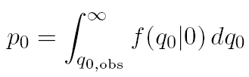
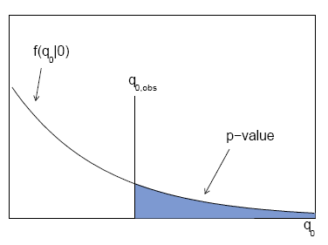

p-value for discovery
Large q₀ means increasing incompatibility between the data
and hypothesis, therefore p-value for an observed q_{0,obs} is
use e.g. asymptotic formula
From p-value get
equivalent significance,

Slide 13
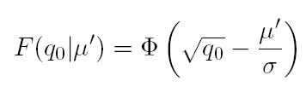



Cowan, Cranmer, Gross, Vitells, arXiv:1007.1727, EPJC 71 (2011) 1554
Cumulative distribution of q₀, significance
From the pdf, the cumulative distribution of q₀ is found to be
The special case μ′ = 0 is
The p-value of the μ = 0 hypothesis is
Therefore the discovery significance Z is simply

Slide 14
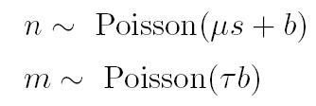
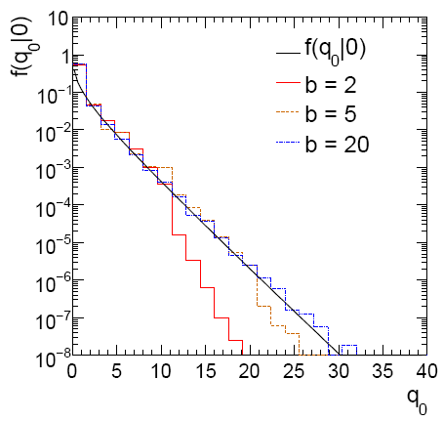
Cowan, Cranmer, Gross, Vitells, arXiv:1007.1727, EPJC 71 (2011) 1554
Monte Carlo test of asymptotic formula
μ = param. of interest
b = nuisance parameter
Here take s known, τ = 1.
Asymptotic formula is
good approximation to 5σ
level (q₀ = 25) already for
b ~ 20.

Slide 15
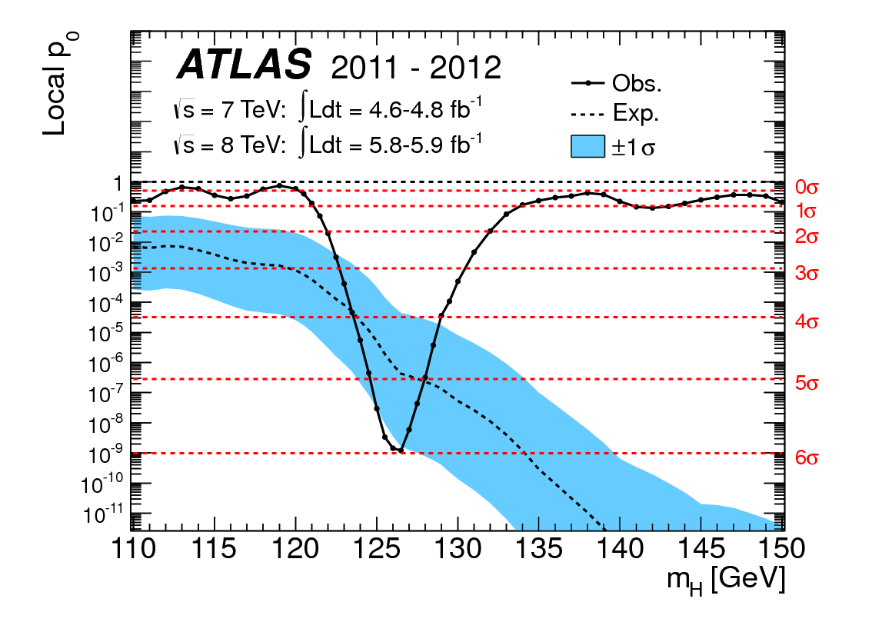
How to read the p₀ plot
The “local” p₀ means the p-value of the background-only
hypothesis obtained from the test of μ = 0 at each individual m_{H}, without any correct for the Look-Elsewhere Effect.
The “Expected” (dashed) curve gives the median p₀ under assumption of the SM Higgs (μ = 1) at each m_{H}.
ATLAS, Phys. Lett. B 716 (2012) 1-29
The blue band gives the
width of the distribution
(±1σ) of significances
under assumption of the
SM Higgs.

Slide 16
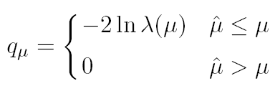



Cowan, Cranmer, Gross, Vitells, arXiv:1007.1727, EPJC 71 (2011) 1554
Test statistic for upper limits
For purposes of setting an upper limit on μ use
where
I.e. when setting an upper limit, an upwards fluctuation of the data
is not taken to mean incompatibility with the hypothesized μ :
From observed q_{μ} find p-value:
Large sample approximation:
To find upper limit at CL = 1−α, set p_{μ} = α and solve for μ.

Slide 17
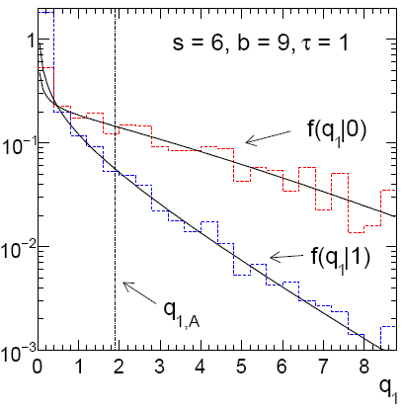
Cowan, Cranmer, Gross, Vitells, arXiv:1007.1727, EPJC 71 (2011) 1554
Monte Carlo test of asymptotic formulae
Consider again n ~ Poisson(μs + b), m ~ Poisson(τb)
Use q_{μ} to find p-value of hypothesized μ values.
E.g. f (q₁|1) for p-value of μ =1.
Typically interested in 95% CL, i.e., p-value threshold = 0.05, i.e.,
q₁ = 2.69 or Z₁ = √q₁ = 1.64.
Median[q₁ |0] gives “exclusion sensitivity”.
Here asymptotic formulae good
for s = 6, b = 9.

Slide 18
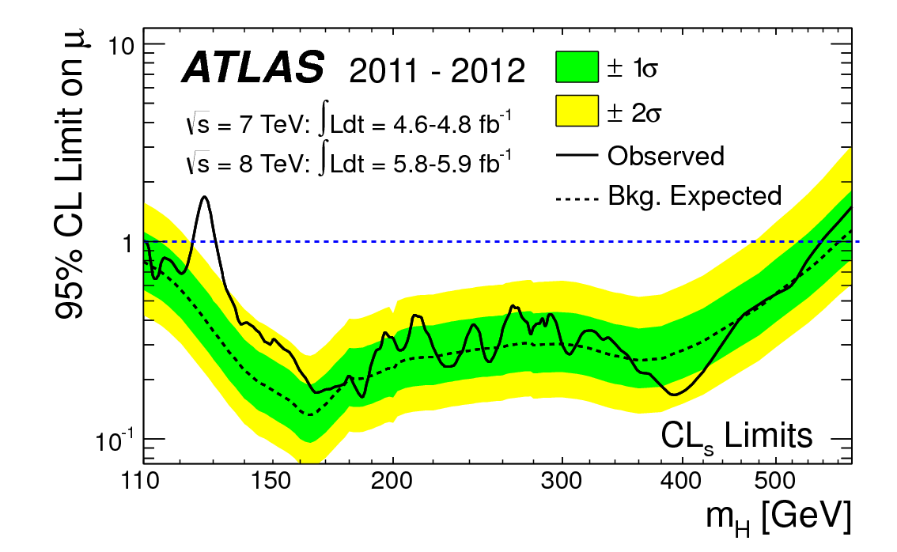
How to read the green and yellow limit plots
For every value of m_{H}, find the upper limit on μ.
Also for each m_{H}, determine the distribution of upper limits μ_{up} one would obtain under the hypothesis of μ = 0.
The dashed curve is the median μ_{up}, and the green (yellow) bands give the ± 1σ (2σ) regions of this distribution.
ATLAS, Phys. Lett. B 716 (2012) 1-29

Slide 19





More Analysis Prototypes
0) Poisson Counting Experiment, known background:
1) Poisson Counting Experiment with nuisance params. (e.g., b):
(a)
“on/off problem”
(b)
or Poisson, Gamma, log-normal,... as appropriate

Slide 20




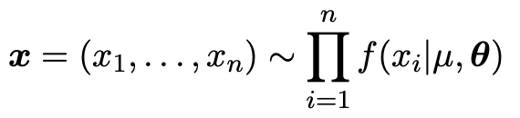
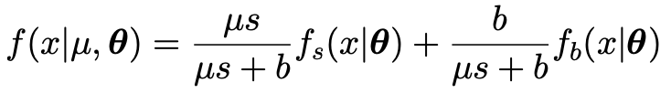
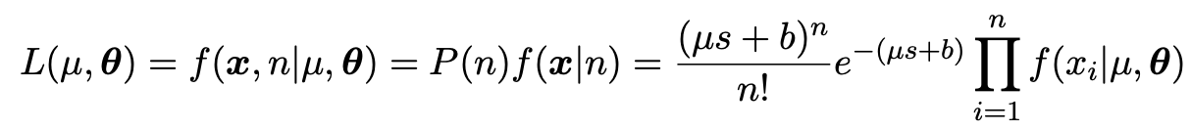
Analysis Prototypes (cont.)
2) Multi-bin Poisson Counting Experiment:
3) Unbinned analysis:

Slide 21


Sensitivity for Poisson counting experiment
Count a number of events n ~ Poisson(s+b), where
s = expected number of events from signal,
b = expected number of background events.
To test for discovery of signal compute p-value of s = 0 hypothesis,
Usually convert to equivalent significance:
where Φ is the standard Gaussian cumulative distribution, e.g.,
Z > 5 (a 5 sigma effect) means p < 2.9 ×10⁻⁷.
To characterize sensitivity to discovery, give expected (mean
or median) Z under assumption of a given s.

Slide 22



s/√b for expected discovery significance
For large s + b, n → x ~ Gaussian(μ,σ) , μ = s + b, σ = √(s + b).
For observed value x_{obs}, p-value of s = 0 is Prob(x > x_{obs} | s = 0),:
Significance for rejecting s = 0 is therefore
Expected (median) significance assuming signal rate s is

Slide 23



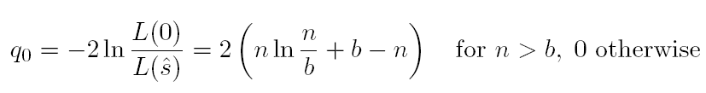
Better approximation for significance
Poisson likelihood for parameter s is
For now
no nuisance
params.
To test for discovery use profile likelihood ratio:
So the likelihood ratio statistic for testing s = 0 is

Slide 24


Approximate Poisson significance (continued)
For sufficiently large s + b, (use Wilks’ theorem),
To find median[Z|s], let n → s + b (i.e., the Asimov data set):
This reduces to s/√b for s << b.

Slide 25
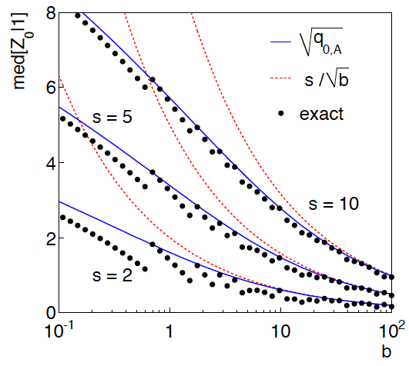
n ~ Poisson(s+b), median significance, assuming s, of the hypothesis s = 0
CCGV, EPJC 71 (2011) 1554, arXiv:1007.1727
“Exact” values from MC,
jumps due to discrete data.
Asimov √q_{0,A} good approx.
for broad range of s, b.
s/√b only good for s ≪ b.

Slide 26

Extending s/√b to case where b uncertain
The intuitive explanation of s/√b is that it compares the signal,
s, to the standard deviation of n assuming no signal, √b.
Now suppose the value of b is uncertain, characterized by a
standard deviation σ_{b}.
A reasonable guess is to replace √b by the quadratic sum of
√b and σ_{b}, i.e.,
This has been used to optimize some analyses e.g. where
σ_{b} cannot be neglected.

Slide 27


Profile likelihood with b uncertain
This is the well studied “on/off” problem: Cranmer 2005;
Cousins, Linnemann, and Tucker 2008; Li and Ma 1983,...
Measure two Poisson distributed values:
n ~ Poisson(s+b) (primary or “search” measurement)
m ~ Poisson(τb) (control measurement, τ known)
The likelihood function is
Use this to construct profile likelihood ratio (b is nuisance
parameter):

Slide 28
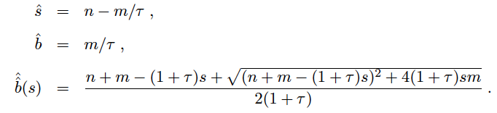

Ingredients for profile likelihood ratio
To construct profile likelihood ratio from this need estimators:
and in particular to test for discovery (s = 0),

Slide 29



Asymptotic significance
Use profile likelihood ratio for q₀, and then from this get discovery
significance using asymptotic approximation (Wilks’ theorem):
Essentially same as in:

Slide 30



Asimov approximation for median significance
To get median discovery significance, replace n, m by their
expectation values assuming background-plus-signal model:
n → s + b
m → τb
ˆ
Or use the variance of b = m/τ,
, to eliminate τ:

Slide 31

Limiting cases
Expanding the Asimov formula in powers of s/b and
σ_{b}²/b (= 1/τ) gives
So the “intuitive” formula can be justified as a limiting case
of the significance from the profile likelihood ratio test evaluated
with the Asimov data set.

Slide 32
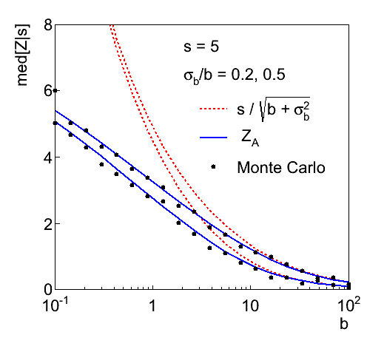
Testing the formulae: s = 5

Slide 33
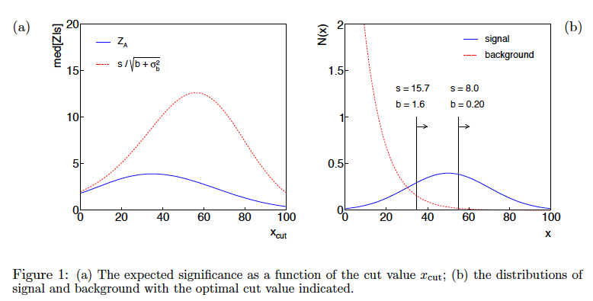
Using sensitivity to optimize a cut

Slide 34
moved to tutorial
Finally
Two lectures only enough for a brief introduction to:
Parameter estimation
Hypothesis tests (→ path to Machine Learning)
Limits (confidence intervals/regions)
Systematics (nuisance parameters)
Experimental sensitivity
No time for many other interesting topics:
Bayesian parameter estimation
Final thought: once the basic formalism is fixed, most of the
work focuses on writing down the likelihood, e.g., P(x|θ), and
including in it enough parameters to adequately describe the data (true for both Bayesian and frequentist approaches) so often best to invest most of your time with it.

Slide 35
Extra slides

Slide 36
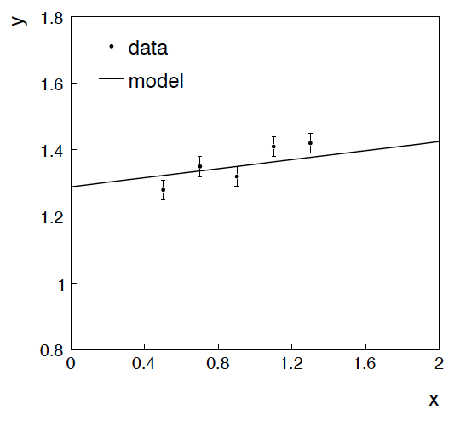
Example: fitting a straight line
Data:
Model: y_{i} independent and all follow y_{i} ~ Gauss(μ(x_{i} ), σ_{i} )
assume x_{i} and σ_{i} known.
Goal: estimate θ₀
Here suppose we don’t care
about θ₁ (example of a
“nuisance parameter”)

Slide 37
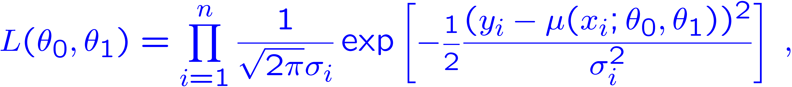
Maximum likelihood fit with Gaussian data
In this example, the y_{i} are assumed independent, so the
likelihood function is a product of Gaussians:
Maximizing the likelihood is here equivalent to minimizing
i.e., for Gaussian data, ML same as Method of Least Squares (LS)

Slide 38
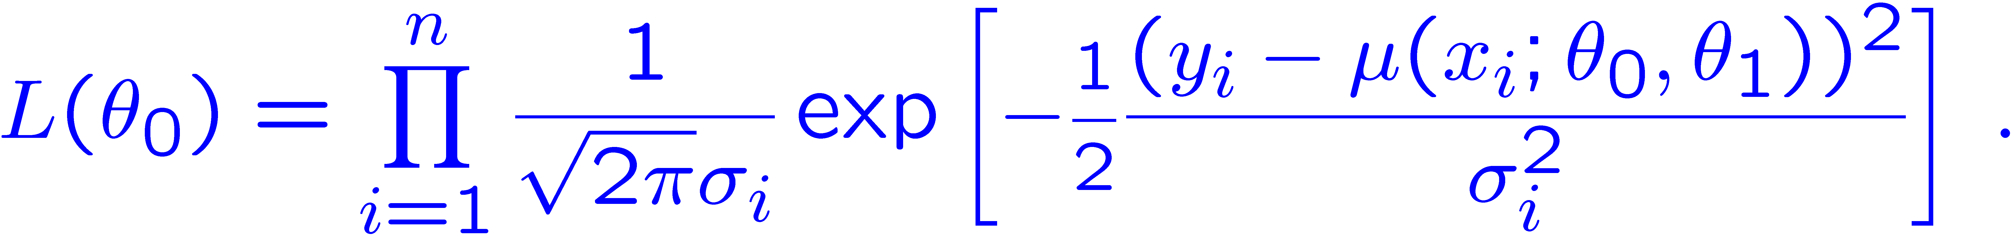
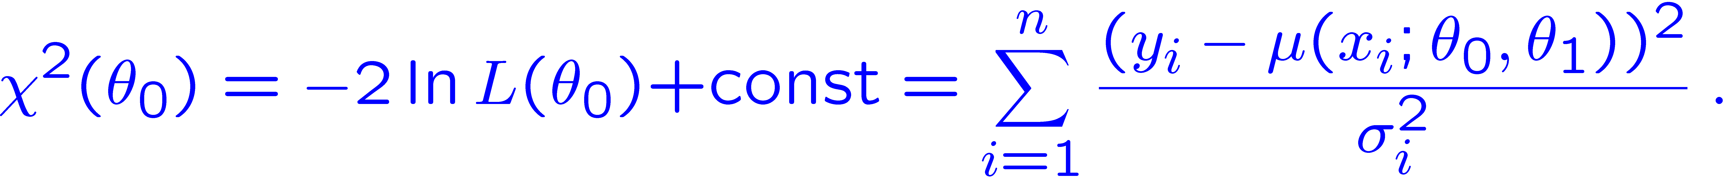
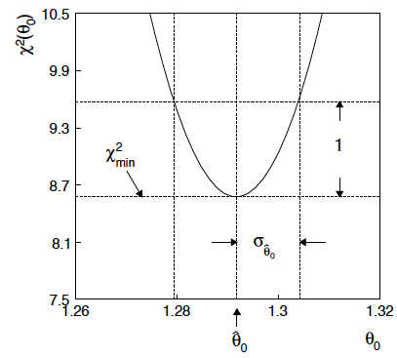



θ₁ known a priori
For Gaussian y_{i}, ML same as LS
Minimize χ² → estimator
Come up one unit from
to find

Slide 39
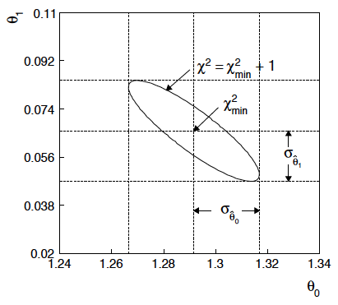

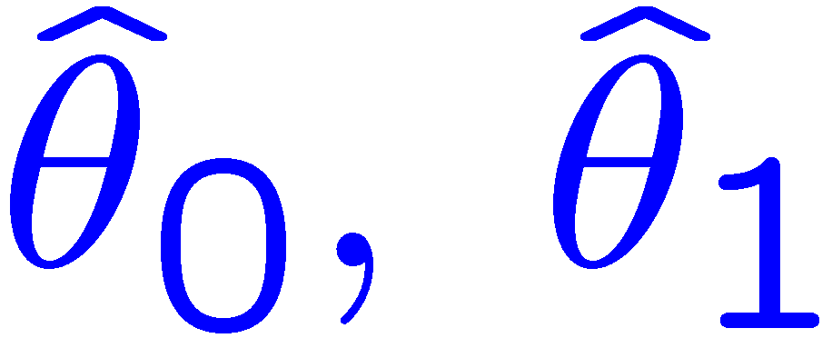
ML (or LS) fit of θ₀ and θ₁
Standard deviations from
tangent lines to contour
Correlation between
causes errors
to increase.

Slide 40


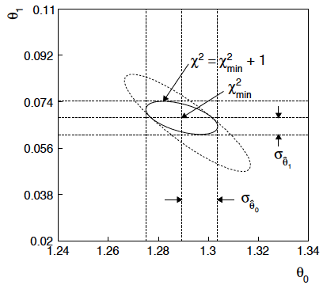
If we have a measurement t₁ ~ Gauss (θ₁, σ_{t1})
The information on θ₁
improves accuracy of

Slide 41
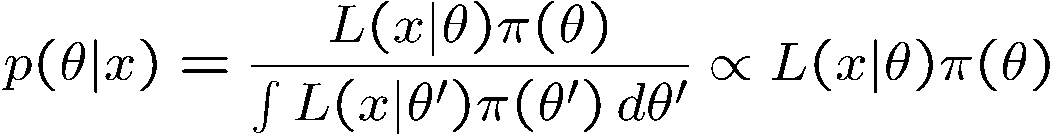
Reminder of Bayesian approach
In Bayesian statistics we can associate a probability with
a hypothesis, e.g., a parameter value θ.
Interpret probability of θ as ‘degree of belief’ (subjective).
Need to start with ‘prior pdf’ π(θ), this reflects degree
of belief about θ before doing the experiment.
Our experiment has data x, → likelihood L(x|θ).
Bayes’ theorem tells how our beliefs should be updated in
light of the data x:
Posterior pdf p(θ|x) contains all our knowledge about θ.

Slide 42
Bayesian approach: y_{i} ~ Gauss(μ(x_{i}; θ₀, θ₁), σ_{i})
We need to associate prior probabilities with θ₀ and θ₁, e.g.,
← suppose knowledge of θ₀ has no influence on knowledge of θ₁
← ‘non-informative’, in any
case much broader than L(θ₀)
prior after t₁,
before y
Ur = “primordial”
prior
Likelihood for control
measurement t₁

Slide 43
Bayesian example: y_{i} ~ Gauss(μ(x_{i}; θ₀, θ₁), σ_{i})
Putting the ingredients into Bayes’ theorem gives:
posterior ∝ likelihood ✕ prior
Note here the likelihood only reflects the measurements y.
The information from the control measurement t₁ has been put into the prior for θ₁.
We would get the same result using the likelihood P(y,t|θ₀,θ₁) and the constant “Ur-prior” for θ₁.

Slide 44
Marginalizing the posterior pdf
We then integrate (marginalize) p(θ₀, θ₁ | y) to find p(θ₀ | y):
In this example we can do the integral (rare). We find
(same as for MLE)
For this example, numbers come out same as in frequentist approach, but interpretation different.

Slide 45
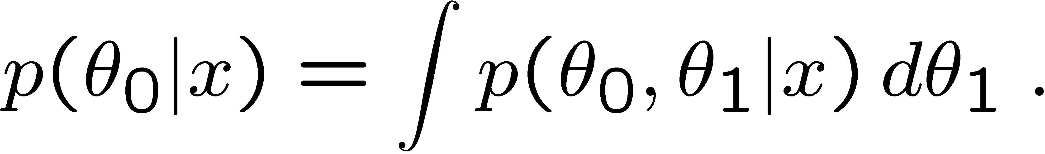
Marginalization with MCMC
Bayesian computations involve integrals like
often high dimensionality and impossible in closed form,
also impossible with ‘normal’ acceptance-rejection Monte Carlo.
Markov Chain Monte Carlo (MCMC) has revolutionized
Bayesian computation.
MCMC (e.g., Metropolis-Hastings algorithm) generates
correlated sequence of random numbers:
cannot use for many applications, e.g., detector MC;
effective stat. error greater than if all values independent .
Basic idea: sample multidimensional θ but look only at distribution of parameters of interest.

Slide 46
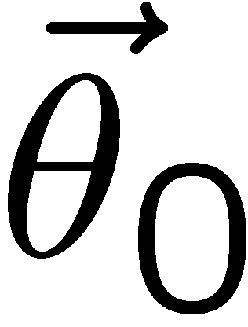
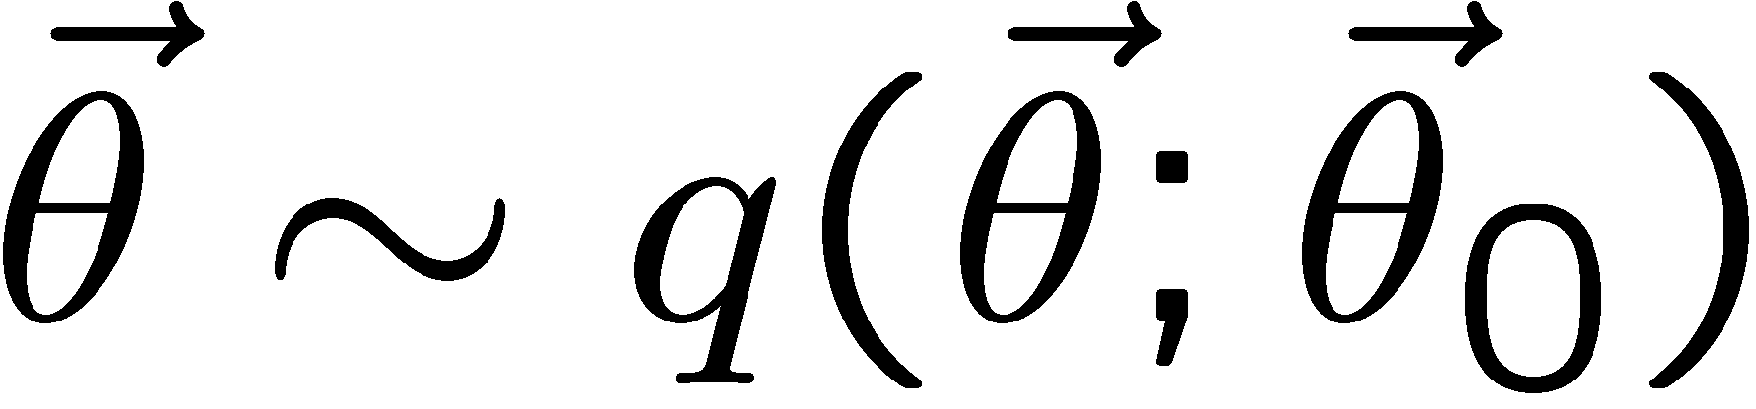
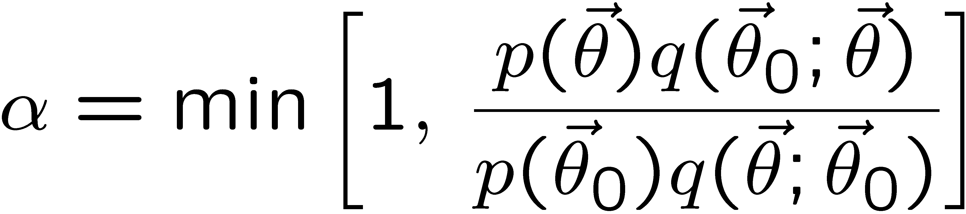

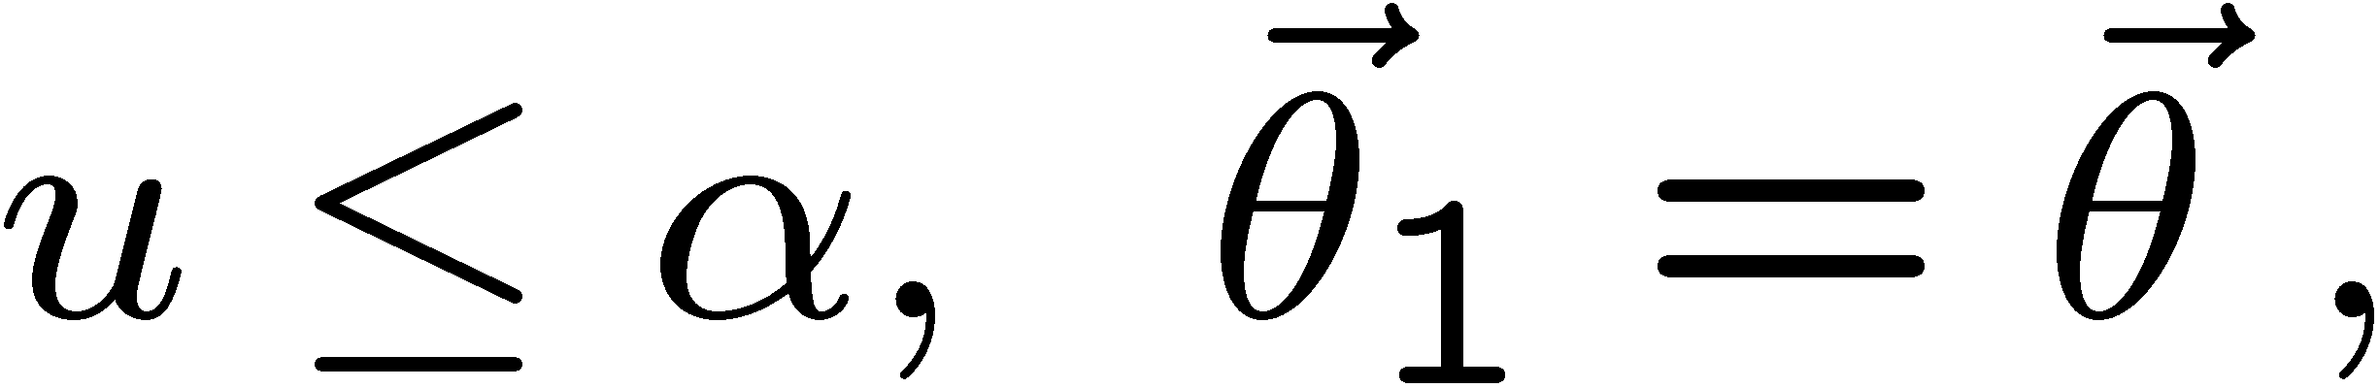
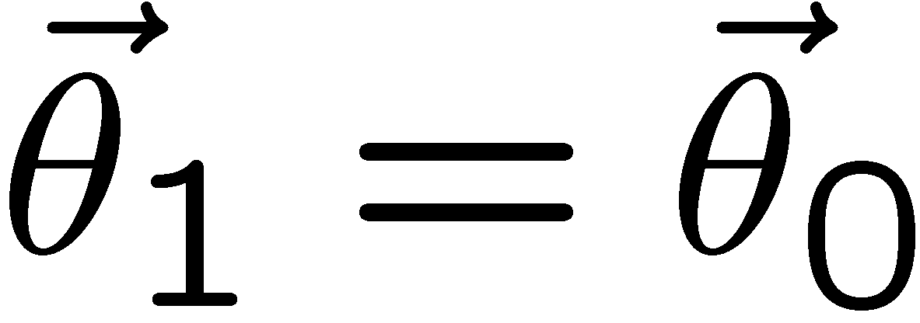
MCMC basics: Metropolis-Hastings algorithm
Goal: given an n-dimensional pdf p(θ) up to a proportionality constant, generate a sequence of points θ₁ , θ₂ , θ₃ ,...
Proposal density q(θ; θ₀ )
e.g. Gaussian centred
about θ₀
1) Start at some point
2) Generate
3) Form test ratio
4) Generate
5) If
move to proposed point
else
old point repeated
6) Iterate

Slide 47
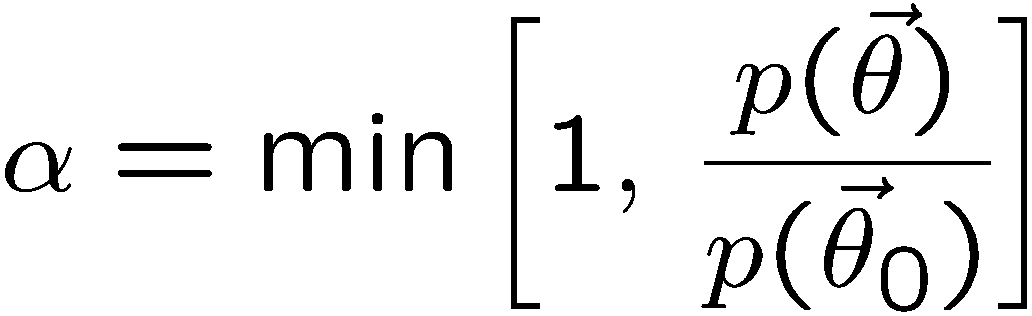
Metropolis-Hastings (continued)
This rule produces a correlated sequence of points (note how
each new point depends on the previous one).
Still works if p(θ) is known only as a proportionality, which is
usually what we have from Bayes’ theorem: p(θ|x) ∝ p(x|θ) π(θ).
The proposal density can be (almost) anything, but choose
so as to minimize autocorrelation. Often take proposal
density symmetric: q(θ; θ₀ ) = q(θ₀; θ )
Test ratio is (Metropolis-Hastings):
I.e. if the proposed step is to a point of higher p(θ), take it;
if not, only take the step with probability p(θ)/p(θ₀).
If proposed step rejected, repeat the current point.

Slide 48

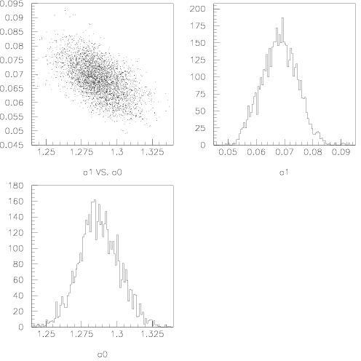

Example: posterior pdf from MCMC
Sample the posterior pdf from previous example with MCMC:
Normalized histogram of θ₀ gives its marginal posterior pdf:

Slide 49
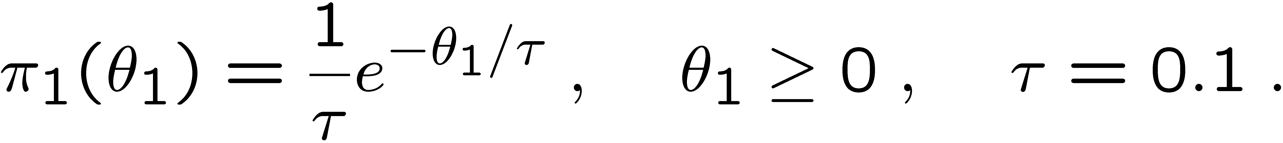
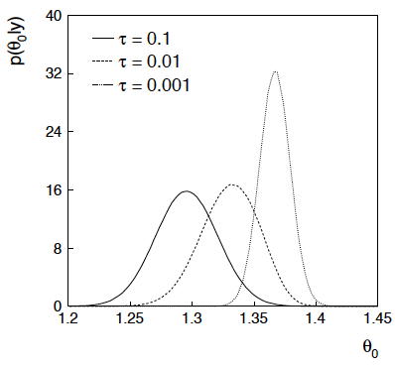
Bayesian method with alternative priors
Suppose we don’t have a previous measurement of θ₁ but rather,
an “expert” says it should be positive and not too much greater than 0.1 or so, i.e., something like
From this we obtain (numerically) the posterior pdf for θ₀:
This summarizes all
knowledge about θ₀.
Look also at result from
variety of priors.

