Slide 1


An Overflight of Statistics in Particle Physics
Data Science & Complexity in Fundamental Physics and the bridge to industry & society
IGFAE, Santiago de Compostela
11-12 June 2026
https://indico.global/event/17473/
Glen Cowan
Physics Department
Royal Holloway, University of London
g.cowan@rhul.ac.uk
www.pp.rhul.ac.uk/~cowan

Slide 2
Some thoughts on the use of statistics in High Energy Physics, touching on three questions:
Foundations of statistics (what is probability?)
Searching for new phenomena
Improving accuracy of measurements

Slide 3
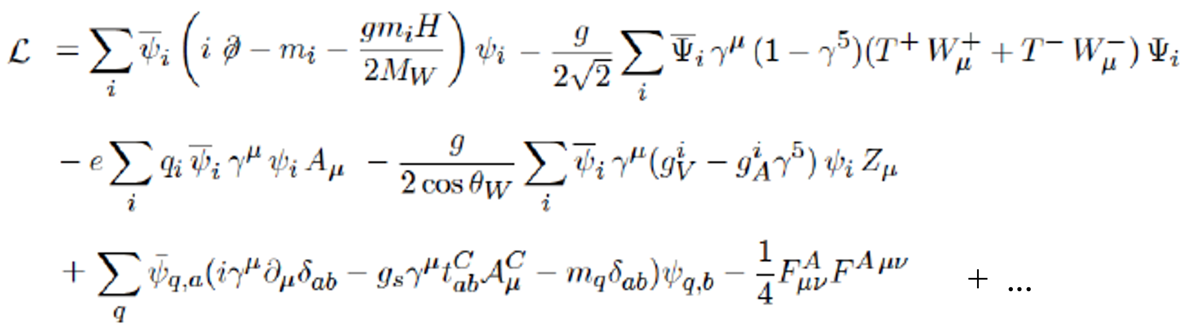
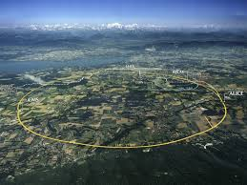
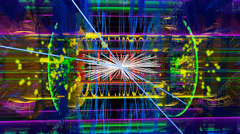
Particle Physics – the Big Questions
What are the rules that govern the behaviour of matter at a fundamental level? Current best theory, the Standard Model (SM):
leptons, quarks,
γ, W±, Z, g, H
Test SM and other theories e.g. by colliding protons at high energy:
CERN
ATLAS Collaboration

Slide 4


Theory ↔ Statistics ↔ Experiment
prediction
Need to compare measurements and theory, both of which have some degree of uncertainty:
data
To take the uncertainty into account, define probability with a set of mathematical rules (Kolmogorov axioms), and interpret as:
A limiting frequency → frequentist statistics
A degree of belief → Bayesian statistics

Slide 5
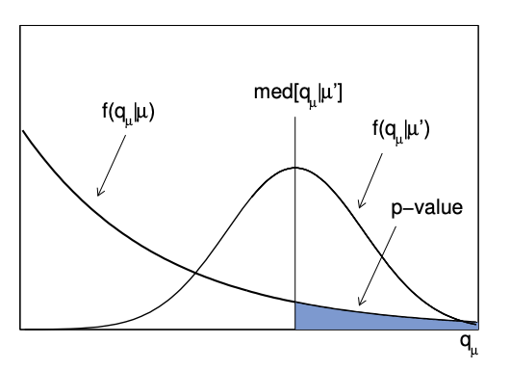
Frequentist Statistics
Probability only assigned to outcome of repeatable observation (“data”)
A rule that defines the probability for all data outcomes is a hypothesis (”theory”)
→ cannot talk about probability that a theory is true
So how can we do science?
A frequentist favours a theory if it predicts a high probability for data similar to what we got (other theory predicts lower).
Examples: maximum-likelihood,
least-squares estimation,
confidence intervals,
p-values,...
p_{H} = P(data as extreme as observed or more| H)

Slide 6
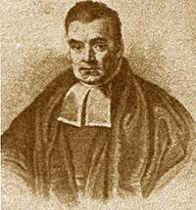
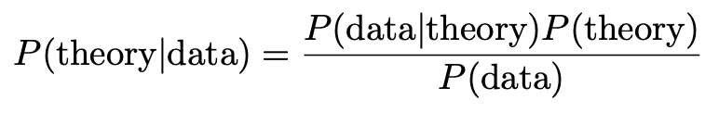
Bayesian Statistics
Extends interpretation of probability to include degree of belief, use this for hypotheses (theories).
Need to start by stating degree of belief in the hypothesis before seeing the data (the prior).
Probability of data given the theory is the likelihood.
Bayes theorem updates the prior to give the posterior probability:
posterior
likelihood
prior
Requires prior probability (subjective).
Thomas Bayes (1701-1761)

Slide 7
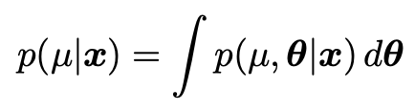
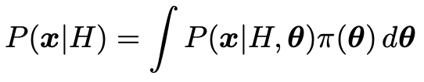
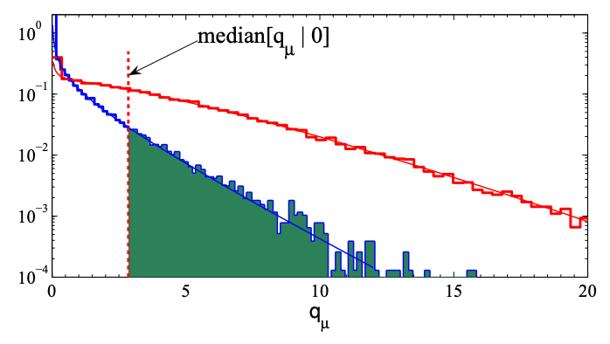
Particle Physics vs Astro
Particle Physics: mainly frequentist
Number of particle collisions very large
Astrophysics/cosmology: mainly Bayesian
One Universe
In practice, the conclusions point towards a similar direction.
But the computational steps involved are very different:
Bayesians marginalise over unwanted parameters (MCMC sampling of parameter space); compute marginal likelihoods
Frequentists compute sampling
distributions of estimators and
test statistics (asymptotic methods,
Monte Carlo sampling of data space)

Slide 8
Conclusion on Frequentist vs Bayesian
Frequentist vs Bayesian debate going on for more than 2 centuries.
Frequentist:
Cannot talk about Prob(theory),
surprisingly subtle issues with confidence limits, p-values
Bayesian:
Can talk about Prob(theory), requires prior probabilities.
Both approaches have their own computational challenges.
The modern view is that each approach answers different, relevant questions, and one can use both.
In practice the methods are chosen by sociology/politics, but I still hold out hope of a more mixed approach.

Slide 9
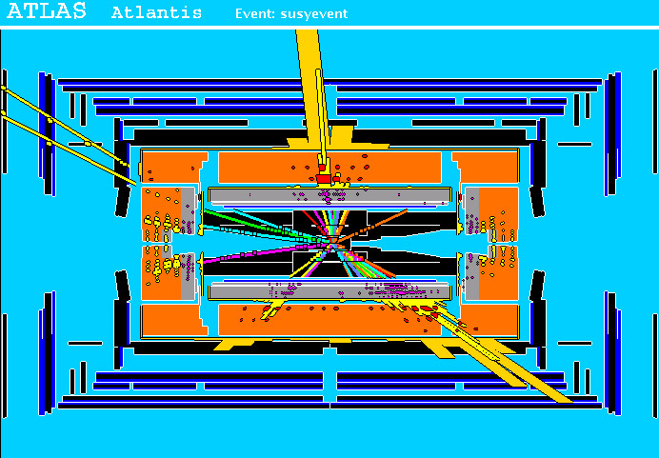
Statistics for Discovery of a Signal
An important goal of Particle Physics is to see if some extensions to the Standard Model are perhaps correct, e.g., Supersymmetry. If it is, we expect proton-proton collision events like this (simulated) one:
high p_{T} jets
of hadrons
high p_{T}
muons
p
p
missing transverse energy

Slide 10
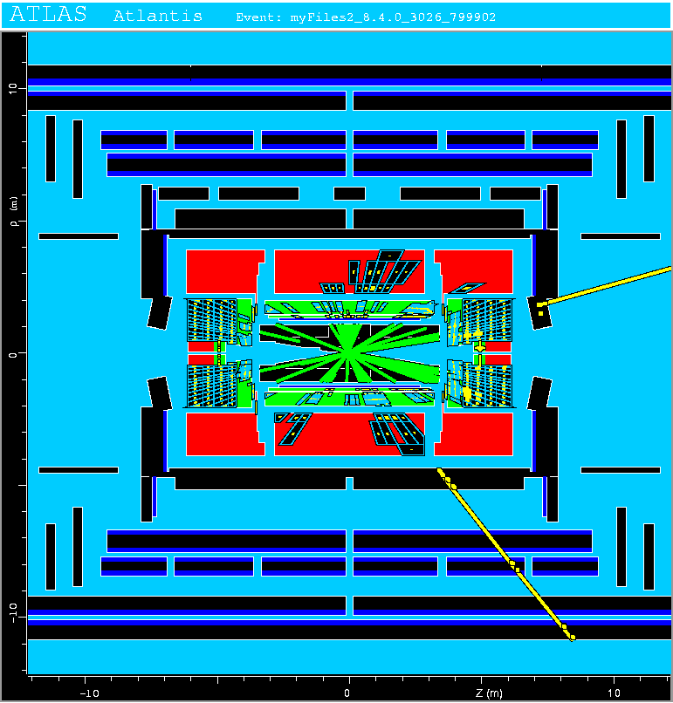
Background Events
But there are collision events produced by known Standard Model processes that can easily mimic the signal, e.g.,
Simulated top-anti-top event, with features similar to those expected from SUSY signal.
For each event, measure a “feature vector” x = (x₁,..., x_{n}):
x₁ = energy of jet
x₂ = p_{T} of muon
x₃ = missing energy
⠇

Slide 11
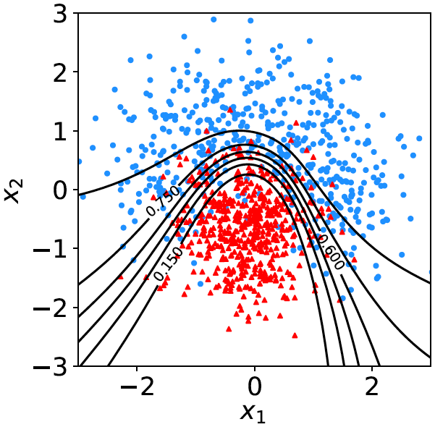
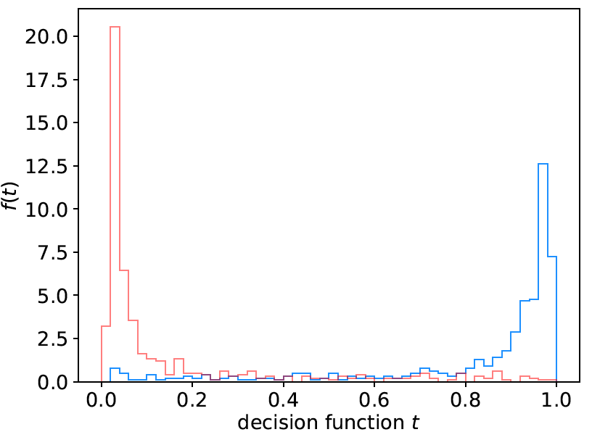

Decision function / test statistic
Distribution of feature vectors expected for signal (blue) and background (red) events.
f (t|H₀)
f (t|H₁)
To obtain a decision boundary,
define a scalar test statistic:
W
defines decision boundary

Slide 12

Optimal Test Statistic
Neyman-Pearson lemma: optimal test statistic is the likelihood ratio
But we usually don’t have explicit formulae for the pdfs f (x|s), f (x|b), so for a given x we can’t evaluate the statistic.
Instead we may have Monte Carlo models for signal and background processes, so we can produce simulated data:
generate x ~ f (x|s) → x₁,..., x_{N}
generate x ~ f (x|b) → x₁,..., x_{N}
This gives samples of “training data” with events of known type.
Can be expensive (1 fully simulated LHC event ~ 1 CPU minute).

Slide 13
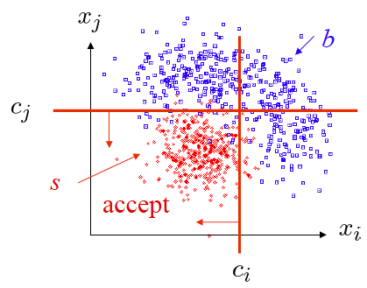
Particle Physics meets Machine Learning
Particle Physics has had a long history of “cut-based” analyses:
Eventually adopted methods from Machine Learning:
1990s Fisher Discriminants, Neural Networks
Early 2000s Boosted Decision Trees,
Support Vector Machines
From mid 2010s Deep Neural Nets, modern architectures,...

Slide 14
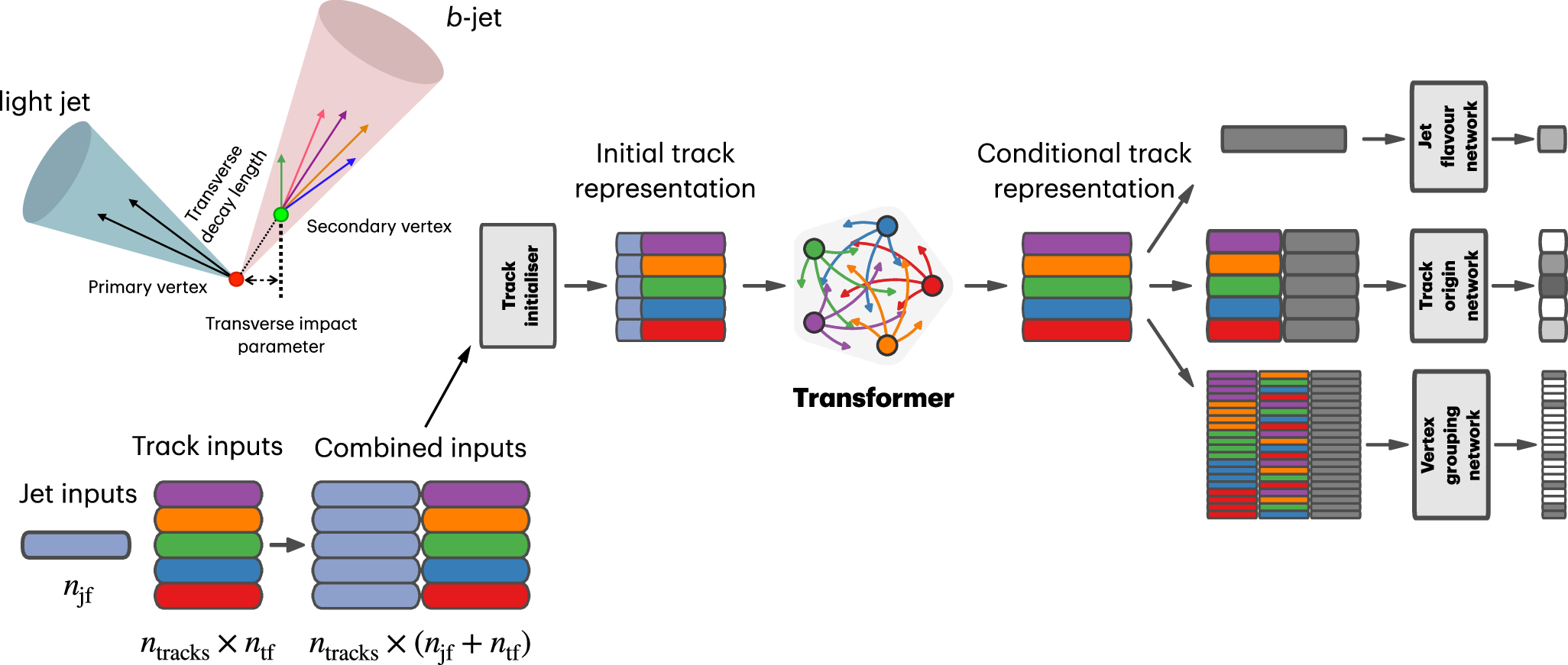
The ATLAS Collaboration, Transforming jet flavour tagging at ATLAS, Nature Comm. 17, 541 (2026)
Transformer-based NN for b-jet tagging
Track+jet becomes “token” in transformer-based DNN architecture.
“Attention” quantifies how these tracks relate to others in same jet.
Resulting ability to identify a jet as originating from a b-quark
with background rejection improved by factor of 1.8 to 3.5.

Slide 15

Systematic uncertainties / modeling
Setup: measure data y, want to estimate parameter μ.
Problem: P(y|μ) in general approximate → systematic error in estimate of μ.
Solution: fix the model, usual by including further adjustable (nuisance) parameter(s) θ: P(y|μ) → P(y|μ,θ)
This inflates the statistical uncertainty on estimate of μ unless then nuisance parameters are themselves well constrained.
Usual procedure:
Original likelihood
New likelihood
Auxiliary measurement u, often u ~ Gauss(θ, σ_{u})

Slide 16
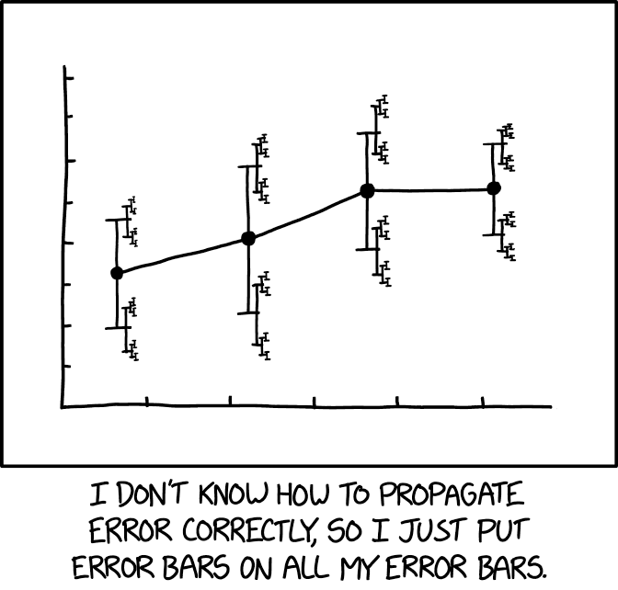
”Errors on errors”
The uncertainties on estimated systematic errors (“errors on errors”) can in general play an important role in many analyses, see:
G. Cowan, Eur. Phys. J. C (2019) 79:133; arXiv:1809.05778
G. Cowan, , EPJ Web of Conferences 258, 09002 (2022); arXiv:2107.02652
E. Canonero, A. Brazzale and G. Cowan, Eur. Phys. J. C (2023) 83:1100; arXiv:2304.10574
E. Canonero, G. Cowan, Eur. Phys. J. C (2025) 85: 156; arXiv:2407.05322
It turns out that models that use
errors on errors have qualitatively
new, interesting, desirable features:
https://xkcd.com/2110/
Sensitivity to outliers reduced.
Confidence intervals sensitive to goodness of fit.
Effect on goodness of fit, p-values, significance.

Slide 17
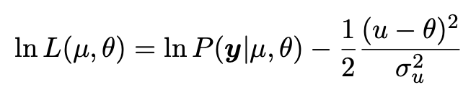
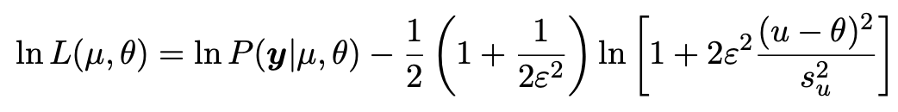
Enzo Canonero
Including the “errors on errors” in a fit
Let σ_{u} → s_{u} become an estimate of the systematic uncertainty,
σ_{u} becomes an adjustable parameter,
Analyst must supply ε = relative “error on the error”
The usual log-likelihood based on u ~ Gauss(θ, σ_{u})
becomes

Slide 18
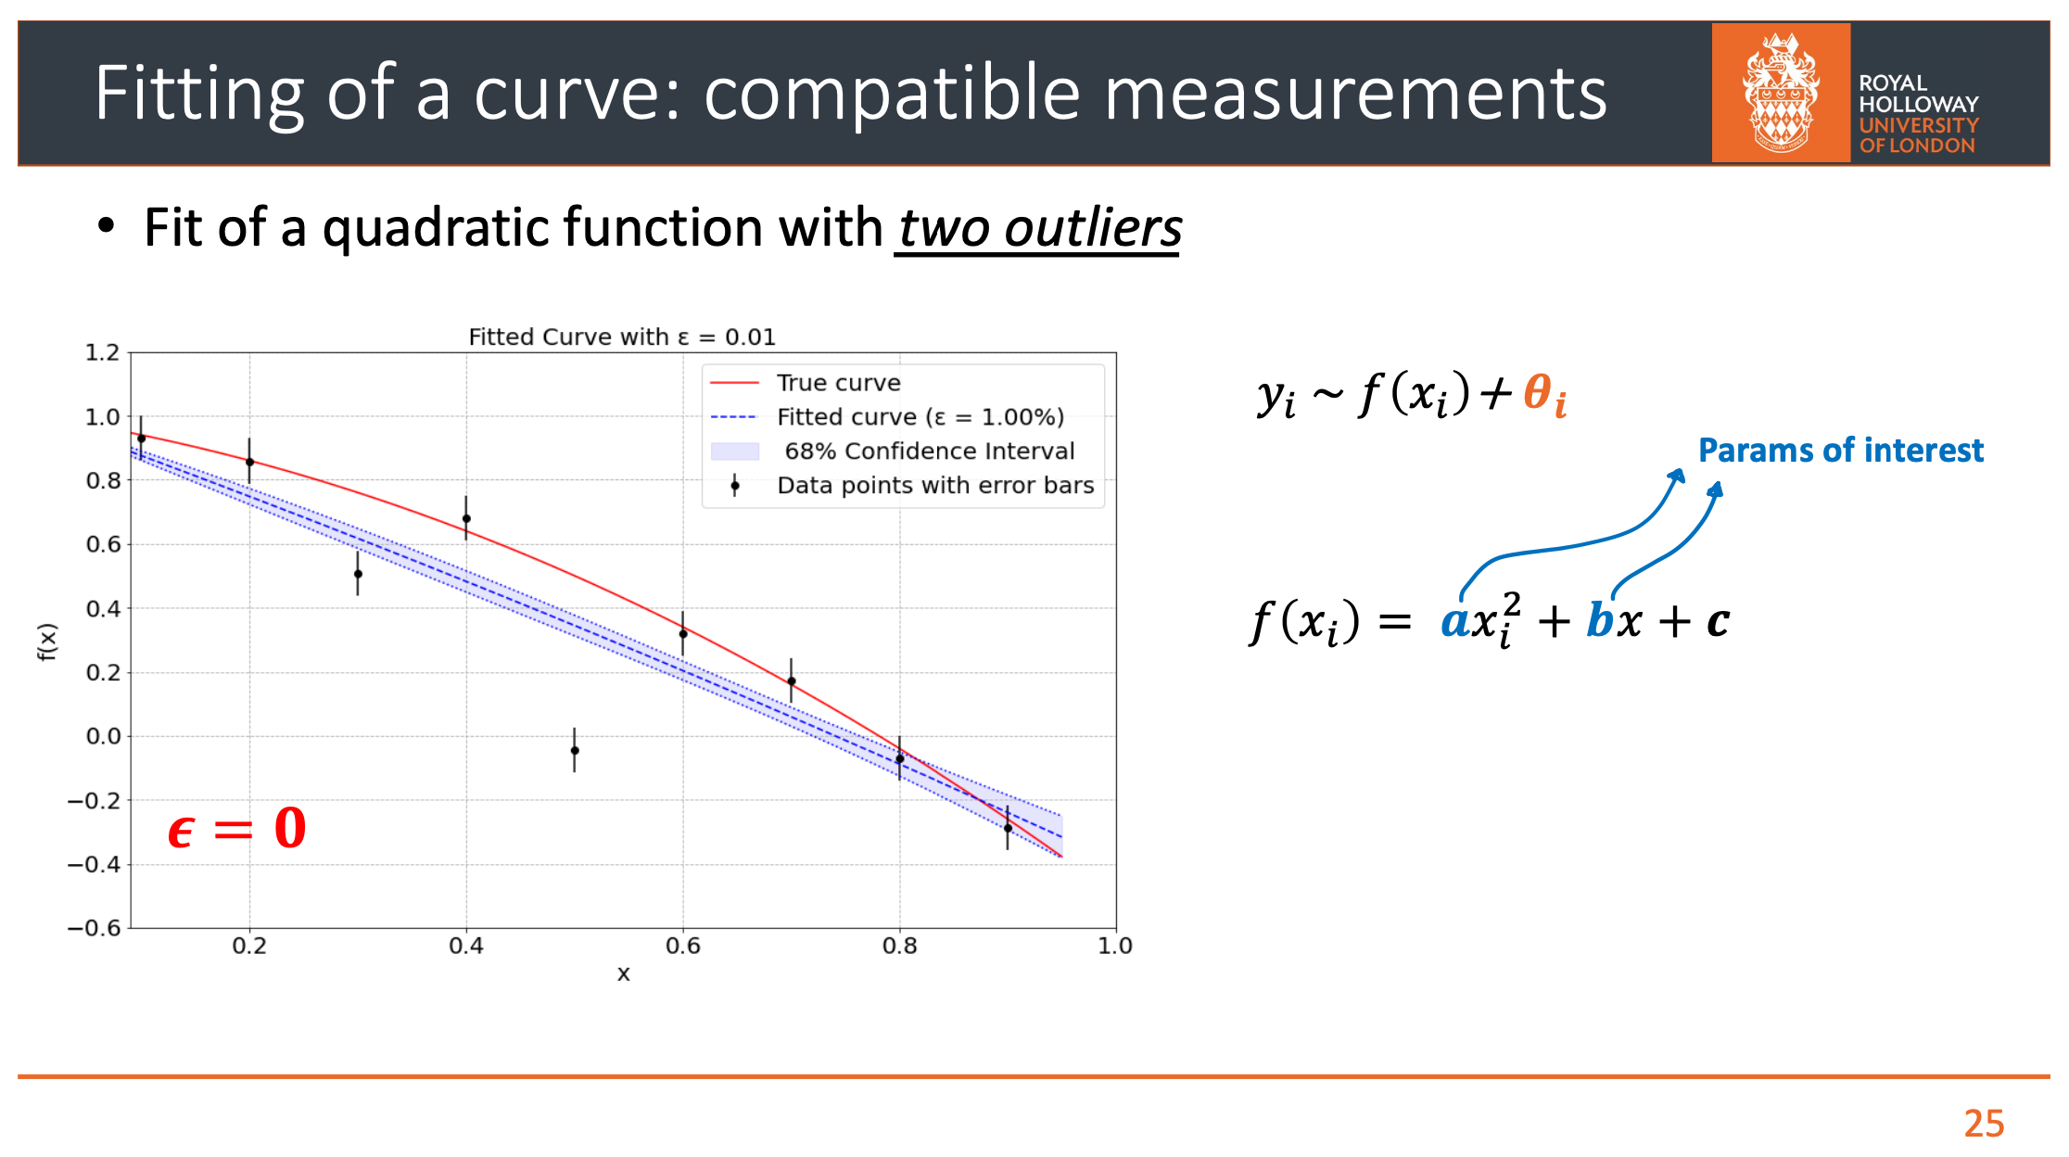
Enzo Canonero
Fitting with outliers (e.g., parton fits)

Slide 19
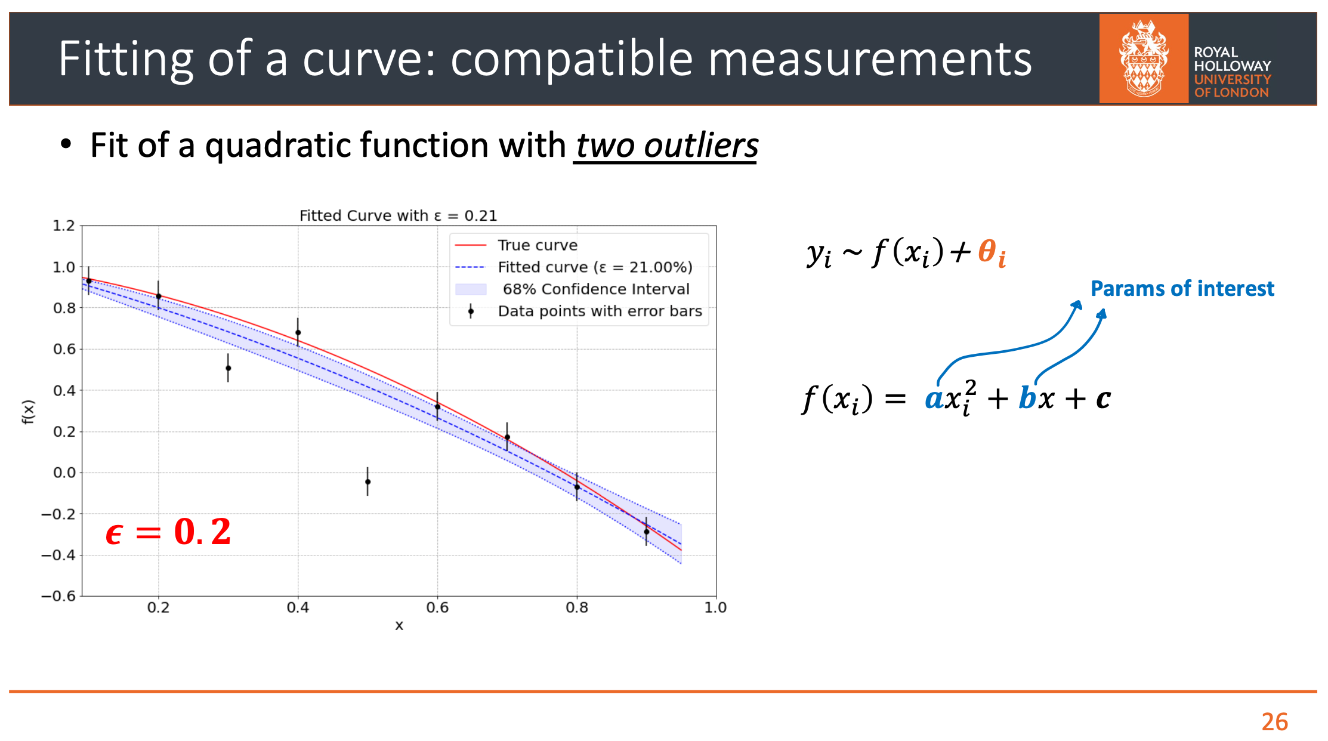
Enzo Canonero

Slide 20
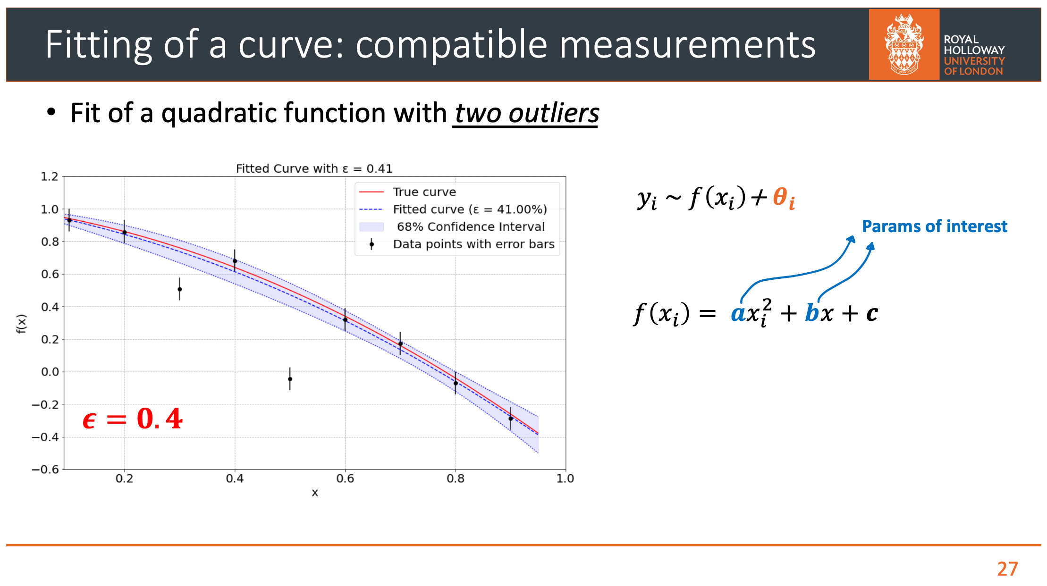
Enzo Canonero

Slide 21
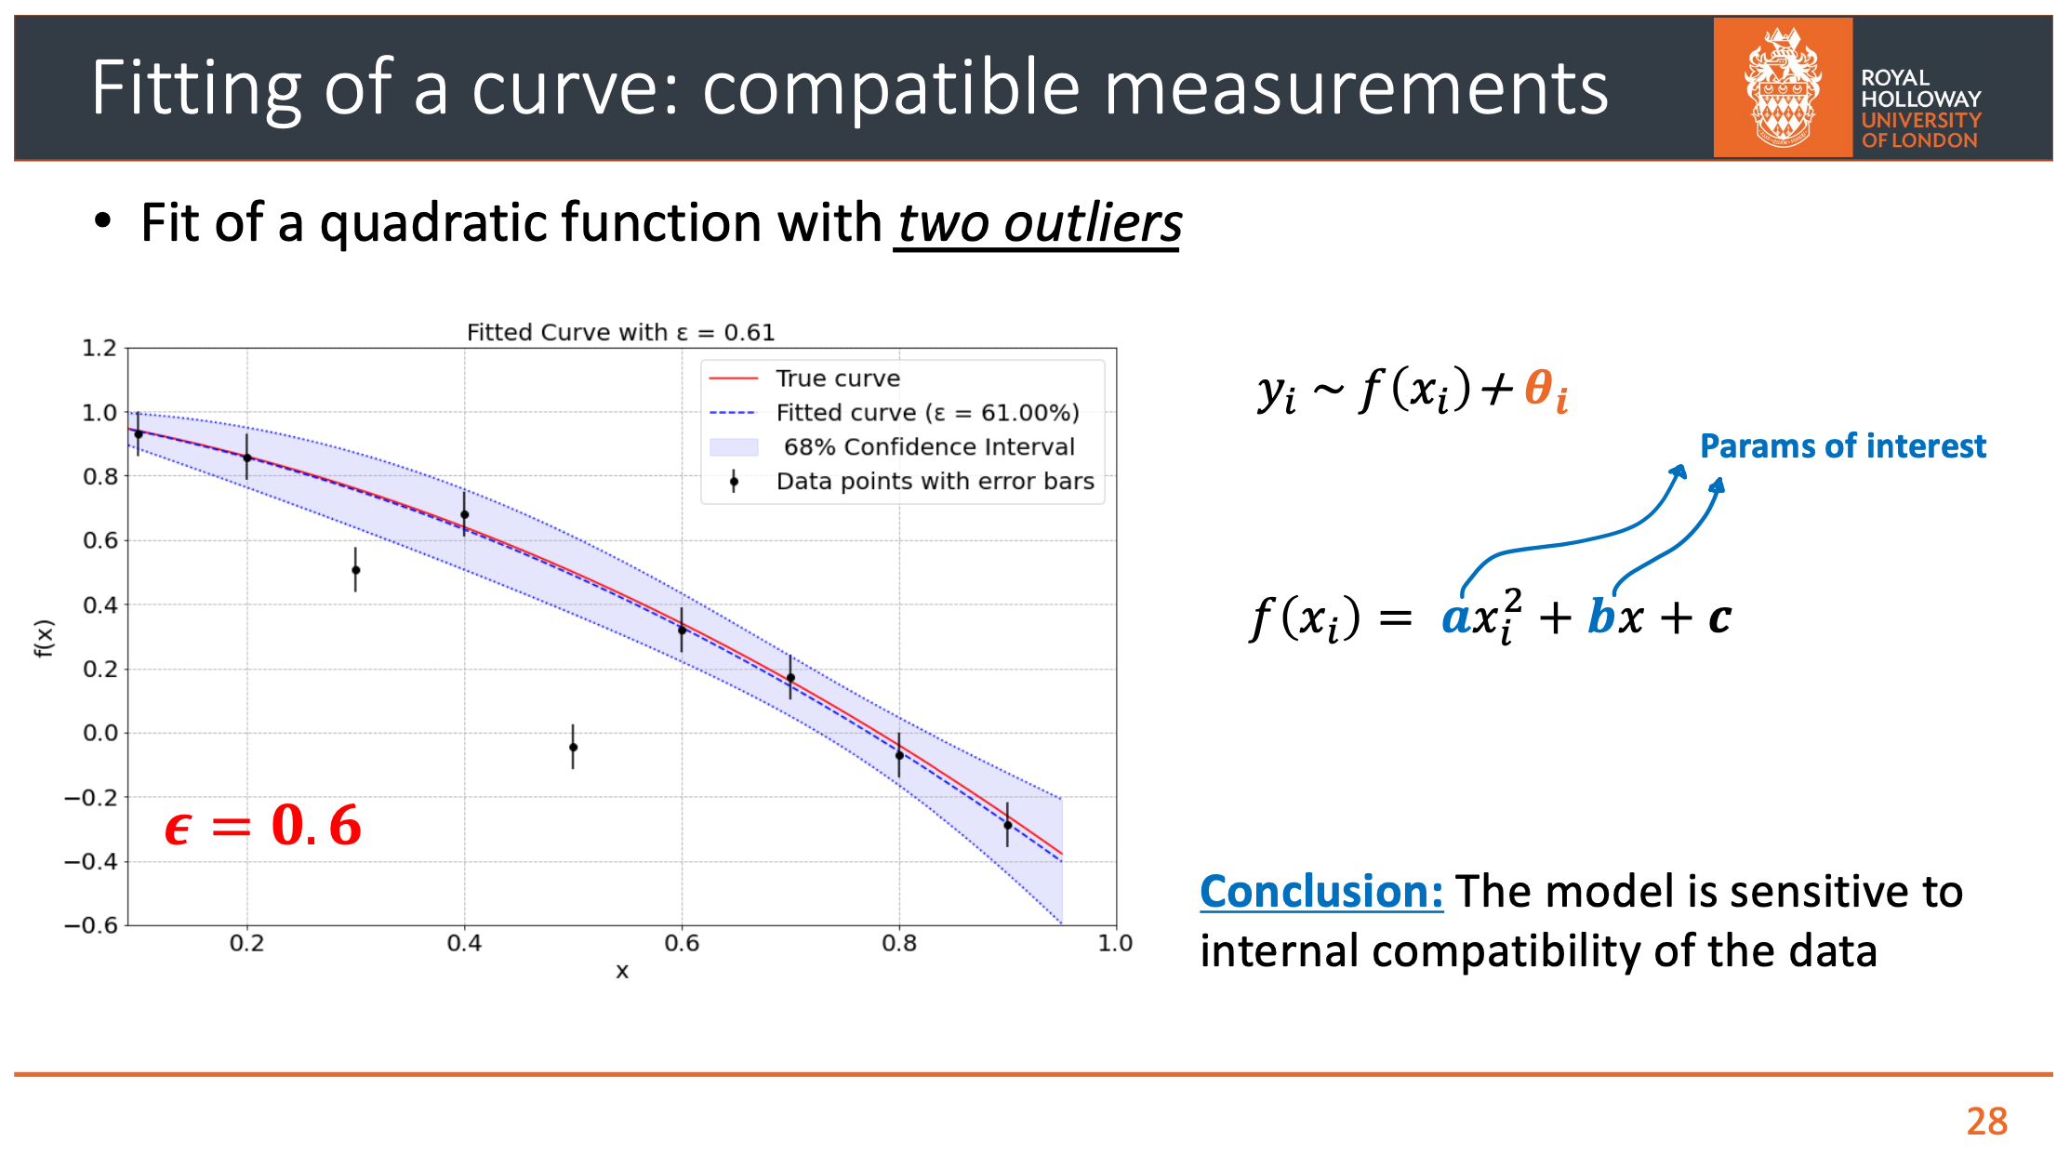
Enzo Canonero

Slide 22
Final thoughts
Statistical data analysis has made significant progress in recent decades; here touched only on three areas:
Attention to subtleties related to foundational issues
Adoption of modern ML methods
Continued development of accurate statistical models
For an overview of recent history, see e.g., PhyStat25 Symposium https://indico.cern.ch/event/1465837/ which concluded that (M. Kuusela, B. Nachman):
”Phystatistics” has emerged as a proper subfield, analogous to biostatistics, with problems requiring distinct expertise, approaches and thinking.
Will Phystatistics become a sandbox of ML/AI algorithms? I think not, because of the fundamental role played by statistics in the scientific method – we will always need to confront our theories with measurements in a way that incorporates all relevant uncertainties.

Slide 23
Extra Slides

Slide 24
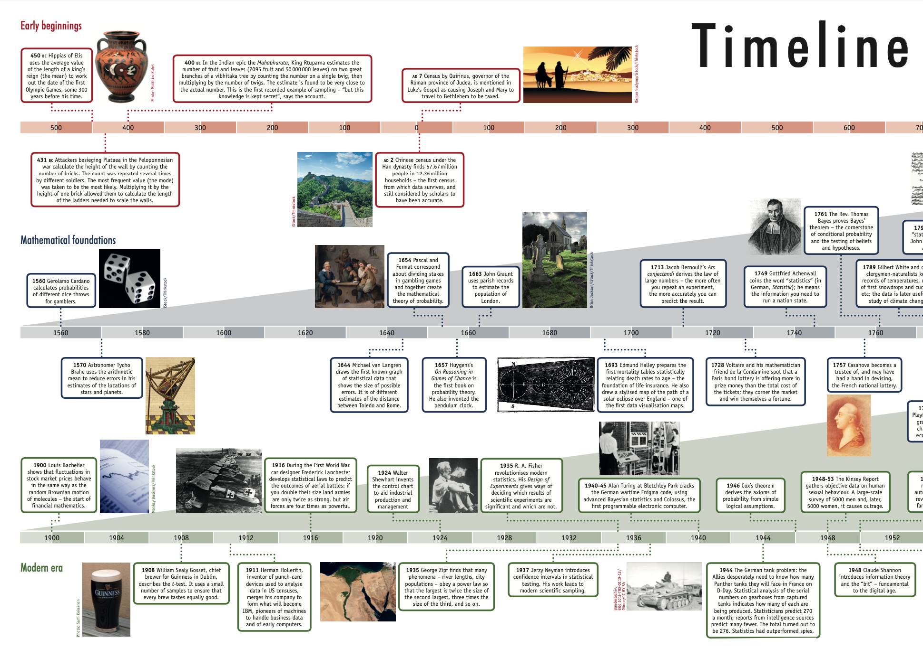
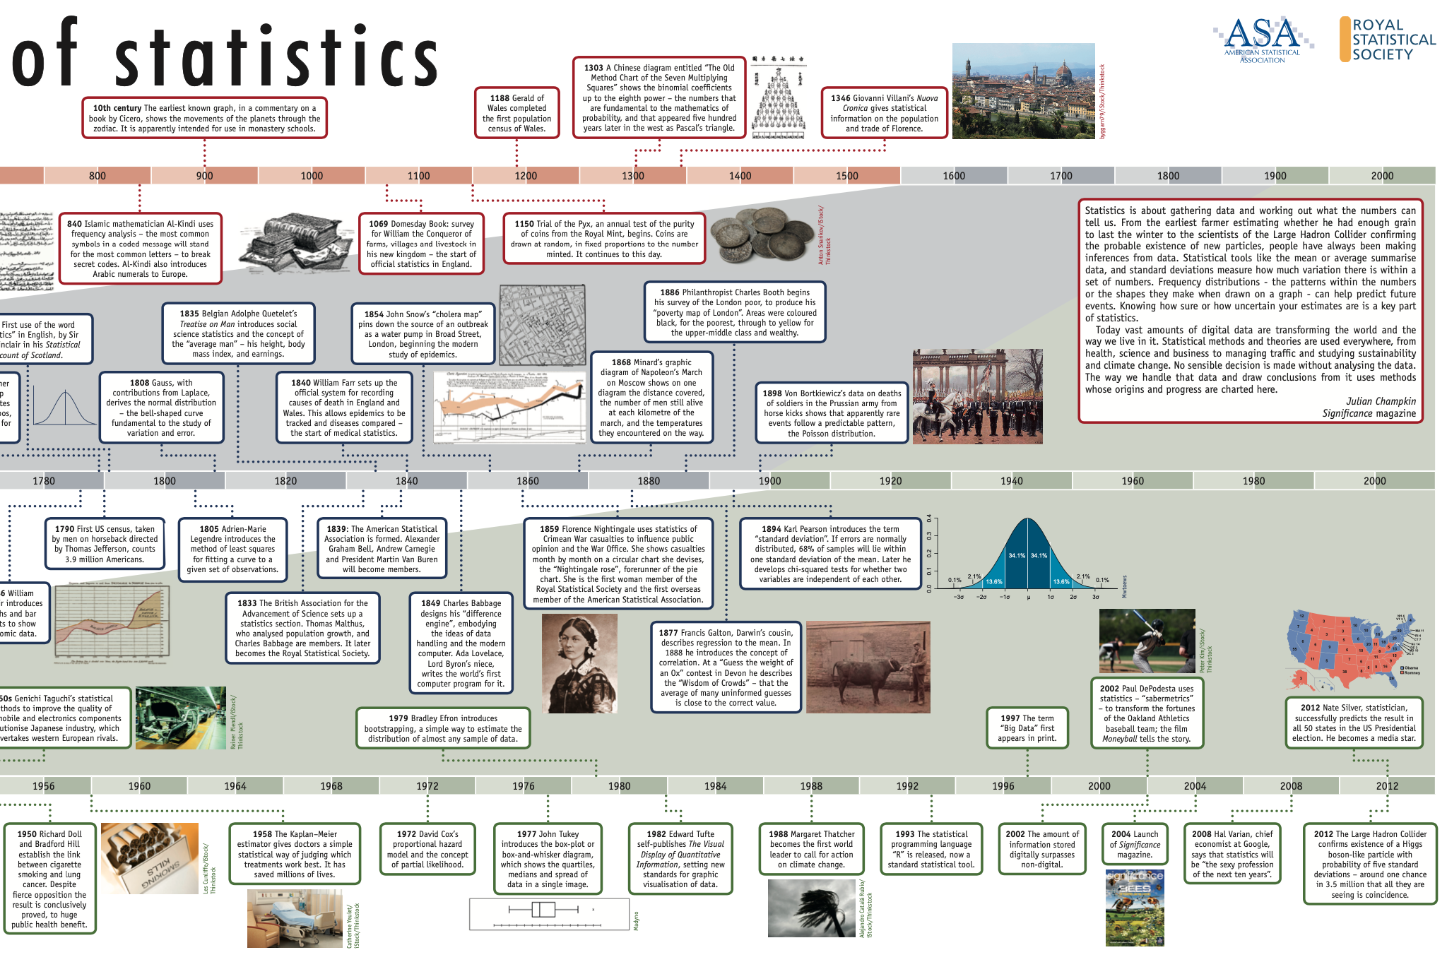
Julian Champkin, Significance, Volume 10, Issue 6, December 2013, Pages 23–26
450 BC, use
of averages,
Hiplas of Elis
2012, discovery of
Higgs boson,
CERN

