Slide 1
Classical interval estimation, limits systematics and beyond - Part I
IN2P3 School of Statistics
Zoom / 19 January 2021
https://indico.in2p3.fr/event/20220/
Glen Cowan
Physics Department
Royal Holloway, University of London
g.cowan@rhul.ac.uk
www.pp.rhul.ac.uk/~cowan

Slide 2
Outline
Interval estimation
Confidence region using Wilks’ theorem
Limits for Poisson parameter

Slide 3
Recap of hypothesis tests
Consider test of a parameter μ, e.g., proportional to cross section.
Result of measurement is data x, whose pdf depends on μ.
To define test of μ, specify critical region w_{μ}, such that probability
to find x ∈ w_{μ} is not greater than α (the size or significance level):
data space Ω
Often use, e.g., α = 0.05.
If observe x ∈ w_{μ}, reject μ.
Equivalently define a p-value p_{μ}
such that the critical region
corresponds to p_{μ} ≤ α.
critical region w

Slide 4
Power of test
In general there are an infinite number of possible critical regions that give the same size α.
To define the test of H₀, consider a relevant alternative H₁ and use it to motivate where to place the critical region.
Roughly speaking, place the critical region where there is a low
probability (α) to be found if H₀ is true, but high if H₁ is true:

Slide 5
Test statistic for p-value
Often define the test with a statistic q_{μ}(x) such that the boundary
of the critical region is q_{μ}(x) = c_{α} for some constant c_{α}.
For examples of statistics based on the profile likelihood ratio,
see, e.g., CCGV, EPJC 71 (2011) 1554; arXiv:1007.1727.
Usually define q_{μ} such that higher values represent increasing
incompatibility between the data and the hypothesized μ, so that the p-value of μ is
observed value of q_{μ}
pdf of q_{μ} assuming μ
Equivalent formulation of test: reject μ if p_{μ} ≤ α.

Slide 6
Confidence intervals by inverting a test
In addition to a ‘point estimate’ of a parameter we should report
an interval reflecting its statistical uncertainty.
Confidence intervals for a parameter θ can be found by
defining a test of the hypothesized value θ (do this for all θ):
Specify values of the data that are ‘disfavoured’ by θ
(critical region) such that P(data in critical region|θ) ≤ α
for a prespecified α, e.g., 0.05 or 0.1.
If data observed in the critical region, reject the value θ.
Now invert the test to define a confidence interval as:
set of θ values that are not rejected in a test of size α
(confidence level CL is 1− α).

Slide 7
Relation between confidence interval and p-value
Equivalently we can consider a significance test for each
hypothesized value of θ, resulting in a p-value, p_{θ}.
If p_{θ} ≤ α, then we reject θ.
The confidence interval at CL = 1 – α consists of those values of
θ that are not rejected.
E.g. an upper limit on θ is the greatest value for which p_{θ} > α.
In practice find by setting p_{θ} = α and solve for θ.
For a multidimensional parameter space θ = (θ₁,... θ_{M}) use same idea – result is a confidence “region” with boundary determined by p_{θ} = α.

Slide 8
Coverage probability of confidence interval
If the true value of θ is rejected, then it’s not in the confidence interval. The probability for this is by construction (equality for continuous data):
P(reject θ|θ) ≤ α = type-I error rate
Therefore, the probability for the interval to contain or “cover” θ is
P(conf. interval “covers” θ|θ) ≥ 1 – α
This assumes that the set of θ values considered includes the true value, i.e., it assumes the composite hypothesis P(x|H,θ).

Slide 9
Example: upper limit on mean of Gaussian
When we test the parameter, we should take the critical region to maximize the power with respect to the relevant alternative(s).
Example: x ~ Gauss(μ, σ) (take σ known)
Test H₀ : μ = μ₀ versus the alternative H₁ : μ < μ₀
→ Put w_{μ} at region of x-space
characteristic of low μ (i.e. at low x)
Equivalently, take the p-value to be

Slide 10
Upper limit on Gaussian mean (2)
To find confidence interval, repeat for all μ₀, i.e., set p_{μ0} = α and solve for μ₀ to find the interval’s boundary
This is an upper limit on μ, i.e., higher μ have even lower p-value and are in even worse agreement with the data.
Usually use Φ⁻¹(α) = −Φ⁻¹(1−α) so as to express the upper limit as x_{obs} plus a positive quantity. E.g. for α = 0.05, Φ⁻¹(1−0.05) = 1.64.

Slide 11
Upper limit on Gaussian mean (3)
μ_{up} = the hypothetical value of μ such that there is only a probability α to find x < x_{obs}.

Slide 12
1- vs. 2-sided intervals
Now test: H₀ : μ = μ₀ versus the alternative H₁ : μ ≠ μ₀
I.e. we consider the alternative to μ₀ to include higher and lower values, so take critical region on both sides:
Result is a “central” confidence interval [μ_{lo}, μ_{up}]:
E.g. for
Note upper edge of two-sided interval is higher (i.e. not as tight
of a limit) than obtained from the one-sided test.

Slide 13
On the meaning of a confidence interval
Often we report the confidence interval [a,b] together with the point estimate as an “asymmetric error bar”, e.g.,
E.g. (at CL = 1 – α = 68.3%):
Does this mean P(80.00 < θ < 80.56) = 68.3%? No, not for a frequentist confidence interval. The parameter θ does not fluctuate upon repetition of the measurement; the endpoints of the interval do, i.e., the endpoints of the interval fluctuate (they are functions of data):

Slide 14
Approximate confidence intervals/regions from the likelihood function
Suppose we test parameter value(s) θ = (θ₁, ..., θ_{n}) using the ratio
Lower λ(θ) means worse agreement between data and hypothesized θ. Equivalently, usually define
so higher t_{θ} means worse agreement between θ and the data.
p-value of θ therefore
need pdf

Slide 15
Confidence region from Wilks’ theorem
Wilks’ theorem says (in large-sample limit and provided
certain conditions hold...)
chi-square dist. with # d.o.f. =
# of components in θ = (θ₁, ..., θ_{n}).
Assuming this holds, the p-value is
← set equal to α
To find boundary of confidence region set p_{θ} = α and solve for t_{θ}:
Recall also

Slide 16
Confidence region from Wilks’ theorem (cont.)
i.e., boundary of confidence region in θ space is where
For example, for 1 – α = 68.3% and n = 1 parameter,
and so the 68.3% confidence level interval is determined by
Same as recipe for finding the estimator’s standard deviation, i.e.,
is a 68.3% CL confidence interval.

Slide 17
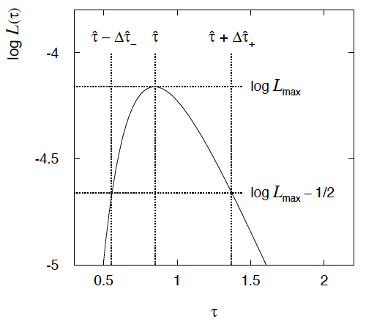
Example of interval from ln L(θ)
For n=1 parameter, CL = 0.683, Q_{α} = 1.
Our exponential
example, now with
only n = 5 events.
Can report ML estimate
with approx. confidence
interval from ln L_{max} – 1/2
as “asymmetric error bar”:

Slide 18
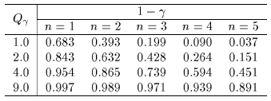
Multiparameter case
For increasing number of parameters, CL = 1 – α decreases for
confidence region determined by a given

Slide 19
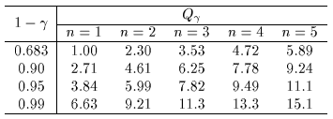
Multiparameter case (cont.)
Equivalently, Q_{α} increases with n for a given CL = 1 – α.

Slide 20
Frequentist upper limit on Poisson parameter
Consider again the case of observing n ~ Poisson(s + b).
Suppose b = 4.5, n_{obs} = 5. Find upper limit on s at 95% CL.
Relevant alternative is s = 0 (critical region at low n)
p-value of hypothesized s is P(n ≤ n_{obs}; s, b)
Upper limit s_{up} at CL = 1 – α found from

Slide 21
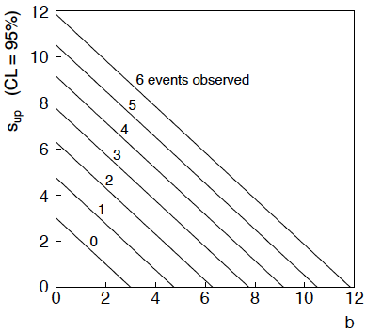
n ~ Poisson(s+b): frequentist upper limit on s
For low fluctuation of n, formula can give negative result for s_{up}; i.e. confidence interval is empty; all values of s ≥ 0 have p_{s} ≤ α.

Slide 22
Limits near a boundary of the parameter space
Suppose e.g. b = 2.5 and we observe n = 0.
If we choose CL = 0.9, we find from the formula for s_{up}
Physicist:
We already knew s ≥ 0 before we started; can’t use negative
upper limit to report result of expensive experiment!
Statistician:
The interval is designed to cover the true value only 90%
of the time — this was clearly not one of those times.
Not uncommon dilemma when testing parameter values for which
one has very little experimental sensitivity, e.g., very small s.

Slide 23
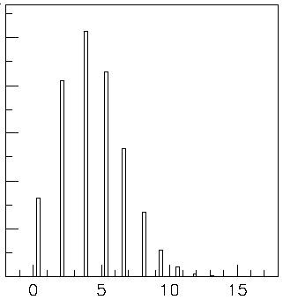
Expected limit for s = 0
Physicist: I should have used CL = 0.95 — then s_{up} = 0.496
Even better: for CL = 0.917923 we get s_{up} = 10⁻⁴ !
Reality check: with b = 2.5, typical Poisson fluctuation in n is
at least √2.5 = 1.6. How can the limit be so low?
Look at the mean limit for the
no-signal hypothesis (s = 0)
(sensitivity).
Distribution of 95% CL limits
with b = 2.5, s = 0.
Mean upper limit = 4.44

Slide 24
The Bayesian approach to limits
In Bayesian statistics need to start with ‘prior pdf’ π(θ), this
reflects degree of belief about θ before doing the experiment.
Bayes’ theorem tells how our beliefs should be updated in
light of the data x:
Integrate posterior pdf p(θ|x) to give interval with any desired
probability content.
For e.g. n ~ Poisson(s+b), 95% CL upper limit on s from

Slide 25
Bayesian prior for Poisson parameter
Include knowledge that s ≥ 0 by setting prior π(s) = 0 for s < 0.
Could try to reflect ‘prior ignorance’ with e.g.
Not normalized; can be OK provided L(s) dies off quickly for large s.
Not invariant under change of parameter — if we had used instead a flat prior for a nonlinear function of s, then this would imply a non-flat prior for s.
Doesn’t really reflect a reasonable degree of belief, but often used as a point of reference; or viewed as a recipe for producing an interval whose frequentist properties can be studied (e.g., coverage probability, which will depend on true s).

Slide 26
Bayesian upper limit with flat prior for s
Put Poisson likelihood and flat prior into Bayes’ theorem:
Normalize to unit area:
upper incomplete
gamma function
Upper limit s_{up} determined by requiring

Slide 27
Bayesian interval with flat prior for s
Solve to find limit s_{up}:
where
For special case b = 0, Bayesian upper limit with flat prior
numerically same as one-sided frequentist case (‘coincidence’).

Slide 28
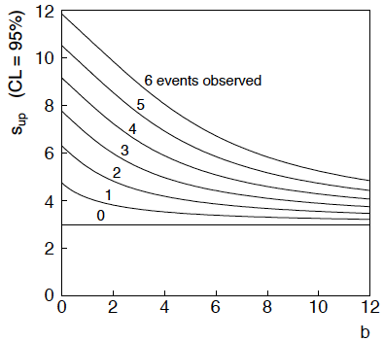
Bayesian interval with flat prior for s
For b > 0 Bayesian limit is everywhere greater than the (one sided) frequentist upper limit.
Never goes negative. Doesn’t depend on b if n = 0.

Slide 29
Priors from formal rules
Last time we took the prior for a Poisson mean to be constant to reflect a lack of prior knowledge; we noted this was not invariant under change of parameter.
Because of difficulties in encoding a vague degree of belief
in a prior, one often attempts to derive the prior from formal rules,
e.g., to satisfy certain invariance principles or to provide maximum
information gain for a certain set of measurements.
Often called “objective priors”
Form basis of Objective Bayesian Statistics
The priors do not reflect a degree of belief (but might represent
possible extreme cases).
In Objective Bayesian analysis, can use the intervals in a
frequentist way, i.e., regard Bayes’ theorem as a recipe to produce
an interval with a given coverage probability.

Slide 30
Priors from formal rules (cont.)
For a review of priors obtained by formal rules see, e.g.,
Formal priors have not been widely used in Particle Physics, but there has been interest in this direction, especially the reference priors of Bernardo and Berger; see e.g.
L. Demortier, S. Jain and H. Prosper, Reference priors for high
energy physics, Phys. Rev. D 82 (2010) 034002, arXiv:1002.1111.
D. Casadei, Reference analysis of the signal + background model
in counting experiments, JINST 7 (2012) 01012; arXiv:1108.4270.

Slide 31
Jeffreys prior
According to Jeffreys’ rule, take prior according to
where
is the Fisher information matrix.
One can show that this leads to inference that is invariant under
a transformation of parameters in the following sense:
Start with the Jeffreys prior for θ: π_{θ}(θ) ~ √(det I(θ))
Use it in Bayes’ theorem to find:

Slide 32
Jeffreys prior (2)
Now consider a function η(θ). The posterior for η is
Alternatively, start with η and use its Jeffreys’ prior:
Use this in Bayes’ theorem:
One can show that Jeffreys’ prior results in the same P(η|x) in both cases. For details (single-parameter case) see:
http://www.pp.rhul.ac.uk/~cowan/stat/notes/JeffreysInvariance.pdf

Slide 33
Jeffreys prior for Poisson mean
Suppose n ~ Poisson(μ). To find the Jeffreys’ prior for μ,
So e.g. for μ = s + b, this means the prior π(s) ~ 1/√(s + b), which depends on b. But this is not designed as a degree of belief about s.

Slide 34
Posterior pdf for Poisson mean
From Bayes’ theorem,
Flat, π(μ) = const.
Jeffreys, π(μ) ~ 1/√μ
In both cases, posterior is special case of gamma distribution.

Slide 35
Upper limit for Poisson mean
To find upper limit at CL = 1−α, solve
Jeffreys prior:
= 7.03
n=3,
CL=0.95
Flat prior:
= 7.75
where P⁻¹ is the inverse of the normalized lower incomplete gamma function (see scipy.special)

Slide 36
Extra slides

Slide 37
Choosing a critical region
To construct a test of a hypothesis H₀, we can ask what are the
relevant alternatives for which one would like to have a high power.
Maximize power wrt H₁ = maximize probability to
reject H₀ if H₁ is true.
Often such a test has a high power not only with respect to a
specific point alternative but for a class of alternatives.
E.g., using a measurement x ~ Gauss (μ, σ) we may test
H₀ : μ = μ₀ versus the composite alternative H₁ : μ > μ₀
We get the highest power with respect to any μ > μ₀ by taking
the critical region x ≥ x_{c} where the cut-off x_{c} is determined by
the significance level such that
α = P(x ≥x_{c}|μ₀).

Slide 38
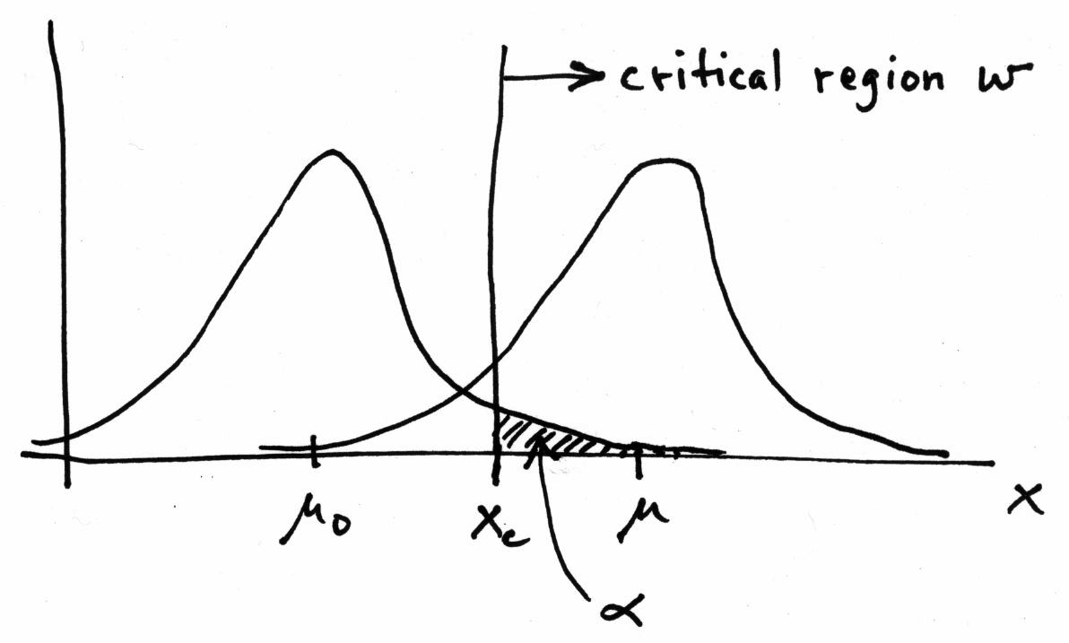
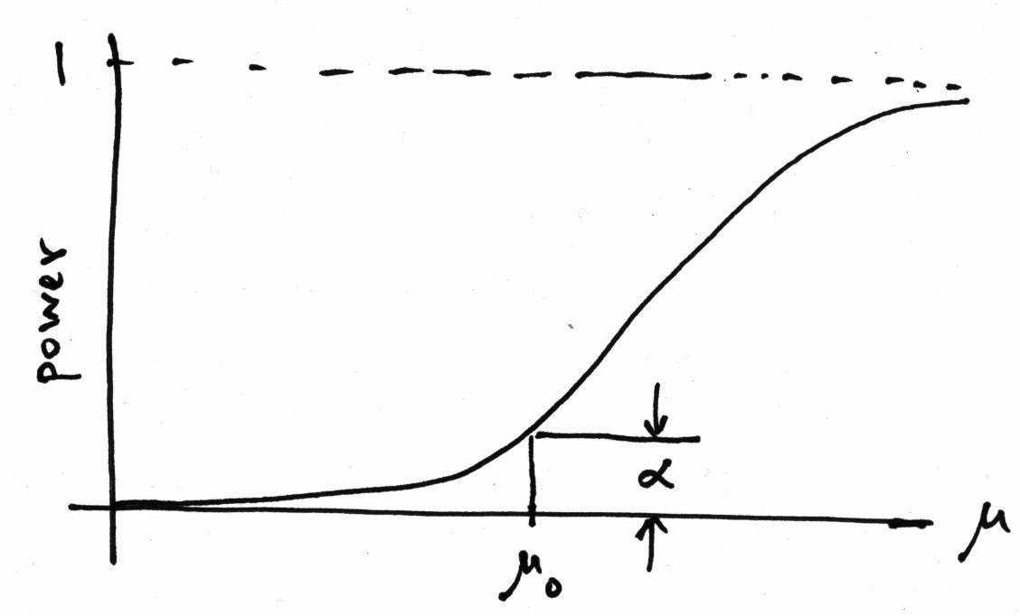
Τest of μ = μ₀ vs. μ > μ₀ with x ~ Gauss(μ,σ)
Standard Gaussian
cumulative distribution
Standard Gaussian quantile

Slide 39
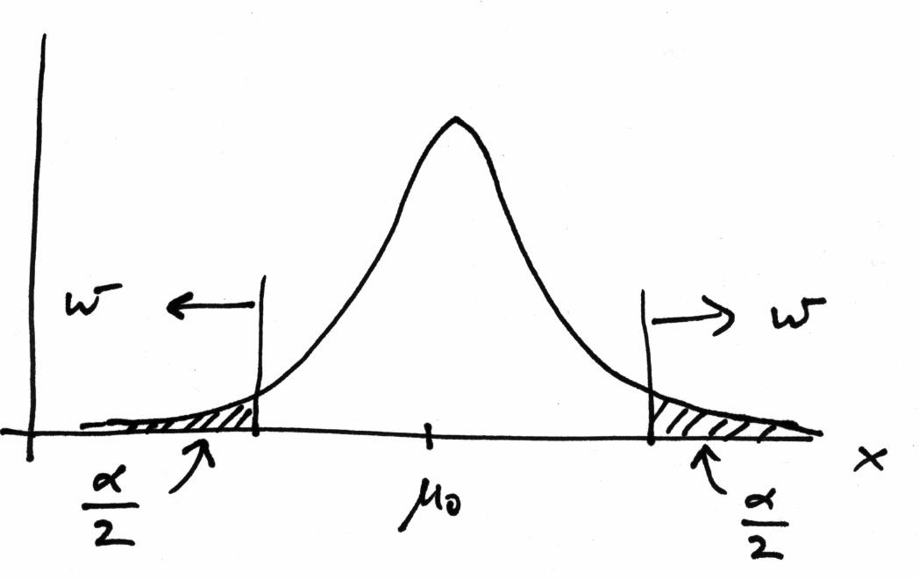
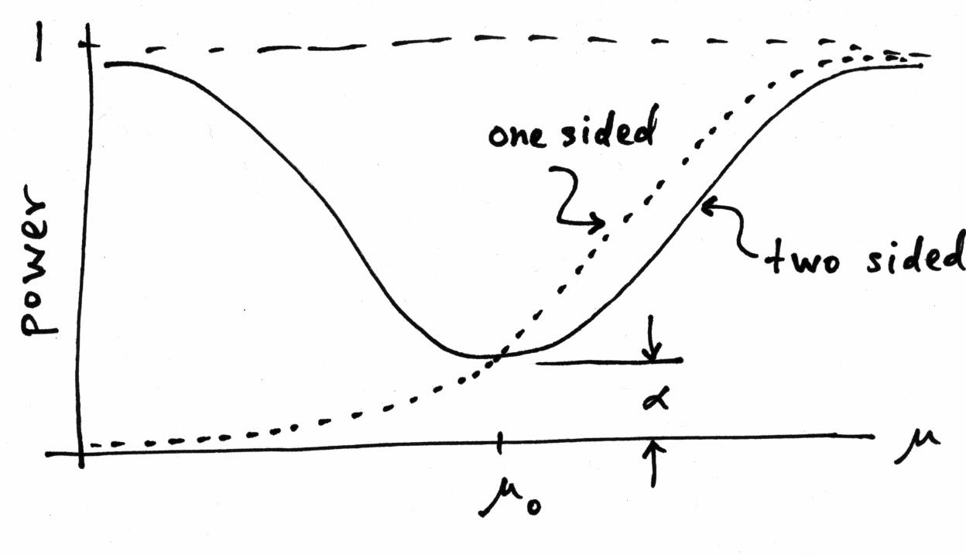
Choice of critical region based on power (3)
But we might consider μ < μ₀ as well as μ > μ₀ to be viable alternatives, and choose the critical region to contain both high and low x (a two-sided test).
New critical region now
gives reasonable power
for μ < μ₀, but less power
for μ > μ₀ than the original
one-sided test.

Slide 40
No such thing as a model-independent test
In general we cannot find a single critical region that gives the
maximum power for all possible alternatives (no “Uniformly
Most Powerful” test).
In HEP we often try to construct a test of
H₀ : Standard Model (or “background only”, etc.)
such that we have a well specified “false discovery rate”,
α = Probability to reject H₀ if it is true,
and high power with respect to some interesting alternative,
H₁ : SUSY, Z′, etc.
But there is no such thing as a “model independent” test. Any
statistical test will inevitably have high power with respect to
some alternatives and less power with respect to others.

Slide 41
p-value from test statistic
x_{j}
x_{obs}
ω> = { x : x “more
compatible” with H }
surface described by test statistic
ω≤ = { x : x “less
or eq. compatible”
with H }
x_{i}
If e.g. we define the region of less or eq. compatibility to be t(x) ≥ t_{obs} then the p-value of H is

Slide 42
Distribution of the p-value
The p-value is a function of the data, and is thus itself a random
variable with a given distribution. Suppose the p-value of H is
found from a test statistic t(x) as
The pdf of p_{H} under assumption of H is
g(p_{H}|H′)
In general for continuous data, under
assumption of H, p_{H} ~ Uniform[0,1]
and is concentrated toward zero for
some (broad) class of alternatives.
g(p_{H}|H)
p_{H}
0
1

