Slide 1

Statistical Data Analysis
Material for Tutorials
(with solutions)
Glen Cowan
Physics Department
Royal Holloway, University of London
g.cowan@rhul.ac.uk
www.pp.rhul.ac.uk/~cowan
[With thanks to Hans Dembinski, Greg Ashton, Asher Kaboth, and Enzo Canonero.]

Slide 2
Outline
Tutorial 1: Maximum Likelihood fitting
Confidence regions from log-likelihood
Tutorial 2: Bayesian parameter estimation
Markov Chain Monte Carlo
Tutorial 3: Hypothesis tests
Experimental sensitivity
----------------------------------------------------------------------------
Tutorial 4 (extra): Student’s t average

Slide 3
Tutorial Materials
The exercises involve some paper-and-pencil calculations and running/modifying python programs.
To use python on your own computer, you will need to install the package iminuit (should just work with “pip install iminuit”). See:
https://pypi.org/project/iminuit/

Slide 4
Tutorial 1: Maximum Likelihood
The materials for this tutorial can be found on
https://www.pp.rhul.ac.uk/~cowan/stat/exercises/mlFit/
The exercise and are described in the file ml_fit_exericise.pdf.
The exercises for parameter estimation are done with the program mlFit.py (or with jupyter mlFit.ipynb).
The exercise does an unbinned maximum-likelihood fit and analysis of the uncertainties.

Slide 5
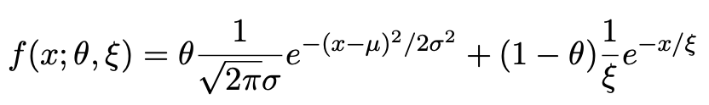
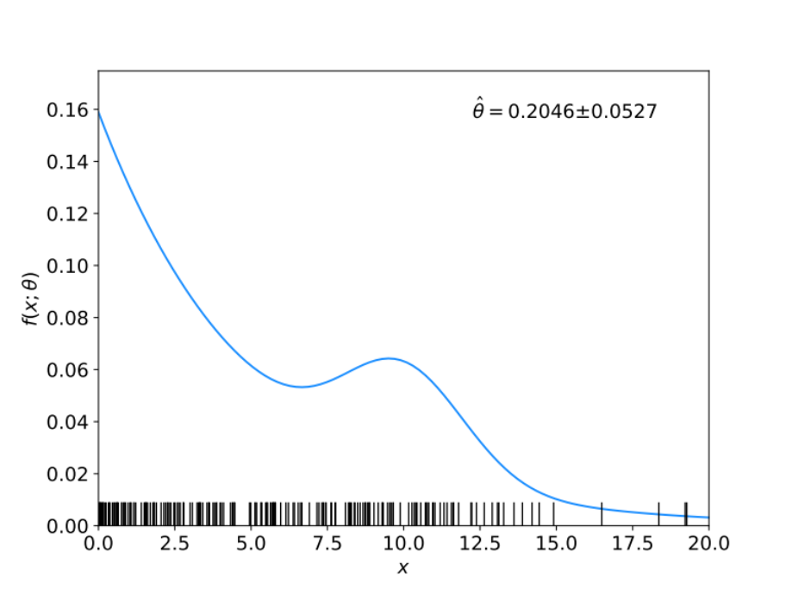
Gaussian signal on exponential background
Consider a pdf for continuous random variable x, (truncate and renormalize in 0 ≤ x ≤ x_{max})
θ = parameter of interest ,
gives signal rate.
Depending on context, take ξ, μ, σ as nuisance parameters or fixed.
Generate i.i.d. sample x₁,..., x_{n}.
Estimate θ (and other params.)

Slide 6
A quick look at mlFit.py
# Example of maximum-likelihood fit with iminuit version 2.
# pdf is a mixture of Gaussian (signal) and exponential (background),
# truncated in [xMin,xMax].
# G. Cowan / RHUL Physics / December 2022
import numpy as np
import scipy.stats as stats
from scipy.stats import truncexpon
from scipy.stats import truncnorm
from scipy.stats import chi2
import iminuit
from iminuit import Minuit
import matplotlib.pyplot as plt
from matplotlib import container
plt.rcParams["font.size"] = 14
print("iminuit version:", iminuit.__version__) # need 2.x
# define pdf and generate data
np.random.seed(seed=1234567) # fix random seed
theta = 0.2 # fraction of signal
mu = 10. # mean of Gaussian
sigma = 2. # std. dev. of Gaussian
xi = 5. # mean of exponential
xMin = 0.
xMax = 20.

Slide 7
Define the fit function
def f(x, par):
theta = par[0]
mu = par[1]
sigma = par[2]
xi = par[3]
fs = stats.truncnorm.pdf(x, a=(xMin-mu)/sigma, b=(xMax-mu)/sigma, loc=mu, scale=sigma)
fb = stats.truncexpon.pdf(x, b=(xMax-xMin)/xi, loc=xMin, scale=xi)
return theta*fs + (1-theta)*fb
Generate the data
numVal = 200
xData = np.empty([numVal])
for i in range (numVal):
r = np.random.uniform();
if r < theta:
xData[i] = stats.truncnorm.rvs(a=(xMin-mu)/sigma, b=(xMax-mu)/sigma,
loc=mu, scale=sigma)
else:
xData[i] = stats.truncexpon.rvs(b=(xMax-xMin)/xi, loc=xMin, scale=xi)

Slide 8
Set up the fit
# Function to be minimized is negative log-likelihood
def negLogL(par):
pdf = f(xData, par)
return -np.sum(np.log(pdf))
# Initialize Minuit and set up fit:
parin = np.array([theta, mu, sigma, xi]) # initial values (here = true values)
parname = ['theta', 'mu', 'sigma', 'xi']
parname_latex = [r'$\theta$', r'$\mu$', r'$\sigma$', r'$\xi$']
parstep = np.array([0.1, 1., 1., 1.]) # initial setp sizes
parfix = [False, True, True, False] # change these to fix/free parameters
parlim = [(0.,1), (None, None), (0., None), (0., None)] # set limits
m = Minuit(negLogL, parin, name=parname)
m.errors = parstep
m.fixed = parfix
m.limits = parlim
m.errordef = 0.5 # errors from lnL = lnLmax - 0.5

Slide 9
Do the fit, get errors, extract results
# Do the fit, get errors, extract results
m.migrad() # minimize -logL
MLE = m.values # max-likelihood estimates
sigmaMLE = m.errors # standard deviations
cov = m.covariance # covariance matrix
rho = m.covariance.correlation() # correlation coeffs.
print(r"par index, name, estimate, standard deviation:")
for i in range(m.npar):
if not m.fixed[i]:
print("{:4d}".format(i), "{:<10s}".format(m.parameters[i]), " = ",
"{:.6f}".format(MLE[i]), " +/- ", "{:.6f}".format(sigmaMLE[i]))
print()
print(r"free par indices, covariance, correlation coeff.:")
for i in range(m.npar):
if not(m.fixed[i]):
for j in range(m.npar):
if not(m.fixed[j]):
print(i, j, "{:.6f}".format(cov[i,j]), "{:.6f}".format(rho[i,j]))
Make some plots...

Slide 10
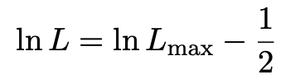
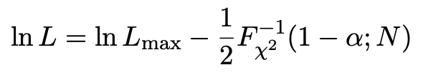

Comment on the lnL = lnL_{max} – ½ contour
In the lectures, we saw that the standard deviations of fitted parameters are found from the tangent lines (planes) to the contour
A similar procedure can be used to find a confidence region in the parameter space that will cover the true parameter with probability CL = 1 – α (the “confidence level”). This uses the contour
, N = number of parameters
If you want the contour lnL = lnL_{max} – ½ in iminuit, you need to choose CL (= 1 – α) such that F_{χ2}⁻¹(1 – α,N) = 1, i.e.,

Slide 11
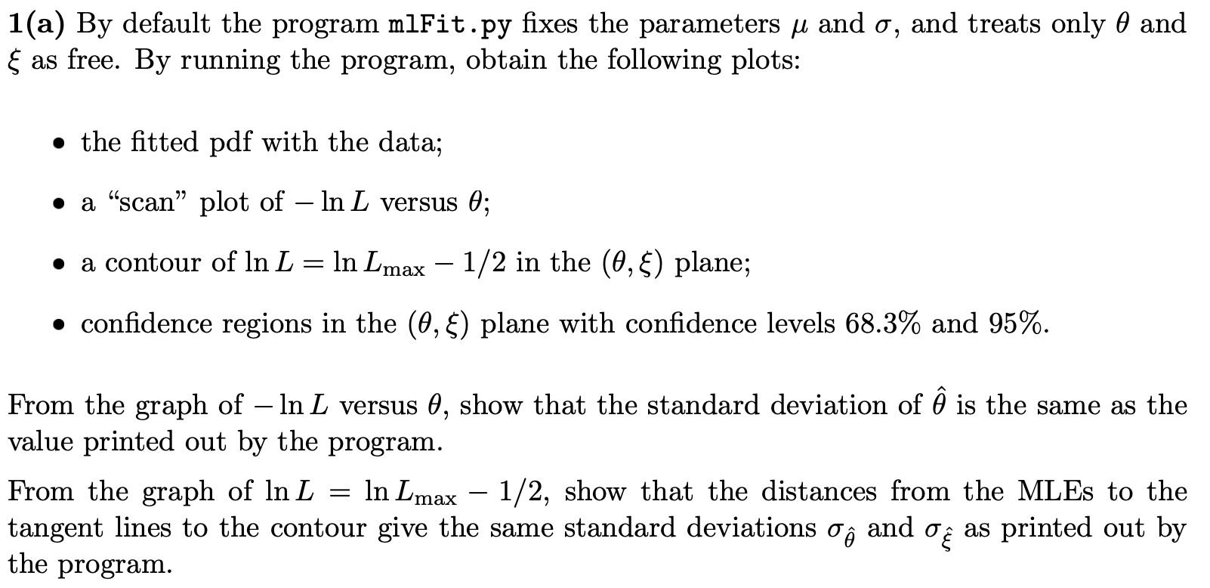
Exercises on Maximum Likelihood (a)
1a) Run mlFit.py, look at the plots

Slide 12
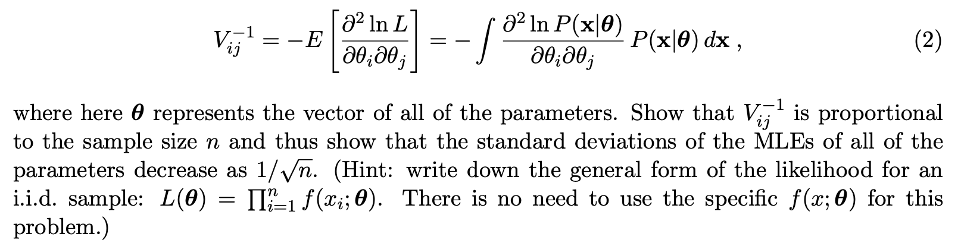
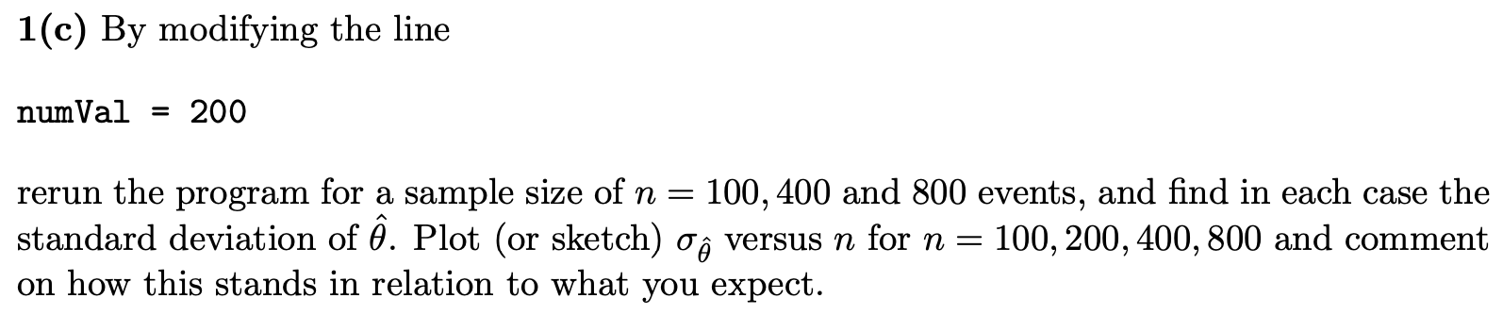
Exercises on Maximum Likelihood (b,c)
1b,c) show standard deviation of estimator ~ 1/√n

Slide 13
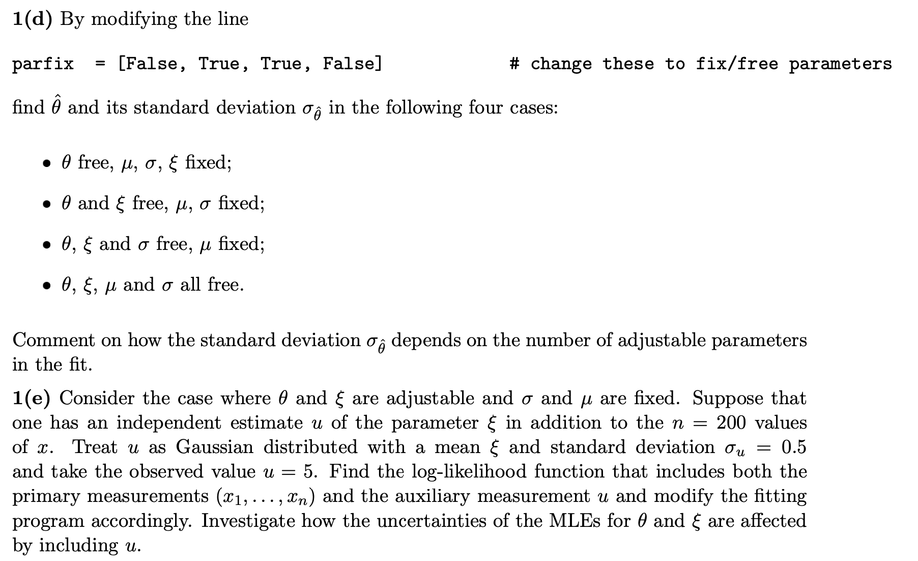
Exercises on Maximum Likelihood (d,e)
1d,e) Investigate effect of nuisance parameters

Slide 14
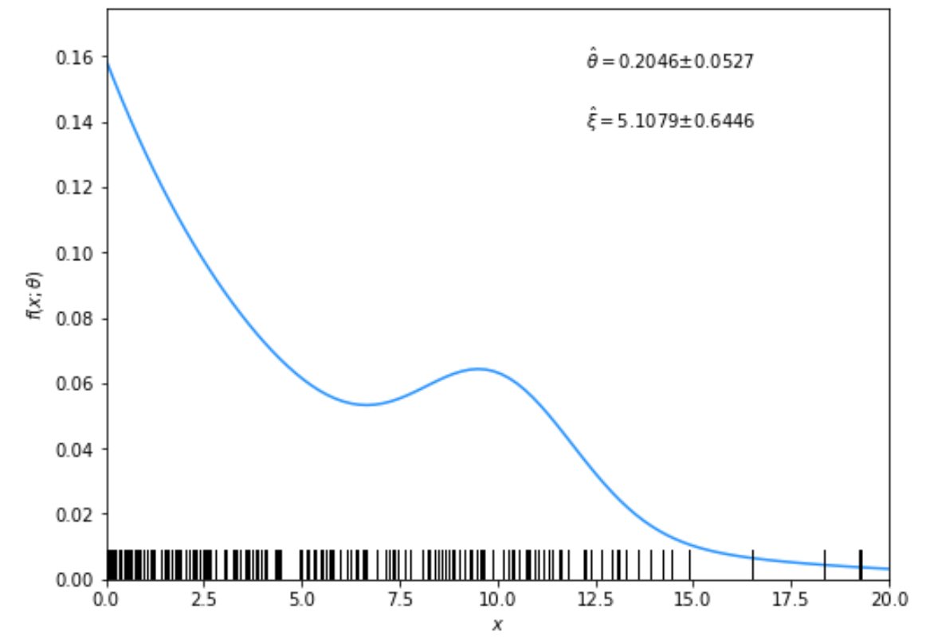
Solutions to exercises
1a) Running the program mlFit.py produces the following plots:
A fit of the pdf:

Slide 15
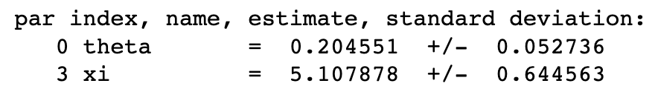
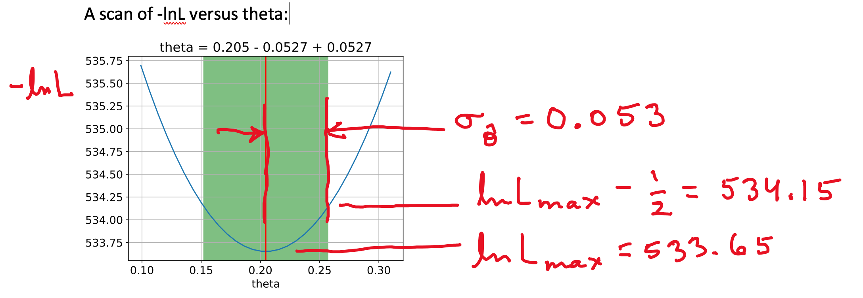
From running program:

Slide 16
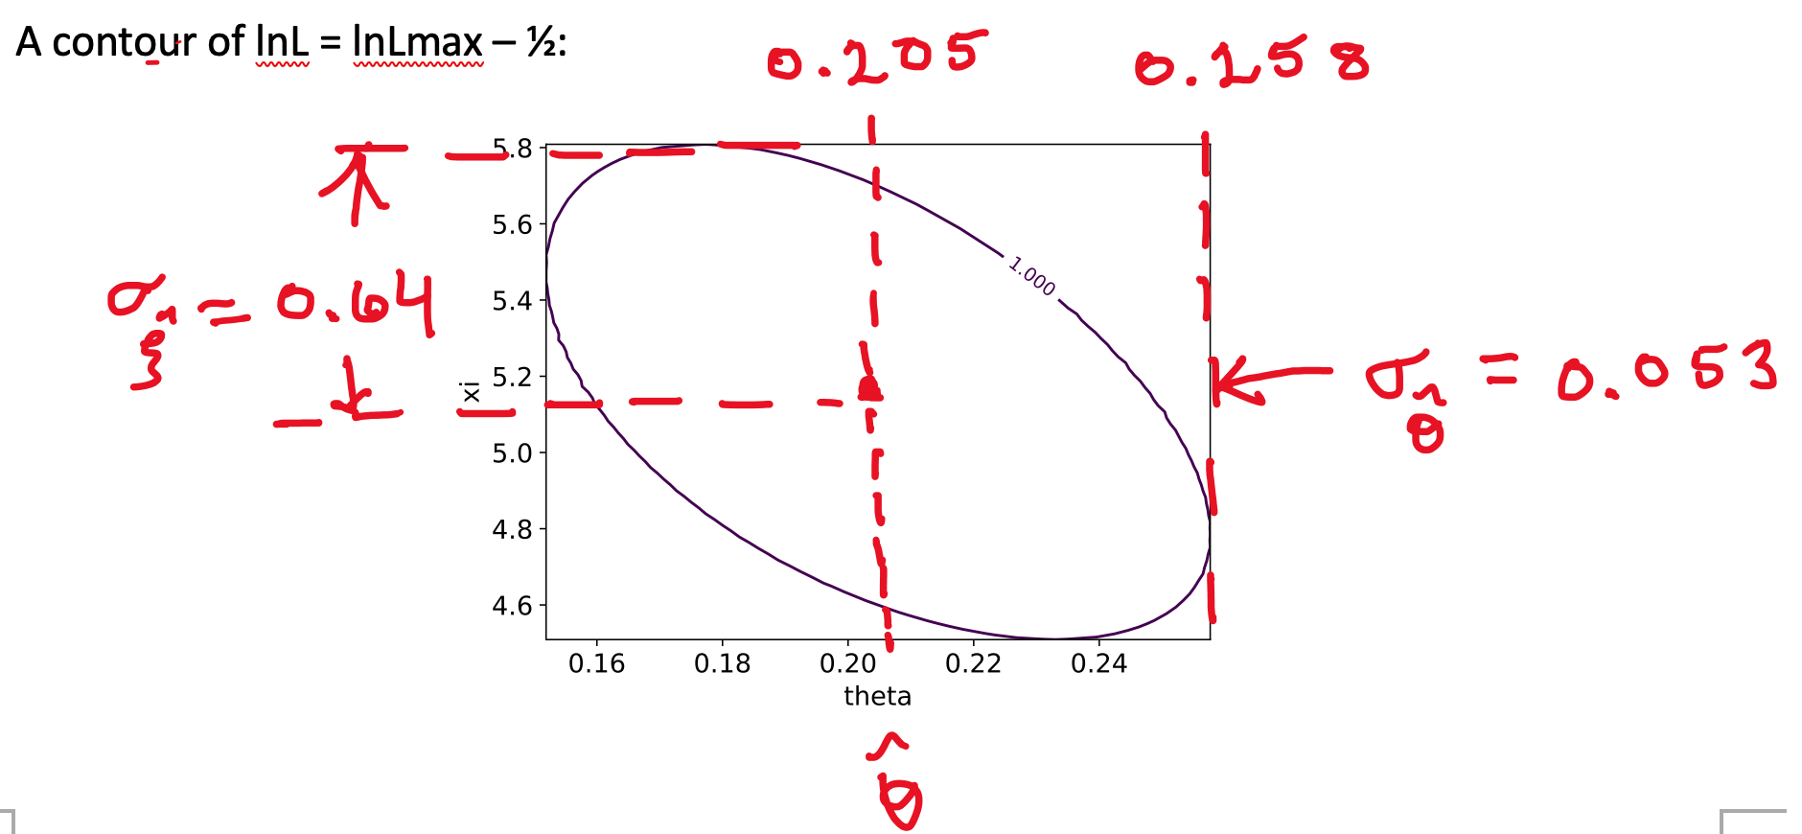

Slide 17
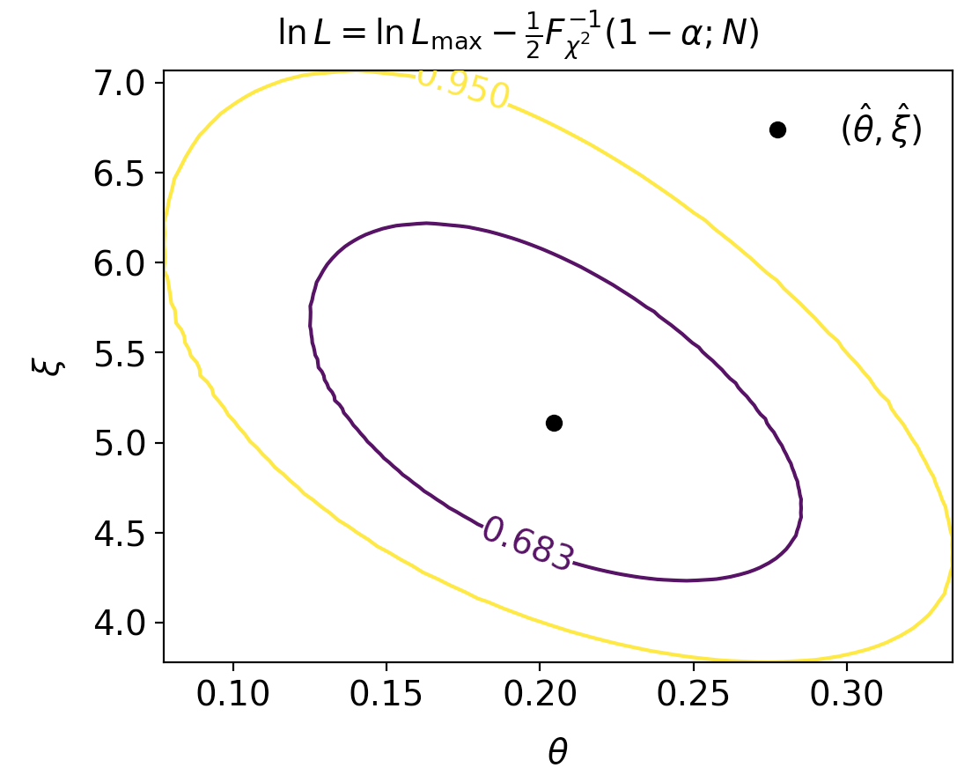
Confidence regions at CL = 68.3% and 95%
In iminuit v2, user can set CL = 1 − α

Slide 18
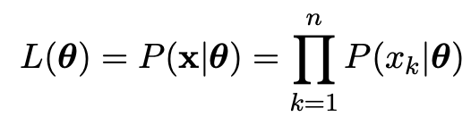
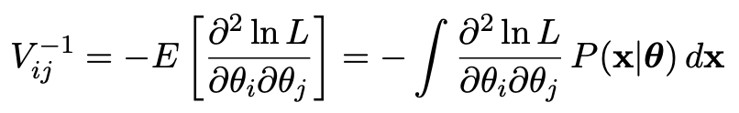
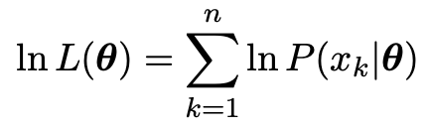
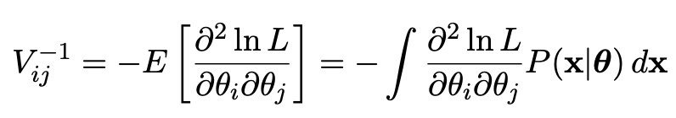
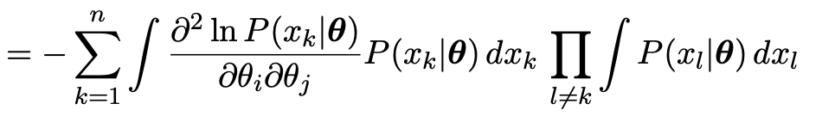
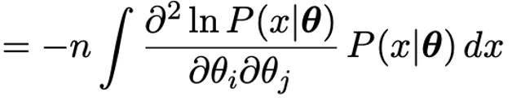

1b) Assume i.i.d. data sample, so
Assume inverse covariance from Fisher Information (large sample):
Since
we find
But V⁻¹V = I so if V⁻¹ ∝ n, then V ∝ 1/n, and so from the square roots of the diagonal elements

Slide 19
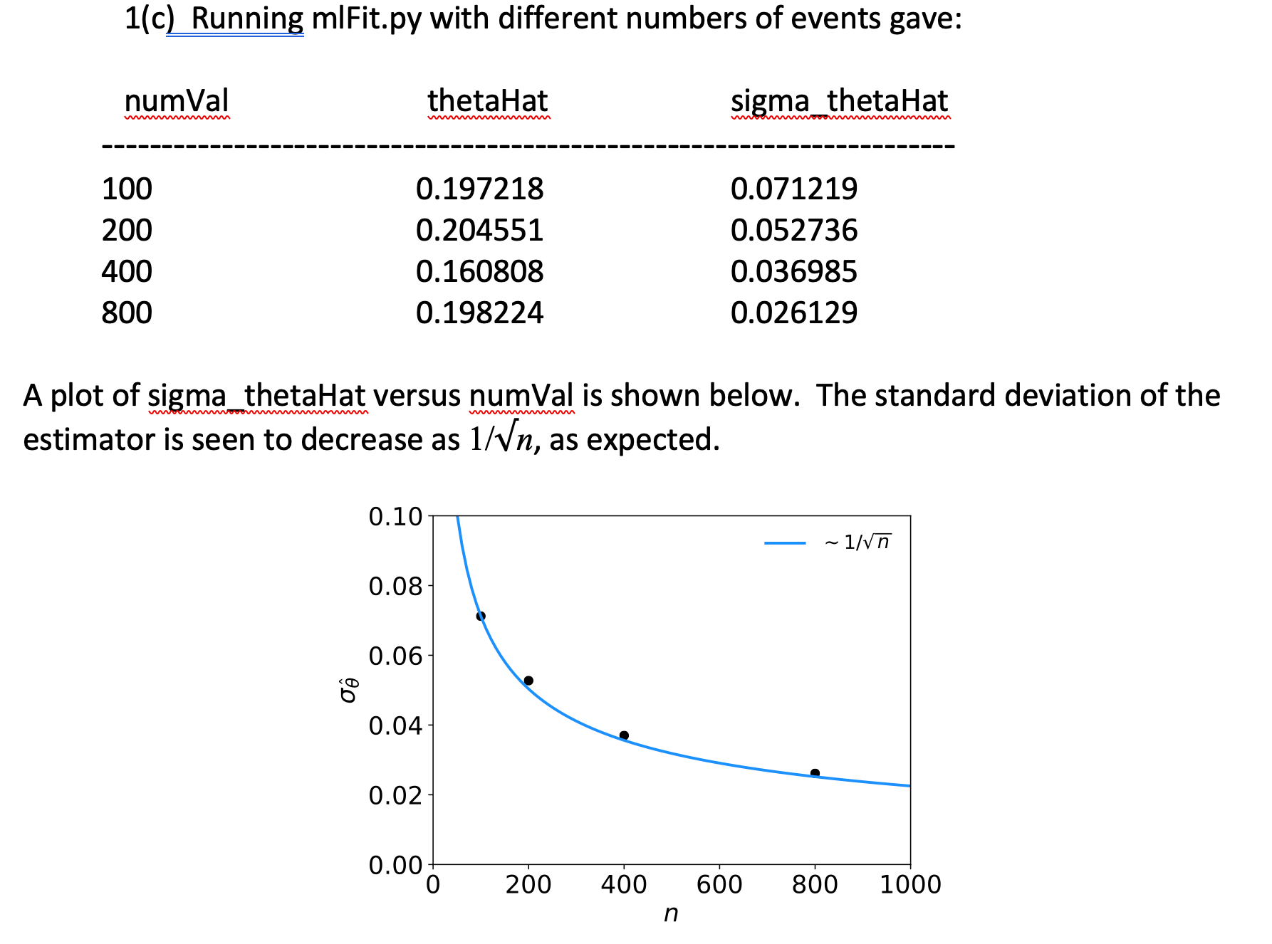

Slide 20
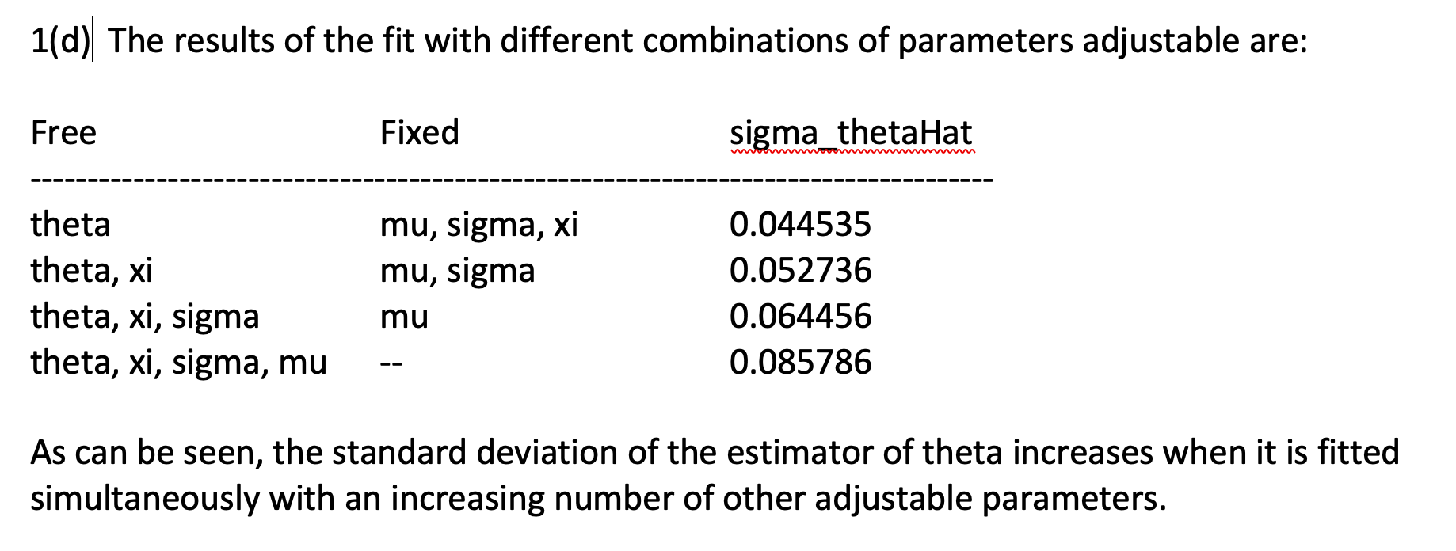

Slide 21
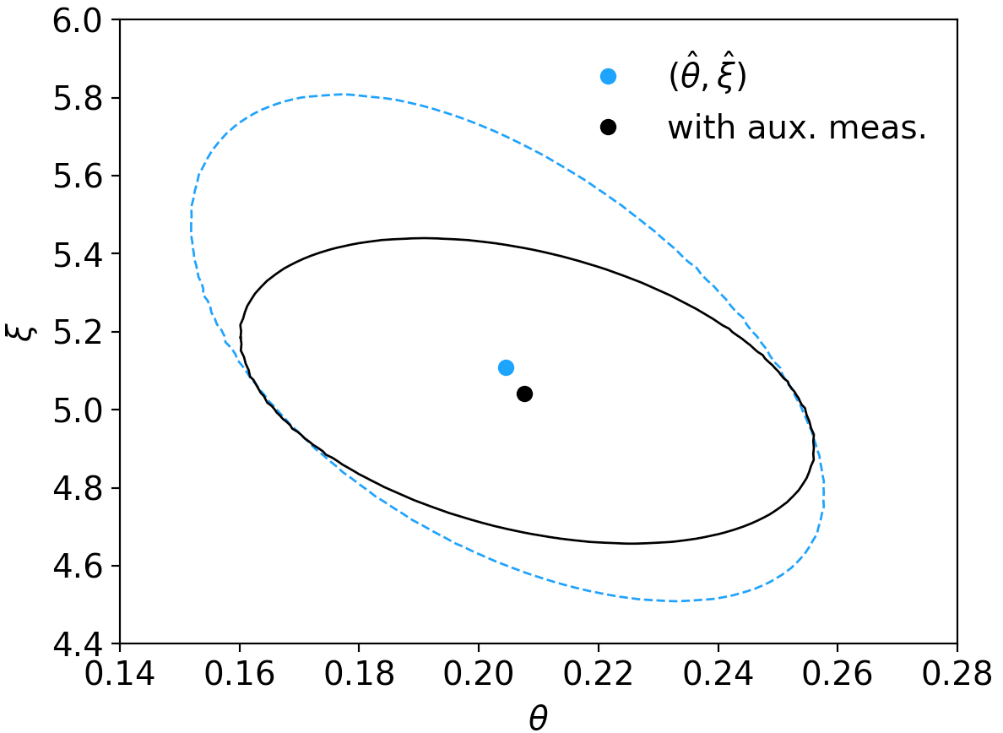
1(e) By including the auxiliary measurement u one uses more information about ξ and thus the covariance ellipse shrinks. This reduces the standard deviations of the MLEs for both ξ and θ.
# Negative log-likelihood including measurement to constrain xi
u = 5. # estimate of xi
sigma_u = 0.5 # standard deviation of u
def negLogL(par):
pdf = f(xData, par)
xi = par[3]
nll = -np.sum(np.log(pdf))
nll += 0.5*((xi-u)/sigma_u)**2
return nll
par index, name, estimate, standard deviation:
0 theta = 0.207539 +/- 0.047847
3 xi = 5.041306 +/- 0.391524
lnL = lnL_{max} – 1/2

Slide 22
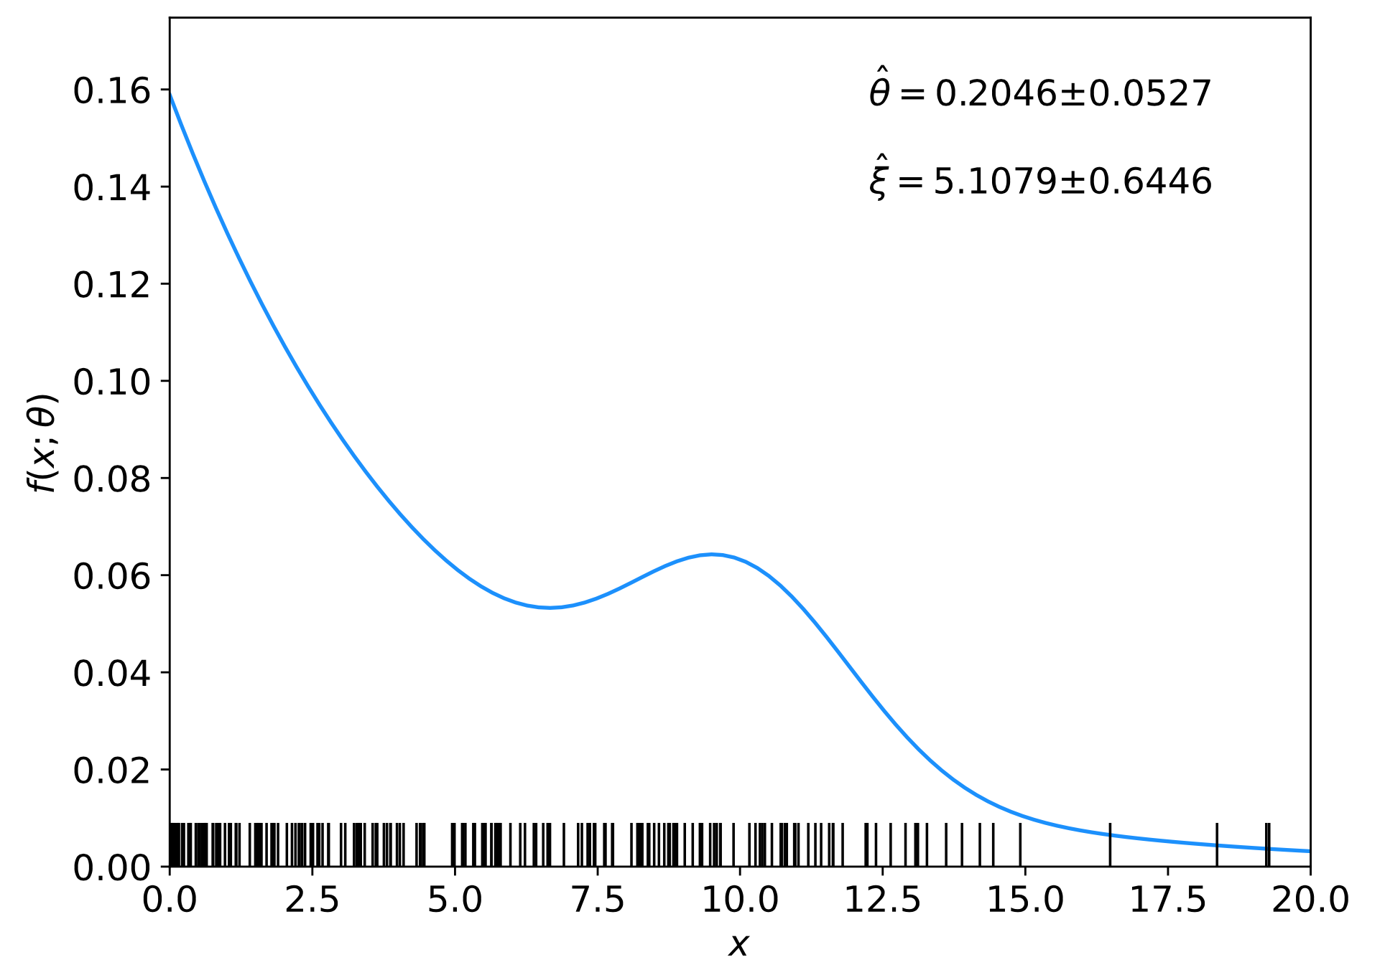
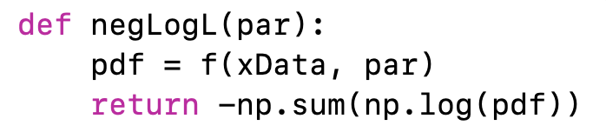
Comments on using iminuit
In our earlier iminuit example mlFit.py, the only argument of the log-likelihood function was the parameter array, and the data array xData entered as global (usually not a good idea):
⠇

Slide 23
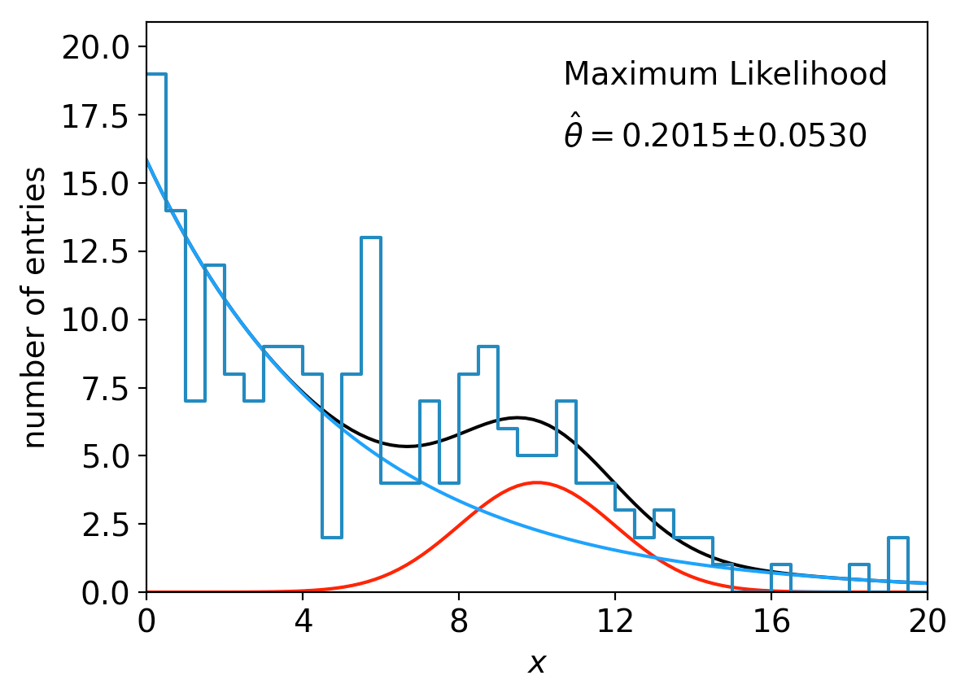
lnL in a class, binned data,...
Sometimes it is convenient to have the function being minimized as a method of a class. An example of this is shown in histFit.py in
https://www.pp.rhul.ac.uk/~cowan/stat/exercises/histFit/ , which does the same fit as in mlFit.py but with a histogram of the data:

Slide 24
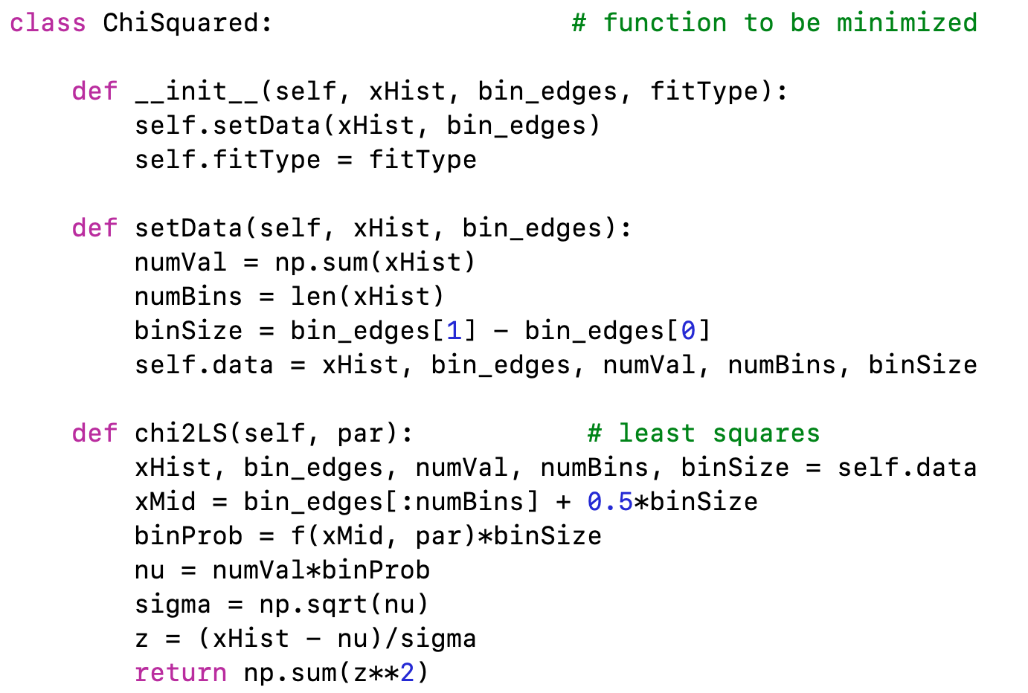
A look at histFit.py
The global data can be avoided if we make the objective function a method of a class:

Slide 25
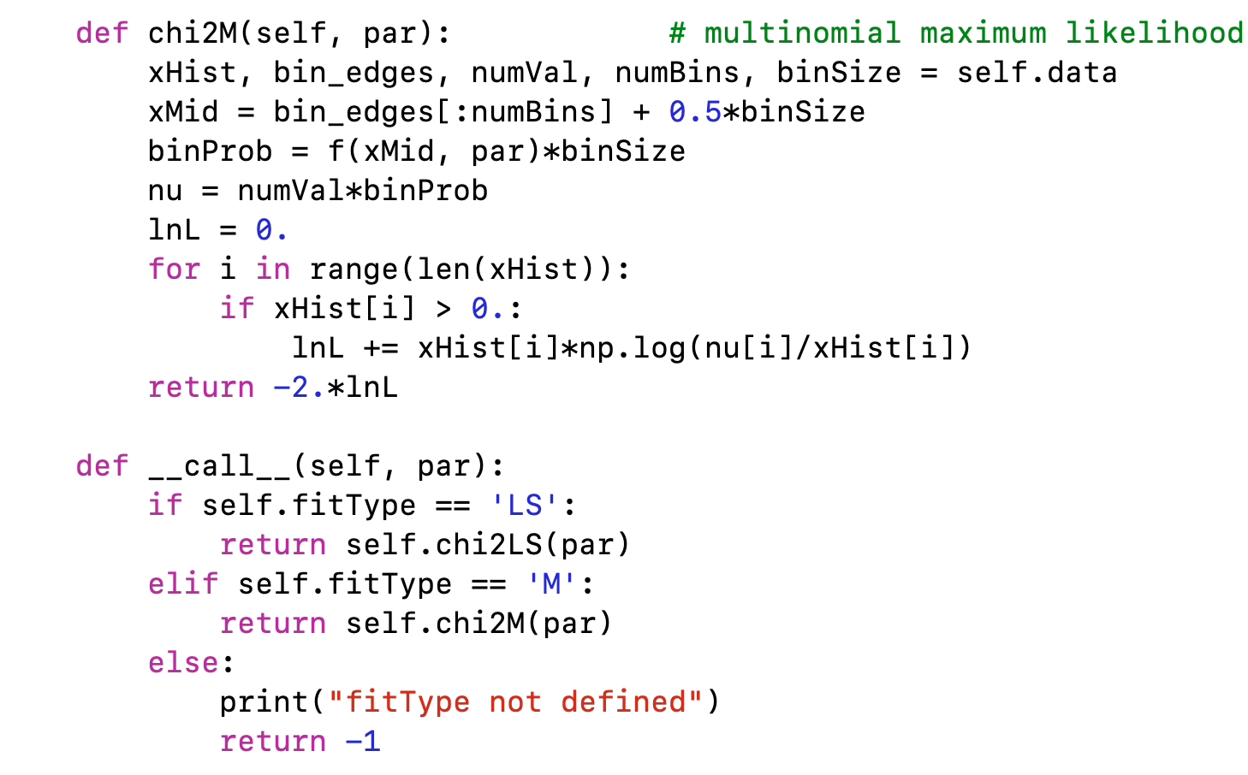
class ChiSquared (continued)

Slide 26
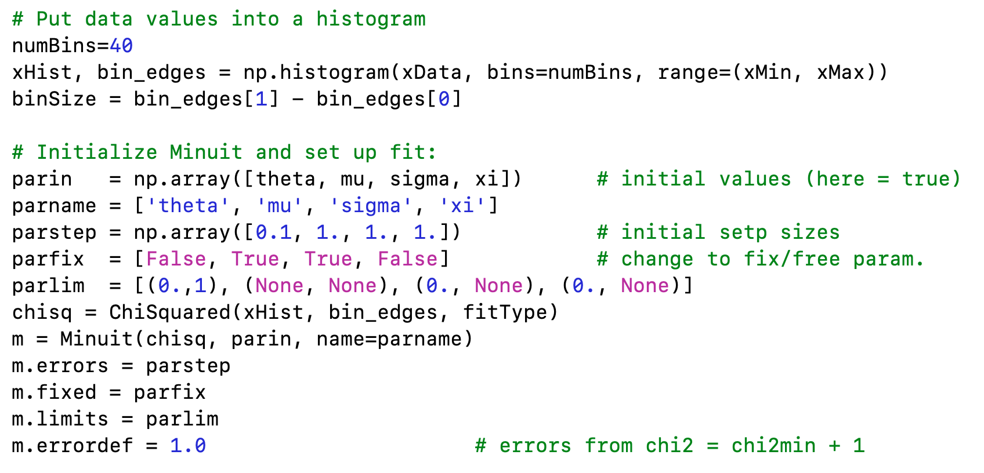
Using the ChiSquared class

Slide 27
Tutorial 2: Bayesian parameter estimation
The exercise is described
https://www.pp.rhul.ac.uk/~cowan/stat/exercises/bayesFit/
in the file bayes_fit_exercise.pdf.
The program is in bayesFit.py or bayesFit.ipynb.
This exercise treats the same fitting problem as seen with maximum likelihood, here using the Bayesian approach.
Bayes’ theorem is used to find the posterior pdf for the parameters, and these are summarized using the posterior mode (MAP estimators).
The posterior pdf is marginalized over the nuisance parameters using Markov Chain Monte Carlo.

Slide 28
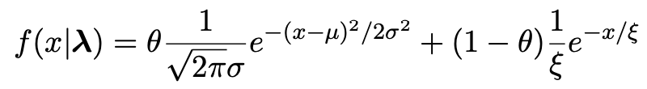
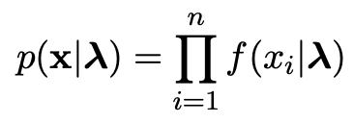

Gaussian signal on exponential background
Same pdf as from mlFit.py (see tutorial 1) with n = 400 independent values of x from
Posterior pdf for parameters λ = (θ, μ, σ, ξ) from Bayes theorem,
where
At first take prior pdf constant for all parameters subject to 0 ≤ θ ≤ 1, σ > 0, ξ > 0 (later try different priors).

Slide 29
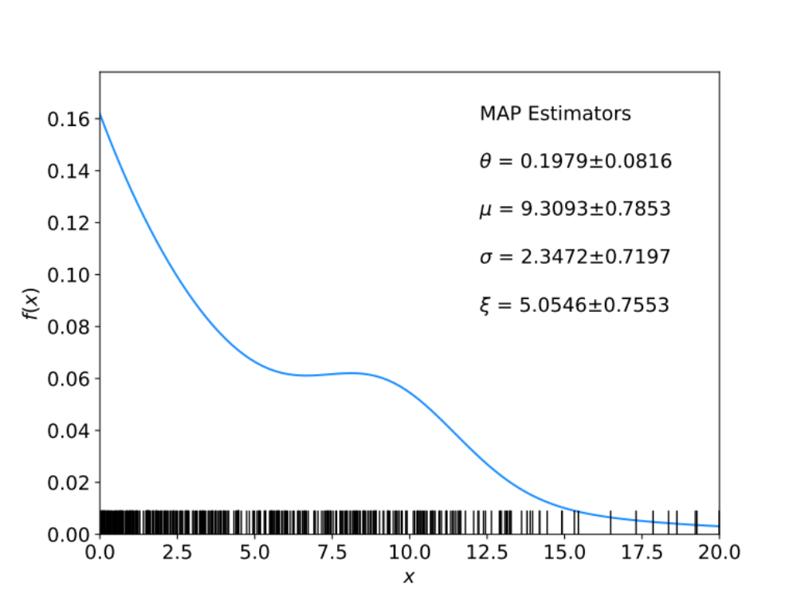
Data and MAP estimates
Maximize posterior with minuit (minimize – ln p(λ|x)).
Standard deviations from minuit correspond to approximating posterior as Gaussian near its peak.
Here priors constant so
MAP estimates same as MLE, covariance matrix
V_{ij} = cov[θ_{i}, θ_{j}] also same.

Slide 30
A look at bayesFit.py
Find maximum of posterior with iminuit (minimize – ln p(λ|x)), similar to maximum likelihood:
# Negative log-likelihood
def negLogL(par):
fx = f(xData, par)
return -np.sum(np.log(fx))
# Prior pdf
def prior(par):
theta = par[0]
mu = par[1]
sigma = par[2]
xi = par[3]
pi_theta = 1. if theta >= 0. and theta <= 1. else 0.
pi_mu = 1. if mu >= 0. else 0.
pi_sigma = 1. if sigma > 0. else 0.
pi_xi = 1. if xi > 0. else 0.
piArr = np.array([pi_theta, pi_mu, pi_sigma, pi_xi])
pi = np.product(piArr[np.array(parfix) == False]) # exclude fixed par
return pi
# Negative log of posterior pdf
def negLogPost(par):
return negLogL(par) - np.log(prior(par))
minimize with iminuit

Slide 31
Metropolis-Hastings algorithm in bayesFit.py
# Iterate with Metropolis-Hastings algorithm
chain = [np.array(MAP)] # start point is MAP estimate
numIterate = 10000
numBurn = 100
numAccept = 0
print("Start MCMC iterations: ", end="")
while len(chain) < numIterate:
par = chain[-1]
log_post = -negLogL(par) + np.log(prior(par))
par_prop = np.random.multivariate_normal(par, cov_prop)
if prior(par_prop) <= 0:
chain.append(chain[-1]) # never accept if prob<=0.
else:
log_post_prop = -negLogL(par_prop) + np.log(prior(par_prop))
alpha = np.exp(log_post_prop - log_post)
u = np.random.uniform(0, 1)
if u <= alpha:
chain.append(par_prop)
numAccept += 1
else:
chain.append(chain[-1])
if len(chain)%(numIterate/100) == 0:
print(".", end="", flush=True)
chain = np.array(chain)
Try increasing number of iterations (10k runs in about 20 s).

Slide 32
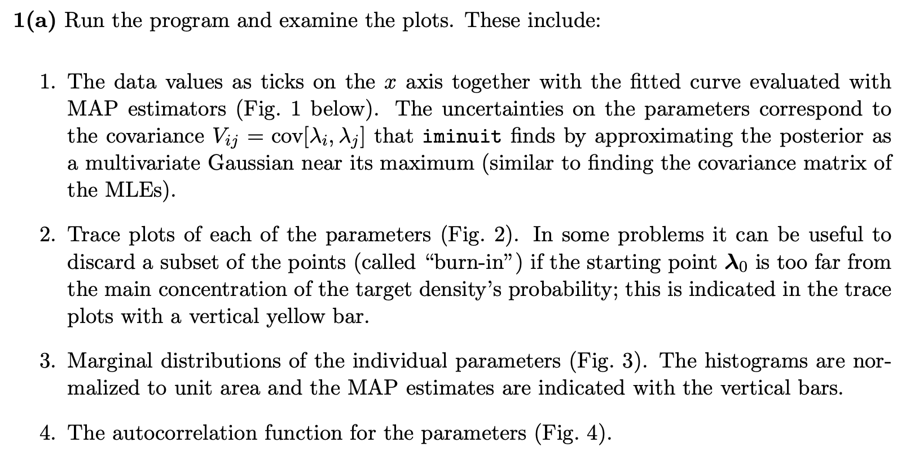
Exercises on Bayesian parameter estimation (a)
1a) Run bayesFit.py, look at the plots

Slide 33
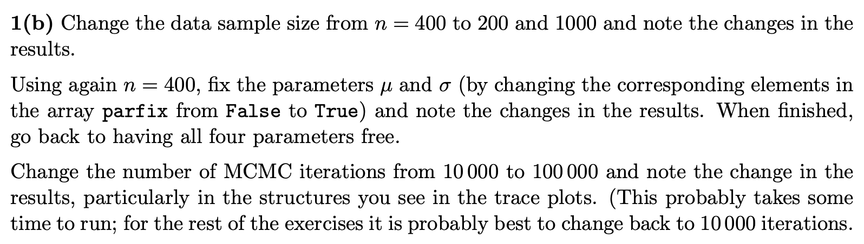
Exercises on Bayesian parameter estimation (b,c)
1b) Investigate effect of data sample size, fixing parameters and length of MCMC chains.
1c) Investigate changing the prior

Slide 34
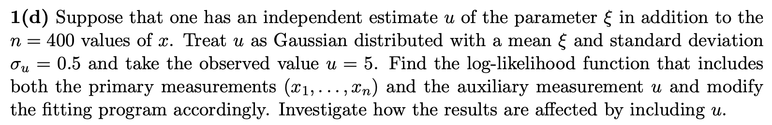
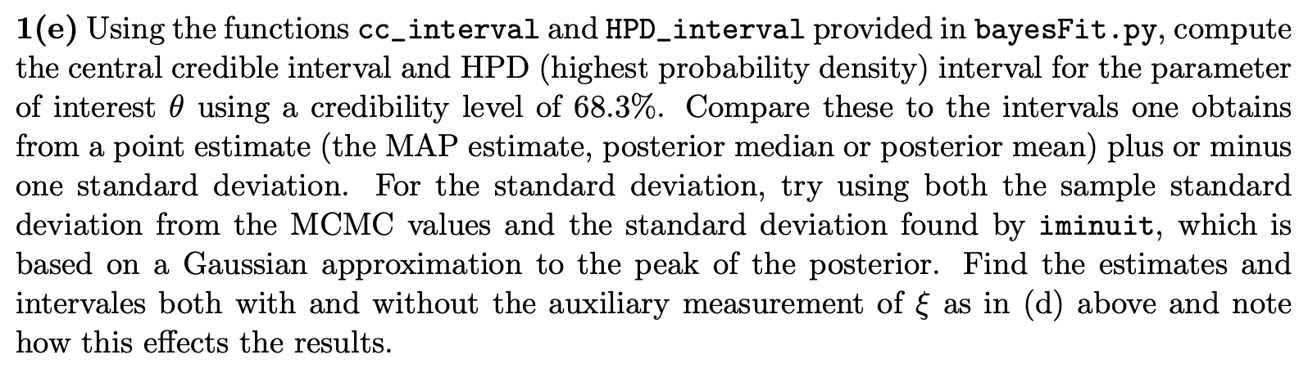
Exercises on Bayesian parameter estimation (d)
1d) Include auxiliary measurement to constrain ξ
1e) Investigate point and interval estimates for θ

Slide 35
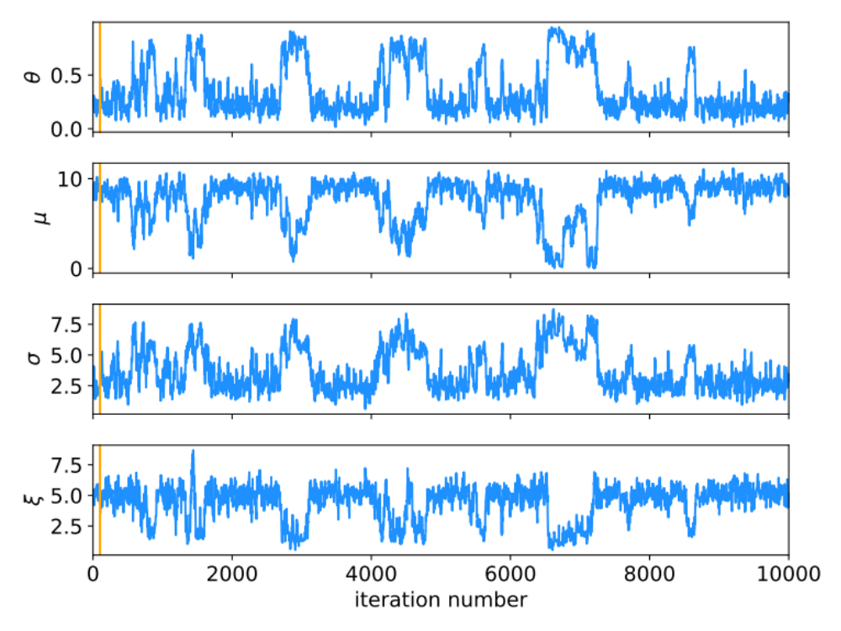
MCMC trace plots
Take θ as parameter of interest, rest are nuisance parameters.
Marginalize by sampling posterior pdf with Metropolis-Hastings.
Gaussian proposal pdf, covariance U = sV,
s = (2.38)²/N_{par} = 1.41, gives acceptance
probability ~ 0.24.
Here 10 000 iterations (should use more).

Slide 36
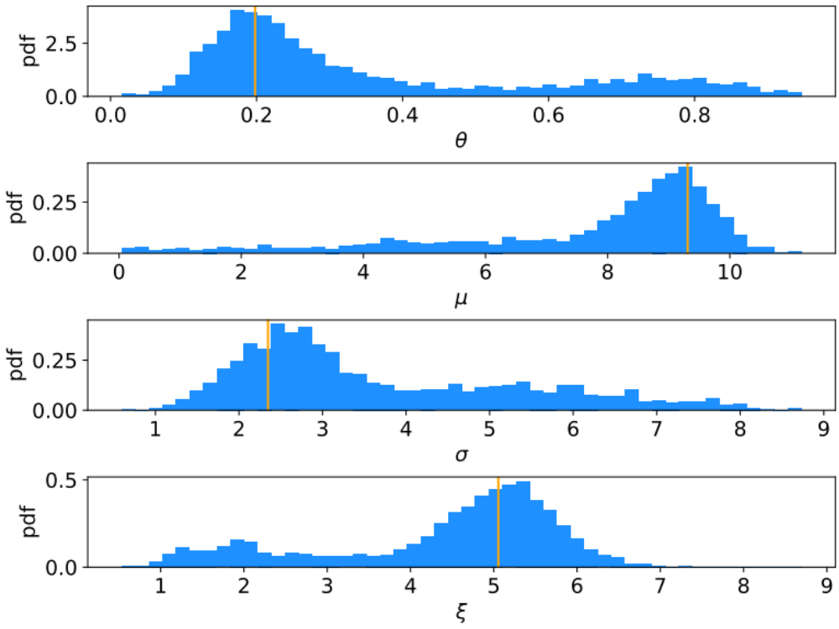

Marginal distributions
MAP estimates shown with vertical bars
Note long tails.
Interpretation: data distribution can be approximated by Gaussian term only, (θ large, μ small) with large width (σ ~ 4-8) and a narrow exponential (ξ ~ 1-3).

Slide 37
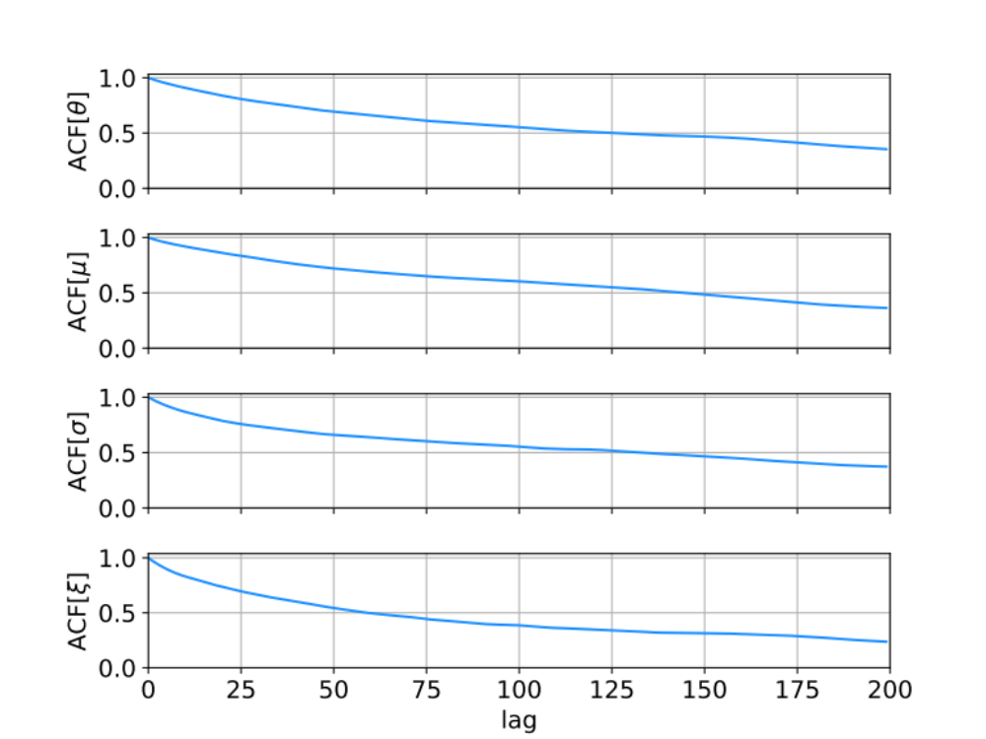
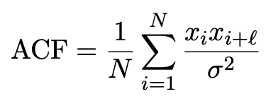
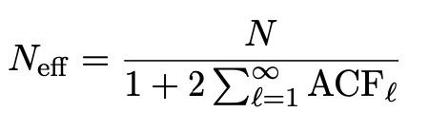
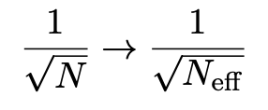
Autocorrelation versus lag
MCMC samples are not independent, autocorrelation function = correlation coefficient of sample x_{i} with x_{i+l} as a function of the lag, l, where x = any of θ, μ, σ, ξ minus its mean:
Effective sample size
In stat. error estimates

Slide 38
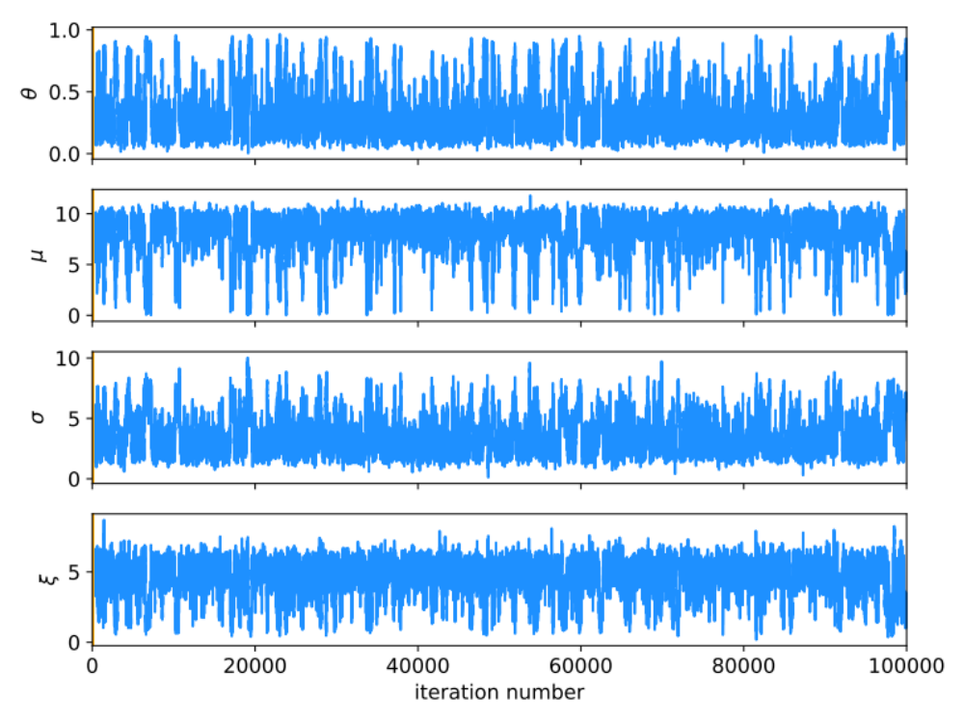
MCMC trace plots
Increase number of iterations to 100 000.
Regions of parameter space now sampled multiple times.

Slide 39
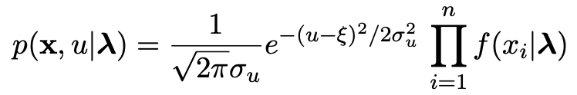
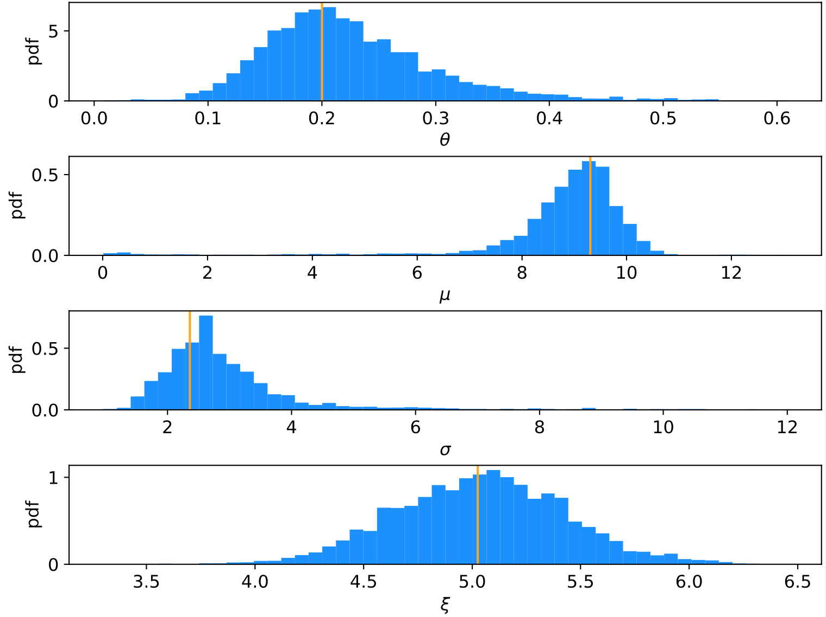
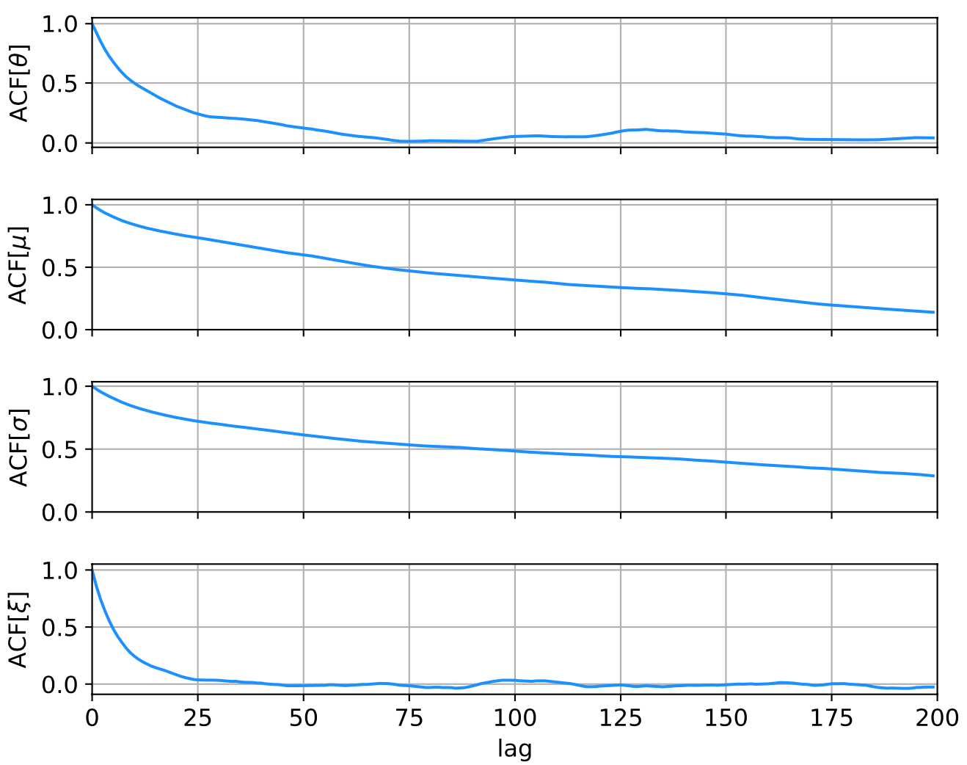
Auxiliary measurement for ξ
Suppose we have an auxiliary measurement u ~ Gauss(ξ, σ_{u}) with σ_{u} = 0.5 and we observe u = 5.
Build into likelihood:
Marginals closer to Gaussian, ACF falls more quickly to ~zero.

Slide 40
Ways to summarize the posterior
Point estimates:
Posterior mode (MAP, coincides with MLE for constant prior).
Posterior median (invariant under monotonic transformation of parameter).
Posterior mean; coincides with above in large-sample limit.
Intervals:
Highest Probability Density (HPD) interval, shortest for a given probability content, not invariant under param. trans.
Central credible intervals, equal upper and lower tail areas, e.g., α/2 for CL = 1 – α.
Point estimate +/- standard deviation, std. dev. from MCMC sample or by approximating core of posterior as Gaussian (from minuit); coincides with above in large-sample limit.

Slide 41
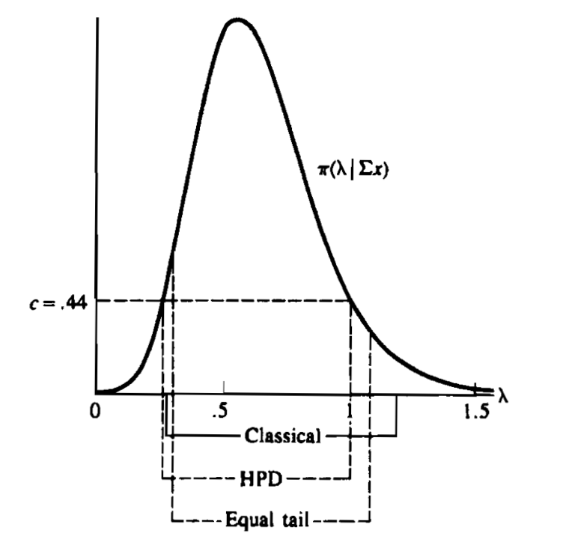
Types of intervals
HPD = Highest Posterior Density
Equal tail (central) from posterior
Classical (frequentist)
G. Casella and R. Berger, Statistical Inference, 2002

Slide 42
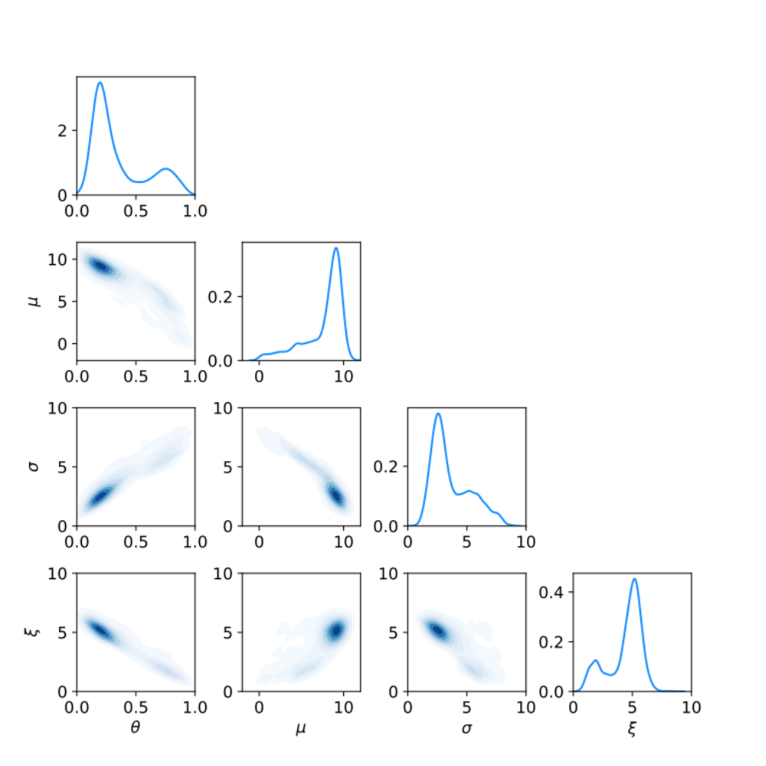
Correlation plots and marginal distributions
Estimates/intervals for theta:
MCMC acceptance fraction = 0.3737
Posterior mode (MAP estimate) = 0.197936
Posterior mean = 0.351234
Posterior median = 0.250764
MAP +/- sigmaMAP (from minuit) = [0.140056, 0.255816]
Posterior mean +/- sigmaMCMC = [0.118503, 0.583964]
68.3% central credible interval = [0.158557, 0.685847]
68.3% HPD interval = [0.093997, 0.392642]

Slide 43
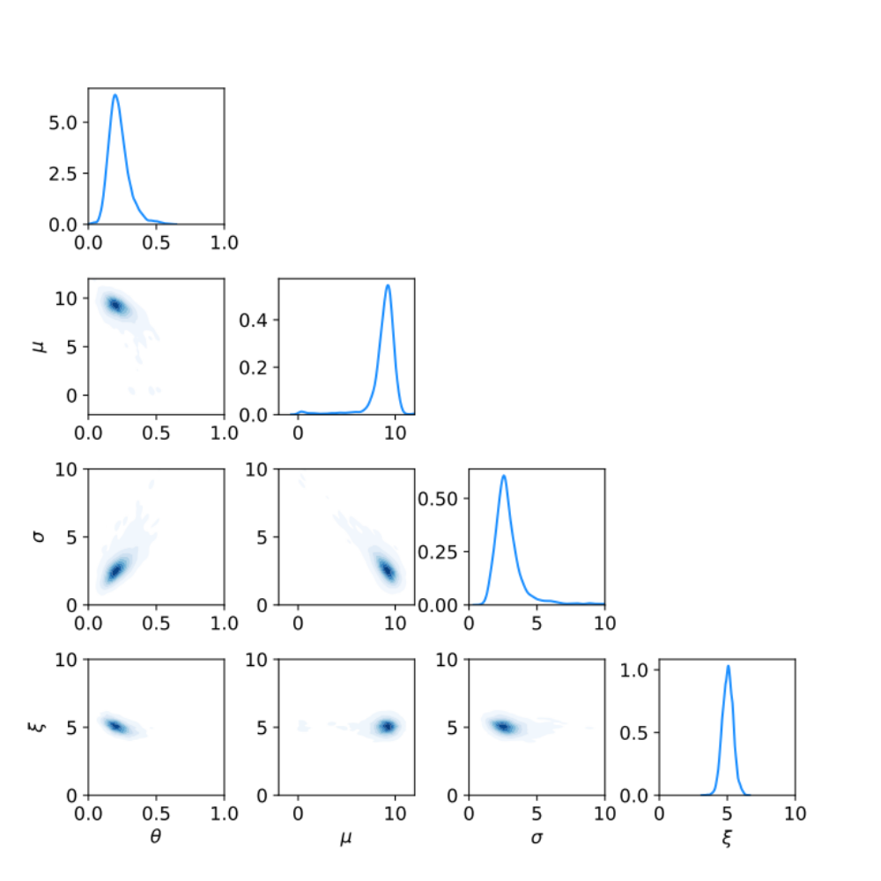
Correlation plots and marginal distributions using auxiliary measurement for ξ
Estimates/intervals for theta:
MCMC acceptance fraction = 0.3516
Posterior mode (MAP estimate) = 0.200077
Posterior mean = 0.224898
Posterior median = 0.212835
MAP +/- sigmaMAP (from minuit) = [0.149282, 0.250873]
Posterior mean +/- sigmaMCMC = [0.148481, 0.301314]
68.3% central credible interval = [0.156736, 0.291246]
68.3% HPD interval = [0.137607, 0.267077]

Slide 44
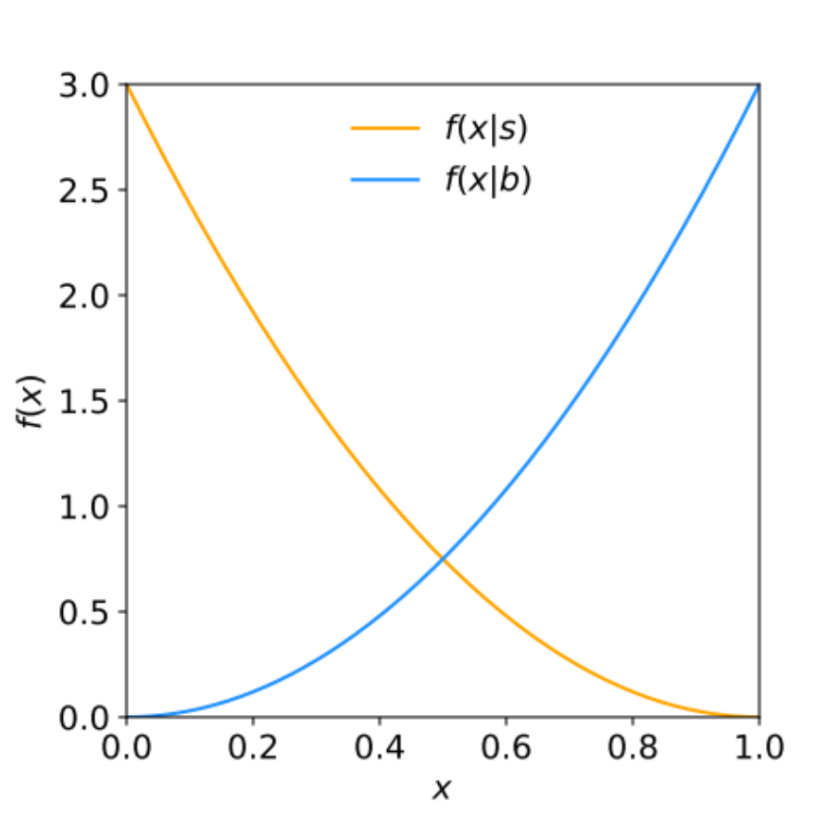

Tutorial 3: Hypothesis Tests
See https://www.pp.rhul.ac.uk/~cowan/stat/exercises/hypTest/
in hyp_test_exercise.pdf. Uses hypTest.py and hypTestMC.py.
Suppose we search for a signal like Dark Matter by counting events, and signal/background events are characterized by a variable x
(0 ≤ x ≤ 1):
As a first step, test the
background hypothesis for
each event: if x < x_{cut},
reject background hypothesis.

Slide 45
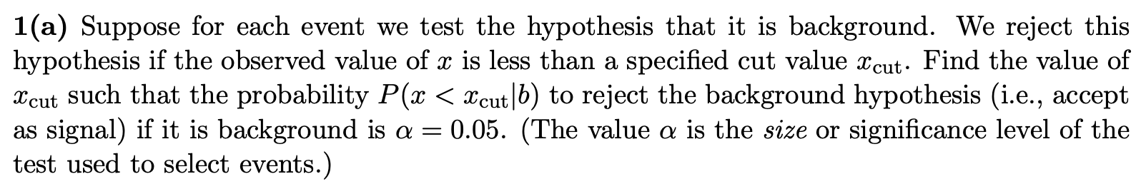

Exercises on hypothesis testing (a,b)
1a) Find boundary of critical region x_{cut} for test event is background.
1b) Find power of the test with respect to event being signal.

Slide 46

Exercises on hypothesis testing (c)
1c) In an experiment, s_{tot}=10, b_{tot}=100, select as s if x < x_{cut} = 0.1, find expected numbers of signal, background.

Slide 47

Exercises on hypothesis testing (d)
1d) Find signal purity

Slide 48


Exercises on hypothesis testing (e)
1e) Suppose n events are found with x < x_{cut} . Find the p-value of the background-only hypthesis (s = 0).
Find the corresponding significance:

Slide 49

Exercises on hypothesis testing (f)
1f) Find the expected discovery significance median[Z_{b}|s+b].
Find the x_{cut} that maximizes median[Z_{b}|s+b].

Slide 50


Exercises on hypothesis testing (g)
1g) Using the Monte Carlo program hypTestMC.py, investigate the test of s=0 by using the x values of each event (no cut).
The likelihood-ratio test statistic is
(s = 10,b = 100, i.e., no cut)
Simulate 10⁶ (or if possible 10⁷) experiments and find the median discovery significance median[Z_{b}|s+b].

Slide 51


Likelihood ratio for test of μ = 0
The likelihood for a signal strength μ is
We can test the hypothesis μ=0 with the likelihood ratio statistic
constant, can drop
According to the Neyman-Pearson lemma, this gives the test of μ=0 with the highest possible sensitivity (power with respect to the alternative μ=1).

Slide 52

Expected discovery significance using q
10⁷ experiments simulated simulated according to ”b” and “s+b”.
Program: hypTestMC.py
Add code to:
find median[q|s+b]
find median p-value of b, median[p_{b}|s+b]
find median significance, median[Z_{b}|s+b]
p-value
of ”b”

Slide 53








1a,b)
Size and power of test for event selection
Size (fix α = 0.05, find x_{cut}):
Power:

Slide 54




1c)
Expected numbers of signal, background selected
Suppose s_{tot} = 10, b_{tot} = 100, and use x_{cut} = 0.1.
Reject b hypothesis (accept as candidate signal) if x < x_{cut} .
Use efficiency formulas from before:
Expected numbers of events:

Slide 55



Purity of selected signal
1d)
Prior probability to be signal or background:
Signal purity from Bayes’ theorem:

Slide 56



1e)
p-value of b-only hypothesis (s = 0)
In the full experiment we will find n events in the signal region (x < x_{cut}), and we can model this with a Poisson distribution:
Suppose total expected events in 0 ≤ x ≤ 1 are b_{tot} = 100, s_{tot} = 10;
expected in x < x_{cut} are s, b.
Suppose for a given x_{cut}, b = 0.5 and we observe n_{obs} = 3 events.
Find the p-value of the hypothesis that s = 0:
and the corresponding significance:

Slide 57


1e)
p-value, significance of b-only hypothesis (s = 0)
(not needed here)
p-value of background-only hypothesis (s = 0):
Or for larger n_{obs}, use trick to sum Poisson probabilities
Significance:

Slide 58


1f)
Experimental sensitivity
To characterize the experimental sensitivity, we can give the
median, assuming s and b both present, of the significance of
a test of s = 0. For s ≪ b this can be approximated by
A better approximation is:
Try this for x_{cut} = 0.1 and if you have time, write a program
to maximize the median Z with respect to x_{cut}.

Slide 59


1f)
Expected significance
Using x_{cut} = 0.1, s_{tot} = 10, b_{tot} = 100, found s = 2.71, b = 0.1
Expected significance:

Slide 60



1f)
s, b, expected significance versus x_{c}
Maximum Z_{A} = 3.68
found for x_{cut} = 0.13

Slide 61


Expected significance versus x_{c} with uncertain background
Maximum Z_{A} = 2.50
found for x_{cut} = 0.34

Slide 62



Using the individual x values
Instead of just counting events with x < x_{cut}, we can make use of all the values of x. I.e. the data are:
where here s and b refer to the total numbers (without any cut) and the pdf of x is a mixture of the signal and background components:
The strength parameter μ has been introduced such that μ=0 means background only (“b”) and μ=1 includes also signal (“s+b”).

Slide 63
Likelihood ratio for test of μ = 0
The likelihood for a signal strength μ is
We can test the hypothesis μ=0 with the likelihood ratio statistic
constant, can drop
According to the Neyman-Pearson lemma, this gives the test of μ=0 with the highest possible sensitivity (power with respect to the alternative μ=1).

Slide 64
Expected discovery significance using q (soln.)
10⁷ experiments simulated simulated according to ”b” and “s+b”.
median[q|s+b] = 21.33
For b hypothesis, 7 out of 10⁷ experiments found with q ≥ median[q|s+b]
median[p_{b}|s+b] = 7.0 ⨉ 10⁻⁷
median[Z_{b}|s+b] = Φ⁻¹ (1-p_{b}) = 4.83
I.e. using the individual x values provides greater sensitivity than counting events with x < x_{cut}, which gave significance of 3.68.
p-value
of ”b”

Slide 65

Tutorial 4: Student’s t average
See: https://www.pp.rhul.ac.uk/~cowan/stat/exercises/stave/
Sample program stave.py
The program stave.py implements the Gamma Variance Model (GVM) for averaging N measurements.
For details see G. Cowan, EPJC (2019) 79:133.
In this version the model does not distinguish between statistical and systematic errors.
Confidence interval for the mean μ becomes sensitive to goodness-of-fit (increases if data internally inconsistent).
Estimated mean less sensitive to outliers.

Slide 66


Least Squares vs Gamma Variance Model
Quadratic terms from Least Squares replaced by logarithmic ones:
where
y_{i} = measured value
v_{i} = s_{i}² = estimated variance
r_{i} = relative uncertainty on estimate of variance
Equivalent to replacing Gauss pdf for measurements by Student’s t, number of degrees of freedom = 1/2r_{i}²

Slide 67
A quick look at stave.py
Set measured values, estimates of std. dev., errors on errors:
y = np.array([17., 19., 15., 3.]) # measured values
s = np.array([1.5, 1.5, 1.5, 1.5]) # estimates of std. dev
v = s**2 # estimates of variances
r = np.array([0.2, 0.2, 0.2, 0.2]) # relative errors on errors
log-likelihood:
class NegLogL:
def __init__(self, y, s, r):
self.setData(y, s, r)
def setData(self, y, s, r):
self.data = y, s, r
def __call__(self, mu):
y, s, r = self.data
v = s ** 2
lnf = -0.5*(1. + 1./(2.*r**2))*np.log(1. + 2.*(r*(y-mu))**2/v)
return -np.sum(lnf)

Slide 68

Example average with GVM
Suppose four measurements of the parameter μ.
Each reports an estimated standard dev. of s = 1.5 and
a “relative error on the error” r = 0.2.
Suggested exercise:
Experiment with different numbers of measurements, different levels of internal consistency, different values for the std. dev. and error on error.
outlier

