Slide 1


Statistical & Mathematical Foundations
Lecture 1: Probability, Hypothesis tests
STEAM Academy
CERN
6,7 July 2026
https://indico.cern.ch/event/1699443/
Glen Cowan
Physics Department
Royal Holloway, University of London
g.cowan@rhul.ac.uk
www.pp.rhul.ac.uk/~cowan

Slide 2
Outline
→ Lecture 1: Introduction
Probability
Hypothesis tests
Lecture 2: Parameter estimation
Confidence limits
Systematic uncertainties
Almost everything is a subset of the University of London course:
http://www.pp.rhul.ac.uk/~cowan/stat_course.html

Slide 3
Theory ↔ Statistics ↔ Experiment
Theory (model, hypothesis):
Experiment (observation):
+ response of measurement
apparatus
= model prediction
data
Uncertainty enters
on many levels
→ quantify with
probability

Slide 4
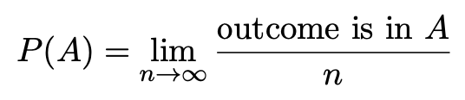

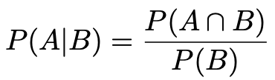

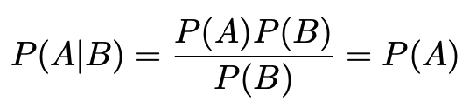
A quick review of probability
Frequentist (A = outcome of
repeatable observation)
Subjective (A = hypothesis)
Conditional probability:
E.g. rolling a die, outcome n = 1,2,...,6:
A and B are independent iff:
I.e. if A, B independent, then

Slide 5

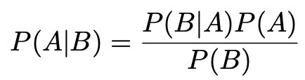
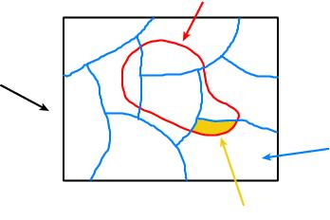
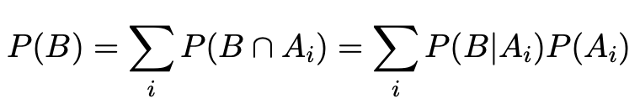
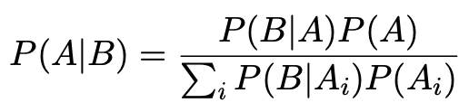
Bayes’ theorem
Use definition of conditional probability and
→
(Bayes’ theorem)
B
If set of all outcomes S = ∪_{i} A_{i}
with A_{i} disjoint, then law of total probability for P(B) says
S
A_{i}
B ∩ A_{i}
so that Bayes’ theorem becomes
Bayes’ theorem holds regardless of how probability is interpreted (frequency, degree of belief...).

Slide 6
Frequentist Statistics − general philosophy
In frequentist statistics, probabilities are associated only with
the data, i.e., outcomes of repeatable observations (shorthand: x).
Probability = limiting frequency
Probabilities such as
P (string theory is true),
P (0.117 < α_{s} < 0.119),
P (Whitmer wins in 2028),
etc. are either 0 or 1, but we don’t know which.
The tools of frequentist statistics tell us what to expect, under
the assumption of certain probabilities, about hypothetical
repeated observations.
Preferred theories (models, hypotheses, ...) are those that predict a high probability for data “like” the data observed.

Slide 7
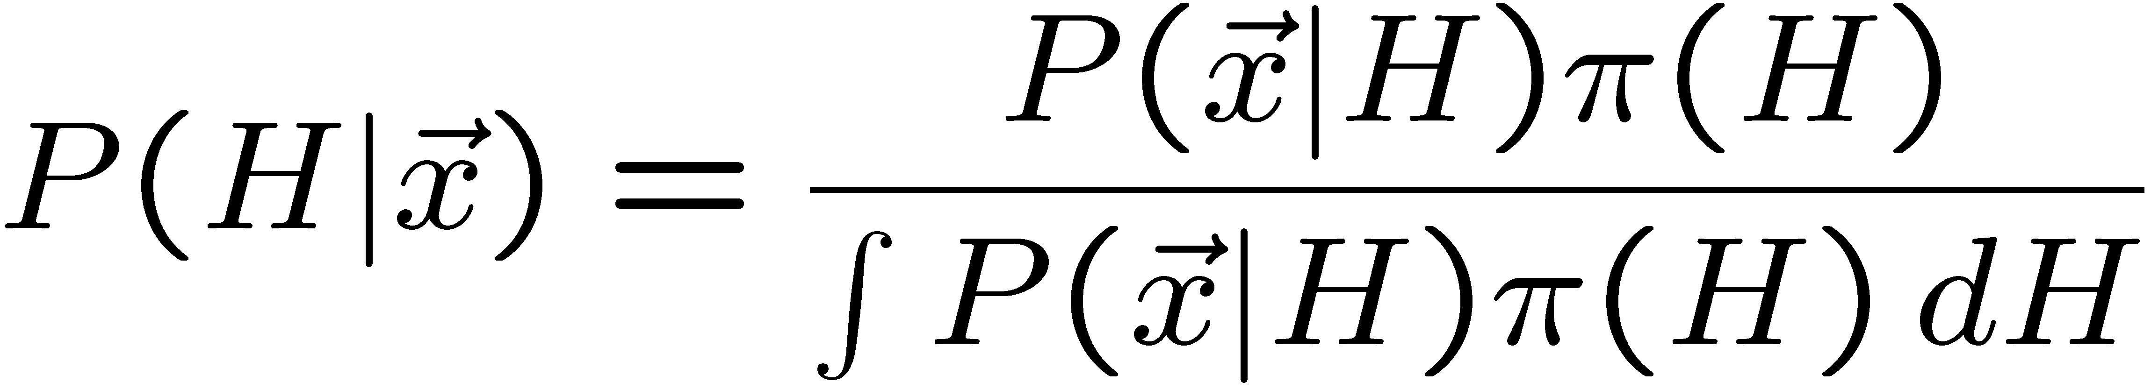
Bayesian Statistics − general philosophy
In Bayesian statistics, use subjective probability for hypotheses:
probability of the data assuming
hypothesis H (the likelihood)
prior probability, i.e.,
before seeing the data
posterior probability, i.e.,
after seeing the data
normalization involves sum
over all possible hypotheses
Bayes’ theorem has an “if-then” character: If your prior
probabilities were π(H), then it says how these probabilities
should change in the light of the data.
No general prescription for priors (subjective!)

Slide 8
Hypothesis, likelihood
Suppose the entire result of an experiment (set of measurements) is a collection of numbers x.
A (simple) hypothesis is a rule that assigns a probability to each possible data outcome:
= the likelihood of H
Often we deal with a family of hypotheses labeled by one or
more undetermined parameters (a composite hypothesis):
= the “likelihood function”
Note:
1) For the likelihood we treat the data x as fixed.
2) The likelihood function L(θ) is not a pdf for θ.

Slide 9
Frequentist hypothesis tests
Suppose a measurement produces data x; consider a hypothesis H₀
we want to test and alternative H₁
H₀, H₁ specify probability for x: P(x|H₀), P(x|H₁)
A test of H₀ is defined by specifying a critical region w of the
data space such that there is no more than some (small) probability
α, assuming H₀ is correct, to observe the data there, i.e.,
P(x ∈ w | H₀) ≤ α
Need inequality if data are
discrete.
α is called the size or
significance level of the test.
If x is observed in the
critical region, reject H₀.
data space Ω
critical region w

Slide 10



Definition of a test (2)
But in general there are an infinite number of possible critical regions that give the same size α.
Use the alternative hypothesis H₁ to motivate where to place the critical region.
Roughly speaking, place the critical region where there is a low
probability (α) to be found if H₀ is true, but high if H₁ is true:

Slide 11


Classification viewed as a statistical test
Suppose events come in two possible types:
s (signal) and b (background)
For each event, test hypothesis that it is background, i.e., H₀ = b.
Carry out test on many events, each is either of type s or b, i.e., here the hypothesis is the “true class label”, which varies randomly from event to event, so we can assign to it a frequentist probability.
Select events for which where H₀ is rejected as “candidate events of type s”. Equivalent Particle Physics terminology:
background efficiency
signal efficiency

Slide 12
Example of a test for classification
Suppose we can measure for
each event a quantity x, where
with 0 ≤ x ≤ 1.
For each event in a mixture of signal (s) and background (b) test
H₀ : event is of type b
using a critical region W of the form: W = { x : x ≤ x_{c} }, where
x_{c} is a constant that we choose to give a test with the desired size α.

Slide 13
Classification example (2)
Suppose we want α = 10⁻⁴. Require:
and therefore
For this test (i.e. this critical region W), the power with respect to the signal hypothesis (s) is
Note: the optimal size and power is a separate question that will depend on goals of the subsequent analysis.

Slide 14
Classification example (3)
Suppose that the prior probabilities for an event to be of type s or b are:
π_{s} = 0.001
π_{b} = 0.999
The “purity” of the selected signal sample (events where b hypothesis rejected) is found using Bayes’ theorem:

Slide 15
Testing significance / goodness-of-fit
Suppose hypothesis H predicts pdf f (x|H) for a set of
observations x = (x₁,...x_{n}).
We observe a single point in this space: x_{obs}.
How can we quantify the level of compatibility between the data and the predictions of H?
x_{j}
x_{obs}
Decide what part of
the data space represents equal or less compatibility with H than does the point x_{obs}. (Not unique!)
ω> = { x : x “more
compatible” with H }
ω≤ = { x : x “less
or eq. compatible”
with H }
x_{i}

Slide 16
p-values
Express level of compatibility between data and hypothesis (sometimes ‘goodness-of-fit’) by giving the p-value for H:
= probability, under assumption of H, to observe data with equal or lesser compatibility with H relative to the data we got.
= probability, under assumption of H, to observe data as discrepant with H as the data we got or more so.
Basic idea: if there is only a very small probability to find data
with even worse (or equal) compatibility, then H is “disfavoured by the data”.
If the p-value is below a user-defined threshold α (e.g. 0.05) then H is rejected (equivalent to hypothesis test of size α as seen earlier).

Slide 17

p-value of H is not P(H)
The p-value of H is not the probability that H is true!
In frequentist statistics we don’t talk about P(H) (unless H
represents a repeatable observation).
If we do define P(H), e.g., in Bayesian statistics as a degree of belief, then we need to use Bayes’ theorem to obtain
where π(H) is the prior probability for H.
For now stick with the frequentist approach;
result is p-value, regrettably easy to misinterpret as P(H).

Slide 18

The Poisson counting experiment
Suppose we do a counting experiment and observe n events.
Events could be from signal process or from background –
we only count the total number.
Poisson model:
s = mean (i.e., expected) # of signal events
b = mean # of background events
Goal is to make inference about s, e.g.,
test s = 0 (rejecting H₀ ≈ “discovery of signal process”)
test all non-zero s (values not rejected = confidence interval)
In both cases need to ask what is relevant alternative hypothesis.

Slide 19
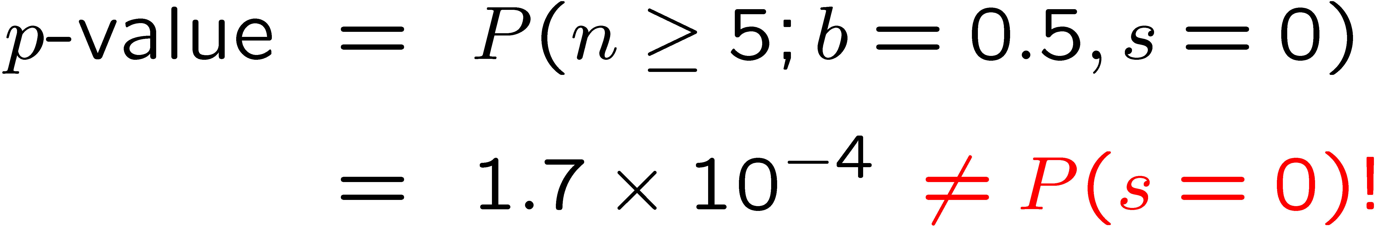
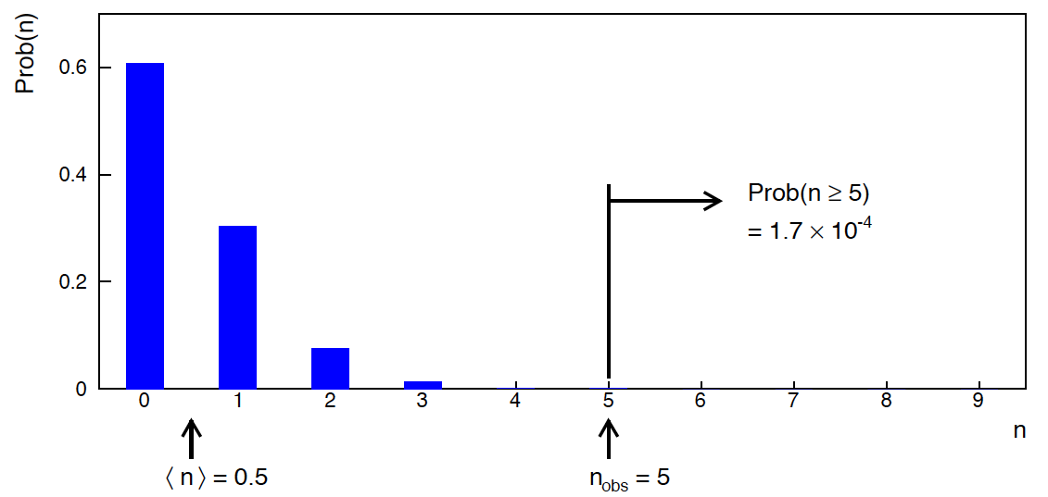
Poisson counting experiment: discovery p-value
Suppose b = 0.5 (known), and we observe n_{obs} = 5.
Should we claim evidence for a new discovery?
Give p-value for hypothesis s = 0, suppose relevant alt. is s > 0.

Slide 20
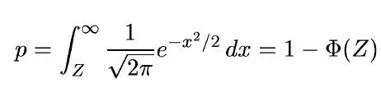
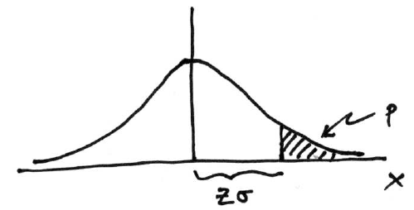

Significance from p-value
Often define significance Z as the number of standard deviations
that a Gaussian variable would fluctuate in one direction
to give the same p-value.
in ROOT:
p = 1 - TMath::Freq(Z)
Z = TMath::NormQuantile(1-p)
in python (scipy.stats):
p = 1 - norm.cdf(Z) = norm.sf(Z)
Z = norm.ppf(1-p)
Result Z is a “number of sigmas”. Note this does not mean that
the original data was Gaussian distributed.

Slide 21

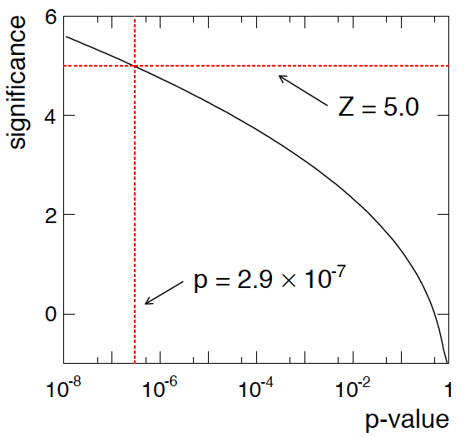
Poisson counting experiment: discovery significance
Equivalent significance for p = 1.7 × 10⁻⁴:
Often claim discovery if Z > 5 (p < 2.9 × 10⁻⁷, i.e., a “5-sigma effect”)
In fact this tradition should be revisited: p-value intended to quantify probability of a signal-like fluctuation assuming background only; not intended to cover, e.g., hidden systematics, plausibility signal model, compatibility of data with signal, “look-elsewhere effect”
(~multiple testing), etc.

Slide 22
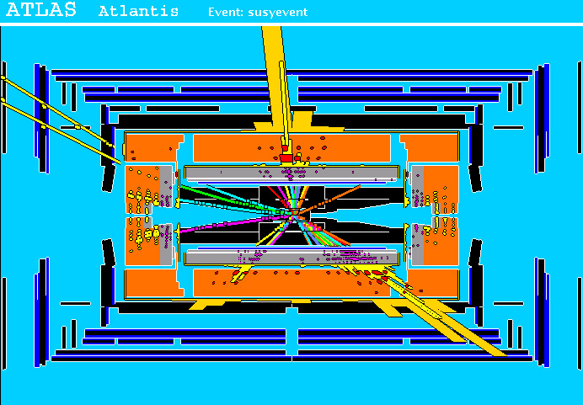
Particle Physics context for a hypothesis test
A simulated SUSY event (“signal”):
high p_{T}
muons
high p_{T} jets
of hadrons
p
p
missing transverse energy

Slide 23
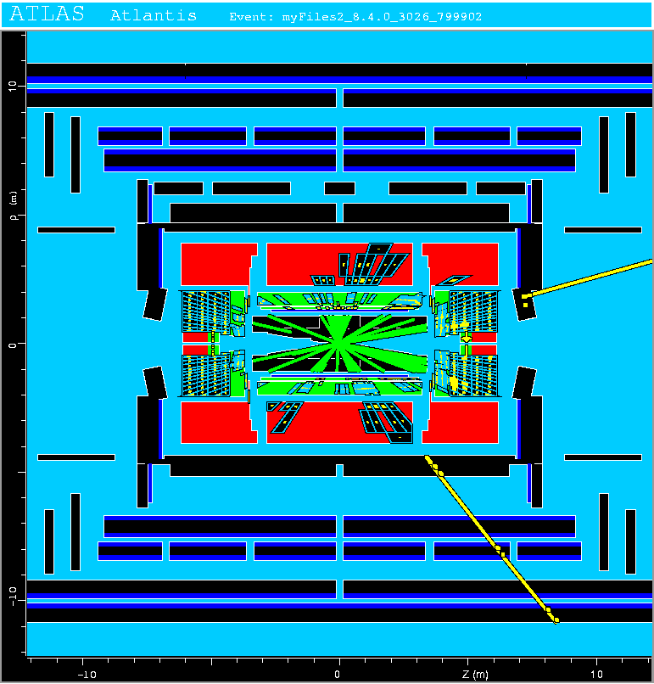
Background events
This event from Standard
Model ttbar production also
has high p_{T} jets and muons,
and some missing transverse
energy.
→ can easily mimic a
signal event.

Slide 24
Classification of proton-proton collisions
Proton-proton collisions can be considered to come in two classes:
signal (the kind of event we’re looking for, y = 1)
background (the kind that mimics signal, y = 0)
For each collision (event), we measure a collection of features:
x₁ = energy of muon x₄ = missing transverse energy
x₂ = angle between jets x₅ = invariant mass of muon pair
x₃ = total jet energy x₆ = ...
The real events don’t come with true class labels, but computer-simulated events do. So we can have a set of simulated events that consist of a feature vector x and true class label y (0 for background, 1 for signal):
(x, y)₁, (x, y)₂, ..., (x, y)_{N}
The simulated events are called “training data”.

Slide 25
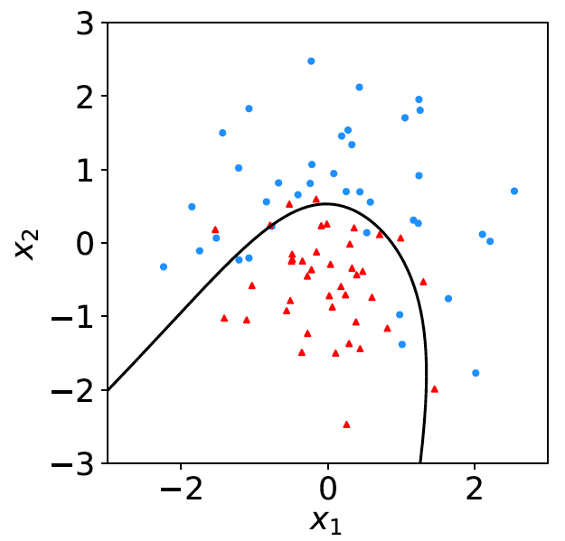
Distributions of the features
If we consider only two
features x = (x₁, x₂), we can
display the results in a scatter
plot (red: y = 0, blue: y = 1).
For real events, the dots are black (true type is not known).
For each real event test the hypothesis that it is background.
(Related to this: test that a sample of events is all background.)
The test’s critical region is defined by a “decision boundary” – without knowing the event type, we can classify them by seeing where their measured features lie relative to the boundary.

Slide 26
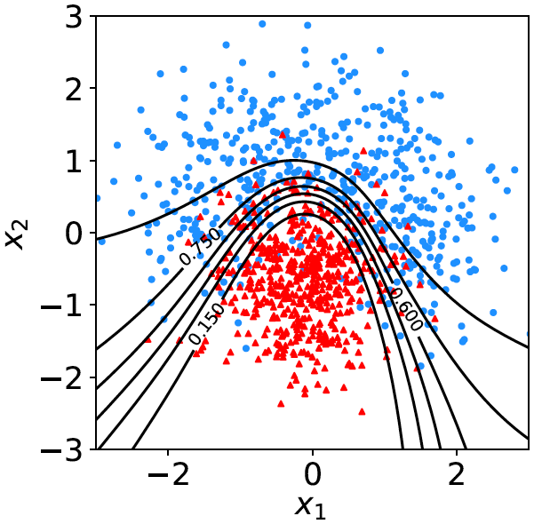

Decision function, test statistic
A surface in an n-dimensional
space can be described by
scalar
function
constant
Different values of the constant
t_{c} result in a family of surfaces.
Problem is reduced to finding
the best decision function or test statistic t (x).

Slide 27
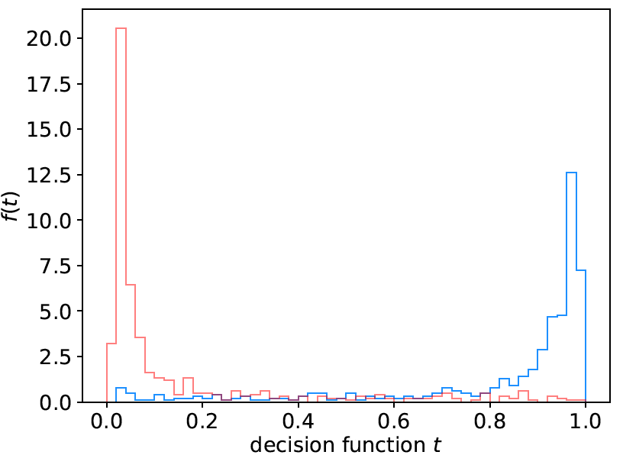
Distribution of t(x)
By forming a test statistic t(x), the boundary of the critical region in the n-dimensional x-space is determined by a single single value t_{c}.
f (t|H₀)
f (t|H₁)
t_{c}
W

Slide 28
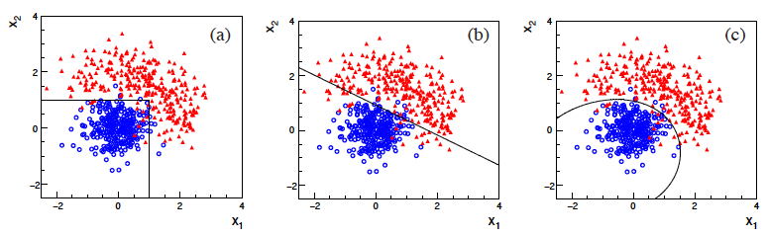
Types of decision boundaries
So what is the optimal boundary for the critical region, i.e., what
is the optimal test statistic t(x)?
First find best t(x), later address issue of optimal size of test.
Remember x-space can have many dimensions.
“cuts”
linear
non-linear

Slide 29
Test statistic based on likelihood ratio
How can we choose a test’s critical region in an ‘optimal way’, in particular if the data space is multidimensional?
Neyman-Pearson lemma states:
For a test of H₀ of size α, to get the highest power with respect to the
alternative H₁ we need for all x in the critical region W
”likelihood
ratio (LR)”
inside W and ≤ c_{α} outside, where c_{α} is a constant chosen to give a test of the desired size.
Equivalently, optimal scalar test statistic is
N.B. any monotonic function of this is leads to the same test.

Slide 30




Proof of Neyman-Pearson Lemma
Consider a critical region W and suppose the LR satisfies the criterion of the Neyman-Pearson lemma:
P(x|H₁)/P(x|H₀) ≥ c_{α} for all x in W,
P(x|H₁)/P(x|H₀) ≤ c_{α} for all x not in W.
W
Try to change this into a different critical region W′ retaining the same size α, i.e.,
δW₊
To do so add a part δW₊, but to keep the size α, we need to remove a part δW₋, i.e.,
W′
δW₋

Slide 31
Proof of Neyman-Pearson Lemma (2)
δW₊
But we are supposing the LR is higher for all x in δW₋ removed than for the x in δW₊ added, and therefore
W′
δW₋
The right-hand sides are equal and therefore

Slide 32
Proof of Neyman-Pearson Lemma (3)
We have
δW₊
W′
Note W and δW₊ are disjoint, and W′ and δW₋ are disjoint, so by Kolmogorov’s 3rd axiom,
δW₋
Therefore

Slide 33
Proof of Neyman-Pearson Lemma (4)
And therefore
i.e. the deformed critical region W′ cannot have higher power than the original one that satisfied the LR criterion of the Neyman-Pearson lemma.

Slide 34

Neyman-Pearson doesn’t usually help
We usually don’t have explicit formulae for the pdfs f (x|s), f (x|b), so for a given x we can’t evaluate the likelihood ratio
Instead we may have Monte Carlo models for signal and background processes, so we can produce simulated data:
generate x ~ f (x|s) → x₁,..., x_{N}
generate x ~ f (x|b) → x₁,..., x_{N}
This gives samples of “training data” with events of known type.
Use these to construct a statistic that is as close as possible to the optimal likelihood ratio (→ Machine Learning).

Slide 35
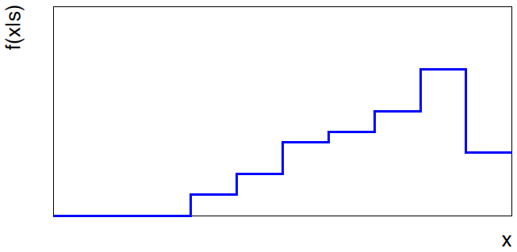
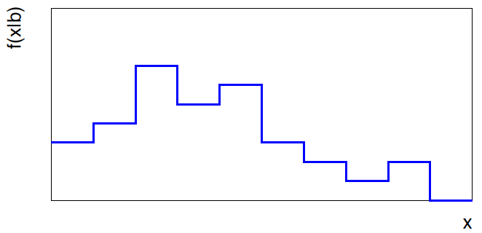


Approximate LR from histograms
Want t(x) = f (x|s)/ f(x|b) for x here
One possibility is to generate
MC data and construct
histograms for both
signal and background.
Use (normalized) histogram
values to approximate LR:
N(x|s)
N (x|s) ≈ f (x|s)
x
N(x|b)
N (x|b) ≈ f (x|b)
Can work well for single
variable.
x

Slide 36
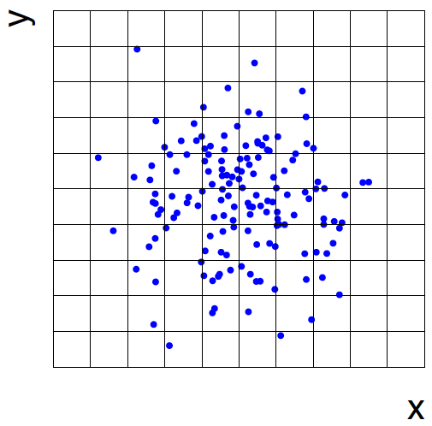
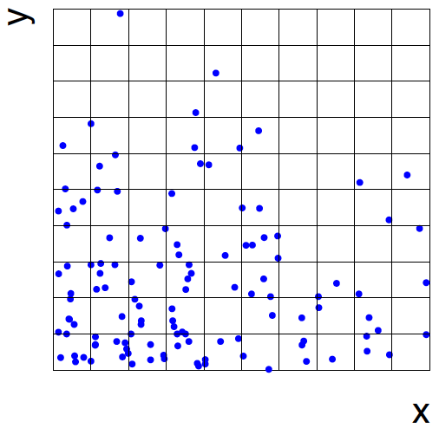
Approximate LR from 2D-histograms
Suppose problem has 2 variables. Try using 2-D histograms:
signal
back-
ground
Approximate pdfs using N (x,y|s), N (x,y|b) in corresponding cells.
But if we want M bins for each variable, then in n-dimensions we
have M^{n} cells; can’t generate enough training data to populate.
→ Histogram method usually not usable for n > 1 dimension.

Slide 37
Strategies for multivariate analysis
Neyman-Pearson lemma gives optimal answer, but cannot be
used directly, because we usually don’t have f (x|s), f (x|b).
Histogram method with M bins for n variables requires that
we estimate M^{n} parameters (the values of the pdfs in each cell),
so this is rarely practical.
A compromise solution is to assume a certain functional form
for the test statistic t (x) with fewer parameters; determine them
(using MC) to give best separation between signal and background.
Alternatively, try to estimate the probability densities f (x|s) and
f (x|b) (with something better than histograms) and use the
estimated pdfs to construct an approximate likelihood ratio.

Slide 38
Multivariate methods (Machine Learning)
Many new (and some old) methods:
Fisher discriminant
(Deep) Neural Networks
Kernel density methods
Support Vector Machines
Decision trees
Boosting
Bagging
More in the lectures on Machine Learning

Slide 39
Extra slides

Slide 40
Some statistics books, papers, etc.
G. Cowan, Statistical Data Analysis, Clarendon, Oxford, 1998
R.J. Barlow, Statistics: A Guide to the Use of Statistical Methods in the Physical Sciences, Wiley, 1989
Ilya Narsky and Frank C. Porter, Statistical Analysis Techniques in Particle Physics, Wiley, 2014.
Luca Lista, Statistical Methods for Data Analysis in Particle Physics, Springer, 2017.
L. Lyons, Statistics for Nuclear and Particle Physics, CUP, 1986
F. James., Statistical and Computational Methods in Experimental Physics, 2nd ed., World Scientific, 2006
S. Brandt, Statistical and Computational Methods in Data Analysis, Springer, New York, 1998.
S. Navas et al. (Particle Data Group), Phys. Rev. D 110, 030001 (2024); pdg.lbl.gov sections on probability, statistics, MC.

