Slide 1


Statistical & Mathematical Foundations
Lecture 2: Parameter and interval estimation
STEAM Academy
CERN
6,7 July 2026
https://indico.cern.ch/event/1699443/
Glen Cowan
Physics Department
Royal Holloway, University of London
g.cowan@rhul.ac.uk
www.pp.rhul.ac.uk/~cowan

Slide 2
Outline
Lecture 1: Introduction
Probability
Hypothesis tests
→ Lecture 2: Parameter estimation
Confidence limits
Systematic uncertainties

Slide 3
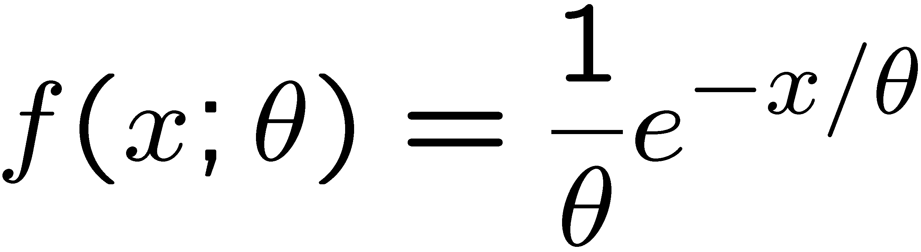
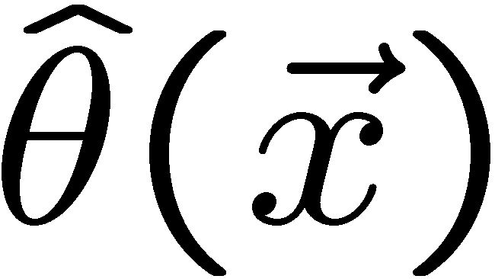
Parameter estimation
The parameters of a pdf are any constants that characterize it,
i.e., θ indexes a
set of hypotheses.
r.v.
parameter
Suppose we have a sample of observed values: x = (x₁, ..., x_{n})
We want to find some function of the data to estimate the
parameter(s):
← estimator written with a hat
Sometimes we say ‘estimator’ for the function of x₁, ..., x_{n};
‘estimate’ for the value of the estimator with a particular data set.

Slide 4
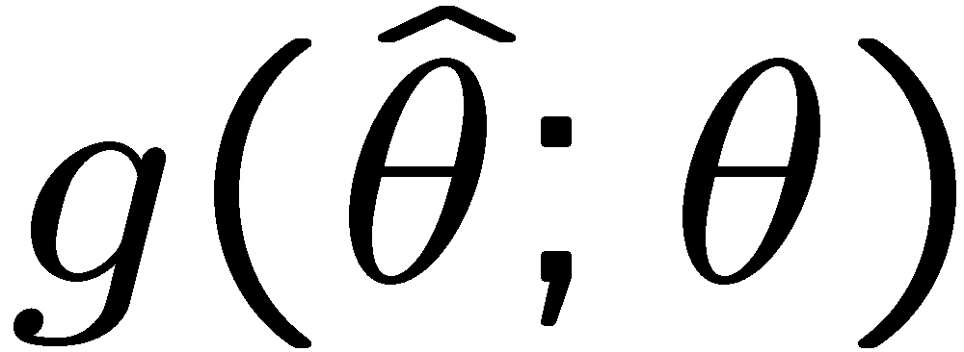
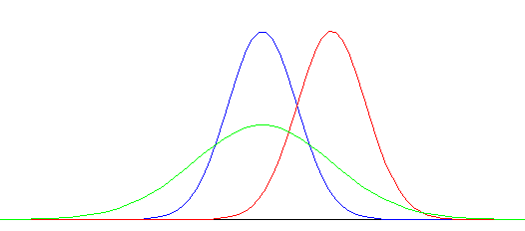

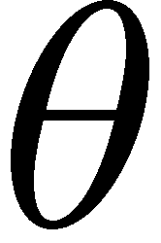
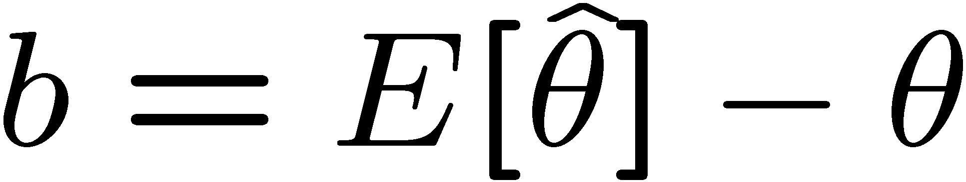
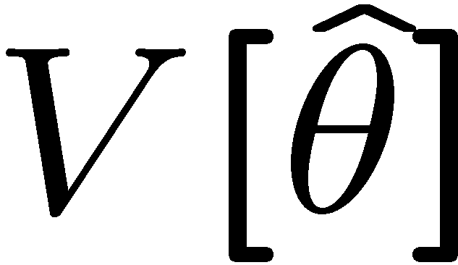
Properties of estimators
If we were to repeat the entire measurement, the estimates
from each would follow a pdf:
best
large
variance
biased
We want small (or zero) bias (systematic error):
→ average of repeated measurements should tend to true value.
And we want a small variance (statistical error):
→ small bias & variance are in general conflicting criteria

Slide 5
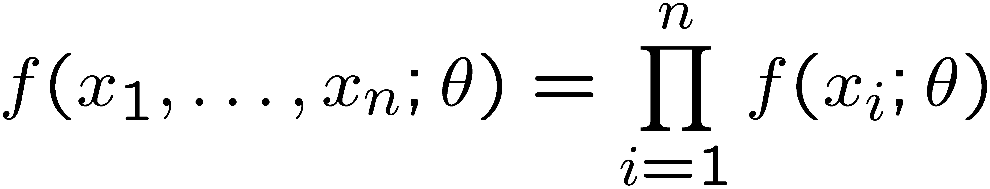
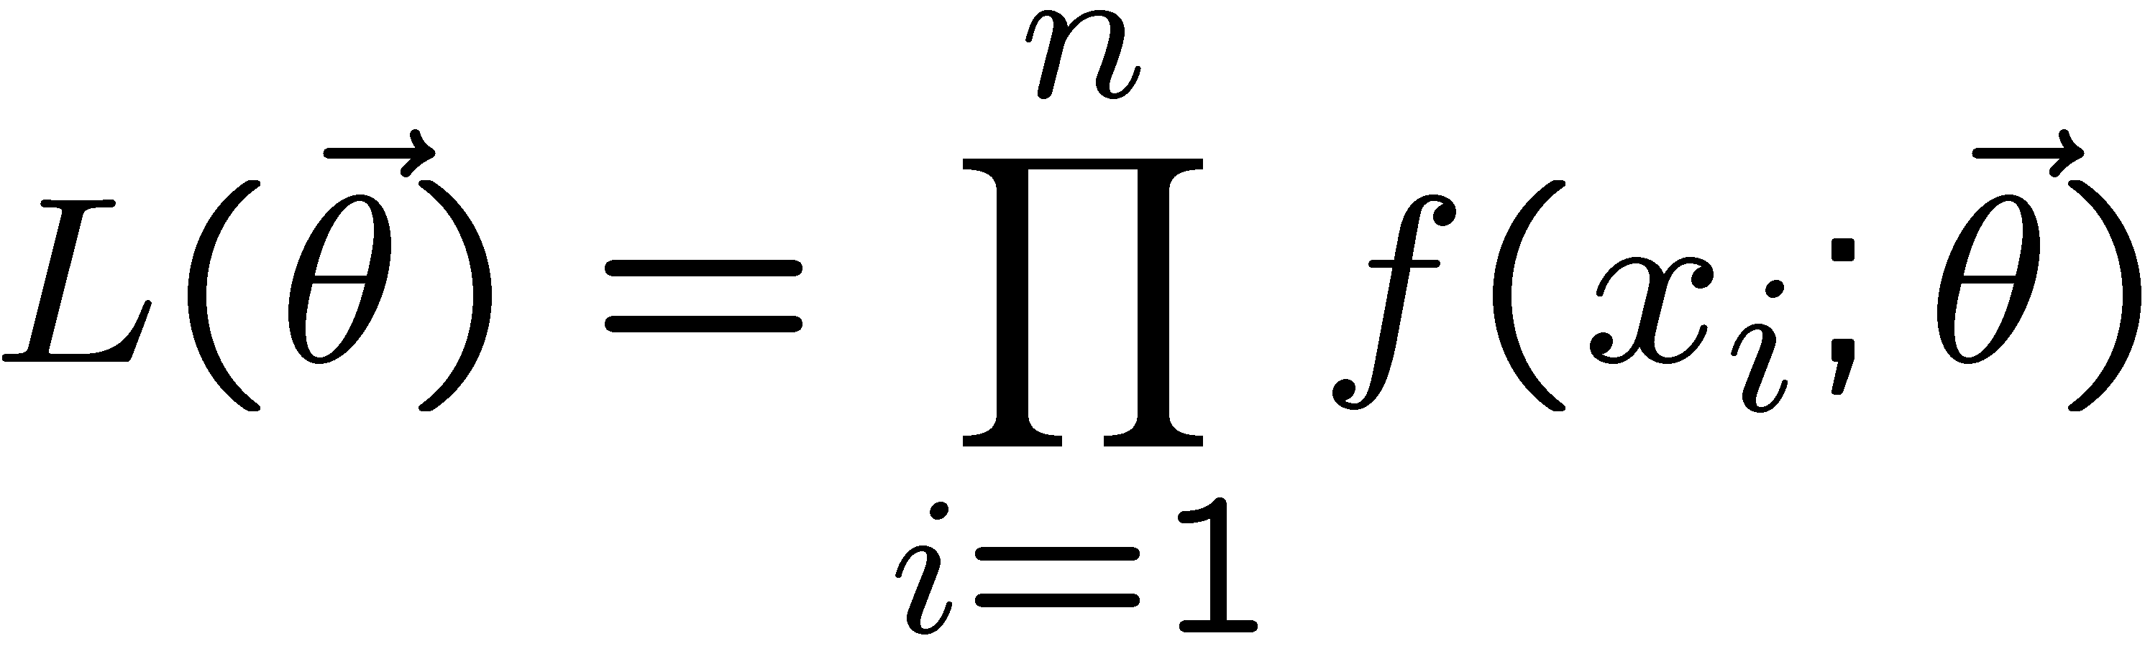
The likelihood function for i.i.d.* data
* i.i.d. = independent and identically distributed
Consider n independent observations of x: x₁, ..., x_{n}, where
x follows f (x; θ). The joint pdf for the whole data sample is:
In this case the likelihood function is
(x_{i} constant)

Slide 6
Maximum Likelihood Estimators (MLEs)
We define the maximum likelihood estimators or MLEs to be
the parameter values for which the likelihood is maximum.
Maximizing L equivalent to maximizing log L
Could have multiple maxima (take highest).
MLEs not guaranteed to have any ‘optimal’ properties, (but in practice they’re very good).

Slide 7
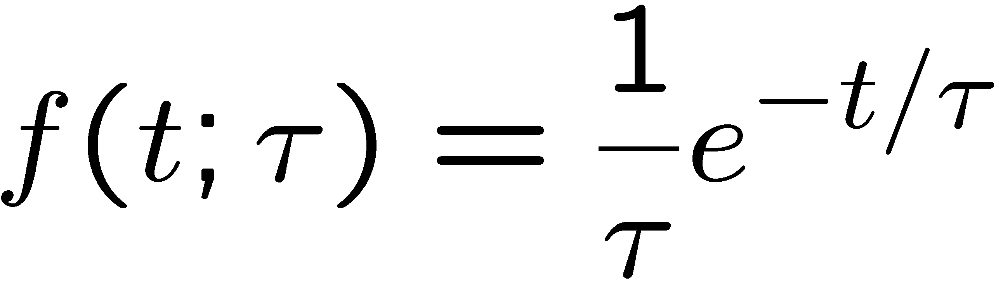
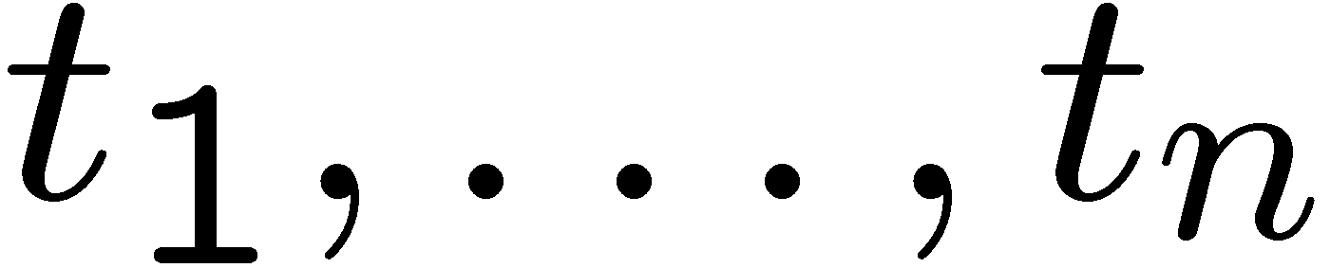
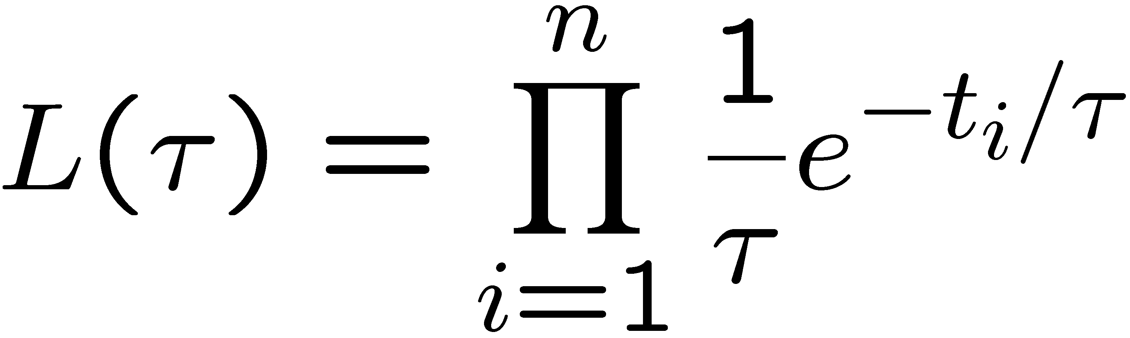
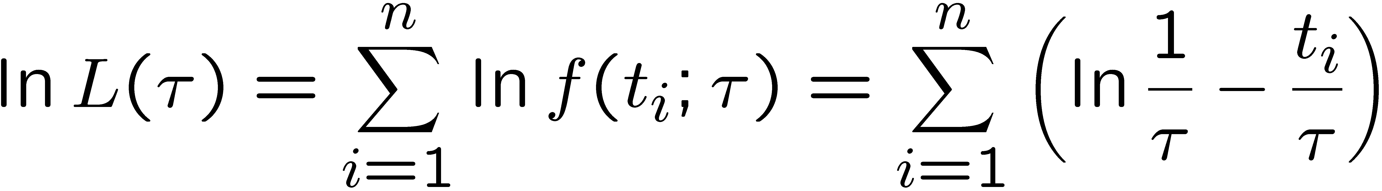
MLE example: parameter of exponential pdf
Consider exponential pdf,
and suppose we have i.i.d. data,
The likelihood function is
The value of τ for which L(τ) is maximum also gives the
maximum value of its logarithm (the log-likelihood function):

Slide 8
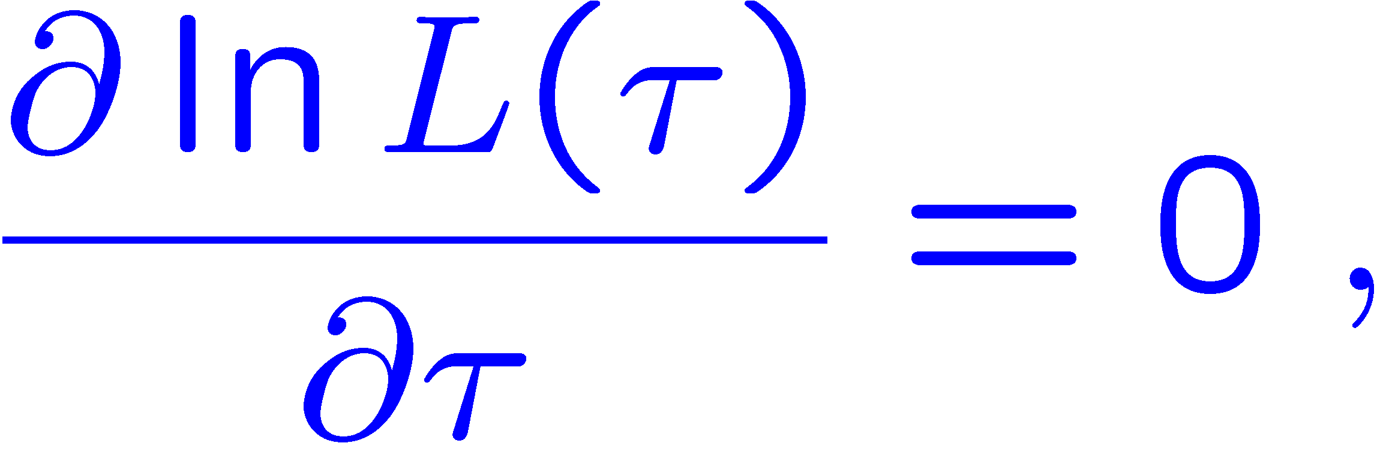
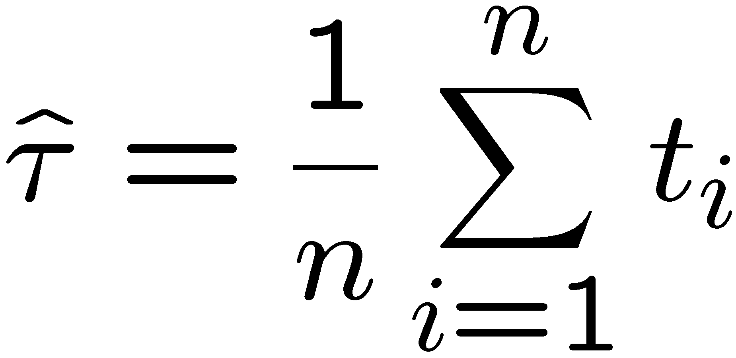
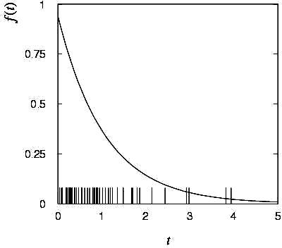
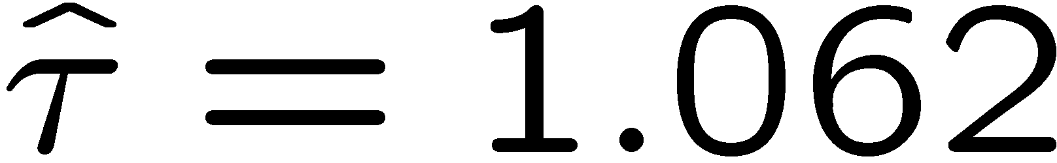
MLE example: parameter of exponential pdf (2)
Find its maximum by setting
→
Monte Carlo test:
generate 50 values
using τ = 1:
We find the ML estimate:

Slide 9






MLE example: parameter of exponential pdf (3)
For the exponential distribution one has for mean, variance:
For the MLE
we therefore find
→
→

Slide 10
Large-sample (asymptotic) properties of MLEs
Suppose we have an i.i.d. data sample of size n: x₁,...,x_{n}
In the large-sample (or “asymptotic”) limit (n → ∞) and assuming regularity conditions one can show that the likelihood and MLE have several important properties.
The regularity conditions include:
the boundaries of the data space cannot depend on the parameter;
the parameter cannot be on the edge of the parameter space;
ln L(θ) must be differentiable;
the only solution to 𝜕ln L/𝜕θ = 0 is θ.
^
In the slides immediately following the properties are shown without proof for a single parameter; the corresponding properties hold also for the multiparameter case, θ = (θ₁,..., θ_{m}).

Slide 11
log-likelihood becomes quadratic
The likelihood function becomes Gaussian in shape, i.e. the log-likelihood becomes quadratic (parabolic).
The MLE becomes increasingly precise as the (log)-likelihood becomes more tightly concentrated about its peak,
but L(θ) = P(x|θ) is the probability for x, not a pdf for θ.

Slide 12
The MLE converges to the true parameter value
In the large-sample limit, the MLE converges in probability
to the true parameter value.
That is, for any ε > 0,
The MLE is said to be consistent.

Slide 13
MLE is asymptotically unbiased
In general the MLE can be biased, but in the large-sample limit, this bias goes to zero:
(Recall for the exponential parameter we found the bias was
identically zero regardless of the sample size n.)

Slide 14
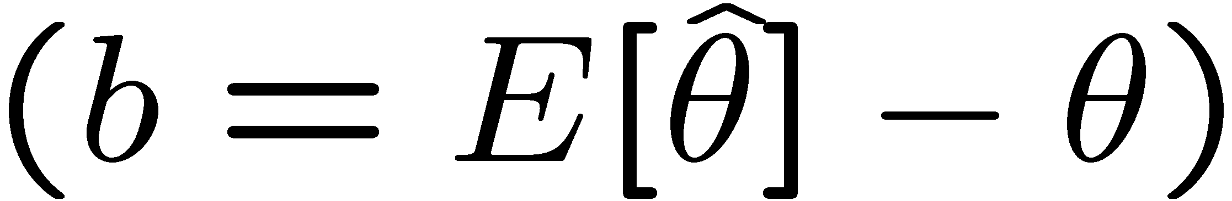
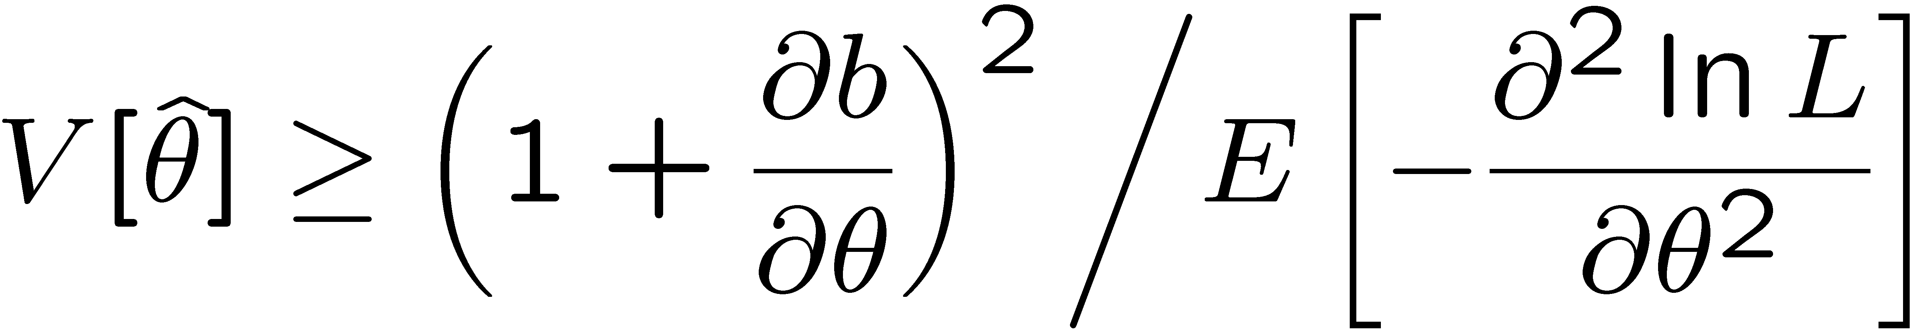
The information inequality
The information inequality (RCF) sets a lower bound on the
variance of any estimator (not only MLE). For a single parameter:
= MVB (Minimum
Variance Bound)
where
Proof in Exercise 6.6 of SDA, http://www.pp.rhul.ac.uk/~cowan/sda/prob/prob_6.pdf
“Efficiency” of an estimator = MVB / actual variance.
An estimator whose variance equals the MVB is said to be efficient.

Slide 15
The MLE’s variance approaches the MVB
In the large-sample limit, the variance of the MLE approaches the minimum-variance bound, i.e., the information inequality becomes an equality (and bias goes to zero):
The MLE is said to be asymptotically efficient.

Slide 16
The MLE’s distribution becomes Gaussian
In the large-sample limit, the pdf of the MLE becomes Gaussian,
where
is the minimum variance bound (note bias is zero).
For example, exponential MLE with sample size n = 100.
Note that for exponential, MLE is arithmetic average, so Gaussian MLE seen to stem from Central Limit Theorem.

Slide 17
Distribution of MLE of exponential parameter

Slide 18
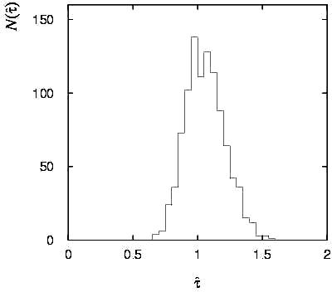
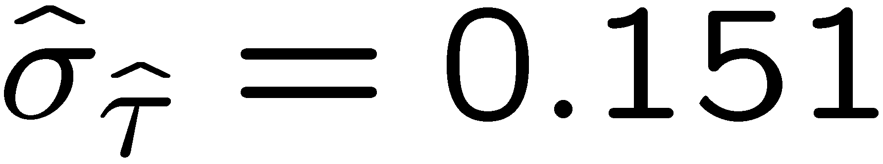
Variance of estimators: Monte Carlo method
Having estimated our parameter we now need to report its
‘statistical error’, using e.g. the estimator’s standard deviation, or (co)variance.
It is usually not possible to do this with an exact calculation.
Another way is to simulate the entire experiment many times with a Monte Carlo program (use ML estimate for MC).
For exponential example (n=50), from sample variance of estimates we find:

Slide 19
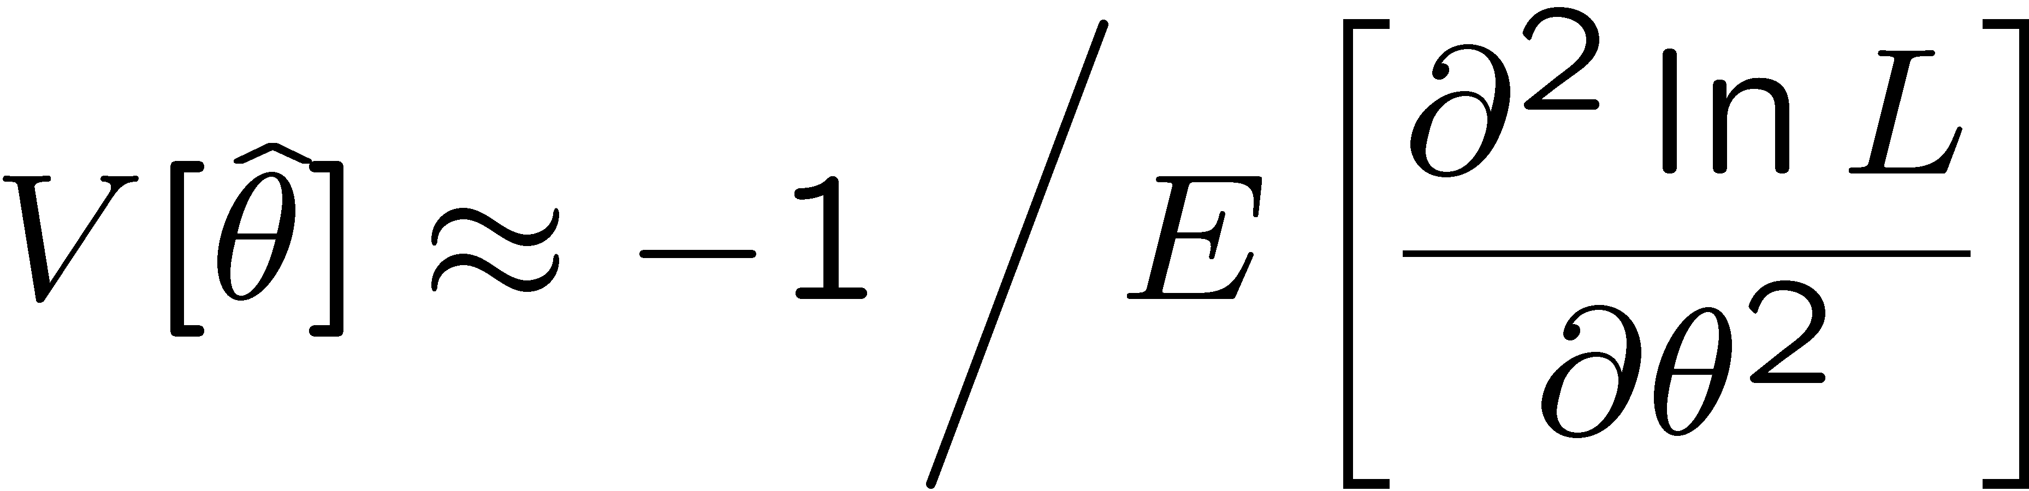
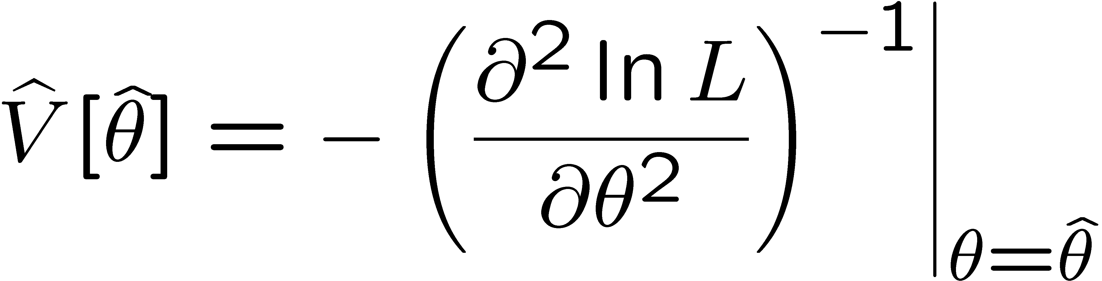
Variance of estimators from information inequality
Recall the information inequality (RCF) sets a lower bound on the
variance of any estimator (not only MLE):
MVB
Often the bias b is small, and equality either holds exactly or
is a good approximation (e.g. large data sample limit). Then,
Estimate this using the 2nd derivative of ln L at its maximum:

Slide 20
MVB for MLE of exponential parameter
Find
We found for the exponential parameter the MLE
and we showed b = 0, hence 𝜕b/𝜕τ = 0.
We find
and since E[t_{i}] = τ for all i,
,
and therefore
.
So here the MLE is efficient.

Slide 21
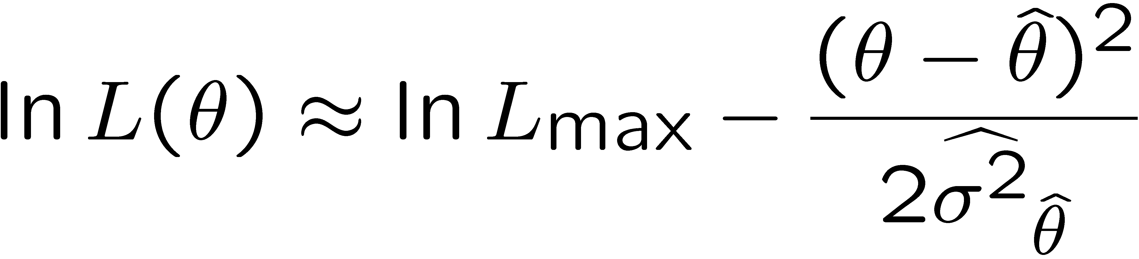
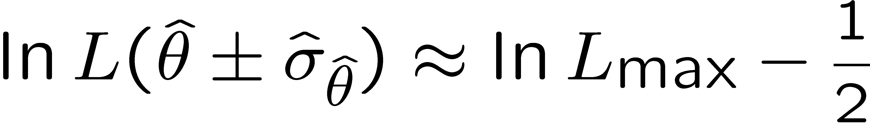


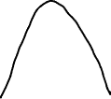
Variance of estimators: graphical method
Expand ln L (θ) about its maximum:
First term is ln L_{max}, second term is zero, for third term use
information inequality (assume equality):
→ to get
, change θ away from
until ln L decreases by 1/2.

Slide 22
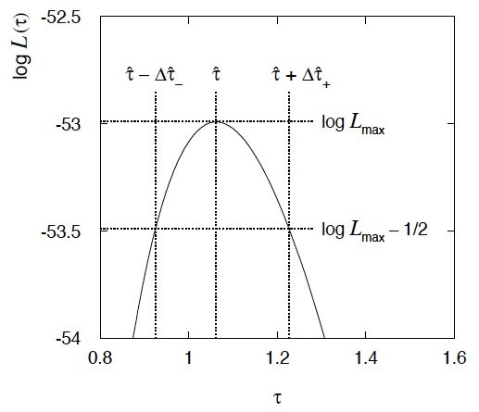
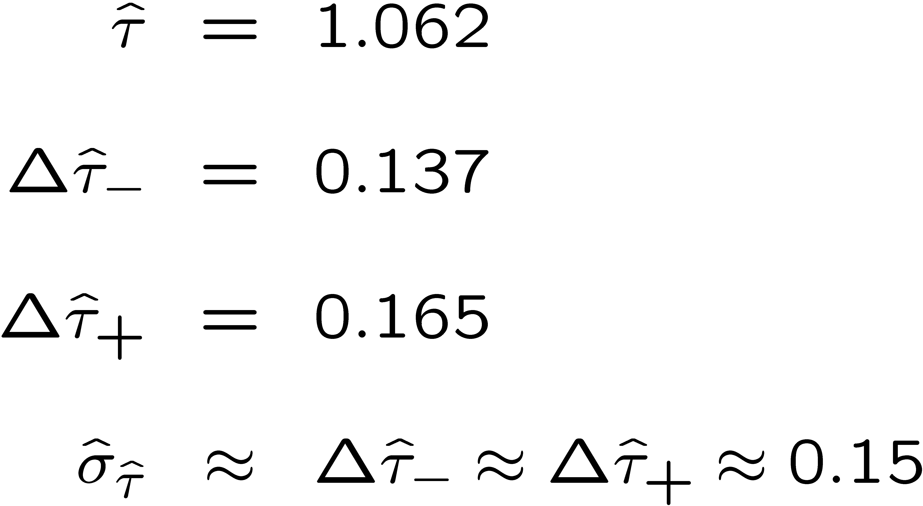
Example of variance by graphical method
ML example with exponential:
Not quite parabolic ln L since finite sample size (n = 50).

Slide 23
Information inequality for N parameters
Suppose we have estimated N parameters θ = (θ₁,...,θ_{N})
The Fisher information matrix is
^
and the covariance matrix of estimators θ is
The information inequality states that the matrix
is positive semi-definite:
z^{T}Mz ≥ 0 for all z ≠ 0, diagonal elements ≥ 0

Slide 24
Information inequality for N parameters (2)
In practice the inequality is ~always used in the large-sample limit:
bias → 0
inequality → equality, i.e, M = 0, and therefore V = I⁻¹
That is,
This can be estimated from data using
Find the matrix V⁻¹ numerically (or with automatic differentiation),
then invert to get the covariance matrix of the estimators

Slide 25
Confidence intervals by inverting a test
In addition to a ‘point estimate’ of a parameter we should report
an interval reflecting its statistical uncertainty.
Confidence intervals for a parameter θ can be found by
defining a test of the hypothesized value θ (do this for all θ):
Specify values of the data that are ‘disfavoured’ by θ
(critical region) such that P(data in critical region|θ) ≤ α
for a prespecified α, e.g., 0.05 or 0.1.
If data observed in the critical region, reject the value θ.
Now invert the test to define a confidence interval as:
set of θ values that are not rejected in a test of size α
(confidence level CL is 1− α).

Slide 26
Relation between confidence interval and p-value
Equivalently we can consider a significance test for each
hypothesized value of θ, resulting in a p-value, p_{θ}.
If p_{θ} ≤ α, then we reject θ.
The confidence interval at CL = 1 – α consists of those values of
θ that are not rejected.
E.g. an upper limit on θ is the greatest value for which p_{θ} > α.
In practice find by setting p_{θ} = α and solve for θ.
For a multidimensional parameter space θ = (θ₁,... θ_{M}) use same idea – result is a confidence “region” with boundary determined by p_{θ} = α.

Slide 27
Coverage probability of confidence interval
If the true value of θ is rejected, then it’s not in the confidence interval. The probability for this is by construction (equality for continuous data):
P(reject θ|θ) ≤ α = type-I error rate
Therefore, the probability for the interval to contain or “cover” θ is
P(conf. interval “covers” θ|θ) ≥ 1 − α
This assumes that the set of θ values considered includes the true value, i.e., it assumes the composite hypothesis P(x|H,θ).

Slide 28



Frequentist upper limit on Poisson parameter
Consider again the case of observing n ~ Poisson(s + b).
Suppose b = 4.5, n_{obs} = 5. Find upper limit on s at 95% CL.
Relevant alternative is s = 0 (critical region at low n)
p-value of hypothesized s is P(n ≤ n_{obs}; s, b)
Upper limit s_{up} at CL = 1 – α found from

Slide 29




Approximate confidence intervals/regions
from the likelihood function
Suppose we test parameter value(s) θ = (θ₁, ..., θ_{n}) using the ratio
Lower λ(θ) means worse agreement between data and hypothesized θ. Equivalently, usually define
so higher t_{θ} means worse agreement between θ and the data.
p-value of θ therefore
need pdf

Slide 30




Confidence region from Wilks’ theorem
Wilks’ theorem says (in large-sample limit and provided
certain conditions hold...)
chi-square dist. with # d.o.f. =
# of components in θ = (θ₁, ..., θ_{n}).
Assuming this holds, the p-value is
← set equal to α
To find boundary of confidence region set p_{θ} = α and solve for t_{θ}:
Recall also

Slide 31




Confidence region from Wilks’ theorem (cont.)
i.e., boundary of confidence region in θ space is where
For example, for 1 – α = 68.3% and n = 1 parameter,
and so the 68.3% confidence level interval is determined by
Same as recipe for finding the estimator’s standard deviation, i.e.,
is a 68.3% CL confidence interval.

Slide 32
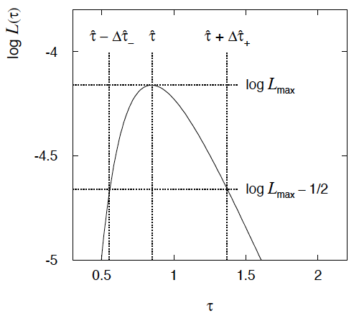

Example of interval from ln L(θ)
For n=1 parameter, CL = 0.683, Q_{α} = 1.
Our exponential
example, now with
only n = 5 events.
Can report ML estimate
with approx. confidence
interval from ln L_{max} – 1/2
as “asymmetric error bar”:

Slide 33

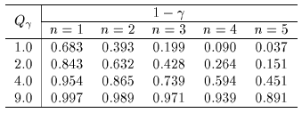

Multiparameter case
For increasing number of parameters, CL = 1 – α decreases for
confidence region determined by a given

Slide 34
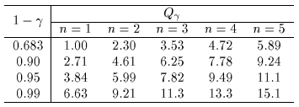
Multiparameter case (cont.)
Equivalently, Q_{α} increases with n for a given CL = 1 – α.

Slide 35



Systematic uncertainties and nuisance parameters
P (x|θ)
In general, our model of the data is not perfect:
model:
truth:
x
Can improve model by including
additional adjustable parameters.
Nuisance parameter ↔ systematic uncertainty. Some point in the
parameter space of the enlarged model should be “true”.
Presence of nuisance parameter decreases sensitivity of analysis
to the parameter of interest (e.g., increases variance of estimate).

Slide 36
Profile Likelihood
Suppose we have a likelihood L(μ,θ) = P(x|μ,θ) with N parameters of interest μ = (μ₁,..., μ_{N}) and M nuisance parameters θ = (θ₁,..., θ_{M}). The “profiled” (or “constrained”) values of θ are:
and the profile likelihood is:
The profile likelihood depends only on the parameters of interest; the nuisance parameters are replaced by their profiled values.
The profile likelihood can be used to obtain confidence intervals/regions for the parameters of interest in the same way as one would for all of the parameters from the full likelihood.

Slide 37
Profile Likelihood Ratio – Wilks theorem
Goal is to test/reject regions of μ space (param. of interest).
Rejecting a point μ should mean p_{μ} ≤ α for all possible values of the nuisance parameters θ.
Test μ using the “profile likelihood ratio”:
Let t_{μ} = −2 ln λ(μ). Wilks’ theorem says in large-sample limit:
where the number of degrees of freedom is the number of
parameters of interest (components of μ). So p-value for μ is

Slide 38
Profile Likelihood Ratio – Wilks theorem (2)
If we have a large enough data sample to justify use of the
asymptotic chi-square pdf, then if μ is rejected, it is rejected for any values of the nuisance parameters.
The recipe to get confidence regions/intervals for the parameters of interest at CL = 1 – α is thus the same as before, simply use the profile likelihood:
where the number of degrees of freedom N for the chi-square quantile is equal to the number of parameters of interest.
If the large-sample limit is not justified, then use e.g. Monte Carlo to get distribution of t_{μ}.

Slide 39
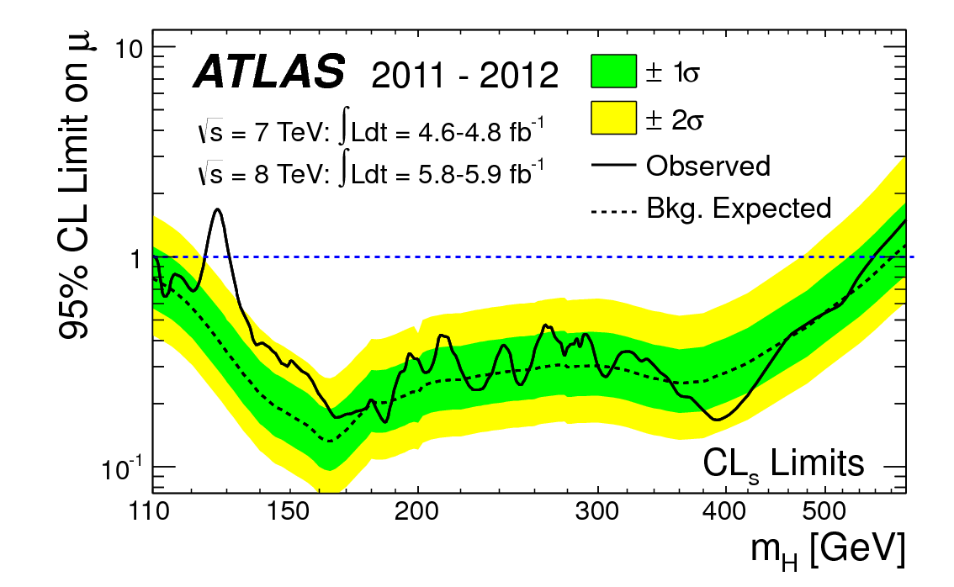
How to read the green and yellow limit plots
For every value of m_{H}, find the upper limit on μ.
Also for each m_{H}, determine the distribution of upper limits μ_{up} one would obtain under the hypothesis of μ = 0.
The dashed curve is the median μ_{up}, and the green (yellow) bands give the ± 1σ (2σ) regions of this distribution.
ATLAS, Phys. Lett. B 716 (2012) 1-29

Slide 40
Extra slides

Slide 41
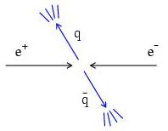
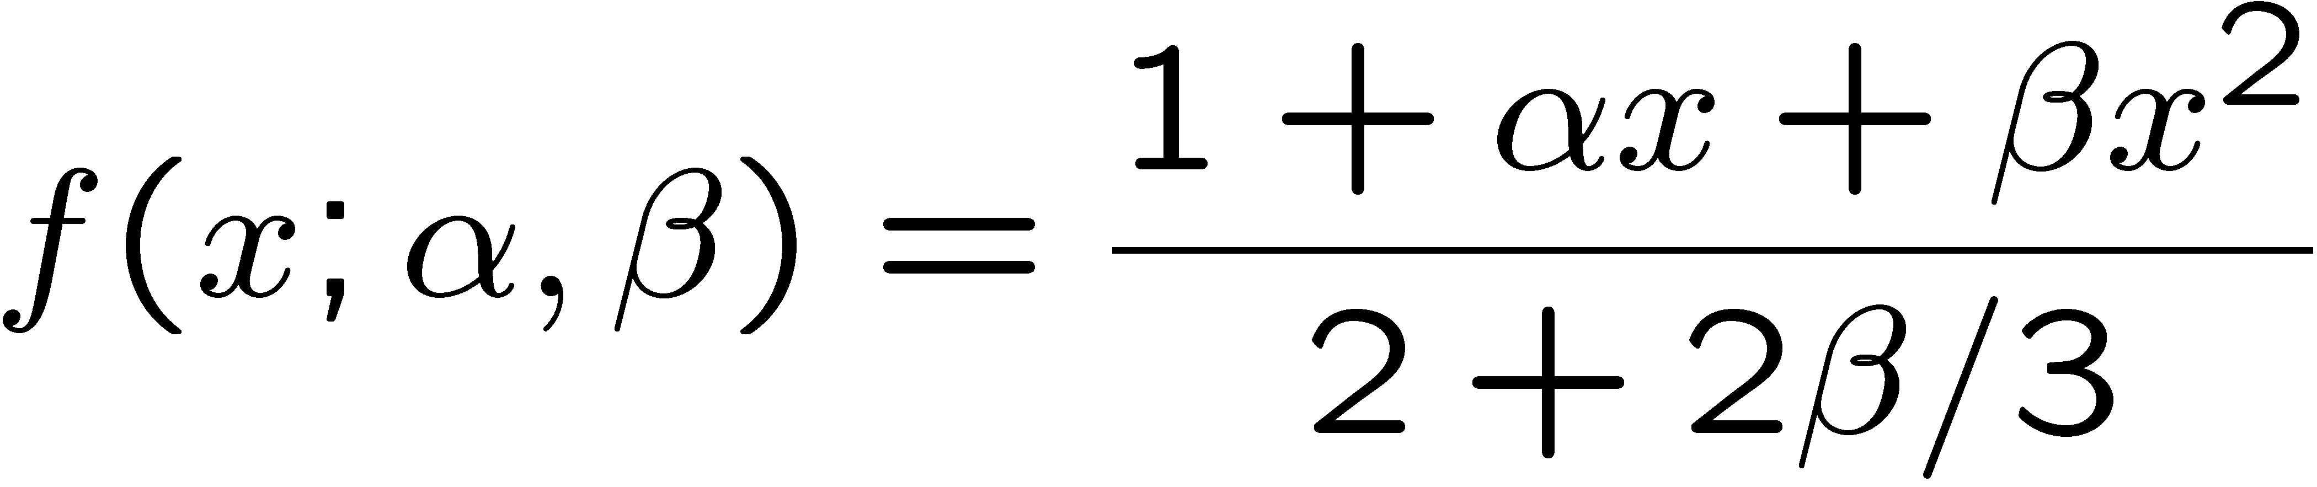
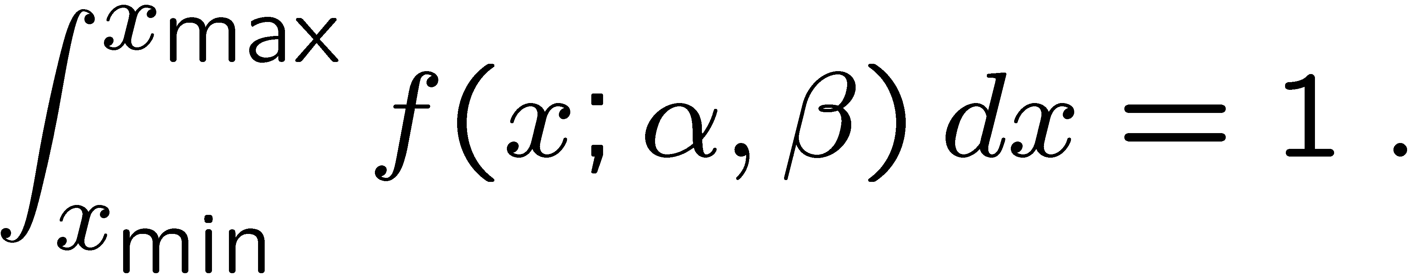
Example of ML with 2 parameters
Consider a scattering angle distribution with x = cos θ,
or if x_{min} < x < x_{max}, need to normalize so that
Example: α = 0.5, β = 0.5, x_{min} = -0.95, x_{max} = 0.95, generate n = 2000 events with Monte Carlo.
need to find maximum
numerically

Slide 42
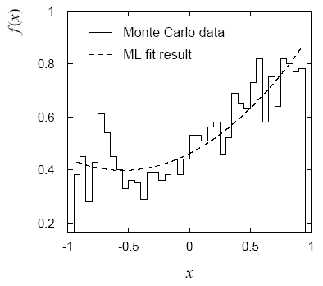
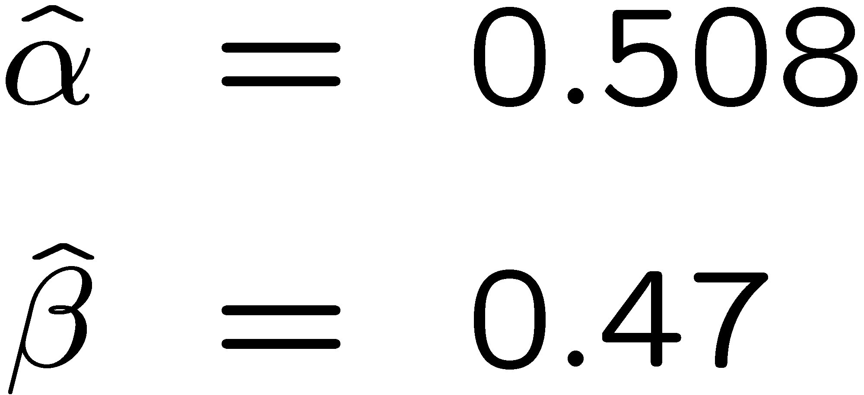
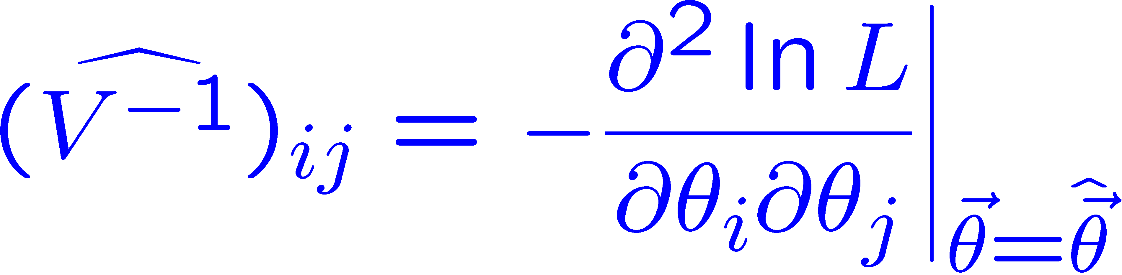
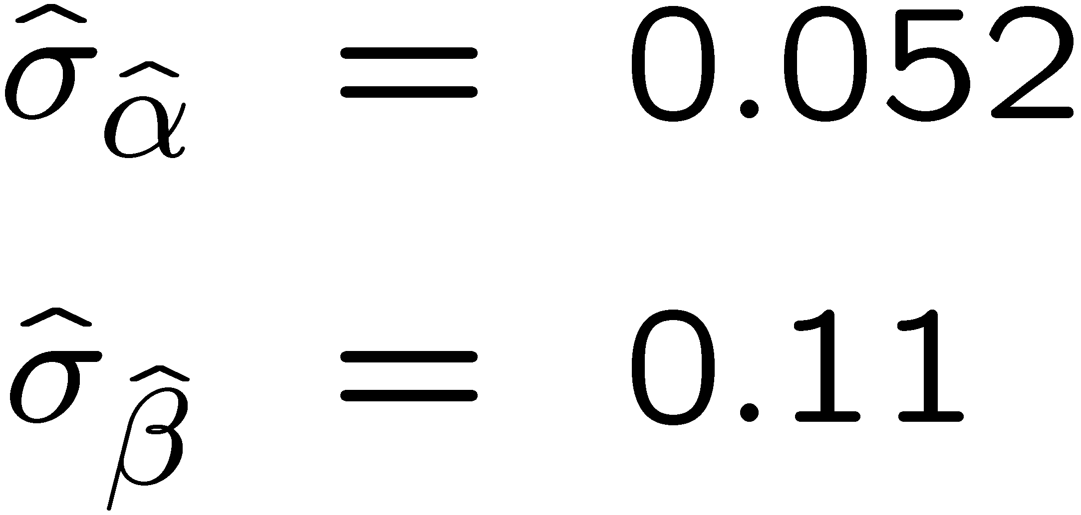
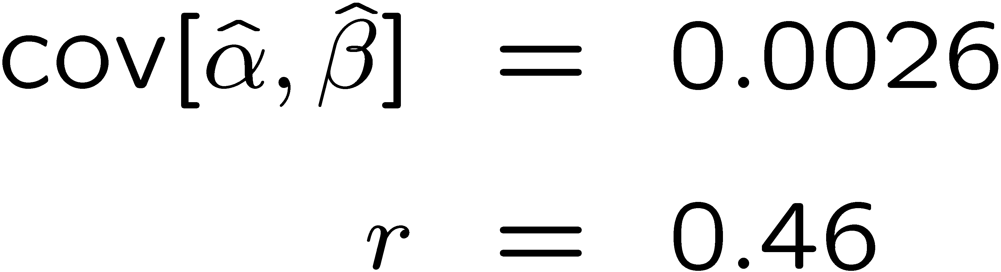
Example of ML with 2 parameters: fit result
Finding maximum of ln L(α, β) numerically gives
N.B. No binning of data for fit,
but can compare to histogram for
goodness-of-fit (e.g. ‘visual’ or χ²).
(Co)variances from
= correlation coefficient

Slide 43
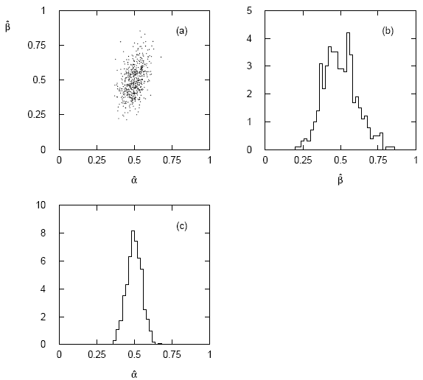




Two-parameter fit: MC study
Repeat ML fit with 500 experiments, all with n = 2000 events:
Estimates average to ~true values;
(Co)variances close to previous estimates;
marginal pdfs approximately Gaussian.

Slide 44
Multiparameter graphical method for variances
Expand ln L(θ) to 2nd order about MLE:
ln L_{max}
zero
relate to covariance matrix of MLEs using information (in)equality.
Result:
So the surface
corresponds to
, which is the equation of a (hyper-) ellipse.

Slide 45



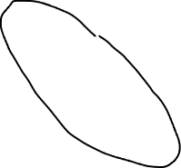
Multiparameter graphical method (2)
Distance from MLE to tangent planes gives standard deviations.

Slide 46
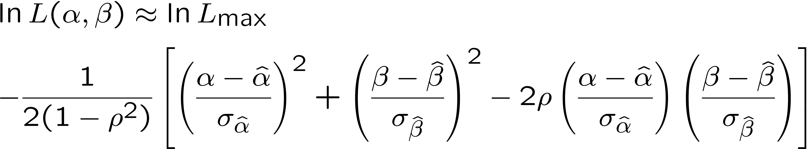
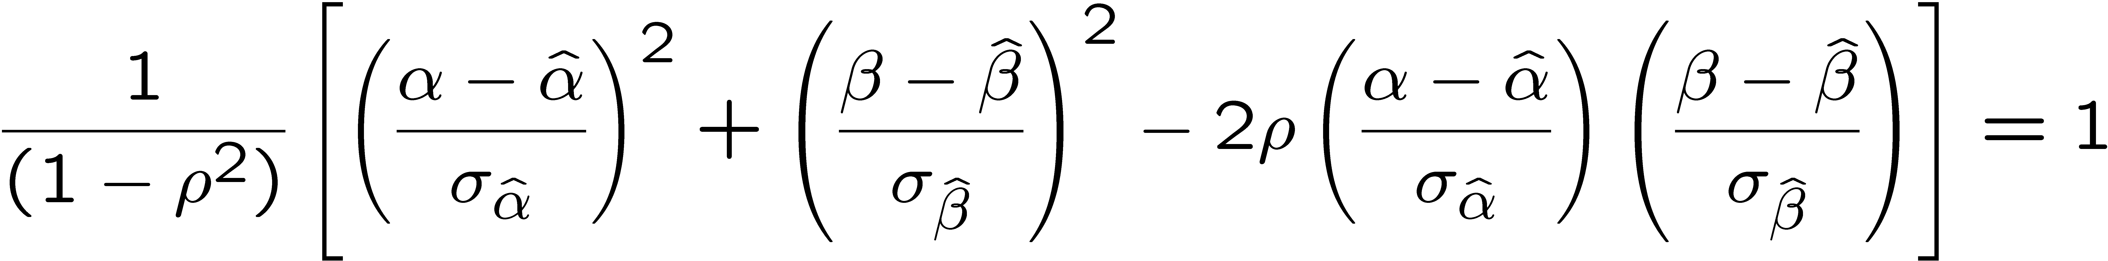
The ln L_{max} − 1/2 contour for two parameters
For large n, ln L takes on quadratic form near maximum:
The contour
is an ellipse:

Slide 47
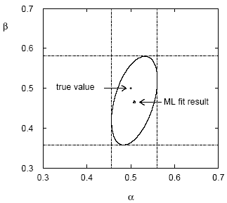
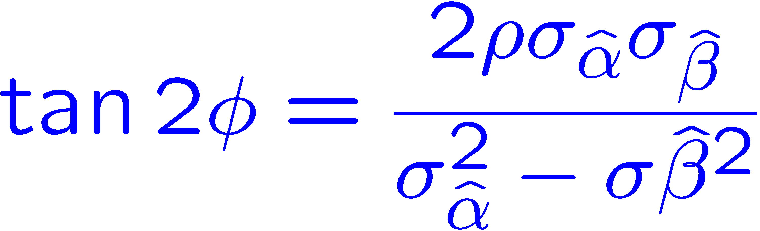
(Co)variances from ln L contour
The α, β plane for the first
MC data set
→ Tangent lines to contours give standard deviations.
→ Angle of ellipse φ related to correlation:

Slide 48
Functions of maximum-likelihood estimators
Suppose likelihood has a parameter θ.
Define a new parameter α given by function α = a(θ).
What is the MLE of α?
For now suppose a(θ) has a unique inverse, so θ = a⁻¹(α).
The likelihood is L(θ) = L(a⁻¹(α)).
The maximum of the likelihood is L_{max} = L(θ).
So to maximize L, find α ≡ α such that
^
^
MLE of a function is the function of the MLE.
If function many-to-one, some complications but related recipe.
Very useful result.

Slide 49
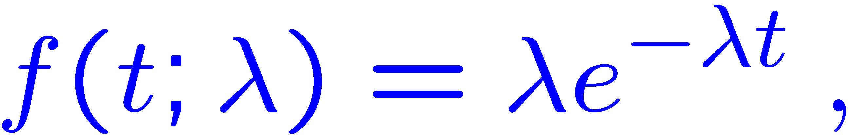
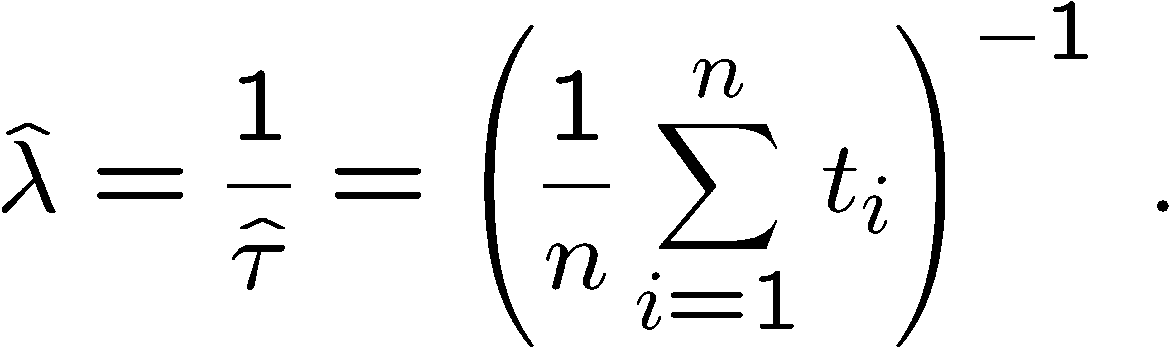


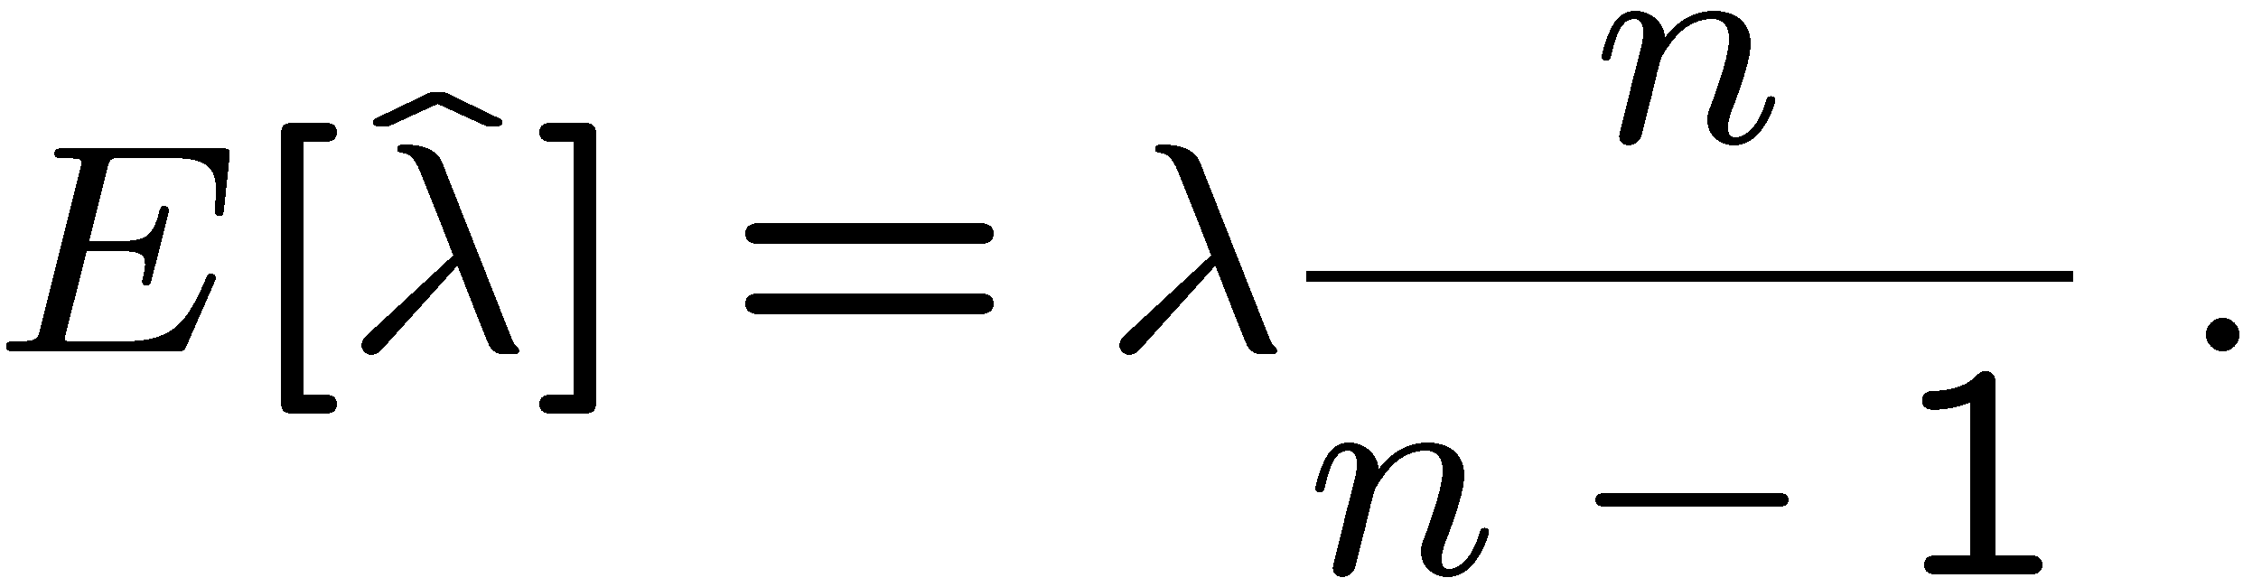
Functions of MLEs: exponential example
Suppose we had written the exponential pdf as
i.e., we use λ = 1/τ. What is the MLE estimator for λ?
For the decay constant we have
Caveat:
is biased, even though
is unbiased.
Can show
(bias →0 for n →∞)
In general MLE for a function of an unbiased estimator stays unbiased only for a linear function.

Slide 50
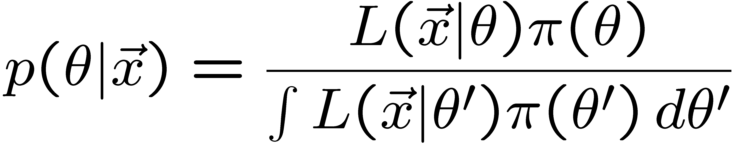
Relationship between ML and Bayesian estimators
Recall the Bayesian approach:
Both θ and x are random variables.
Use subjective probability for hypotheses (θ);
before experiment, knowledge summarized by prior pdf π(θ);
use Bayes’ theorem to update prior in light of data:
Posterior pdf (conditional pdf for θ given x)

Slide 51



ML and Bayesian estimators (2)
Purist Bayesian: p(θ | x) contains all knowledge about θ.
Pragmatist Bayesian: p(θ | x) could be a complicated function,
→ summarize using an estimator
Take mode of p(θ | x), (could also use e.g. expectation value)
What do we use for π(θ)?
No golden rule (subjective!), often represent ‘prior ignorance’ by π(θ) = constant, in which case

Slide 52
ML and Bayesian estimators (3)
Note π_{θ}(θ) = const. cannot be normalized – “improper prior”.
Can be allowed for some problems; prior always appears multiplied
by likelihood, so product L(θ)π_{θ}(θ) can result in normalizable posterior probability.
But... we could have used a different parameter, e.g., λ= 1/θ,
and if prior π_{θ}(θ) is constant, then π_{λ}(λ) is not:
Maybe we know say we nothing about λ, so take π_{λ}(λ) = const.
Then
‘Complete prior ignorance’ is not well defined.

Slide 53

n ~ Poisson(s+b): frequentist upper limit on s
For low fluctuation of n, formula can give negative result for s_{up}; i.e. confidence interval is empty; all values of s ≥ 0 have p_{s} ≤ α.

Slide 54
Limits near a boundary of the parameter space
Suppose e.g. b = 2.5 and we observe n = 0.
If we choose CL = 0.9, we find from the formula for s_{up}
Physicist:
We already knew s ≥ 0 before we started; can’t use negative
upper limit to report result of expensive experiment!
Statistician:
The interval is designed to cover the true value only 90%
of the time — this was clearly not one of those times.
Not uncommon dilemma when testing parameter values for which
one has very little experimental sensitivity, e.g., very small s.

Slide 55


Expected limit for s = 0
Physicist: I should have used CL = 0.95 — then s_{up} = 0.496
Even better: for CL = 0.917923 we get s_{up} = 10⁻⁴ !
Reality check: with b = 2.5, typical Poisson fluctuation in n is
at least √2.5 = 1.6. How can the limit be so low?
Look at the mean limit for the
no-signal hypothesis (s = 0)
(sensitivity).
Distribution of 95% CL limits
with b = 2.5, s = 0.
Mean upper limit = 4.44

