Slide 1
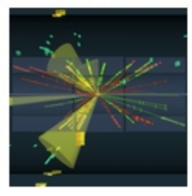
Statistics for Particle Physics
Lecture day 2
Taller de Altas Energías
Benasque, Spain (online)
4,5 September 2023
http://benasque.org/2023tae/
Glen Cowan
Physics Department
Royal Holloway, University of London
g.cowan@rhul.ac.uk
www.pp.rhul.ac.uk/~cowan

Slide 2
Outline
Monday 9:00: Introduction
Probability
Hypothesis tests
→ Tuesday 9:00: Parameter estimation
Confidence limits
Systematic uncertainties
Experimental sensitivity
Tuesday 15:30: Tutorial on parameter estimation
Almost everything is a subset of the University of London course:
http://www.pp.rhul.ac.uk/~cowan/stat_course.html

Slide 3
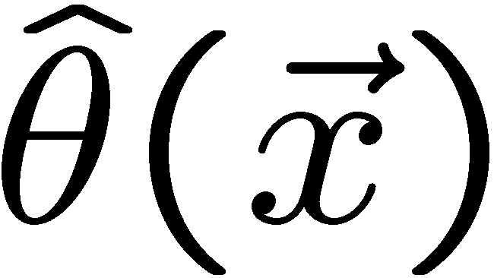
Parameter estimation
The parameters of a pdf are any constants that characterize it,
i.e., θ indexes a
set of hypotheses.
r.v.
parameter
Suppose we have a sample of observed values: x = (x₁, ..., x_{n})
We want to find some function of the data to estimate the
parameter(s):
← estimator written with a hat
Sometimes we say ‘estimator’ for the function of x₁, ..., x_{n};
‘estimate’ for the value of the estimator with a particular data set.

Slide 4
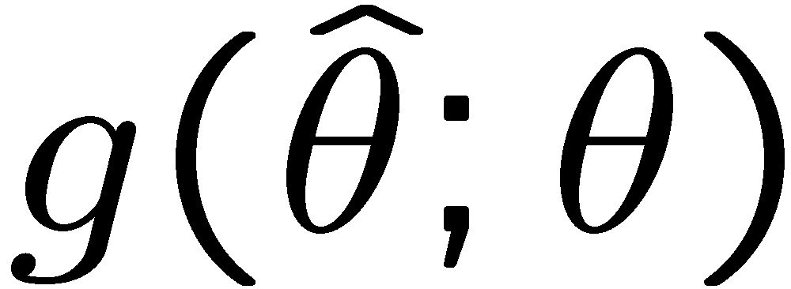
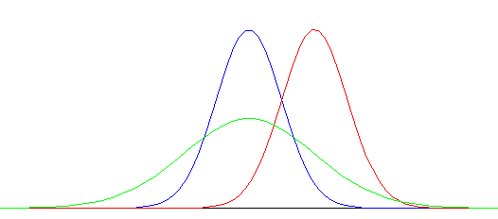
Properties of estimators
If we were to repeat the entire measurement, the estimates
from each would follow a pdf:
best
large
variance
biased
We want small (or zero) bias (systematic error):
→ average of repeated measurements should tend to true value.
And we want a small variance (statistical error):
→ small bias & variance are in general conflicting criteria

Slide 5
The likelihood function for i.i.d.* data
* i.i.d. = independent and identically distributed
Consider n independent observations of x: x₁, ..., x_{n}, where
x follows f (x; θ). The joint pdf for the whole data sample is:
In this case the likelihood function is
(x_{i} constant)

Slide 6
Maximum Likelihood Estimators (MLEs)
We define the maximum likelihood estimators or MLEs to be
the parameter values for which the likelihood is maximum.
Maximizing L equivalent to maximizing log L
Could have multiple maxima (take highest).
MLEs not guaranteed to have any ‘optimal’ properties, (but in practice they’re very good).

Slide 7
MLE example: parameter of exponential pdf
Consider exponential pdf,
and suppose we have i.i.d. data,
The likelihood function is
The value of τ for which L(τ) is maximum also gives the
maximum value of its logarithm (the log-likelihood function):

Slide 8
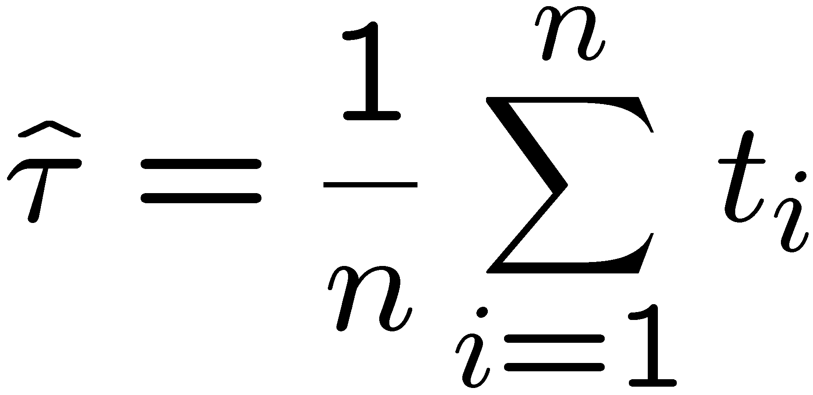
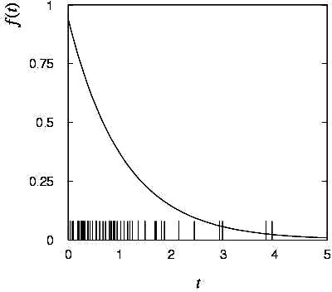
MLE example: parameter of exponential pdf (2)
Find its maximum by setting
→
Monte Carlo test:
generate 50 values
using τ = 1:
We find the ML estimate:

Slide 9
MLE example: parameter of exponential pdf (3)
For the exponential distribution one has for mean, variance:
For the MLE
we therefore find
→
→

Slide 10
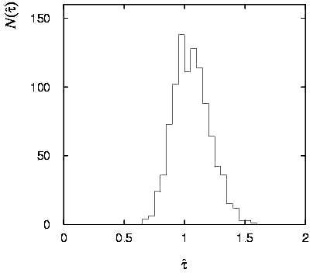
Variance of estimators: Monte Carlo method
Having estimated our parameter we now need to report its
‘statistical error’, i.e., how widely distributed would estimates
be if we were to repeat the entire measurement many times.
One way to do this would be to simulate the entire experiment
many times with a Monte Carlo program (use ML estimate for MC).
For exponential example, from
sample variance of estimates
we find:
Note distribution of estimates is roughly
Gaussian − (almost) always true for
ML in large sample limit.

Slide 11
Variance of estimators from information inequality
The information inequality (RCF) sets a lower bound on the
variance of any estimator (not only ML):
Minimum Variance
Bound (MVB)
Often the bias b is small, and equality either holds exactly or
is a good approximation (e.g. large data sample limit). Then,
Estimate this using the 2nd derivative of ln L at its maximum:

Slide 12
MVB for MLE of exponential parameter
Find
We found for the exponential parameter the MLE
and we showed b = 0, hence 𝜕b/𝜕τ = 0.
We find
and since E[t_{i}] = τ for all i,
,
and therefore
.
(Here MLE is “efficient”).

Slide 13
Variance of estimators: graphical method
Expand ln L(θ) about its maximum:
First term is ln L_{max}, second term is zero, for third term use
information inequality (assume equality):
i.e.,
→ to get
, change θ away from
until ln L decreases by 1/2.

Slide 14
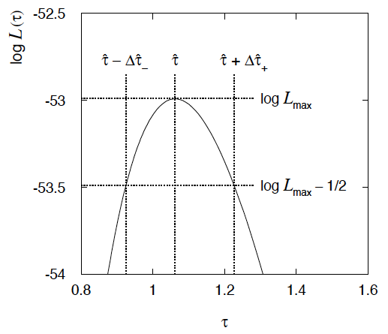
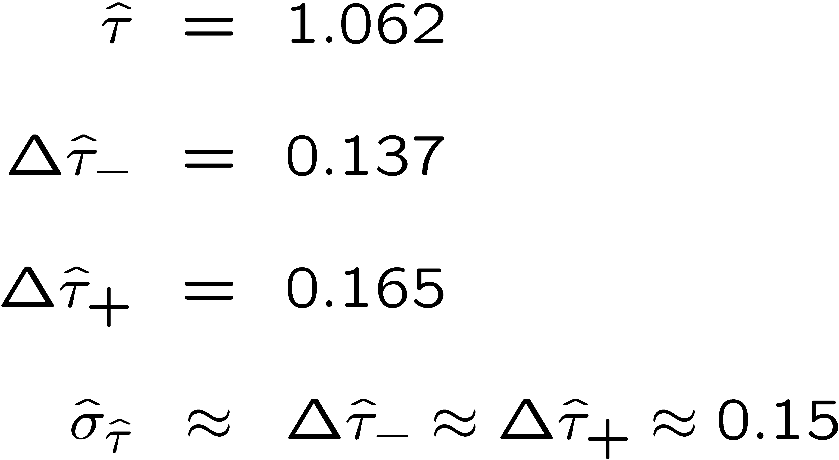
Example of variance by graphical method
ML example with exponential:
Not quite parabolic ln L since finite sample size (n = 50).

Slide 15
Confidence intervals by inverting a test
In addition to a ‘point estimate’ of a parameter we should report
an interval reflecting its statistical uncertainty.
Confidence intervals for a parameter θ can be found by
defining a test of the hypothesized value θ (do this for all θ):
Specify values of the data that are ‘disfavoured’ by θ
(critical region) such that P(data in critical region|θ) ≤ α
for a prespecified α, e.g., 0.05 or 0.1.
If data observed in the critical region, reject the value θ.
Now invert the test to define a confidence interval as:
set of θ values that are not rejected in a test of size α
(confidence level CL is 1− α).

Slide 16
Relation between confidence interval and p-value
Equivalently we can consider a significance test for each
hypothesized value of θ, resulting in a p-value, p_{θ}.
If p_{θ} ≤ α, then we reject θ.
The confidence interval at CL = 1 – α consists of those values of
θ that are not rejected.
E.g. an upper limit on θ is the greatest value for which p_{θ} > α.
In practice find by setting p_{θ} = α and solve for θ.
For a multidimensional parameter space θ = (θ₁,... θ_{M}) use same idea – result is a confidence “region” with boundary determined by p_{θ} = α.

Slide 17
Coverage probability of confidence interval
If the true value of θ is rejected, then it’s not in the confidence interval. The probability for this is by construction (equality for continuous data):
P(reject θ|θ) ≤ α = type-I error rate
Therefore, the probability for the interval to contain or “cover” θ is
P(conf. interval “covers” θ|θ) ≥ 1 – α
This assumes that the set of θ values considered includes the true value, i.e., it assumes the composite hypothesis P(x|H,θ).

Slide 18
Frequentist upper limit on Poisson parameter
Consider again the case of observing n ~ Poisson(s + b).
Suppose b = 4.5, n_{obs} = 5. Find upper limit on s at 95% CL.
Relevant alternative is s = 0 (critical region at low n)
p-value of hypothesized s is P(n ≤ n_{obs}; s, b)
Upper limit s_{up} at CL = 1 – α found from

Slide 19
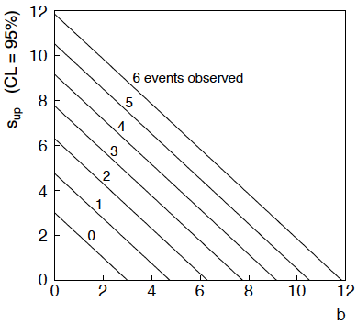
n ~ Poisson(s+b): frequentist upper limit on s
For low fluctuation of n, formula can give negative result for s_{up}; i.e. confidence interval is empty; all values of s ≥ 0 have p_{s} ≤ α.

Slide 20
Limits near a boundary of the parameter space
Suppose e.g. b = 2.5 and we observe n = 0.
If we choose CL = 0.9, we find from the formula for s_{up}
Physicist:
We already knew s ≥ 0 before we started; can’t use negative
upper limit to report result of expensive experiment!
Statistician:
The interval is designed to cover the true value only 90%
of the time — this was clearly not one of those times.
Not uncommon dilemma when testing parameter values for which
one has very little experimental sensitivity, e.g., very small s.

Slide 21
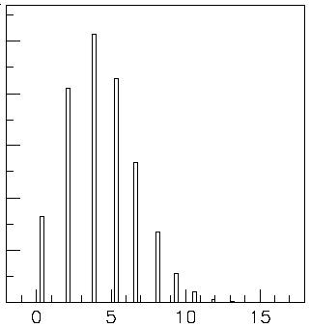
Expected limit for s = 0
Physicist: I should have used CL = 0.95 — then s_{up} = 0.496
Even better: for CL = 0.917923 we get s_{up} = 10⁻⁴ !
Reality check: with b = 2.5, typical Poisson fluctuation in n is
at least √2.5 = 1.6. How can the limit be so low?
Look at the mean limit for the
no-signal hypothesis (s = 0)
(sensitivity).
Distribution of 95% CL limits
with b = 2.5, s = 0.
Mean upper limit = 4.44

Slide 22
moved to tutorial
Approximate confidence intervals/regions from the likelihood function
Suppose we test parameter value(s) θ = (θ₁, ..., θ_{n}) using the ratio
Lower λ(θ) means worse agreement between data and hypothesized θ. Equivalently, usually define
so higher t_{θ} means worse agreement between θ and the data.
p-value of θ therefore
need pdf

Slide 23
moved to tutorial
Confidence region from Wilks’ theorem
Wilks’ theorem says (in large-sample limit and provided
certain conditions hold...)
chi-square dist. with # d.o.f. =
# of components in θ = (θ₁, ..., θ_{n}).
Assuming this holds, the p-value is
← set equal to α
To find boundary of confidence region set p_{θ} = α and solve for t_{θ}:
Recall also

Slide 24
moved to tutorial
Confidence region from Wilks’ theorem (cont.)
i.e., boundary of confidence region in θ space is where
For example, for 1 – α = 68.3% and n = 1 parameter,
and so the 68.3% confidence level interval is determined by
Same as recipe for finding the estimator’s standard deviation, i.e.,
is a 68.3% CL confidence interval.

Slide 25
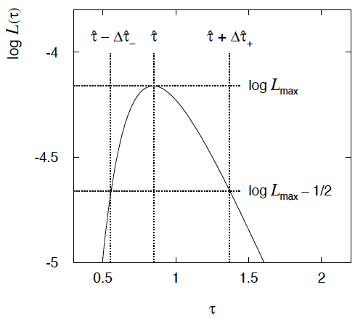
moved to tutorial
Example of interval from ln L(θ)
For n=1 parameter, CL = 0.683, Q_{α} = 1.
Our exponential
example, now with
only n = 5 events.
Can report ML estimate
with approx. confidence
interval from ln L_{max} – 1/2
as “asymmetric error bar”:

Slide 26
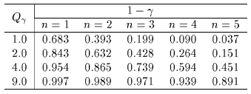
moved to tutorial
Multiparameter case
For increasing number of parameters, CL = 1 – α decreases for
confidence region determined by a given

Slide 27
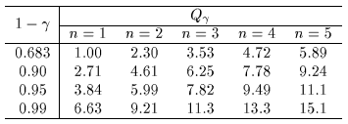
moved to tutorial
Multiparameter case (cont.)
Equivalently, Q_{α} increases with n for a given CL = 1 – α.

Slide 28
Systematic uncertainties and nuisance parameters
P (x|μ)
In general, our model of the data is not perfect:
model:
truth:
x
Can improve model by including
additional adjustable parameters.
Nuisance parameter ↔ systematic uncertainty. Some point in the
parameter space of the enlarged model should be “true”.
Presence of nuisance parameter decreases sensitivity of analysis
to the parameter of interest (e.g., increases variance of estimate).

Slide 29
Profile Likelihood
Suppose we have a likelihood L(μ,θ) = P(x|μ,θ) with N parameters of interest μ = (μ₁,..., μ_{N}) and M nuisance parameters θ = (θ₁,..., θ_{M}). The “profiled” (or “constrained”) values of θ are:
and the profile likelihood is:
The profile likelihood depends only on the parameters of interest; the nuisance parameters are replaced by their profiled values.
The profile likelihood can be used to obtain confidence intervals/regions for the parameters of interest in the same way as one would for all of the parameters from the full likelihood.

Slide 30
Profile Likelihood Ratio – Wilks theorem
Goal is to test/reject regions of μ space (param. of interest).
Rejecting a point μ should mean p_{μ} ≤ α for all possible values of the nuisance parameters θ.
Test μ using the “profile likelihood ratio”:
Let t_{μ} = −2 ln λ(μ). Wilks’ theorem says in large-sample limit:
where the number of degrees of freedom is the number of
parameters of interest (components of μ). So p-value for μ is

Slide 31
Profile Likelihood Ratio – Wilks theorem (2)
If we have a large enough data sample to justify use of the
asymptotic chi-square pdf, then if μ is rejected, it is rejected for any values of the nuisance parameters.
The recipe to get confidence regions/intervals for the parameters of interest at CL = 1 – α is thus the same as before, simply use the profile likelihood:
where the number of degrees of freedom N for the chi-square quantile is equal to the number of parameters of interest.
If the large-sample limit is not justified, then use e.g. Monte Carlo to get distribution of t_{μ}.

Slide 32
Finally
Two lectures only enough for a brief introduction to:
Parameter estimation
Hypothesis tests (→ path to Machine Learning)
Limits (confidence intervals/regions)
Systematics (nuisance parameters)
No time for many other interesting topics:
Experimental sensitivity
Bayesian parameter estimation
Final thought: once the basic formalism is fixed, most of the
work focuses on writing down the likelihood, e.g., P(x|θ), and
including in it enough parameters to adequately describe the data (true for both Bayesian and frequentist approaches) so often best to invest most of your time with it.

Slide 33
Extra slides

Slide 34
Information inequality for N parameters
Suppose we have estimated N parameters θ = (θ₁,...,θ_{N})
The Fisher information matrix is
^
and the covariance matrix of estimators θ is
The information inequality states that the matrix
is positive semi-definite:
z^{T}Mz ≥ 0 for all z ≠ 0, diagonal elements ≥ 0

Slide 35
Information inequality for N parameters (2)
In practice the inequality is ~always used in the large-sample limit:
bias → 0
inequality → equality, i.e, M = 0, and therefore V⁻¹ = I
That is,
This can be estimated from data using
Find the matrix V⁻¹ numerically (or with automatic differentiation),
then invert to get the covariance matrix of the estimators

Slide 36
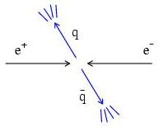
Example of ML with 2 parameters
Consider a scattering angle distribution with x = cos θ,
or if x_{min} < x < x_{max}, need to normalize so that
Example: α = 0.5, β = 0.5, x_{min} = −0.95, x_{max} = 0.95, generate n = 2000 events with Monte Carlo.
need to find maximum
numerically

Slide 37
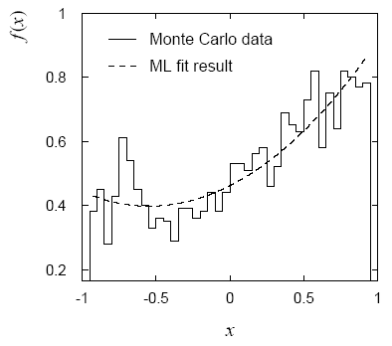
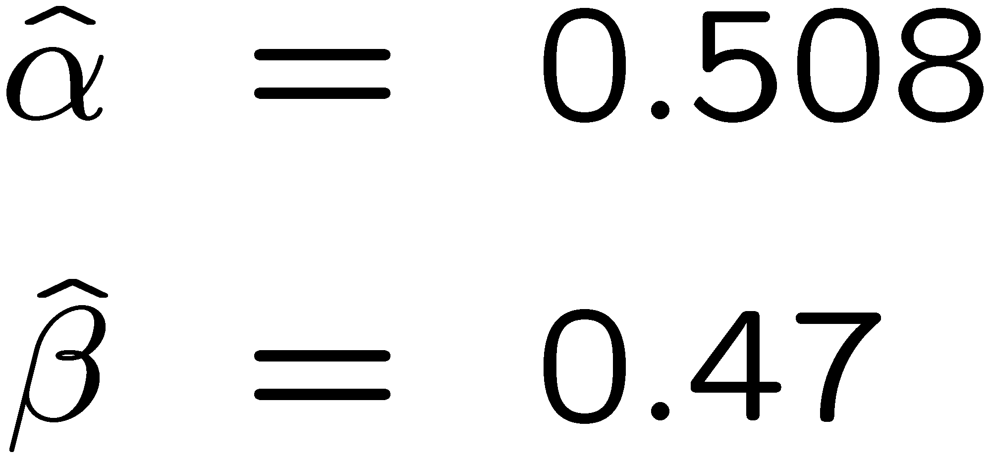
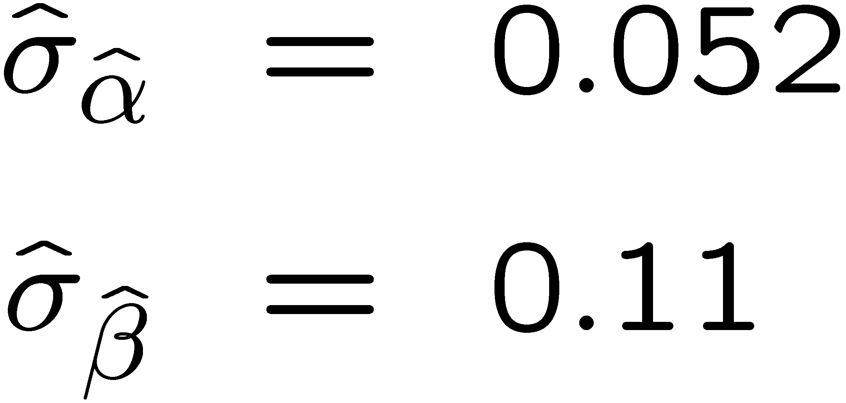
Example of ML with 2 parameters: fit result
Finding maximum of ln L(α, β) numerically gives
N.B. No binning of data for fit,
but can compare to histogram for
goodness-of-fit (e.g. ‘visual’ or χ²).
(Co)variances from
= correlation coefficient

Slide 38
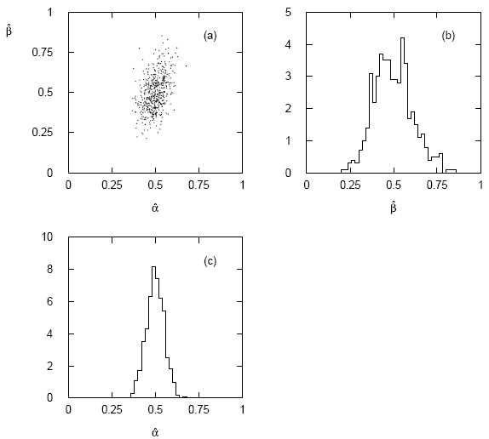
Two-parameter fit: MC study
Repeat ML fit with 500 experiments, all with n = 2000 events:
Estimates average to ~true values;
(Co)variances close to previous estimates;
marginal pdfs approximately Gaussian.

Slide 39
Multiparameter graphical method for variances
Expand ln L(θ) to 2nd order about MLE:
ln L_{max}
zero
relate to covariance matrix of MLEs using information (in)equality.
Result:
So the surface
corresponds to
, which is the equation of a (hyper-) ellipse.

Slide 40
Multiparameter graphical method (2)
Distance from MLE to tangent planes gives standard deviations.

Slide 41
The ln L_{max} − 1/2 contour for two parameters
For large n, ln L takes on quadratic form near maximum:
The contour
is an ellipse:

Slide 42
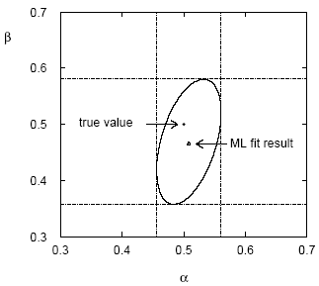
(Co)variances from ln L contour
The α, β plane for the first
MC data set
→ Tangent lines to contours give standard deviations.
→ Angle of ellipse φ related to correlation:

Slide 43
Prototype search analysis
Search for signal in a region of phase space; result is histogram
of some variable x giving numbers:
Assume the n_{i} are Poisson distributed with expectation values
strength parameter
where
signal
background

Slide 44
Prototype analysis (II)
Often also have a subsidiary measurement that constrains some
of the background and/or shape parameters:
Assume the m_{i} are Poisson distributed with expectation values
nuisance parameters (θ_{s}, θ_{b},b_{tot})
Likelihood function is

Slide 45
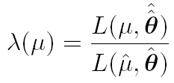
The profile likelihood ratio
Base significance test on the profile likelihood ratio:
maximizes L for
specified μ
maximize L
Define critical region of test of μ by the region of data space
that gives the lowest values of λ(μ).
Important advantage of profile LR is that its distribution becomes independent of nuisance parameters in large sample limit.

Slide 46
Test statistic for discovery
Suppose relevant alternative to background-only (μ = 0) is μ ≥ 0.
So take critical region for test of μ = 0 corresponding to high q₀
and > 0 (data characteristic for μ ≥ 0).
That is, to test background-only hypothesis define statistic
i.e. here only large (positive) observed signal strength is evidence against the background-only hypothesis.
Note that even though here physically μ ≥ 0, we allow
to be negative. In large sample limit its distribution becomes
Gaussian, and this will allow us to write down simple
expressions for distributions of our test statistics.

Slide 47
Cowan, Cranmer, Gross, Vitells, arXiv:1007.1727, EPJC 71 (2011) 1554
Distribution of q₀ in large-sample limit
Assuming approximations valid in the large sample (asymptotic)
limit, we can write down the full distribution of q₀ as
The special case μ′ = 0 is a “half chi-square” distribution:
In large sample limit, f (q₀|0) independent of nuisance parameters;
f (q₀|μ′) depends on nuisance parameters through σ.

Slide 48
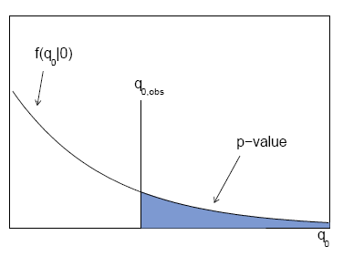
p-value for discovery
Large q₀ means increasing incompatibility between the data
and hypothesis, therefore p-value for an observed q_{0,obs} is
use e.g. asymptotic formula
From p-value get
equivalent significance,

Slide 49
Cowan, Cranmer, Gross, Vitells, arXiv:1007.1727, EPJC 71 (2011) 1554
Cumulative distribution of q₀, significance
From the pdf, the cumulative distribution of q₀ is found to be
The special case μ′ = 0 is
The p-value of the μ = 0 hypothesis is
Therefore the discovery significance Z is simply

Slide 50
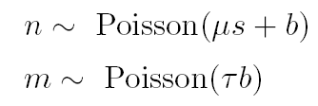
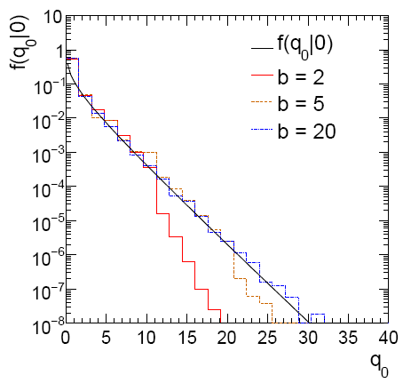
Cowan, Cranmer, Gross, Vitells, arXiv:1007.1727, EPJC 71 (2011) 1554
Monte Carlo test of asymptotic formula
μ = param. of interest
b = nuisance parameter
Here take s known, τ = 1.
Asymptotic formula is
good approximation to 5σ
level (q₀ = 25) already for
b ~ 20.

Slide 51
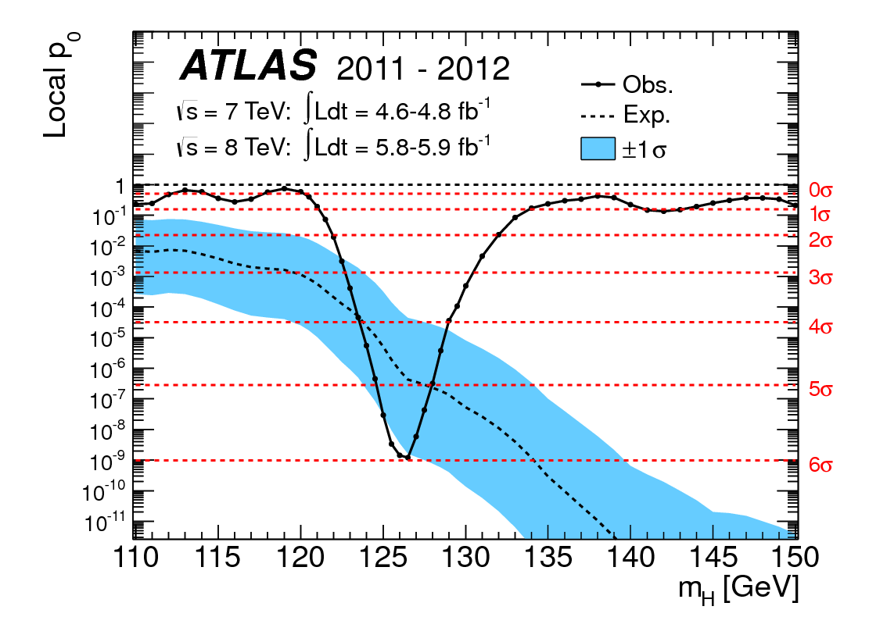
How to read the p₀ plot
The “local” p₀ means the p-value of the background-only
hypothesis obtained from the test of μ = 0 at each individual m_{H}, without any correct for the Look-Elsewhere Effect.
The “Expected” (dashed) curve gives the median p₀ under assumption of the SM Higgs (μ = 1) at each m_{H}.
ATLAS, Phys. Lett. B 716 (2012) 1-29
The blue band gives the
width of the distribution
(±1σ) of significances
under assumption of the
SM Higgs.

Slide 52
Cowan, Cranmer, Gross, Vitells, arXiv:1007.1727, EPJC 71 (2011) 1554
Test statistic for upper limits
For purposes of setting an upper limit on μ use
where
I.e. when setting an upper limit, an upwards fluctuation of the data
is not taken to mean incompatibility with the hypothesized μ :
From observed q_{μ} find p-value:
Large sample approximation:
To find upper limit at CL = 1−α, set p_{μ} = α and solve for μ.

Slide 53
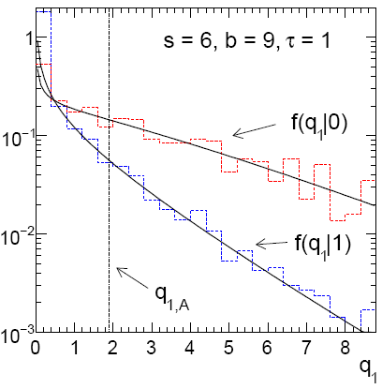
Cowan, Cranmer, Gross, Vitells, arXiv:1007.1727, EPJC 71 (2011) 1554
Monte Carlo test of asymptotic formulae
Consider again n ~ Poisson(μs + b), m ~ Poisson(τb)
Use q_{μ} to find p-value of hypothesized μ values.
E.g. f (q₁|1) for p-value of μ =1.
Typically interested in 95% CL, i.e., p-value threshold = 0.05, i.e.,
q₁ = 2.69 or Z₁ = √q₁ = 1.64.
Median[q₁ |0] gives “exclusion sensitivity”.
Here asymptotic formulae good
for s = 6, b = 9.

Slide 54
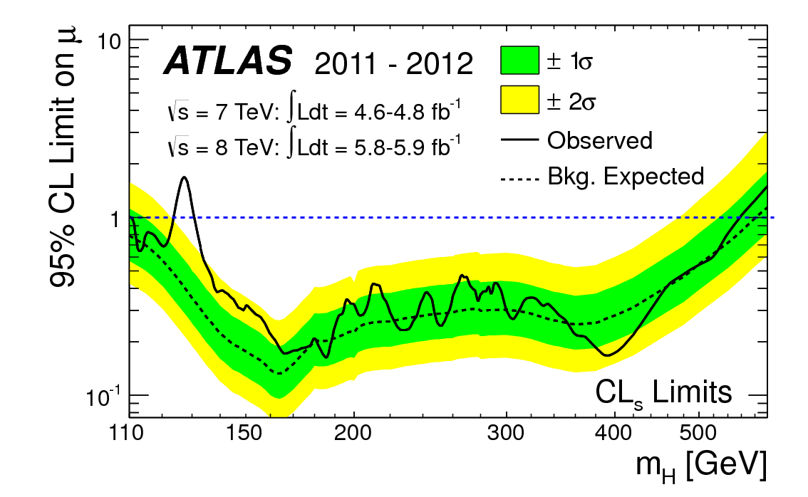
How to read the green and yellow limit plots
For every value of m_{H}, find the upper limit on μ.
Also for each m_{H}, determine the distribution of upper limits μ_{up} one would obtain under the hypothesis of μ = 0.
The dashed curve is the median μ_{up}, and the green (yellow) bands give the ± 1σ (2σ) regions of this distribution.
ATLAS, Phys. Lett. B 716 (2012) 1-29

Slide 55
Sensitivity for Poisson counting experiment
Count a number of events n ~ Poisson(s+b), where
s = expected number of events from signal,
b = expected number of background events.
To test for discovery of signal compute p-value of s = 0 hypothesis,
Usually convert to equivalent significance:
where Φ is the standard Gaussian cumulative distribution, e.g.,
Z > 5 (a 5 sigma effect) means p < 2.9 ×10⁻⁷.
To characterize sensitivity to discovery, give expected (mean
or median) Z under assumption of a given s.

Slide 56
s/√b for expected discovery significance
For large s + b, n → x ~ Gaussian(μ,σ) , μ = s + b, σ = √(s + b).
For observed value x_{obs}, p-value of s = 0 is Prob(x > x_{obs} | s = 0),:
Significance for rejecting s = 0 is therefore
Expected (median) significance assuming signal rate s is

Slide 57
Better approximation for significance
Poisson likelihood for parameter s is
For now
no nuisance
params.
To test for discovery use profile likelihood ratio:
So the likelihood ratio statistic for testing s = 0 is

Slide 58
Approximate Poisson significance (continued)
For sufficiently large s + b, (use Wilks’ theorem),
To find median[Z|s], let n → s + b (i.e., the Asimov data set):
This reduces to s/√b for s << b.

Slide 59
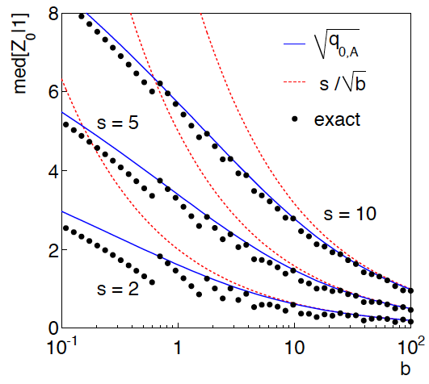
n ~ Poisson(s+b), median significance, assuming s, of the hypothesis s = 0
CCGV, EPJC 71 (2011) 1554, arXiv:1007.1727
“Exact” values from MC,
jumps due to discrete data.
Asimov √q_{0,A} good approx.
for broad range of s, b.
s/√b only good for s ≪ b.

