Slide 1
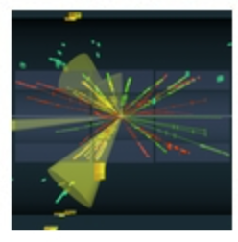


Statistics for Particle Physics
Lecture 2
Taller de Altas Energías
Benasque, Spain
4,5 September 2025
http://benasque.org/2025tae/
Glen Cowan
Physics Department
Royal Holloway, University of London
g.cowan@rhul.ac.uk
www.pp.rhul.ac.uk/~cowan

Slide 2
Outline
Thursday 11:30: Introduction
Probability
Hypothesis tests
→ Thursday 12:30: Parameter estimation
Confidence limits
Thursday 16:30: Tutorial on parameter estimation
https://www.pp.rhul.ac.uk/~cowan/stat/exercises/cowan_stat_exercises.pdf
Friday 11:30: Systematic uncertainties
Experimental sensitivity
Almost everything is a subset of the University of London course:
http://www.pp.rhul.ac.uk/~cowan/stat_course.html

Slide 3
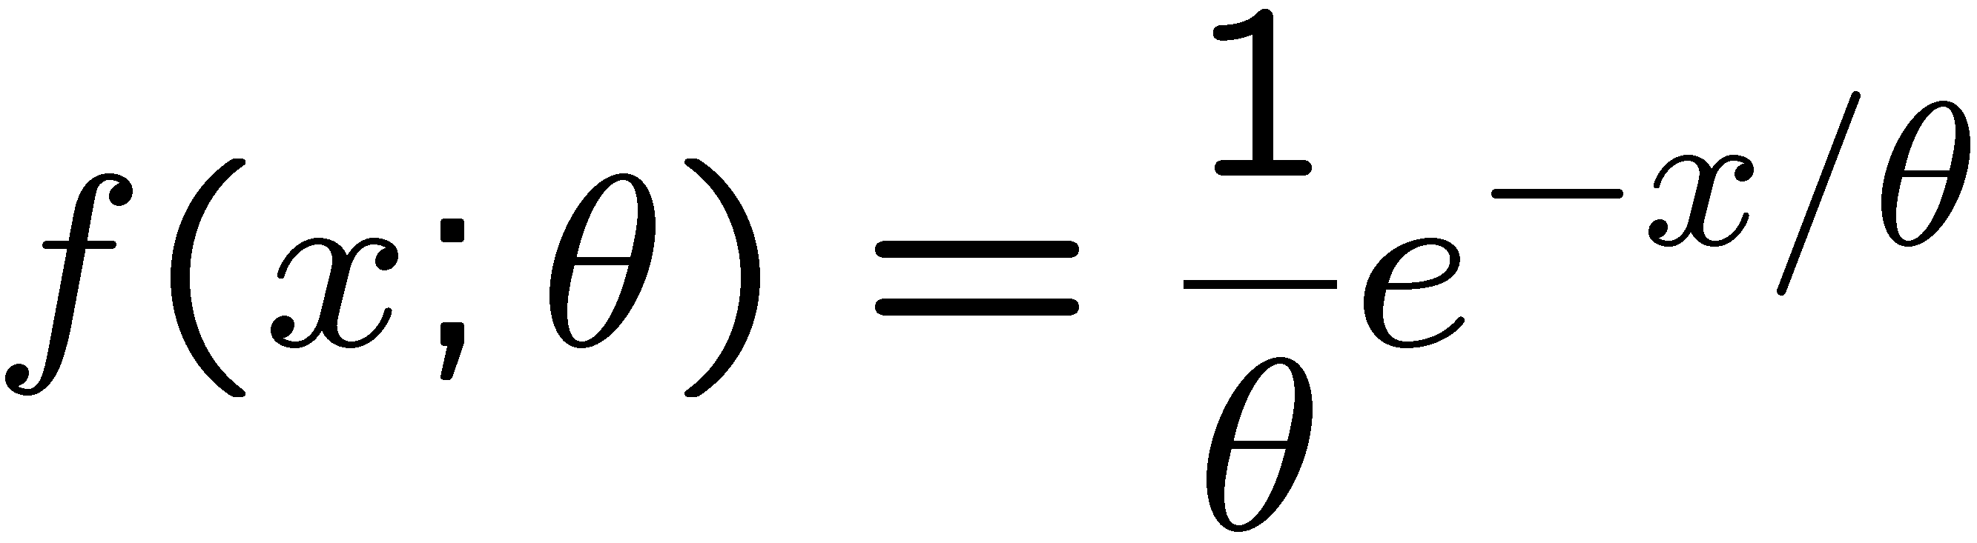
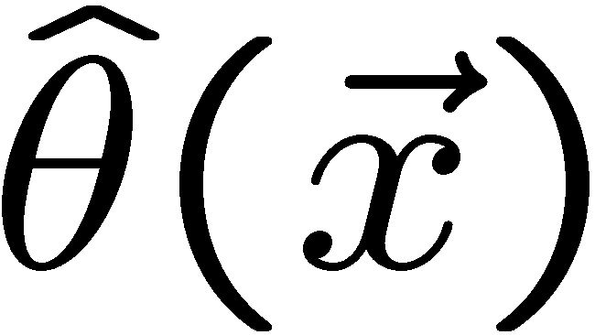
Parameter estimation
The parameters of a pdf are any constants that characterize it,
i.e., θ indexes a
set of hypotheses.
r.v.
parameter
Suppose we have a sample of observed values: x = (x₁, ..., x_{n})
We want to find some function of the data to estimate the
parameter(s):
← estimator written with a hat
Sometimes we say ‘estimator’ for the function of x₁, ..., x_{n};
‘estimate’ for the value of the estimator with a particular data set.

Slide 4
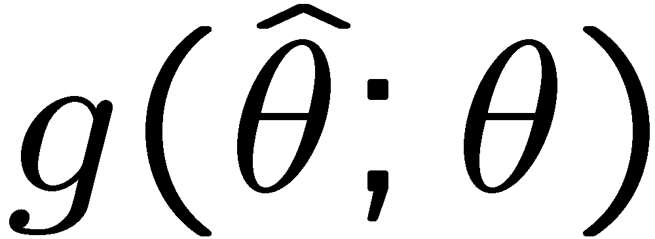
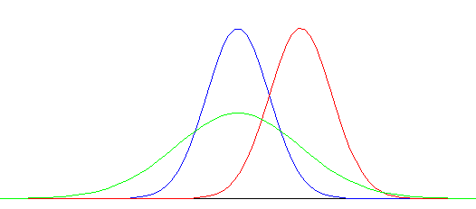
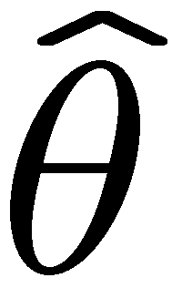
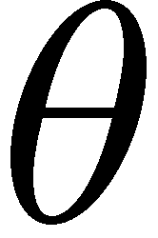
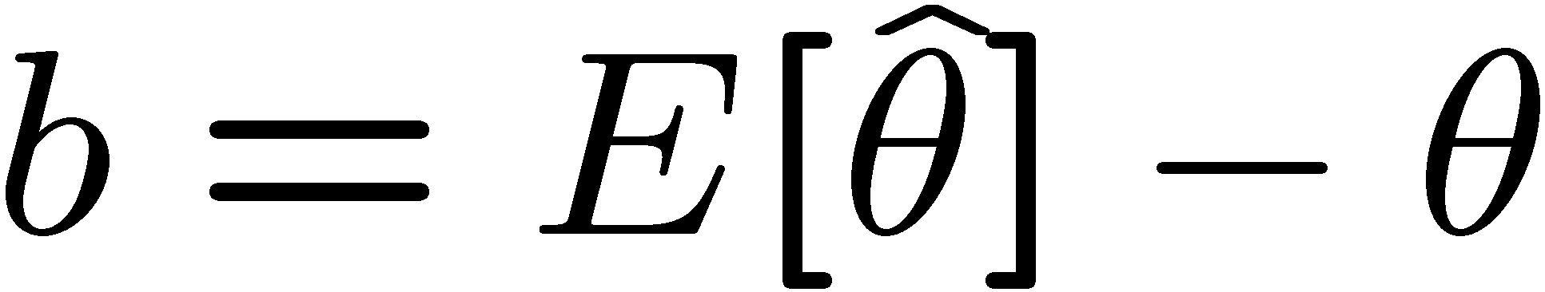
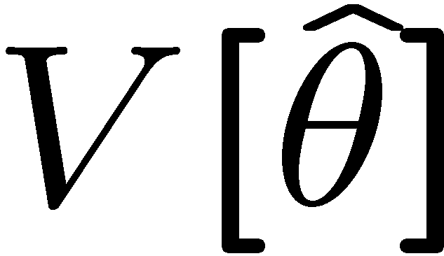
Properties of estimators
If we were to repeat the entire measurement, the estimates
from each would follow a pdf:
best
large
variance
biased
We want small (or zero) bias (systematic error):
→ average of repeated measurements should tend to true value.
And we want a small variance (statistical error):
→ small bias & variance are in general conflicting criteria

Slide 5
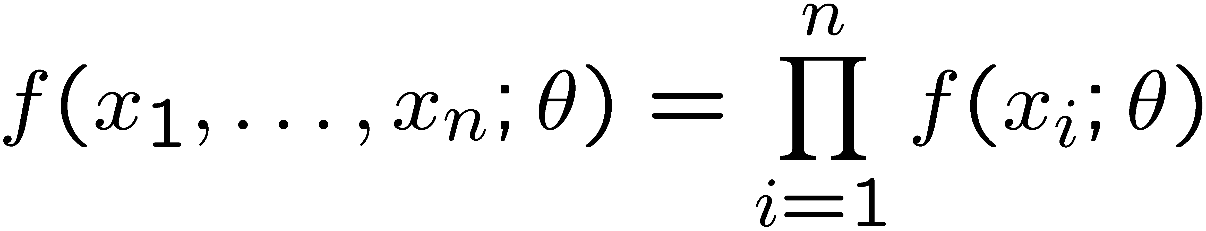
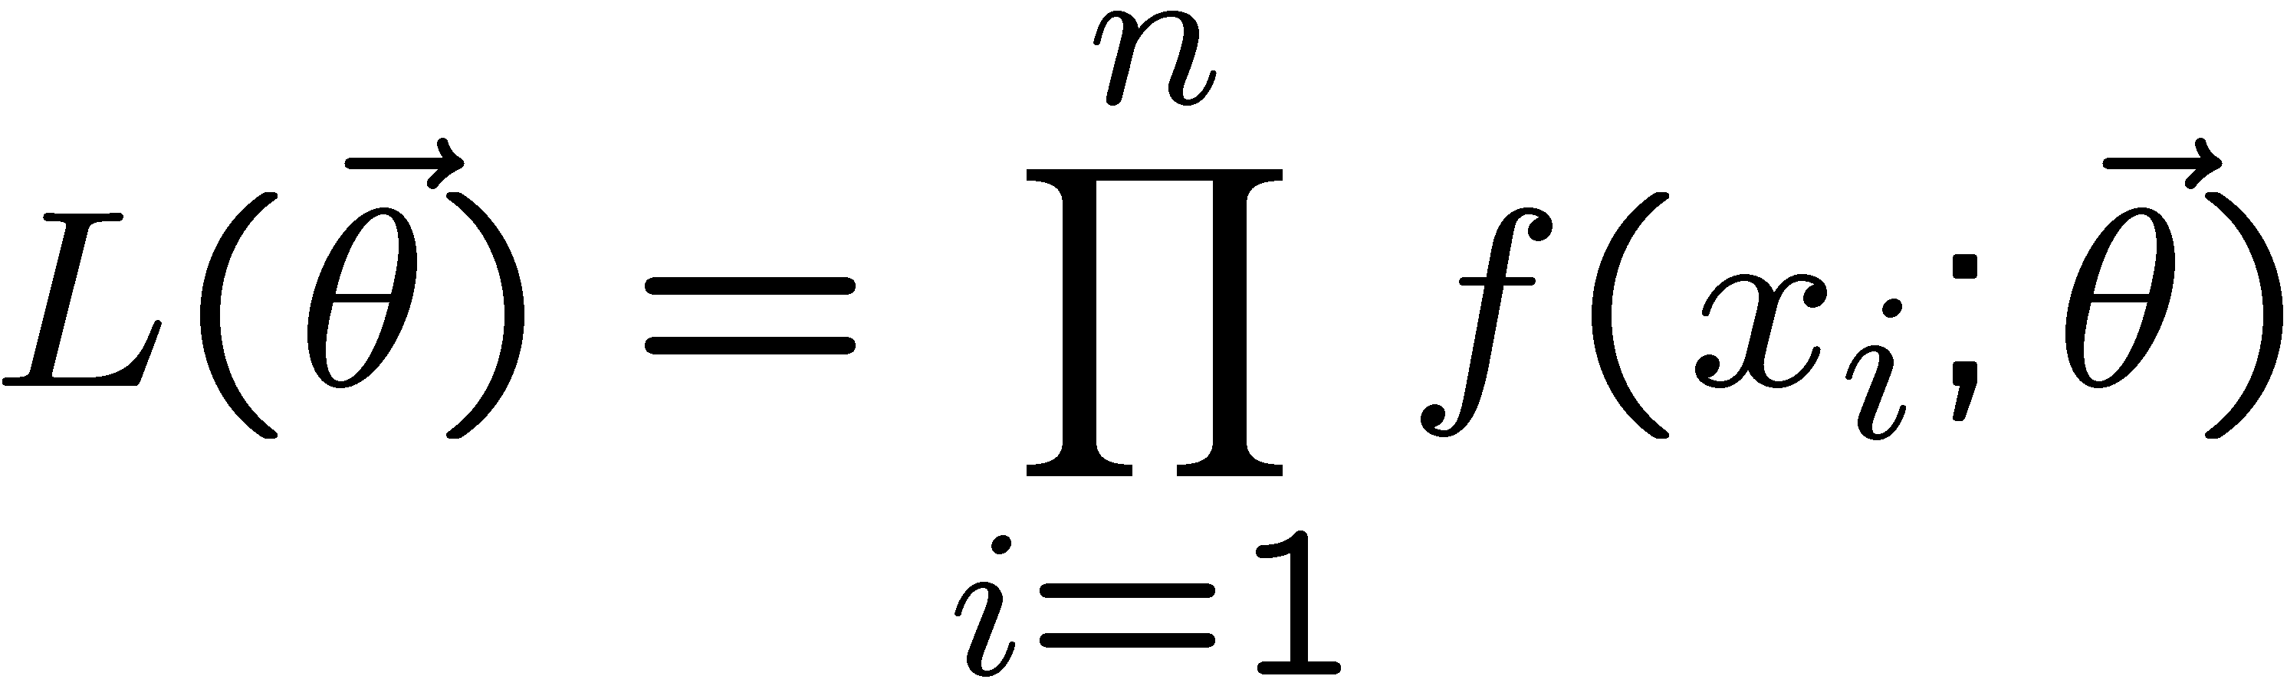
The likelihood function for i.i.d.* data
* i.i.d. = independent and identically distributed
Consider n independent observations of x: x₁, ..., x_{n}, where
x follows f (x; θ). The joint pdf for the whole data sample is:
In this case the likelihood function is
(x_{i} constant)

Slide 6
Maximum Likelihood Estimators (MLEs)
We define the maximum likelihood estimators or MLEs to be
the parameter values for which the likelihood is maximum.
Maximizing L equivalent to maximizing log L
Could have multiple maxima (take highest).
MLEs not guaranteed to have any ‘optimal’ properties, (but in practice they’re very good).

Slide 7
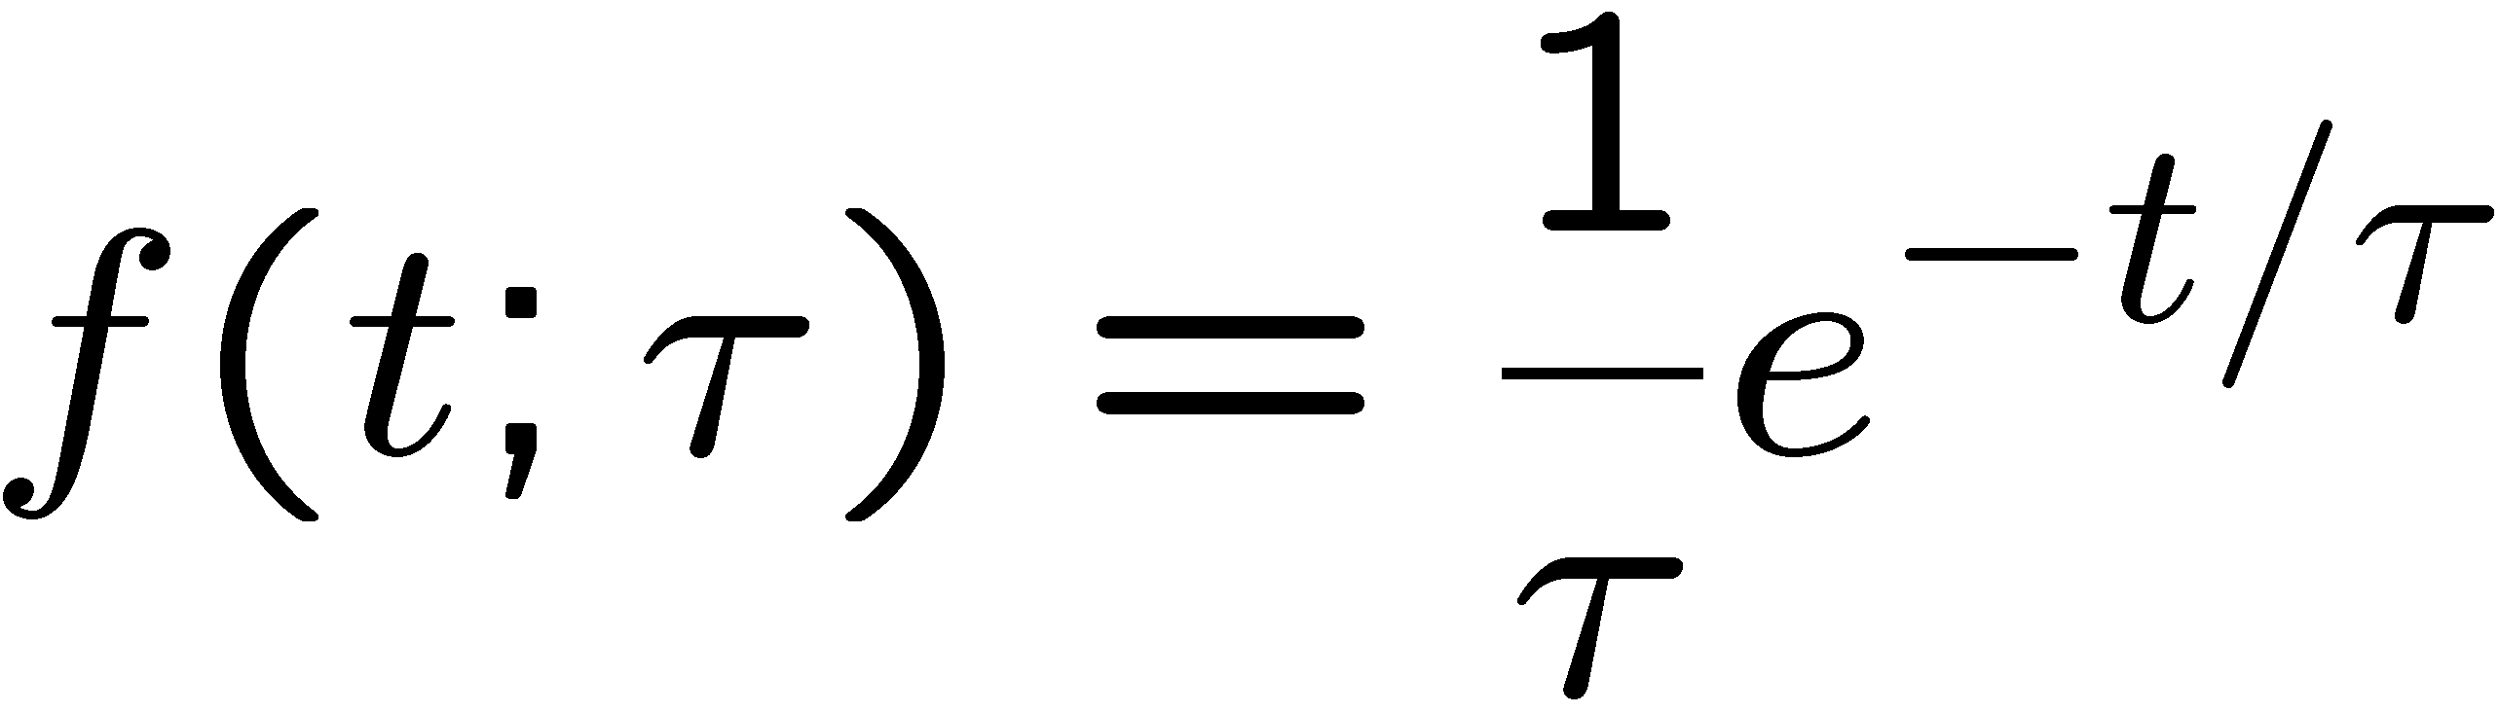
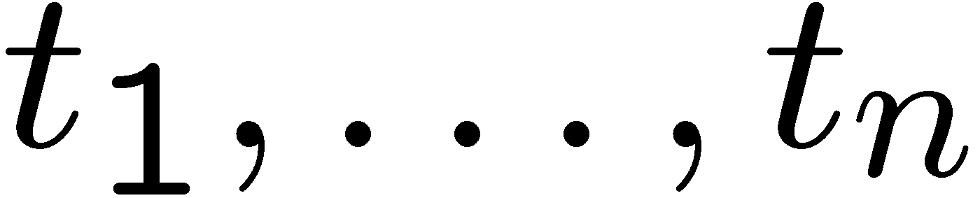
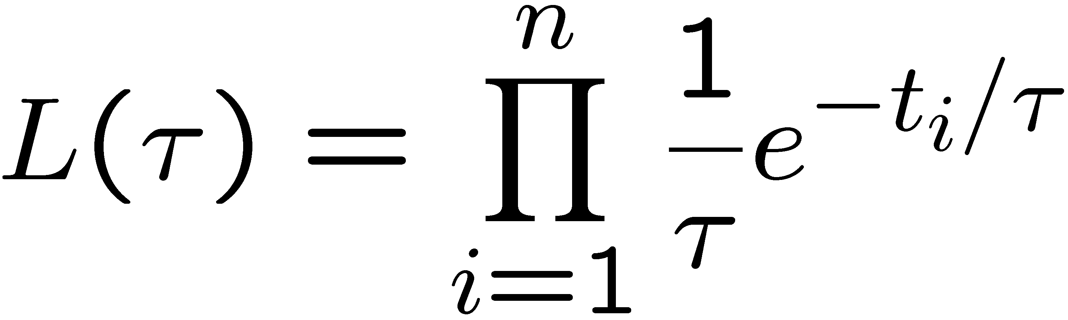
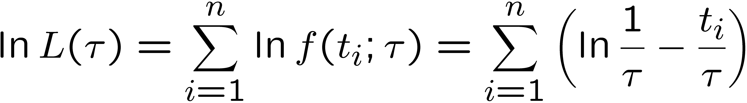
MLE example: parameter of exponential pdf
Consider exponential pdf,
and suppose we have i.i.d. data,
The likelihood function is
The value of τ for which L(τ) is maximum also gives the
maximum value of its logarithm (the log-likelihood function):

Slide 8
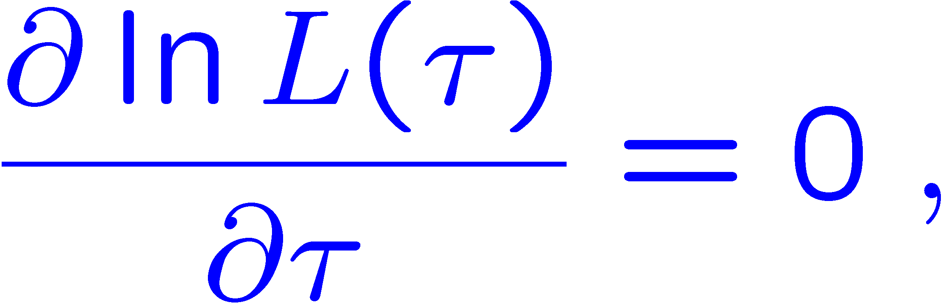
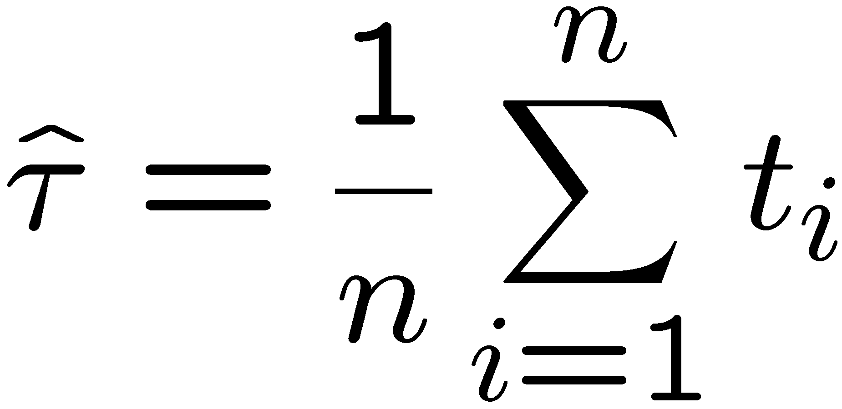
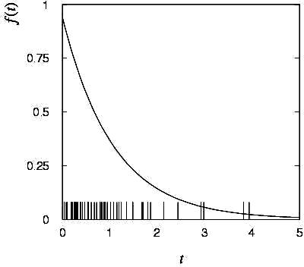
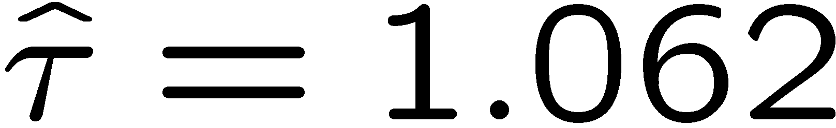
MLE example: parameter of exponential pdf (2)
Find its maximum by setting
→
Monte Carlo test:
generate 50 values
using τ = 1:
We find the ML estimate:

Slide 9






MLE example: parameter of exponential pdf (3)
For the exponential distribution one has for mean, variance:
For the MLE
we therefore find
→
→

Slide 10
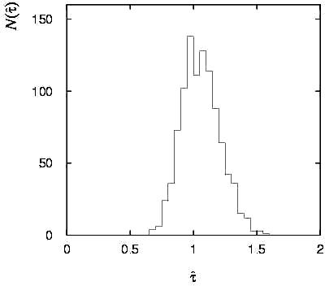
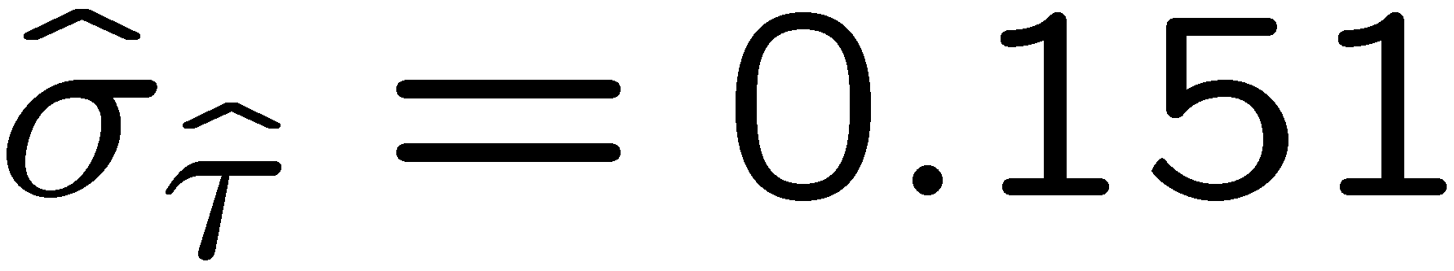
Variance of estimators: Monte Carlo method
Having estimated our parameter we now need to report its
‘statistical error’, i.e., how widely distributed would estimates
be if we were to repeat the entire measurement many times.
One way to do this would be to simulate the entire experiment
many times with a Monte Carlo program (use ML estimate for MC).
For exponential example, from
sample variance of estimates
we find:
Note distribution of estimates is roughly
Gaussian − (almost) always true for
ML in large sample limit.

Slide 11
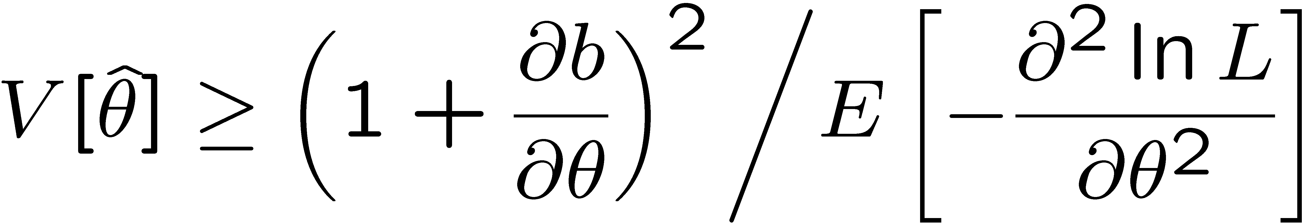
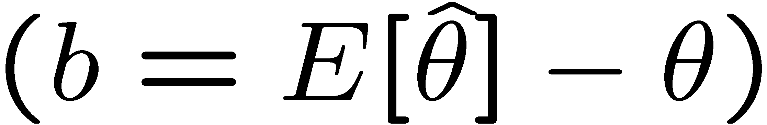
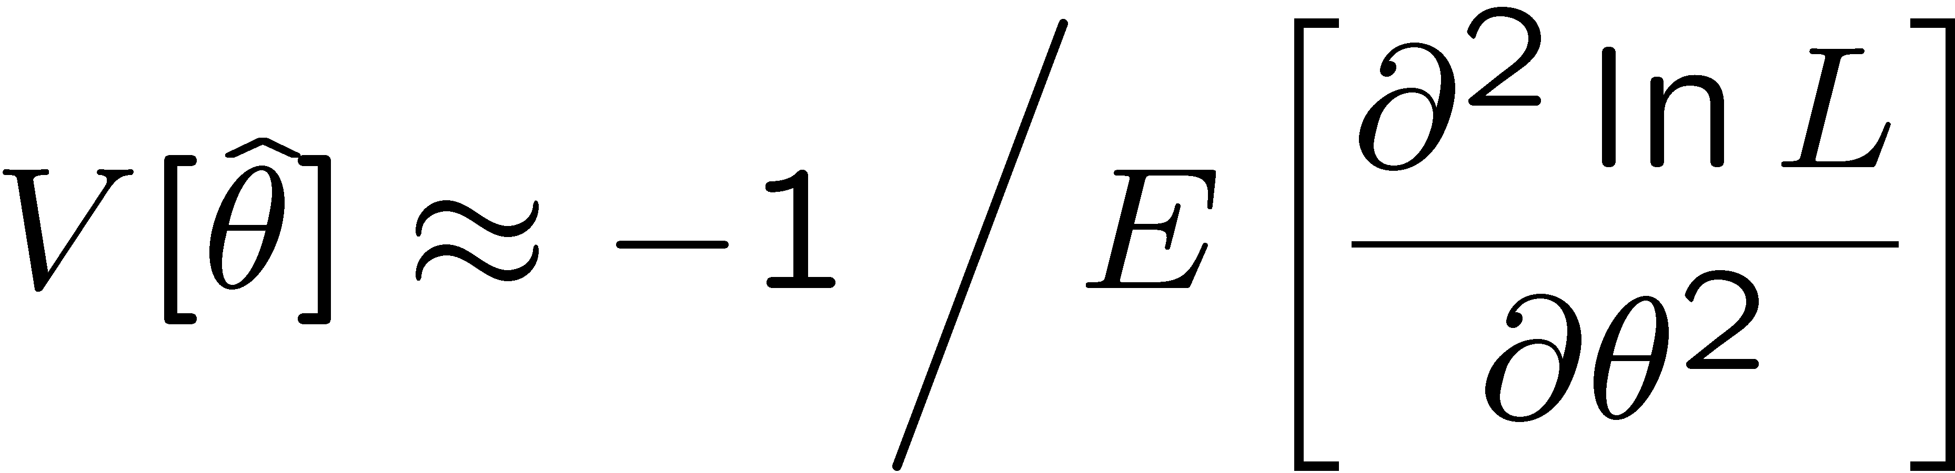
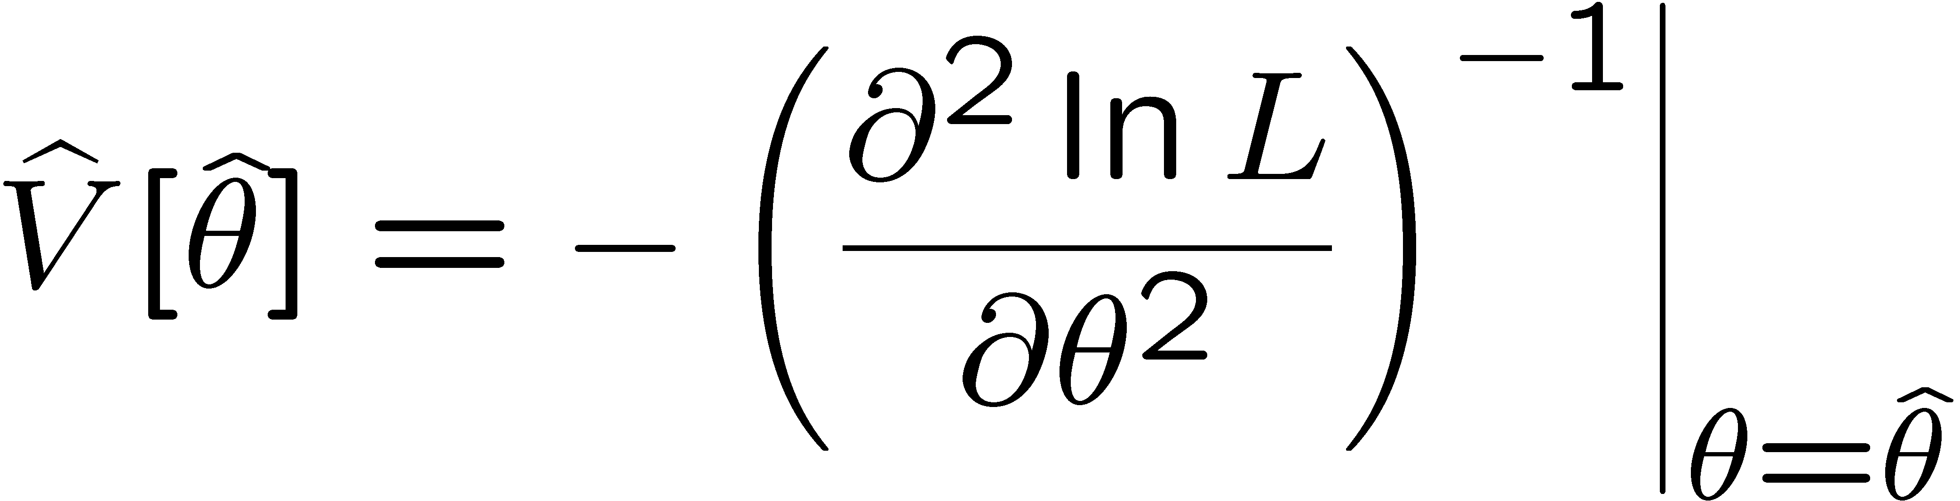
Variance of estimators from information inequality
The information inequality (RCF) sets a lower bound on the
variance of any estimator (not only ML):
Minimum Variance
Bound (MVB)
Often the bias b is small, and equality either holds exactly or
is a good approximation (e.g. large data sample limit). Then,
Estimate this using the 2nd derivative of ln L at its maximum:

Slide 12
MVB for MLE of exponential parameter
Find
We found for the exponential parameter the MLE
and we showed b = 0, hence 𝜕b/𝜕τ = 0.
We find
and since E[t_{i}] = τ for all i,
,
and therefore
.
(Here MLE is “efficient”).

Slide 13
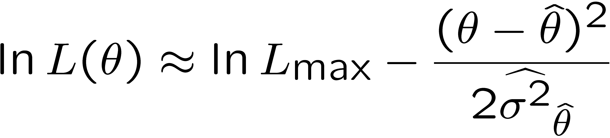
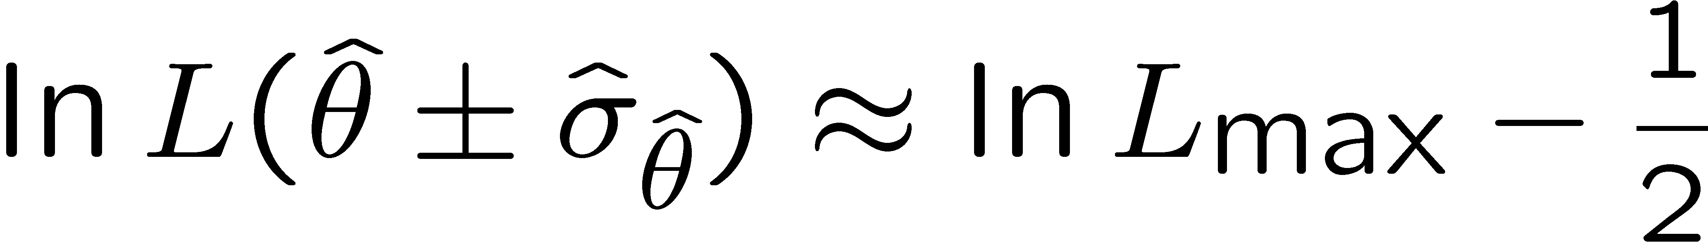


Variance of estimators: graphical method
Expand ln L(θ) about its maximum:
First term is ln L_{max}, second term is zero, for third term use
information inequality (assume equality):
i.e.,
→ to get
, change θ away from
until ln L decreases by 1/2.

Slide 14
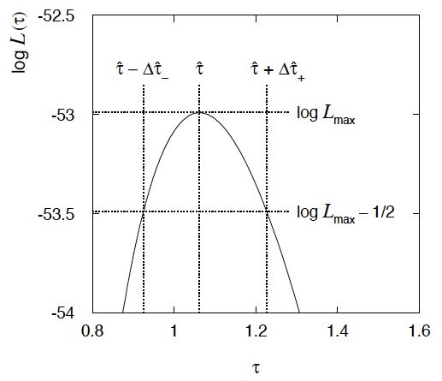
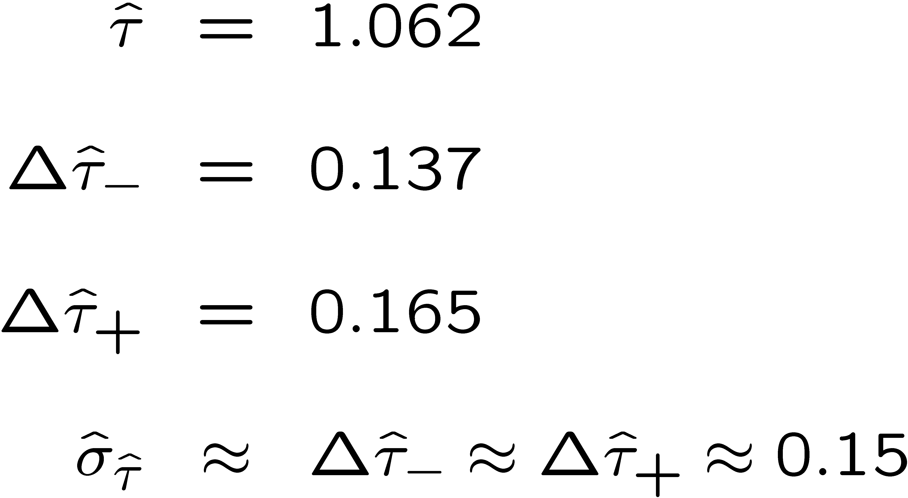
Example of variance by graphical method
ML example with exponential:
Not quite parabolic ln L since finite sample size (n = 50).

Slide 15
Information inequality for N parameters
Suppose we have estimated N parameters θ = (θ₁,...,θ_{N})
The Fisher information matrix is
^
and the covariance matrix of estimators θ is
The information inequality states that the matrix
is positive semi-definite:
z^{T}Mz ≥ 0 for all z ≠ 0, diagonal elements ≥ 0

Slide 16
Information inequality for N parameters (2)
In practice the inequality is ~always used in the large-sample limit:
bias → 0
inequality → equality, i.e, M = 0, and therefore V⁻¹ = I
That is,
This can be estimated from data using
Find the matrix V⁻¹ numerically (or with automatic differentiation),
then invert to get the covariance matrix of the estimators

Slide 17
Confidence intervals by inverting a test
In addition to a ‘point estimate’ of a parameter we should report
an interval reflecting its statistical uncertainty.
Confidence intervals for a parameter θ can be found by
defining a test of the hypothesized value θ (do this for all θ):
Specify values of the data that are ‘disfavoured’ by θ
(critical region) such that P(data in critical region|θ) ≤ α
for a prespecified α, e.g., 0.05 or 0.1.
If data observed in the critical region, reject the value θ.
Now invert the test to define a confidence interval as:
set of θ values that are not rejected in a test of size α
(confidence level CL is 1− α).

Slide 18
Relation between confidence interval and p-value
Equivalently we can consider a significance test for each
hypothesized value of θ, resulting in a p-value, p_{θ}.
If p_{θ} ≤ α, then we reject θ.
The confidence interval at CL = 1 – α consists of those values of
θ that are not rejected.
E.g. an upper limit on θ is the greatest value for which p_{θ} > α.
In practice find by setting p_{θ} = α and solve for θ.
For a multidimensional parameter space θ = (θ₁,... θ_{M}) use same idea – result is a confidence “region” with boundary determined by p_{θ} = α.

Slide 19
Coverage probability of confidence interval
If the true value of θ is rejected, then it’s not in the confidence interval. The probability for this is by construction (equality for continuous data):
P(reject θ|θ) ≤ α = type-I error rate
Therefore, the probability for the interval to contain or “cover” θ is
P(conf. interval “covers” θ|θ) ≥ 1 − α
This assumes that the set of θ values considered includes the true value, i.e., it assumes the composite hypothesis P(x|H,θ).

Slide 20



Frequentist upper limit on Poisson parameter
Consider again the case of observing n ~ Poisson(s + b).
Suppose b = 4.5, n_{obs} = 5. Find upper limit on s at 95% CL.
Relevant alternative is s = 0 (critical region at low n)
p-value of hypothesized s is P(n ≤ n_{obs}; s, b)
Upper limit s_{up} at CL = 1 – α found from

Slide 21
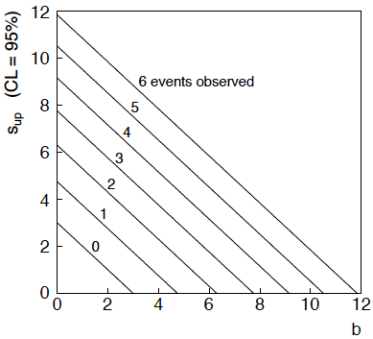
n ~ Poisson(s+b): frequentist upper limit on s
For low fluctuation of n, formula can give negative result for s_{up}; i.e. confidence interval is empty; all values of s ≥ 0 have p_{s} ≤ α.

Slide 22
Limits near a boundary of the parameter space
Suppose e.g. b = 2.5 and we observe n = 0.
If we choose CL = 0.9, we find from the formula for s_{up}
Physicist:
We already knew s ≥ 0 before we started; can’t use negative
upper limit to report result of expensive experiment!
Statistician:
The interval is designed to cover the true value only 90%
of the time — this was clearly not one of those times.
Not uncommon dilemma when testing parameter values for which
one has very little experimental sensitivity, e.g., very small s.

Slide 23
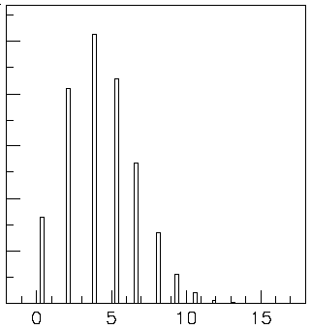

Expected limit for s = 0
Physicist: I should have used CL = 0.95 — then s_{up} = 0.496
Even better: for CL = 0.917923 we get s_{up} = 10⁻⁴ !
Reality check: with b = 2.5, typical Poisson fluctuation in n is
at least √2.5 = 1.6. How can the limit be so low?
Look at the mean limit for the
no-signal hypothesis (s = 0)
(sensitivity).
Distribution of 95% CL limits
with b = 2.5, s = 0.
Mean upper limit = 4.44

Slide 24




Approximate confidence intervals/regions
from the likelihood function
Suppose we test parameter value(s) θ = (θ₁, ..., θ_{n}) using the ratio
Lower λ(θ) means worse agreement between data and hypothesized θ. Equivalently, usually define
so higher t_{θ} means worse agreement between θ and the data.
p-value of θ therefore
need pdf

Slide 25




Confidence region from Wilks’ theorem
Wilks’ theorem says (in large-sample limit and provided
certain conditions hold...)
chi-square dist. with # d.o.f. =
# of components in θ = (θ₁, ..., θ_{n}).
Assuming this holds, the p-value is
← set equal to α
To find boundary of confidence region set p_{θ} = α and solve for t_{θ}:
Recall also

Slide 26




Confidence region from Wilks’ theorem (cont.)
i.e., boundary of confidence region in θ space is where
For example, for 1 – α = 68.3% and n = 1 parameter,
and so the 68.3% confidence level interval is determined by
Same as recipe for finding the estimator’s standard deviation, i.e.,
is a 68.3% CL confidence interval.

Slide 27
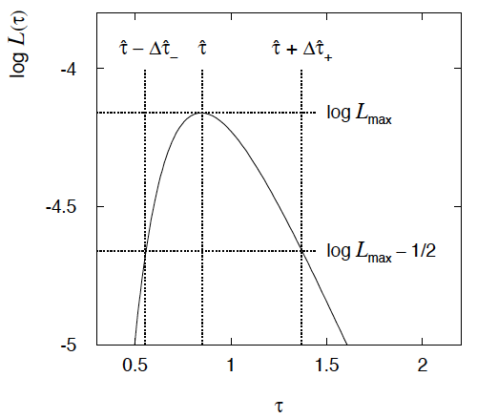

Example of interval from ln L(θ)
For n=1 parameter, CL = 0.683, Q_{α} = 1.
Our exponential
example, now with
only n = 5 events.
Can report ML estimate
with approx. confidence
interval from ln L_{max} – 1/2
as “asymmetric error bar”:

Slide 28

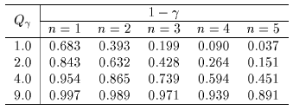

Multiparameter case
For increasing number of parameters, CL = 1 – α decreases for
confidence region determined by a given

Slide 29
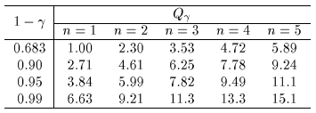
Multiparameter case (cont.)
Equivalently, Q_{α} increases with n for a given CL = 1 – α.

Slide 30
Extra slides

Slide 31
Large-sample (asymptotic) properties of MLEs
Suppose we have an i.i.d. data sample of size n: x₁,...,x_{n}
In the large-sample (or “asymptotic”) limit (n → ∞) and assuming regularity conditions one can show that the likelihood and MLE have several important properties.
The regularity conditions include:
the boundaries of the data space cannot depend on the parameter;
the parameter cannot be on the edge of the parameter space;
ln L(θ) must be differentiable;
the only solution to 𝜕ln L/𝜕θ = 0 is θ.
^
In the slides immediately following, the properties are shown without proof for a single parameter; the corresponding properties hold also for the multiparameter case, θ = (θ₁,..., θ_{m}).

Slide 32
log-likelihood becomes quadratic
The likelihood function becomes Gaussian in shape, i.e. the log-likelihood becomes quadratic (parabolic).
The MLE becomes increasingly precise as the (log)-likelihood becomes more tightly concentrated about its peak,
but L(θ) = P(x|θ) is the probability for x, not a pdf for θ.

Slide 33
The MLE converges to the true parameter value
In the large-sample limit, the MLE converges in probability
to the true parameter value.
That is, for any ε > 0,
The MLE is said to be consistent.

Slide 34
MLE is asymptotically unbiased
In general the MLE can be biased, but in the large-sample limit, this bias goes to zero:
(Recall for the exponential parameter we found the bias was
identically zero regardless of the sample size n.)

Slide 35
The MLE’s variance approaches the MVB
In the large-sample limit, the variance of the MLE approaches the minimum-variance bound, i.e., the information inequality becomes an equality (and bias goes to zero):
The MLE is said to be asymptotically efficient.

Slide 36
The MLE’s distribution becomes Gaussian
In the large-sample limit, the pdf of the MLE becomes Gaussian,
where
is the minimum variance bound (note bias is zero).
For example, exponential MLE with sample size n = 100.
Note that for exponential, MLE is arithmetic average, so Gaussian MLE seen to stem from Central Limit Theorem.

Slide 37
Distribution of MLE of exponential parameter

Slide 38
Multiparameter graphical method for variances
Expand ln L(θ) to 2nd order about MLE:
ln L_{max}
zero
relate to covariance matrix of MLEs using information (in)equality.
Result:
So the surface
corresponds to
, which is the equation of a (hyper-) ellipse.

Slide 39



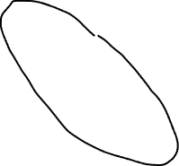
Multiparameter graphical method (2)
Distance from MLE to tangent planes gives standard deviations.

