Slide 1


Statistical Data Analysis 2025/26
Exam Revision Session
London Postgraduate Lectures on Particle Physics
University of London MSc/MSci course PH4515
Glen Cowan
Physics Department
Royal Holloway, University of London
g.cowan@rhul.ac.uk
www.pp.rhul.ac.uk/~cowan
Course web page via RHUL moodle (PH4515) and also
www.pp.rhul.ac.uk/~cowan/stat_course.html

Slide 2
General Info
The exam is in-person. Full details will have been communicated to you by RHUL administration. If not, please contact epms-school@rhul.ac.uk
The exam time is 2 ½ hours, with extra time for special circumstances authorised as appropriate.
Exam counts 80%, coursework 20% of module; module pass mark is 50.
The examination is closed-book and no notes are allowed.
You do not need a calculator for the exam.
The final details regarding venue, times, special arrangements, etc., are made through the RHUL admin team in conjunction with your College’s Physics Department – please turn to them (not me) for any questions about these matters.
Every effort has been made to ensure that the exam does not contain any errors. If you believe a question has a typo, it will not be possible to query this during the exam. If you suspect a question contains an error, you should explain what you believe the problem is and proceed on the basis of your stated assumptions.

Slide 3
Exam format
Answer any 3 questions out of the 5.
No credit is given for work on any further questions.
You must indicate on the cover of the exam book which questions you have attempted and want to have considered for marking.
Just to be safe, if you have a partially attempted question in your exam booklet that you do not want to have marked, it is best to indicate this clearly in the booklet.
If you write down answers for more than 3 questions but do not indicate which you want to have considered, then you run the risk that the questions marked be not those that you intended.

Slide 4
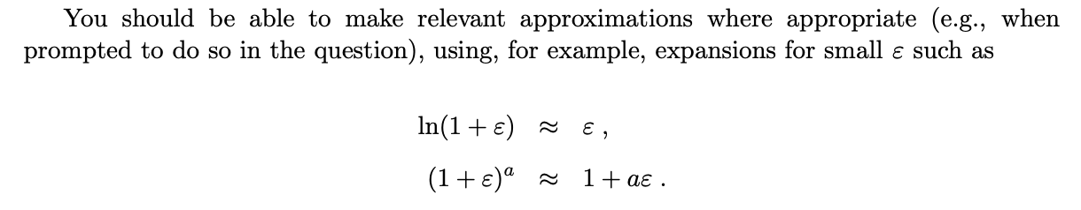
Reminder of revision resources
There are past exams and (some) solutions on:
http://www.pp.rhul.ac.uk/~cowan/ph4515/
Solutions for the papers since 2011 will not be posted, except for those problems worked in discussion sessions.
Remember that the solutions to the problem sheets are contained in the discussion notes on moodle (PS n discussed in week n+3).
And here is a note with some advice on reviewing for the exam:
http://www.pp.rhul.ac.uk/~cowan/ph4515/ph4515_review.pdf

Slide 5
Brief course overview
1 Probability, Bayes’ theorem
2 Random variables and probability densities
3 Expectation values, error propagation
4 Catalogue of pdfs
5 The Monte Carlo method
6 Statistical tests: general concepts
7 Test statistics, multivariate methods
8 Goodness-of-fit tests
9 Parameter estimation, maximum likelihood
10 More maximum likelihood
11 Method of least squares
12 Interval estimation, setting limits
13 Nuisance parameters, systematic uncertainties
14 Examples of Bayesian approach

Slide 6
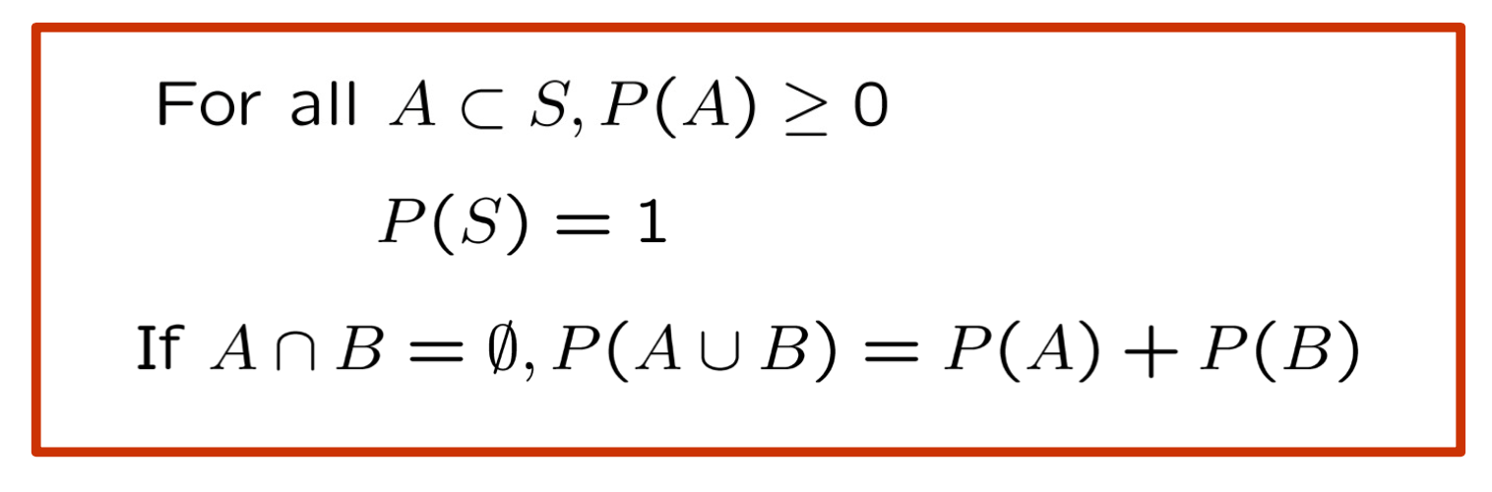
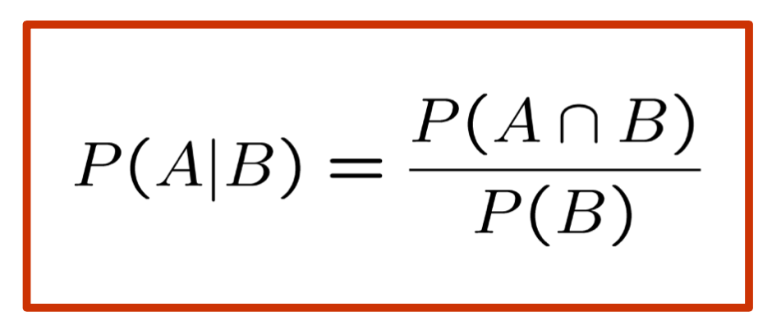
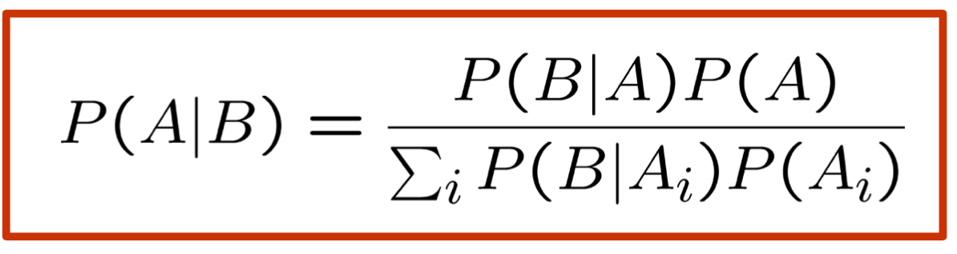
Probability, Bayes’ theorem
Kolmogorov axioms
Conditional probability
Bayes’ theorem
Interpretations: frequentist, subjective (degree of belief, Bayesian)

Slide 7
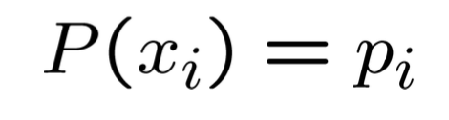
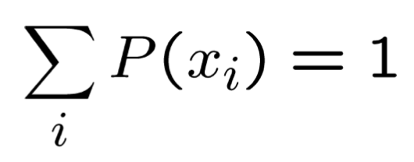
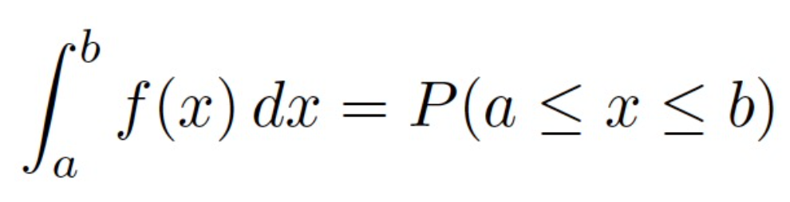
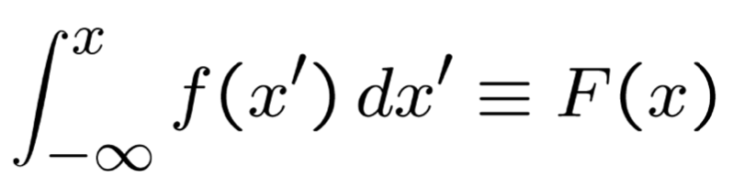
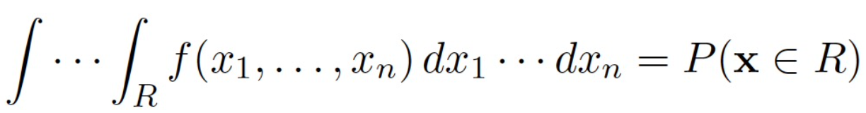
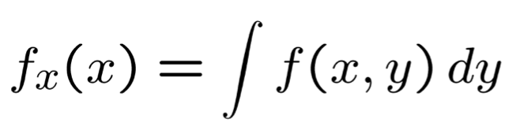
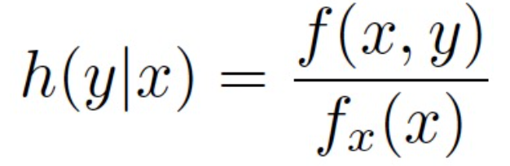
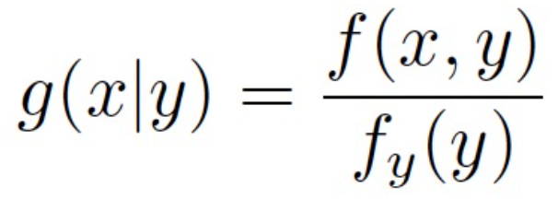
Random variables and probability densities
Discrete → probability (mass) function
Continuous → probability density function (pdf)
Cumulative distribution
Joint pdf
Marginal pdf
Conditional pdf

Slide 8
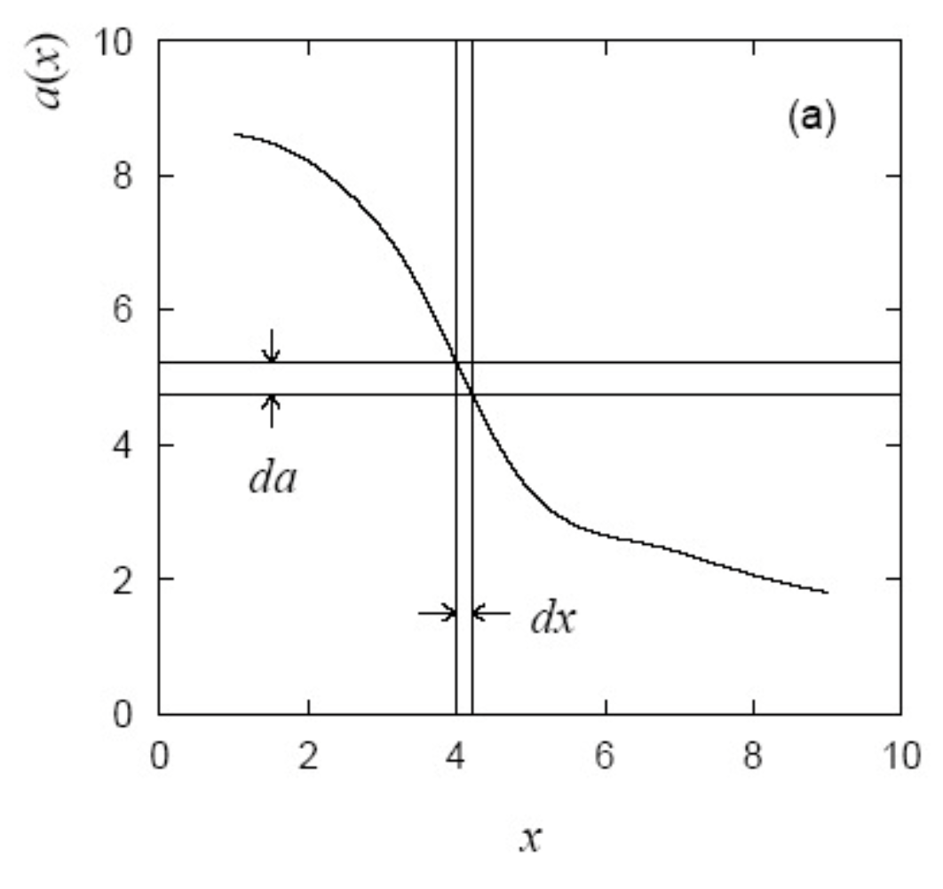
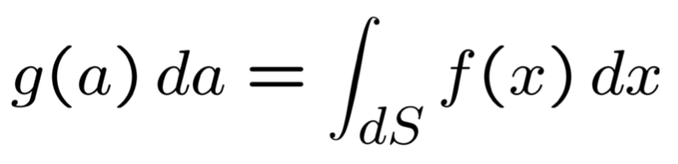
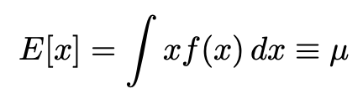
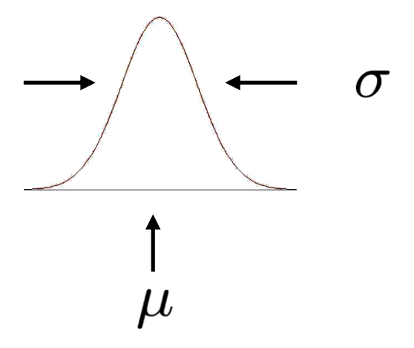
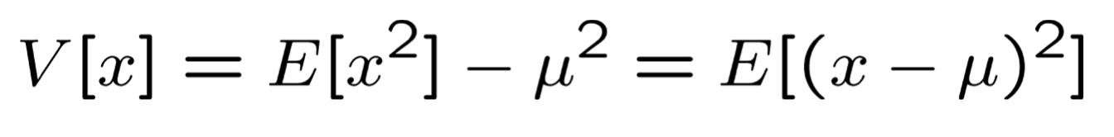

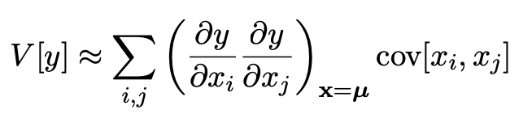
Functions of r.v.s, expectation values, error propagation
Function a(x) of random variable x,
pdf of a:
Expectation (mean) of x
Variance of x
Covariance of x, y
“Error propagation” for V[y(x)]:

Slide 9
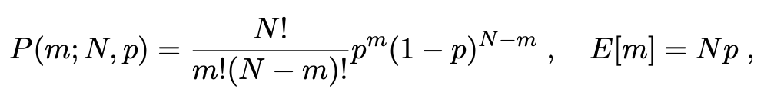

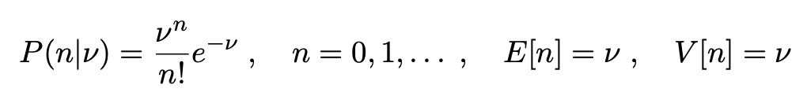
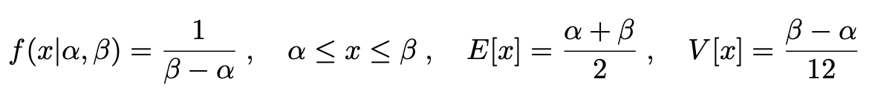
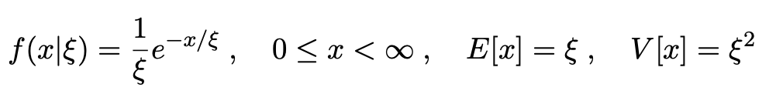
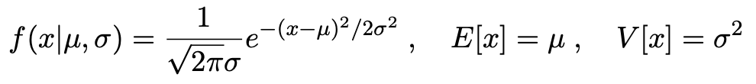
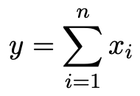
Catalogue of pdfs
and many more (but know these)
Binomial
Poisson
Uniform
Exponential
Gaussian
Central Limit Theorem:
distribution of
tends to Gaussian when n → ∞ (under specific conditions)

Slide 10
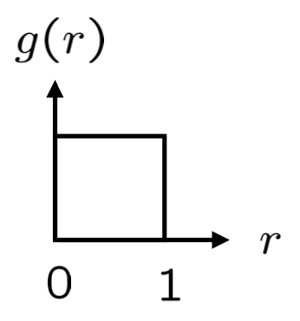

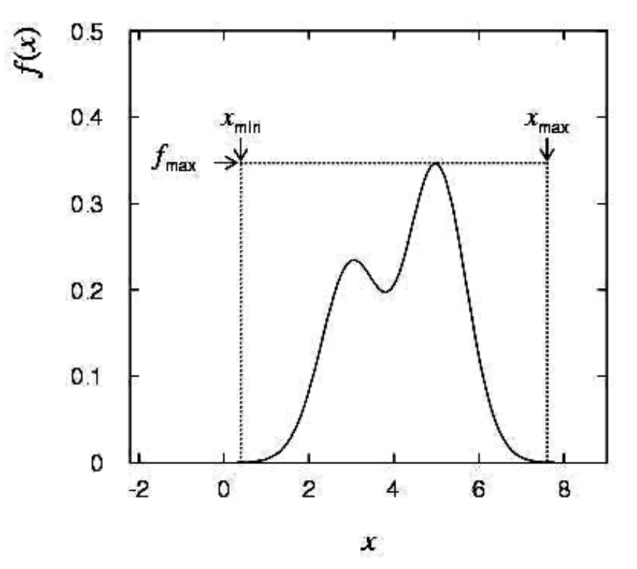
The Monte Carlo method
Random number generator to produce r ~ U[0,1]
Convert sequence of r values to x values for x ~ f (x)
Transformation method:
Find cumulative distribution F(x)
Set F(x) = r and solve for x(r)
Acceptance-rejection method:
Generate points uniform under enclosing curve
Accept x if point is below f (x).

Slide 11
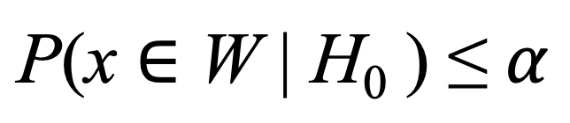

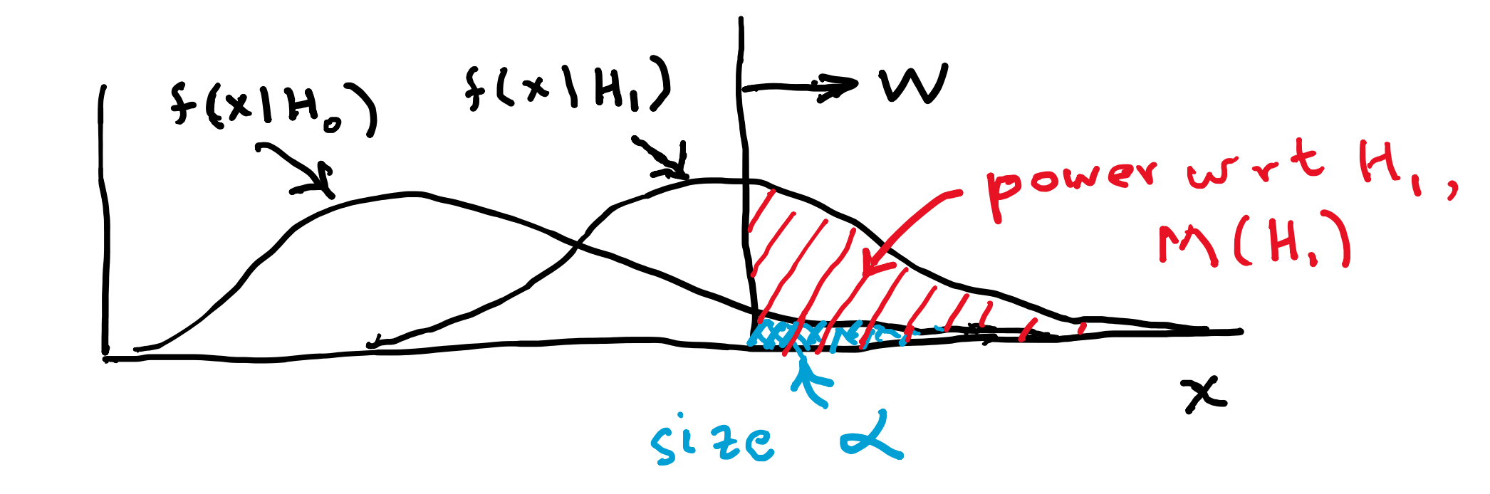
Hypothesis tests: general concepts
Define test of H₀ by specifying critical region W:
α = size of test (small, e.g., 0.05)
If observe data x in W, reject H₀.
Choose critical region to maximize power with respect to relevant
alternative H₁:

Slide 12
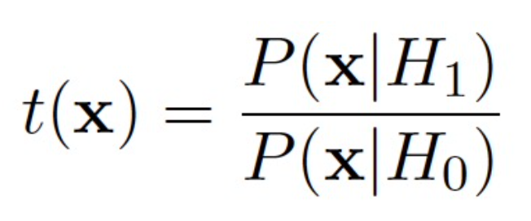
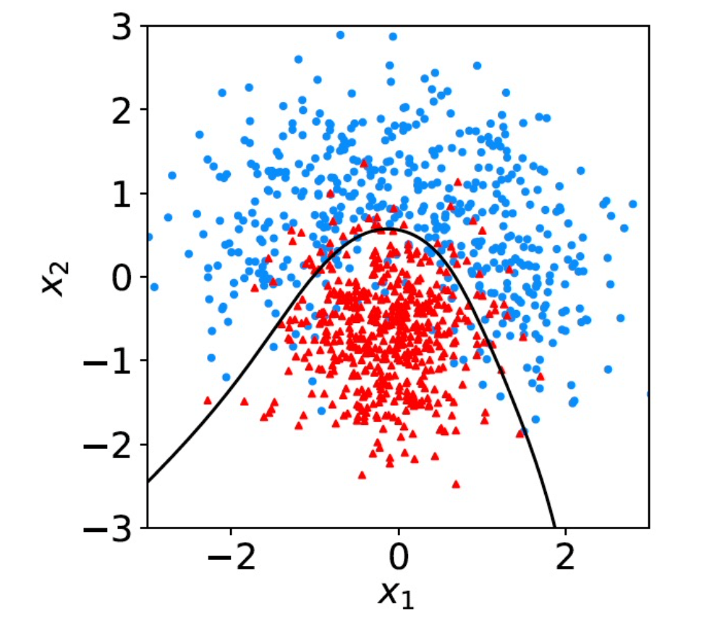
Test statistics, multivariate methods
Define boundary of critical region by statistic t(x) = t_{c}.
Neyman-Pearson: optimal W from
But often cannot compute likelihood ratio, need to use
multivariate methods (Machine Learning), adjust parameters of
statistic using training data.
Linear discriminant (Fisher)
Neural networks
Naive Bayes, KDE
Boosted Decision Trees
Issues: overtraining

Slide 13
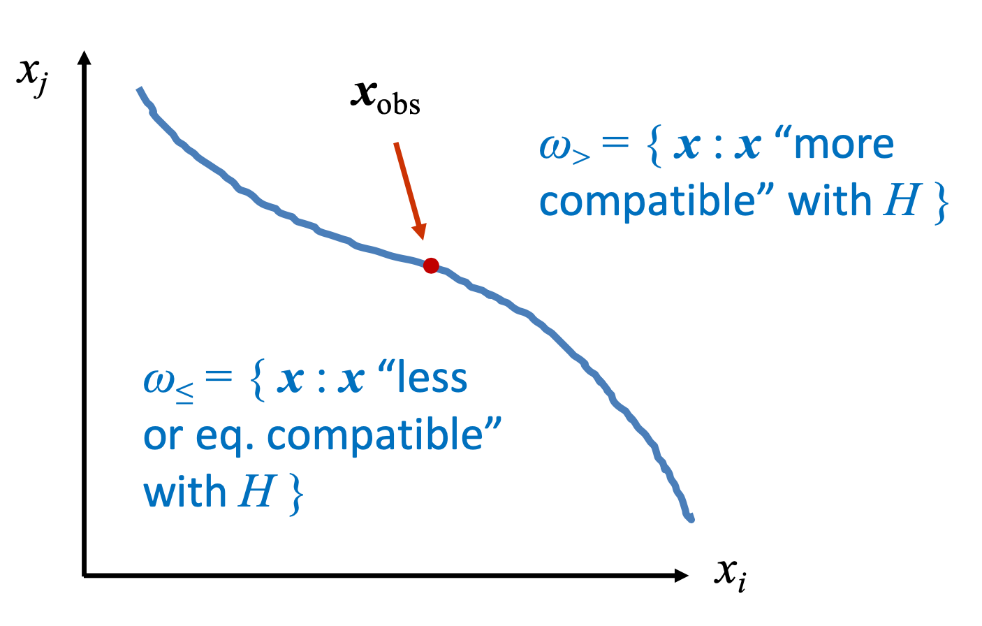
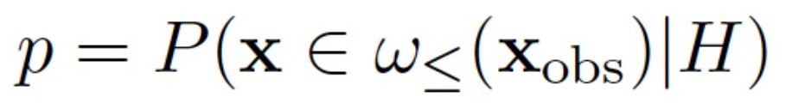
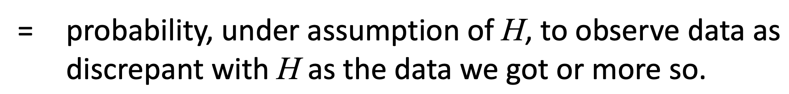
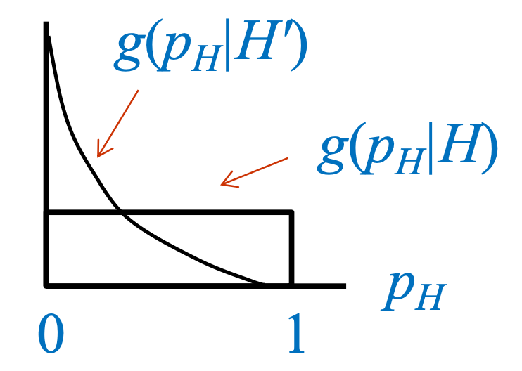
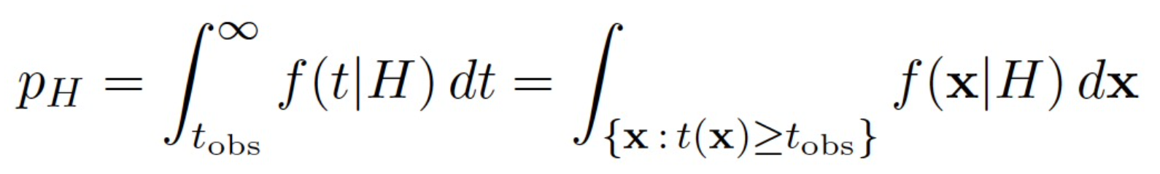
Goodness-of-fit tests
Quantify compatibility between observation x_{obs} and predictions of hypothesis P(x|H) with p-value:
Define region of equal/lesser compatibility with t(x) ≥ t_{obs}

Slide 14
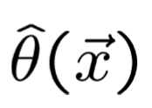
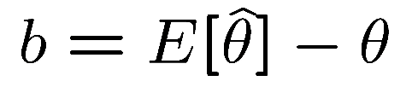
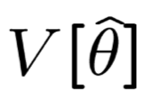
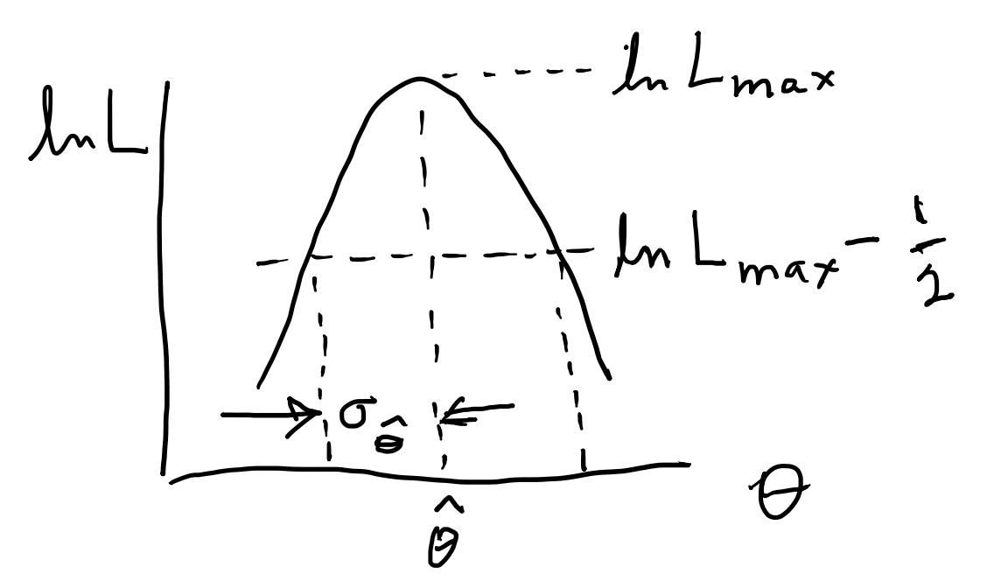
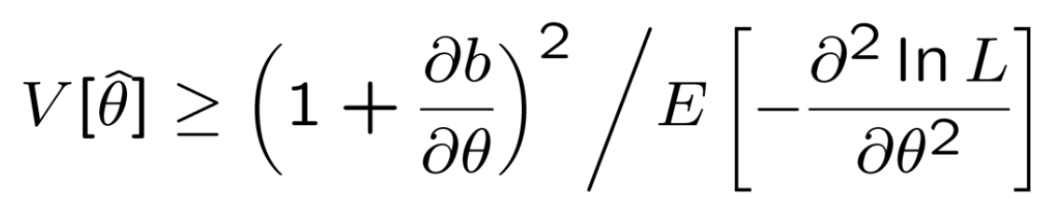
Parameter estimation, maximum likelihood
= function of data (written with hat)
Want small bias
and small variance
(cannot in general minimize both simultaneously)
Maximum Likelihood: maximize L(θ) = P(x|θ)
Variance of MLE:
Sometimes closed form
Monte Carlo
Information inequality
Graphical method

Slide 15
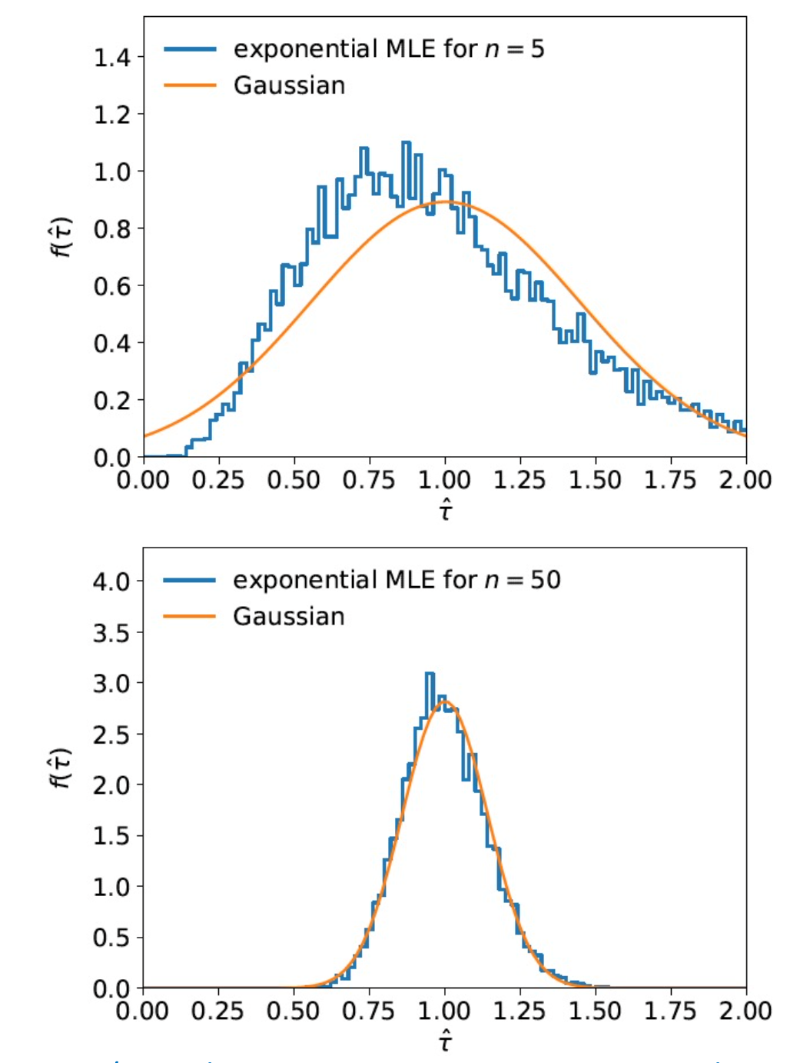
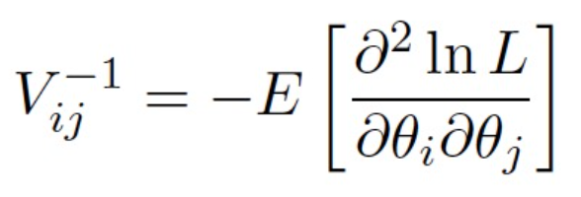
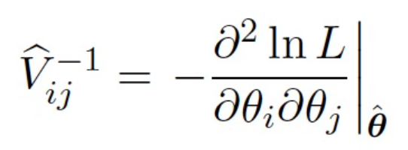
Asymptotic properties of likelihood and MLE
Likelihood becomes Gaussian in shape
MLE consistent, asymptotically unbiased
MLE Gaussian distributed
Information inequality becomes
equality:
Estimate using

Slide 16
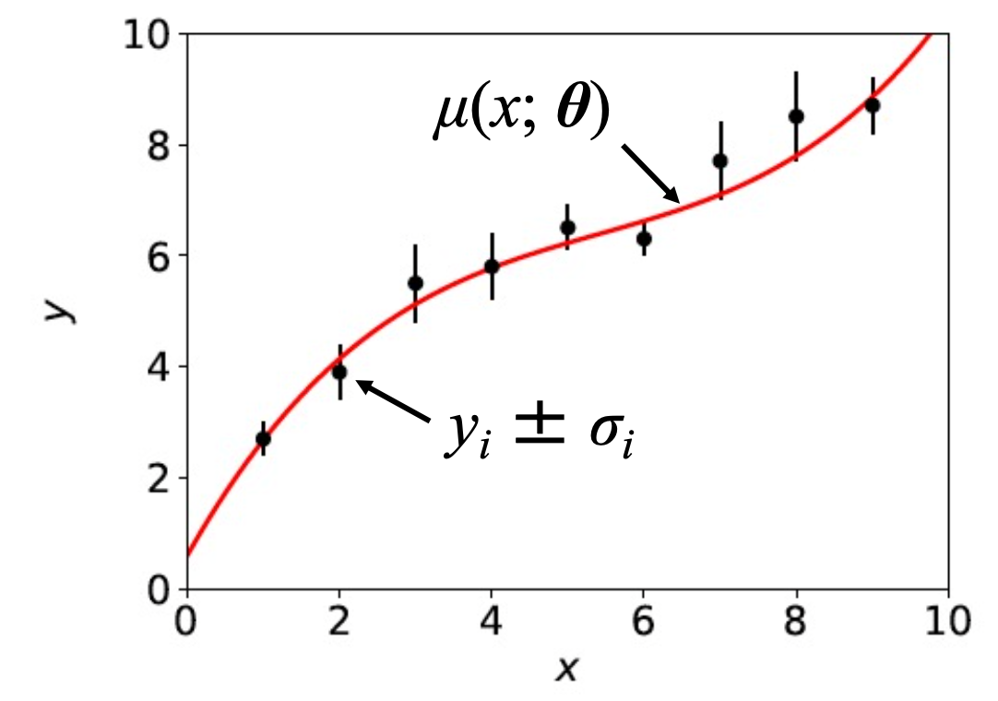
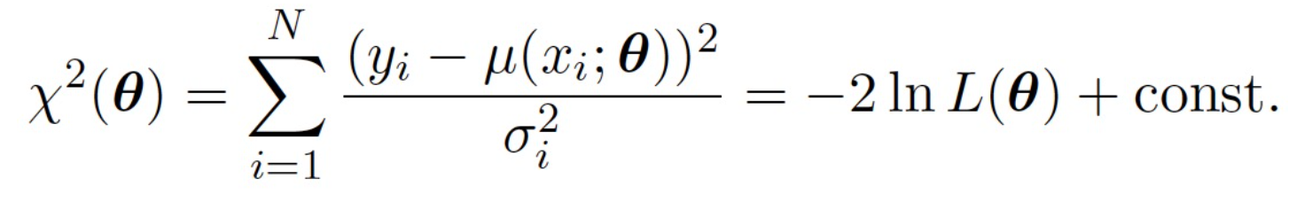
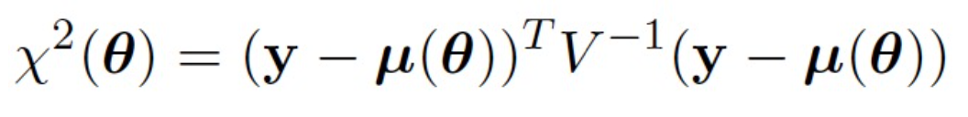
Method of least squares
Independent measurements:
y_{i} ~ Gauss(μ(x_{i},θ), σ_{i}), i=1,...,N
Maximizing lnL equivalent to
minimizing
or for correlated data
For variances of estimators use same technology as for MLE.
Minimized χ² → p-value (goodness of fit)

Slide 17
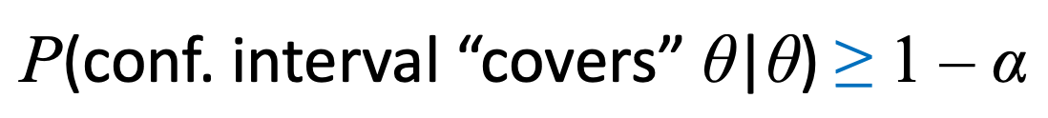
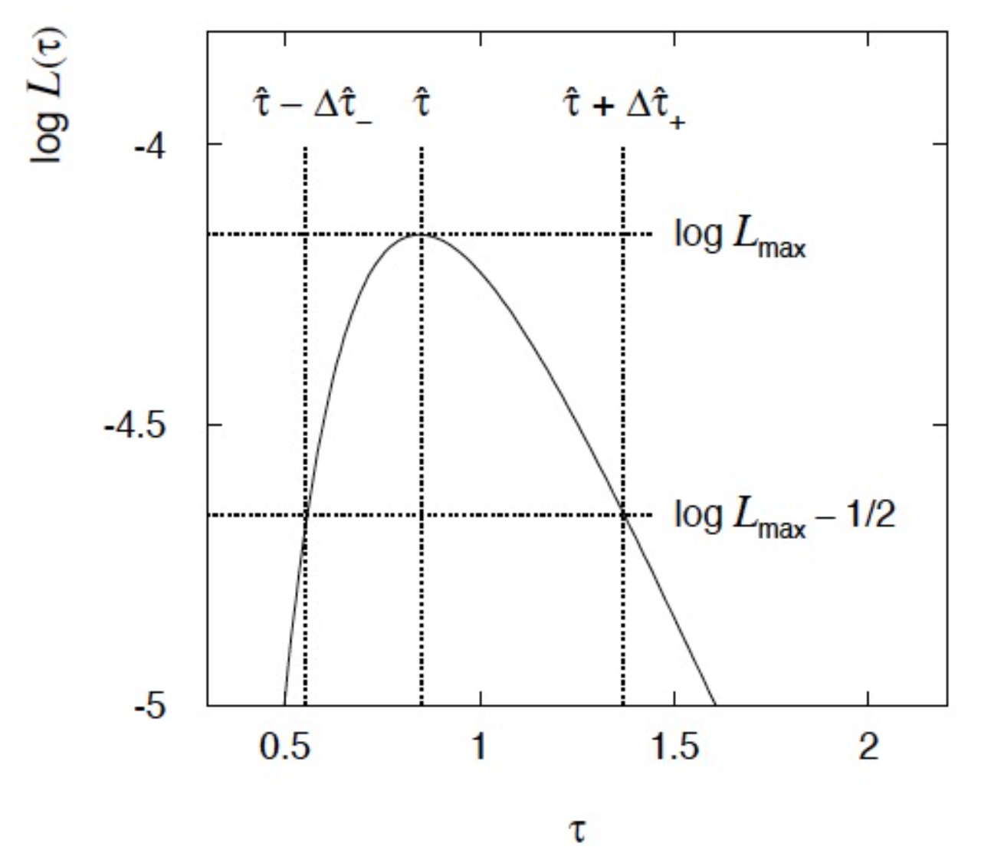
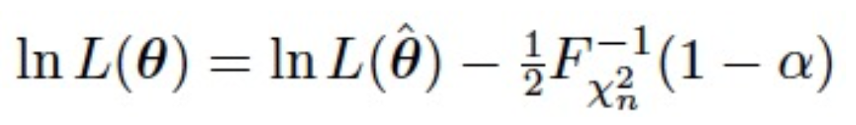
Interval estimation, setting limits
Test (size α) hypothesized parameter value θ for all θ.
Set of θ values not rejected = confidence interval at CL = 1 – α
Equivalently, critical region of test = data that gives p_{θ} ≤ α
To find boundary of interval, set p_{θ} = α and solve for θ.
Approximate construction from likelihood function

Slide 18



Systematic uncertainties and nuisance parameters
P (x|μ)
In general, our model of the data is not perfect:
model:
truth:
x
Can improve model by including
additional adjustable parameters.
Nuisance parameter ↔ systematic uncertainty. Some point in the
parameter space of the enlarged model should be “true”.
Presence of nuisance parameter decreases sensitivity of analysis
to the parameter of interest (e.g., increases variance of estimate).

Slide 19
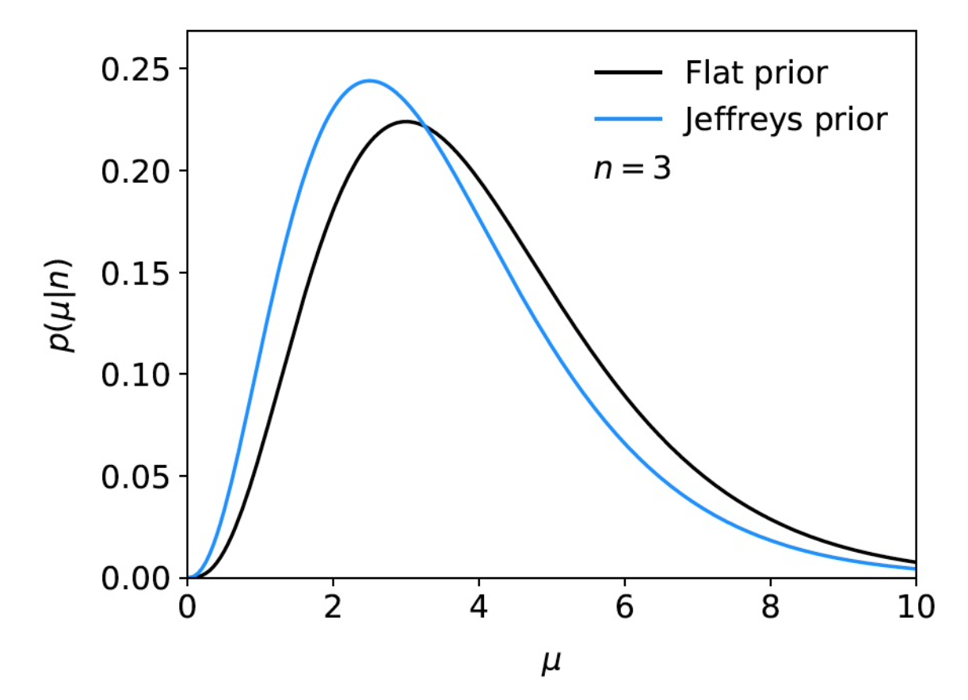




Some Bayesian methods
Bayes’ theorem gives
Bayesian interval/limit from e.g.
MCMC for marginalizing posterior (Metropolis-Hastings)
Bayes factor for model selection:

Slide 20


2019 Exam Question 5(a)

Slide 21
2019 Exam Question 5(a)

Slide 22


2019 Exam Question 5(a)

Slide 23

2019 Exam Question 5(b)

Slide 24

2019 Exam Question 5(c)

Slide 25


2019 Exam Question 5(d)

Slide 26



2019 Exam Question 5(e)

Slide 27

2019 Exam Question 5(e)

Slide 28


2019 Exam Question 5(e)

Slide 29


2019 Exam Question 5(f)

Slide 30

2019 Exam Question 5(f)

Slide 31

2019 Exam Question 5(g)

Slide 32

2019 Exam Question 3(a)

Slide 33

2019 Exam Question 3(a)

Slide 34


2019 Exam Question 3(b)

Slide 35

2019 Exam Question 3(b)

Slide 36


2019 Exam Question 3(c)

Slide 37

2019 Exam Question 3(c)

Slide 38


2019 Exam Question 3(d)

Slide 39

2019 Exam Question 3(e)

Slide 40


2019 Exam Question 3(f)

